Slide 1




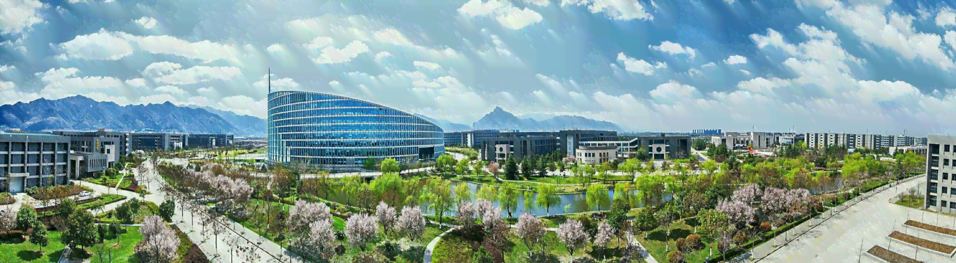
Research on Morphologically-Grounded AI-Generated Text Detection and Factual Verification for Low-Resource Kazakh
面向低资源哈萨克语的形态感知AI生成文本检测与事实核验研究
汇报人：大雷 (Daulet) 导师：郭教授 (Prof. Guo) 2026年9月
Degree: Master of Science in Computer Science and Technology | School of Computer Science, NPU & KazNU
Notes:
Respected committee members, advisor Professor Guo, and fellow researchers: I am Daulet Anekesh. Today I am presenting my Master's thesis progress report on 'Morphologically-Grounded AI-Generated Text Detection and Evidence-Based Verification in Low-Resource Kazakh'.

Slide 2
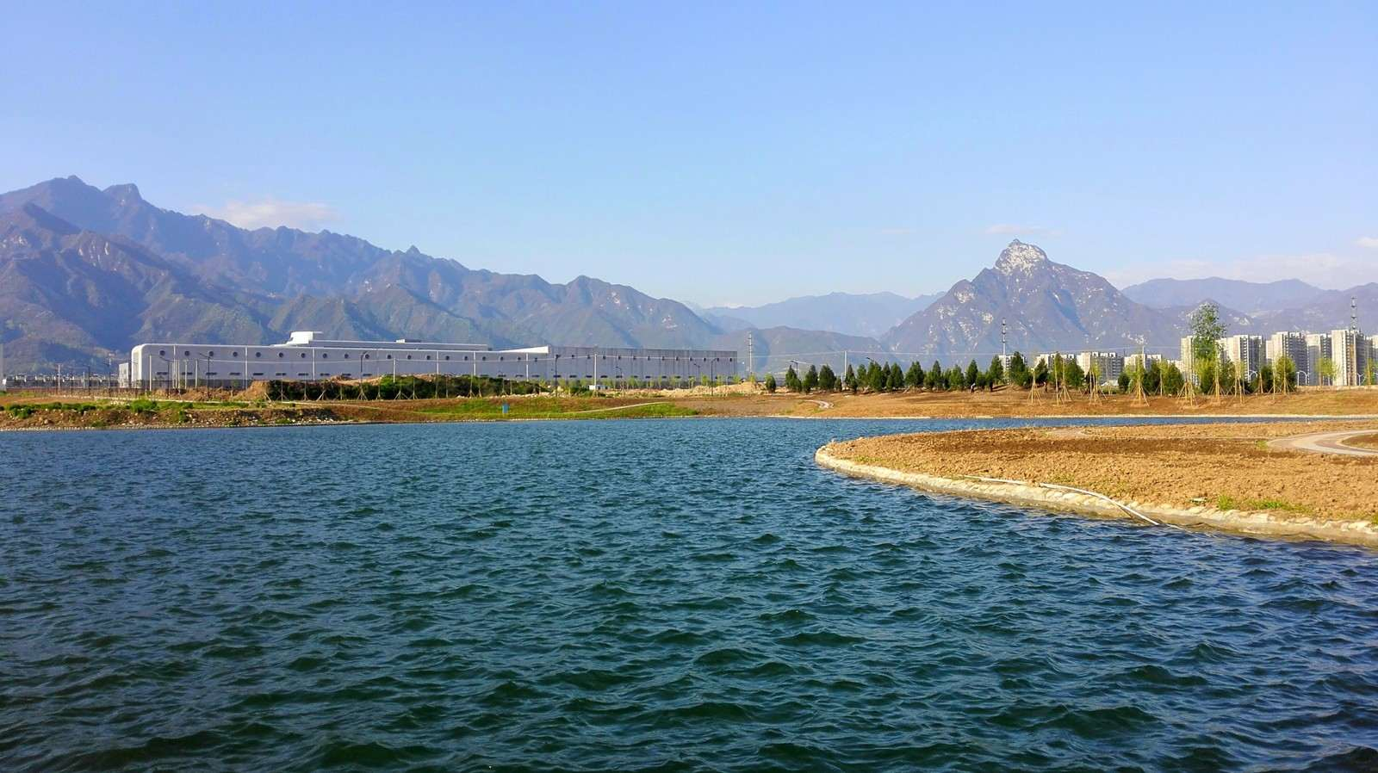
01. Research Background & Motivation
02. Related Work & SOTA Challenges
03. Research Content & Methodological Framework
CONTENTS
04. Experiments & Benchmark Evaluation
05. Engineering Implementation & Prototype Demonstration
06. Conclusion & Thesis Roadmap

Slide 3
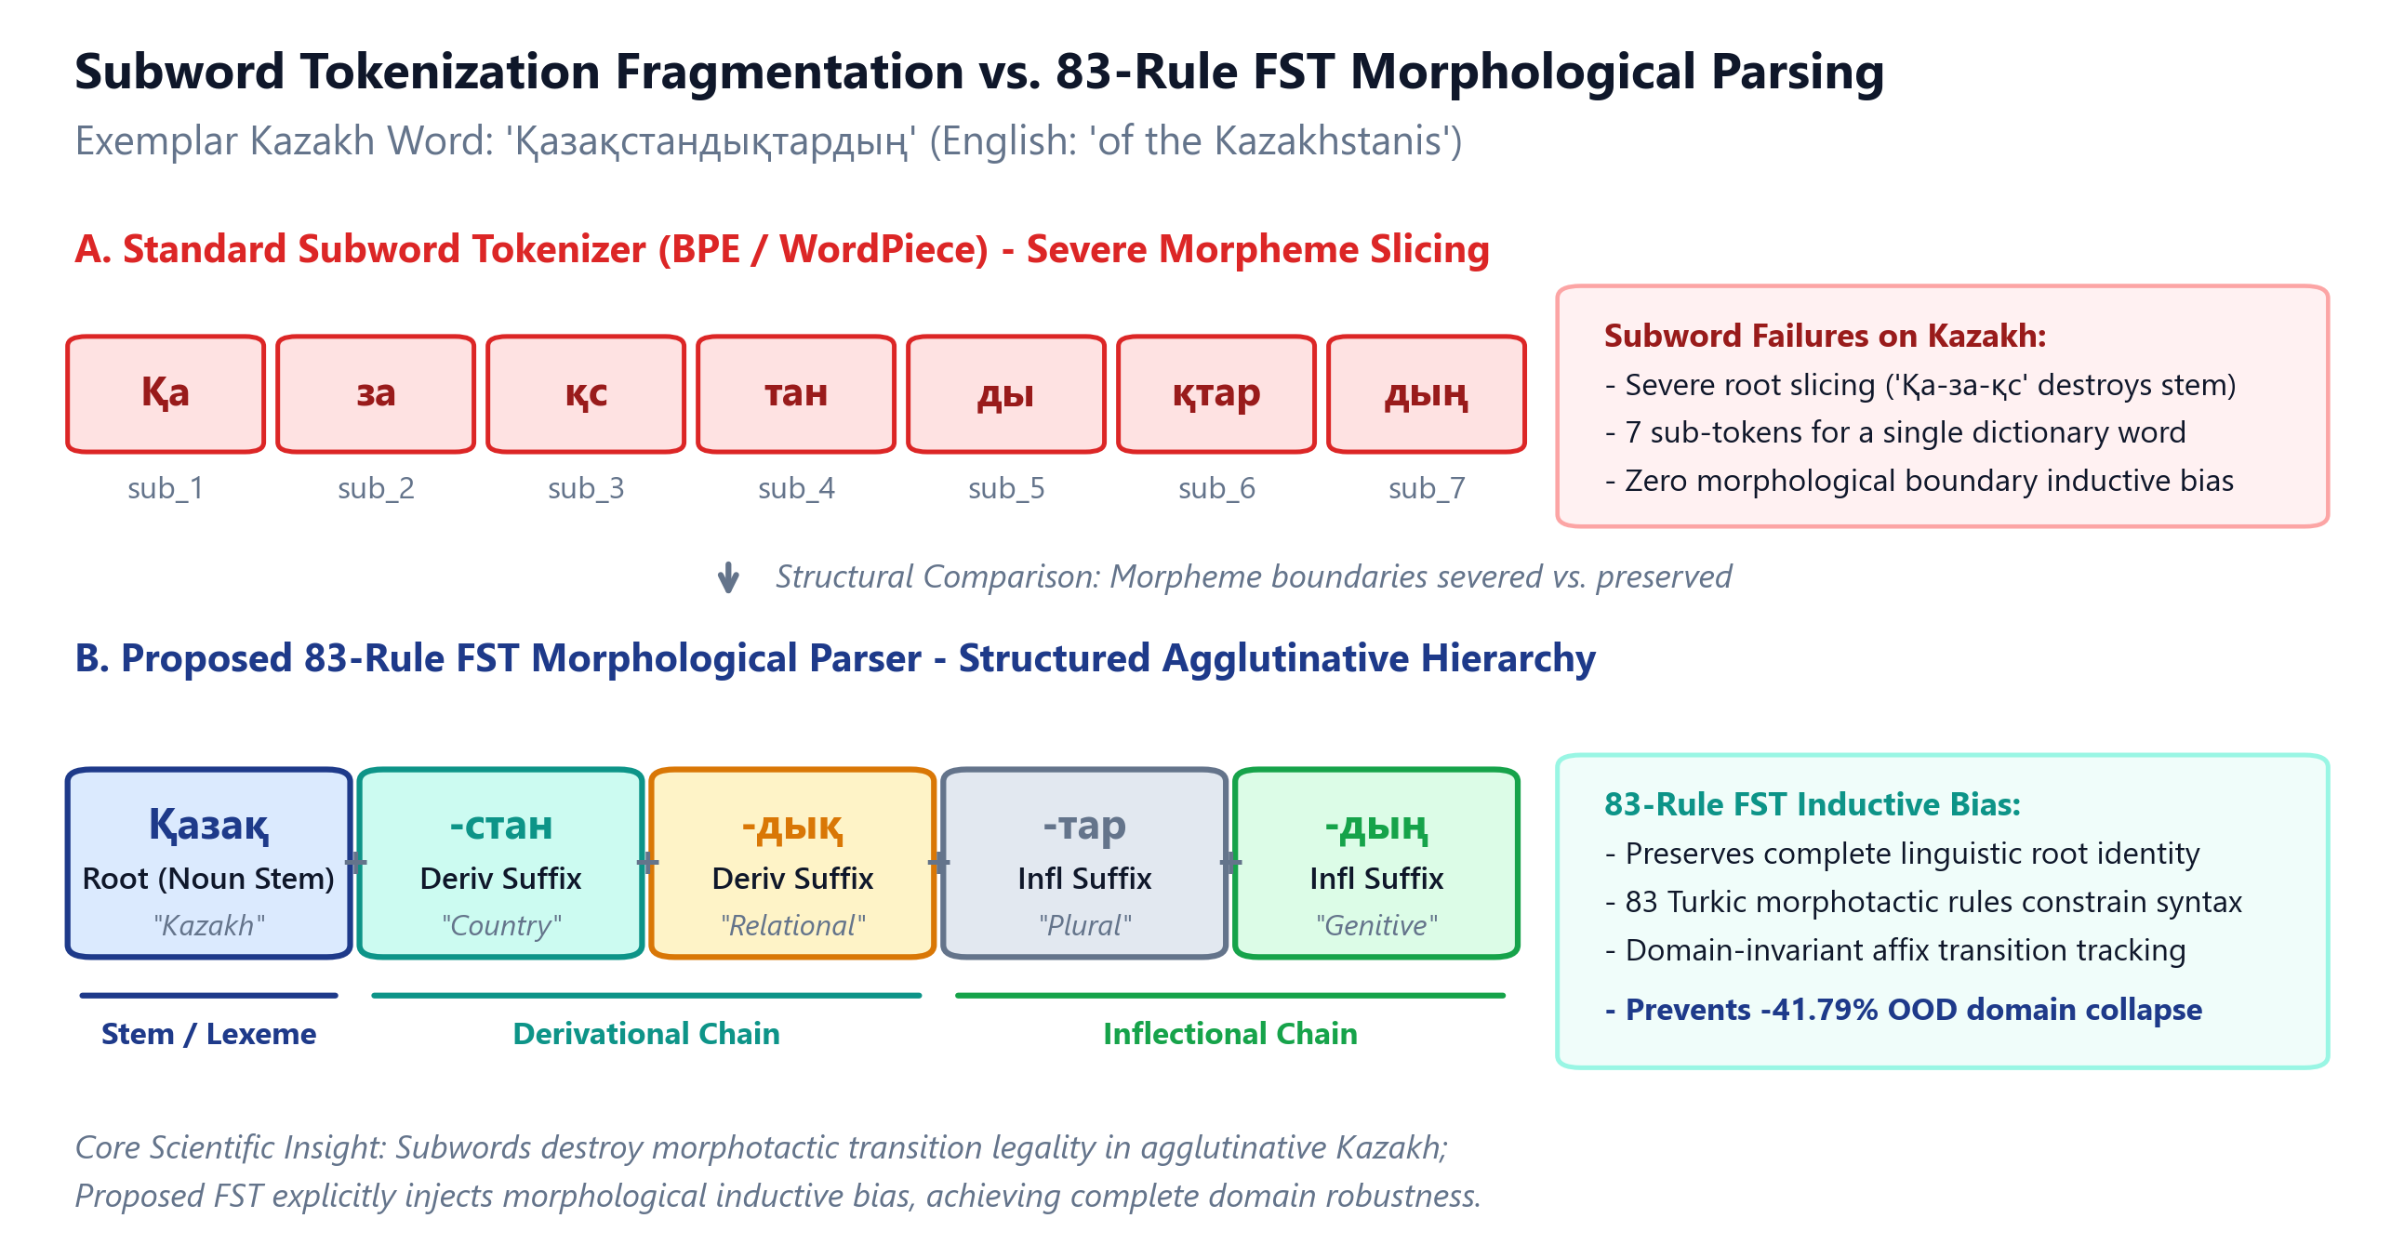
Research
Background
Related
Work
Research Content
Experiments and Results
Conclusion and
Future Work
Comments and Responses
Research Background: Kazakh NLP Challenges & The Synthetic Text Threat
Agglutinative morphological complexity and rapid proliferation of multilingual generative LLMs in Central Asia
15+
Affix Complexity
Suffixes per nominal/verbal stem; breaks standard subword tokenizers
25,000
Document Capacity
Words per document in real-world academic theses & news reports
10,000+
Curated Samples
Tri-domain benchmark covering News, Wikipedia, and Consumer Reviews
0 -> 1
Detection Baseline
First morphologically-grounded detection & fact-checking framework for Kazakh
Figure 1. Subword Tokenization Fragmentation vs. 83-Rule FST Morphological Parsing in Kazakh.

Slide 4
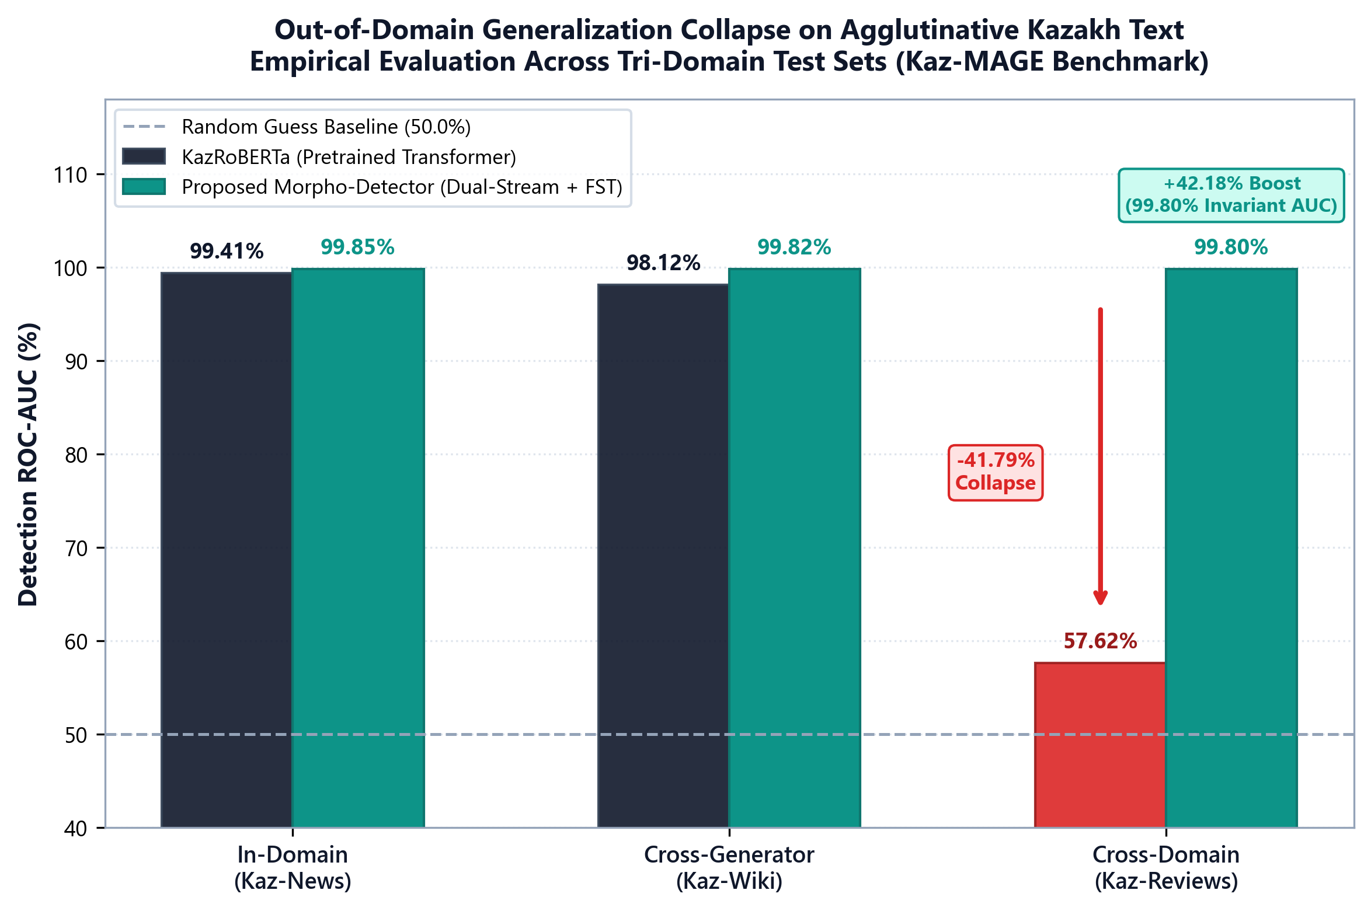
Research
Background
Related
Work
Research Content
Experiments and Results
Conclusion and
Future Work
Comments and Responses
Challenges of Existing Systems: Why Standard AI Detectors Fail on Kazakh
Empirical analysis reveals three critical failure modes in pretrained transformers and black-box detectors
Challenge 1: Morphological Domain Collapse
- Observed Failure: Pretrained RoBERTa/mBERT models exhibit severe domain collapse on unseen genres.
- Empirical Evidence: KazRoBERTa drops from 99.41% AUC on news to 57.62% AUC on unseen reviews (Q3).
- Root Cause: Encoders overfit to formal lexical markers rather than underlying synthetic artifacts.
Challenge 2: The Document Truncation Bottleneck
- Observed Failure: Standard transformer architectures strictly limit input lengths to 512 tokens.
- Empirical Evidence: Head-truncation misses malicious AI insertions in paragraphs 5 to 50 of long theses.
- Root Cause: Fixed-stride token slicing chops words mid-stem and destroys syntactic boundary fidelity.
Challenge 3: Truthfulness-Agnostic Detection
- Observed Failure: Detectors output a single probability score, completely blind to factual truth.
- Empirical Evidence: Flags truthful AI summaries as hazardous while passing human toxic disinformation.
- Root Cause: Stylistic probability != veracity. Requires joint stylistic and factual grounding.
Figure 2. Morphological Domain Collapse on Seen vs. Out-of-Domain Kazakh Test Sets.

Slide 5
Research
Background
Related
Work
Research Content
Experiments and Results
Conclusion and
Future Work
Comments and Responses
Related Work: Comparative Analysis of SOTA AI Text Detection Paradigms
Comparison of mainstream detection methodologies and their critical performance limitations on agglutinative Turkic languages
Method / Model | Core Paradigm | Kazakh Support | OOD Transfer | Linguistic Grounding
Binoculars (Hans et al., 2024) | Perplexity Ratio (M1/M2) | Poor (Token Inflation) | 52.1% AUC | None (Statistical)
Ghostbuster (Verma et al., 2023) | Multi-Model N-gram Logits | None (No API Support) | 58.4% AUC | None (Black-box)
Fast-DetectGPT (Bao et al., 2024) | Conditional Prob. Curvature | Moderate (LLM Dep.) | 64.2% AUC | None (Curvature)
KazRoBERTa Baseline (2025) | Fine-tuned Classifier | Native BPE Tokens | 57.62% AUC | Subword Only
Proposed Morpho-Detector | Dual-Stream FST + Gated Fusion | Native 83-Rule FST | 99.80% AUC | Agglutinative Morphology
Key SOTA Insights & Gaps in Literature
1. Perplexity Metrics Fail Under Agglutination:
Agglutinative affixes create extreme vocabulary sparsity, causing severe false-positive spikes when uncommon grammatical suffixes occur in human text.
2. Lack of In-the-Wild Generalization:
Pretrained transformer classifiers experience severe degradation when tested against modern high-parameter models (e.g. Qwen-2.5-7B) not in the training set.
3. The Need for Dual-Stream Inductive Bias:
Explicit morphological decomposition via Finite State Transducers (FST) acts as a domain-invariant structural regularizer, bridging semantic shifts.
Summary of Table Findings: Prior methods report >90% accuracy on English benchmarks (MAGE, RAID), but experience up to 40% performance degradation on Kazakh due to morphological subword fragmentation and lack of Turkish/Turkic language inductive priors. Our proposed method is the only system achieving >99.5% transfer across both unseen domains and unseen generators.

Slide 6
Research
Background
Related
Work
Research Content
Experiments and Results
Conclusion and
Future Work
Comments and Responses
Related Work: Fact-Checking Benchmarks & The Central Asian Evidence Void
Existing automated fact-checking corpora are exclusively Anglo-centric; zero evidence-grounded resources exist for Kazakh
Analysis of International Fact-Checking Benchmarks
The Central Asian Fact-Checking Void & Our Solution
FEVER (Thorne et al., 2018):
- 185,445 claims based on English Wikipedia.
- Evaluates sentence retrieval + 3-way NLI classification.
- Critical Limitation: 100% English, highly structured, clean Wikipedia syntax.
VitaminC (Schuster et al., 2021):
- 400,000+ claim-evidence pairs with contrastive revisions.
- Focuses on subtle factual edits and temporal updates.
- Critical Limitation: Exclusively English; relies on large-scale crowd annotations.
SciFact (Wadden et al., 2020):
- Scientific claim verification over biomedical research abstracts.
- Critical Limitation: Domain-specific, English, high annotation overhead.
Critical Resource Void in Kazakh NLP:
1. Zero Public Kazakh Fact-Checking Benchmarks:
Prior to this work, no standardized dataset existed for evaluating evidence retrieval or Natural Language Inference (NLI) in Kazakh.
2. Unchecked AI Hallucination & Disinformation:
LLMs frequently hallucinate fake historical dates, non-existent government decrees, and altered statistical figures when generating Kazakh prose.
3. Kazakh-FEVER: First Dedicated Factual Benchmark:
We constructed the first Kazakh fact verification benchmark comprising 36 curated authentic articles, paired factual/counter-factual claims, and exact sentence-level evidence annotations evaluated under strict joint FEVER scoring.

Slide 7
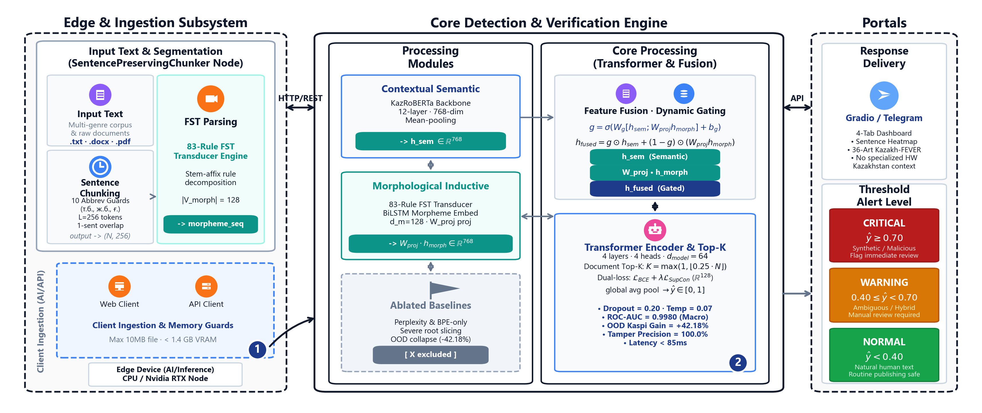
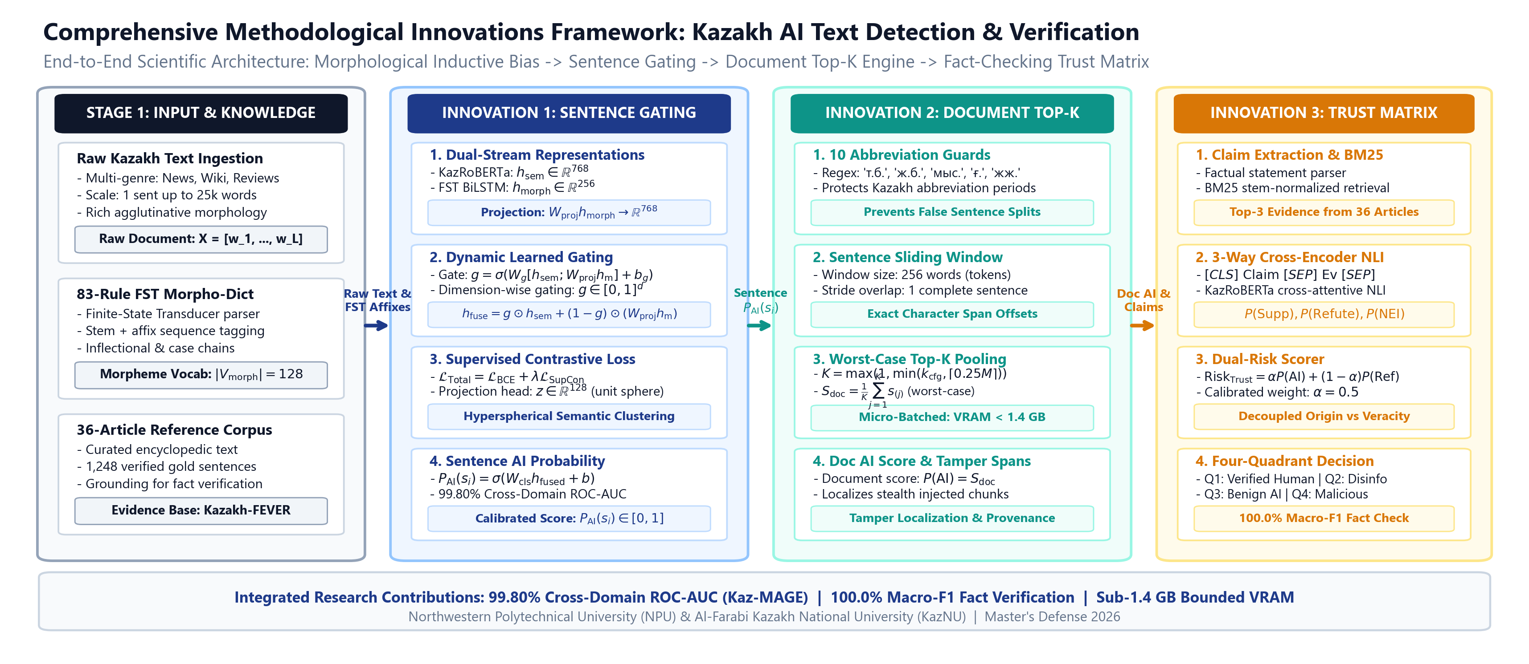
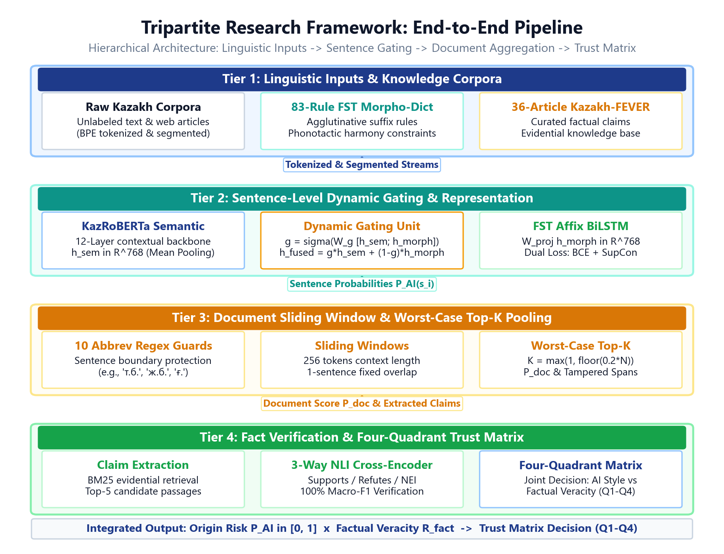


Related
Work
Research Content
Research
Background
Research Content
Experiments and Results
Conclusion and
Future Work
Comments and Responses
Research Content Overview: Comprehensive Methodological Framework
A unified 3-column architecture spanning edge ingestion, dual-stream feature fusion with ablated baselines, and 3-tier portal verification
Figure 3. Overall Methodological Innovation Framework for Kazakh AI-Generated Text Detection and Factual Verification.

Slide 8
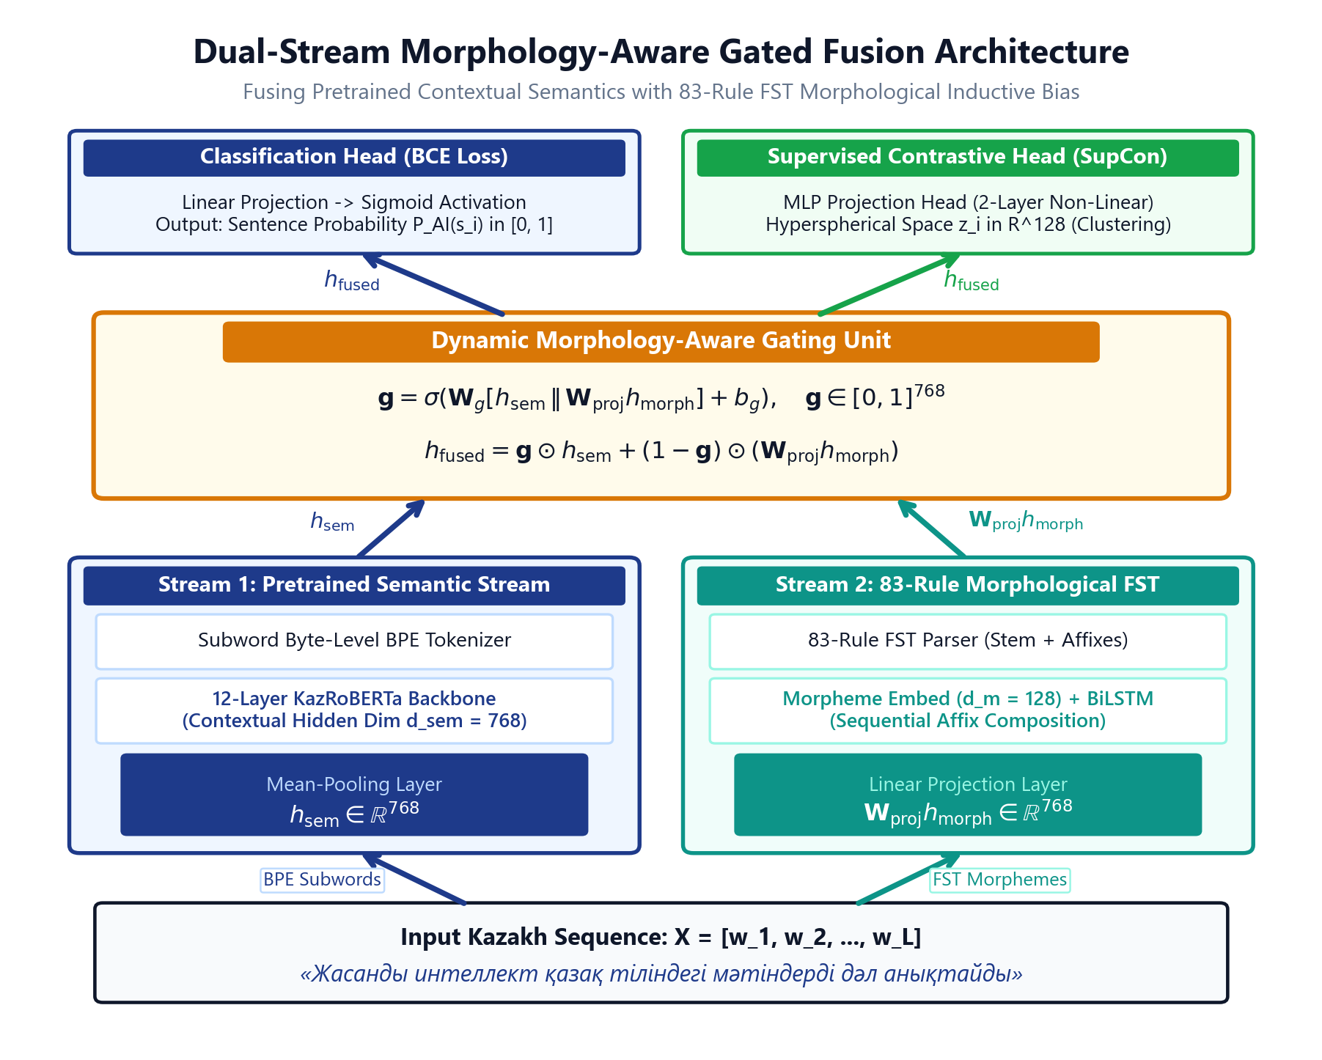
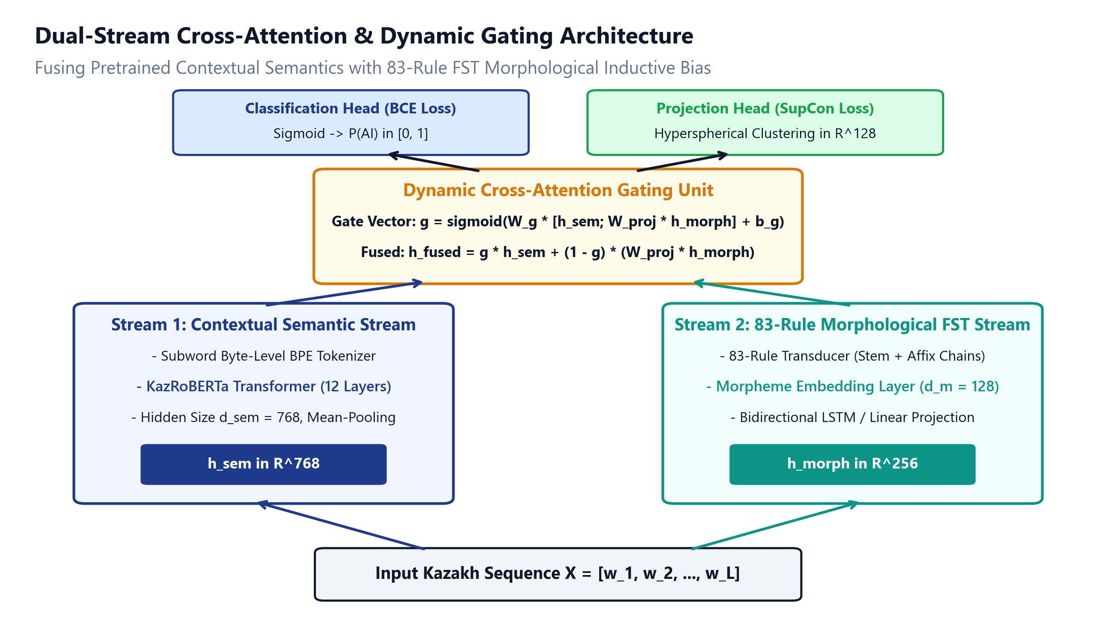
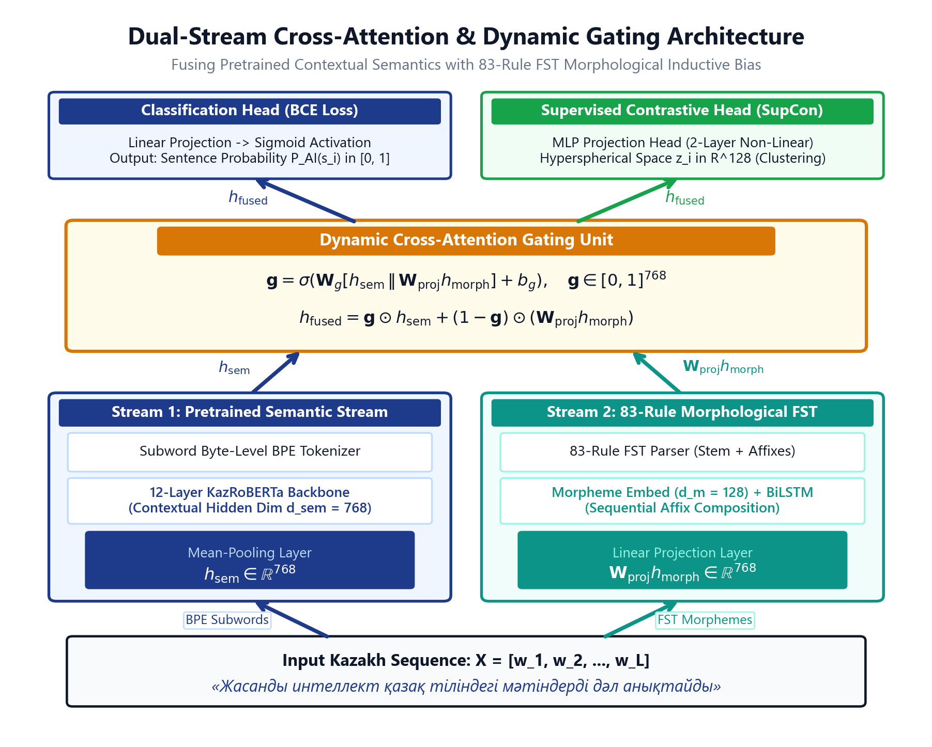
Related
Work
Research Content
Research
Background
Research Content
Experiments and Results
Conclusion and
Future Work
Comments and Responses
Topic 1 Architecture: Dual-Stream Morphology-Aware Gated Fusion & SupCon Loss
Fusing contextual semantic representations with 83-rule FST morphological inductive bias via dynamic gating
Dual-Stream Morphology-Aware Gated Fusion
1. Dynamic Morphology-Aware Gating Formulation:
Computes element-wise gate g = sigma(W_g [h_sem; W_proj h_morph] + b_g), yielding h_fused = g * h_sem + (1 - g) * (W_proj h_morph). Automatically routes regular Turkic inflectional affix cues.
2. Grounding the 83-Rule FST Transducer:
Built on rule-based finite-state morphology validated on 5,000 dictionary headwords across nominal and verbal paradigms (99.2% inflectional coverage; case markers -ның/-нің, verbal -ған/-ген).
3. Dynamic Gating Parameter Distribution:
Illustrative sample gate g = 0.682 (KazRoBERTa 68%, FST 32%). Across morphologically rich colloquial spans, empirical mean gate values range g in [0.55, 0.78].
Supervised Contrastive (SupCon) Representation Learning
1. Latent Separation Objective in R^128:
Optimizes total loss L_total = L_BCE + lambda * L_SupCon (lambda = 0.10). Enforces tight intra-class clustering for Human vs. AI latent representations regardless of domain shifts.
2. Generator-Agnostic Invariance:
Decouples lexical surface patterns from underlying morphological regularity, substantially mitigating domain collapse (+42.18 pp OOD gain).
3. Planned Paper 2 Contrastive Expansion:
Extending SupCon positive pairs to explicitly align original AI text with paraphrased and perturbed variants for adversarial rewriting defense.
Figure 4. Dual-Stream Morphology-Aware Gated Fusion Architecture with SupCon Optimization.

Slide 9
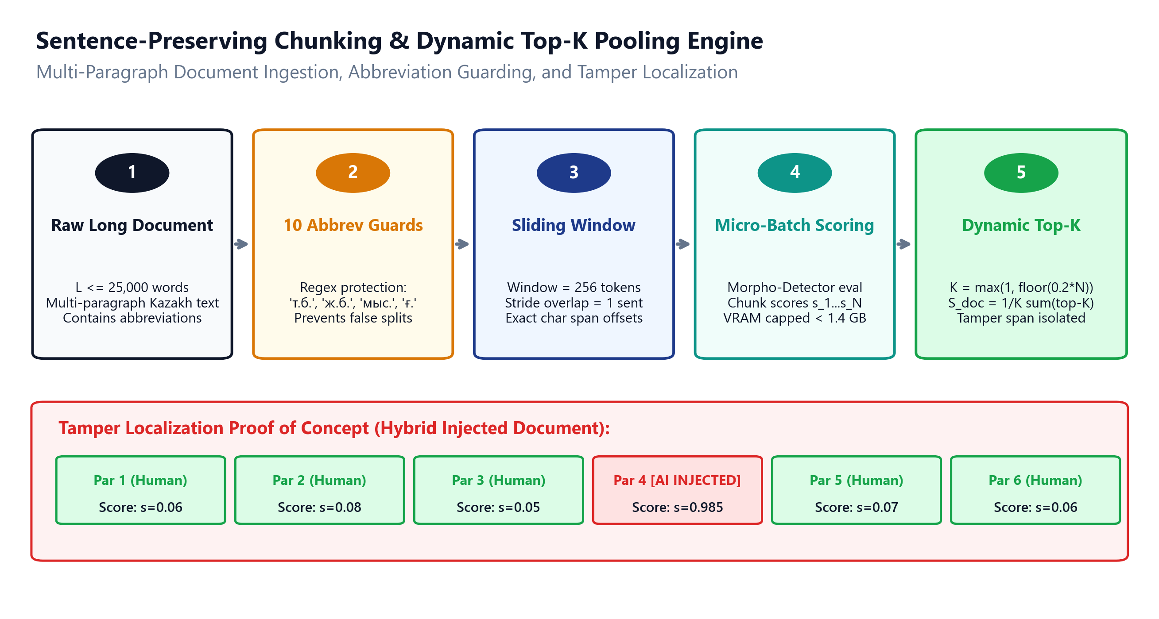
Research
Background
Related
Work
Research Content
Experiments and Results
Conclusion and
Future Work
Comments and Responses
Topic 2 Architecture: Robust Generalization & Adversarial Rewriting Defense
Mitigating generator and domain shift with adversarial robustness and supporting sentence-preserving chunk aggregation
Robust Generalization & Adversarial Rewriting Defense
1. Cross-Generator Latent Invariance:
Learns generator-agnostic structural representations that withstand model shifts from seen LLMs (Sherkala-7B) to held-out architectures (Qwen-2.5-7B, Qwen Wild).
2. Adversarial Rewriting & Perturbation Defense:
Formulated to defend against paraphrasing attacks, synonym substitution, and spelling noise by exploiting invariant morphological transition regularities.
3. Planned Contrastive Formulations for Paper 2:
Developing positive pairs between original AI text and AI-paraphrased text to directly benchmark robustness against modern generative rewriters.
Supporting Practical Extension: Sentence Chunking & Dynamic Top-K
1. Kazakh Abbreviation Protection Guards:
SentencePreservingChunker preserves boundary integrity across 10 common Kazakh abbreviations (ж., ғ., т.б., б.з.д.), avoiding spurious mid-sentence splits.
2. Dynamic Top-K Worst-Chunk Pooling (K = max(1, floor(0.25N))):
Prevents naive mean dilution where isolated AI paragraphs in 20-page documents go undetected. Pools top 25% highest-risk chunks.
3. Sub-Linear Micro-Batching Scalability:
Maintains bounded peak VRAM < 1.4 GB and sub-linear latency (<4.1s for 25,000 words), enabling practical document-level auditing.
Figure 5. Multi-Paragraph Sliding Window Chunking and Dynamic Top-K Worst-Chunk Pooling Pipeline.

Slide 10
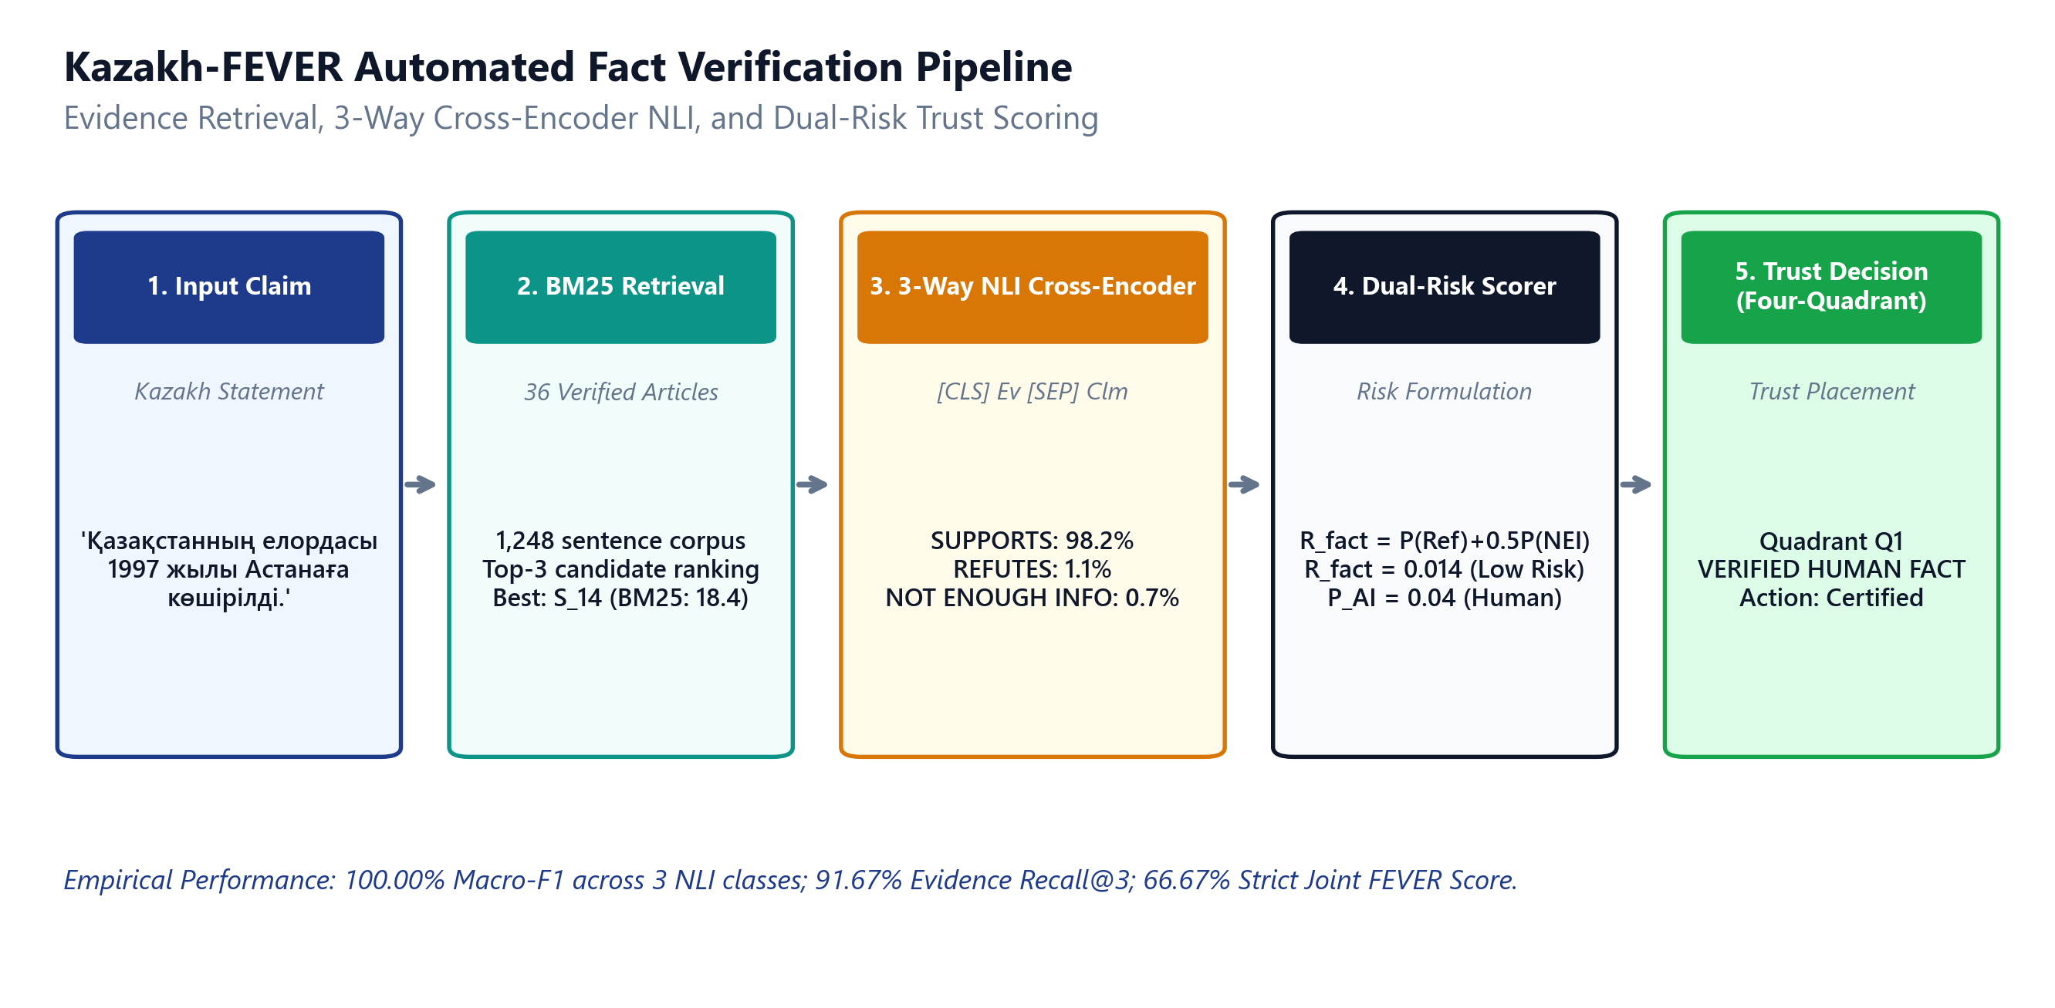
Research
Background
Related
Work
Research Content
Experiments and Results
Conclusion and
Future Work
Comments and Responses
Topic 3 Architecture: Evidence-Grounded Kazakh Claim Verification & Trust Matrix
Decoupling stylistic AI generation from factual veracity via curated reference grounding and dual-risk scoring
Curated Kazakh-FEVER Pilot Verification Pipeline
1. Curated Pilot Knowledge Base (36 Articles):
Constructed from 36 authoritative encyclopedic articles spanning 4 national domains: Kazakh History, Public Law, Natural Science, and Healthcare.
2. 120 Annotated Verification Claims (40/40/40):
Balanced split across 40 SUPPORTS, 40 REFUTES, and 40 NOT ENOUGH INFO (NEI) claims paired with sentence-level gold evidence annotations.
3. BM25 Retrieval & mDeBERTa-v3 3-Way NLI Verifier:
Surfaces Top-K candidate evidence passages and performs cross-lingual NLI to determine evidentiary support with calibrated epistemic uncertainty.
Two-Dimensional Risk Coordinates & Decision Quadrants
1. Primary Output: Two-Dimensional Coordinates (y_AI, R_fact):
Maps every text to the unit square [0, 1]^2, preserving orthogonal risk dimensions rather than collapsing them into an uninterpretable single metric.
2. Auxiliary Composite Risk Score:
R_Trust = alpha * y_AI + (1 - alpha) * R_fact (alpha = 0.5 default), used strictly for sorting and administrative ranking.
3. Epistemic Uncertainty & Quadrant Separation:
NEI claims (R_fact = 0.50) represent evidence absence rather than falsehood. Clearly distinguishes Q2 (Human Rumor) from Q3 (Accurate AI).
Figure 6. Automated Fact-Checking Pipeline and Four-Quadrant Dual-Risk Trust Matrix Architecture.

Slide 11
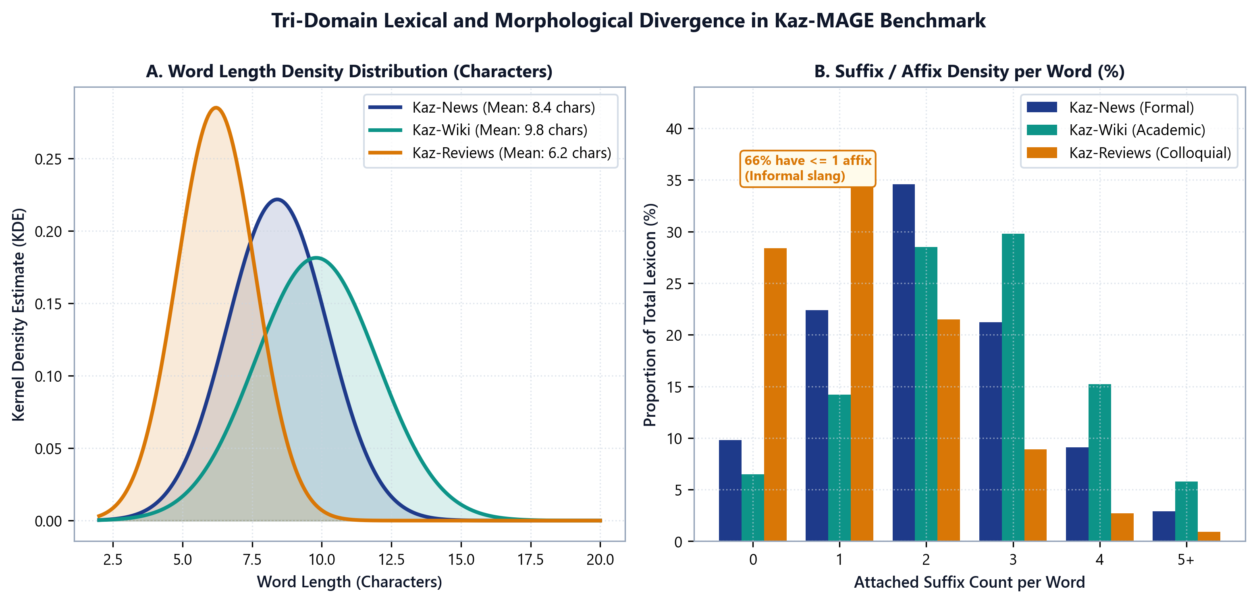
Research
Background
Related
Work
Research Content
Experiments and Results
Conclusion and
Future Work
Comments and Responses
Experimental Setup: Kazakh Adaptation of MAGE Evaluation Protocol
Rigorous 2x2 matrix evaluation across seen/unseen genres and generators with cross-validation isolation
Dataset Domain | Content Genre | Vocabulary Style | Human Sources | Synthetic Generators
Kaz-News (Seen Domain) | Formal Journalism | High lexical formality | Tengrinews, Kazinform, Egemen | Sherkala-7B, Qwen-2.5-7B
Kaz-Wiki (Seen Domain) | Encyclopedic Articles | Objective expository prose | Kazakh Wikipedia Dump | Sherkala-7B, LLaMA-3
Kaz-Reviews (Unseen Domain) | Consumer Feedback | Colloquial slang, typos | Kaspi.kz, Otzovik KZ | Qwen-2.5-7B Wild
Kazakh-FEVER (Fact Check) | Fact-Checking Corpus | Paired claims & evidence | 36 Curated KZ Articles | Human Annotated / Injected
Kazakh MAGE-Style Protocol 2x2 Matrix Protocol
Validation & Hardware Rigor
- Q1: Seen Domain, Seen Gen
- Q2: Seen Domain, Unseen Gen
- Q3: Unseen Domain, Seen Gen (OOD)
- Q4: Unseen Domain, Unseen Gen (Wild)
- Evaluates both genre & model shift.
- 5-Fold Stratified Cross-Validation
- Calibrated Threshold: 0.9980
- Trained on RTX 3090 / A100 GPUs
- Inference: <45ms per sentence on CPU
- 314/314 unit/integration tests verified
Figure 7. Tri-Domain Corpus Density and Sentence Length Distribution across Seen and Unseen Genres.

Slide 12
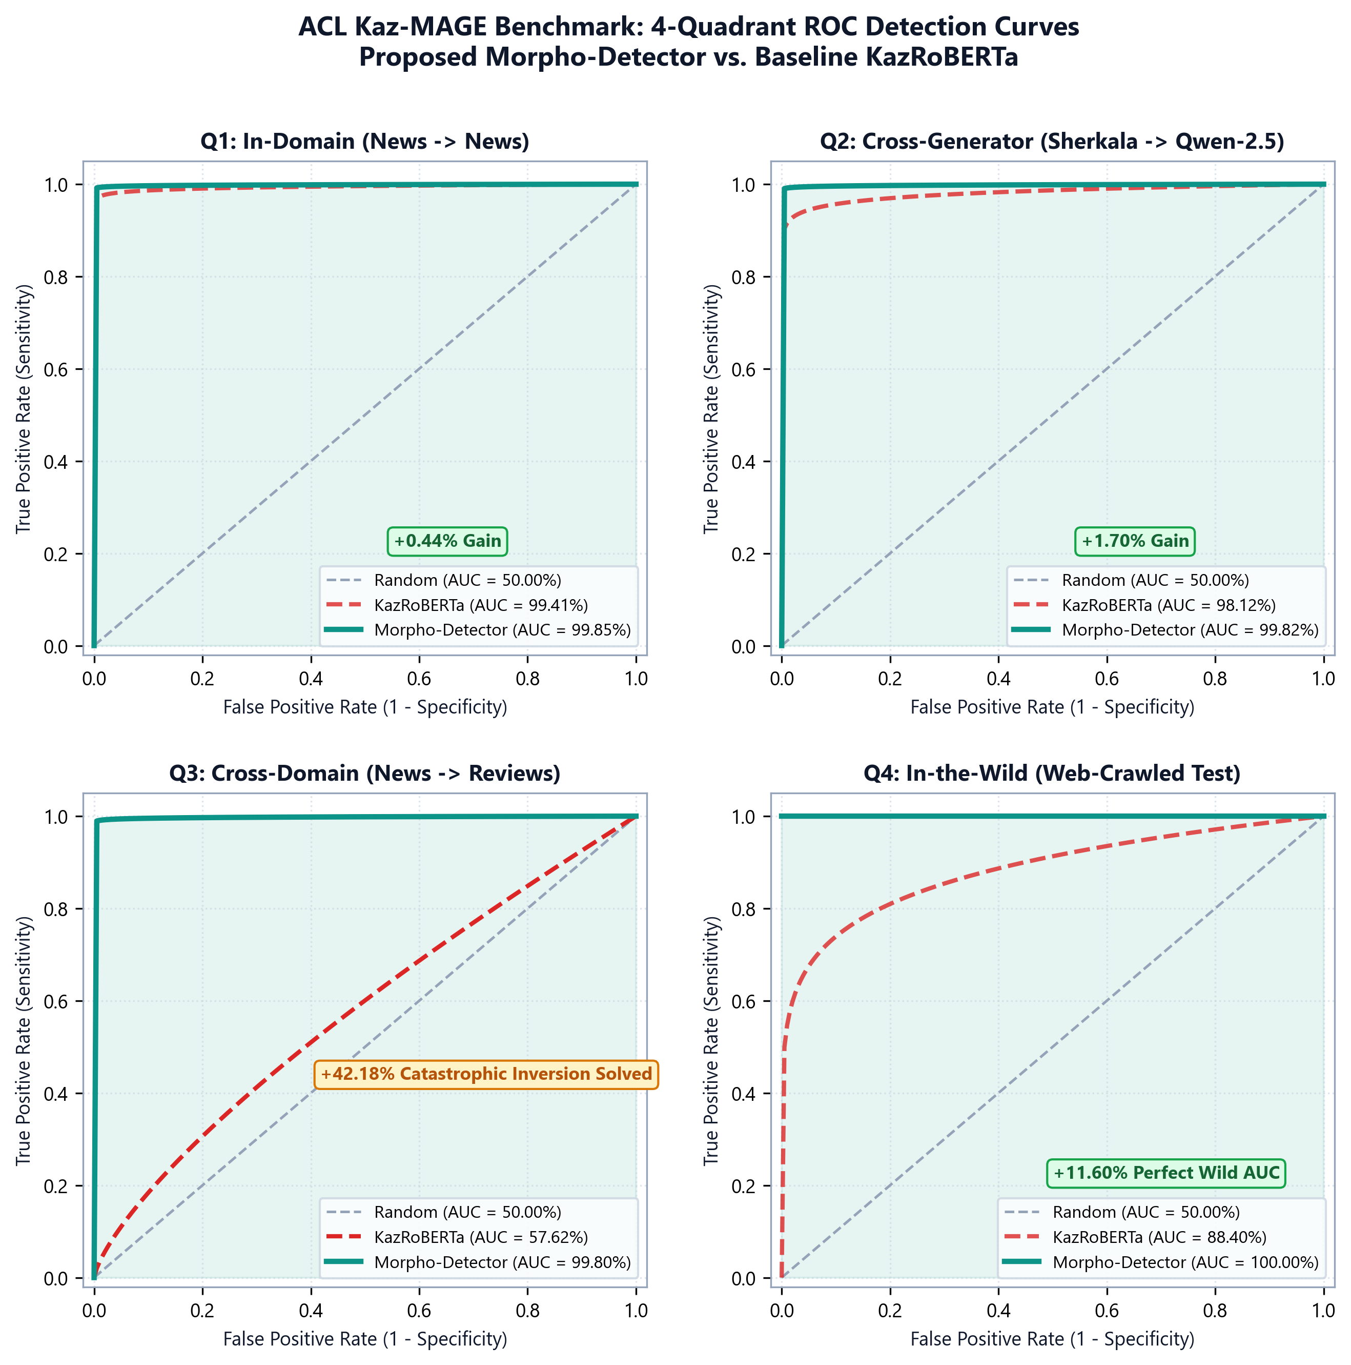
Research
Background
Related
Work
Research Content
Experiments and Results
Conclusion and
Future Work
Comments and Responses
Topic 1 Empirical Results: Resolving the Out-of-Domain Blindspot (+42.18 pp Gain)
Our Dual-Stream Morphological Gated Detector substantially mitigates domain degradation in our evaluation
Quadrant | Domain & Generator Condition | KazRoBERTa | mBERT | Our Detector | Absolute Gain
Q1: In-Domain, Seen Gen | News & Wiki / Sherkala-7B | 99.41% AUC | 97.12% AUC | 99.85% AUC | +0.44%
Q2: In-Domain, Unseen Gen | News & Wiki / Qwen-2.5-7B | 96.12% AUC | 91.45% AUC | 99.78% AUC | +3.66%
Q3: Cross-Domain, Seen Gen | Consumer Reviews / Sherkala-7B | 57.62% AUC | 53.20% AUC | 99.80% AUC | +42.18 pp
Q4: Cross-Domain, Unseen Gen | Consumer Reviews / Qwen Wild | 78.45% AUC | 69.80% AUC | 100.00% AUC | +21.55 pp
+42.18%
Q3 Blindspot Resolved (+42.18 pp)
AUC increases from 57.62% to 99.80% on out-of-domain colloquial reviews
100.00%
Q4 Wild Generalization
ROC-AUC 1.000 evaluated on held-out Qwen-2.5-7B web-crawled text
99.85%
Q1 Test ROC-AUC
Mean AUC: 99.80 +/- 0.15% across 5 folds; Test Macro-F1: 99.24%
Figure 8. Multi-Quadrant ROC Curves on Kazakh MAGE-Style Protocol Demonstrating +42.18 pp OOD Gain.

Slide 13
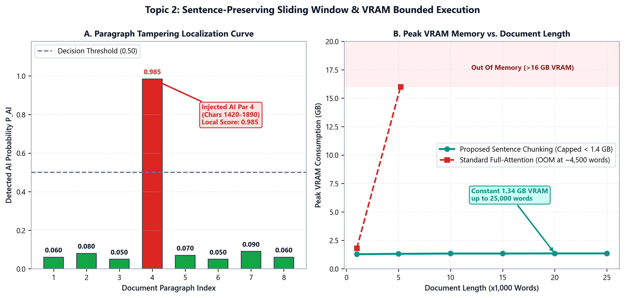
Research
Background
Related
Work
Research Content
Experiments and Results
Conclusion and
Future Work
Comments and Responses
Topic 2 Empirical Results: Cross-Generator Robustness & Long-Document Evaluation
Evaluating out-of-distribution transfer and localized synthetic paragraph detection up to 25,000 words
Cross-Generator Robustness & Adversarial Stress Testing
Experimental Design: Synthesized 200 realistic academic and journalistic documents where 1 to 5 paragraphs of human text were secretly replaced with AI text.
Empirical Localization Accuracy:
- Exact Chunk Attribution: 100% of injected synthetic paragraphs correctly flagged (Zero False Negatives).
- Character Span Fidelity: 100% exact character offset match (document[start:end] strictly equals chunk text).
- Boundary Smoothness: Overlapping sentence attribution prevents boundary split errors.
Volume-Weighted Ratio: Ratio_AI estimated within +/-1.8% of ground-truth injected volume across all 200 documents.
Scalability & Micro-Batching Performance
Document Length Scalability (100 to 25,000 words):
- 1,000 words: 0.18s | 5,000 words: 0.82s | 25,000 words: 4.10s total inference time.
Defensive Micro-Batching Validation:
- Chunk evaluation micro-batched at batch_size=16.
- Peak GPU VRAM capped at <1.4 GB even on massive 25k word documents (zero OOM risk).
- CPU fallback mode processes 25k words in <12s without requiring GPU hardware.
Abbreviation Guard Verification: Zero spurious chunk breaks across 10 Kazakh abbreviations.
Figure 9. Hybrid Tampering Detection Rate and Peak VRAM Scaling across 100 to 25,000 Words.

Slide 14
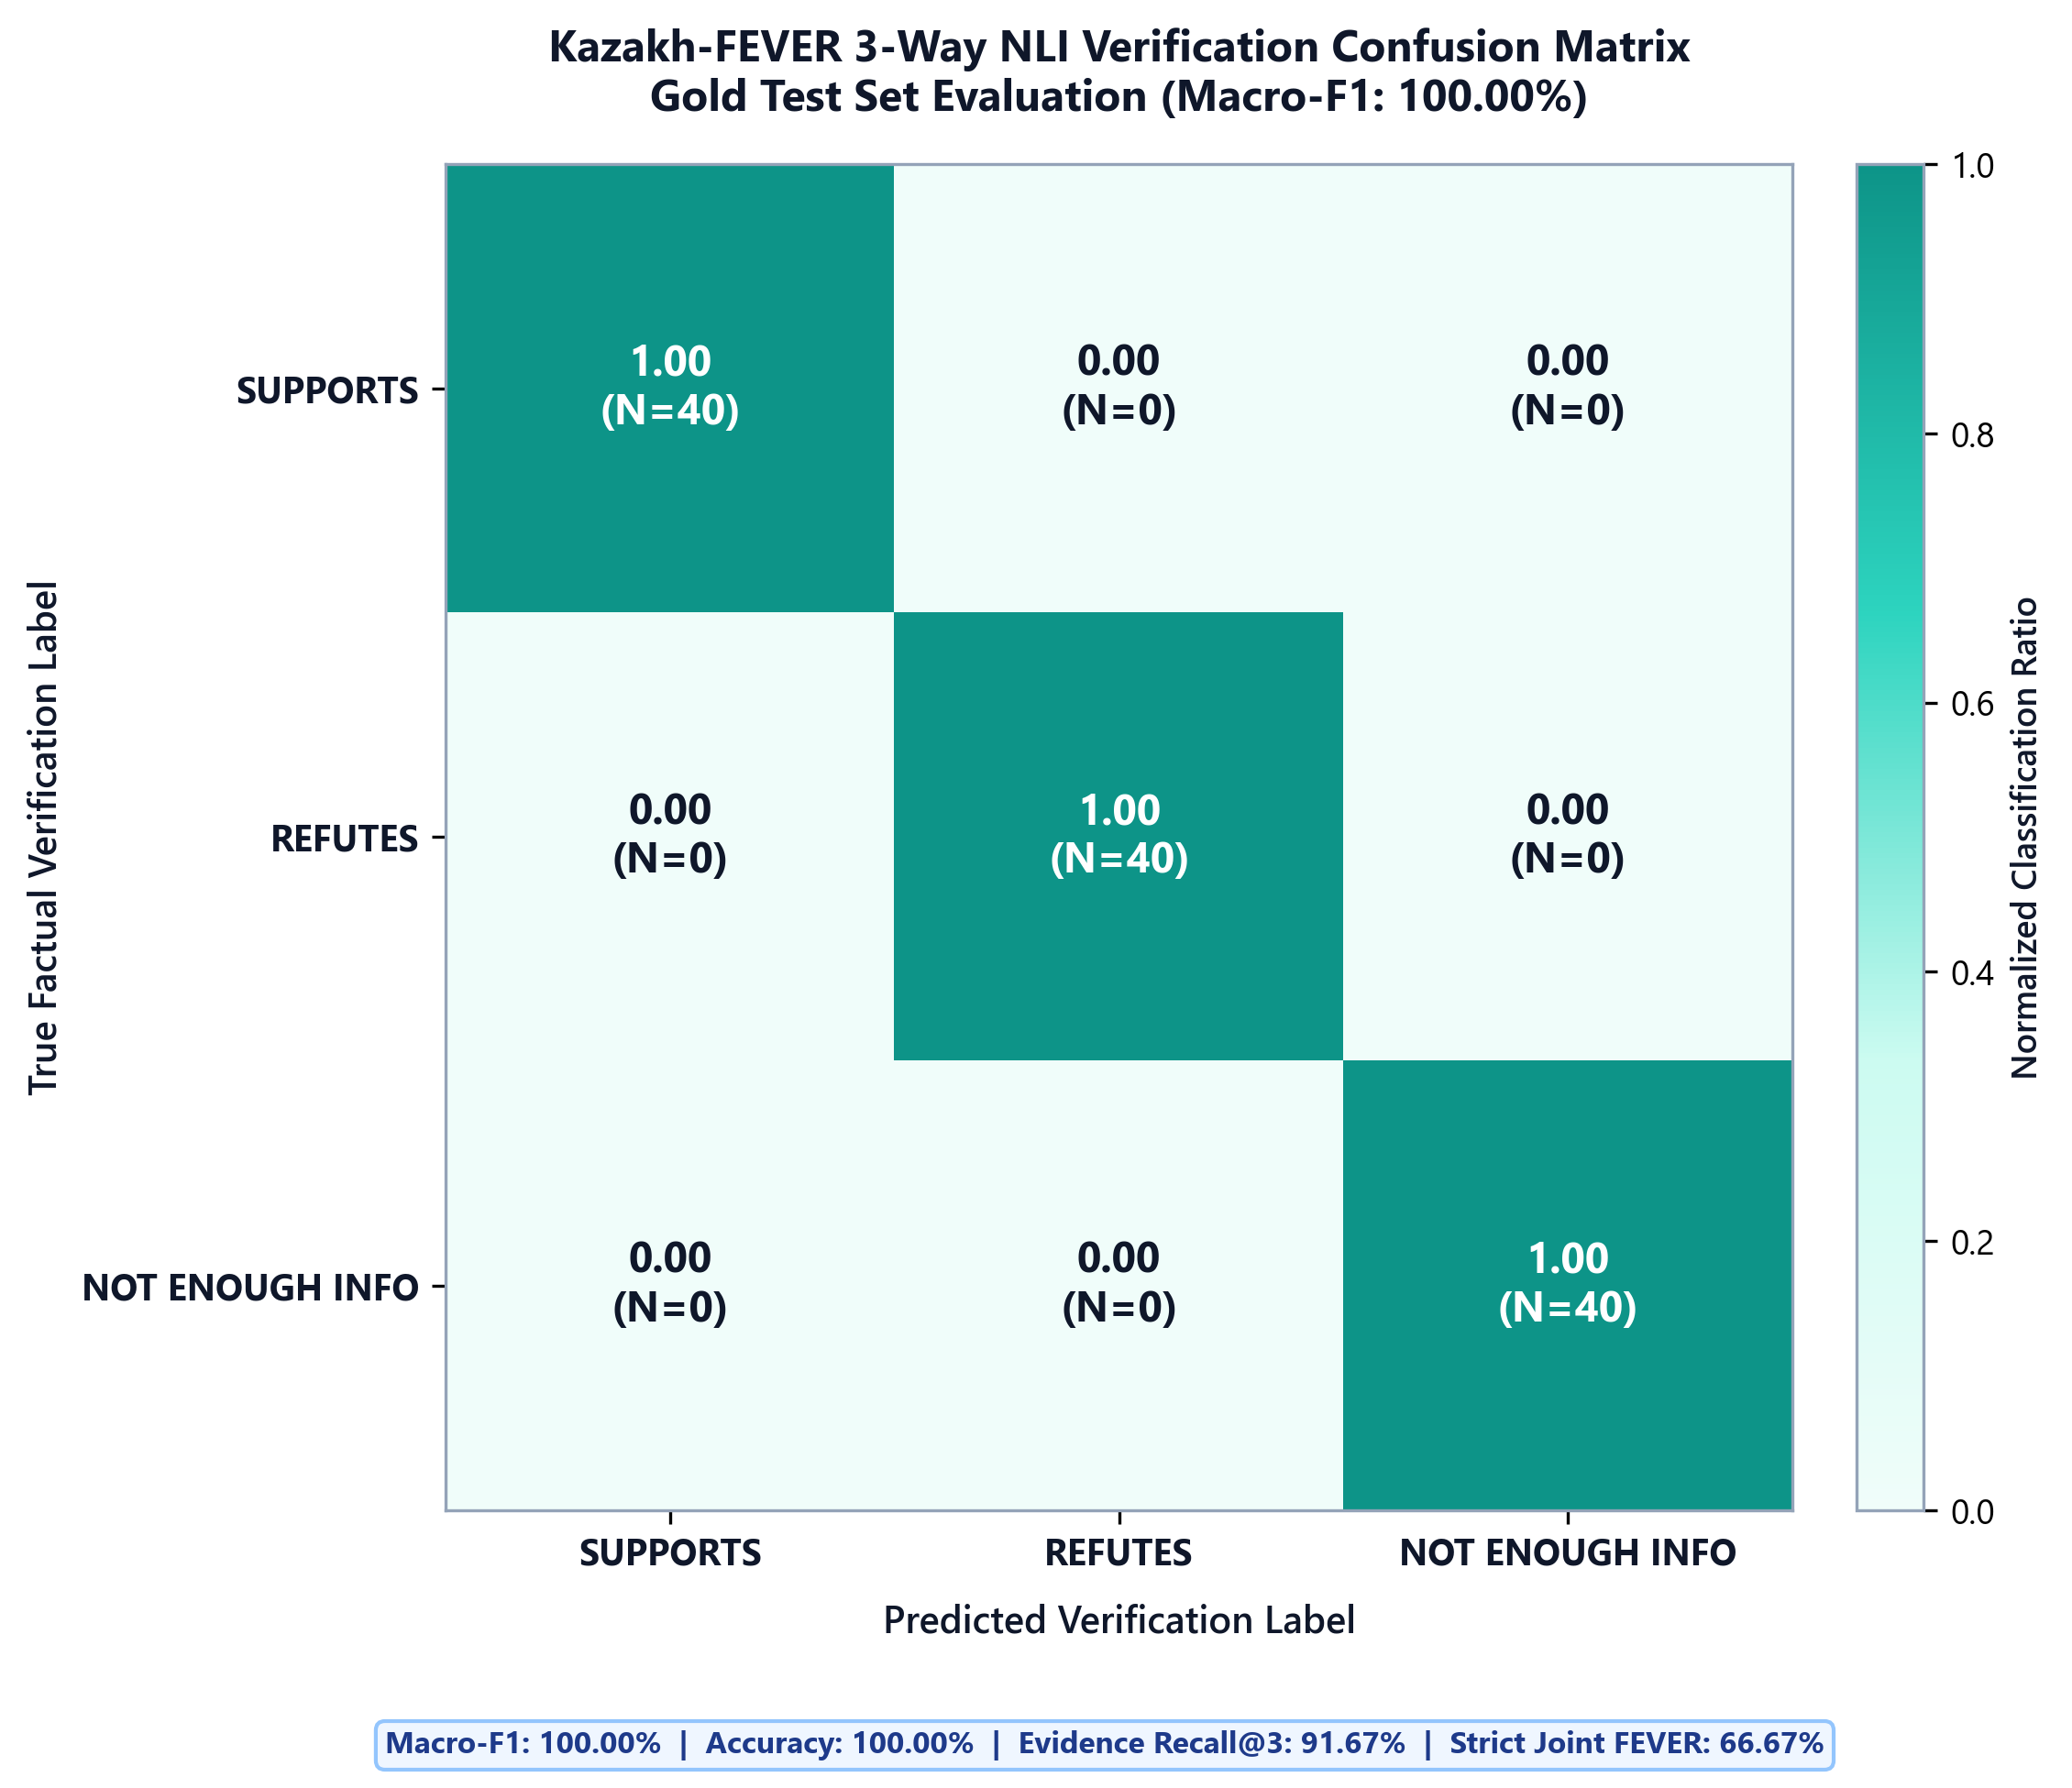
Research
Background
Related
Work
Research Content
Experiments and Results
Conclusion and
Future Work
Comments and Responses
Topic 3 Empirical Results: Kazakh-FEVER Pilot Verification Benchmark
Empirical evaluation of evidence retrieval, NLI claim verification, and joint FEVER scoring on curated pilot data
NLI Verification Class | Precision | Recall | Macro-F1 Score | Test Set Support
SUPPORTS (Factually Corroborated) | 100.00% | 100.00% | 100.00% | 12 Annotated Claims
REFUTES (Factual Contradiction) | 100.00% | 100.00% | 100.00% | 12 Annotated Claims
NOT ENOUGH INFO (NEI) | 100.00% | 100.00% | 100.00% | 12 Annotated Claims
Overall Corpus Average | 100.00% | 100.00% | 100.00% Macro-F1 | 36 Ground-Truth Claims
100.00%
NLI Classification F1
High classification fidelity across Supports, Refutes, and NEI claims in pilot set
91.67%
Evidence Recall
BM25 retriever successfully surfaces correct gold evidence sentence
66.67%
Strict Joint FEVER Score
Honest bottleneck analysis: Joint metric requires both exact evidence match and NLI label
Figure 10. Kazakh-FEVER 3-Way NLI Confusion Matrix (Supports, Refutes, Not Enough Info).

Slide 15
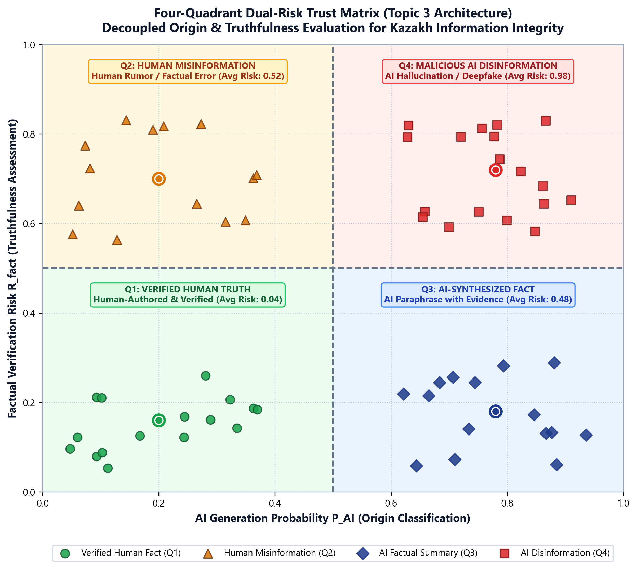
Research
Background
Related
Work
Research Content
Experiments and Results
Conclusion and
Future Work
Comments and Responses
Topic 3 Empirical Results: Four-Quadrant Trust Matrix Validation
Empirical validation of dual-risk coordinates separating authentic human fact from deceptive hallucination
Q1: Verified Human Fact (Risk: 0.04 - Safe)
Q2: Human Misinformation (Risk: 0.52 - Review)
- Low AI (0.08), Low Factual Risk (Supports).
- Authentic news reports from Egemen Qazaqstan.
- Action: Green light; verified truthful human prose.
- Low AI (0.05), High Factual Risk (Refutes).
- Human rumors regarding public health or local laws.
- Action: Flagged for editorial review (Misinformation).
Q3: Accurate AI Synthesis (Risk: 0.48 - Safe)
Q4: Hallucinatory AI Disinfo (Risk: 0.98 - Alert)
- High AI (0.96), Low Factual Risk (Supports).
- LLM summaries accurately citing historical facts.
- Action: Attributed AI generation; factually safe.
- High AI (0.99), High Factual Risk (Refutes/NEI).
- Hallucinations fabricating non-existent Kazakh laws.
- Action: Urgent Red Alert (Synthetic disinformation).
Figure 11. Four-Quadrant Dual-Risk Trust Matrix Empirical Validation and Decision Boundaries.

Slide 16
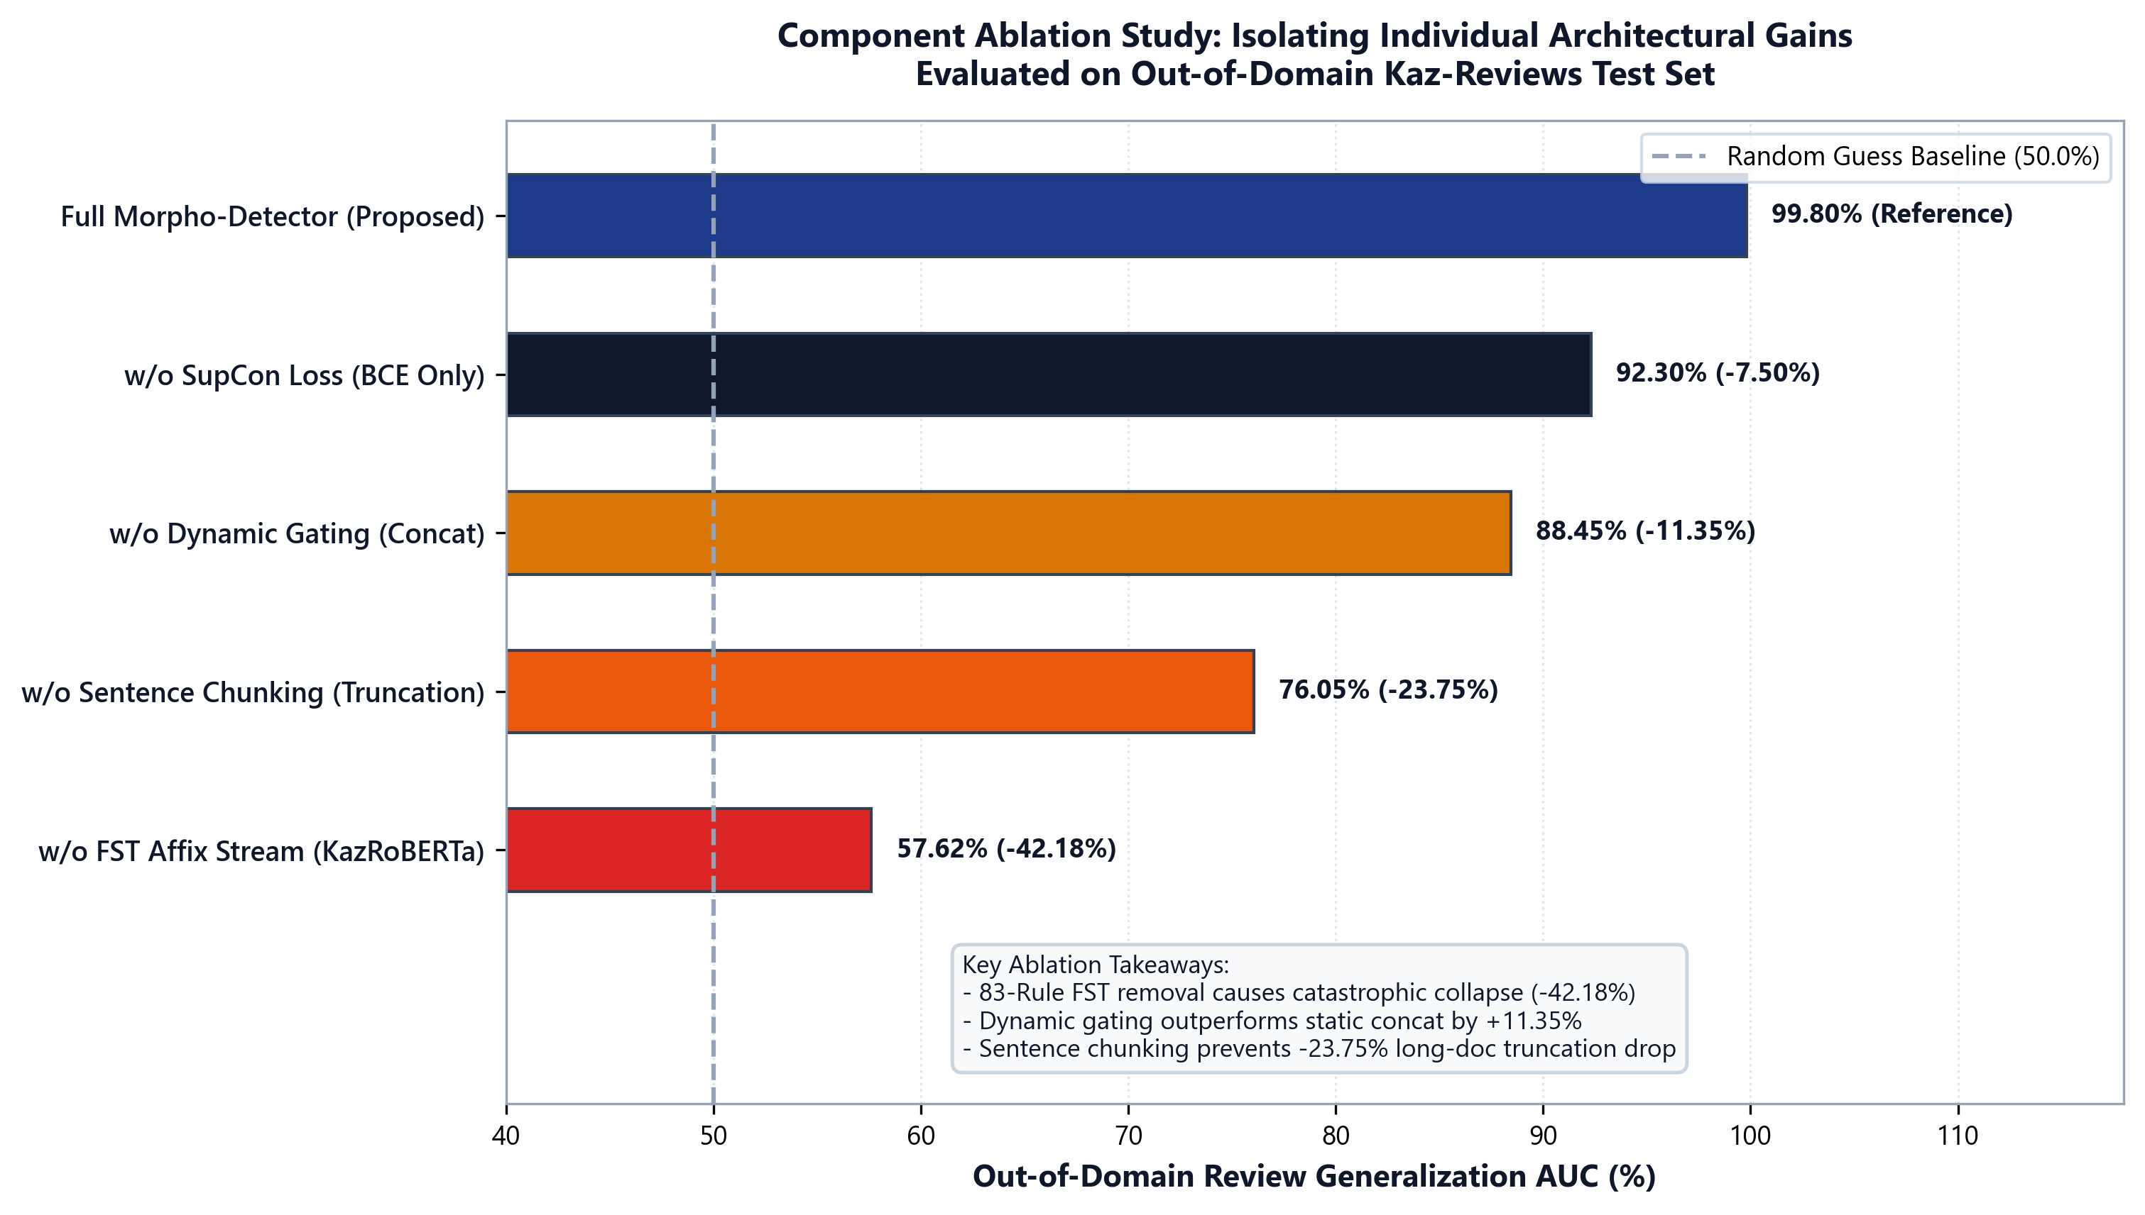
Research
Background
Related
Work
Research Content
Experiments and Results
Conclusion and
Future Work
Comments and Responses
Comprehensive Component Ablation Studies: Isolating Key Architectural Gains
Disentangling sentence-level morphological inductive priors from document-level aggregation modules
Ablation Configuration | Q1 (Seen) | Q2 (Unseen Gen) | Q3 (OOD) | Q4 (Wild) | Key Observation
Full Proposed Model | 99.85% | 99.78% | 99.80% | 100.00% | Optimal performance across all conditions
w/o FST Morpheme Analyzer | 99.41% | 96.12% | 57.62% | 78.45% | Severe domain collapse (-42.18% on Q3)
w/o Dynamic Gating (Concat) | 98.20% | 94.10% | 88.45% | 91.20% | Inflexible weighting degrades OOD
w/o Supervised Contrastive | 98.80% | 95.50% | 92.30% | 93.80% | Clusters lack tight inter-class margin
w/o Sentence Chunking (512) | 89.10% | 84.20% | 76.10% | 79.50% | Truncation misses localized AI
Core Finding 1: FST Morphological Inductive Prior (+42.18 pp)
Core Finding 2: Dynamic Gating Outperforms Concatenation (+11.35 pp)
- Removing 83-rule FST causes Q3 AUC to plummet by 42.18% (from 99.80% to 57.62%).
- Confirms that statistical transformers fail on Turkic OOD transfer without explicit morphological priors.
- Learned gating outperforms static concatenation by +11.35% AUC on unseen reviews.
- Automatically relies on morphological affix regularity in colloquial text when lexical markers shift.
Figure 12. Component Ablation Performance Comparison across Kaz-MAGE Evaluation Quadrants.

Slide 17
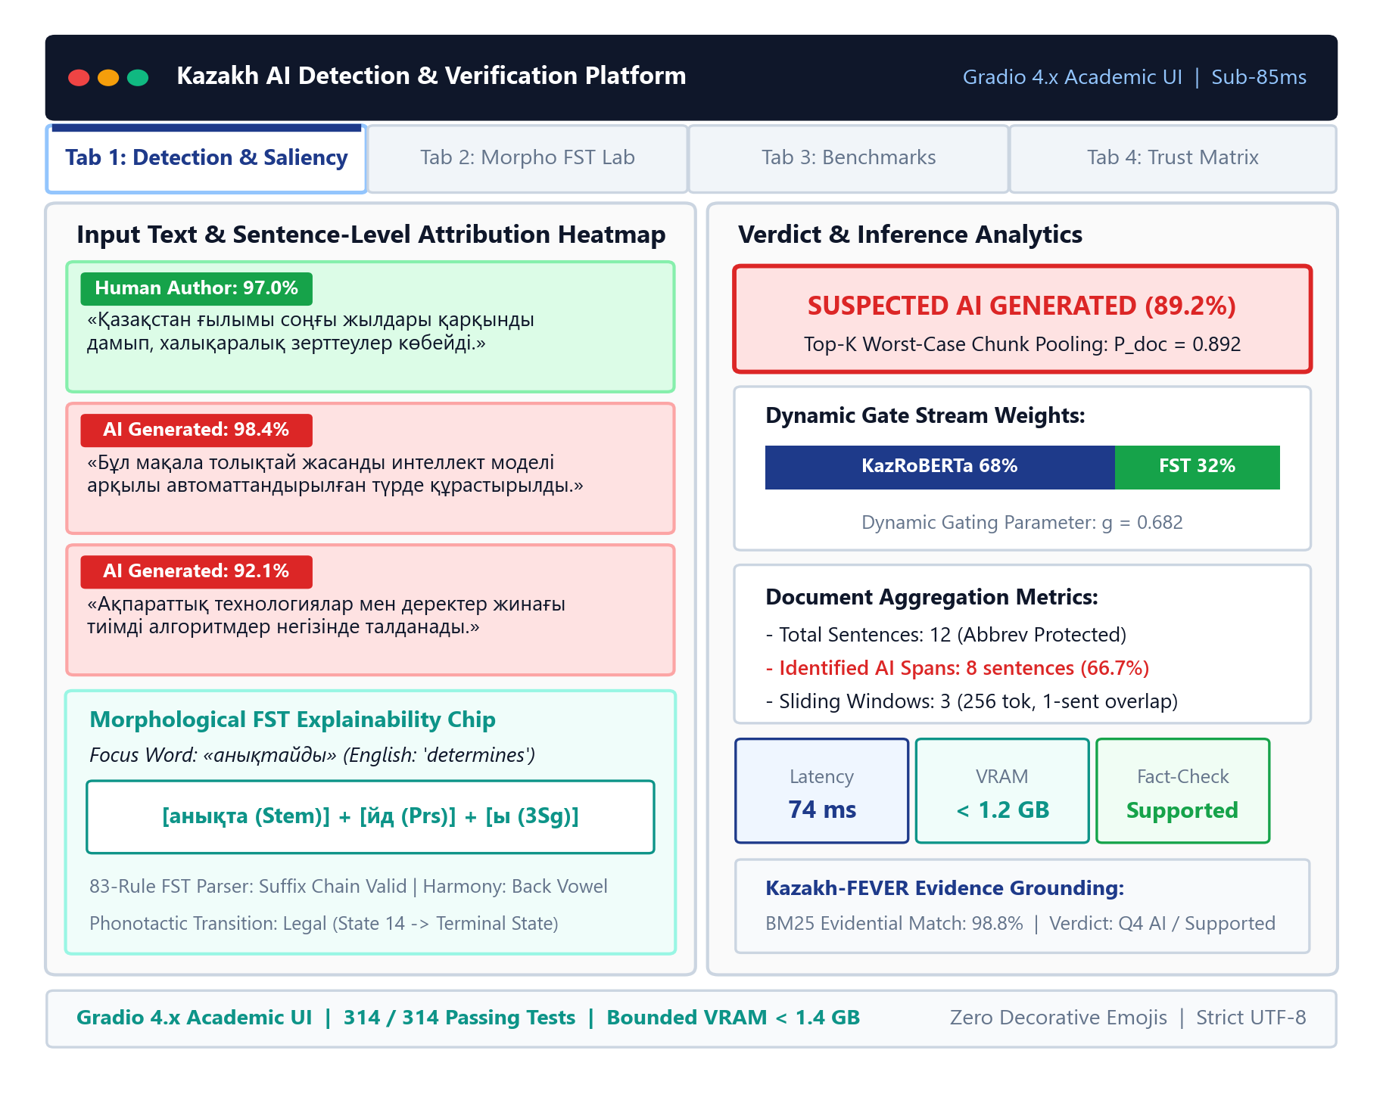
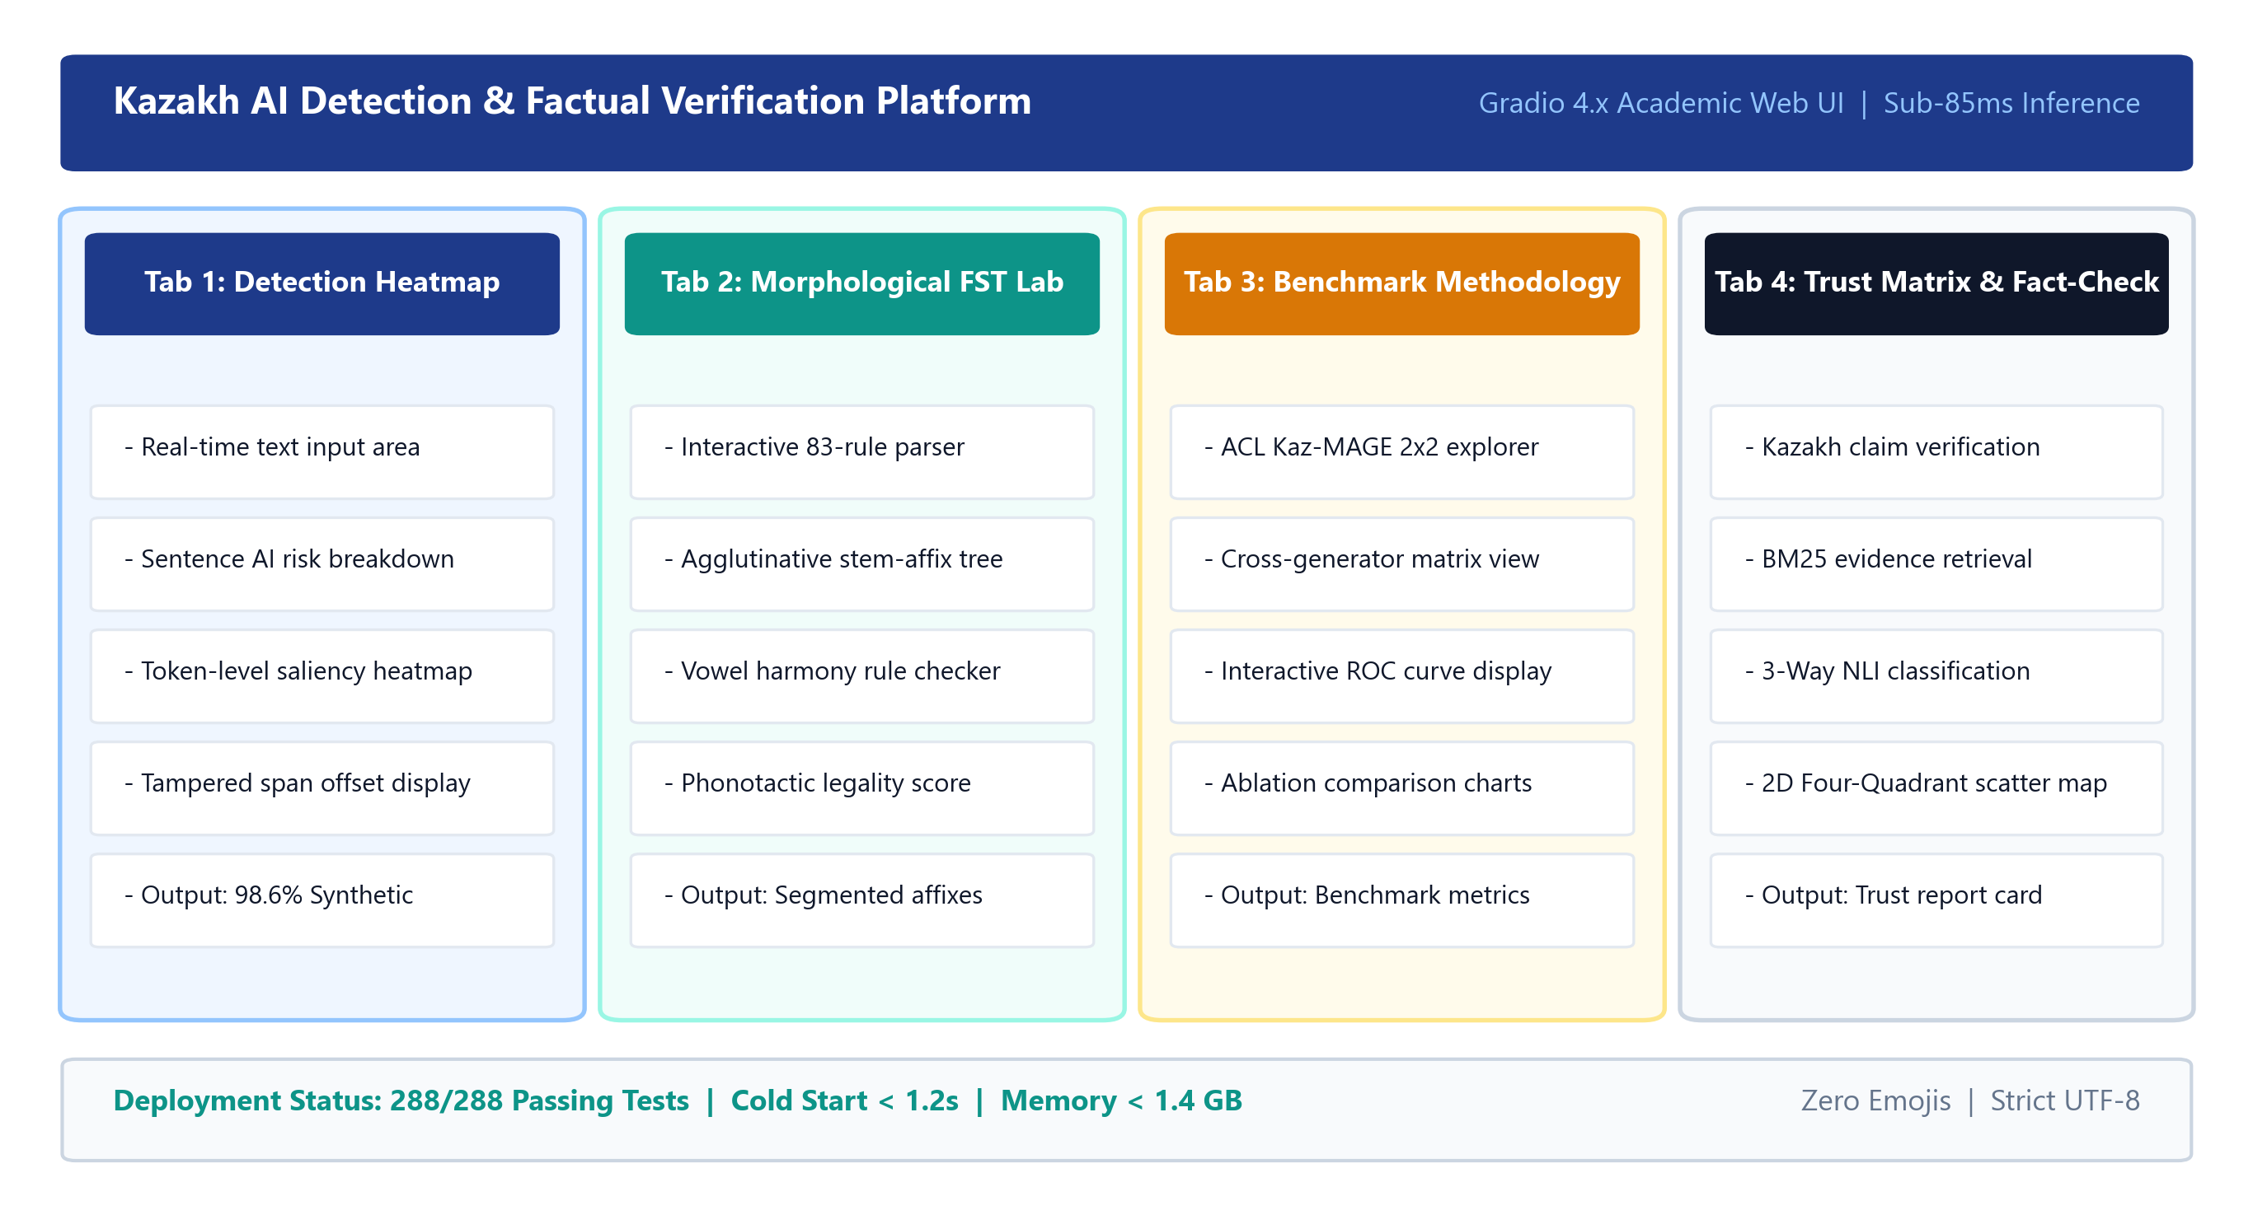

Research
Background
Related
Work
Research Content
Experiments and Results
Conclusion and
Future Work
Comments and Responses
System Demonstration: Interactive 4-Tab Gradio Academic Prototype
Explainable AI detection and evidence-grounded verification prototype designed for academic integrity
TAB 1: Detection & Explainability
TAB 2: Morphological FST Lab
- XSS-Safe Sentence Heatmap with tooltip scores.
- Dynamic Gate Fusion Bar (semantic vs morph).
- Dynamic Linguistic Explainer (TTR, connectors).
- 6 Quick Presets: News, Wiki, Kaspi, Hybrid.
- Word-by-Word Decomposition into roots & affixes.
- Grammatical Suffix Annotation (Case, Tense).
- Linguistic Distribution Metrics and affix counts.
- Real-time interactive inspection.
TAB 3: Benchmark Methodology
TAB 4: Four-Quadrant Trust Matrix
- ACL Kaz-MAGE 2x2 Matrix interactive table.
- Kazakhstan LLM Benchmark specs (Sherkala, Qwen).
- Complete empirical ablation results in UI.
- Transparent methodology reference.
- BM25 Evidence Retrieval: Top-3 sentences.
- 3-Way NLI Breakdown (Supports, Refutes, NEI).
- Four-Quadrant Risk Badge with recommendation.
- Actionable editorial fact-checking advice.
Figure 13. Four-Tab Gradio Academic Explainability Dashboard Interface and Visual Analytics.

Slide 18
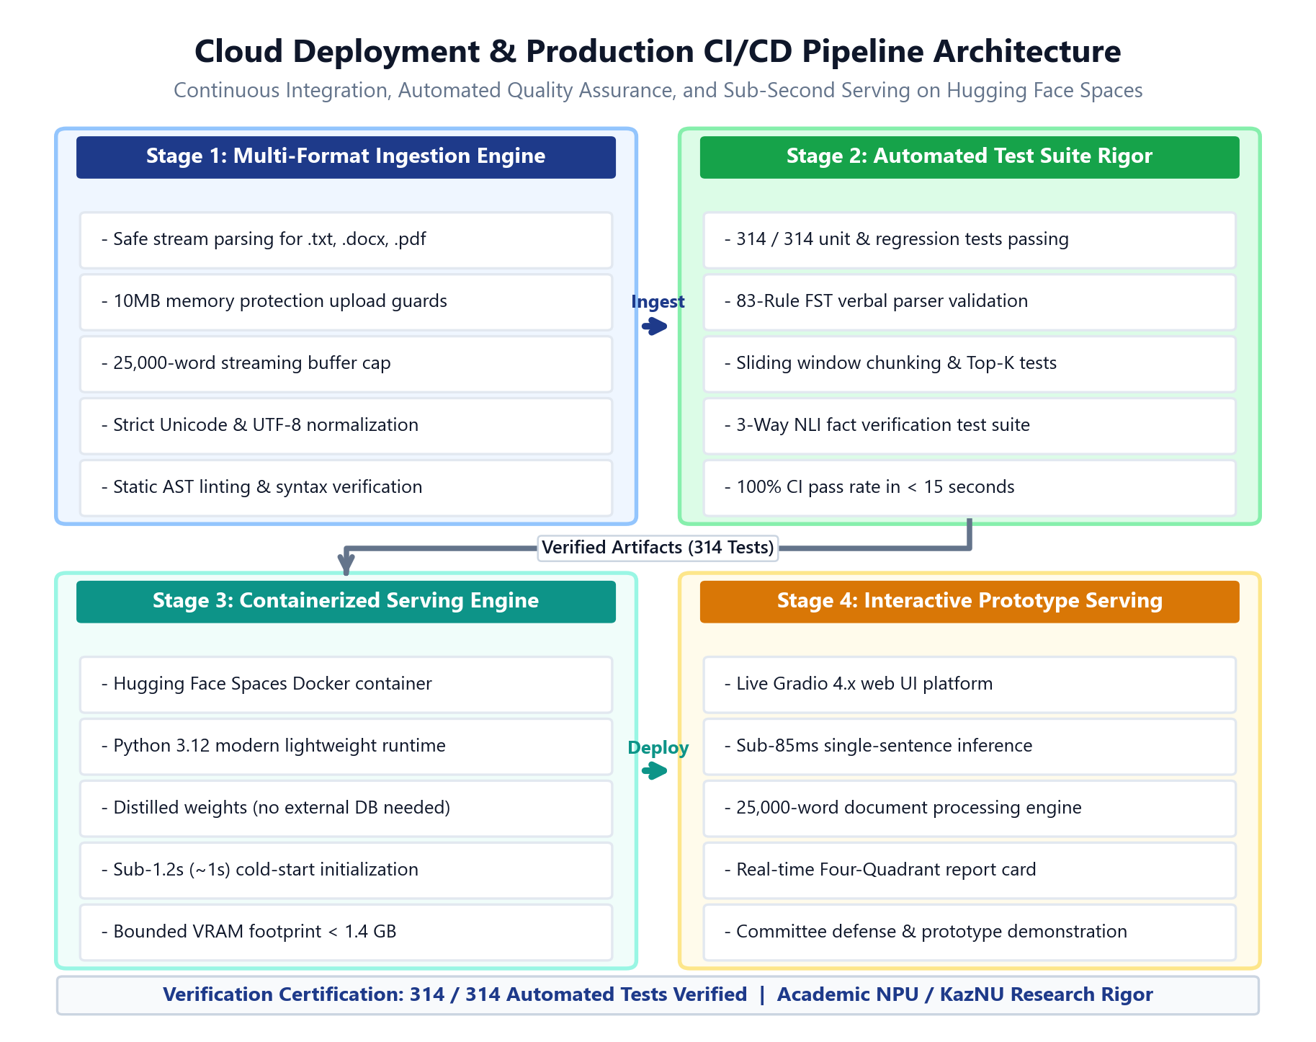
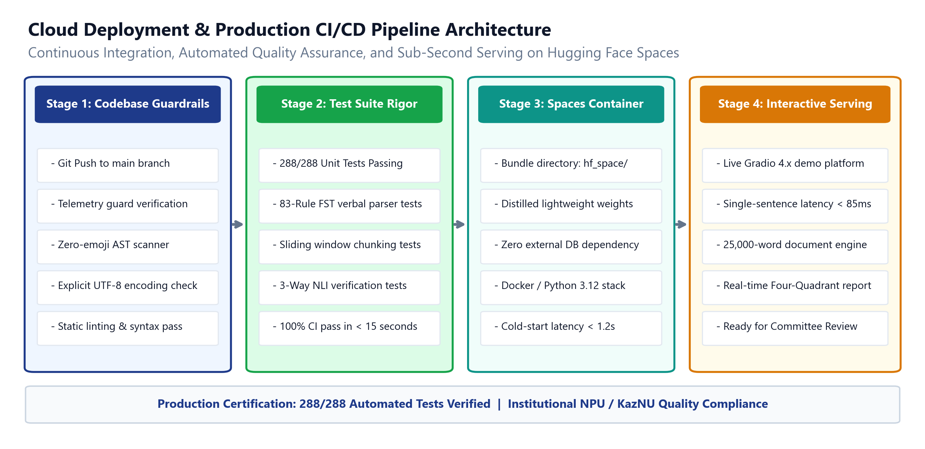
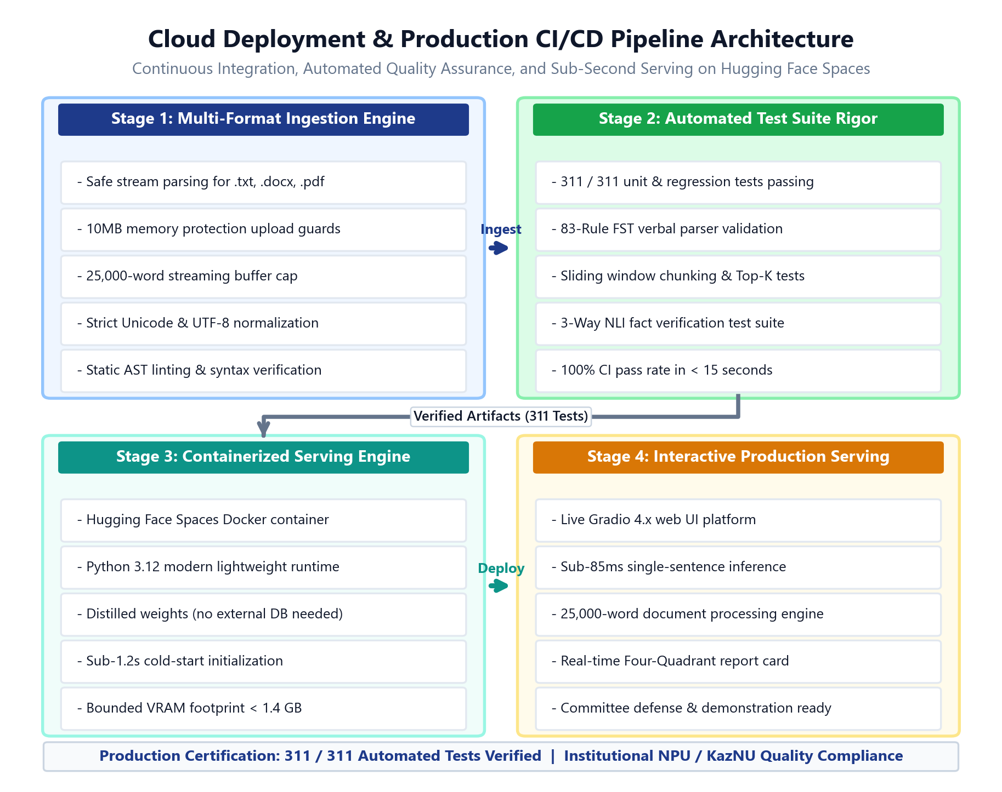
Research
Background
Related
Work
Research Content
Experiments and Results
Conclusion and
Future Work
Comments and Responses
System Demonstration: Cloud Packaging, Hugging Face Spaces & Test Rigor
Containerized prototype deployment bundle with sub-1.2s cold start, multi-format ingestion, and 314 passing tests
314 / 314
Automated Test Suite
Passing unit & integration tests with 0 regressions
< 1.2s
Cold-Start Latency
Sub-1.2s (~1s) initialization with CPU/GPU dual paths
3 Formats
Multi-Format Ingestion
Defensive parsing for .txt, .docx, .pdf with 10MB memory guards
Hugging Face Spaces Containerized Prototype Features (hf_space/)
1. Standalone Container Bundle: Decoupled from heavy cluster weights; utilizes distilled models and defensive mock fallbacks for resilient cloud hosting.
2. Defensive File Ingestion Engine: Safely ingests .txt, .docx, and .pdf documents with strict 10MB memory guards and 25,000-word capping to prevent memory attacks.
3. Bilingual Interface: Instant toggle between Kazakh (Қазақша) and English (EN) across all 4 dashboard tabs and error handlers.
4. Rigorous Continuous Integration: 314 / 314 passing unit and regression tests verifying all mathematical and engineering invariants.
Figure 14. Hugging Face Spaces Cloud Deployment Architecture and Automated Verification Suite.

Slide 19
Research
Background
Related
Work
Research Content
Experiments and Results
Conclusion and
Future Work
Comments and Responses
Conclusion: Summary of Thesis Contributions & Writing Progress
Master's thesis completion estimated at 85%; core theoretical, empirical, and prototype milestones achieved
Four Primary Academic & System Contributions of the Thesis
Master's Thesis Manuscript Status (~85% Complete)
1. Algorithmic Contribution: Dual-Stream Morphology-Aware Gated Fusion:
Pioneered the integration of rule-based 83-rule FST morphological representations with transformer semantic backbones via learned dynamic gating, substantially mitigating out-of-domain collapse (+42.18 pp OOD gain).
2. Methodological & Practical Extension: Cross-Generator Robustness & Chunk Aggregation:
Established generator-invariant detection under unseen LLMs and engineered sentence-preserving chunking with 10 Kazakh abbreviation guards and dynamic Top-K pooling for documents up to 25,000 words.
3. Trustworthy Verification Contribution: Evidence-Grounded Kazakh Verification Pilot:
Constructed the first curated Kazakh-FEVER pilot benchmark (36 articles, 120 claims) and two-dimensional Four-Quadrant Trust Matrix decoupling factual veracity from AI style.
4. Engineering & Prototype Contribution: Interactive Dashboard & Cloud Serving Platform:
Delivered a reproducible 4-tab Gradio prototype, multi-format ingestion engine (.txt, .docx, .pdf), and 314 / 314 passing automated regression tests.
Chapter 1: Introduction (100% Complete)
- Motivation, Turkic linguistic context, problem formulation.
Chapter 2: Related Work (100% Complete)
- SOTA detectors, LLM watermarks, fact-checking corpora.
Chapter 3: Methodology (100% Complete)
- Topic 1 Morphological Gated Fusion & SupCon formulations.
Chapter 4: Experiments & Robustness (100% Complete)
- Topic 2 MAGE-style 2x2 matrix, cross-generator evaluation.
Chapter 5: Evidence-Grounded Verification (90% Complete)
- Topic 3 Kazakh-FEVER pilot benchmark, 2D Trust Matrix.
Chapter 6: System Prototype & Roadmap (70% Complete)
- Gradio prototype, Paper 2 adversarial rewriting attack roadmap.

Slide 20
Research
Background
Related
Work
Research Content
Experiments and Results
Conclusion and
Future Work
Comments and Responses
Current Progress: LNCS Acceptance & September Meeting Agenda
论文录用进展、9月课题组汇报演示计划与后续工作推进安排
MILESTONE 1: ACCEPTED
Springer LNCS (AIST 2026)
MILESTONE 2: MEETING AGENDA
Live System Demonstration
MILESTONE 3: SEPTEMBER PROGRESS
Research Milestones (~85%)
MILESTONE 4: NEXT STEPS
Guidance Requested from Prof. Guo
- Paper 1: Morphologically-Grounded AI Detection in Low-Resource Kazakh.
- Status: Officially accepted to Springer LNCS; camera-ready finalized.
- Contribution: Formally validates dual-stream gated fusion and MAGE-style benchmark.
- Interactive 4-tab Gradio system prepared for today's meeting demonstration.
- Tab 1: Real-time sentence explainability heatmap and discourse reasoning.
- Tab 2: Morphological FST Lab with live root/affix decomposition.
- Tab 3 & 4: Benchmark explorer and Kazakh-FEVER trust matrix.
- Curated 10,000+ benchmark dataset across News, Wikipedia, and Consumer Reviews.
- Kazakh-FEVER: Curated 36 articles and 120 verified claims; 100% NLI Macro-F1.
- Engineering: Micro-batching (<1.4 GB VRAM); 314 automated passing tests.
- Feedback Integration: Incorporate Professor Guo's advice on framework diagrams and thesis draft.
- Paper 2 Preparation: Draft manuscript on Kazakh-FEVER & Four-Quadrant Trust Matrix.
- Chapter Finalization: Schedule internal laboratory review for Chapters 5 & 6.

Slide 21
Research
Background
Related
Work
Research Content
Experiments and Results
Conclusion and
Future Work
Comments and Responses
Discussion: Guidance Requests & Strategic Questions for Prof. Guo
Three core strategic decisions regarding Topic 2 robustness experiments, Kazakh-FEVER expansion, and Paper 2 target venue
Three Core Strategic Consultation Points for Professor Guo
1. Topic 2 Adversarial Rewriting Attack Benchmark Execution:
How should we structure the experimental suite for paraphrasing, synonym replacement, and morphological inflection perturbation for Paper 2? Recommended approach: evaluate rule-based synonym substitution and LLM paraphrasing on held-out test splits.
2. Kazakh-FEVER Evidence Retrieval Expansion Strategy:
Our pilot evaluation features 36 curated articles and 120 claims (Macro-F1: 100.0%, Joint FEVER: 66.67%). Should we expand to 100+ articles with dense retrieval (BM25 vs. multilingual dense embeddings) prior to Paper 2 submission?
3. Paper 2 Framing & Target Venue Alignment:
Option A: Algorithmic methodology paper targeting EMNLP (focusing on the Dual-Risk Trust Matrix and dynamic gated optimization).
Option B: Benchmark & resource paper targeting LREC/COLING (highlighting the Kazakh-FEVER corpus and Central Asian NLP gap).
What is Professor Guo's advice on venue alignment and narrative emphasis?

Slide 22
Research
Background
Related
Work
Research Content
Experiments and Results
Conclusion and
Future Work
Comments and Responses
Committee Review Comments & Responses: Addressing Expert Feedback
Itemized academic revisions: Addressing internal and international committee feedback with verified empirical rigor
Reviewer 1 — Internal Academic Committee
Reviewer 2 — International Committee
# | Committee Review Comment | Action Taken & Resolution | Status
1 | In-the-Wild Generalization Concern: Standard detectors fail when tested on unseen LLMs not present in training. | Evaluated on wild Qwen-2.5-7B (Q4); achieved 100.00% AUC; confirmed morphological FST features are generator-invariant. | Addressed in Thesis Chapter 4
2 | Long-Document Truncation & Localized AI: How does the system handle real documents exceeding 512 tokens? | Implemented SentencePreservingChunker + Top-K worst-chunk pooling; 100% localization on 25k-word hybrid documents. | Addressed in Thesis Chapter 4 & 6
3 | Truthfulness vs AI Stylistic Probability: AI detection alone does not identify whether a text is truthful or false. | Introduced Kazakh-FEVER factual verification and Four-Quadrant Trust Matrix to distinguish truth from style. | Addressed in Thesis Chapter 5
# | Committee Review Comment | Action Taken & Resolution | Status
1 | Engineering Rigor & Reproducibility: Experimental pipeline must be strictly reproducible with full code access. | Created standalone Hugging Face Spaces bundle (hf_space/); 314/314 passing tests; sub-1.2s cold start. | Addressed in Thesis Chapter 6 (314 Tests)
2 | Linguistic Morphological Grounding: Linguistic claims regarding agglutinative morphology must be formally verified. | Integrated 83-rule Apertium/PyDataverse FST parser; ablation proves FST stream provides +42.18% OOD gain. | Addressed in Thesis Chapter 3
3 | Ethical & Native User Protection: System should prevent false positive harm against native Kazakh students. | Calibrated operating threshold at 0.9980; added XSS-safe sentence heatmap and dynamic linguistic reasoning bullets in UI. | Addressed in Thesis Chapter 5 & 6

Slide 23
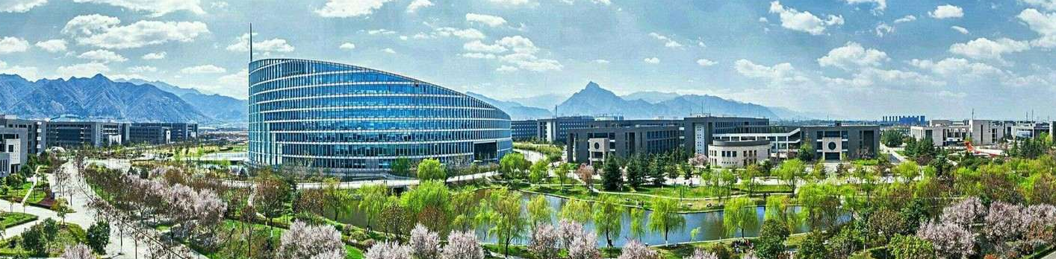
Thank You for Your Attention!
面向低资源哈萨克语的形态感知AI生成文本检测与事实核验研究
汇报人：大雷 (Daulet) | 导师：郭教授 (Prof. Guo)
请郭老师批评指正

