Slide 1
Ve-Can or Ve-Can’t
Restaurant finder: Vegan/Vegetarian Friendly

Slide 2
Challenge
Using Yelp restaurant review data
Can we find Vegan/Vegetarian friendly dinning options

Slide 3
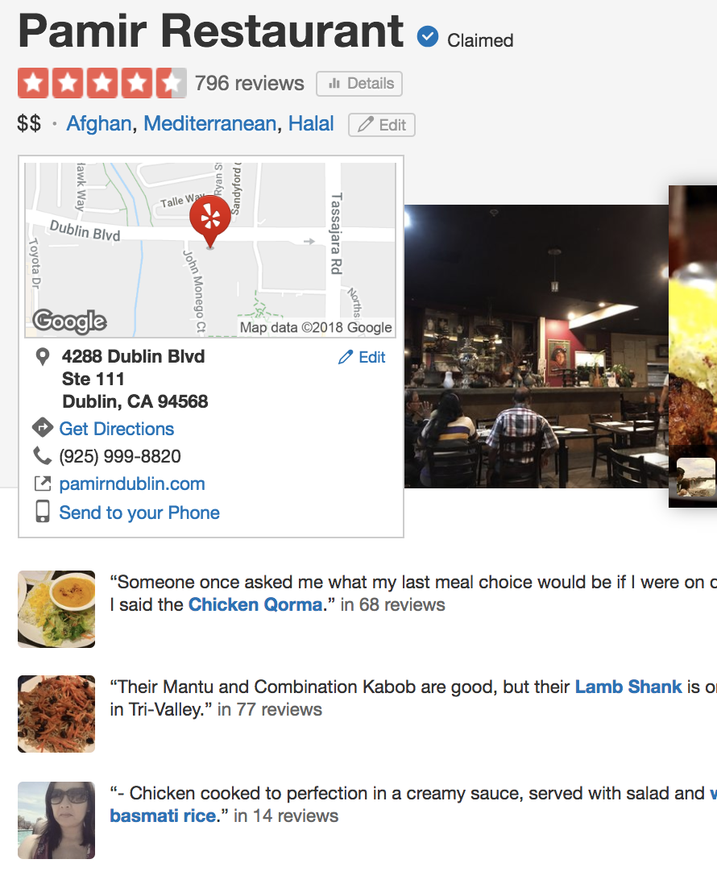
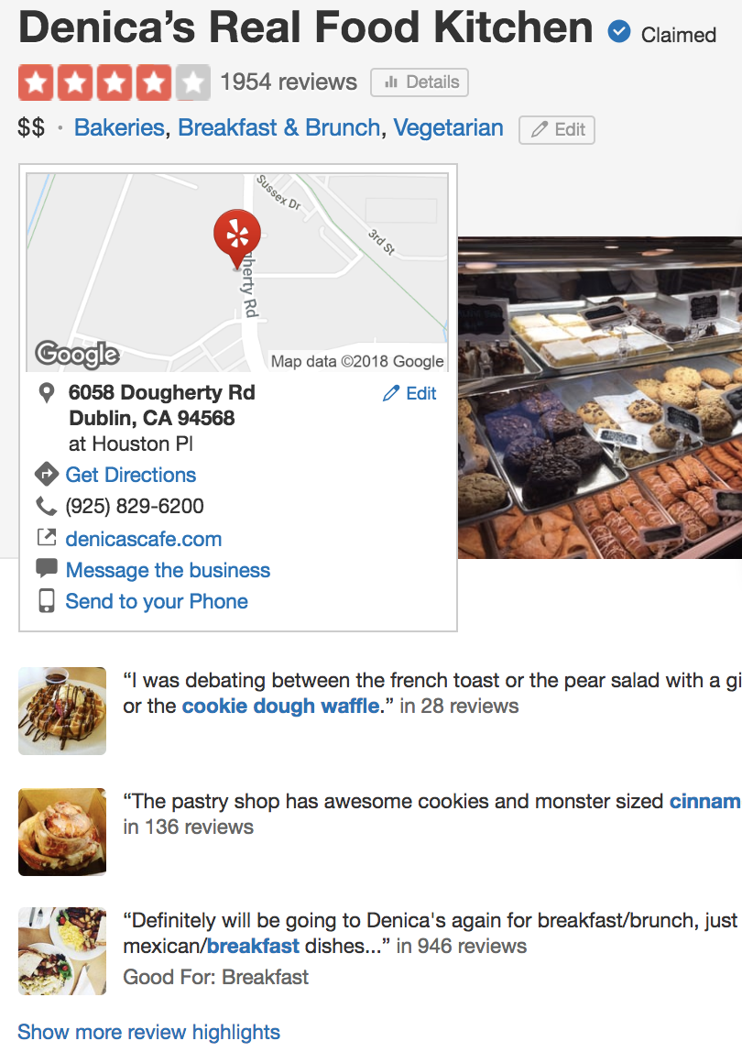
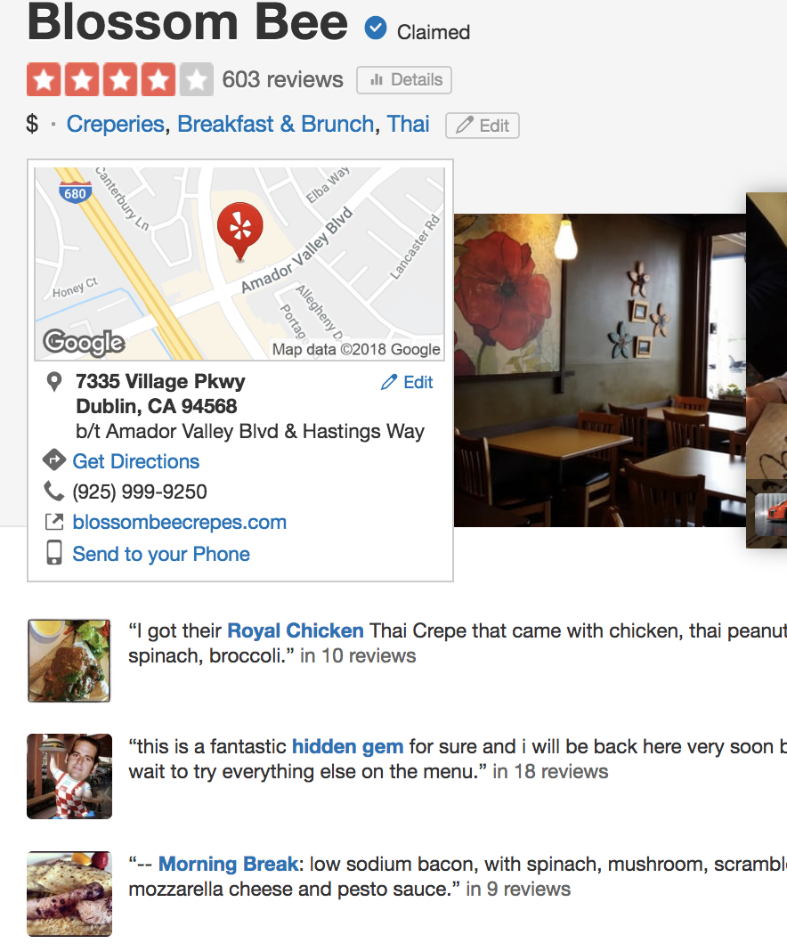
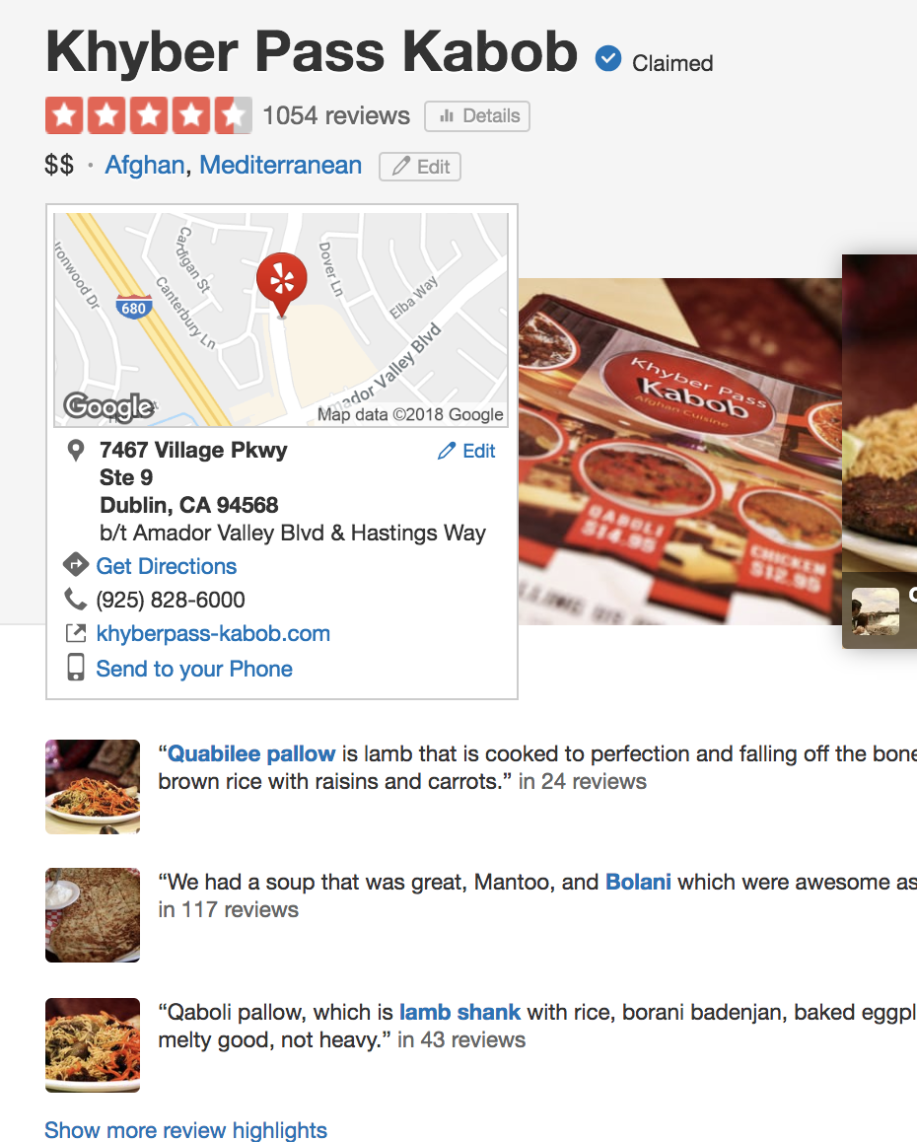
What’s for dinner?
Commence the endless search through restaurant reviews

Slide 4
Data
Yelp Challenge Data Set
MM rows (5-US cuisines 1.1MM rows)

Slide 5
Models
Naïve Bayes
RF – cannot pickle
Kmeans

Slide 6
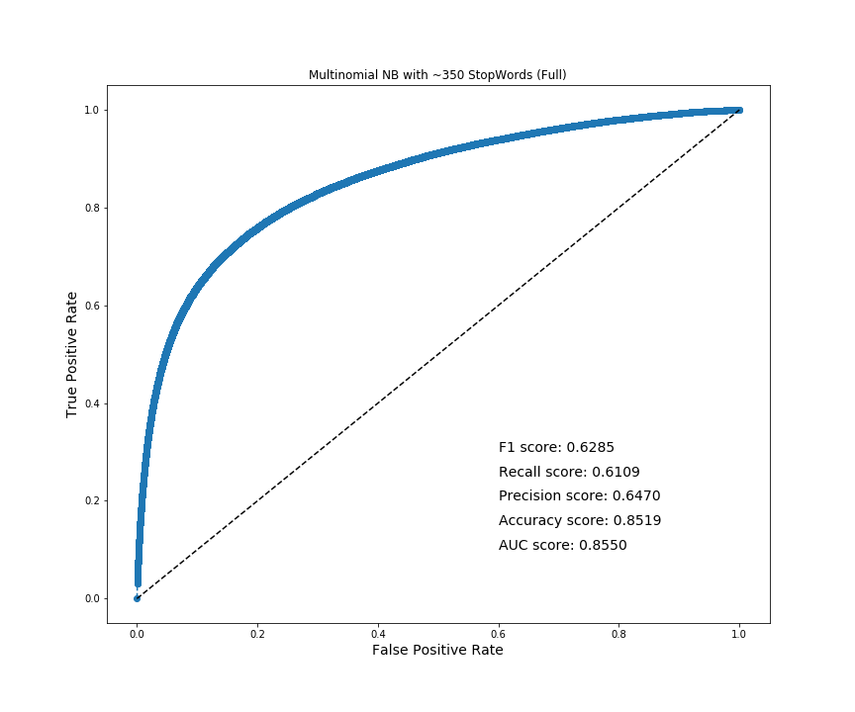
Results
I know everything!
Any questions?

Slide 7
False Negatives
Naïve Bayes
RF – cannot pickle
Kmeans

Slide 8
False Positive

