Slide 1
Dine with me?
Date Night helper for Veggie Friendly

Slide 2
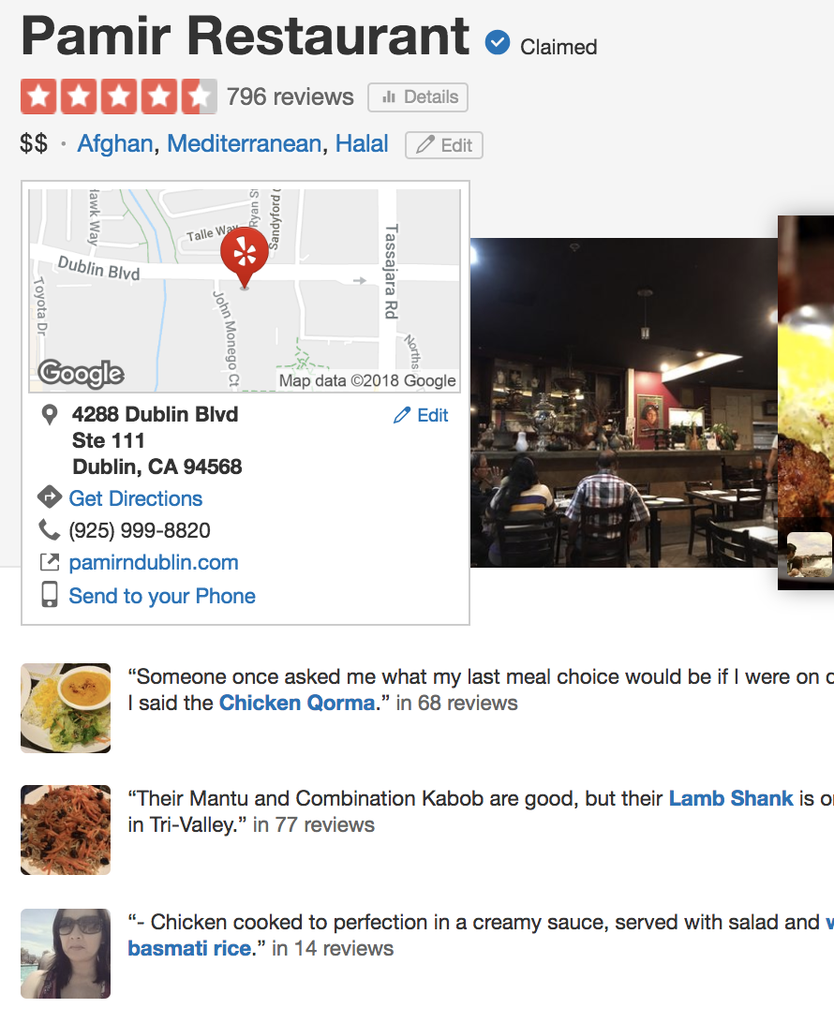
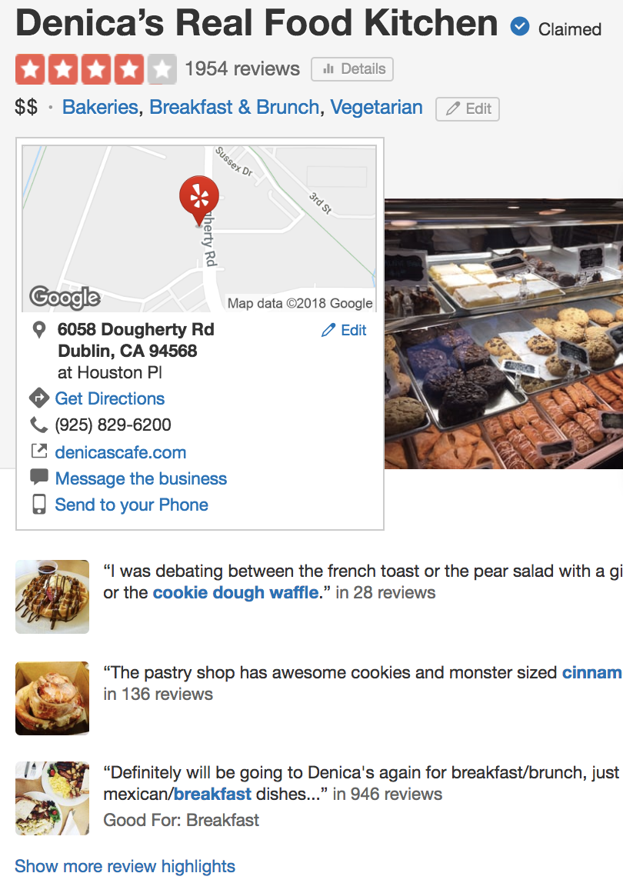
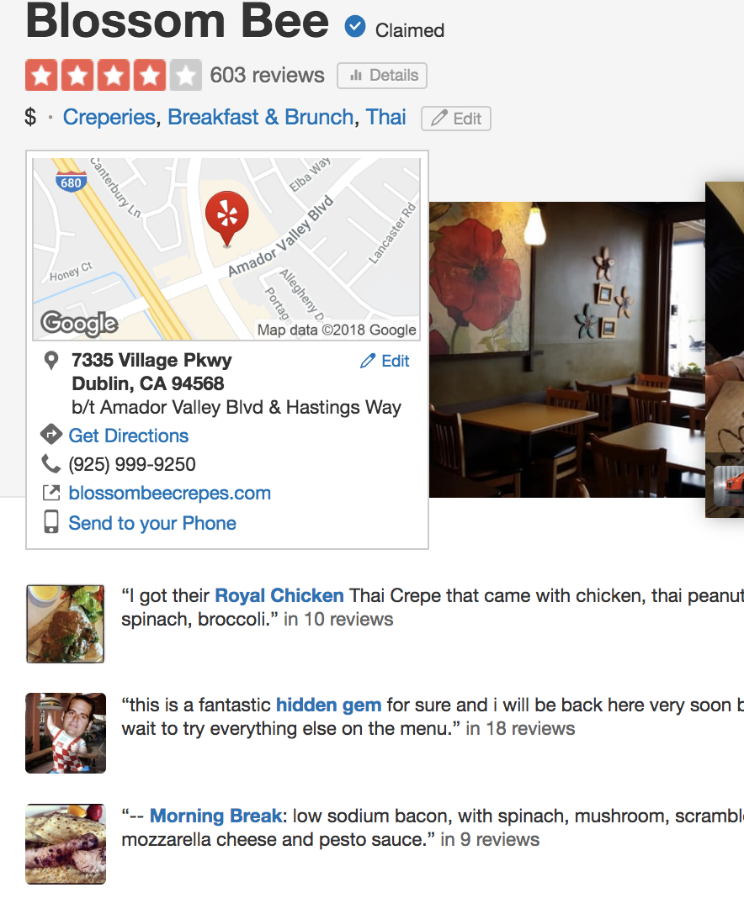
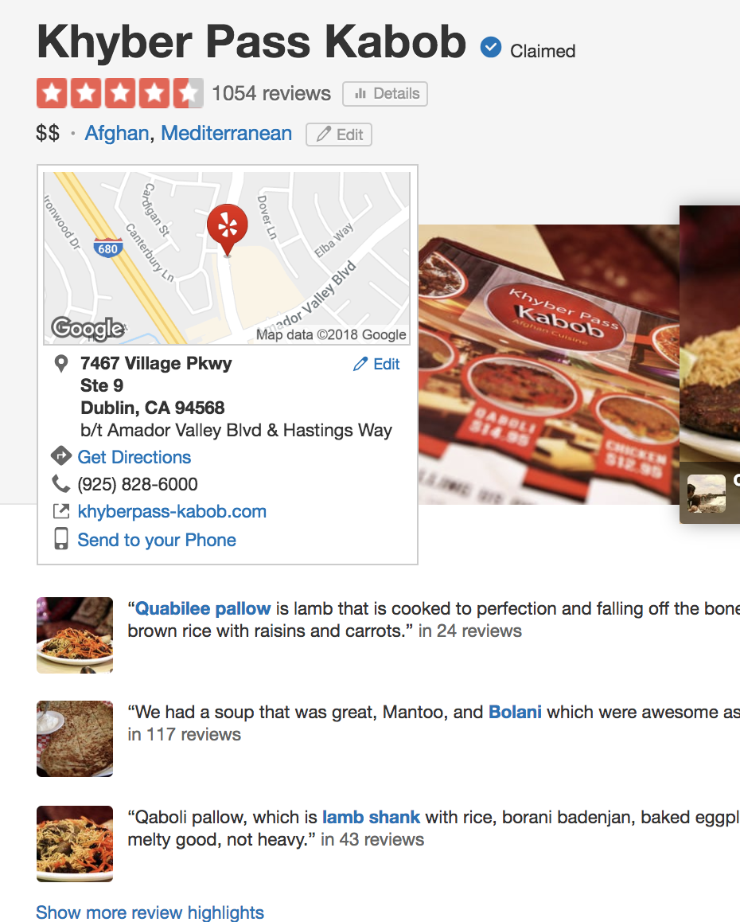
Dinner?: Yes Please
Endless restaurant review search

Slide 3
Data
Yelp Challenge Data Set
MM rows

Slide 4
Models
RF
Kmeans
Naïve Bayes

Slide 5
Results
I know everything!
Any questions?

