Slide 1
Dine with me?
Date Night helper: Veggie Friendly

Slide 2
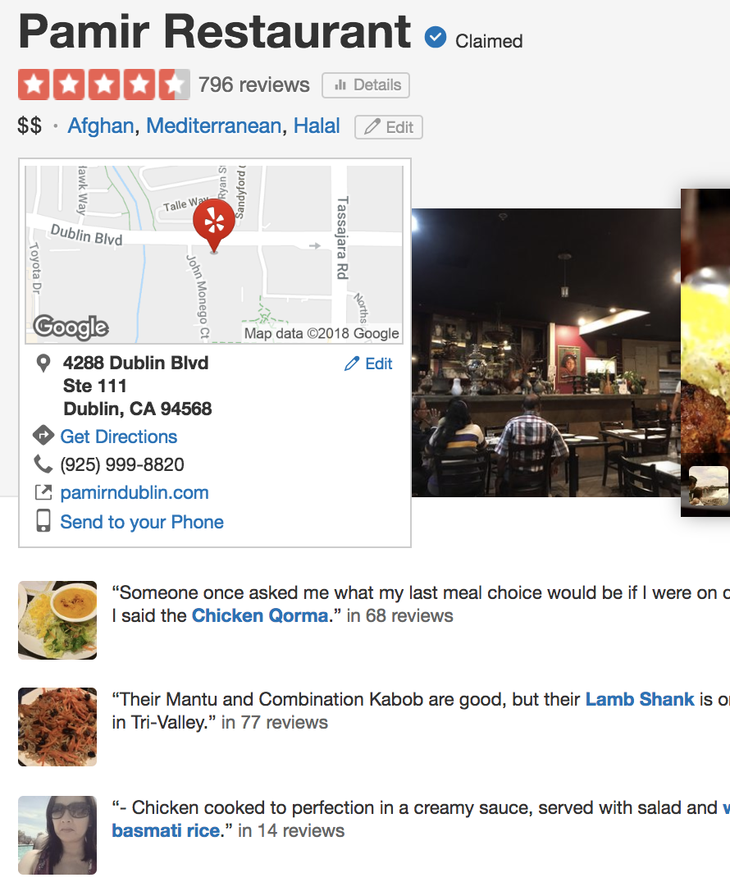
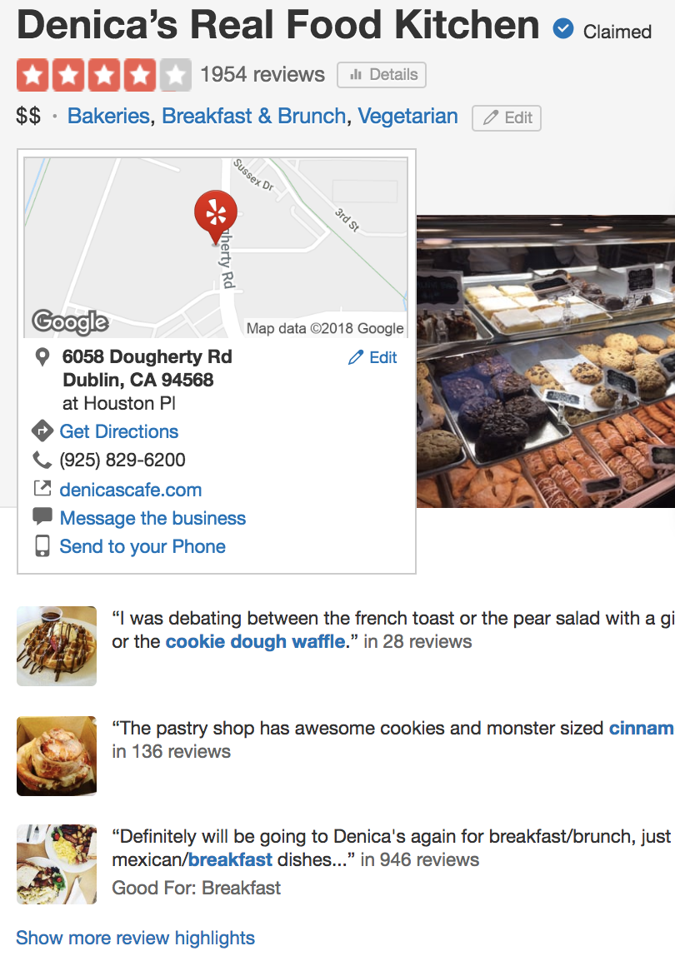
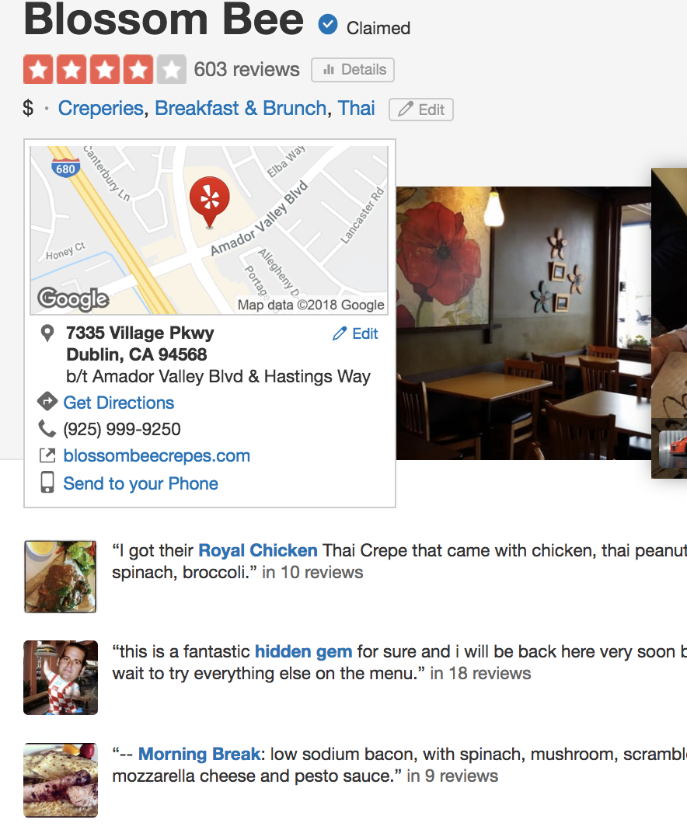
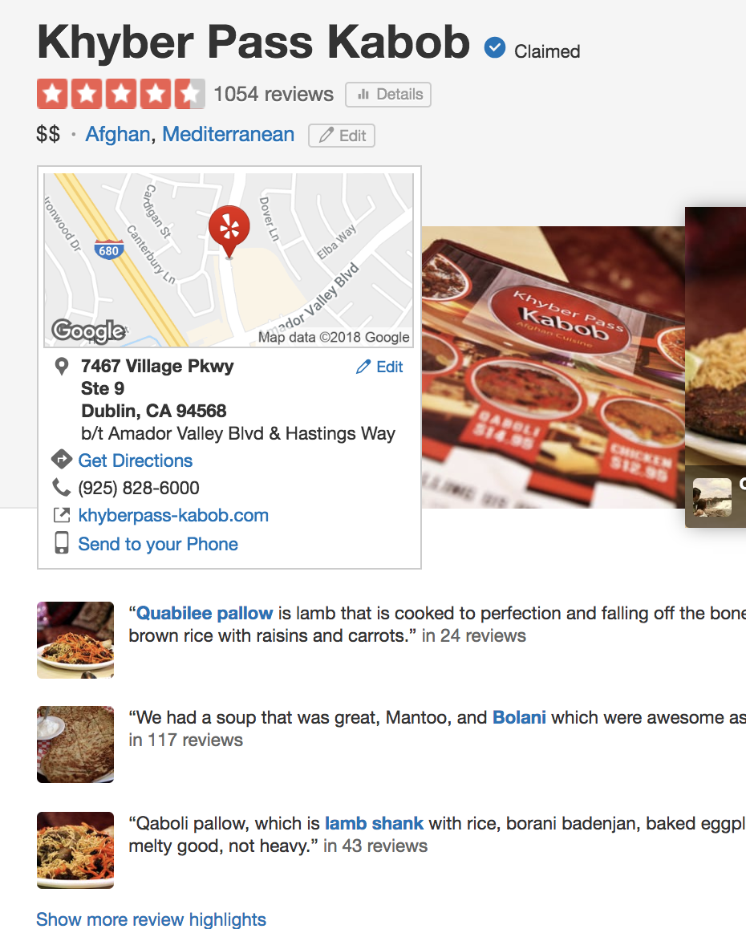
Dinner?: Yes Please
Endless restaurant review search

Slide 3
Data
Yelp Challenge Data Set
MM rows (5-US cuisines 1.1MM rows)

Slide 4
Models
Naïve Bayes
RF – cannot pickle
Kmeans

Slide 5
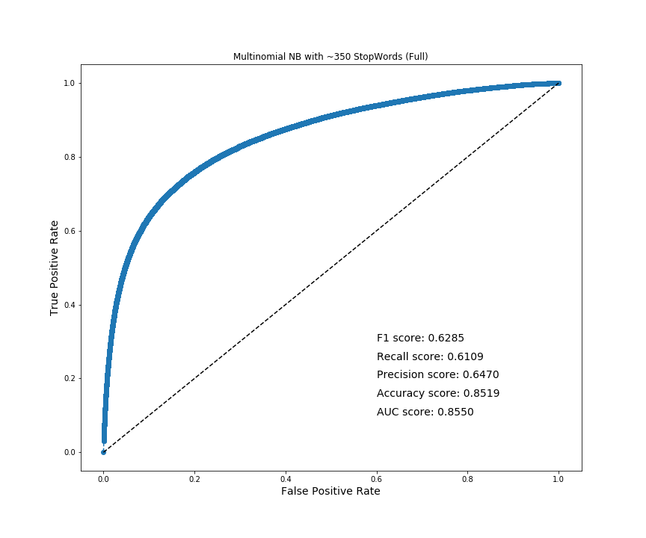
Results
I know everything!
Any questions?

