Slide 1




Modern Web Application Development in Angular
CORS

Slide 2

Summary
Same-Origin policy?
What is CORS
How CORS works
Preflight Request
JWT
Pratice
Explanation of the exam project

Slide 3
Same-Origin Policy
The same-origin policy is an important concept in the web application security model. Under the policy, a web browser permits scripts contained in a first web page to access data in a second web page, but only if both web pages have the same origin. An origin is defined as a combination of protocol, host name, and port number. This policy prevents a malicious script on one page from obtaining access to sensitive data on another web page through that page's Document Object Model.

Slide 4
Same-Origin Policy
Expedient:
Document.domain
JSONP
CORS
Websockets
Others

Slide 5
What is CORS ?
CORS (cross origin resource sharing) is a mechanism to allow client web applications make HTTP requests to other domains.
Describes new HTTP headers which provide browsers and servers a way to request remote URLs only when they have permission. Although some validation and authorization can be performed by the server, it is generally the browser's responsibility to support these headers and honor the restrictions they impose.

Slide 6
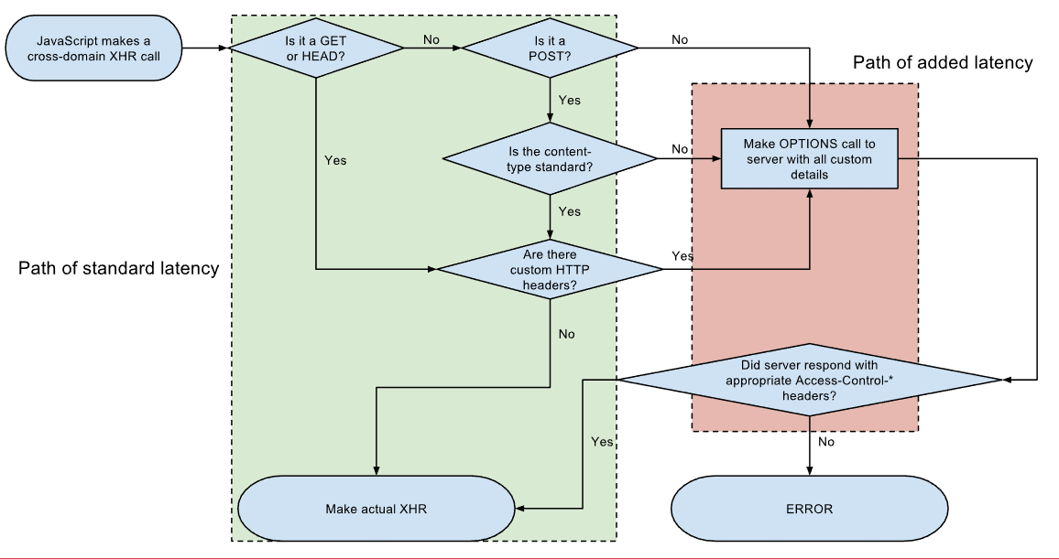
How CORS works ?

Slide 7
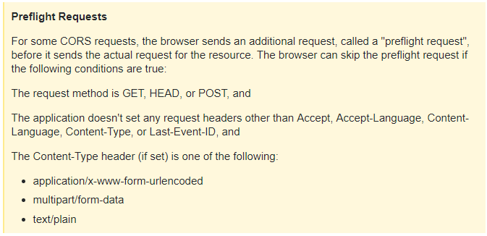
Preflight request
Access-Control-Allow-Origin: http://www.example.com
Access-Control-Allow-Methods: PUT, DELETE

Slide 8
JWT
JSON Web Token is a JSON-based open standard for creating access tokens that assert some number of claims. The client could then use that token to prove that it is logged in as admin. The tokens are signed by one party's private key (usually the server's), so that both parties are able to verify that the token is legitimate. The tokens are designed to be compact and usable especially in a web-browser single-sign-on (SSO) context. JWT claims can be typically used to pass identity of authenticated users between an identity provider and a service provider, or any other type of claims as required by business processes.

Slide 9
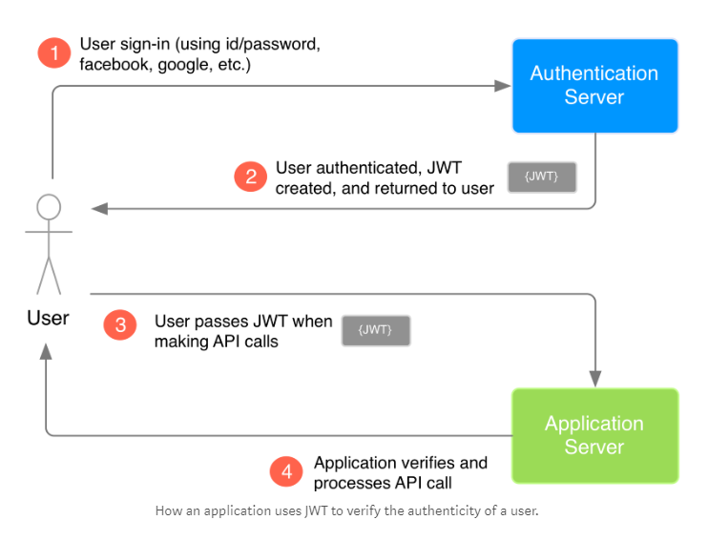
JWT

Slide 10
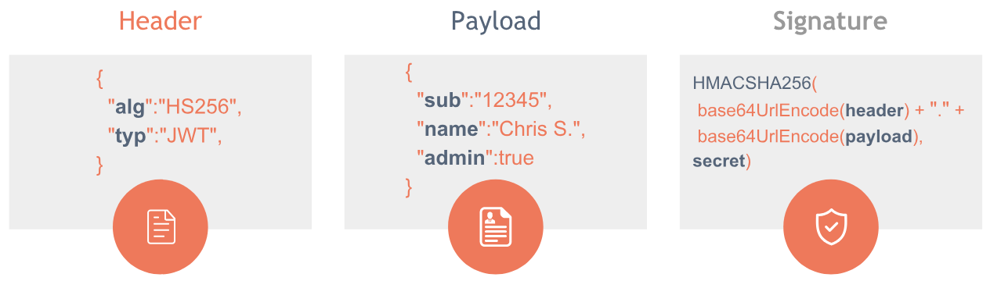
JWT Structure

Slide 11
JWT Payload
code | name | description
iss | Issuer | Identifies principal that issued the JWT.
sub | Subject | Identifies the subject of the JWT.
aud | Audience | Identifies the recipients that the JWT is intended for. Each principal intended to process the JWT must identify itself with a value in the audience claim. If the principal processing the claim does not identify itself with a value in the aud claim when this claim is present, then the JWT must be rejected.
exp | Expiration Time | Identifies the expiration time on and after which the JWT must not be accepted for processing. The value must be a NumericDate: either an integer or decimal, representing seconds past 1970-01-01 00:00:00Z.
nbf | Not Before | Identifies the time on which the JWT will start to be accepted for processing. The value must be a NumericDate.
iat | Issued at | Identifies the time at which the JWT was issued. The value must be a NumericDate.
jti | JWT ID | Case sensitive unique identifier of the token even among different issuers.
Standard fields

Slide 12
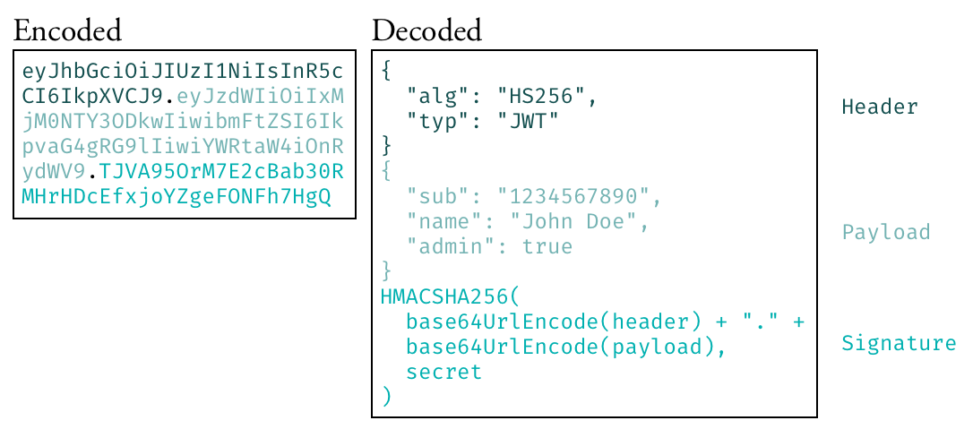
JWT

Slide 13
JWT disadvantages
Compromised secret key
Inability to manage clients from the server
Inability to be aware of currently logged in users
Length of a token

