Slide 1
Solving Secondary structure problems of RNAs
Sanchay Harneja IIIT-H
13/05/2010

Slide 2
Intro to Problem
Given PDB data :
Determine Secondary structure of RNA, i.e. compute (and classify) Hydrogen bonds.
Determine secondary structure elements of functional importance like triplets, quartets, stems, stem-loops, bulges, internal loops, multi-way, kissing loops, pseudo knots etc. [1]

Slide 3
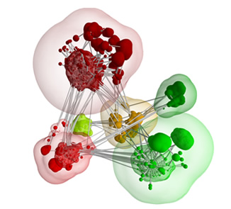
Computing Hydrogen Bonds
[4]

Slide 4
Modeling raw PDB data
The heart of algorithm of finding hydrogen bonds is – given a donor atom (x, y, z) find all acceptor atoms satisfying some distance constraint.
This is essentially a spatial range query. Hence we can try to model our data in a spatial database.
A spatial database is a database that is optimized to store and query data related to objects in space, including points, lines and polygons [2]. Spatial indexes are used by spatial databases to optimize spatial queries – example R-tree [3].
Some examples of spatial databases which can handle 3D – Oracle spatial, AllegroGraph 4.0 Geospatial (not yet released).
There are many more spatial databases which solve exclusively 2D, but we need a 3D spatial database which is rare at this time.

Slide 5
What we did ..
Although it is ideal to use a spatial database to solve this problem, unfortunately we couldn’t find a free 3D spatial database.
Instead we tried to optimize modifyincar.py – the Python script which computes hydrogen bonds.
The core idea we tried is to sort all acceptor atoms (based on x coordinate), and binary search through this list instead of the brute force approach of iterating over all acceptors for each donor.

Slide 6
What we did .. Contd.
We decided to implement this in Java/Clojure because of two reasons :
Java is generally faster than most scripting languages including Python.
It is easy to find developers in future to maintain or enhance the functionality.
Performance:
Just moving the code from Python to Java gave us a speed up of ~30 (20 min to 40 sec).
Additionally optimizing it by sorting the acceptors gave us an additional speedup of ~40 (40 sec to 1 sec).
In effect, for a PDB file containing ~50k atoms, hydrogen bonds can be computed in 1 sec (down from 20 min).

Slide 7
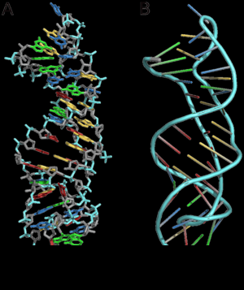
Secondary Structure elements
[5]

Slide 8
Data model
Let us have a look at the data – nucleotides with covalent bonds and hydrogen bonds.
This data is inherently network oriented. An intuitive way to model it is: nucleotides as nodes and covalent bonds, hydrogen bonds as two distinct kinds of edges.
We need to translate the various secondary structure elements into a precise mathematical definition based on the above data model.

Slide 9
Graph databases
Although network based data can be modeled and queried in a traditional relational database (table oriented). It is more suitably handled and queried in graph databases.
A graph database uses nodes, edges and properties to represent and store information [6].
Some popular examples of graph databases are – AllegroGraph [8], Neo4j [9], HyperGraphDB [10] etc.
Note that Graph databases are a relatively new technology (~10 years), as compared to relational databases (~30 years); so it is not as mature or supported as relational databases [11].

Slide 10
N-lets (triplets, quartets)
Definition – A set of N connected (by hbonds) nodes.
Pseudo graph query to find triplets:
SELECT n1, n2, n3
FROM graph
WHERE (n1 hBond n2) AND (n2 hBond n3)
Pseudo graph query to find quartets:
SELECT n1, n2, n3, n4
FROM graph
WHERE ((n1 hBond n2) AND (n2 hBond n3) AND (n3 hBond n4))
OR ((n1 hBond n2) AND (n2 hBond n3) AND (n2 hBond n4))
Note: The above queries will produce duplicate results, which will need to be programmatically eliminated.

Slide 11
N-lets (triplets, quartets) contd.
N | No. of distinct N-lets
2 | 1188
3 | 1179
4 | 1356
5 | 1562
6 | 1819
7 | 2133
8 | 2516
9 | 2904
10 | 3282
11 | 3681
12 | 4155
13 | 4726
14 | 5282
15 | 5583
16 | 5408
17 | 4701
18 | 3617
19 | 2430
20 | 1396
21 | 663
22 | 248
23 | 68
24 | 12
25 | 1
26 | 0
Unfortunately we weren’t able to
obtain acceptable performance running
N-let queries on AllegroGraph.
So, we implemented a graph
data structure and custom code
to find n-lets.
On the right are few results generated
using a sample PDB containing
50k atoms if only base pairs are
considered.
Further work :- these N-lets can be
classified as desired – example
do they form a loop etc.

Slide 12
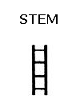
Stems
A set S of two sets S1, S2 of equal number of nodes (say ‘N’) such that, S1 = {r1, r2, … } with ri covalently bonded to both ri-1 and ri+1 ; S2 = {t1, t2, … } with ti covalently bonded to both ti-1 and ti+1 ; additionally each ri and ti form hydrogen bonds.
Pseudo graph query for finding all stems of length 4 (note- need to eliminate duplicates):
SELECT r1, r2, r3, r4, t1, t2, t3, t4
FROM graph
WHERE (r1 cBond r2) AND (r2 cBond r3) AND (r3 cBond r4)
AND (t1 cBond t2) AND (t2 cBond t3) AND (t3 cBond t4)
AND (r1 hBond t1) AND (r2 hBond t2) AND (r3 hBond t3) AND (r4 hBond t4)
[7]

Slide 13
Stems
Again we weren’t able to obtain acceptable performance running the Stem queries on AllegroGraph.
So, using the graph data
structure we wrote code
to find out stems.
Following are
results of a
sample PDB file
Two stems of length 15 :
-A-U-G-A-G-G-C-C-C-U-U-A-A-G-G-
| | | | | | | | | | | | | | |
-G-A-U-A-C-C-G-G-G-A-G-G-A-A-C-
-A-G-C-C-C-A-U-C-U-C-G-G-G-C-G-
| | | | | | | | | | | | | | |
-G-A-G-G-G-U-A-G-G-G-C-C-C-G-U-
N | Number of stems | N | Number of stems
2 | 503 | 10 | 24
3 | 361 | 11 | 16
4 | 267 | 12 | 11
5 | 192 | 13 | 6
6 | 140 | 14 | 4
7 | 96 | 15 | 2
8 | 64 | 16 | 0
9 | 39

Slide 14
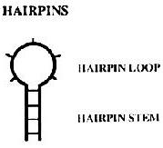
Stem loops
Stem loops (aka hair pin loops) are stems with an additional property that r1 and t1 are on the same chain connected through a series of small number of nodes bonded covalently, i.e. L = {l1, l2, … li, … } is a set of ‘K’ nodes with li covalently bonded to both li-1 and li+1 ; l1 is covalently bonded to r1 and lk is covalently bonded to t1. Additionally their should be no hydrogen bonds among L (except among neighbors). Thus the set L forms the loop of the stem-loop {S1, S2, L}.
Pseudo graph query for finding all stem-loops of N=3, K=3 (note- need to eliminate duplicates):
SELECT r1, r2, r3, l1, l2, l3, t1, t2, t3
FROM graph
WHERE (r1 cBond r2) AND (r2 cBond r3)
AND (t1 cBond t2) AND (t2 cBond t3)
AND (r1 hBond t1) AND (r2 hBond t2) AND (r3 hBond t3)
AND (l1 cBond l2) AND (l2 cBond l3)
AND (r1 cBond l1) AND (l3 cBond t1)
AND !(r1 hBond l2) AND !(r1 hBond l3)
AND !(l1 hBond l3) AND !(l2 hBond t1)
[7]

Slide 15
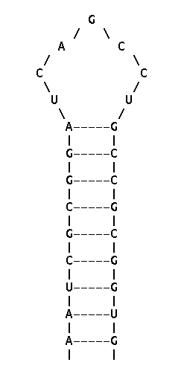
Stem loops
Example of a stem loop
found from the
sample PDB file.
N = 9
K = 7

Slide 16
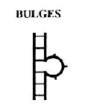
Bulges
Bulges are two stems {{r1, r2, … } {t1, t2, … }} (length N1) and {{u1, u2, … } {v1, v2, … }} (length N2) such that rN1 is covalently bonded to u1 and tN1 and v1 are on the same chain connected through a series of small number of nodes bonded covalently, i.e. L = {l1, l2, … li, … } is a set of ‘K’ nodes with li covalently bonded to both li-1 and li+1 ; l1 is covalently bonded to tN1 and lk is covalently bonded to v1. Thus {{{r1, r2, … } {t1, t2, … }} {{u1, u2, … } {v1, v2, … }} {l1, l2, … li, … }} (N1, N2, K) is a bulge.
Pseudo graph query for finding all bulges of N1=3, N2=3, K=2(note- need to eliminate duplicates):
SELECT r1, r2, r3, t1, t2, t3, u1, u2, u3, v1, v2, v3, l1, l2
FROM graph
WHERE (r1 cBond r2) AND (r2 cBond r3)
AND (t1 cBond t2) AND (t2 cBond t3)
AND (r1 hBond t1) AND (r2 hBond t2) AND (r3 hBond t3)
AND (u1 cBond u2) AND (u2 cBond u3)
AND (v1 cBond v2) AND (v2 cBond v3)
AND (u1 hBond v1) AND (u2 hBond v2) AND (u3 hBond v3)
AND (r3 cBond u1)
AND (l1 cBond l2)
AND (l1 cBond t3) AND (l2 cBond v1)
[7]

Slide 17
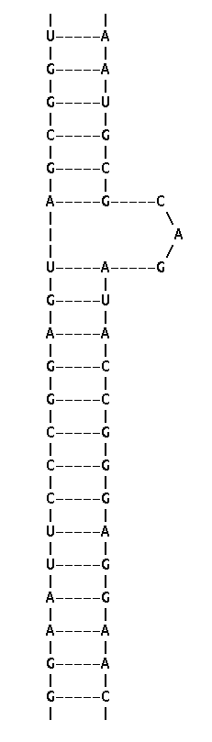
Bulges
Example of a bulge
found from the
sample PDB file.
N1 = 6
N2 = 14
K = 3

Slide 18
Higher motifs
Kissing loops - two stem loops kiss when their loop sets interact via hydrogen bonds.
As earlier we can form a graph query for kissing loops as well. Just combine two stem loops queries and introduce loops’ interaction via H bonds.
We can simplify the graph queries by storing the results of simpler queries and using these results to form more sophisticated queries. For example we can store each stem and as a separate node, with edges to the 4 corner nucleotides.

Slide 19
Conclusions
Using a spatial database can theoretically speed up hydrogen bond calculations.
Modeling the secondary structure of RNA as a graph leads to natural intuitive solutions to the problem of finding functional motifs. Neo4j is a good Java/Clojure based graph database. AllegroGraph is another industrial strength graph database.
Limitations of graph databases
Upcoming technology, not as mature as relational databases. Hence support and documentation are also less.
No one, standard SQL, like query framework.

Slide 20
Thanks. Questions?

Slide 21
References
[1] http://en.wikipedia.org/wiki/Nucleic_acid_secondary_structure
[2] http://en.wikipedia.org/wiki/Spatial_database
[3] http://en.wikipedia.org/wiki/Spatial_index
[4] http://geowebconference.org/wp-content/uploads/2009/08/haflich_steven-efficient-encoding.pdf
[5] http://en.wikipedia.org/wiki/Pseudoknot
[6] http://en.wikipedia.org/wiki/Graph_database
[7] http://www.fli-leibniz.de/ImgLibDoc/nana/IMAGE_NANA.html
[8] http://www.franz.com/agraph/allegrograph/
[9] http://neo4j.org/
[10] http://www.kobrix.com/hgdb.jsp
[11] http://dist.neo4j.org/neo-technology-introduction.pdf

