Slide 1
Campus Network Scenario

Slide 2


Presented to:
Presented by:
MS. TANPIA TASNIM Program Coordinator (Evening Program) & Lecturer
Dept. of CSE
Green University of Bangladesh
Nur Ahmed
20100238
Zobayer Arman Nadim
202002039
Dept. of CSE
Green University of Bangladesh

Slide 3
TABLE OF CONTENTS
1 | Introduction
2 | Problem Domain
3 | Objectives/Goals
4 | Tools & Technology
5 | Project demonstration
6 | Conclusion

Slide 4
INTRODUCTION
This Campus Network Scenario is about designing a hybrid topology of a network that is a Local Area Network for our university city campus in which various computers of different buildings are set up. So that they can interact and communicate with each other by sharing data.

Slide 5
Problem Domain
The network has both wired and wireless connections. This will be less hassle and less expensive. Hence, the university campus network provides different type of services such as
Connecting the user to the internet
Data sharing among students, teachers, and different university members

Slide 6
Objectives/Goals
The main objective of the proposed network is:
To update the existing network
Also enhance its capabilities and increase the flexibility of the network
To provide good security
Set up a smart room

Slide 7
Tools & Technology
This is a simulation-based project. Cisco Packet Tracer is the best choice for the simulation.
Cisco Packet Tracer 8.2 (64 bit):
OS : Microsoft Windows 8.1, 10, 11 (64bit) or macOS 10.14 or newer.
CPU : amd64(x86-64) CPU
Ram : 4GB
Storage : 1.5GB

Slide 8
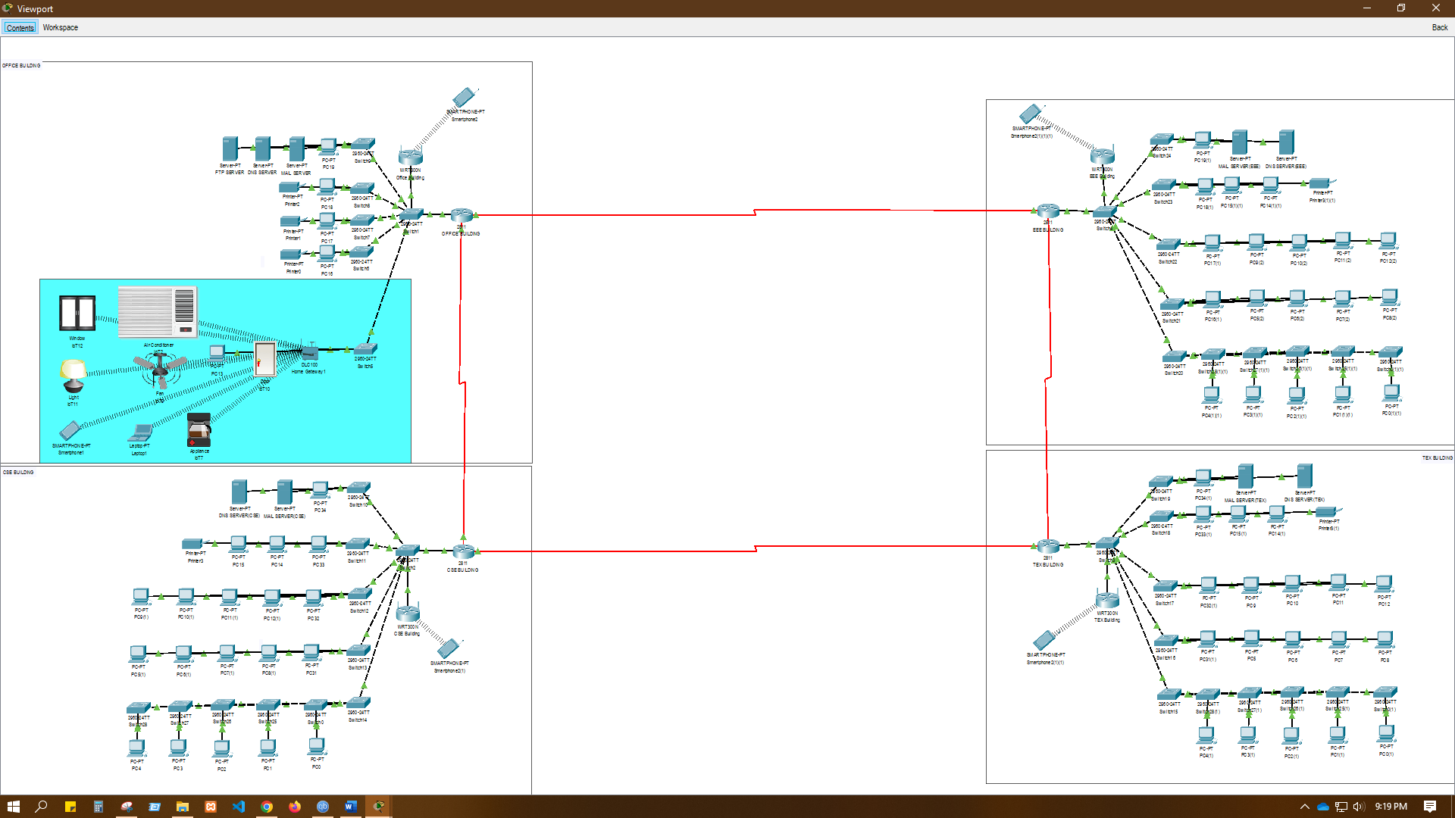
Project Demonstration

Slide 9
Conclusion
To improve campus network design service, the technology used was creating LAN using cheap device to reduce cost of the network. But the network can also become more enhanced using better routing protocols and many other protocols can be used to improve the security

Slide 10

THANK YOU
ANY QUESTIONS?

