Slide 1
Identify Susceptible Locations in Medical Records via Adversarial Attacks on Deep Predictive Models
Nivedita Chatterjee ,Nissan Azizov

Slide 2



General problem statement
Deep Predictive models are used for ”Patients Diagnosis” based on Electronic Health Record
These models can be sensitive to input
“Adversarial Attack” can be leveraged to identify ”Susceptible Location” in Input
Changed input record

Slide 3
Approach taken in the paper
The proposed framework produces a ”susceptibly score” to identify susceptible events and measurement using below components
Prediction Model (LSTM)
Adversarial Generator (Sparse Version)
Adversarial Evaluation Metric (Susceptibility score)

Slide 4
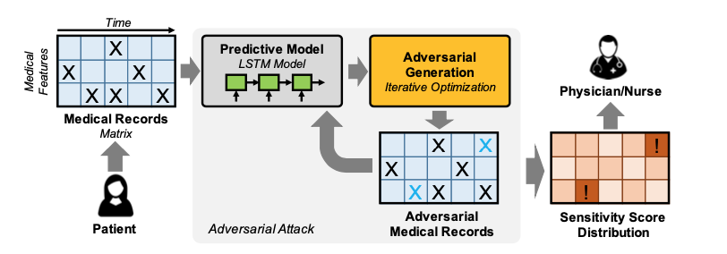
Framework

Slide 5
Claim in the paper
Using susceptibility score which takes into consideration sparsity and magnitude of a certain attack to help decision makers to pay more attention to the susceptible location
Some features are more susceptible than others
Timestamp affects susceptibility score

Slide 6
Reproduction Attempts
Preprocessing steps
Access MIMIC3 dataset - download from Physionet
Set up postgres database structure for MIMIC following MIMIC-code github
Preparing specific .csv files from the tables using preprocess steps suggested by the author
Prepare final .pkl train and test data sets for the prediction model

Slide 7
Prediction Model
We have used author’s code for prediction model & Adversarial Generator
We tried changing learning rate and epoch to see the effect on ”evolution metric”
We have added Dropout layer to measure the effect

Slide 8
Challenges
Data exploration
Preprocessing
Final Data set preparation
Main code base update

