Slide 1
Custom CRM Development: Senior Design Project
Nachiket Dighe

Slide 2
Project Purpose and Goals
Develop a custom CRM system.
1
Enable efficient customer record management (add/delete functionality).
2
Assign teams to individuals for streamlined operations.
3
Utilize Django, Tailwind, and SQLite tech stack.
4

Slide 3
Team Member Details
Name: Nachiket Dighe
Email: dighent@mail.uc.edu
Phone: 8577078098
Advisor: Sabrina Pang
Email: hello@aprescleo.com

Slide 4
Focus Areas
Coding
Testing
Debugging
Documentation

Slide 5
Project Abstract
Building a custom CRM system using Django, Tailwind, and SQLite.
Combines theoretical understanding and practical application.
Aligns with academic and professional goals.
Serves small-to-medium businesses.

Slide 6
Relevance of Coursework & Co-op
Courses like Data Structures, Python, and Software Engineering prepared for technical challenges.
Co-op at Delta Air Lines reinforced web frameworks knowledge.
Data analysis skills gained from Bearcat Buddies department.

Slide 7

User Stories
Small business owner: Manage customer profiles efficiently.
Team manager: Assign customers to team members.
Sales rep: Access detailed customer information.
Admin: Manage user access and permissions.
Business analyst: Generate performance reports.

Slide 8
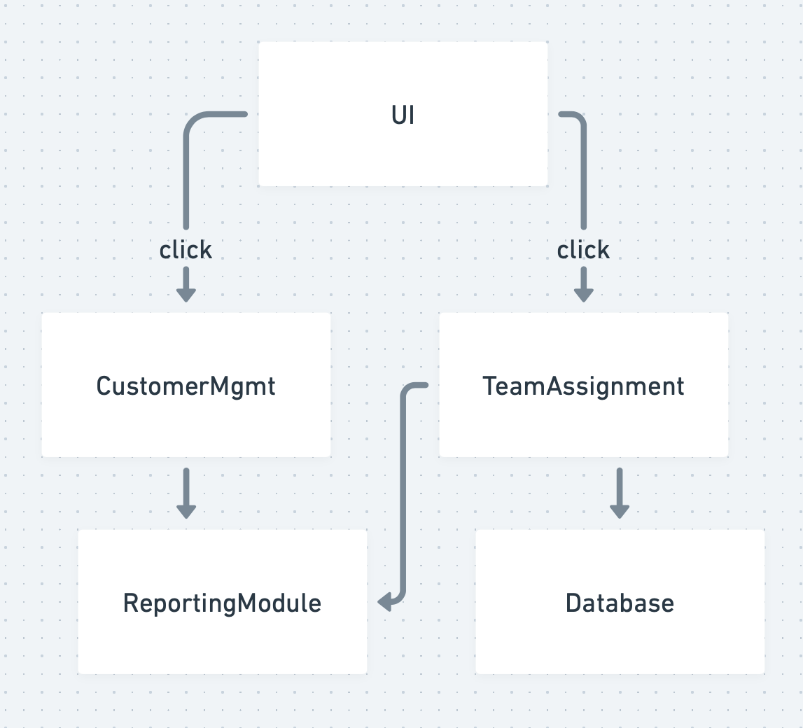
Design Diagrams
High-level architecture for CRM system.
Database schema design.
Frontend-backend interaction.

Slide 9
Major Project Constraints
Time limitations for iterative testing.
Scalability concerns for growing businesses.
Data privacy and security considerations.

Slide 10
Current State of Project
Developed a custom CRM using Django-TailwindCSS.
Utilized SQLite for database management.
Leveraged Django's admin panel for system administration.

Slide 11
Expected Accomplishments by Term-End
Implement team assignments.
01
Develop a robust database schema.
02
Finalize responsive UI design.
03

Slide 12
Division of Work & Milestones
Project Initialization: Requirements gathering.
UI Design: Tailwind CSS implementation.
Database Design: Schema development.
Testing & Integration: Comprehensive testing phases.

Slide 13
Milestones & Timeline Overview
20 Oct.
Project Initialization.
27 Oct.
UI Design Completion.
3 Nov.
Database Schema Implementation.
1 Dec.
Team Assignment Module.
15 Feb.
Final Presentation.

Slide 14
Expected Demo at Expo
Deliver a fully functional CRM system.
Showcase streamlined customer and team management.
Highlight usability, reliability, and scalability.

Slide 15

Thank you

