Slide 1
Predicting Car Accident Severity in Virginia
Enhancing Road Safety Through Data-Driven Insights
VeriSafe Analytics LLC
Prepared by: Nasim Aalemi
Date: May 7, 2025
Class: DATA602

Slide 2
Introduction
Predicting Car Accident Severity in Virginia
Severe crashes during Dec 2024–Feb 2025 caused disproportionate harm to Virginians.
Our consulting firm uses machine learning to predict crash severity and identify key risk factors, guiding VDOT and policymakers to reduce fatalities through targeted safety interventions.

Slide 3
Business Problem
Key Questions
What factors drive severe crashes?
Can machine learning guide proactive safety measures?

Slide 4
Executive Summary
Overview
VeriSafe analyzed 138,813 crashes in Virginia (Dec 20, 2024 – Feb 28, 2025).
Focus: Predicting severe crashes to reduce fatalities.
Goal: Provide VDOT and local governments with targeted safety interventions.
Context:
Car accidents cause significant loss of life, injuries, and economic costs
Severe crashes (0.7%, 922 of 138,813) cause disproportionate harm
Critical Needs:
Prioritize safety interventions via key crash drivers
Optimize resource allocation for urban/rural districts
Reduce fatalities with data-driven policies

Slide 5
Approach: CRISP-DM Methodology
Data Preparation:
Class imbalance: 0.7% high, 23.5% medium, 75.8% low
Subsampling: 20,000 low, 10,000 medium, 922 high
Applied SMOTE for balance
Target encoding for high cardinality
Modeling:
BalancedRandomForestClassifier
Higher weight to severe crashes
Optimized recall (>0.7), precision (>0.05)
Features:
Max speed difference, collision type, vehicle count, vulnerable road users, roadway type, impaired driving, VDOT district, crash hour

Slide 6
Key Findings: Drivers of Severe Crashes
Top Contributors (~79% Predictive Power):
Speed Difference (43.7%): Higher impact forces
Head-on/Sideswipe Collisions (15.9%): High-impact crashes
Multi-vehicle Crashes (7.6%): Complex pileups
Impaired Driving (6.0%): Reduced reaction times
Vulnerable Road Users (5.7%): Pedestrians, cyclists, motorcyclists
Other Factors:
Roadway Type (5.3%), Regional Differences (5.1%), Nighttime/Rush-hour (3.7%)
Minimal: Road Surface (1.26%), Weather (0.99%)

Slide 7
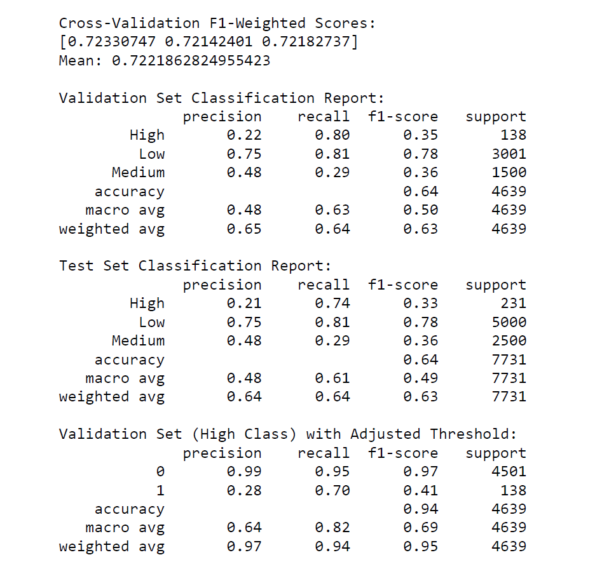
Model Evaluation Summary

Slide 8
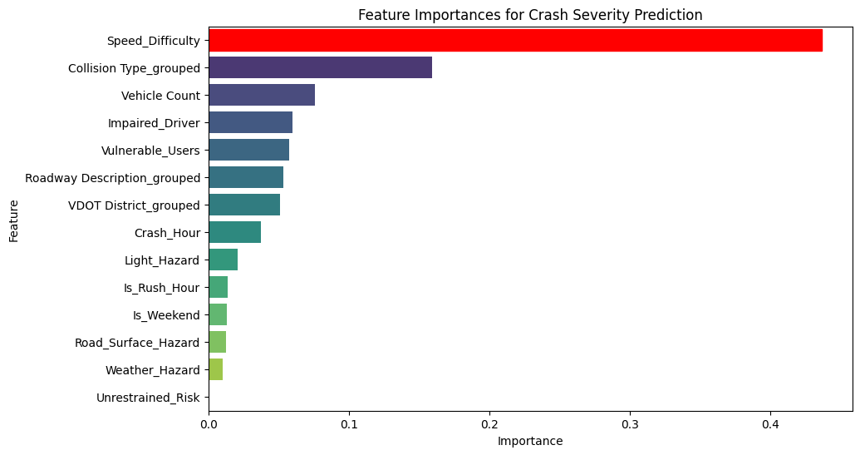
Feature Importance

Slide 9
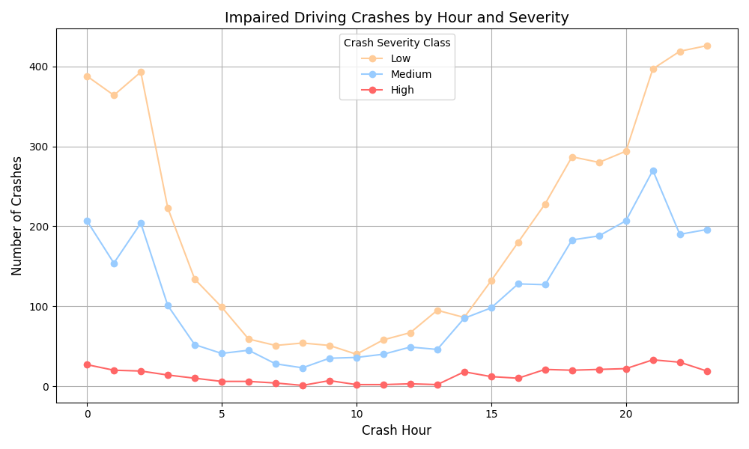
Impaired Driving Accidents by Hour

Slide 10
Recommendations
Speed & Enforcement:
Deploy speed cameras, increase patrols on high-risk roads
Focus on highways, urban primary roads during rush hours/night
Increase DUI patrols at night
Public Awareness:
Campaigns for impaired driving and cyclist/pedestrian safety
Infrastructure:
Install median barriers on highways
Enhance pedestrian crossings in urban areas
Regional Focus:
Target rural (undivided roads) and urban (dense traffic) districts

Slide 11
Conclusion
Key Takeaways:
Machine learning predicts severe crash risks effectively
Targets: Speed differences, head-on collisions, impaired driving, vulnerable road users
Benefits: Reduced fatalities via precise interventions
Next Steps:
Ongoing data collection and model refinement
Support Virginia’s road safety strategy

Slide 12
Thank You
Questions?
Reference: Di, S. (2025, March 20). Crash Data Basic. Virginia Roads. Retrieved April 14, 2025, from https://www.virginiaroads.org/datasets/VDOT::crash-data-1/about?layer=0
?

