Slide 1

Context-Sensitive Query Auto-Completion
WWW 2011 Hyderabad India
Naama Kraus
Computer Science, Technion, Israel
Ziv Bar-Yossef
Google Israel &
Electrical Engineering, Technion, Israel

Slide 2

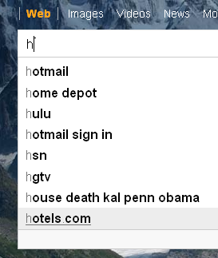

Motivating Example
I am attending WWW 2011
I need some information about
Hyderabad
hyderabad
hyderabad airport
hyderabad history
hyderabad maps
hyderabad india
hyderabad hotels
hyderabad www
Current
Desired

Slide 3
Our Goal
Tackle the most challenging query auto-completion scenario:
User enters a single character
Search engine predicts the user’s intended query with high probability
Motivation
Make search experience faster
Reduce load on servers in Instant Search

Slide 4
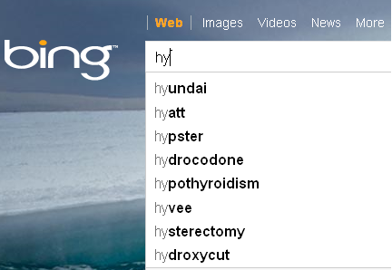
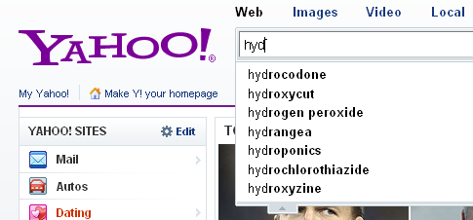

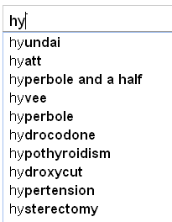
MostPopular Completion
MostPopular is not always good enough
User queries follow a power law distribution
→ A heavy tail of unpopular queries
→ MostPopular is likely
to mis-predict when given a
small number of keystrokes

Slide 5

Context-Sensitive Query Auto-Completion
Observation:
User searches within some context
User context hints to the user intent
Context examples
Recent queries
Recently visited pages
Recent tweets
…
Our focus - recent queries
Accessible by search engines
49% of searches are preceded by a different query in the same session
For simplicity, in this presentation we focus on the most recent query

Slide 6
Related Work
Context-sensitive query auto-completion
[Arias et al., 2008]
Not based on query logs → limited scalability
Query recommendations
[Beeferman and Berger, 2000], [Fonseca et al., 2003]
[Zhang and Nasraoui, 2006], [Baeza-Yates et al., 2007]
[Cao et al., 2008, 2009], [Mei et al., 2008], [Boldi et al., 2009] and more…
Different problems:
auto-completion | recommendation
short prefix input | full query input
query prediction | query re-formulation

Slide 7
Our Approach: Nearest Completion
hyderabad
hyderabad
maps
hyderabad
airport
www 2011
hyatt
hyderabad
india
hyundai
hydroxycut
hyperbola
Intuition: The user’s intended query is semantically related to the context query

Slide 8
Semantic Relatedness Between Queries: Challenges
Precision. Completions must be semantically related to the context query.
Ex: How do we know that “www 2011” and “wef 2011” are unrelated?
Coverage. Queries are sparse → not clear how to measure relatedness between any given context query and any candidate completion.
Ex: How do we know “www 2011” and “hyderabad” are related?
Efficiency. Auto-completion latency should be very low, as completions are suggested while the user is typing her query.

Slide 9
Recommendation-Based Query Expansion (why)
To achieve coverage → expand (enrich) queries
The IR way to overcome query sparsity
To achieve precision → Expand queries with related vocabulary
Queries sharing a similar vocabulary are deemed to be semantically related
Observation: query recommendations reveal semantically related vocabulary →
Expand a query using a query recommendation algorithm

Slide 10
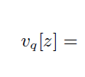

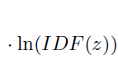
Recommendation-Based Query Expansion (how)
query recommendation tree
query vector
term | weighted TF | idf | final
uranus | 1+1/2+1/2+1/3 | 4.9 | 11.43
moon | 1/2 + 1/3 | 4.3 | 3.58
picture | 1/2 | 1.6 | 0.8
disney | 1/3 | 2.3 | 0.76
…
1
uranus
level weight
uranus
pictures
uranus
moons
1/2
pluto
Level weight: terms that occur deep in the tree are less likely to relate to the seed query
→ semantic decay
1/3
pluto
disney
pluto planet
jupiter
moons
uranus
planet

Slide 11
Nearest Completion: Framework
online
1. Expand context query
2. Search for similar completions
3. Return top k completions
offline
Expand completions
Index completions
context
Nearest
Neighbors
Search
candidate
completions
Repository
top k
context-
related
completions
Efficient implementation using a standard search library
Similar framework for ad targeting [Broder et al 2008]

Slide 12
Evaluation Framework
Evaluation set:
A random sample of (context, query) pairs from the AOL log
Prediction task:
Given context query and first character of intended query → predict intended query at as high rank as possible

Slide 13
Evaluation Metric
MRR – Mean Reciprocal Rank
A standard IR measure to evaluate a retrieval of a specific object at a high rank
Value range [0,1] ; 1 is best
wMRR - weighted MRR
Weight sample pairs according to “prediction difficulty” (total # of candidate completions)

Slide 14
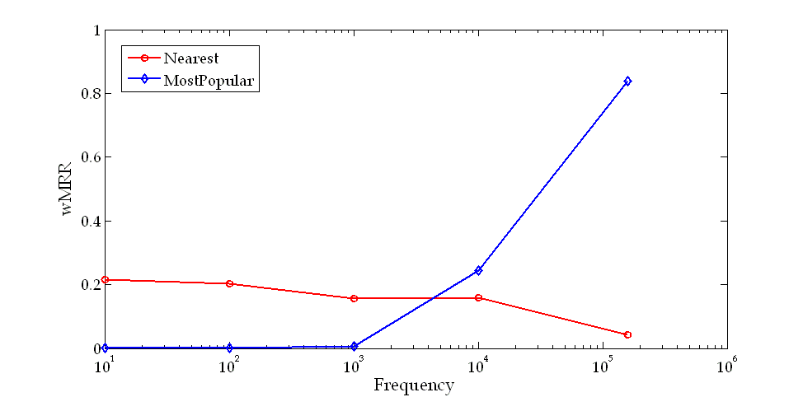
MostPopular vs. Nearest (1)

Slide 15
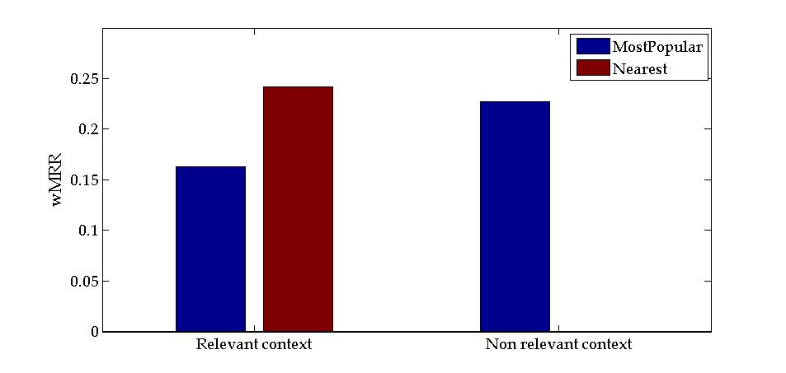
MostPopular vs. Nearest (2)

Slide 16
HybridCompletion
Conclusion - none of the two wins
MostPopular:
Fails when the intended query is not highly popular (long tail)
NearestCompletion:
Fails when the context is irrelevant (difficult to predict whether the context is relevant)
Solution
HybridCompletion: a combination of highly popular and highly context-similar completions
Completions that are both popular and context-similar get promoted

Slide 17


How HybridCompletion Works?
Produce top k completions of Nearest
Produce top k completions of MostPopular
Two lists differ in units and scale → standardize:
Hybrid score is a convex combination:
0≤ α ≤1 is a tunable parameter
Prior probability that context is relevant

Slide 18
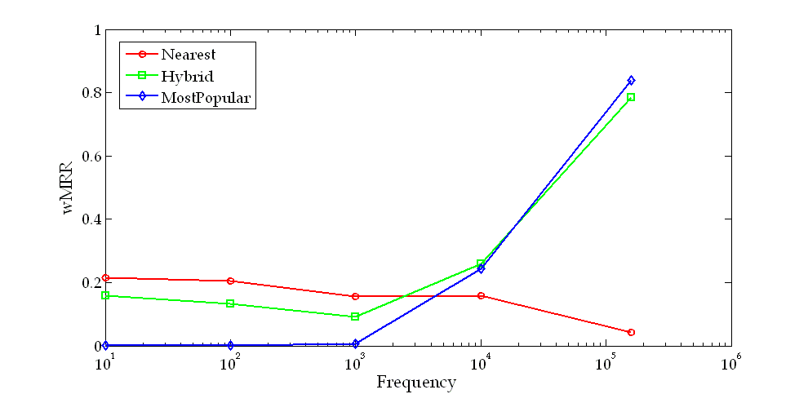
MostPopular, Nearest, and Hybrid (1)

Slide 19
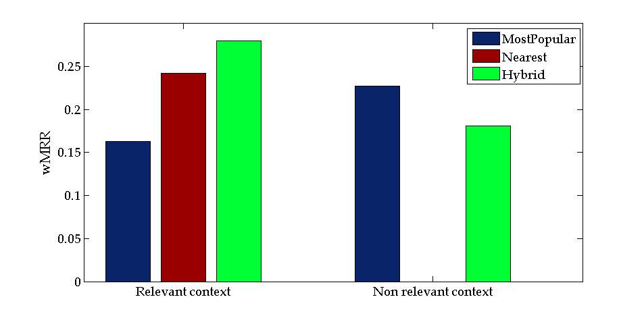
MostPopular, Nearest, and Hybrid (2)

Slide 20
Anecdotal Examples
context | query | MostPopular | Nearest | Hybrid
french flag | italian flag | internet im help irs ikea internet explorer | italian flag itunes and french ireland italy irealand | internet italian flag itunes and french im help irs
neptune | uranus | ups usps united airlines usbank used cars | uranus uranas university university of chic… ultrasound | uranus uranas ups united airlines usps
improving acer laptop battery | bank of america | bank of america bankofamerica best buy bed bath and b… | battery powered … battery plus cha… | bank of america best buy battery powered …

Slide 21
Parameter Tuning Experiments
α in HybridCompletion
α = 0.5 found to be the best on average
Recommendation tree depth
Quality grows with tree depth
Depth 2-3 found to be the most cost-effective
Context length
Quality grows moderately with context length
Recommendation algorithm used for query expansion
Google Related Searches yields higher quality than Google Suggest but is exceedingly more expensive to use externally
Bi-grams
No significant improvement over unigrams
Depth weighting function
No significant difference between linear, logarithmic and exponential variations

Slide 22
Conclusions
First context-sensitive query auto-completion algorithm
based on query logs
NearestCompletion for relevant context
HybridCompletion for any context
Recommendation-based query expansion technique introduced
May be of interest to other applications, e.g. web search
Automatic evaluation framework
Based on real user data

Slide 23
Future Directions
Use other context resources
E.g., recently visited web-pages
Use context in other applications
E.g., web search
Adaptive choice of alpha
Learn an optimal alpha as a function of the context features
Compare the recommendation-based expansion technique with traditional ones
Also in other applications such as web search

Slide 24
Thank You !

