Slide 1
Bayesian approach to linear inverse problems
Gradient based optimisation in x-ray imaging

Slide 2
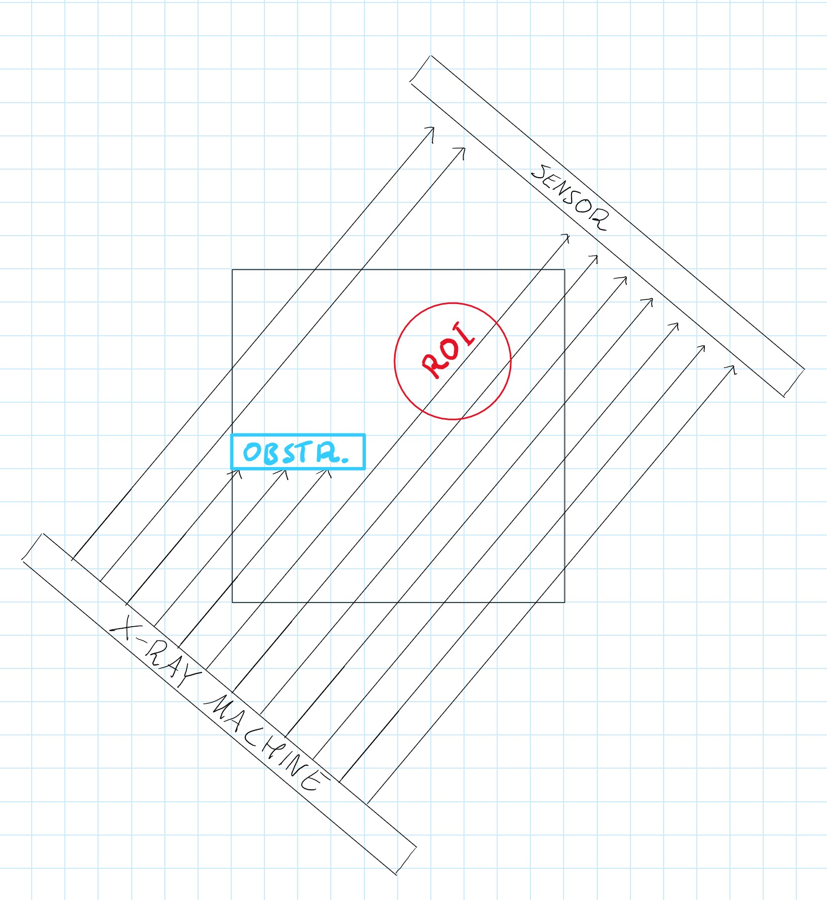
Introduction
Inverse problems try to find the initial parameters of an experiment based on its results
The reconstruction of X-ray targets is a traditional inverse problem [1]
Write an algorithm that computes sequential x-ray images and minimizes the variance of of the posterior distribution
⇒ Get the best images with constant amount of radiation to the target
Goal to improve the work of M Burger , A Hauptmann, T Helin, N Hyvönen,and J-P Puska in [1] by using gradient based optimization methods

Slide 3
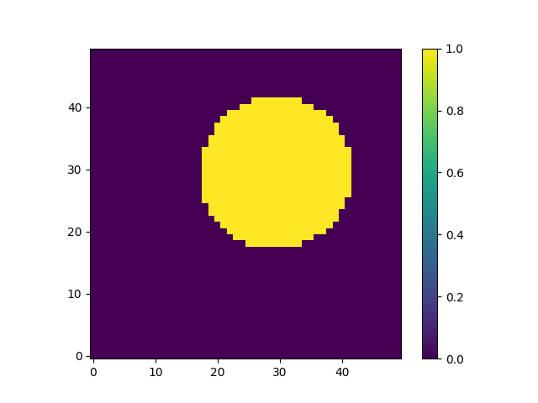
Problem formulation
Take some region of interest and try to shoot x-rays from different directions towards it
Try to minimize the variance [3] of the results with constant amount of radiation
⇒ Mainly shoot the x-rays towards the region of interest instead of other directions
In real life the x-ray machine would spend more time on the interesting angles and go through the uninteresting angles quickly

Slide 4
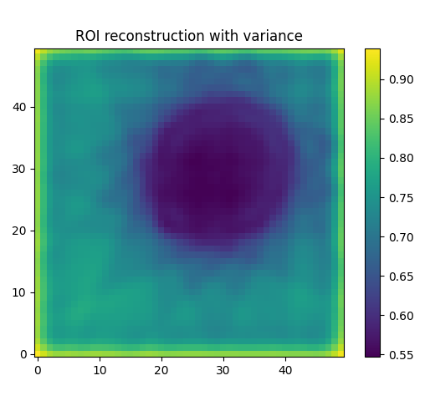
Preliminary findings
Already a few promising figures
Variance is the smallest on the ROI
ROI on the previous slide is prioritised
⇒ We are more certain of the contents on that part of the picture
Edges are blurred due to the gaussian prior used in this figure
Aatu Selkee
19.6.2024
4

Slide 5
Future Research Goals
Optimise the code to make the program faster
Explore various prior distributions to encourage different outcomes from the algorithm, such as achieving sharper edges
Gaussian prior [1]
Smooths out the edges
Total variation prior
Pays more attention to the change from the ROI to the background ie. the edges
Promotes piece-wise constant functions [2]
Perhaps implement obstructions such that no ray can pass through

Slide 6
References
[1] Burger, Martin & Hauptmann, Andreas & Helin, Tapio & Hyvönen, Nuutti & Puska, Juha- Pekka. (2020). Sequentially optimized projections in X-ray imaging.
[2] Maaninen, Jarno. (2023). Bayesian Experimental Design for Magnetorelaxometry Imaging.
[3] Wanyonyi, Samson & Okango, Ayubu & Koech, Julius. (2021). Exploration of D-, A-, I-and G-Optimality Criteria in Mixture Modeling. Asian Journal of Mathematics & Statistics. 12. 15-28. 10.9734/AJPAS/2021/v12i430292.

