Slide 1
OpenAI
In Google SHEETS

Slide 2
Job Search and Networking Example
Step 1: Install Chrome Plugin GPT for Sheets
Step 2: Post Installing go to https://docs.google.com/spreadsheets/
Step 3: Extensions => GPT for Sheets and Docs => Setup API Key
Step 4: Go to https://platform.openai.com/account/api-keys and copy your key and paste it in step 3

Slide 3

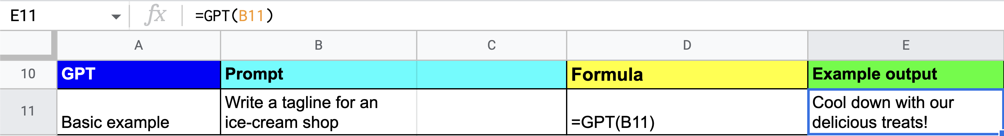
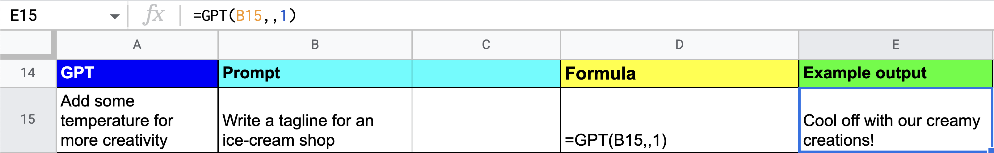
GPT Functions
Write a tagline:
Write a tagline with temperate:

Slide 4

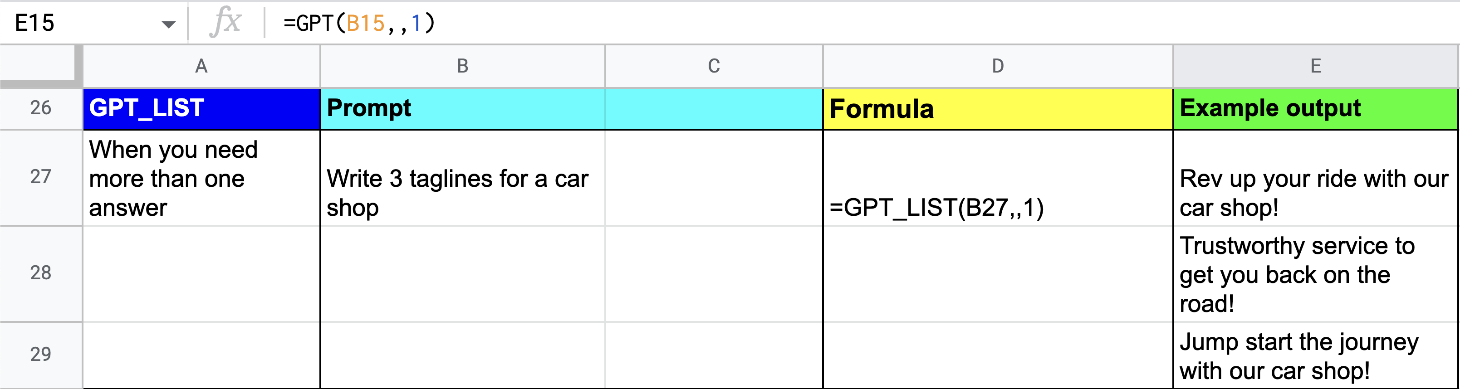
GPT_LIST function
When you need more than one answer:

Slide 5
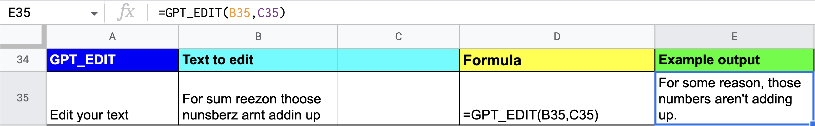
GPT_EDIT

Slide 6
GPT_LIST function :When you need more than one answer:

Slide 7
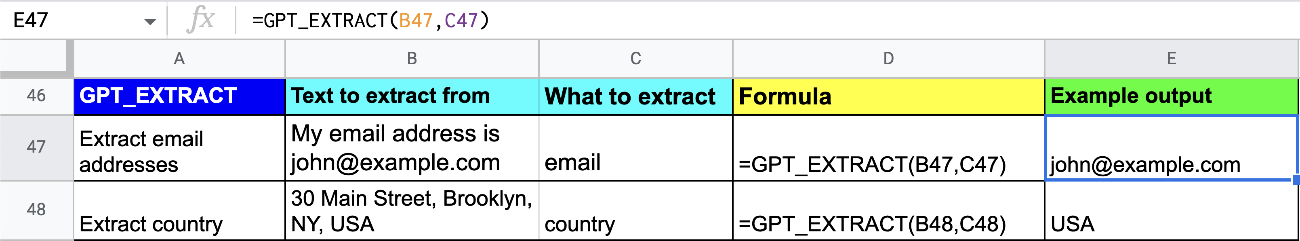
GPT_EXTRACT function
Extract email addresses or country:

Slide 8
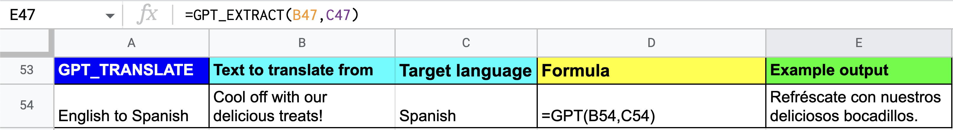
GPT_TRANSLATE function
Translate from English to Spanish:

Slide 9
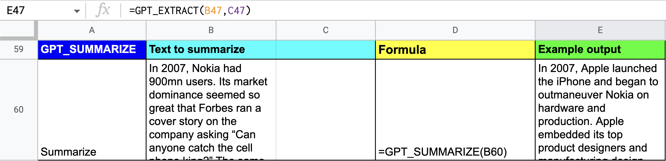
GPT_SUMMARIZE function

Slide 10
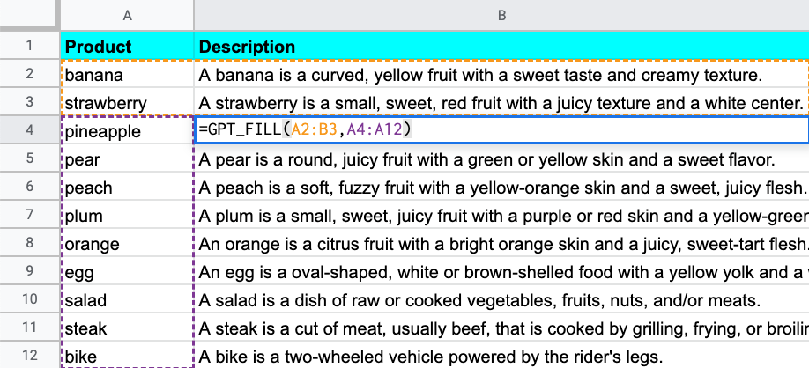
GPT_FILL function
Populate descriptions in a product catalog:

Slide 11
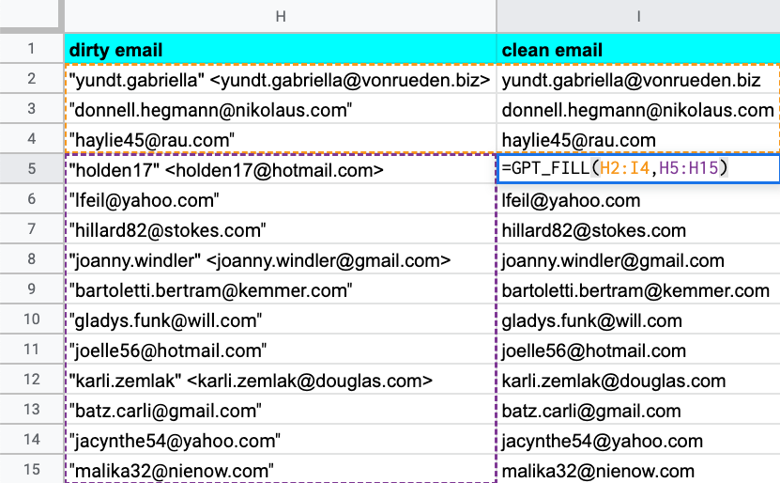
Clean up an email list:

Slide 12
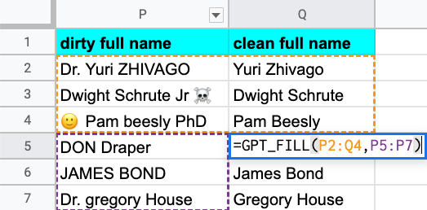
Clean up names:

Slide 13
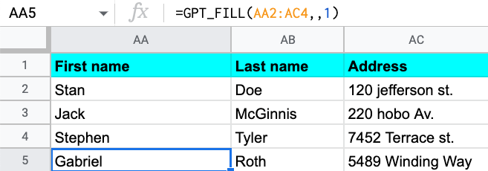
Generate dummy data:

