Slide 1
PYTHON PARALLEL COMPUTING
Avinash

Slide 2
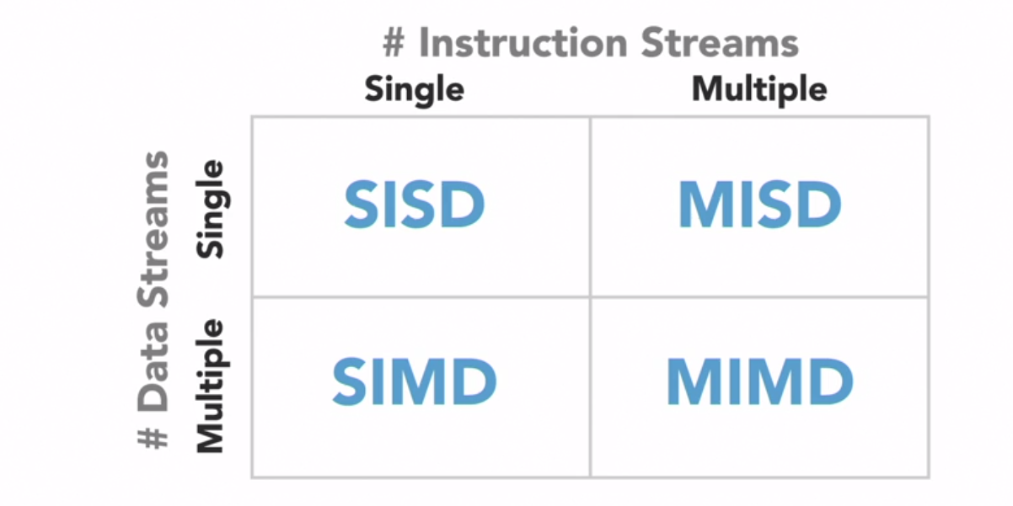
FLYNN TAXONOMY

Slide 3
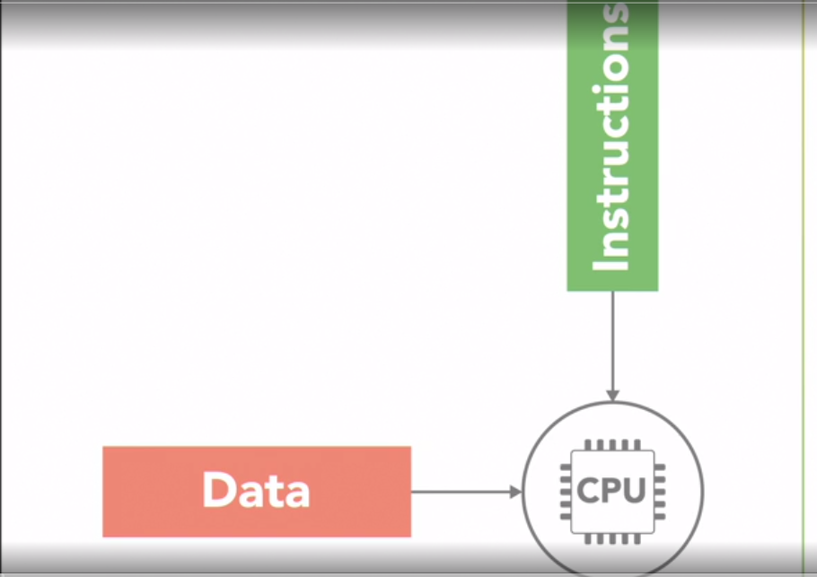
Single Instruction Single DATA (SISD)

Slide 4
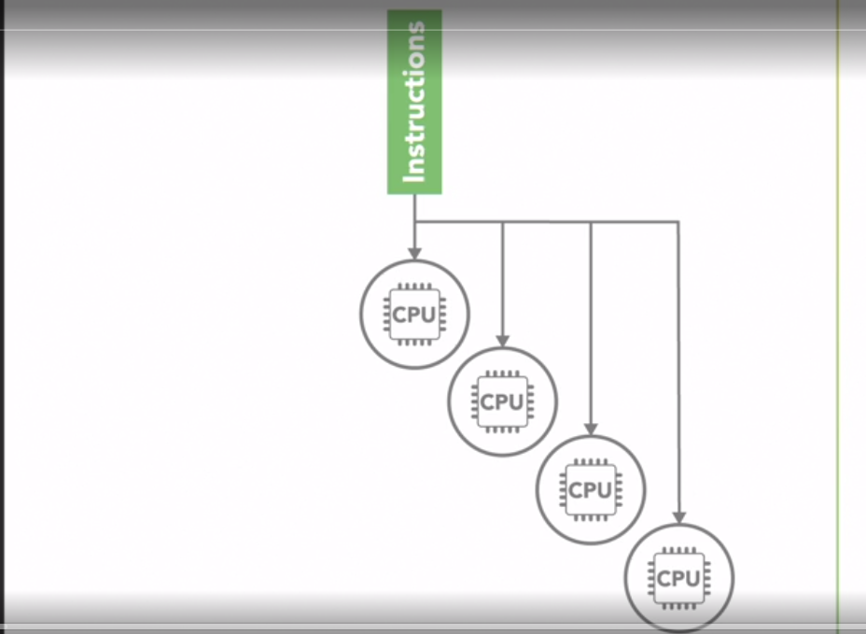
SINGLE INSTRUCTION MULTIPLE DATA (SIMD)

Slide 5
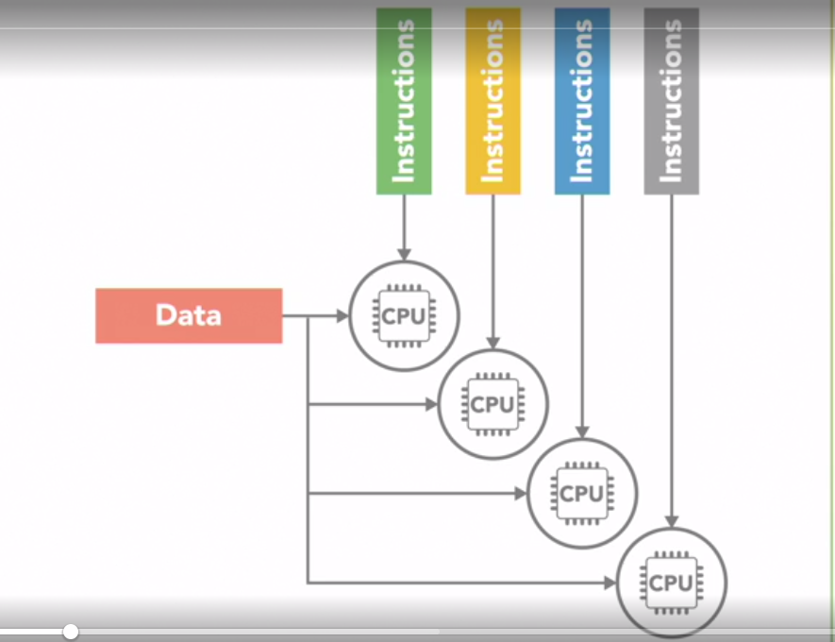
MULTIPLE INSTRUCTION SINGLE DATA (SIMD)

Slide 6
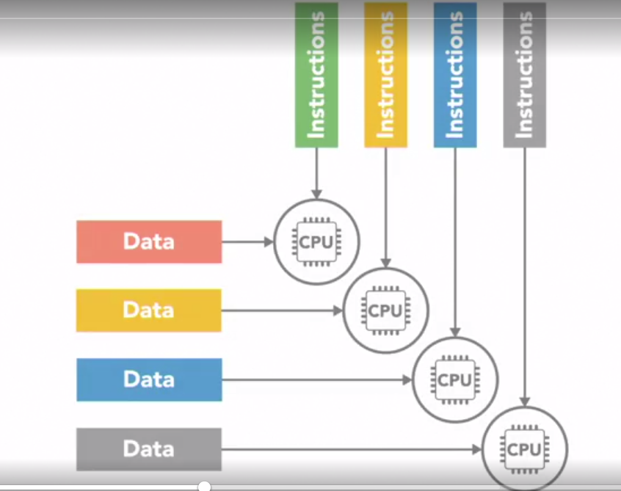
MULTIPLE INSTRUCTION MULTIPLE DATA (MIMD)

Slide 7
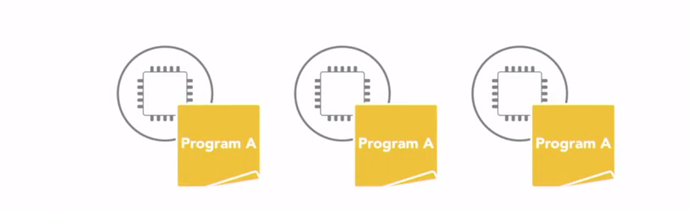
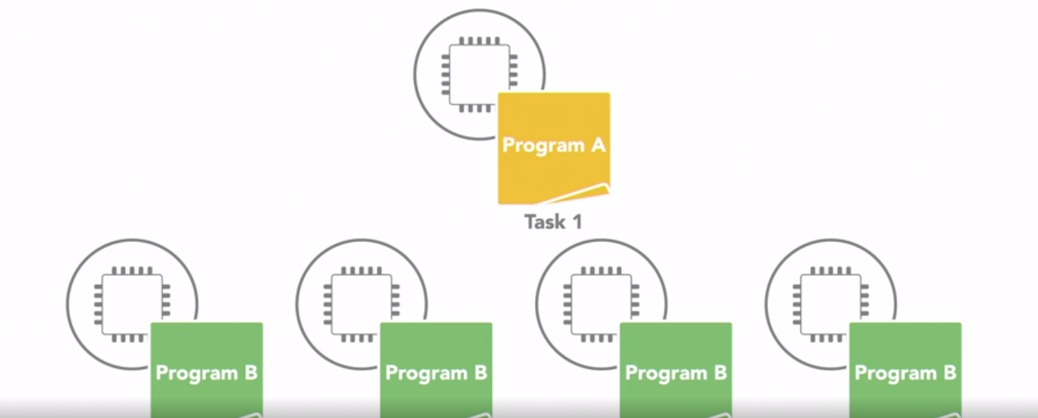
Parallel Programing Model
Single Program Multiple Data (SPMD)
Multiple Program Multiple Data (MPMD)

Slide 8
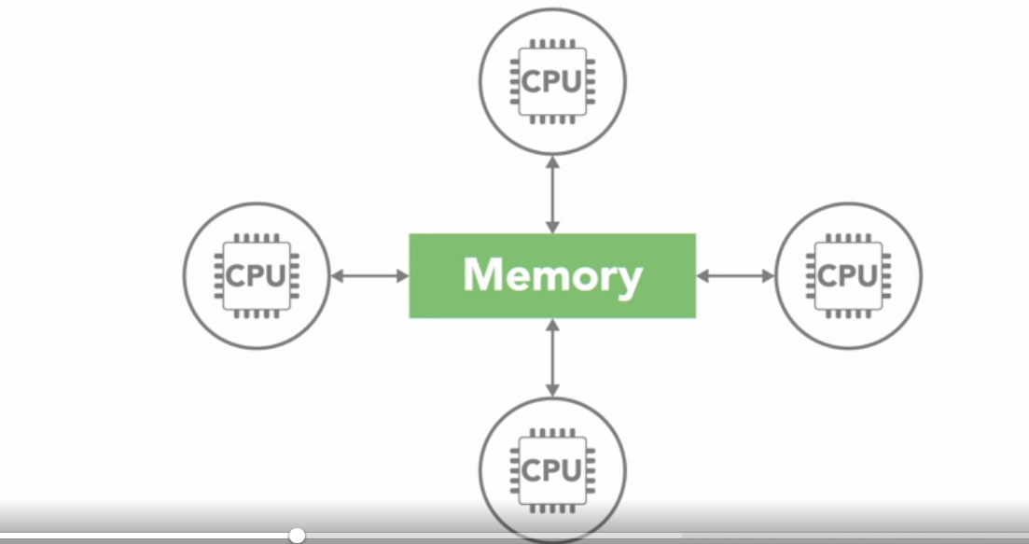
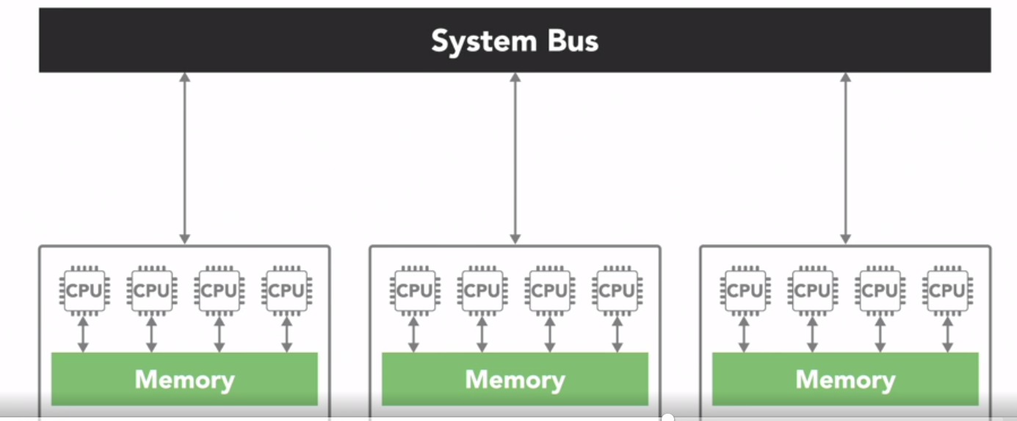
SHARED MEMORY
Uniform Memory Access (UMA)
NON Uniform Memory Access (NUMA)

Slide 9
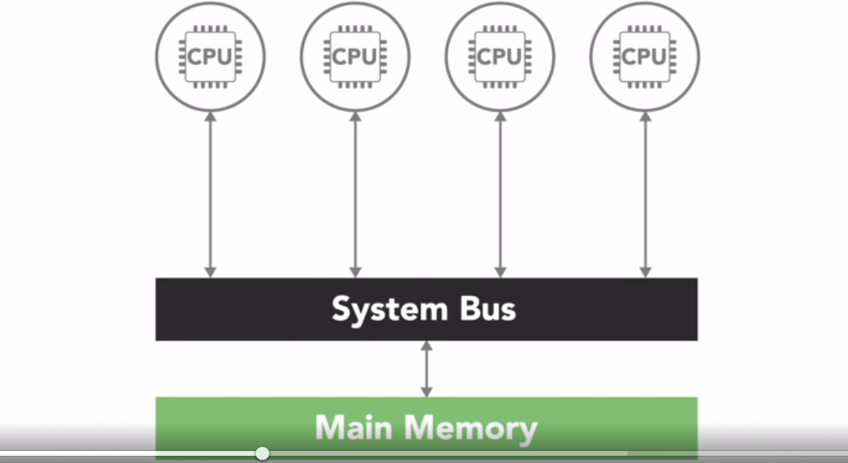
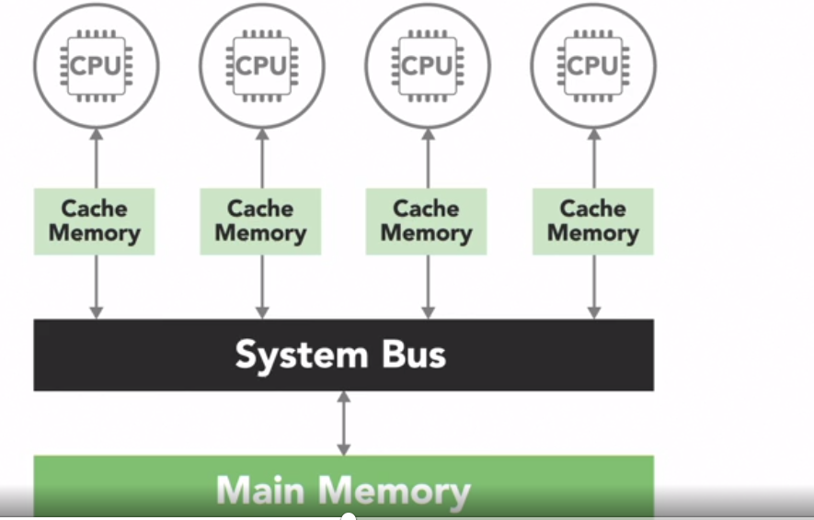
Uniform Memory Access (UMA)
Symmetric Multi PROCESSING (SMP)
CACHE COHERENCY

Slide 10
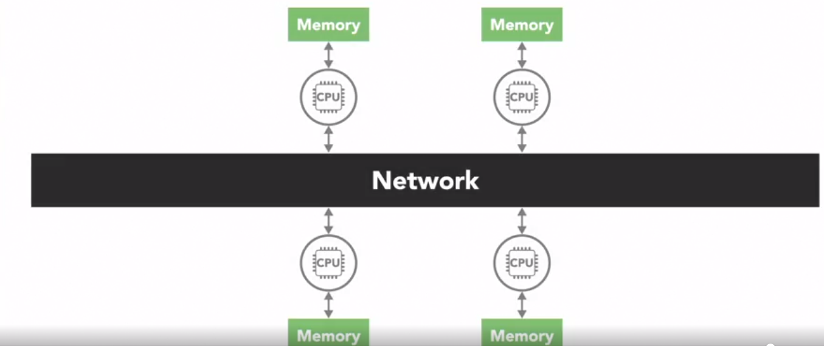
DISTRIBUTED MEMORY

Slide 11
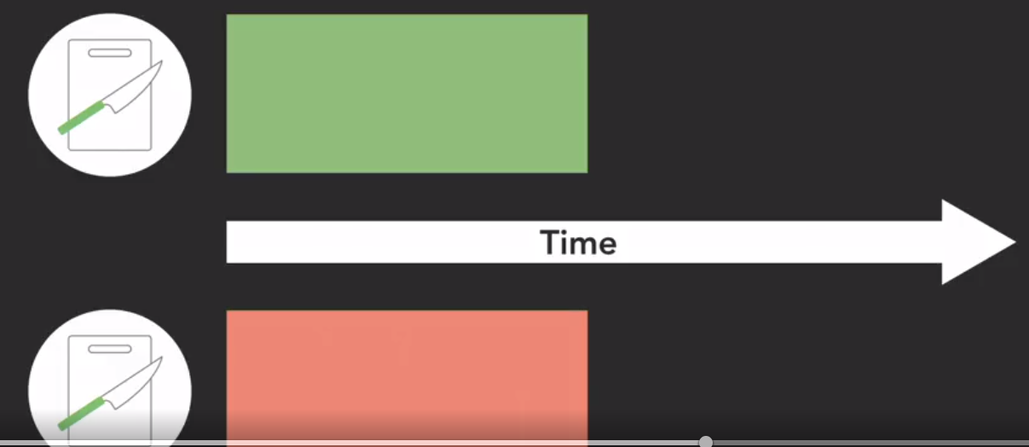

Concurrent v/s PARALLEL
Concurrent
PARALLEL

