Slide 1
Cinema Seat Booking System
Team No: 7
Meer Naatiq Hyder 2620030257
Sharantej Ram Gardasu 2620030318
Sankeerth 2620030292
A Java Console Application | Problem Solving using Programming (Java) | Subject Code: 26SC1101E

Slide 2
Abstract
The Cinema Seat Booking System is a menu-driven Java console application that automates seat reservation for a multi-movie cinema hall. Each movie's hall is modelled as a 5 × 8 seat matrix; users can view the live layout, book a seat by its label (for example B4), cancel it, and generate booking reports.
Row-wise pricing with a student discount, validation through a custom exception, and receipts saved to a text file make the system practical. Built with core Java only, it brings together variables, control flow, methods, recursion, arrays, OOP, exception handling, strings, file I/O, collections and streams from all six course modules.

Slide 3
Understanding Problem Statement
Problem: manual seat booking (registers, counters) is slow and error-prone, and double bookings and wrong entries are common.
Need: customers and staff must see seat availability instantly and get a reliable receipt and total.
Aim: build a console application that shows live seat layout, books and cancels seats, and prevents double booking.
Robustness: invalid seats and wrong inputs must be handled gracefully without crashing.
Records: bookings are saved to a file and summarised per movie, using core Java only.

Slide 4
Project Overview
A menu-driven Java console application that lets a user book, cancel, and view seats for a movie show.
The cinema hall is modelled as a grid of seats, with each seat marked as available or booked.
Users interact through simple text prompts — choose a movie, pick a seat such as B4, confirm a booking.
The system prevents double booking by validating seat status before every confirmation.
Built entirely with core Java — no external libraries — to reinforce fundamental programming concepts.
SCREEN
A
B
C
D
E
Available
Booked

Slide 5
How the System Works
1
2
3
4
5
Display
Seat Layout
Select
Movie & Seat
Check
Availability
Confirm
Booking
Update &
Show Receipt
The menu repeats in a loop (View / Book / Cancel / Report / Receipts / Exit) until the user chooses to quit.

Slide 6
Booking Algorithm
1
Initialize a 2D char array for each movie — 'A' for available, 'X' for booked — and store them in a Map.
2
Display the layout to the user by looping through the matrix rows and columns.
3
Read the movie, name and seat label (e.g. B4) using Scanner, and validate the input.
4
Check the seat: is halls.get(movie)[row][col] equal to 'A'? If not, throw SeatUnavailableException.
5
If available, mark it 'X', compute the price (row-wise, student discount) and store a Booking receipt.
6
Loop back to the menu (switch-case) until the user exits; on exit, save receipts to bookings.txt.

Slide 7
System Architecture
Presentation Layer
Console interface — Scanner input; printf / StringBuilder seat-map output
Control Layer
main(): do-while menu loop, switch-case dispatch, try-catch input handling
Logic Layer
bookSeat, cancelSeat, price (overloaded), freeSeats (recursive), showReport (streams)
Data Layer
Map of char[][] seat matrices, List<Booking> history, bookings.txt receipts file

Slide 8
CO 1 Topics
Module 1 – From Problem to Program: Computational Thinking & Java Foundations
Problem solving: algorithm and flowchart for the booking flow
Java program structure: class CinemaSeatBooking with main() running on the JDK console
Data types, variables, constants: int ROWS, COLS, totalAmount; char seat status; boolean student; static final
Operators: arithmetic (+, *), relational (==, <), logical (&&, ||), ternary (row < 2 ? 250 : 150), unary (i++), compound (+=)
Typecasting: (int)(price * 0.9) for discount, (char)('A' + row) for row labels
Console I/O: Scanner.nextLine() for input, printf for formatted output

Slide 9
CO 2 Topics
Module 2 – Control Flow: Selection & Iteration
if / else and nested conditions: seat available, already booked, or out of range (row < 0 || row >= ROWS ...)
switch with default and break: main menu — View, Book, Cancel, Report, Receipts, Exit
do-while loop: menu repeats until Exit; movie choice re-asked until valid
for loop: initialise seats, list movies, count free seats
Nested loops: traverse rows × columns of the seat matrix to build and print the layout

Slide 10
CO 3 Topics
Module 3 – Decomposition with Methods, Recursion & Arrays
Modular programming: newHall, displaySeats, bookSeat, cancelSeat, showReport
Parameters and return values: bookSeat(...) returns a Booking; cancelSeat(...) returns boolean
Method overloading: price(int row) and price(int row, boolean student)
Recursion: freeSeats(h, row) — base case row == ROWS, recursive case adds the next row
Enhanced for-each: count free seats in a row; iterate over MOVIES
1D array: MOVIES[] and row traversal with counting
2D array: char[ROWS][COLS] seat matrix for every movie

Slide 11
CO 4 Topics
Module 4 – Object-Oriented Modelling, Design & Exception Handling
Classes and objects: Booking is the blueprint; objects are created with new
Constructor and this: parameterized constructor Booking(name, movie, row, col, amt)
Encapsulation: private final fields with getters (getMovie, getAmount)
static members: halls, history, totalAmount, ROWS and COLS shared by all methods
toString(): builds the receipt line shown on screen and saved to file
Inheritance and interfaces: SeatUnavailableException extends Exception; Booking implements Comparable
Exception handling: throw / throws, try-catch-finally, multi-catch (NumberFormatException | StringIndexOutOfBoundsException)

Slide 12
CO 5 Topics
Module 5 – Strings, Library Algorithms & File I/O
String operations: trim(), toUpperCase(), charAt(), substring() to parse a seat label like B4
equals() vs ==: movie.equals(...) and equalsIgnoreCase("y") compare values, not references
StringBuilder and format: StringBuilder builds the seat map; String.format builds receipts
Sorting with Comparable: sorted() orders bookings by amount using Booking.compareTo
File I/O (java.nio.file): Files.write() saves receipts; Files.newBufferedReader() reads them back
try-with-resources: BufferedReader closed automatically; IOException handles a missing file

Slide 13
CO 6 Topics
Module 6 – Functional Programming with Collections & Streams
Collections: ArrayList<Booking> for history; LinkedHashMap<String, char[][]> for halls
Generics: typed List<Booking> and Map<String, char[][]> give compile-time type safety
Lambda expressions: removeIf(b -> ...) to cancel a booking; forEach((m, n) -> ...)
Method references: Booking::getAmount, Booking::toString, System.out::println
Stream pipelines: sorted, map, mapToInt().sum(), collect, forEach on the booking list
Collectors: groupingBy + counting (seats per movie), joining (report), toList
File lines as a stream: br.lines().forEach(...) when viewing saved receipts

Slide 14
Conclusion
The Cinema Seat Booking System demonstrates how core Java concepts — variables, operators, control flow, loops, methods, arrays, OOP, exceptions, file I/O and streams — combine into a complete, working, menu-driven console application.
Models a real-world scenario (booking a cinema seat) using 2D arrays as seat maps.
Uses modular, reusable methods to keep booking, cancellation, display and reporting organized.
Validates every action with conditional checks and exceptions, preventing invalid or duplicate bookings.
Stores receipts in a file and summarises sales with streams.
Runs entirely on core Java and provides an extensible base for a GUI or database-backed application.

Slide 15
Future Scope
GUI front end: JavaFX or Swing seat map with clickable seats instead of the console
Database: replace the text file with MySQL through JDBC for reliable storage
User accounts: login with customer and admin roles, booking history per user
Payments and e-tickets: online payment and QR-code tickets
Richer halls: multiple screens, show timings, and seat types such as recliner or couple seats
Concurrency: thread-safe booking so two users cannot take the same seat at once

Slide 16
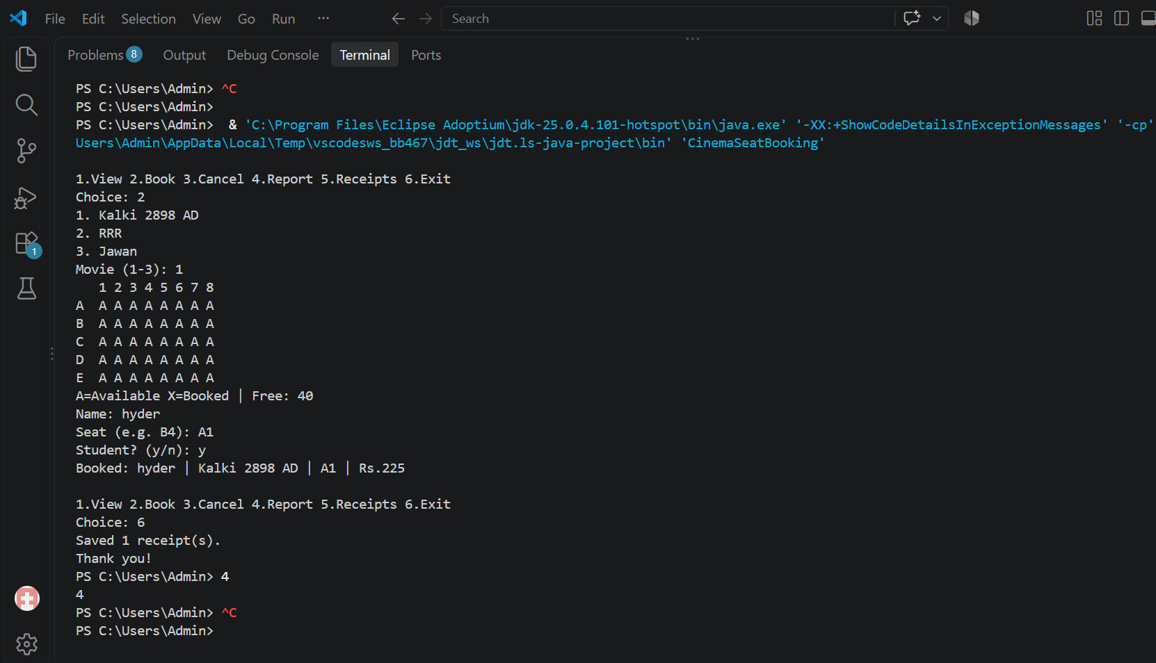
Screen Shots

Slide 17
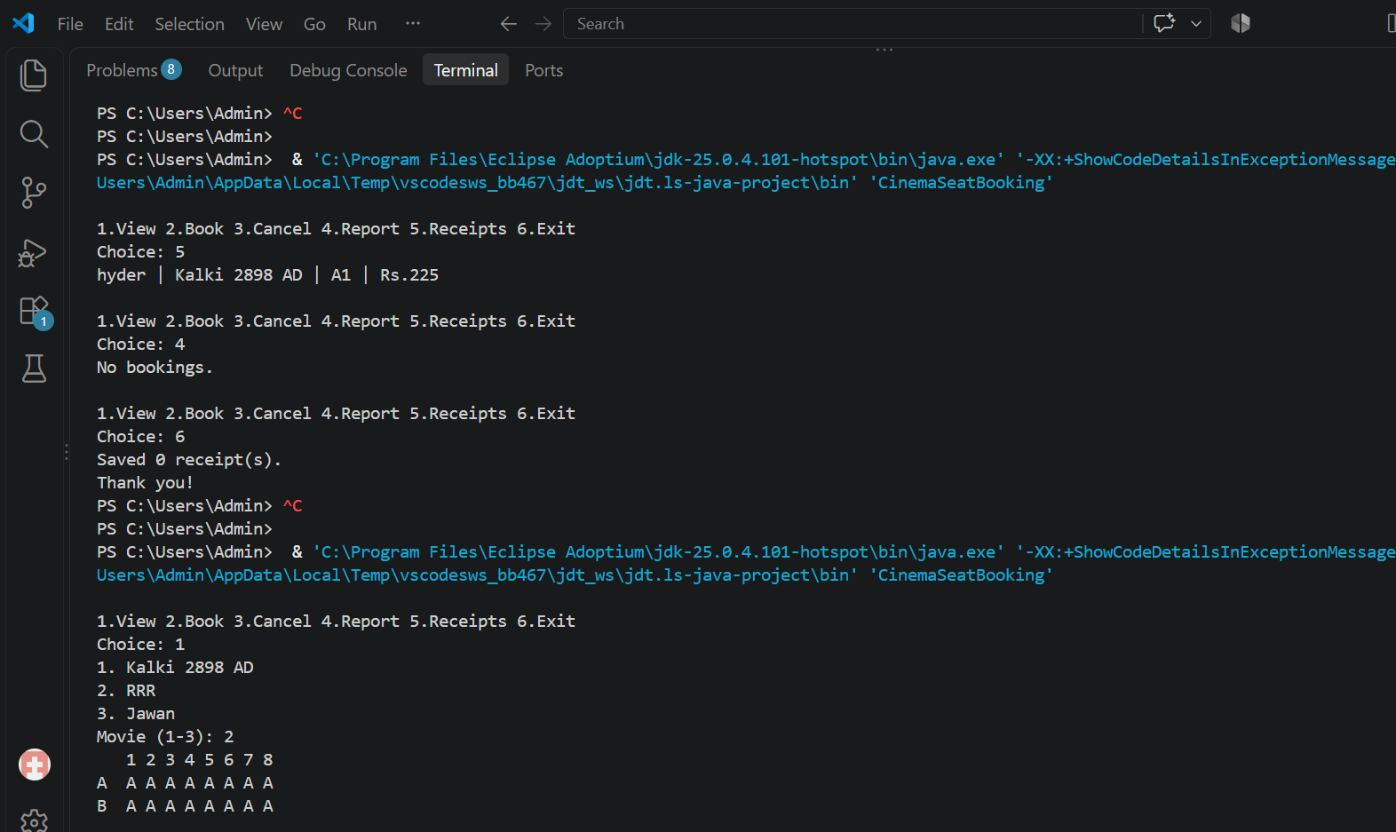

Slide 18
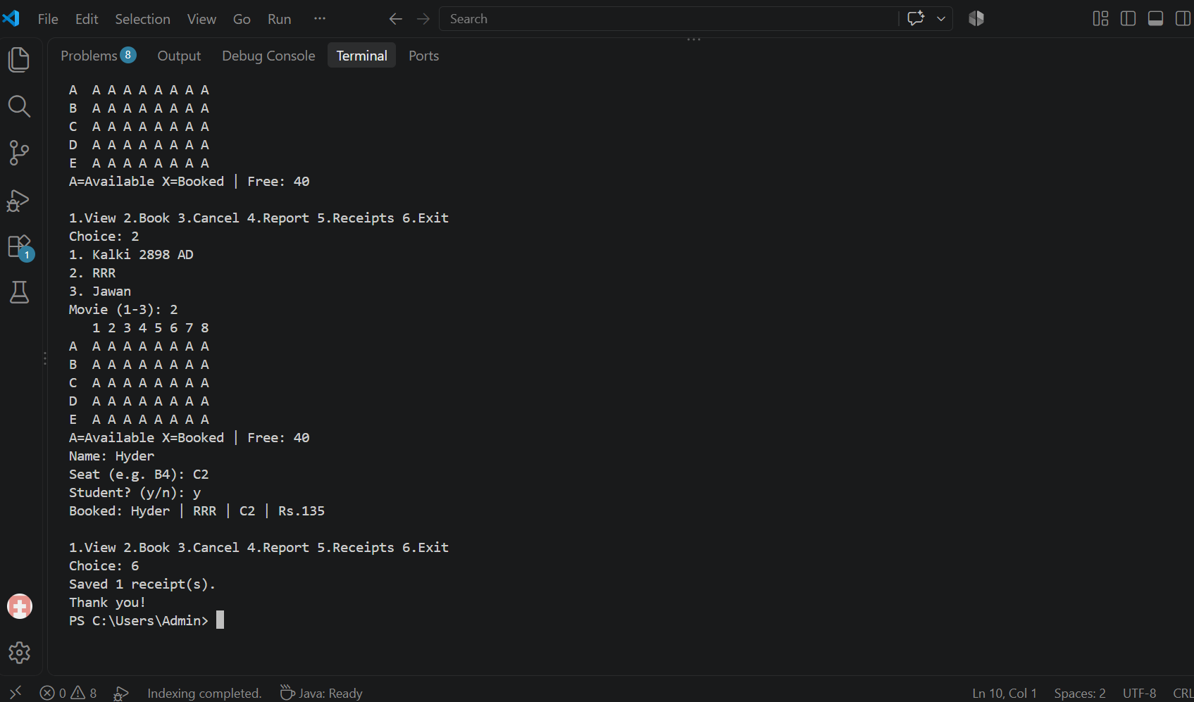

Slide 19
Geo Tag Photo and git hub link
GitHub link:
https://github.com/naatiqhyder-72/KLH-PSPJ-S16-TEAM-No.-7

