Slide 1
Panorama and perspective matching

Slide 2
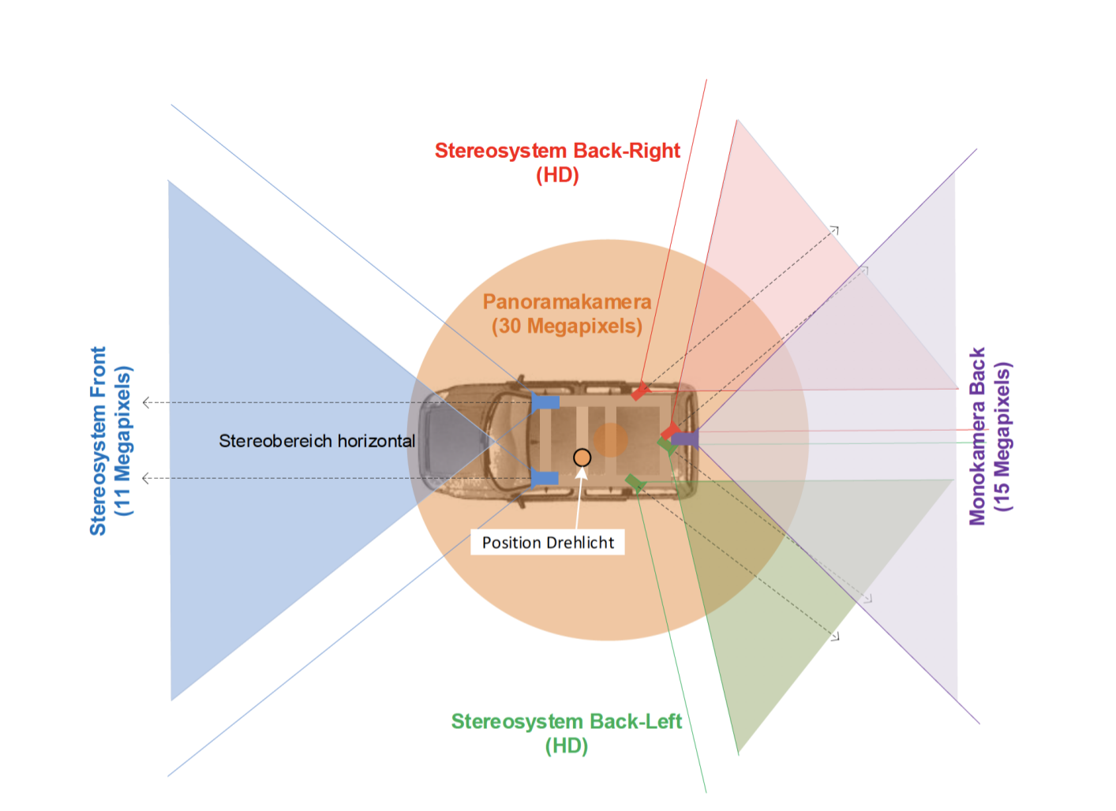
Panorama have 6 directions
Perspective only have 3 directions

Slide 3
Feature points Matching

Slide 4
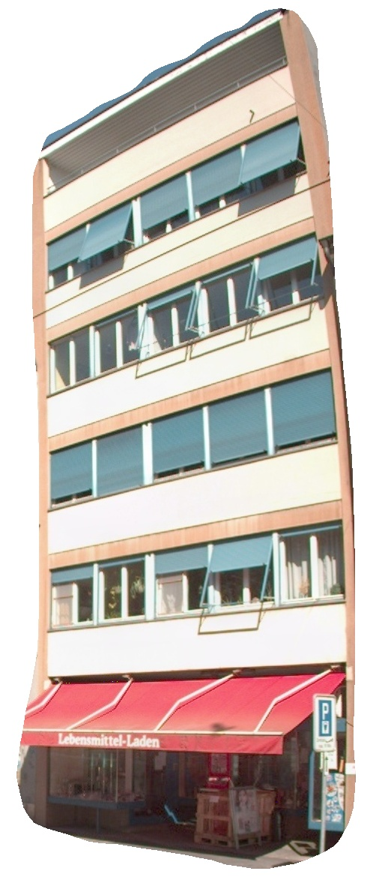
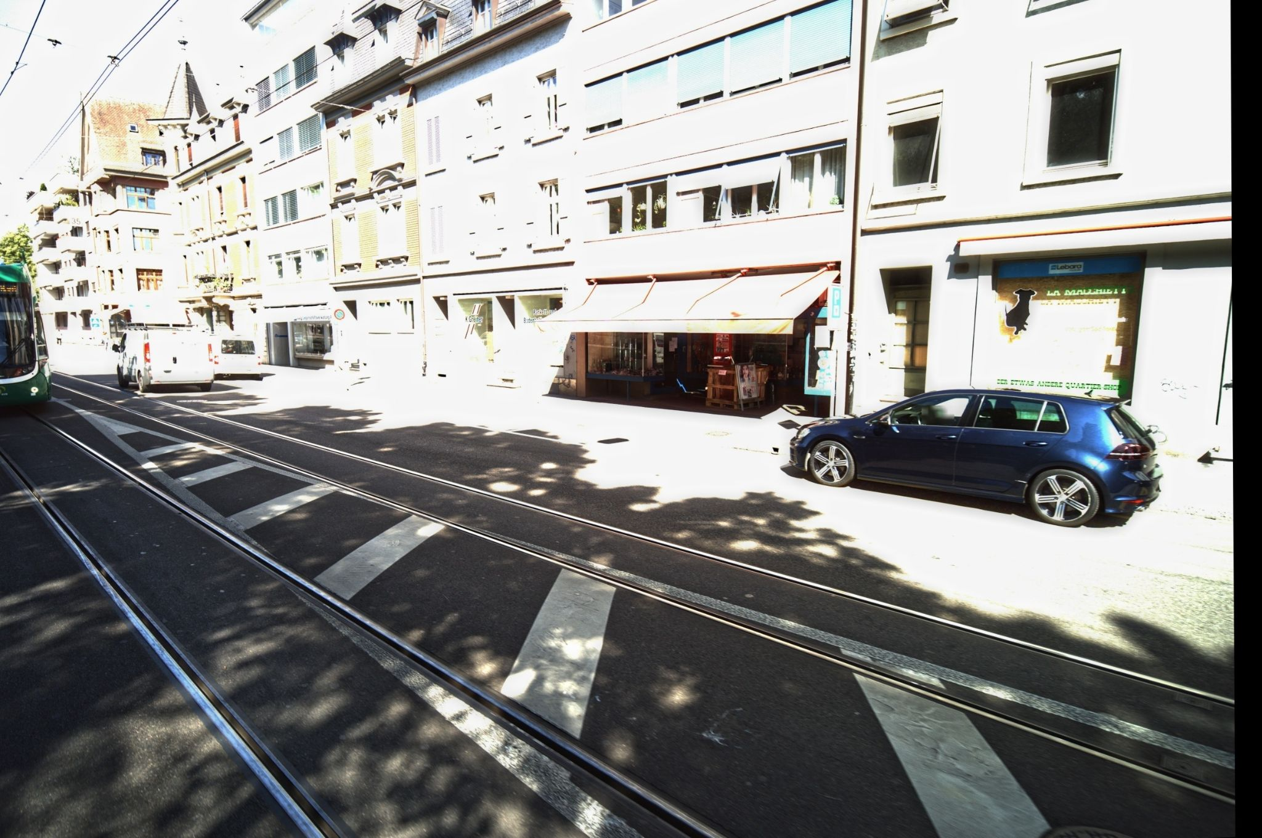
Matching
cropped building instances from panorama camera direction 3, named image A
building images from prespective camera, named image B
Do the matching between image A and image B
Image A (panorama)
Image B (perspective)

Slide 5
Matching result

Slide 6
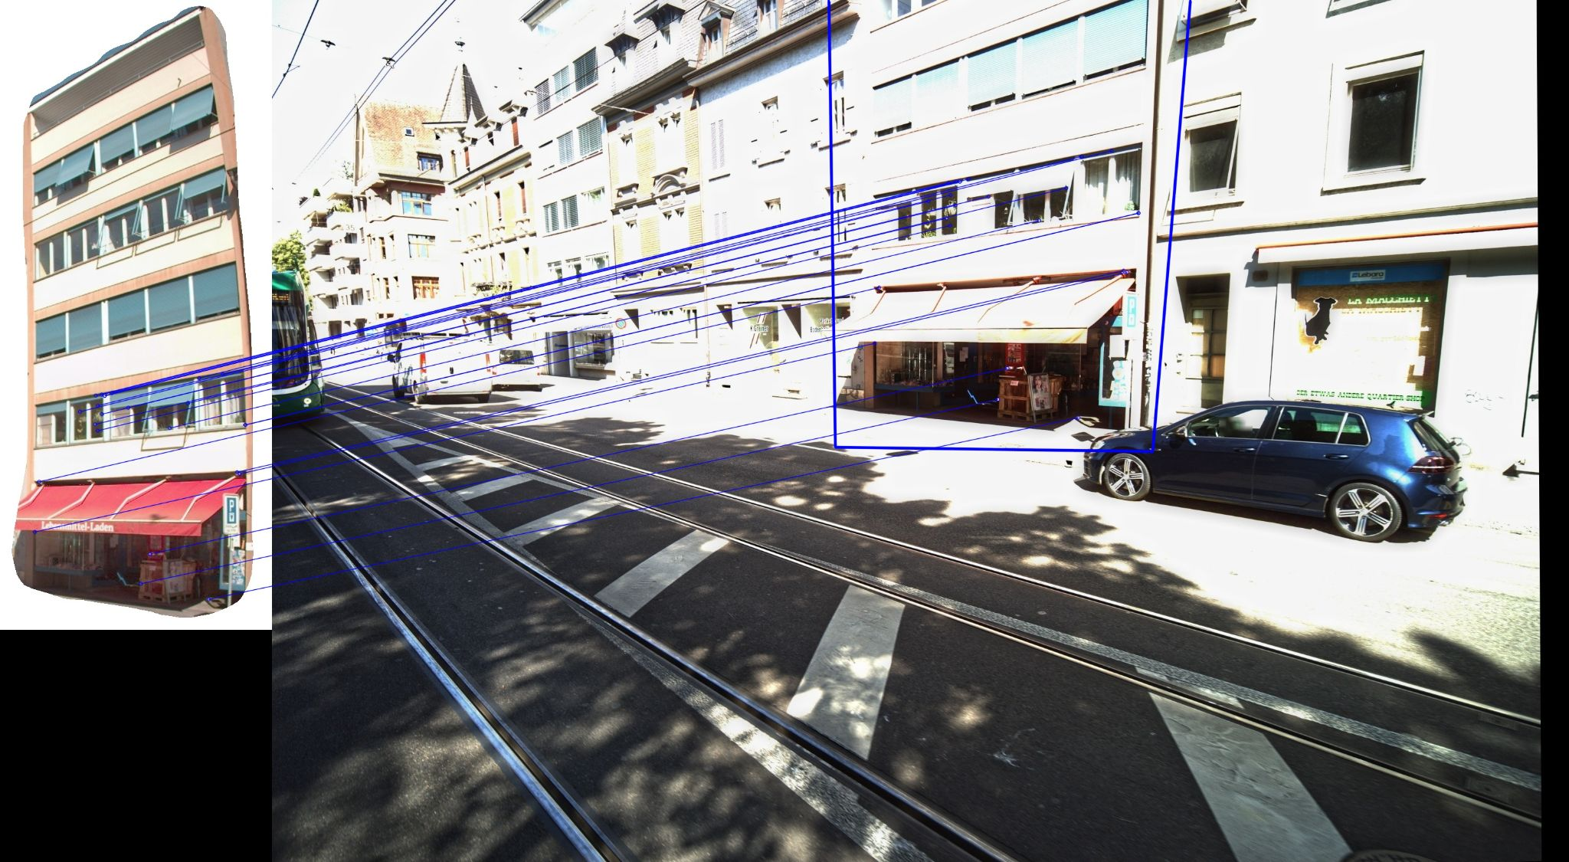

Slide 7
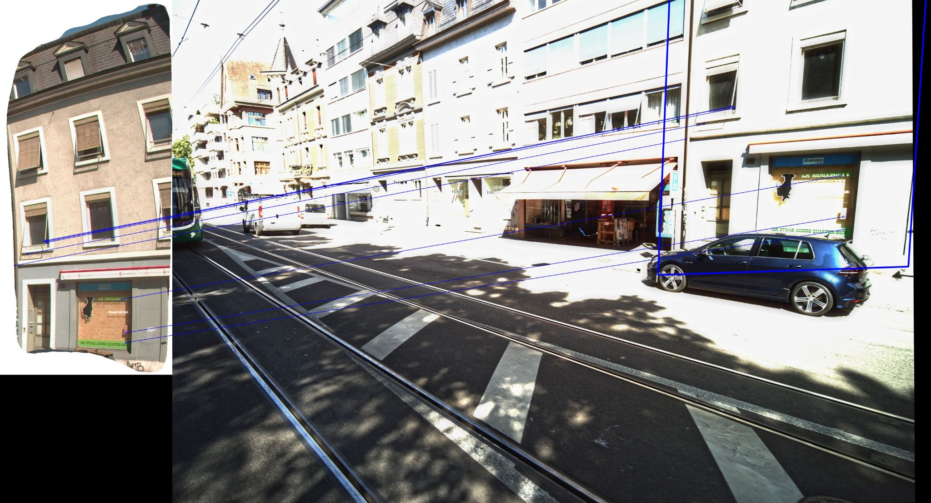

Slide 8
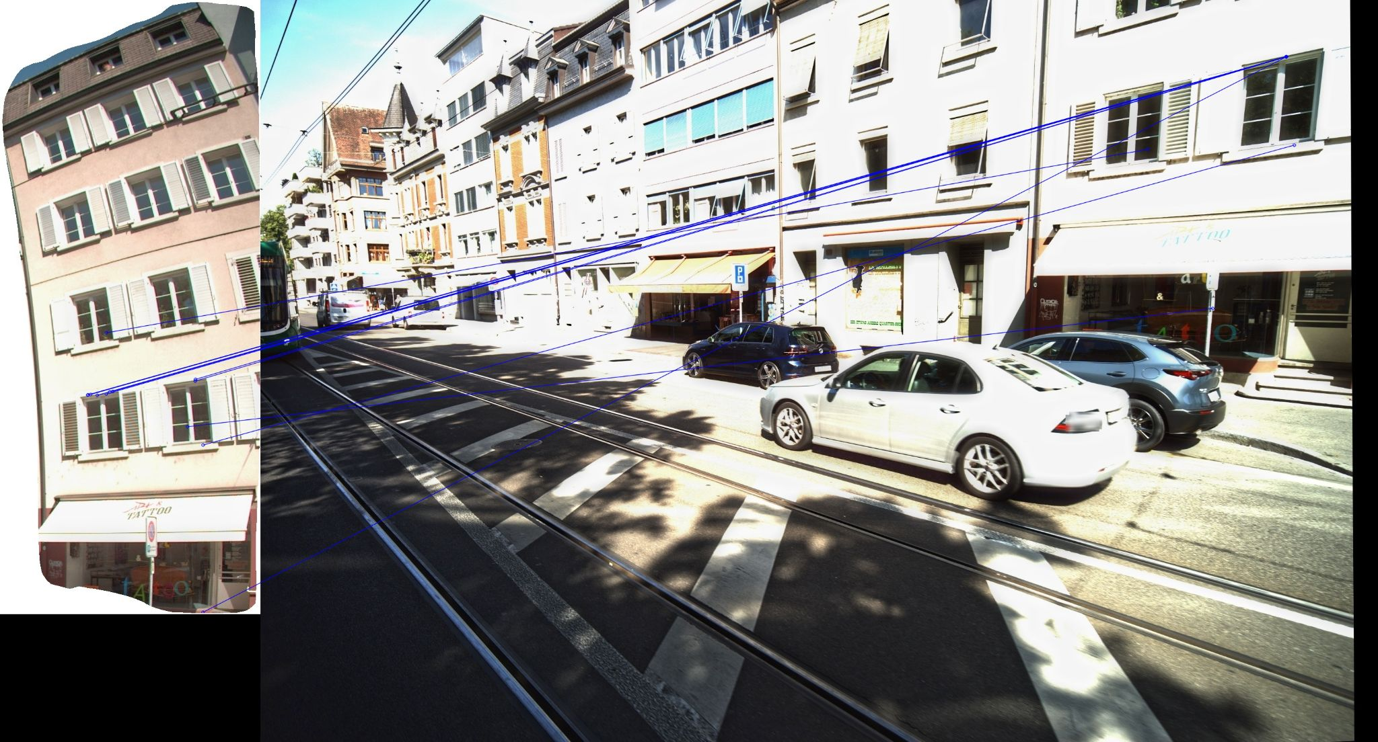

Slide 9
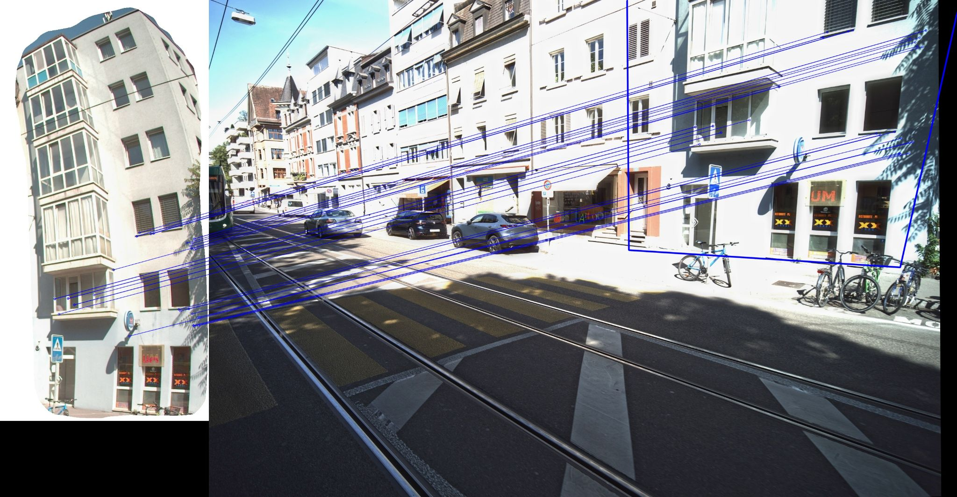

Slide 10
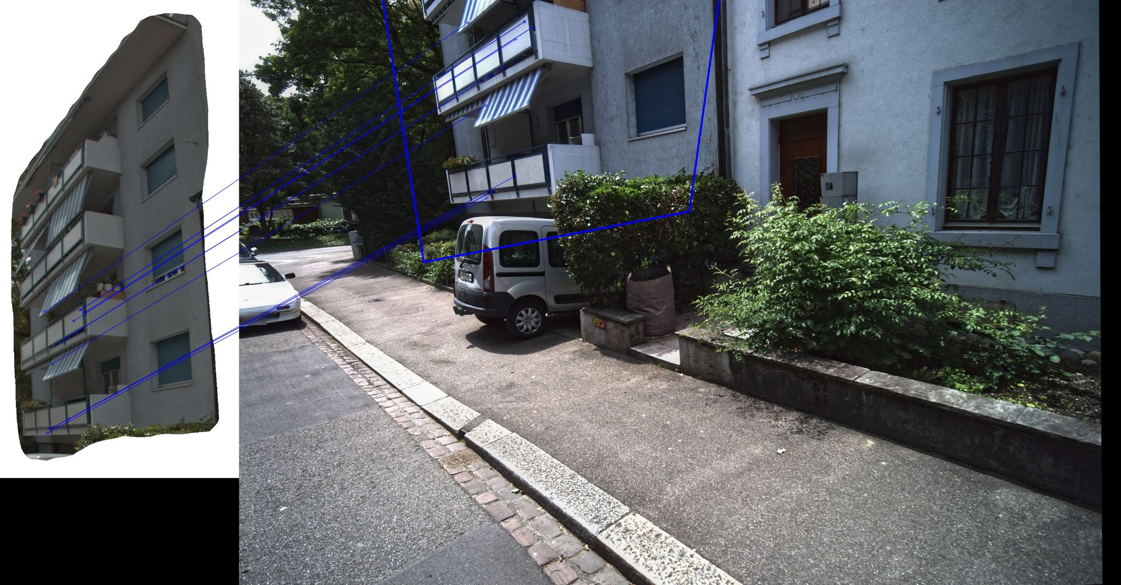

Slide 11
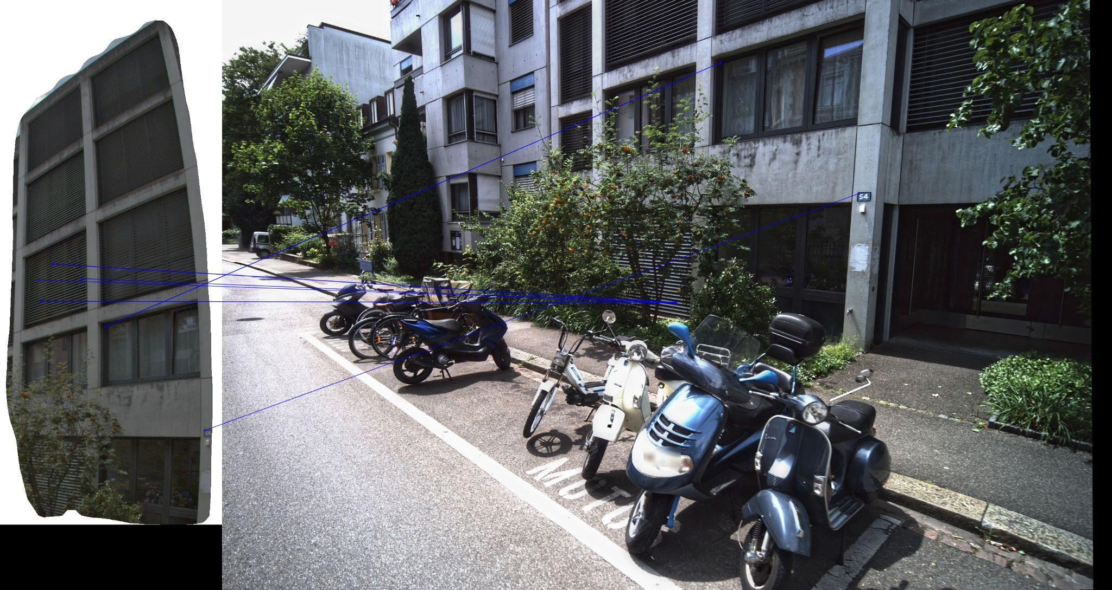

Slide 12
