Slide 1
Research Paper Review: Learning an Interpretable Traffic Signal Control Policy
Paper By: James Ault | Josiah P. Hanna | Guni Sharon
Presented by Group 161 :
Devarshi | 2025AE05592
Shantanu Pawar | 2025AE05707
Rithu Jalgar | 2025AE05933
Naman Dwivedi | 2025AE05935
Naaz | 2025AF05094

Slide 2
Presentation Outline
Motivation & Objective of the Paper
Paper Objective & Contributions
Traffic signal control as an MDP
Experimental Setup
Key Concept: Regulatable Control Function
Key Techniques & Algorithmic Approaches
Main Results & Interpretation
Limitations & Future Scope
Conclusion & Key Takeaways

Slide 3

Motivation & Problem Statement
The Interpretability Gap in Traffic Signal Control
Core Research Question Can we design traffic signal controllers that are BOTH high-performing AND human-interpretable? Performance (DNN) vs. Interpretability
• Traffic congestion costs billions annually in fuel, time, and emissions
• Reinforcement Learning with DNNs can reduce vehicle delay by up to 73%
• However, DNNs are black boxes — decisions cannot be explained
• Government agencies require interpretable, auditable controllers
• Current RL approaches are impractical for real-world deployment
Why Interpretability is Non-Negotiable • Liability: Who is responsible if an accident occurs? • Regulation: Agencies must approve control logic • Trust: Engineers need to understand & tune the system • Safety: Black-box failures can be catastrophic Traffic signals are safety-critical infrastructure.

Slide 4
Paper Objective & Contributions
Objective: Design interpretable, regulatable control policies for traffic signals that match deep neural network performance while remaining fully human-understandable and tunable.
Six Key Contributions:
1. Formally define a "regulatable" control function for signal control
2. Compare regulatable functions against DNN-based policies
3. Study three optimization methods: CMA-ES, PPO, Deep Q-Learning
4. Develop three novel DQN variants using regulatable functions
→ DRQ, DRSQ, DRHQ (core technical contribution)
5. Evaluate on simulations of real intersections with observed traffic demand
6. Compare against deployed actuated controllers (practical baseline)

Slide 5

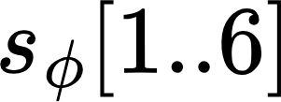

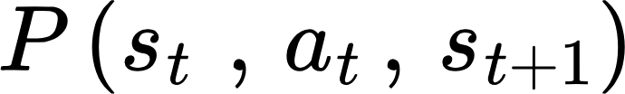
Traffic signal control as an MDP ( 1 / 2 )
State :
current signal assignment
lane/phase traffic variables
Action :
choose legal non-conflicting phase set Φ
policy output π(s;θ)→(Φg,Φy,Φr) (assign green, yellow, red)
Reward rt:
reduction in accumulated traffic delay
Transition:
from traffic demand + intersection dynamics
Decision score:
g(s,Φ;θ′), choose arg⁡max⁡Φg(s,Φ;θ′)
Environment State
sφ[1]: stopped vehicles
sφ[2]: approaching vehicles
sφ[3]: cumulative stopped time
sφ[4]: average stopped time
sφ[5]: average queue length
sφ[6]: average approach speed

Slide 6
Traffic signal control as an MDP ( 2 / 2 )
Environment
Environment State
(Φg,Φy,Φr)
Environment State
Next State
Reward
Action
sφ[1]: stopped vehicles
sφ[2]: approaching vehicles
sφ[3]: cumulative stopped time
sφ[4]: average stopped time
sφ[5]: average queue length
sφ[6]: average approach speed
St+1
Rt
at = argmaxΦ g(s,Φ;θ′)
Agent
π(s; θ)

Slide 7
Experimental Setup
Simulation Environment
Traffic Demand Profiles
• Simulator: SUMO (Simulation of Urban Mobility)
• Real traffic data from Utah DOT (2,092 intersections)
• Test site: State St & E 4500 S, Murray, Utah
• 10 traffic phases, 11 non-conflicting phase pairs
• >50,000 vehicles/day, peak rate: 95 cars/min
• 352 tunable parameters for regulatable policy
• Delay results are averaged over 30 episodes
Low: 45,112 vehicles | 1.04 v/sec | Wed May 1, 2019
Medium: 51,298 vehicles | 1.19 v/sec | Mon May 6, 2019
High: 61,261 vehicles | 1.42 v/sec | Fri Jun 21, 2019
DQN Hyperparameters
• 3 hidden layers, 64 units each
• Replay buffer: 100,000 transitions
• Minibatch size: 32 | Optimizer: Adam
• Epsilon-greedy: 0.05 → 0 after 20 episodes
• Discount factor: 0.8 (low/med), 0.9 (high)
Baseline: Actuated Signal Controller
• SUMO’s actuated controller (used in real deployments)
• Phases in fixed order (protected lefts → through traffic)
• Maximum green time: 300 seconds
• This is what real intersections use today

Slide 8
Key Concept: Regulatable Control Function
Formal Definition A precedence function g(s, Φ; θ) is regulatable if for every state variable s[i]: ∂g/∂s[i] ≥ 0 for all states, OR ∂g/∂s[i] ≤ 0 for all states i.e., monotonic input-output relationships.
Practical Intuition "Green was given to Phase 4 BECAUSE stopped Southbound vehicles increased while Eastbound queue decreased." Every decision has a human-readable reason. Engineers can adjust individual weights.
State Variables (per traffic phase):
Polynomial Precedence Function:
1. Stopped vehicles count
2. Approaching vehicles count
3. Cumulative stopped time
4. Average stopped time
5. Average queue length (stopped vehicles / lane count)
6. Average approaching vehicle speed
g(s, Φ; θ') = Σφ∈Φ Σi=1..6 (wi · s[i])^pi × Σj=1..4 (w'j · fj)^p'j
• Weights (w) and exponents (p) per state variable per phase
• For 8-phase intersection: 256 total tunable parameters
• Proven regulatable via Lemma 1 (monotonic partial derivatives)

Slide 9
Algorithmic Approaches
1. Deep Q-Network (DQN)
Uses a deep neural network to approximate Q-values for state–action pairs in reinforcement learning.
Serves as a high-performance baseline but lacks interpretability for real-world traffic control.
2. Deep Regulatable Q-Learning (DRQ)
Trains an interpretable (regulatable) function to directly match Q-values learned by DQN.
Simple approach, but struggles due to limited expressive power of the regulatable function.
3. Deep Regulatable Softmax Q-Learning (DRSQ)
Matches the probability distribution of actions (via softmax) instead of exact Q-values.
Improves flexibility and achieves better policy approximation than DRQ.
4. Deep Regulatable Hardmax Q-Learning (DRHQ)
Learns only the best action (argmax) from DQN rather than full value distribution.
Most effective variant—fast convergence and strong performance with interpretability.
5. Proximal Policy Optimization (PPO)
Policy-gradient method ensuring stable and smooth learning updates.
Safe but slower convergence and often gets stuck in suboptimal solutions.
6. Covariance Matrix Adaptation Evolution Strategy (CMA-ES)
Evolutionary optimization technique for tuning parameters without gradients.
Achieves strong results but is computationally expensive and impractical for online learning.

Slide 10
DRQ Deep Regulatable Q-Learning
How DRQ Works
Objective Function:
DRQ is used to align a simple, regulatable function ‘G’ with a complex Deep Q-Network so that the simple function can make the same decisions as the AI.
This allows for a interpretable or controllable policy that mimics the performance of a black-box model without needing the full complexity of a deep neural network.
Core Mechanism: DRQ
Dual-Network Architecture: Uses a standard DQN to learn optimal Q-values while training a Regulatable Function ‘G(s, a)’ to approximate them.
Knowledge Distillation: ‘G’ learns via supervised regression using a squared loss function to mirror the DQN’s outputs.
Training Stability: Leverages a replay buffer and target networks to ensure consistent learning for both the Q-function and the regulatable approximator.
Constrained Optimization: Designed to extract a manageable, interpretable policy from a high-capacity black-box model.
Application in This Paper
Role:
Basic regulatable Q-learning variant
Trains interpretable precedence function parameters
Enables action selection using a human-regulatable policy instead of DNN
Why DRQ Was Chosen:
Ensures policy interpretability and regulation
Leverages DQN for learning optimal behavior
Provides direct mapping between Q-values and control policy
Serves as baseline for improved variants (DRSQ, DRHQ)
Key Property: DRQ transfers knowledge from a deep Q-network to a regulatable function using value matching — but struggles due to limited flexibility of the interpretable model.
DRQ enforces direct matching between the regulatable function and Q-values, ensuring interpretability — but may limit performance due to constrained function representation.

Slide 11

DRSQ Deep Regulatable Softmax Q
Why DRSQ?
Directly matching Q-values (DRQ) is difficult for simple, interpretable models .Need a way to simplify learning without losing decision quality
Key Idea
Instead of exact values, learn relative preference of actions
Preserve decision behavior, not numerical accuracy
How It Learns
Convert outputs of both models into action-wise probabilities
Train G to follow the same preference pattern as the Q-network
Use cross-entropy loss for alignment
What Makes It Better
Easier for interpretable function to learn
Avoids strict requirement of matching Q-values
Maintains correct ranking of actions
Limitation
Still tries to learn full action distribution
More information than actually needed for decision making
Takeaway
Focuses on “how actions compare”, not exact values

Slide 12

DRHQ Deep Regulatable Hardmax Q
Why DRHQ?
Even learning full action preferences (DRSQ) is unnecessary
For decision-making, we only need the best action
Key Idea
Learn only which action is optimal
Ignore exact values and relative differences
How It Learns
Q-network identifies the best action
Convert it into a one-hot target:
Best action → 1
Others → 0
Train G to predict this choice using softmax + log-loss
What Makes It Better
Simplest learning objective
Easier for interpretable function to learn
Focuses directly on decision-making
Limitation
Achieves best performance among variants
Up to ~19.4% reduction in delay
Takeaway
Learns “which action to take” — nothing extra

Slide 13
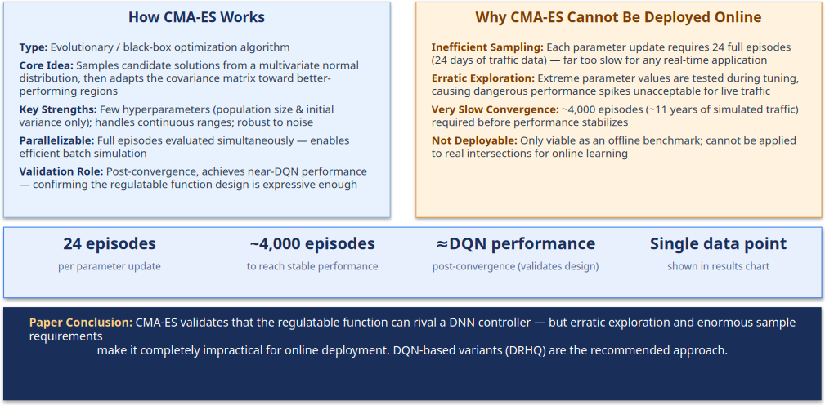
CMA-ES (Covariance Matrix Adaptation Evolution Strategy)

Slide 14
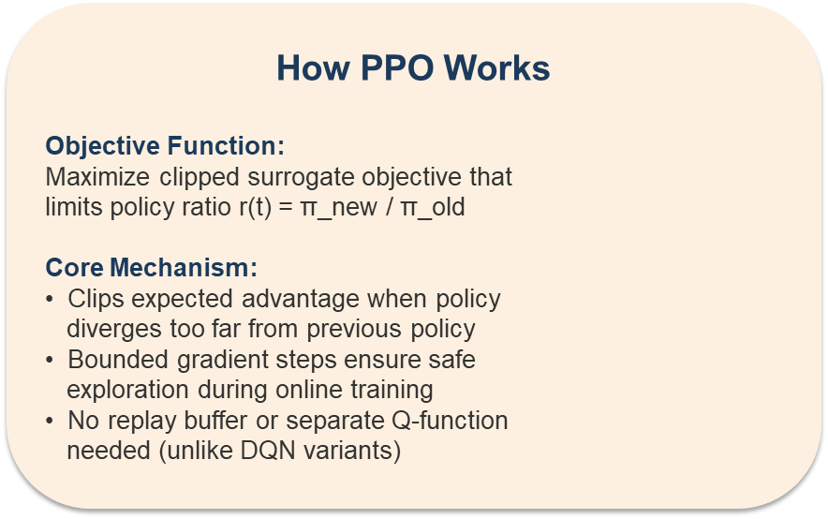
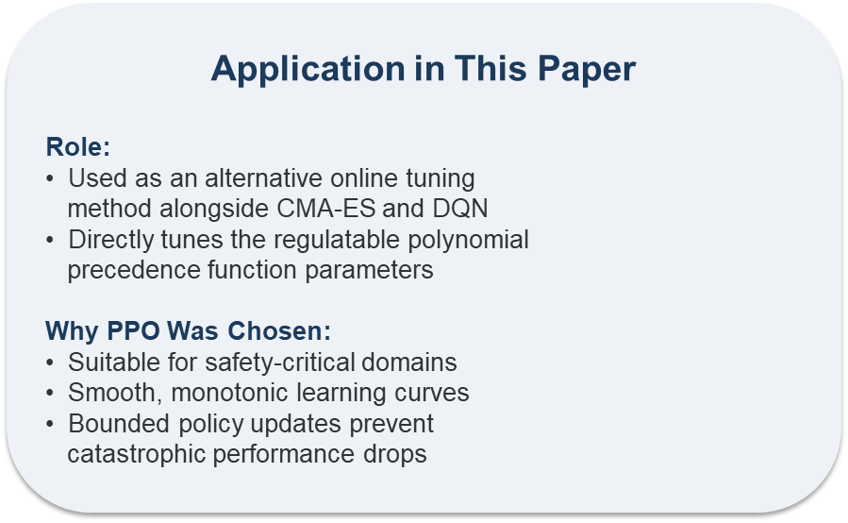
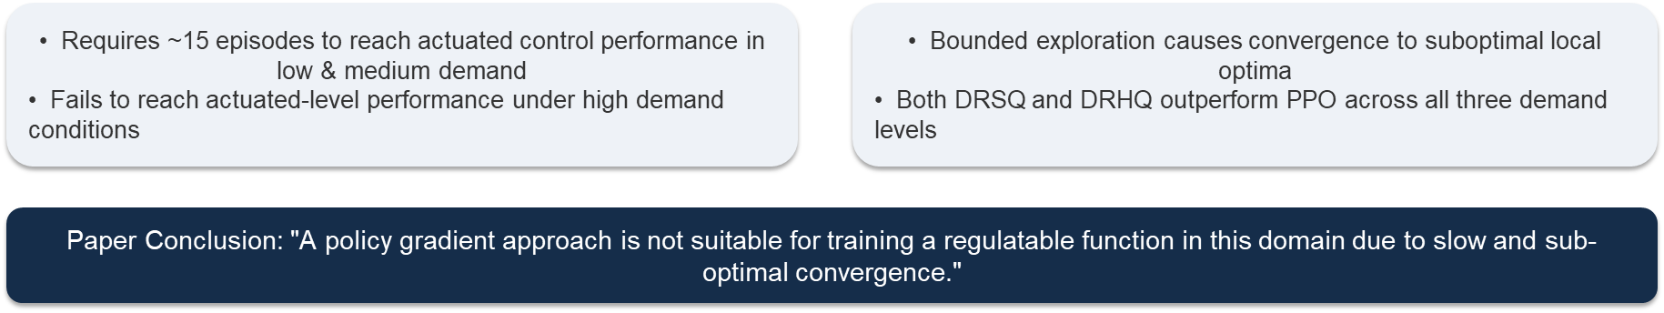
PPO (Proximal Policy Optimization)

Slide 15
Main Results: Average Vehicle Delay Comparison
Average Vehicle Delay (seconds) — Lower is Better
Method Low Demand Medium Demand High Demand
Actuated (Baseline) ~60 sec ~70 sec ~95 sec
CMA-ES ~50 sec ~58 sec ~85 sec
PPO ~55 sec ~65 sec ~95 sec (fails in high)
DRQ Poor Poor Poor
DRSQ ~52 sec ~62 sec ~87 sec
DRHQ (Best Interpretable) ~50 sec ~60 sec ~85 sec
DQN (Black-box Upper Bound) ~48 sec ~57 sec ~82 sec
Key Finding: DRHQ achieves up to 19.4% reduced vehicle delay compared to deployed actuated controllers, while remaining fully interpretable. The gap vs. the black-box DQN is only 1–3 seconds.

Slide 16
Interpretation of Results
Why DRHQ Works Best
Why Other Methods Fall Short
• Only needs to match which action wins, not exact Q-values
• Gives maximum flexibility to the polynomial function
• Hardmax formulation directly targets policy equivalence
• Converges within a single episode for low/medium demand
• "Less is more": easier target = better practical fit
• DRQ: Cannot approximate the full Q-function surface
• DRSQ: Softmax ranking harder to match than just the winner
• PPO: Over-regularized, converges to local optima
• CMA-ES: Requires thousands of episodes, unsafe exploration
• Pure polynomial/Fourier: Cannot complete basic scenarios
Critical Insight The performance gap between DRHQ (~50–85 sec) and the full black-box DQN (~48–82 sec) is only 1–3 seconds. This marginal cost buys complete interpretability — every decision can be explained, audited, and manually adjusted by traffic engineers. For safety-critical infrastructure, this is an excellent trade-off.

Slide 17
Limitations & Future Scope
Limitations of This Work
Future Research Directions
• Single intersection only — transferability is unknown
• All results are from simulation (SUMO), no real-world test
• CMA-ES is impractical despite showing ceiling performance
• PPO fails under high demand scenarios
• No warm-starting from existing controllers explored
• 352 parameters still requires significant compute
• Limited to one geographic region (Utah traffic data only)
• Warm-starting from currently deployed controller behavior
• Multi-intersection coordination & network optimization
• Real-world deployment and field testing validation
• Transferability studies across intersection types
• Incorporating pedestrian and cyclist signal phases
• Adaptive parameter count based on intersection complexity
• Integration with connected & autonomous vehicle data

Slide 18
Conclusion & Key Takeaways
1. Interpretable polynomial policies CAN match DNN performance (gap ≤ 1–3 sec)
2. DRHQ (Hardmax variant) achieves 19.4% delay reduction vs. actuated controllers
3. "Regulatable" = monotonic input-output relationship = human-understandable decisions
4. Policy gradient methods (PPO) are unsuitable for traffic signal optimization
5. The paper bridges the gap between AI performance and real-world deployability
6. Interpretability is not a luxury — it is a requirement for safety-critical systems
"We can build AI systems that are both powerful and explainable. We do not always have to choose one over the other."

Slide 19
Thank You
Presented by:
Assignment Presentation : Devarshi Aggarwal | Shantanu Pawar | Rithu Jalgar | Naman Dwivedi | Naaz

