Slide 1

TUTORIAL
Molecular Docking Using Autodock4
GUWAHATI
Nabajyoti Goswami
Senior Faculty in Bioinformatics
Smart Bioinformatics Ecosystem Project

Slide 2
Separating Molecules from Their Complexes
PDB entry 1HSG is a protein–ligand complex as entitled, “CRYSTAL STRUCTURE AT 1.9 ANGSTROMS RESOLUTION OF HUMAN IMMUNODEFICIENCY VIRUS (HIV) II PROTEASE COMPLEXED WITH L-735,524, AN ORALLY BIOAVAILABLE INHIBITOR OF THE HIV PROTEASES”.
In order perform a benchmark docking with the same ligand associated with HIV II Protease, first we need to separate the ligand from the protein and individual PDB files of both protein and ligand should be created.
For this purpose, we are using UCSF Chimera.
Following figures will show how to overcome this situation.

Slide 3
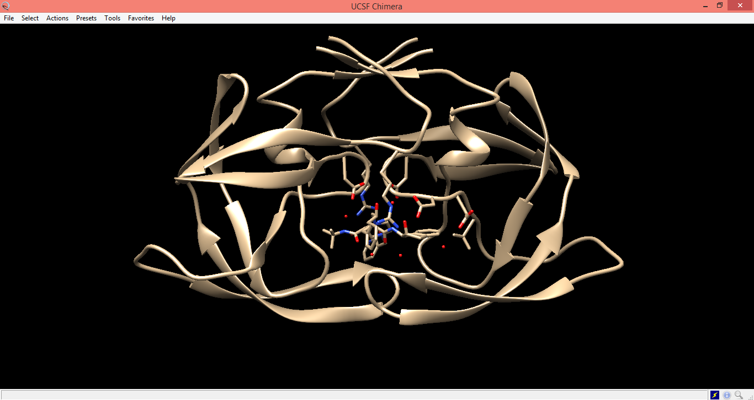

Slide 4
Separating Molecules from Their Complexes (contd...)
Before proceeding to separate the molecules, it is recommended to visualize the molecule opened in UCSF Chimera very carefully.
One can easily visualize the protein residues that are interacting with the ligand attached to it.
In this case, these residues are Arg8, Asp25, Asp29, Asp30 and Val32.

Slide 5
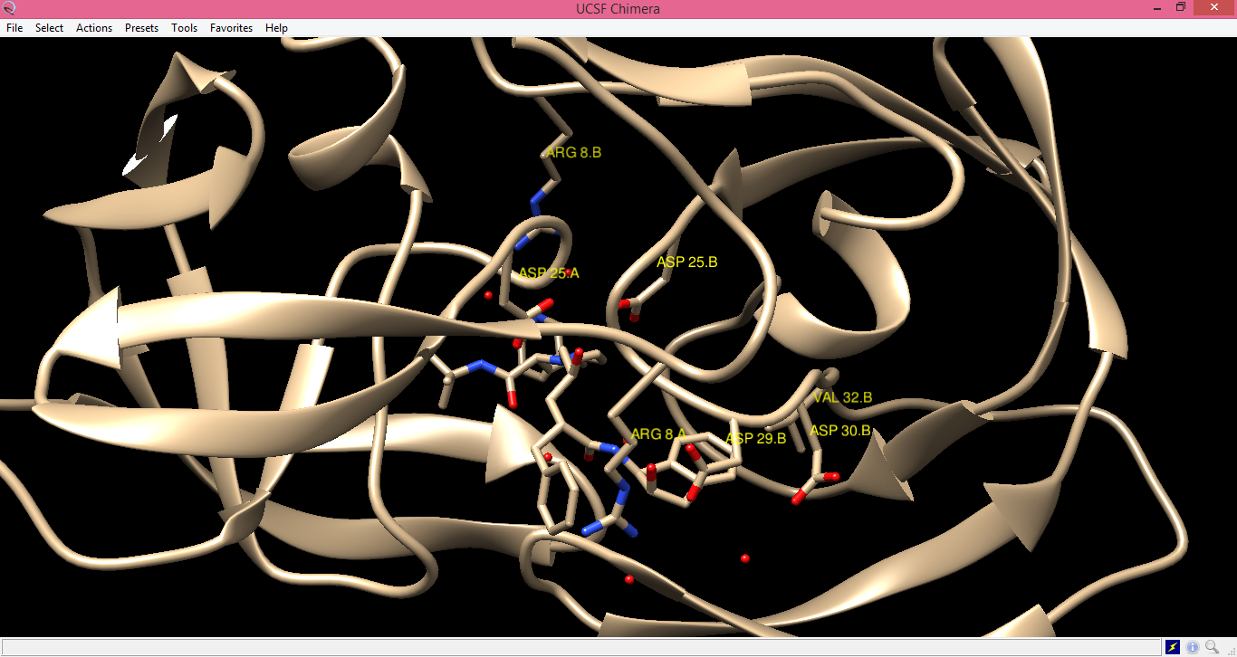

Slide 6
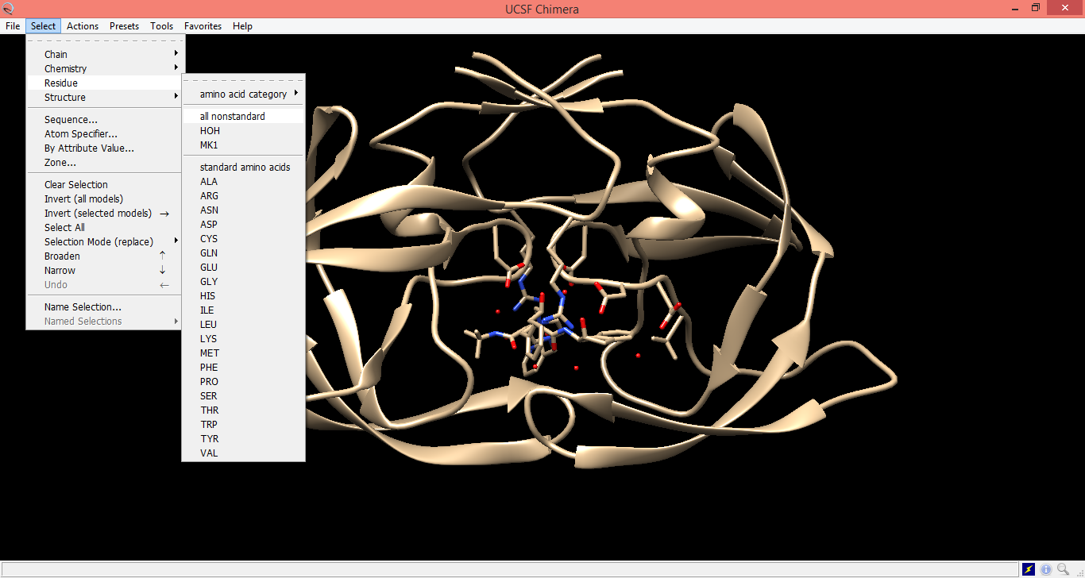

Slide 7
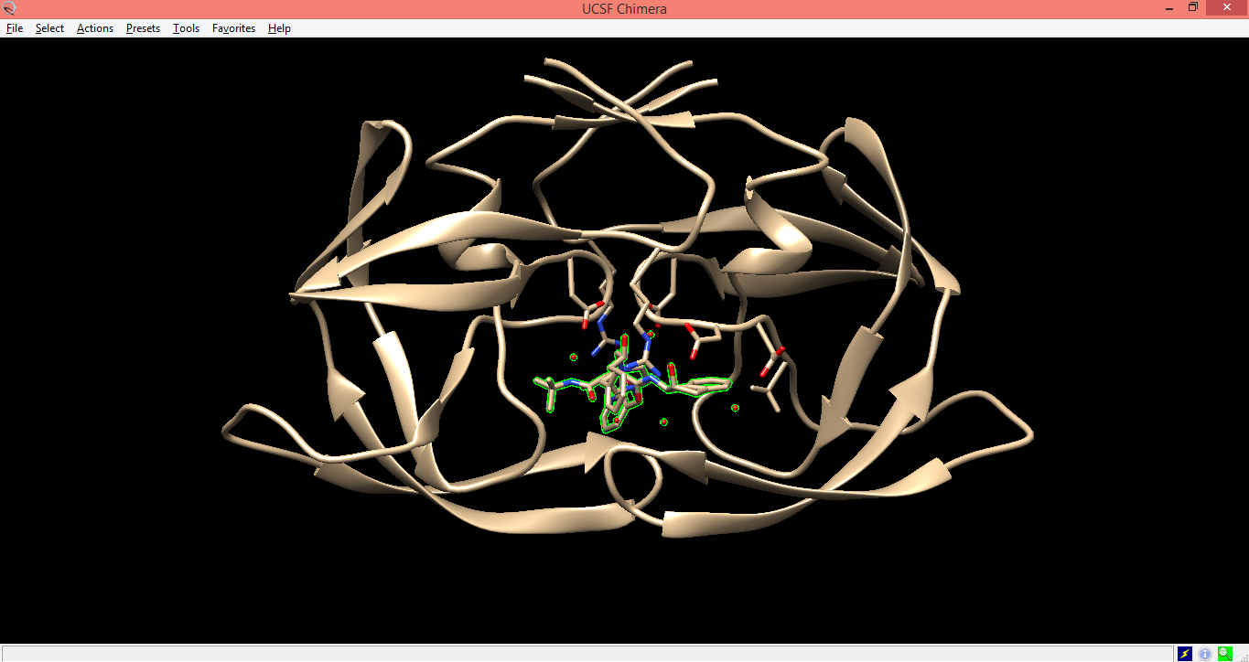

Slide 8
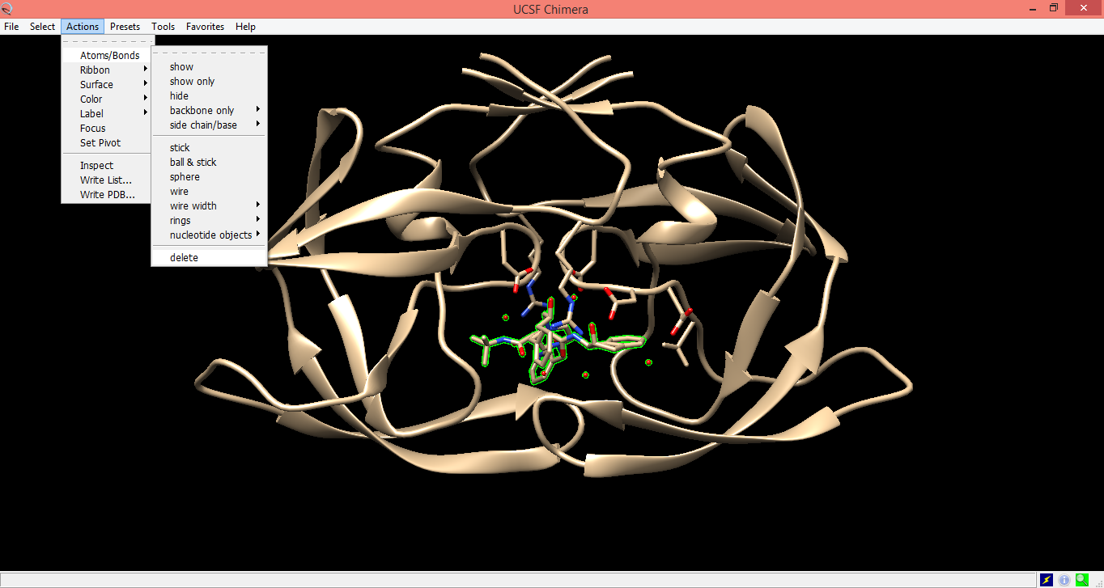

Slide 9
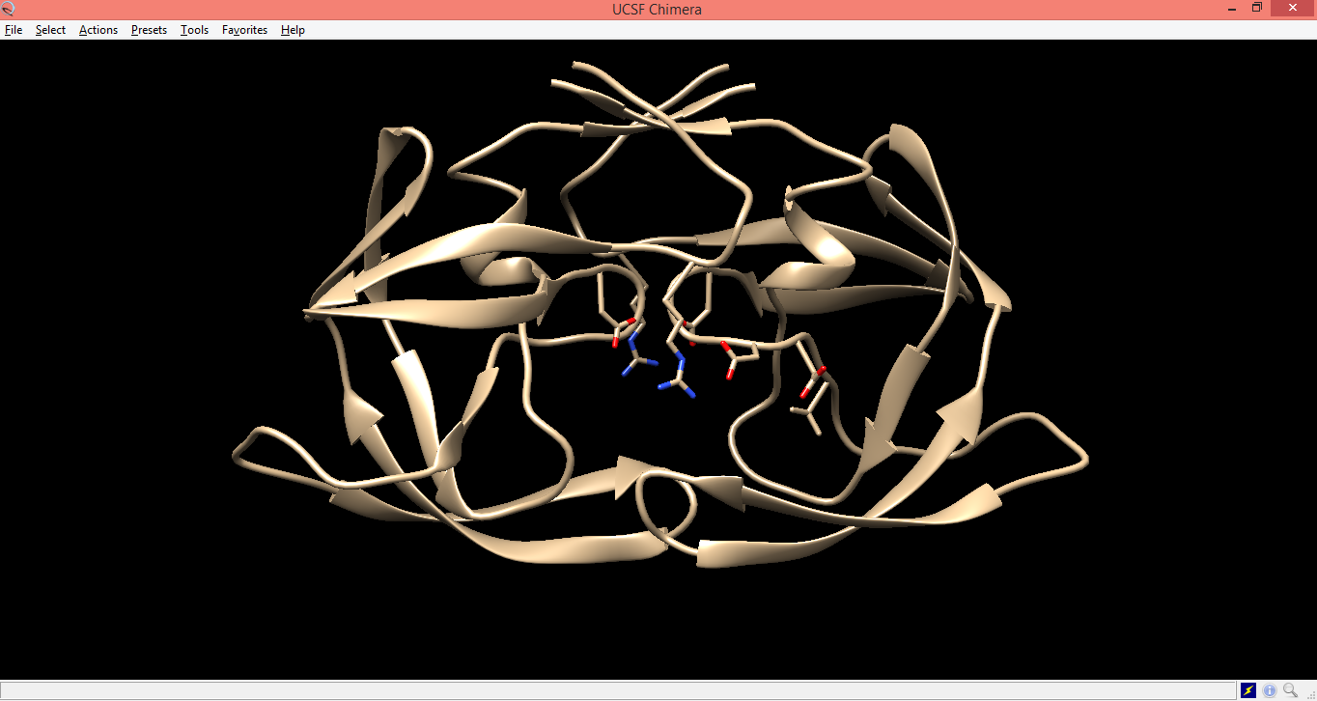

Slide 10
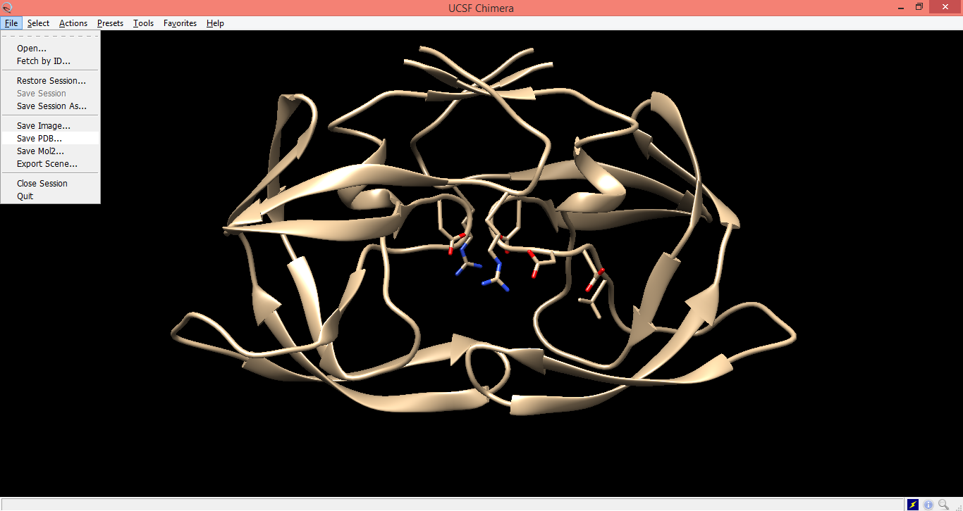

Slide 11
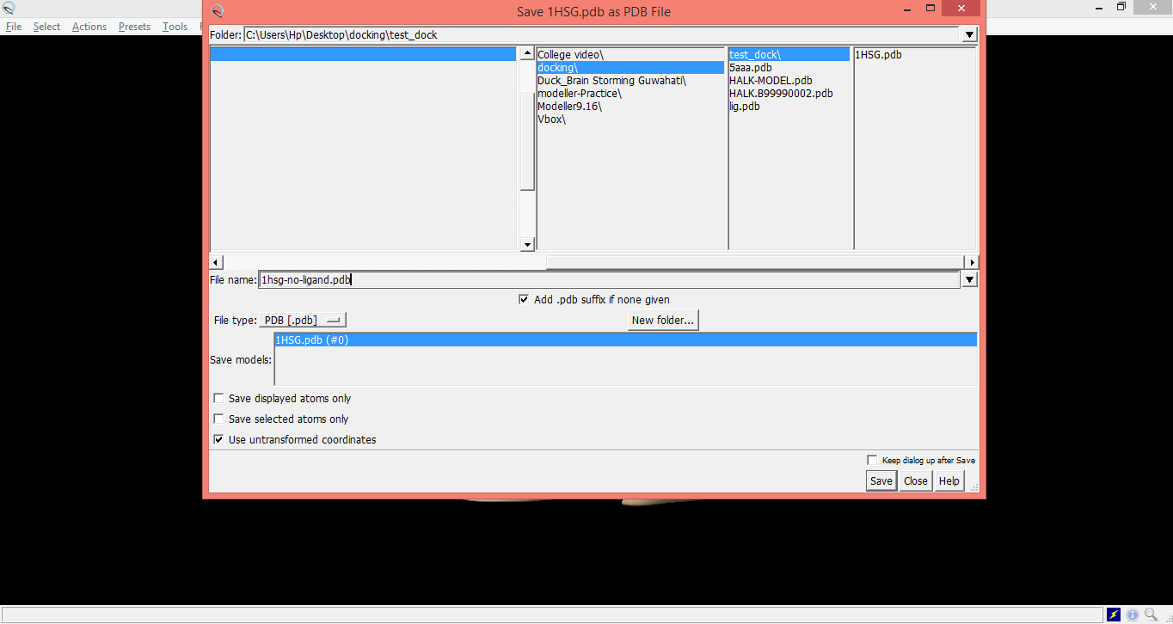

Slide 12
Separating Molecules from Their Complexes (contd...)
After saving the protein file as a PDB, the task is to obtain the ligand.
For this, the original, un-edited PDB file 1HSG.pdb should be again opened in UCSF Chimera.

Slide 13
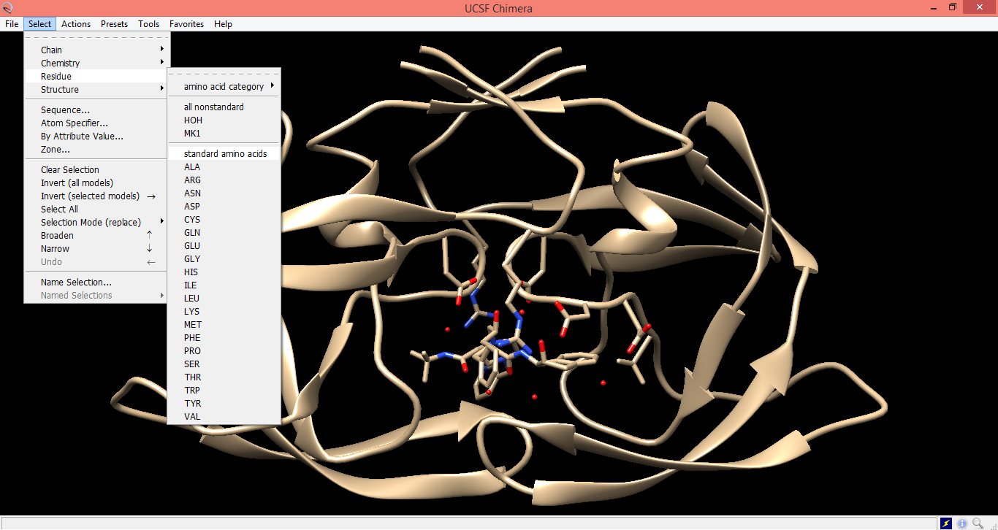

Slide 14
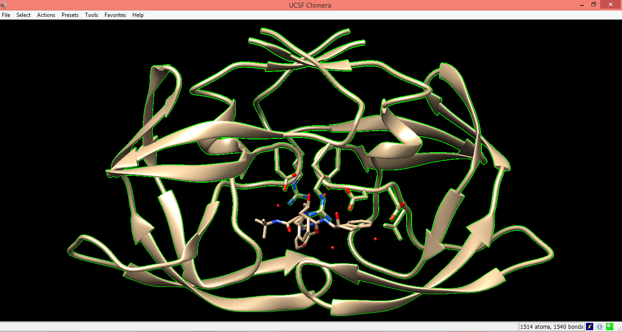

Slide 15
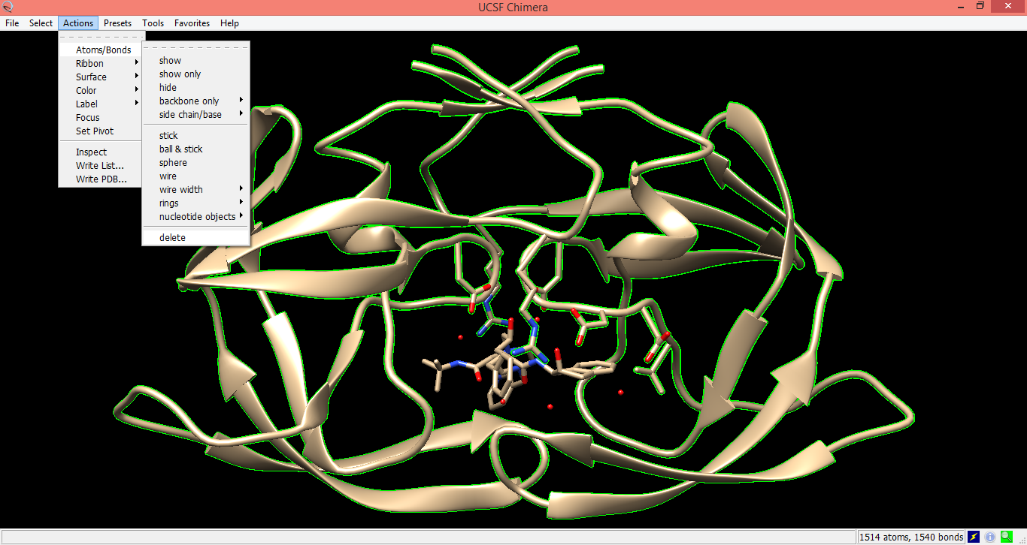

Slide 16
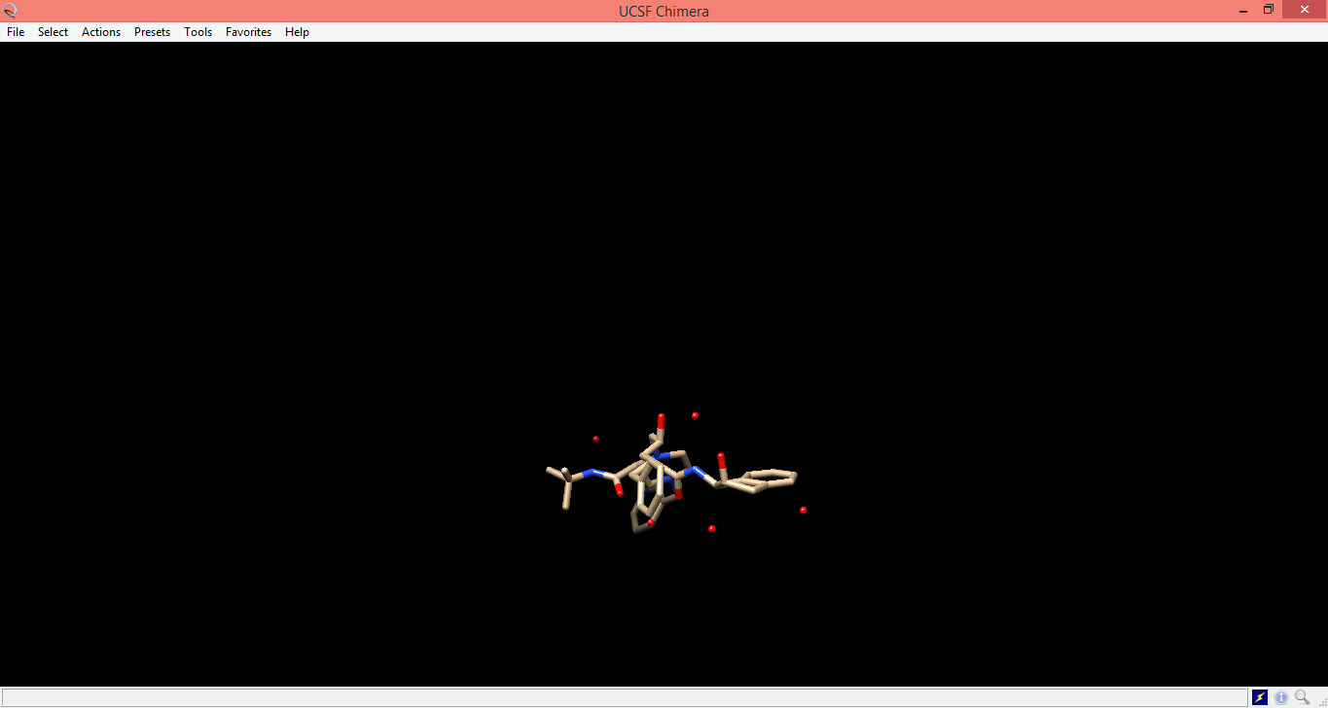

Slide 17
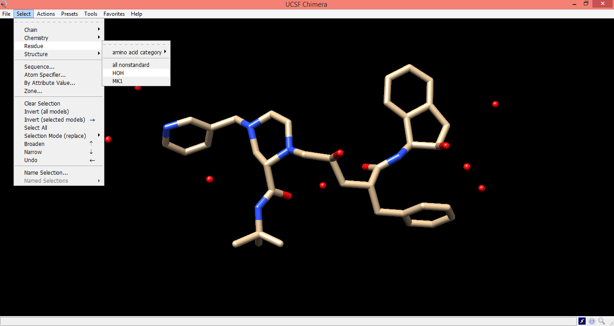

Slide 18
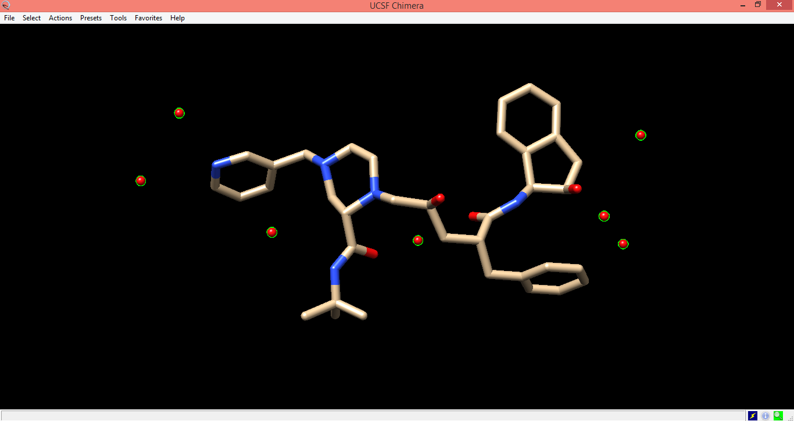

Slide 19
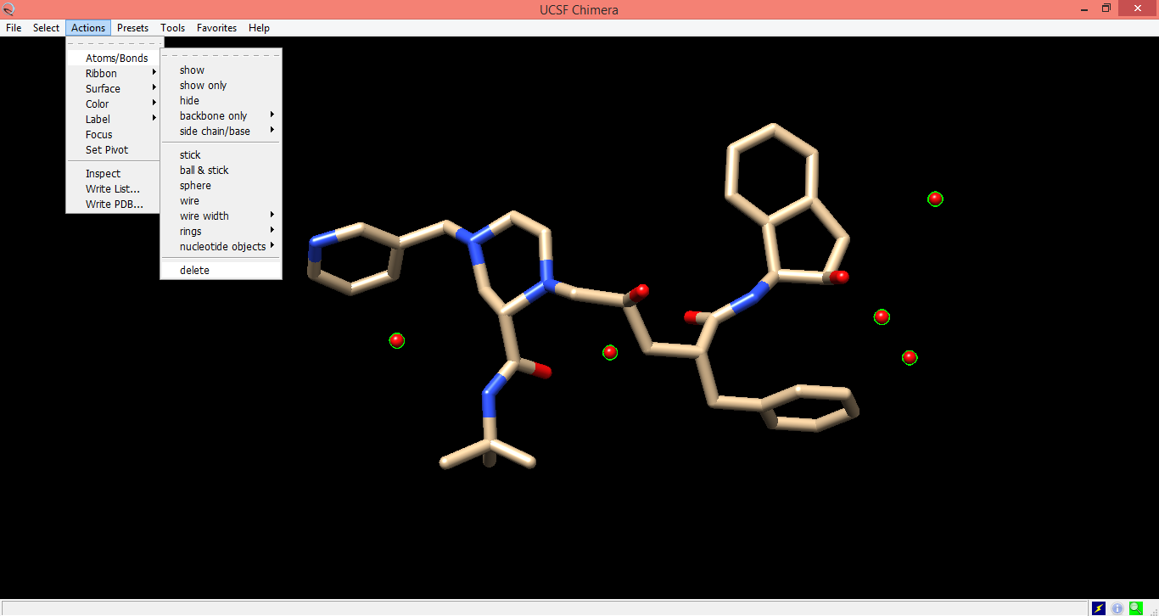

Slide 20


Slide 21
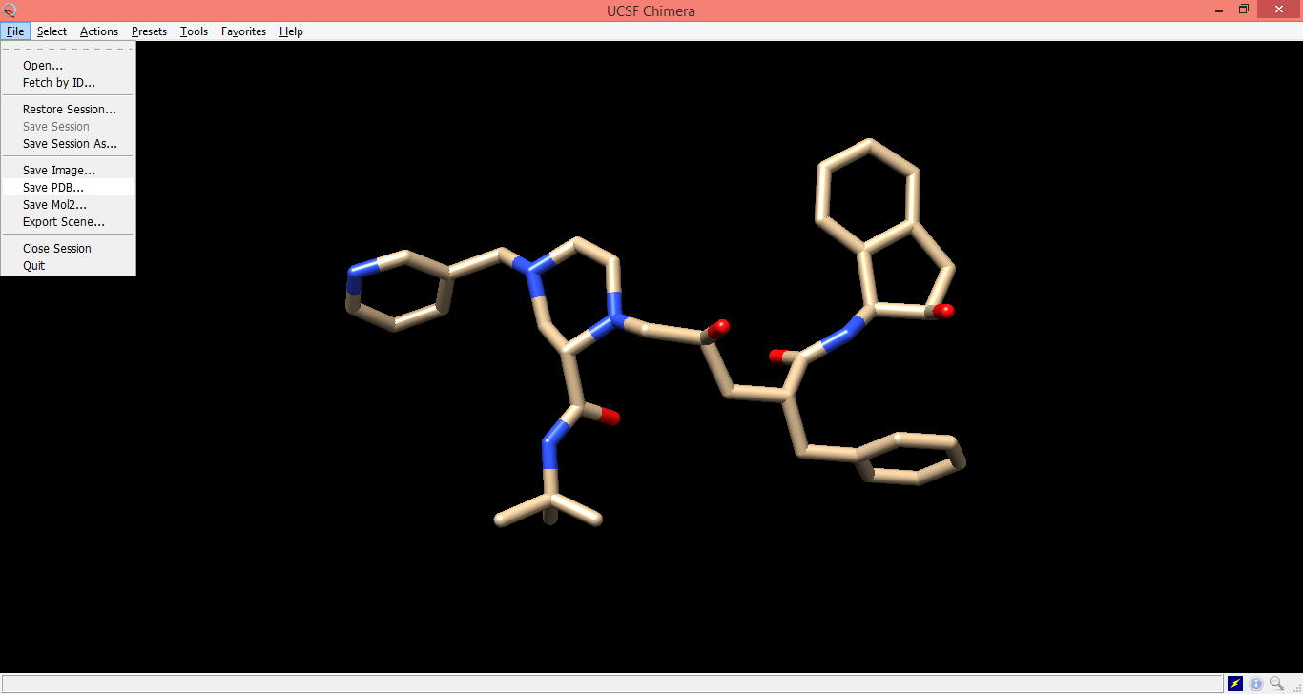

Slide 22
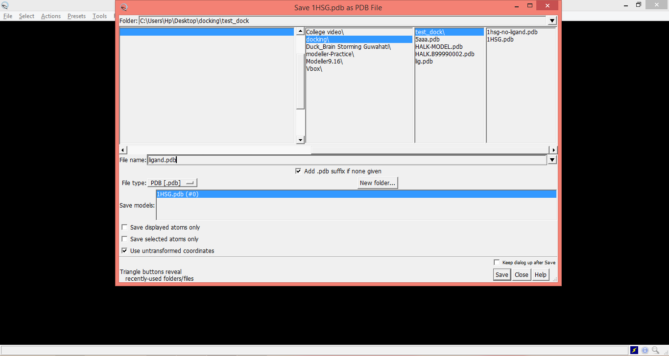

Slide 23
Docking by AutoDock Pre-requisites
Following programs should be installed in order to perform protein–ligand docking using AutoDock:
autodocksuite-4.2.6.i86Windows.exe (or latest version)
  it provides two essential programs, viz.,
    autodock4 and
    autogrid4
mgltools_win32_1.5.6_Setup.exe (or latest version)
  it provides four programs viz.,
    PMV (Python Molecule Viewer),
    ADT (AutoDockTools),
    CADD (Computer-Aided Drug Designing) and
    Vision (a simple visualization tool)
Here we need only ADT for our purpose

Slide 24
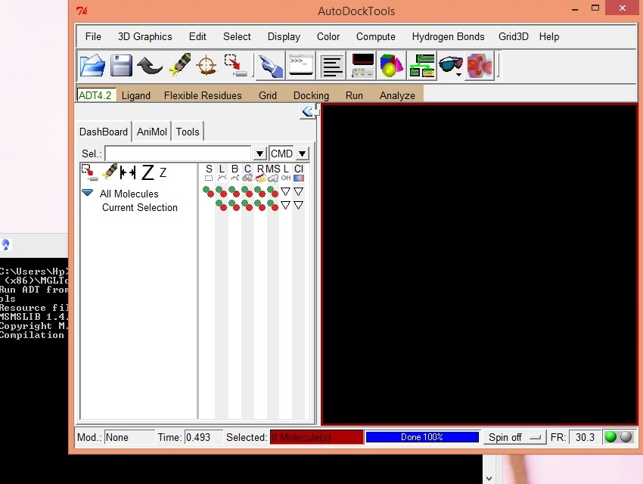

Receptor Preparation
Open ADT by double clicking

Slide 25
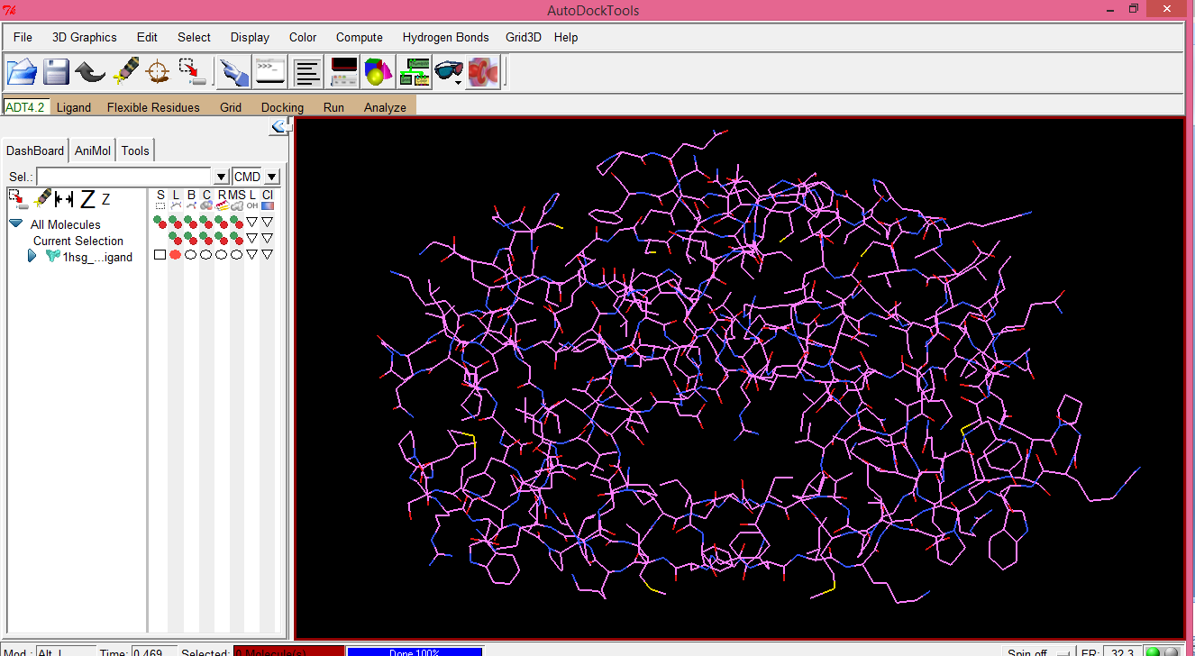
File
Read Molecule
Open the PDB file
Receptor Preparation contd...
Press “D” on the keyboard to have a distinct display

Slide 26
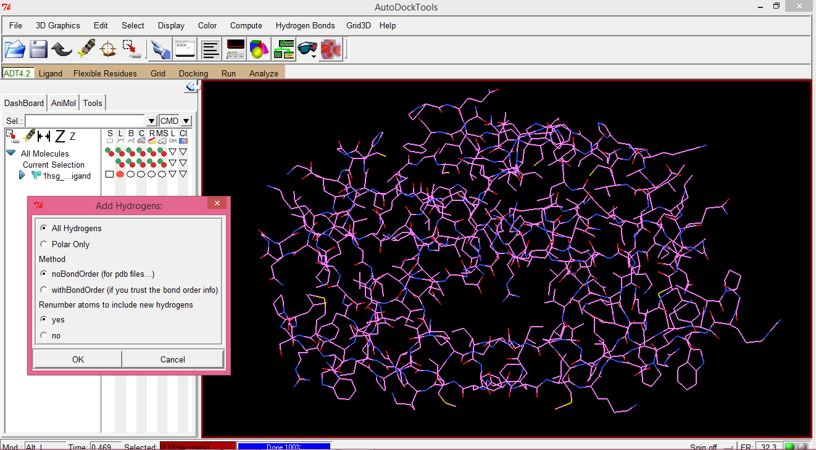
Edit
Hydrogens
Add
OK
Receptor Preparation contd...

Slide 27
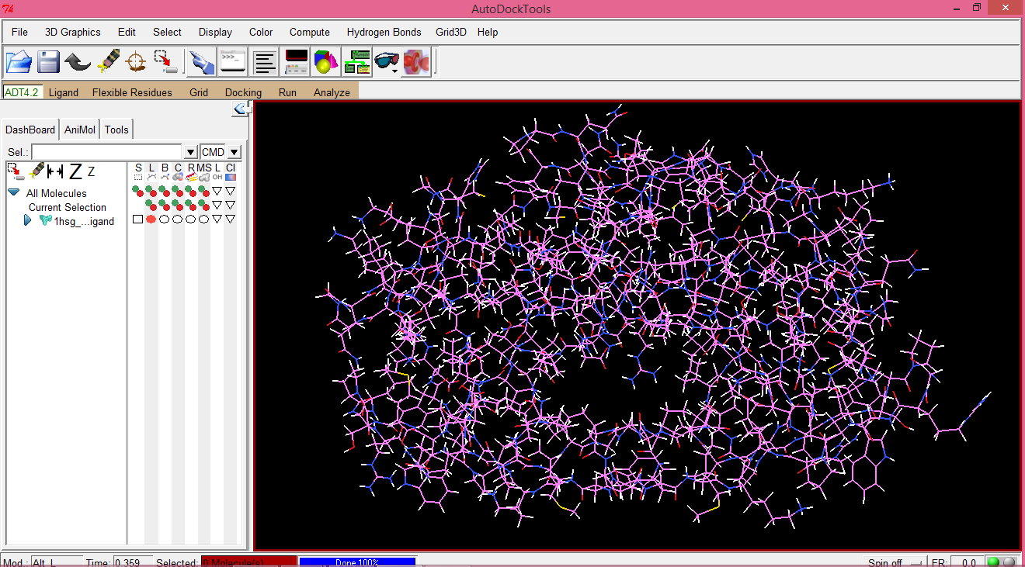
All hydrogens are added.
Receptor Preparation contd...

Slide 28
Edit
Charges
Add Kollman Charges
OK
Follow the instructions:
1.
2.
3.
Edit
Charges
Compute Gasteiger Charges
OK
Receptor Preparation contd...
Edit
Hydrogens
Merge Non-Polar
CONTINUE

Slide 29
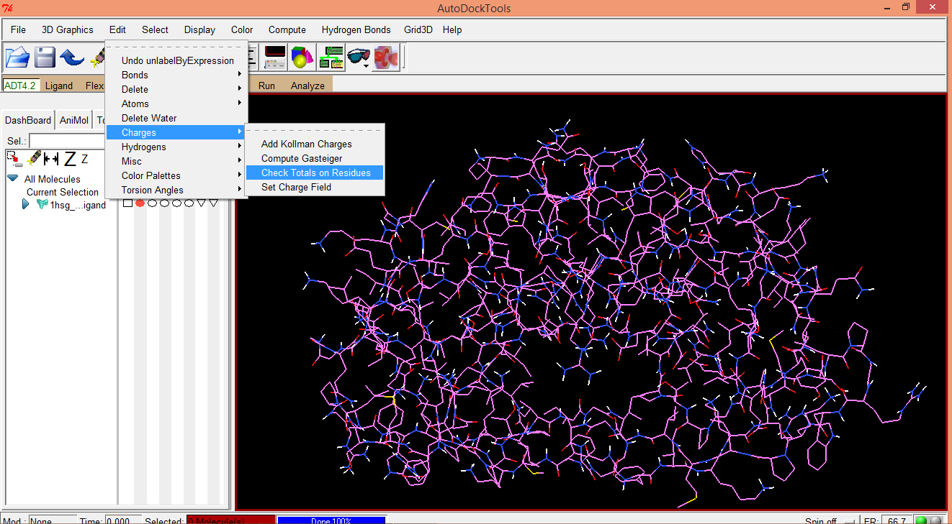
Edit
Charges
Check Totals on Residues
5.
Receptor Preparation contd...

Slide 30
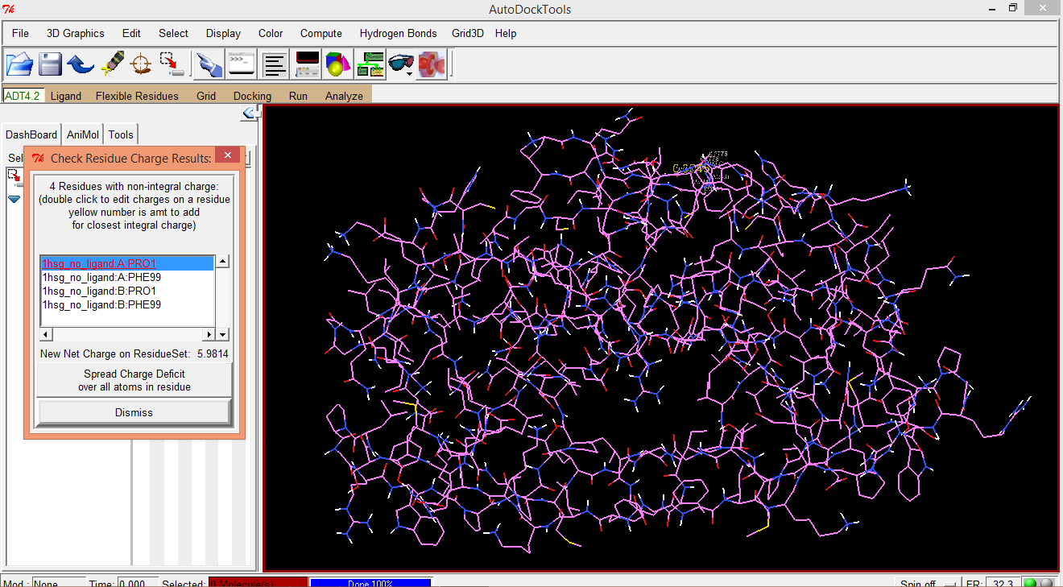
Select one by one all the residues listed in “Check Residue Charge Results:” window and click on “Spread Charge Deficit over all atoms in residue”.
Receptor Preparation contd...

Slide 31

Select one by one all the residues listed in “Check Residue Charge Results:” window and click on “Spread Charge Deficit over all atoms in residue”.
Receptor Preparation contd...

Slide 32

Select one by one all the residues listed in “Check Residue Charge Results:” window and click on “Spread Charge Deficit over all atoms in residue”.
Receptor Preparation contd...

Slide 33
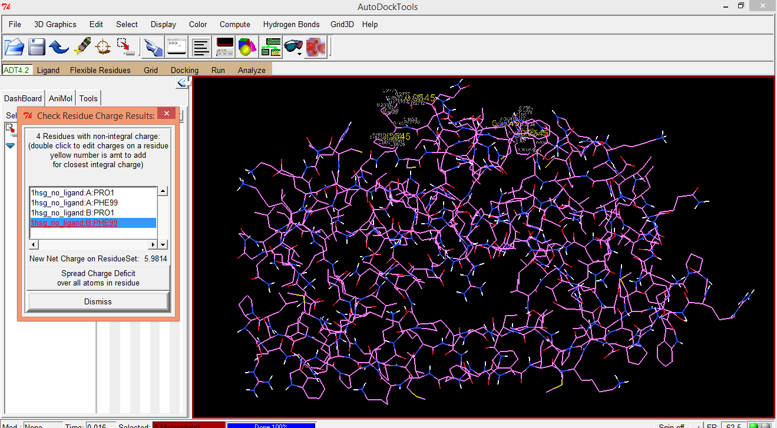
Select one by one all the residues listed in “Check Residue Charge Results:” window and click on “Spread Charge Deficit over all atoms in residue”.
Receptor Preparation contd...

Slide 34
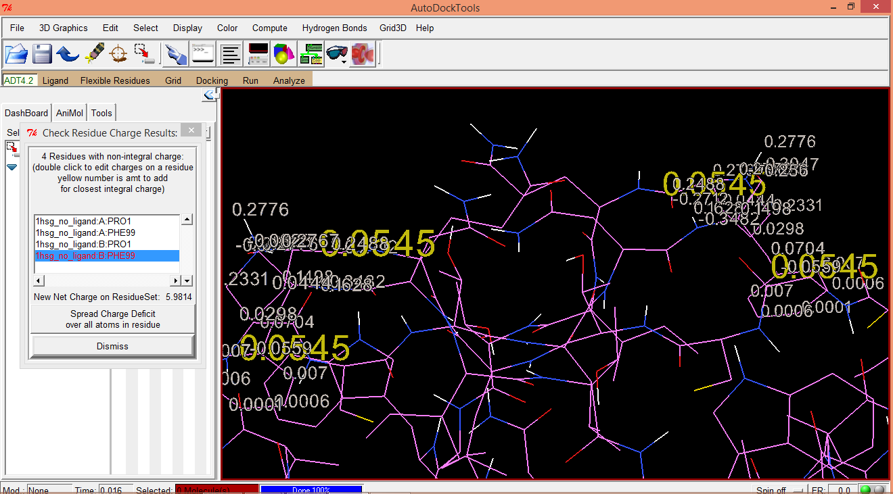
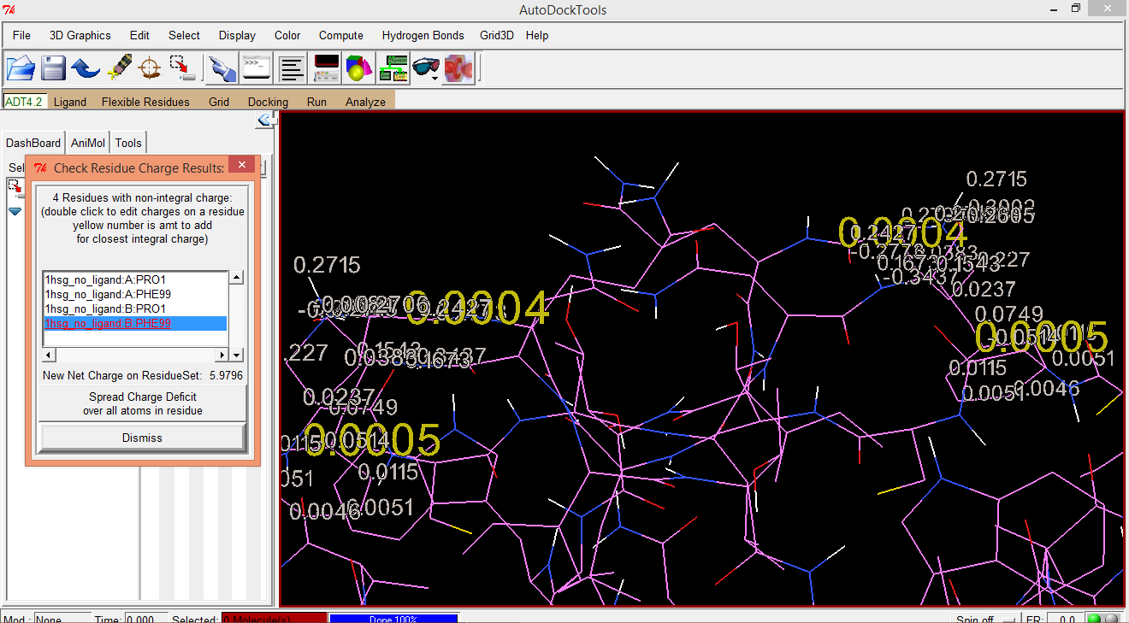
Select one by one all the residues listed in “Check Residue Charge Results:” window and click on “Spread Charge Deficit over all atoms in residue”.
Receptor Preparation contd...

Slide 35
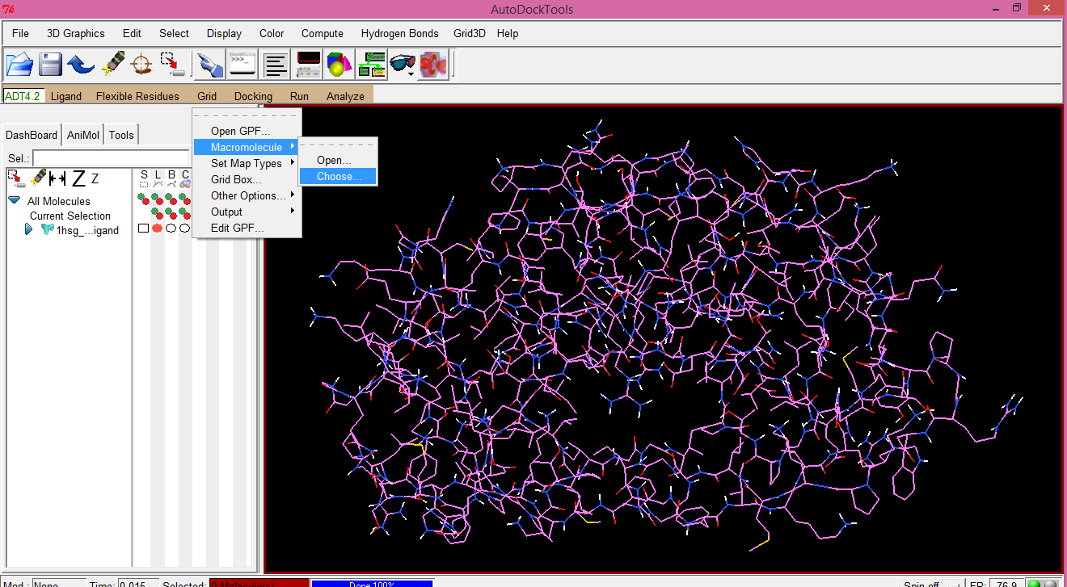
6.
Grid
Macromolecule
Choose...
Save the file.
Receptor Preparation contd...

Slide 36
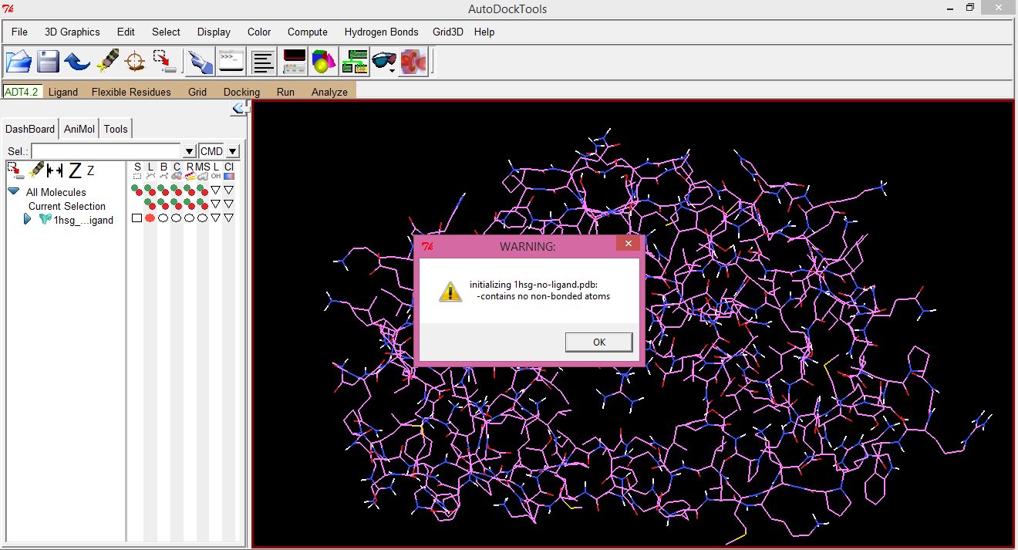
Default warning of no non-bonded atoms in the receptor will appear. Click on “OK”.
Receptor Preparation contd...

Slide 37
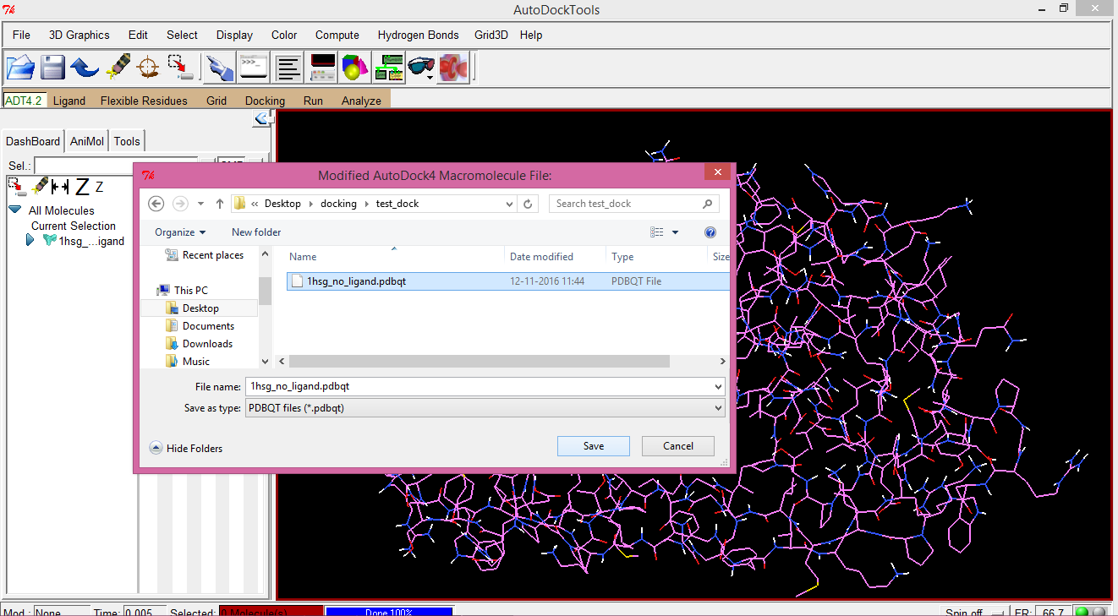
File saving wizard will open and save the file in the working folder.
Receptor Preparation contd...

Slide 38
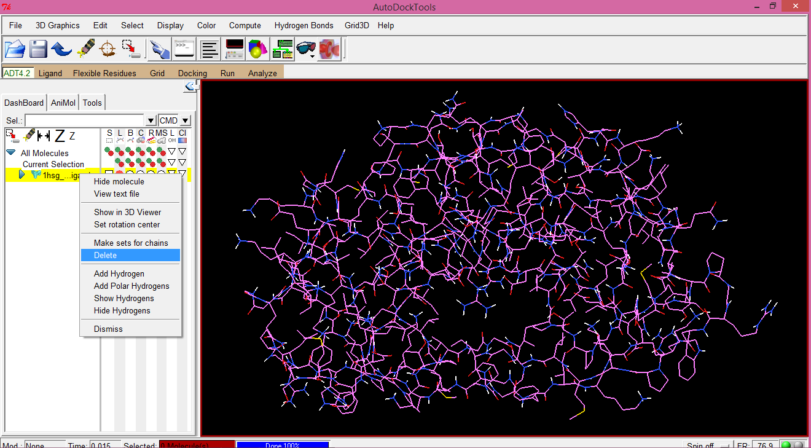
Now, the protein molecule can be deleted from the viewer.
Use right click button of mouse on the name of the protein molecule in the viewer.
Receptor Preparation contd...

Slide 39
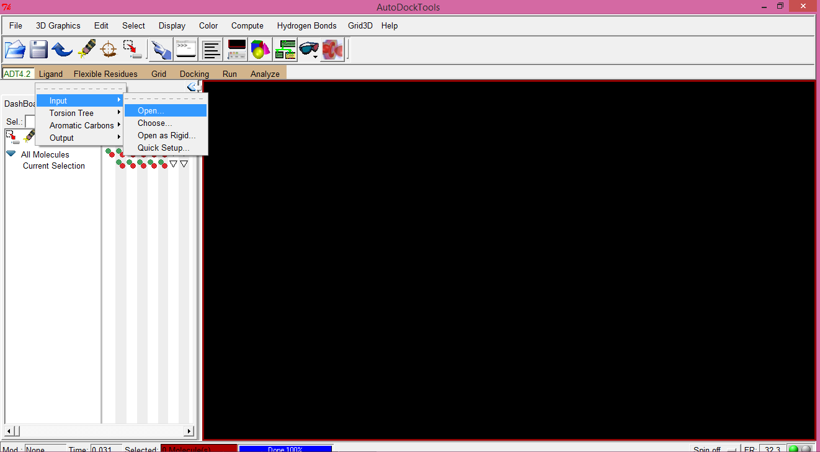
Ligand Preparation
1.
Ligand
Input
Open...

Slide 40
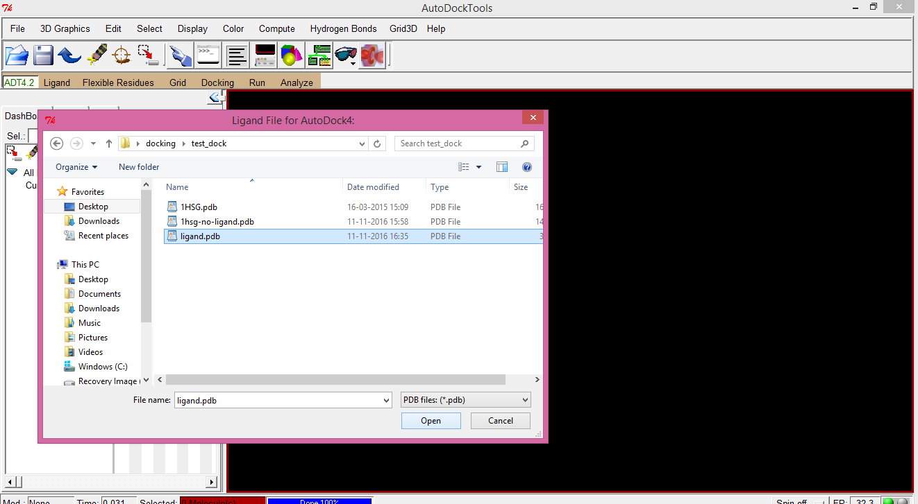
By default, AutoDockTools will look for pdbqt files. Therefore, file types has to be changed to “PDB files: (*.pdb)”.
Ligand Preparation contd...

Slide 41
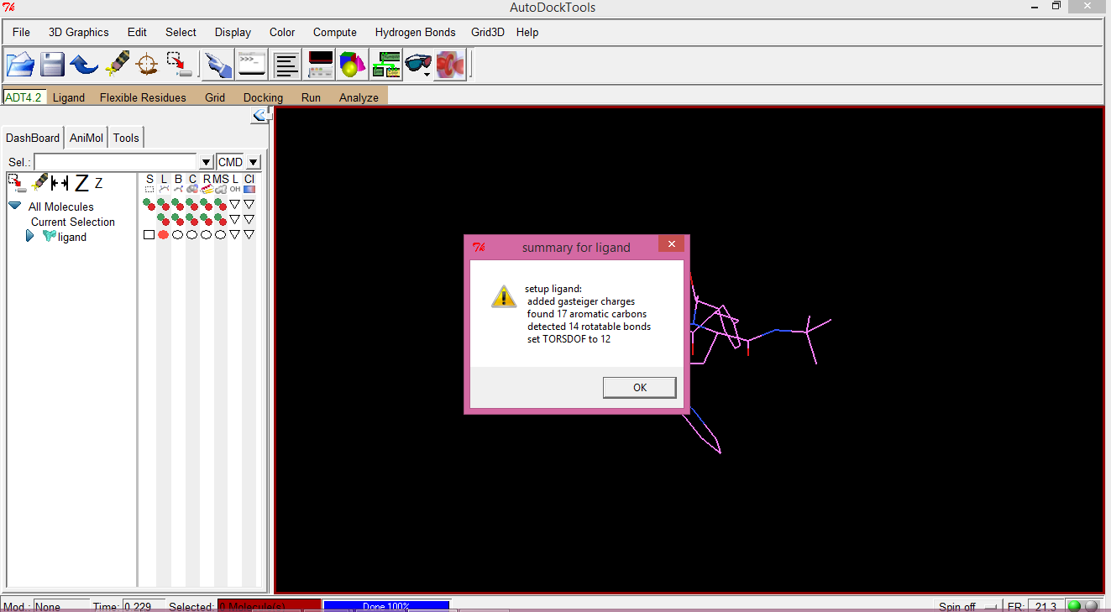
While opening the ligand, a summary about the ligand will appear. Read the summary carefully whether everything is OK.
Ligand Preparation contd...

Slide 42
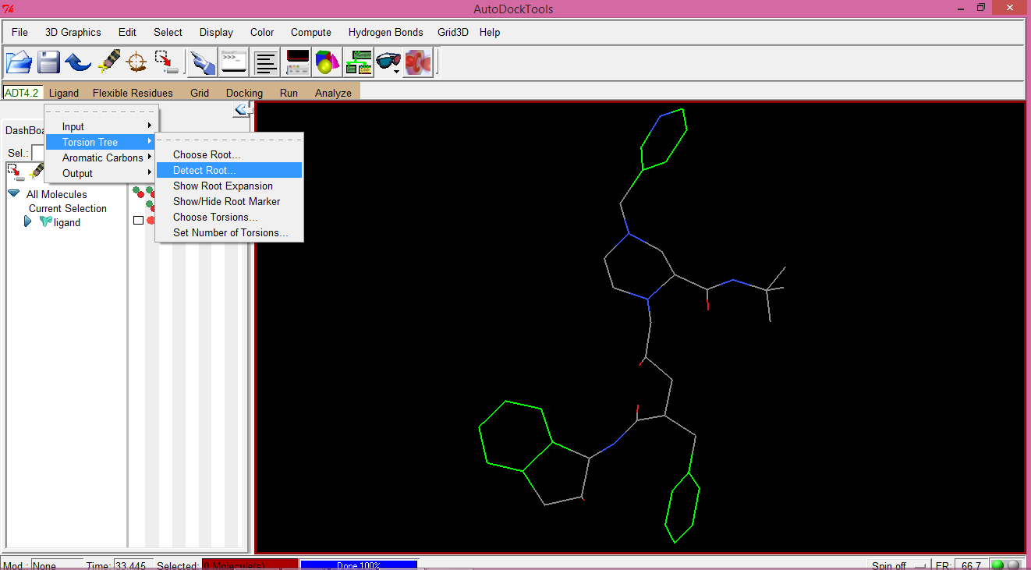
2.
Ligand
Torsion Tree
Detect Root...
Ligand Preparation contd...

Slide 43
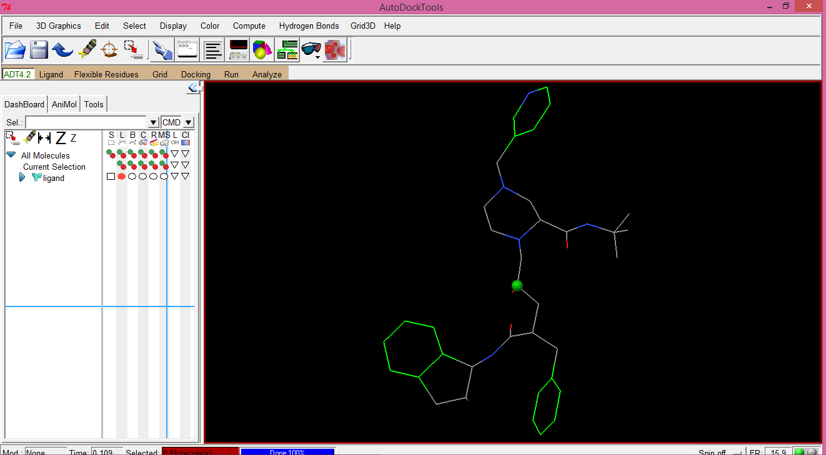
A central point on the ligand will be detected, based on which the ligand will exhibit its movements.
Ligand Preparation contd...

Slide 44
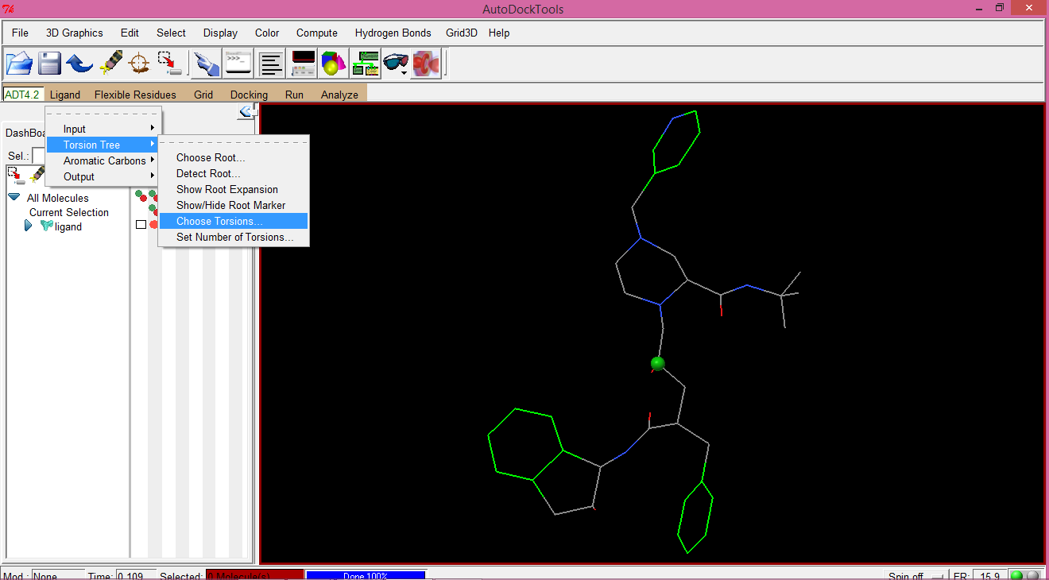
3.
Ligand
Torsion Tree
Choose Torsions...
Ligand Preparation contd...

Slide 45
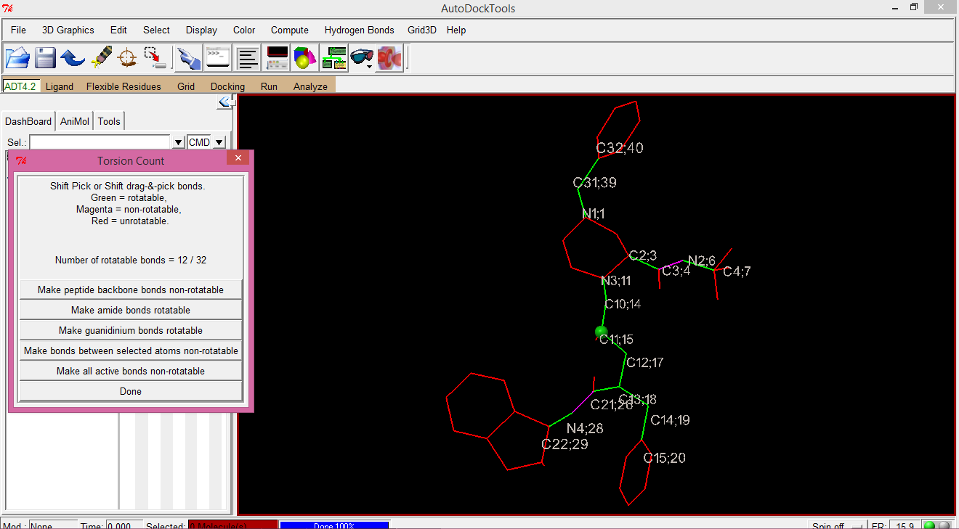
Color legends on the “Torsion Count” window depict that green bonds are rotatable, magenta bonds are non-rotatable and red bonds are unrotatable. However, non-rotatable bonds can be made rotatable by clicking on that bond with shift+ctrl key on keyboard.
Ligand Preparation contd...

Slide 46
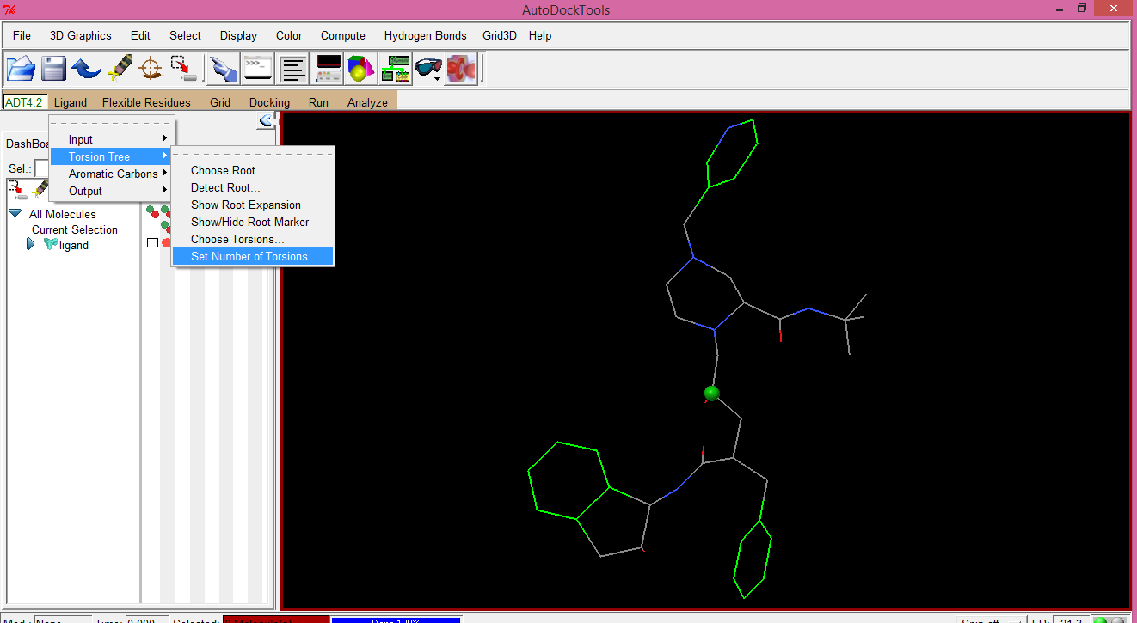
4.
Ligand
Torsion Tree
Set Number of Torsions...
Ligand Preparation contd...

Slide 47
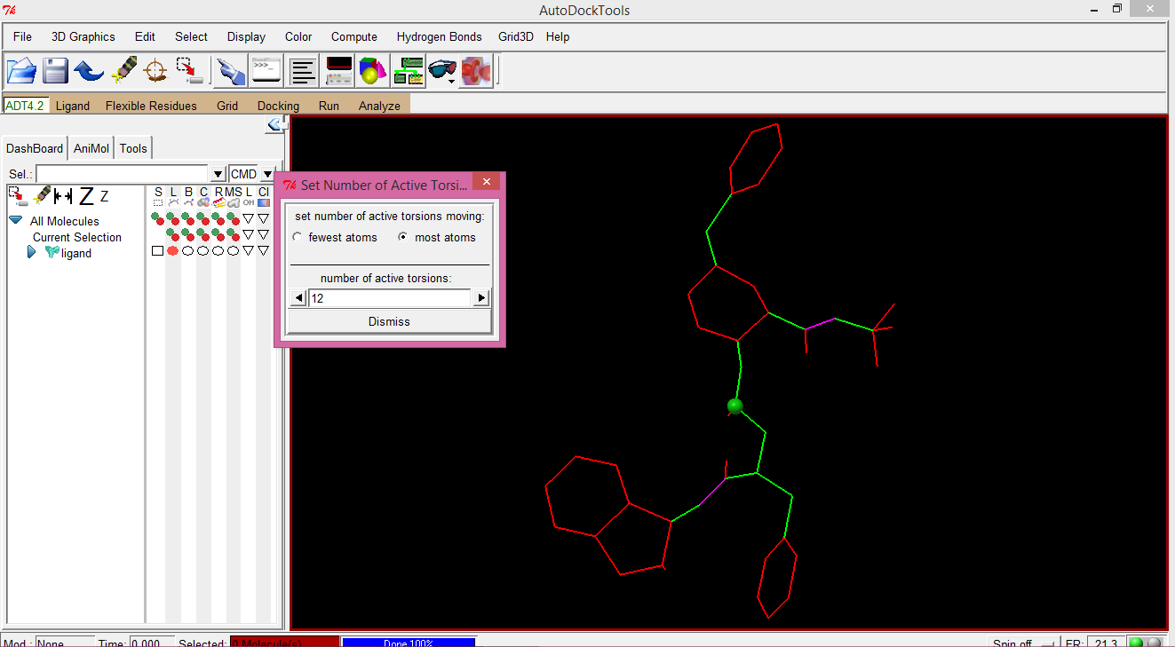
Set number of active torsions to most atoms.
Ligand Preparation contd...

Slide 48
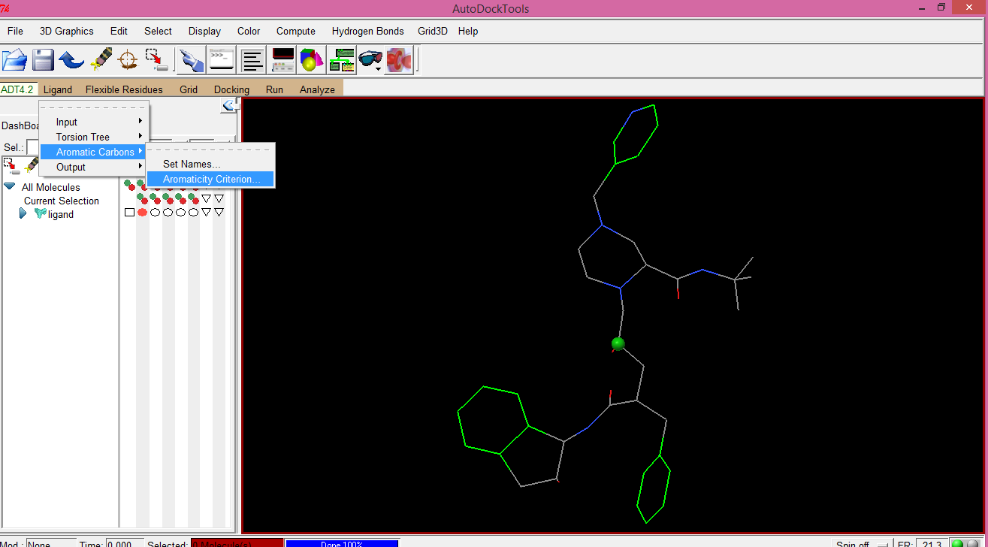
5.
Ligand
Aromatic Carbons
Aromaticity Criterion...
Ligand Preparation contd...

Slide 49
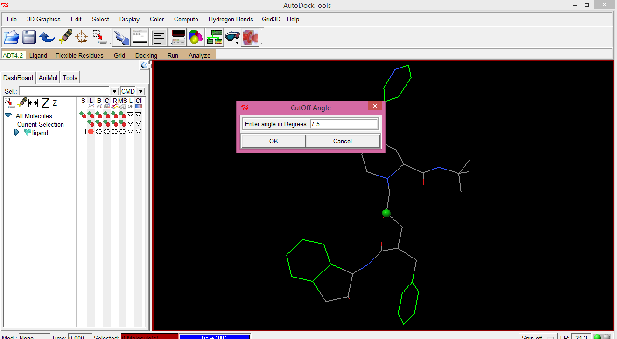
Click on OK as default.
Ligand Preparation contd...

Slide 50
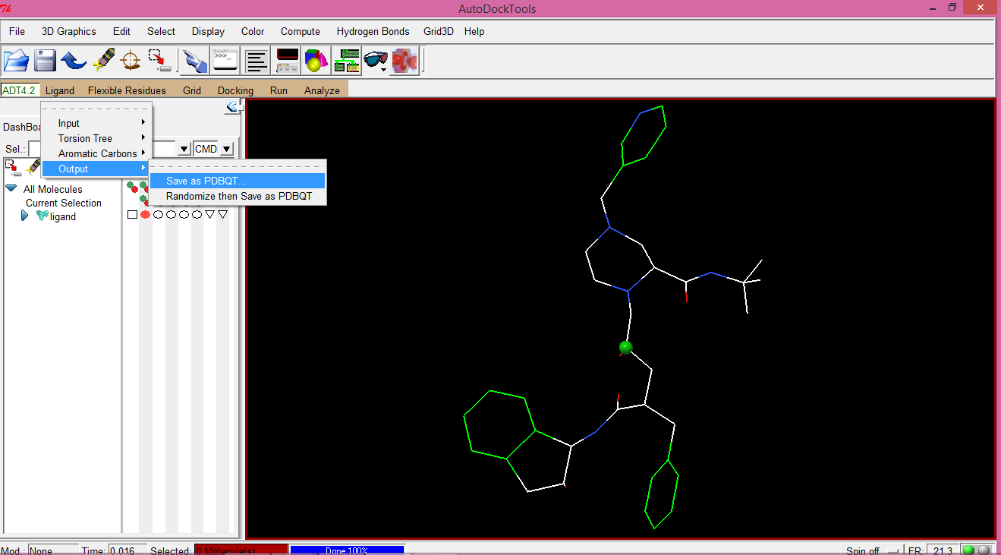
6.
Ligand
Output
Save as PDBQT...
Ligand Preparation contd...

Slide 51
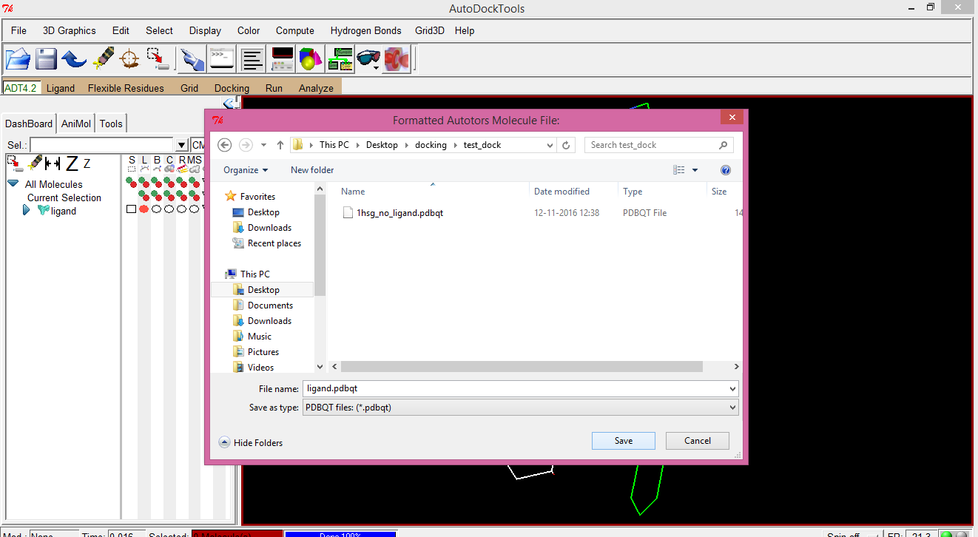
Save the ligand as ligand.pdbqt or as any name but with pdbqt extension.
Ligand Preparation contd...

Slide 52
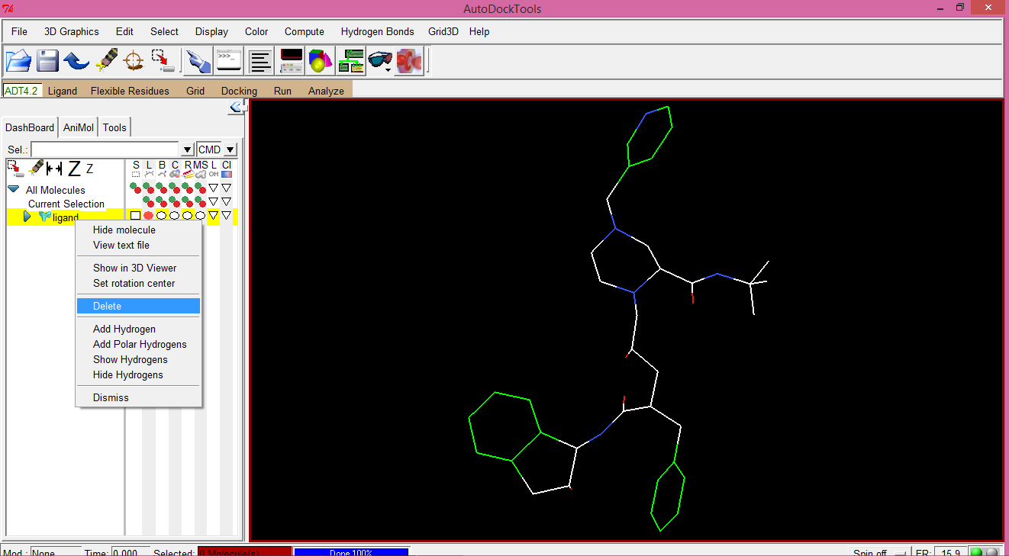
Now, the ligand molecule can be deleted from the viewer.
Use right click button of mouse on the name of the ligand molecule in the viewer.
Ligand Preparation contd...

Slide 53
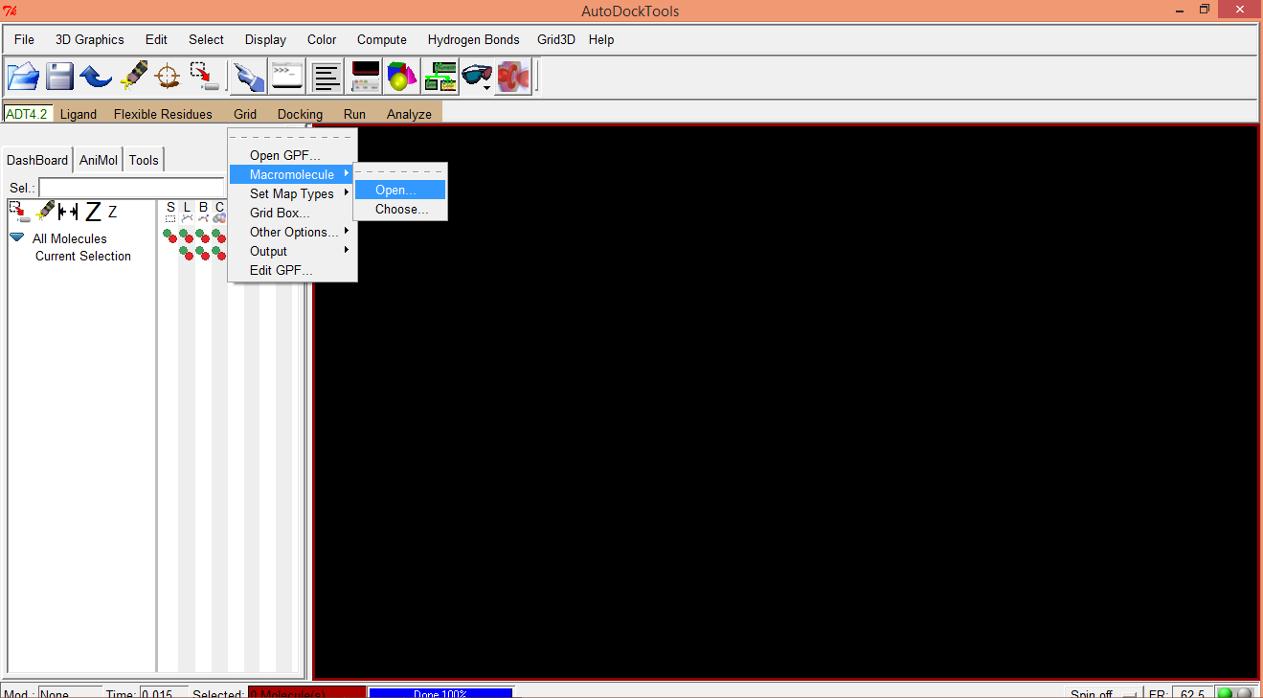
Grid Parameter File Preparation
Re-open ADT and follow the instructions:
Grid
Macromolecule
Open..
1.

Slide 54
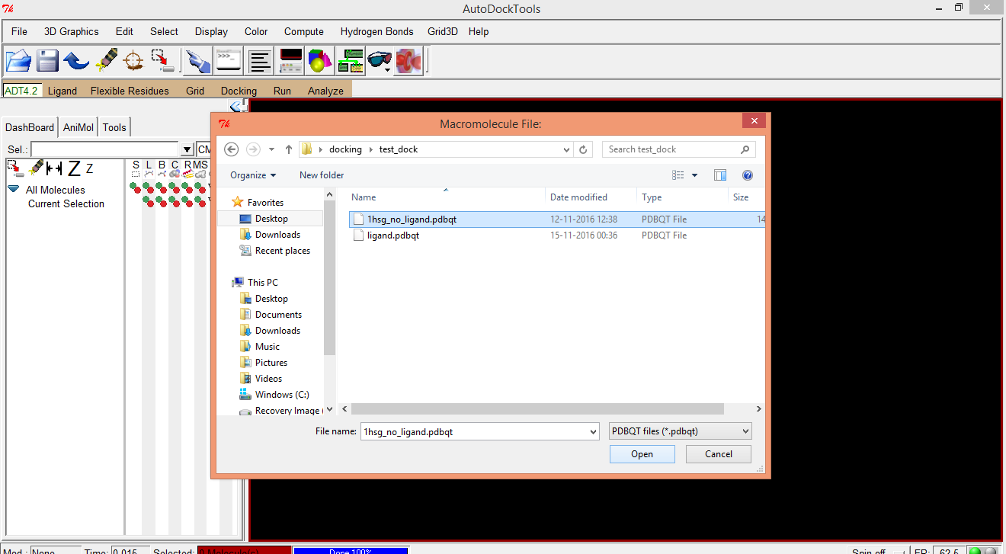
Browse into the working folder and open 1hsg-no-ligand.pdbqt, which was saved in the end of Receptor Preparation steps.
Grid Parameter File Preparation contd...

Slide 55
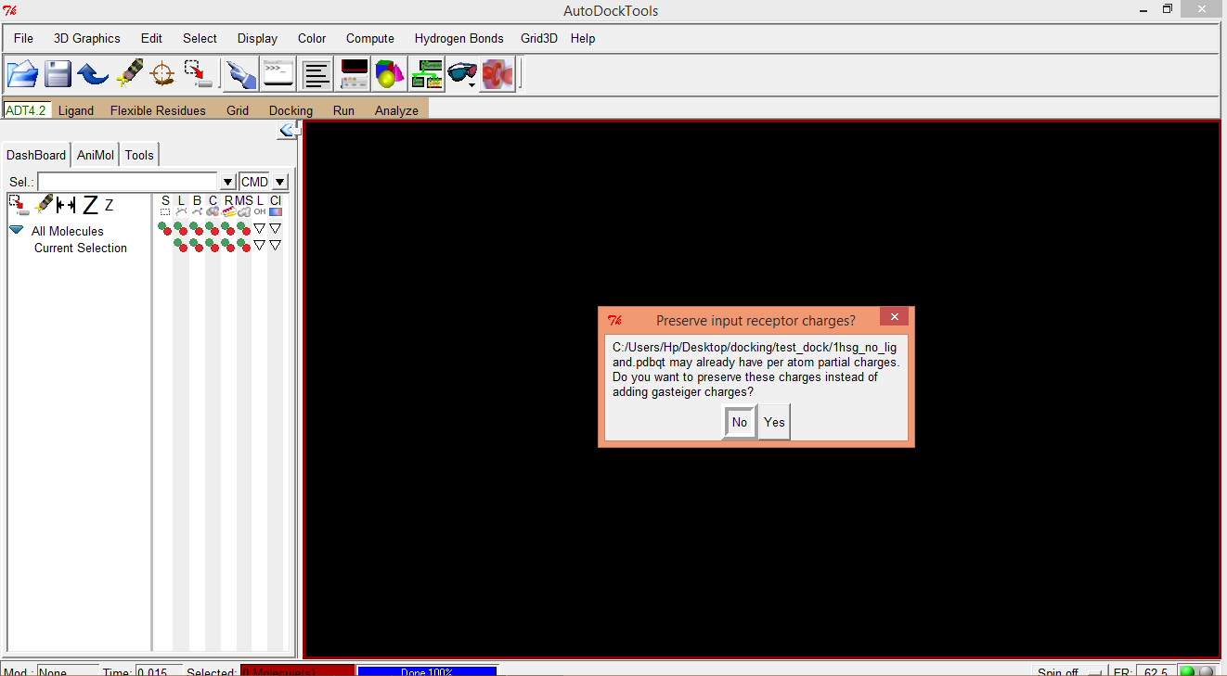
A message will appear to ask to preserve the input receptor charges. Click on “Yes”.
Grid Parameter File Preparation contd...

Slide 56
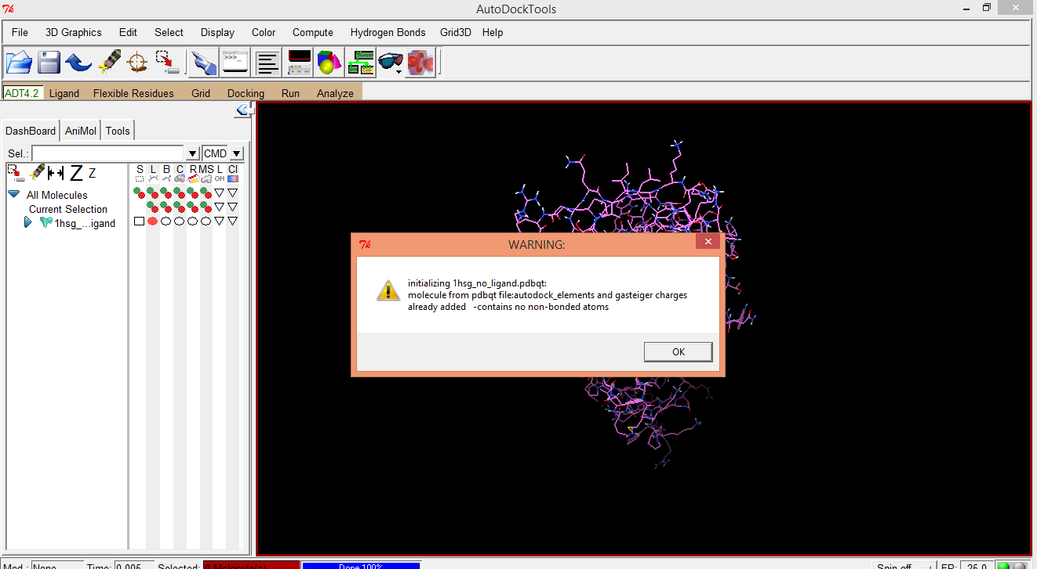
A warning will appear as follows. Click on “OK”.
Grid Parameter File Preparation contd...

Slide 57
Once again repeat the following step of receptor preparation
And select one by one all the residues listed in “Check Residue Charge Results:” window and click on “Spread Charge Deficit over all atoms in residue”
Edit
Charges
Check Totals on Residues
Grid Parameter File Preparation contd...

Slide 58
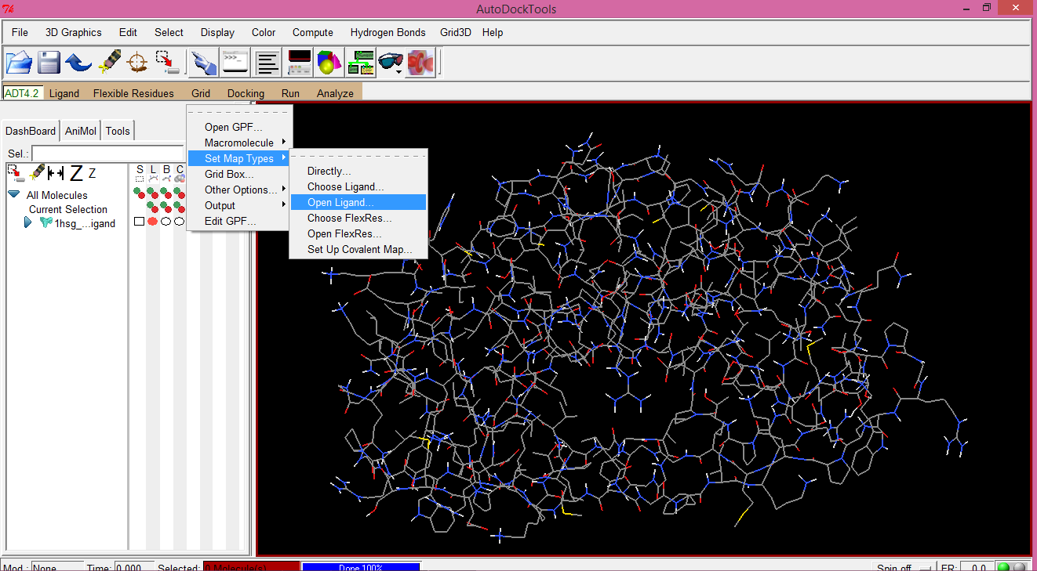
2.
Grid
Set Map Types
Open Ligand..
Grid Parameter File Preparation contd...

Slide 59
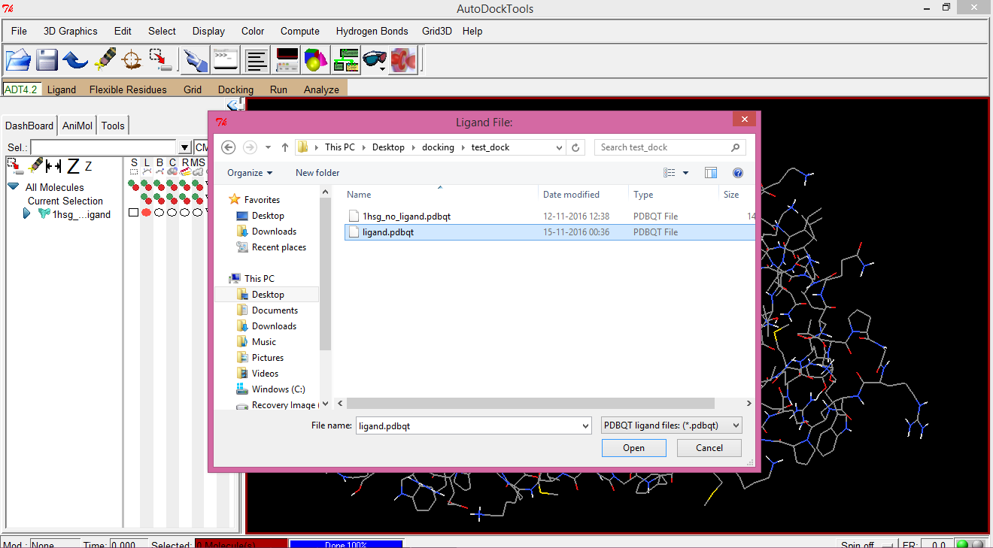
Browse into the working folder and open ligand.pdbqt, which was also saved in one of the previous steps.
Grid Parameter File Preparation contd...

Slide 60

Now both protein and ligand are loaded in the viewer.
Grid Parameter File Preparation contd...

Slide 61

Select
Select From String
In order to proceed further, we need to detect the protein residues that are interacting with the ligand as visualized in Slide 4.
Grid Parameter File Preparation contd...

Slide 62


In the “Select From String” window, type the residue three letter code with their positions. Click on “Add”.
Grid Parameter File Preparation contd...

Slide 63

Display
CPK
Grid Parameter File Preparation contd...

Slide 64

Click on OK on the “Display CPKs ” window with default values.
Grid Parameter File Preparation contd...

Slide 65


Now, the residue of our interest become very much distinct from the rest of the protein molecule.
Grid Parameter File Preparation contd...

Slide 66

Grid Parameter File Preparation contd...

Slide 67

3.
Grid
Grid Box...
Grid Parameter File Preparation contd...

Slide 68

A three dimensional cubic box will appear with “Grid Options” window.
Grid Parameter File Preparation contd...

Slide 69

Resize and reposition the box by using the “Grid Options” window so as to enclose the interacting residues within the box and save the new box by clicking on “Close saving current” on the “Grid Options” window.
Grid Parameter File Preparation contd...

Slide 70

5.
Grid
Output
Save GPF...
Browse into the working folder and save the file as grid.gpf
Grid Parameter File Preparation contd...

Slide 71

Grid Parameter File Preparation contd...

Slide 72

Grid
Edit GPF...
Just to have a look:
Grid Parameter File Preparation contd...

Slide 73

All those .map files are going to be produced when autogrid will run successfully.
It should be always ensured that after the word “receptor” there must be the protein pdbqt file specified.
Grid Parameter File Preparation contd...

Slide 74



Running Autogrid
1. In order to run the autogrid program successfully, one need to find out the installation files of Autodock . They usually located in
as
autodock4
and
autogrid4.
C:\Program Files (x86)\The Scripps Research Institute\Autodock\4.2.6
2. Next, command prompt is required to be opened and navigated in to the working folder where protein and ligand files are kept.

Slide 75

3. “Restore Down” both the windows and then drag the autogrid4 program from its installation path to the command prompt.
&
Type
Running Autogrid contd...
Drag & drop
–p grid.gpf –l grid.glg
Where, grid.glg will be the log file for the autogrid run.
Press Enter on the keyboard.

Slide 76

Upon successful completion of autogrid, active site of the receptor has been mapped for the ligand, as observed that .glg and .map files are produced.
Running Autogrid contd...

Slide 77

Docking Parameter File Preparation
1.
Docking
Macromolecule
Set Rigid Filename...
Following are the un-edited snapshots taken during docking parameter file preparation.

Slide 78


Slide 79


Slide 80


Slide 81


Slide 82


Slide 83


Slide 84


Slide 85


Slide 86


Slide 87


Slide 88


Slide 89

Running Autodock
Drag the autodock4 program from its installation path to the command prompt.
&
Type
Drag & drop
–p docking.dpf –l docking.dlg
Then press Enter on keyboard

Slide 90
ANALYSIS

Slide 91

Analyze
Dockings
Open...
1.
Analysis contd...

Slide 92

Browse into the working folder and select “docking.dlg” file to open.
Analysis contd...

Slide 93

While opening, “WARNING:” box will show the total number of conformations generated during the docking.
Analysis contd...

Slide 94

Analyze
Macromolecule
Open...
2.
Analysis contd...

Slide 95

“WARNING:” box will say that the protein pdbqt is not found in this directory. Click on “OK” to find that file.
Analysis contd...

Slide 96

Browse into the working folder and select “1hsg-no-ligand.pdbqt” file to open.
Analysis contd...

Slide 97

To distinguish the ligand from the protein, change the representation of the ligand to ball and sticks. For this, click on a circle at left hand side of the viewer under the letter “B” against the ligand name.
Analysis contd...

Slide 98

Representation of the ligand will be changed to ball and sticks.
Analysis contd...

Slide 99

Analyze
Conformations
Play, ranked by energy...
3.
Analysis contd...

Slide 100

A small new window with name “ligand” will appear. This window can be used extensively to analyze the ligand conformations.
Analysis contd...

Slide 101

Click on “&” of “ligand” window, which will open another window called as “Set Play Options”.
Analysis contd...

Slide 102

Tick on the check box for “Buid H-bonds” in “Set Play Options” window . Another window for hydrogen bonds information will appear.
Analysis contd...

Slide 103

Tick on the check box for “Show Info” in “Set Play Options” window . Another window displaying the information of the corresponding ligand conformation will appear.
Analysis contd...

Slide 104

Zoom in to observe the hydrogen bonds formed between the atoms of the ligand and nearby amino acid residue of the protein molecule.
Analysis contd...

Slide 105

In order to visualize the ligand, whether it is binding inside the protein cavity or not, change the representation of the protein to MS, i.e., molecular surface.
Analysis contd...

Slide 106

Conformation 1 is the best according to the binding energy and it is seen deep inside the protein cavity.
Similarly, all generated conformations can be analyzed with the help of the windows opened in the viewer.
Analysis contd...

Slide 107

Analysis contd...

Slide 108

Analysis contd...

Slide 109

Analysis contd...

Slide 110

Analysis contd...

Slide 111

Analysis contd...

Slide 112

Analysis contd...

Slide 113

Analysis contd...

Slide 114

Analysis contd...

Slide 115

Analysis contd...

Slide 116

More Analysis
If number of ligand conformations generated are more than 100, clustering analysis has to be performed.

Slide 117

In this case, because we have generated only 10 ligand conformations, Clustering analysis is not so informative. However, number of conformations against the binding energy are plotted and one can easily locate conformation with corresponding binding energies from the cluster shown here.
More Analysis contd...

Slide 118

For the best viewing and learning experience, please play this tutorial in Slide Show mode.
Happy Docking!
With warm regards,
Thank you
Nabajyoti Goswami
Senior Bioinformatics Faculty,
National Institute of Electronics and Information Technology (NIELIT), Guwahati,
Ministry of Electronics and Information Technology (MeitY), Government of India
First Floor, Centre for Brahmaputra Studies, Gauhati University Campus
Jalukbari, Guwahati - 781014, Assam
Website https://www.nielit.gov.in/guwahati || Email nabajyoti.goswami@gmail.com
Phone: +91 93654 46383
GUWAHATI

