Slide 1
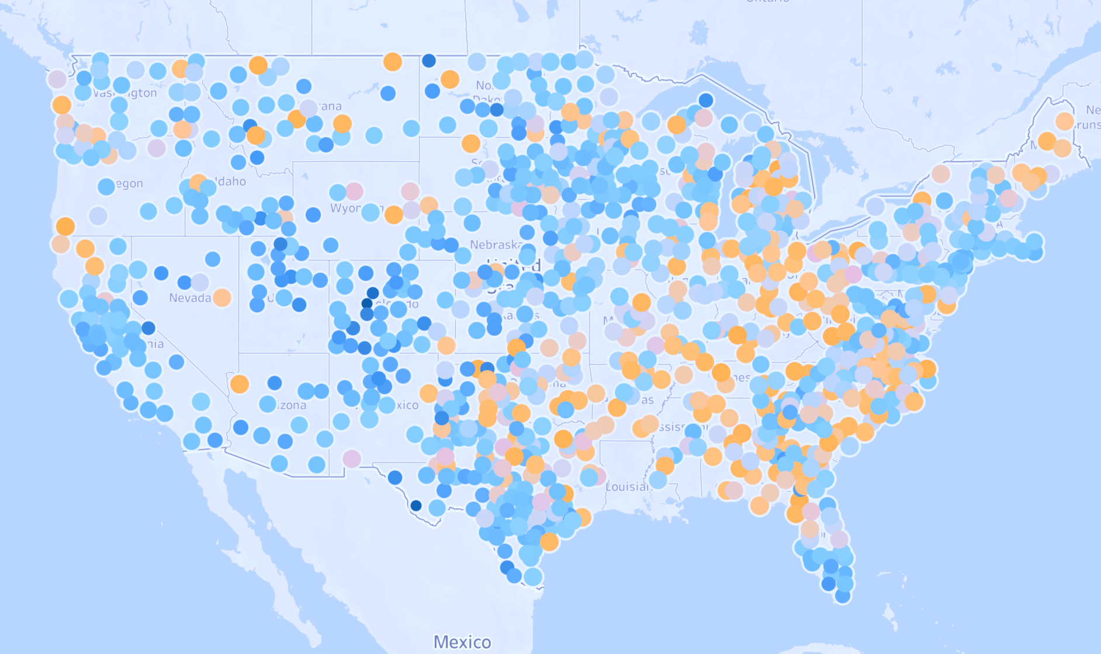
Data analysis on U.S. Cancer Mortality data with multivariate linear regression
Group Members: Elaheh Rajabi, Lulu Xu, Nabanita Gupta, Yi Zhang
11/08/2023

Slide 2
Agenda
Introduction
Data Preparation
Data Analysis
Results - Model Performance
Conclusions and Recommendations

Slide 3
Introduction
Cancer as a leading cause of death globally
Project Objectives:
Develop a multivariate linear regression model
Identify key factors associated with cancer mortality rates
Estimate cancer mortality rates and understand variable interactions
Notes:
Cancer remains one of the leading causes of death worldwide. Understanding the factors that contribute to cancer mortality rates can help in formulating effective public health policies and interventions. Based on the cancer data of U.S. counties, this project aims to address the following main issues:
Building a multivariate linear regression model based on the cancer data.
Identifying the key factors that tightly correlated with cancer mortality rates in US counties.
Understanding the relationships and interactions between different variables in the context of cancer mortality.
Estimating cancer mortality rates based on these factors.
Our research questions and hypotheses include:
Which socio-economic factors have the most significant impact on cancer mortality rates?
How do demographic factors such as race, and marital status influence cancer mortality rates?
Is there a correlation between the availability of health coverage and cancer mortality rates?
Hypothesis: Higher median income and lower poverty rates in a county will be associated with lower cancer mortality rates.
Hypothesis: Counties with higher percentages of residents with health coverage will have lower cancer mortality rates.
How accurate can we predict cancer mortality rate for us counties?
What’s relationship between age and target variable? Is it same for men and women?

Slide 4
Research Questions
Which socio-economic factors have the most significant impact on cancer mortality rates?
How do demographic factors like race, insurance coverage influence cancer mortality rates?
What is the effect of one set of variables on cancer mortality rate after taking into account rest of the variables?
Lower poverty associates with lower cancer mortality rates?
Counties with higher percentages of residents with health coverage will have lower cancer mortality rates?
How accurate can we predict cancer mortality rate for U.S. counties?

Slide 5
Data Source
Dataset: “cancer” with 3047 U.S. county observation
2010-2016
34 variables: 33 independent, 1 dependent (Mean per capita cancer mortalities)
Sources: Data.world, American Community Survey, census.gov, clinicaltrials.gov, cancer.gov
Notes:
The dataset for this project is called “cancer” and it includes 3047 observations and 34 variables. Originally, this “cancer” dataset was aggregated from three sources: American Community Survey, clinicaltrials.gov, and cancer.gov. The data was compiled by Noah Ripper on “data.World” website.
The “cancer” data includes 3047 observations which are 3047 U.S. counties. There are 34 variables in this data, with 33 independent variables and 1 target variable. These variables were related to demographics, socio-economic status, health coverage, and cancer-related clinical trials. The Target variable is “Mean per capita cancer mortalities” which is the mean number of deaths related to cancer per year for every 100,000 population in a county through year 2010-2016.
The 33 Independent variables were divided into 5 categories (detailed variable list in appendix)
Number of cases diagnosed, 4 variables.
Economic factors such as income, unemployment rate, health coverage,10 variables
Population, age, marriage, and other social factors, 9 variables
Education, 6 variables
Ethnicity, 4 variables

Slide 6
Remove repetitive variables
Combine variables
Remove variables we aren’t interesting.
Stepwise reduce variables
Regression subsets
R2,Cp, AIC, PRESS
LASSO
Standardize
Best 9
(2895 X 10)
Raw Data
(3047 X 34)
Order Data
(2895 X 17)
df2
(2895 X 13)
Base model: lm2.data_normal (12 predictors + 1 response)
Category Hypothesis test
Interaction test
Stepwise regression
Best model: lm.best9 (9 predictors + 1 response)
Interaction check
Partial coefficient
Outliner, constant variance, influential points
Prediction
Correlation Check
VIF check
Residual check
Notes:
A snapshot of our analysis

Slide 7
Data Preparation
Overview
Examine data for: missing values, errors, outliers
Feature reduction to mitigate redundant information
Combining columns to reduce multicollinearity
Correlation analysis
Multicollinearity checking with VIF
LASSO regression
L.I.N.E assumptions check
Notes:
We conducted a thorough examination of the dataset to ensure its completeness, addressing issues such as missing values, data errors, and outliers. Given that our dataset originates from various sources, we identified overlapping columns that could lead to multicollinearity.

Slide 8
Feature Reduction & Missing Value Handling
Deletion of categorical and overlapping variables
Merging and recreation of variables to reduce correlation
Handling missing values by eliminating certain features
Final dataset: 2895 observations, 16 independent variables

Slide 9
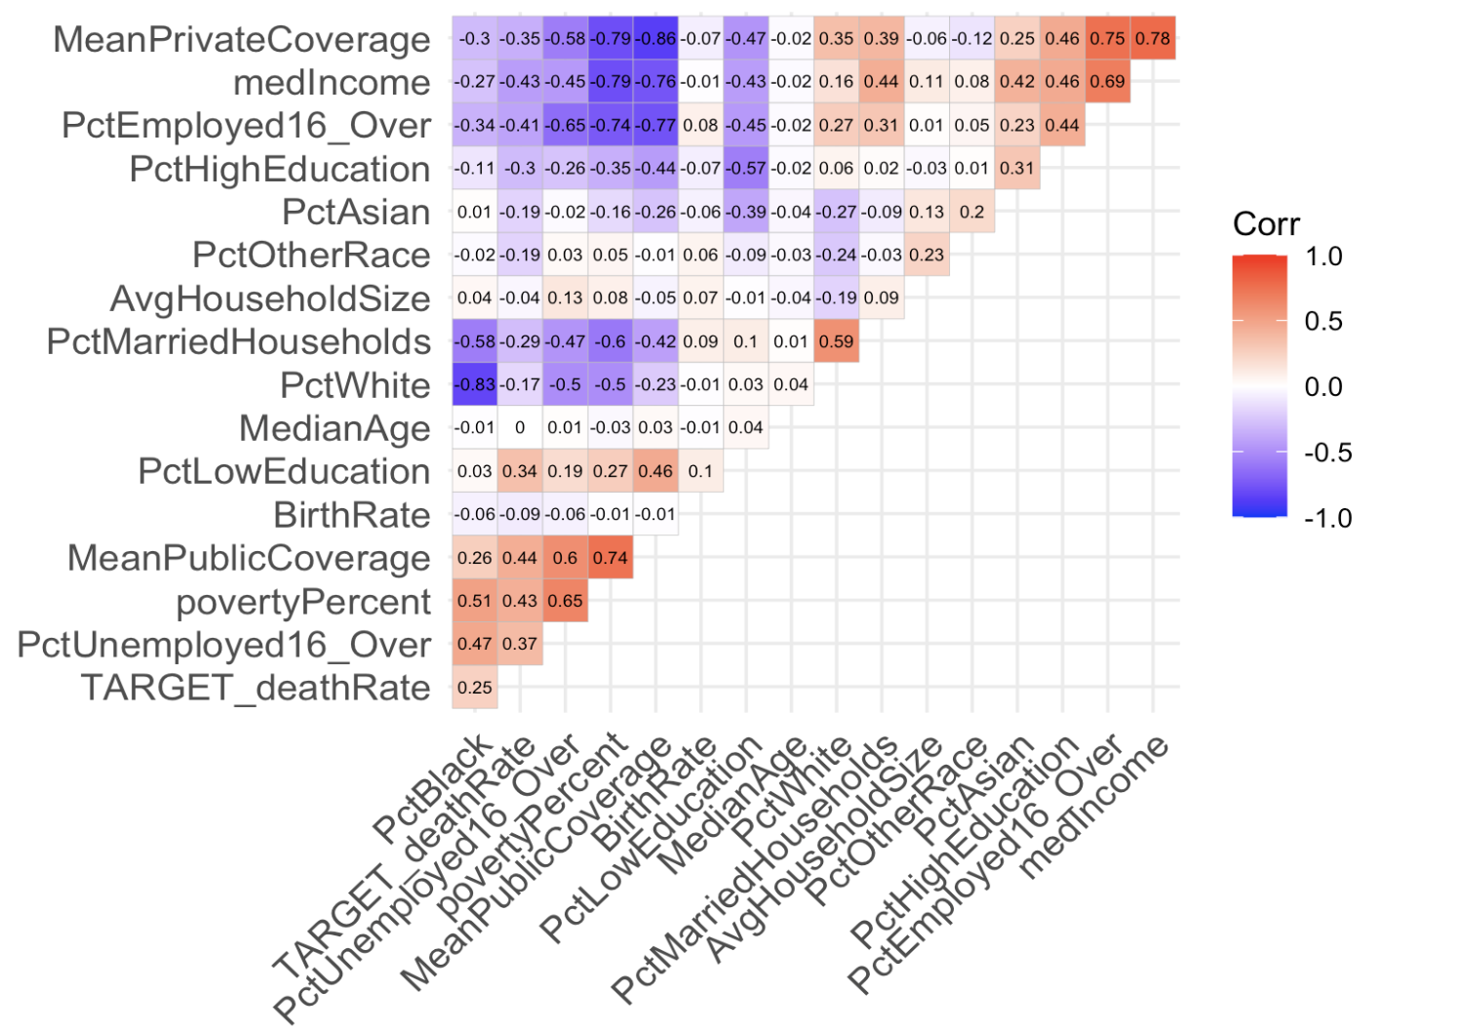
Correlation Analysis
Correlation between the independent variables & the target variable
MeanPublicCoverage | 0.44
povertyPercent | 0.43
medIncome | 0.43
PctEmployed16_Over | 0.41
PctUnemployed16_Over | 0.37
MeanPrivateCoverage | 0.35
PctLowEducation | 0.34
PctHighEducation | 0.3
PctMarriedHouseholds | 0.29
PctBlack | 0.25
PctAsian | 0.19
PctOtherRace | 0.19
PctWhite | 0.17
BirthRate | 0.09
AvgHouseholdSize | 0.04
Notes:
We see lot of multicollinearity for different factors within economic categories and among different races
The highest correlations is around 44% between the target and different predictors
Correlation Analysis:
The correlation matrix and plot highlighted significant association between "Target Death Rate" and variables. The top 5 highest correlations coefficient observed are: PctUnemployed16_Over(0.37), Employed16_Over (-0.41), Poverty Percent (0.43), Median Income (-0.43), Mean Public Coverage (0.44).
Nature of the data implies that we can use this data for inferences rather than prediction
Multicollinearity checking
For the 16 variables, we checked multicollinearity with VIF values and found that all 16 variables have vif value less than 7, the highest one is “PctWhite” with 6.98.

Slide 10
Assess Multicollinearity : VIF
VIF >4, need more observations, VIF>10, strong collinearity issue
Highest one is “PctWhite” with 6.98
Pay attention to these high VIF value variables latter
MedianAge | AvgHouseholdSize | PctWhite | PctBlack | PctAsian
1.012389 | 1.248041 | 6.984307 | 5.152302 | 1.769346
PctOtherRace | PctMarriedHouseholds | BirthRate | PctEmployed16_Over | PctUnemployed16_Over
1.350847 | 2.678539 | 1.091232 | 3.781947 | 2.433859
PctLowEducation | PctHighEducation | medIncome | povertyPercent | MeanPrivateCoverage
1.98773 | 1.656416 | 5.426431 | 6.144861 | 6.424273
MeanPublicCoverage
5.348816

Slide 11
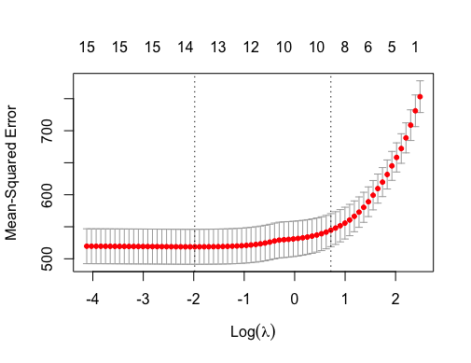
LASSO Regression
Reduce predictor variables from 16 into 12
LASSO coefficient
(Intercept) | 112.78
PctLowEducation | 1.09
PctOtherRace | -1.06
PctUnemployed16_Over | 1.01
BirthRate | -0.89
MeanPublicCoverage | 0.77
povertyPercent | 0.71
MeanPrivateCoverage | 0.66
PctMarriedHouseholds | -0.46
AvgHouseholdSize | 0.31
PctHighEducation | -0.26
PctAsian | -0.12
PctBlack | 0.03
MedianAge | -0.01
PctWhite | 0
PctEmployed16_Over | 0
medIncome | 0
Lambda: 0.1380048
General Linear Test
Res.Df RSS Df Sum of Sq F Pr(>F)
2882 1959.7
2878 1954.8 4 4.9151 1.8091 0.1242
Notes:
LASSO regression made coefficients zero/close to zero for some of the variables with lambda = 0.138
When compared with the full model the p-value as 0.12. FRH0. Hence, we proceeded with only 12 variables in our next step as all 4 of these variables are correlated with other variables. For example, medIncome is related with povertyPercent.

Slide 12
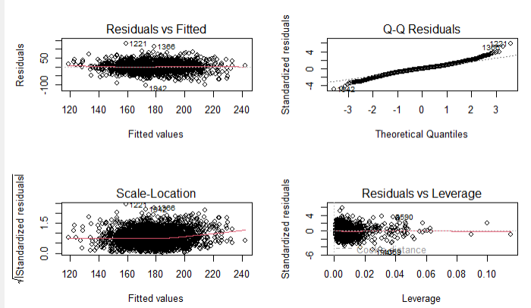
Checking L.I.N.E. Assumptions
Building an elementary multivariate linear regression model
Checking the L.I.N.E statistics assumptions
R squre 0.32, linear relation
Independent error
Normality
Notes:
L.I.N.E assumptions
We built an elementary multivariate linear regression model first, and checked that data satisfaction of the “L.I.N.E” statistics assumptions. There is linear relationship between target and variables(R square is 0.32), errors are independent, normally distributed, and have equal variance.
LASSO Regression
To further reduce the number of predictors, we fit the data with LASSO regression.
Predictions for the "Target Death Rate" were generated using the LASSO model. fine-tuned through cross-validation with an optimal lambda value of 0.114574. Variables such as MedianAge, PctWhite, PctEmployed16_Over, and medIncome have coefficients close to zero, indicating minimal influence on predictions. The model highlighted the significance of variables such as Intercept, AvgHouseholdSize, PctBlack, and others, with coefficients above 0.01. Finally, the LASSO model identified 12 variables as influential for predicting the "Target Death Rate."
Standardization
Since the variables have different scale, we standardized features and then build multivariate regression model based on 12 independent features and 2895 observations. The data size satisfies rule of thumb and the sample size of model is more than 10 times the number of predictors.

Slide 13
Dataset Summary
Variables | Description
PctAsian | Percent of county residents who identify as Asian
PctBlack | Percent of county residents who identify as Black
PctOtherRace | Percent of county residents who identify in a category which is not White, Black, or Asian (b)
PctMarriedHouseholds | Percent of married households
AvgHouseholdSize | Mean household size of county
BirthRate | Number of live births relative to number of women in county
PctHighEducation | Percentage of population with high education (college)
PctLowEducation | Percentage of population with low education
MeanPublicCoverage | Percent of county residents with government-provided health coverage
povertyPercent | Percent of populace in poverty
MeanPrivateCoverage | Percent of county residents with private health coverage
PctUnemployed16_Over | Percent of county residents ages 16 and over unemployed
Response variable
Death rate
Mean per capita (100,000) cancer mortalities
13 numeric Variables
2895 Observations

Slide 14
Data Analysis
Overview
Hypothesis test
Categorical parameters
Interaction terms
Stepwise regression
Regression subsets selection
Model comparison with criterion
Notes:
We conducted a thorough examination of the dataset to ensure its completeness, addressing issues such as missing values, data errors, and outliers. Given that our dataset originates from various sources, we identified overlapping columns that could lead to multicollinearity.

Slide 15
Dataset Summary
Variables | Category
PctAsian | 1. Race
PctBlack
PctOtherRace
PctMarriedHouseholds | 2. Household
AvgHouseholdSize
BirthRate | 3. Birth rate
PctHighEducation | 4. Education
PctLowEducation
MeanPublicCoverage | 5. Economic
povertyPercent
MeanPrivateCoverage
PctUnemployed16_Over

Slide 16
Hypothesis Test: Categorical Parameters
Categories: (1) Race, (2) Household, (3) Birth rate, (4) Education, (5) Economic
Research questions: what the effects of 1 category on cancer mortality rate after taking into account all the other categories?
Null Hypothesis (H₀): The coefficients of predictors in each category are equal to zero.
Alternative Hypothesis (H_{a}): At least one of the coefficients of predictors is NOT zero.
Decision Rule: The decision rule is based on the p-value:
If p-value < α, we reject H₀
If p-value > α, we fail to reject H₀
Conclusion: Significant influence of each category on cancer mortality rates.
Notes:
In this part, we addressed our research questions Hypothesis test by categories. Based on the full model (lm2.data_normal), we categorized 12 predictors into 5 categories: Race (PctBlack, PctAsian, PctOtherRace), Household (AvgHouseholdSize, PctMarriedHouseholds), Birth rate (BirthRate), Education (PctLowEducation, PctHighEducation), and Economic (PctUnemployed16_Over, povertyPercent, MeanPrivateCoverage, MeanPublicCoverage). Instead of comparing variables within each category, each category as a whole was tested if it is significant. We assessed whether all variables in a category had coefficients bi​=0 or if at least one of them was not zero.
For example: Hypothesis Test for Race category in the Model, the Null Hypothesis (H0): The coefficients of PctBlack, PctAsian, and PctOtherRace are equal to zero, which means these variables have no effect on the target variable. Alternative Hypothesis (Ha): The coefficients of the variables are not all equal to zero, which means at least one of these variables influence the target.
Decision Rule: based on the p-value, If p-value < α, we reject H0; If p-value > α, we fail to reject H0.
Conclusion for Race category: The F-statistic is 29.013. The p-value is less than 2.2e-16, which is much smaller than the significance level of 0.05, indicating a highly significant result.
Based on this output, we reject the null hypothesis that the coefficients for "PctBlack", "PctAsian", and "PctOtherRace" are all equal to zero. This means that including these race terms significantly improves the model's predictive ability for "TARGET_deathRate".
After that we did the same hypothesis tests for the other four categories(household, birth rate, education, and economic). They all obtain similar results. The p-value are all less than the significance level of 0.05. We reject the each of null hypothesis that the coefficients for predictors in each category are equal to zero. The addition of category to the model (lm2.data_normal) significantly improves its ability to predict the target death rate. This is evidenced by the substantial decrease in RSS and the highly significant p-value, indicating that these five categories are crucial in modeling the target death rate in this context.The all-category hypothesis has significantly improved its ability to predict the target death rate.

Slide 17
Categorical Parameters: General Linear Test
Res.Df RSS Df Sum of Sq F Pr(>F)
2885 2018.9
2882 1959.7 3 59.186 29.013 < 2.2e-16 ***
RH0. Hence, race( 1.PctBlack , 2.PctAsian , 3.PctOtherRace ) is statistically significant
Res.Df RSS Df Sum of Sq F Pr(>F)
2884 1979.3
2882 1959.7 2 19.54 14.368 6.18e-07 ***
RH0. Hence, household,(1. AvgHouseholdSize, 2. PctMarriedHouseholds ) is statistically significant
Res.Df RSS Df Sum of Sq F Pr(>F)
2883 1972.5
2882 1959.7 1 12.739 18.734 1.554e-05 **
RH0. Hence, Birth( BirthRate ) is statistically significant
Res.Df RSS Df Sum of Sq F Pr(>F)
2884 2091.0
2882 1959.7 2 131.32 96.561 < 2.2e-16 ***
RH0. Hence, education ( 1. PctLowEducation , 2. PctHighEducation )is statistically significant
RH0. Hence, economic parameters (1.PctUnemployed16_Over,2.povertyPercent,3.MeanPrivateCoverage,4. MeanPublicCoverage)is statistically significant
Res.Df RSS Df Sum of Sq F Pr(>F)
2886 2104.8
2882 1959.7 4 145.03 53.32 < 2.2e-16 ***

Slide 18
Stepwise Regression for Best Subsets
Stepwise regression, 10 of 12 variables were identified as significant
The full model is “lm2.data_Normal” (12 variables)
Stepwise (Both forward and backward direction)
Select predictors based on AIC (10 variables): minimal AIC: -1107.08
Regression Subset selection, 9 variable optimal also.
dropped 3 variables (avg household size, %black,% asian), BIC minimal
Remaining 9 variables: %OtherRace, %Married Households, BirthRate, %Unemployed16_Over, % Low education, %poverty, Private Coverage, PublicCoverage
Notes:
Here stepwise regression was applied to choose best model. The full model is “lm2.data_Normal” which has 12 variables chosen by LASSO. Both forward and backward direction were tested and they both show same results. With 10 variables included, model AIC value reached smallest -1107.08. 2 variabels(PctBlack and – AvgHouseholdSize) were reduced.
Also, regression subsets selection procedure was applied to compare with stepwise regression results. It shows that for subsets size of 10 variables, same like step wise results, avghouseholdsize, pctblack.variables can be deleted.

Slide 19
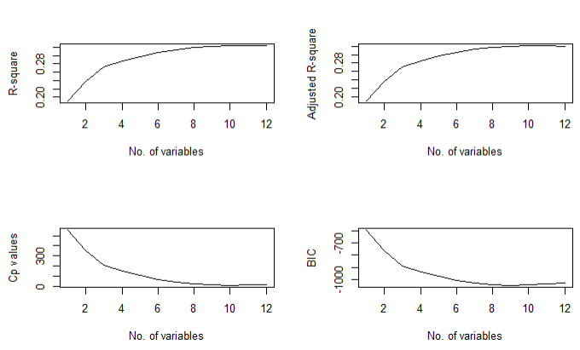
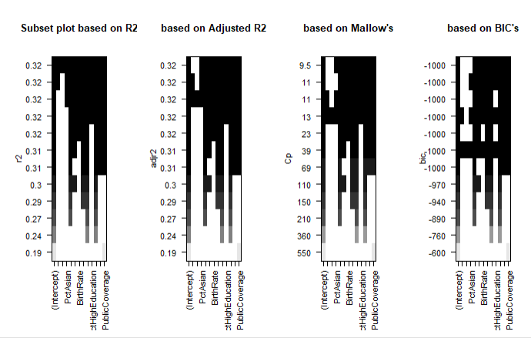
Model Analysis Criterion
Optimal model with 9-variables based on
R²: full model
adjusted R², 10 varables
Cp, 10 variables
BIC,9 variables.
Notes:
Based on regression results, compared different criteria such as R2,Cp, AIC, PRESS and decided the best model.
It shows that: r square reach maximum with 12 variables; adjust r square, reach maximum at 10 variables; Cp reaches minimum at 10 variables; BIC reaches minimum at 9 variable. Overall, from the previous results, the model has the best results by 9 variables included. (exclude PctBlack)
Thus, we built new full model with these 9 variables and the Summary of the model expressed that R square value of 0.3219,and adjusted R squared value of 0.3198. the intercept estimated is not significant at all( with t value of 0 and p-value =1), so the intercept term b0 of model could be 0. Other than that, all the 9 variables are significant and their p value is less than 0.001, The overall F statistics is 152 and p-value is also significant.
ANOVA table of this model shows the SSR of each single variable. It can be tell that “meanPublicCoverage”,”PctOtherRace”,”povertyPercent”, “PctLowEducation” are 4 variables which explained most sum of squared regression amount among 9 variables.

Slide 20
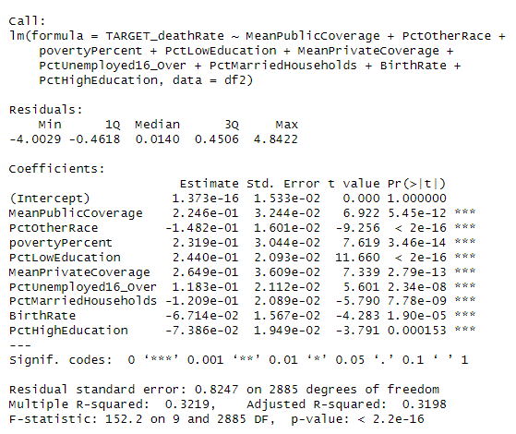
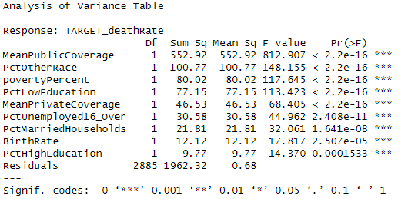






Best Model: What are the top5 variables which contributed most?

Slide 21


Best Model: What is the confidence interval for coefficients? Is b0 = 0?
2.5 % 97.5 %
(Intercept) -0.03005513 0.03005513
MeanPublicCoverage 0.16095362 0.28816974
PctOtherRace -0.17961594 -0.11682071
povertyPercent 0.17223123 0.29161093
PctLowEducation 0.20298554 0.28505496
MeanPrivateCoverage 0.19408660 0.33561731
PctUnemployed16_Over 0.07687634 0.15970112
PctMarriedHouseholds -0.16189988 -0.07998945
BirthRate -0.09787510 -0.03640467
PctHighEducation -0.11207096 -0.03565752

Slide 22
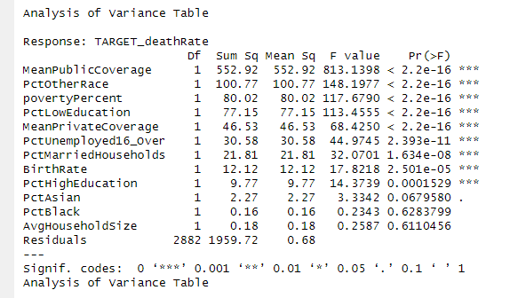


Best Model Analysis: Can we drop these 3 variables from 12 variables?
Individual P value not significant
High p-value for the general linear F-test. FRH0
Conclude: 3 variables ("PctAsian, PctBlack, AvgHouseholdSize) can be dropped

Slide 23
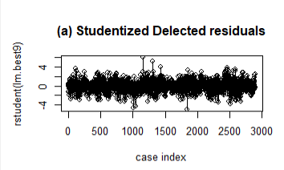
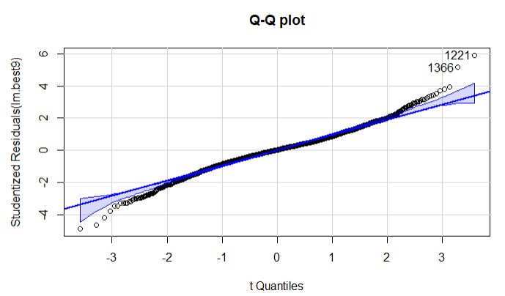
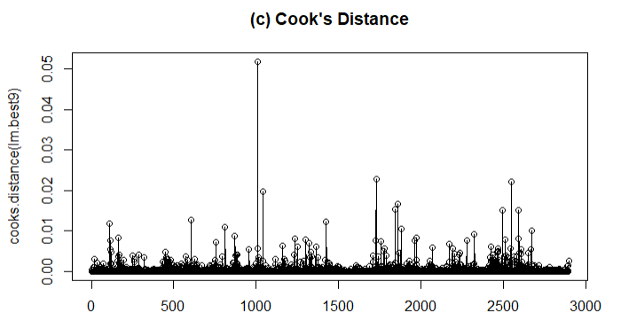
Outliers and Influential Points
Identification of outliers using studentized residuals.
Cook's distance used to evaluate influence: Highest cook's distance- 0.0518 with <0.2 percentile, thus not influential.
Notes:
Here stepwise regression was applied to choose best model. The full model is “lm2.data_Normal” which has 12 variables chosen by LASSO. Both forward and backward direction were tested and they both show same results. With 10 variables included, model AIC value reached smallest -1107.08. 2 variabels(PctBlack and – AvgHouseholdSize) were reduced.
Also, regression subsets selection procedure was applied to compare with stepwise regression results. It shows that for subsets size of 10 variables, same like step wise results, avghouseholdsize, pctblack.variables can be deleted.

Slide 24
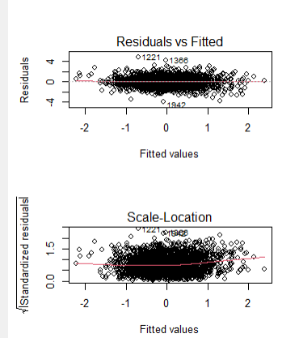
Constant Variance Check
BF test: pvalue is significant, p-value =0.002.
sign of non constant variance.
ncvTest: suggest power transformation 0.89
Power transform

Slide 25
Hypothesis Testing for Interaction Terms
Research questions: Does the relationship between feature1 and response also depends on the level of other predictors?
Null Hypothesis (H₀): The coefficients of interaction terms are all equal to zero.
Alternative Hypothesis (H_{a}): At least one of the coefficients of interaction terms is NOT equal to zero.
Decision Rule: The decision rule is based on the p-value:
If p-value < α, we reject H₀
If p-value > α, we fail to reject H₀
Conclusion: Adding some interaction terms can improve the model slightly, but will lead to Overfitting, even after simplified the model with interaction terms.
Notes:
To test the interaction terms are significant or not, model with all the possible interaction terms was build. Null Hypothesis (H0): The coefficients of interaction terms are equal to zero, which means these variables have no effect on the TARGET_deathRate. Alternative Hypothesis (Ha): The coefficients of the variables are not all equal to zero, which means at least one term will effect on target.
Decision Rule: based on the p-value: If p-value < α, we reject H0.If p-value > α, we fail to reject H0.
Conclusion: Overall Model Significance: Based on the R output, the overall F-statistic (26.26) and its associated p-value (< 2.2e-16) indicate that the model with all the predictors and their interaction terms is statistically significant when compared to a model without these predictors.
Even though interaction terms have improved the model, not all of them might be necessary. we can use stepwise regression to simplify the model, retaining only the terms that contribute significantly to the model. This helps to prevent overfitting.The predictors of simplified_model was selected using stepwise, based on CIA-value.Based on the R output provided, there are 46 predictors in the simplified_model, including 12 original predictors and 34 interaction terms. This is still a large number of predictors for a regression model, which could potentially lead to an overfitting problem.

Slide 26
Question: Interaction Term Significant?
4 individually tested interaction terms:
'MeanPrivateCoverage’ : 'PctUnemployed16_Over’
'MeanPublicCoverage’:'PctLowEducation’
'PctUnemployed16_Over:'PctMarriedHouseholds’
'BirthRate’ : 'PctHighEducation’.
Hypothesis test:
Null Hypothesis (H0): The coefficients of interaction terms are equal to zero.
Alternative Hypothesis (Ha): At least one of the coefficients of interaction terms is NOT equal to zero.
Decision Rule: The decision rule is based on the p-value:
Notes:
We observed 4 intercation terms based on best model: between 'MeanPublicCoverage' and 'PctLowEducation'; 'MeanPrivateCoverage' and 'PctUnemployed16_Over'; between 'PctUnemployed16_Over' and 'PctMarriedHouseholds', between 'BirthRate' and 'PctHighEducation'.

Slide 27
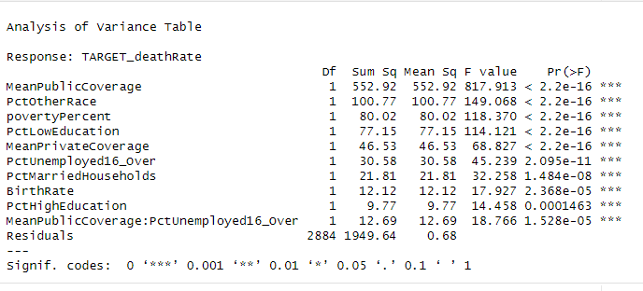
Question: Interaction Term Significant?
Significant interaction term: PctUnemployed16_Over * MeanPublicCoverage
General Linear Test
Res.Df RSS Df Sum of Sq F Pr(>F)
2884 1949.6
1962.3 -1 -12.686 18.766 1.528e-05 ***
Reject null hypothesis

Slide 28
Question: Interaction Term Significant?
21 interaction terms out of 36 possible interaction are significantly associated
Interaction_Term | P_Value
AvgHouseholdSize:PctBlack | 0.00465 (**)
AvgHouseholdSize:PctUnemployed16_Over | 0.01584 (*)
AvgHouseholdSize:povertyPercent | 4.12e-05 (***)
AvgHouseholdSize:MeanPrivateCoverage | 0.01890 (*)
PctBlack:PctAsian | 1.98e-05 (***)
PctBlack:PctLowEducation | 3.89e-09 (***)
PctBlack:PctHighEducation | 0.00700 (**)
PctBlack:povertyPercent | 1.05e-05 (***)
PctBlack:MeanPrivateCoverage | 0.00589 (**)
PctAsian:PctMarriedHouseholds | 0.03123 (*)
povertyPercent:MeanPublicCoverage | 6.01e-05 (***)
PctAsian:PctUnemployed16_Over | 0.00190 (**)
PctAsian:MeanPublicCoverage | 0.00619 (**)
PctOtherRace:PctUnemployed16_Over | 0.01028 (*)
BirthRate:PctMarriedHouseholds | 3.38e-05 (***)
BirthRate:povertyPercent | 4.37e-05 (***)
BirthRate:MeanPrivateCoverage | 4.02e-05 (***)
BirthRate:MeanPublicCoverage | 0.00506 (**)
PctMarriedHouseholds:PctLowEducation | 0.00206 (**)
PctUnemployed16_Over:PctLowEducation | 0.01450 (*)
povertyPercent:MeanPrivateCoverage | 0.00334 (***)

Slide 29
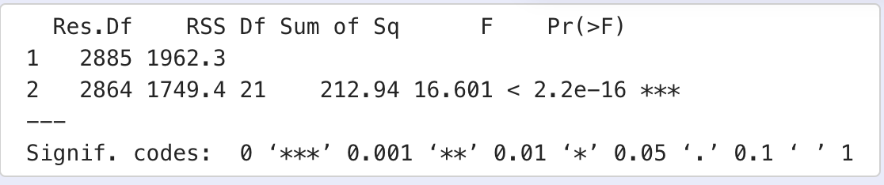
Question: Interaction Term required?
ANOVA Table
Full Model: model with interaction terms
Reduced Model: without interaction terms
The p-value < 2.2e-16 indicates that Model 2 significantly improves over Model 1

Slide 30
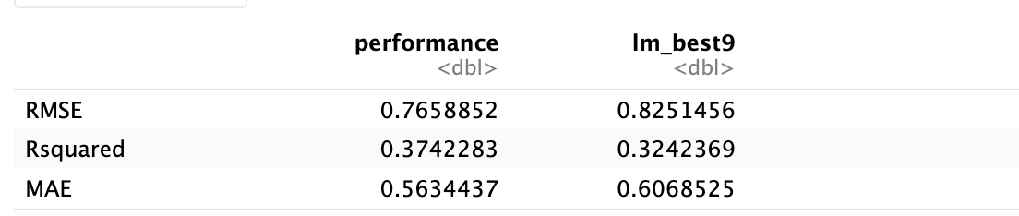
Prediction Performance
training (70%) and testing (30%) sets
High RMSE indicates challenges in prediction.
Predictive power of the model considered insufficient.
with interactions without interactions
Notes:
The main purpose of this project is to inference from regression model, we also did prediction with the model. We trained best model on training data ,and use it to predict test death rate.The results shows very high RMSE rate which is 0.797. It may indicate that for prediction purpose, building regression model on this data set is not desirable.

Slide 31
Conclusions and Future Work
Answered research questions
Addressed hypotheses
Challenges: Complex data through several fields, high dimension , prediction error
Improvements: Dimensionality reduction, alternative models (SVM, RandomForest)
Notes:
Conclusion
Answer the question in the introduction:
…..
Comment on difficulties:
Very complicated real life data, hard to fit with appropriate regression model.
Too many features, relationship hard to analysis.
Very high prediction error.
Possible improvement:
Dimension reduction method may needed :PCA
For prediction, may need other machine learning method:SVM or RandomForest for regression .

Slide 32
Thank you !

Slide 33
Final 9 variables
Variables | Category
PctOtherRace | 1. Race
PctMarriedHouseholds | 2. Household
BirthRate | 3. Birth rate
PctHighEducation | 4. Education
PctLowEducation
MeanPublicCoverage | 5. Economic
povertyPercent
MeanPrivateCoverage
PctUnemployed16_Over

Slide 34
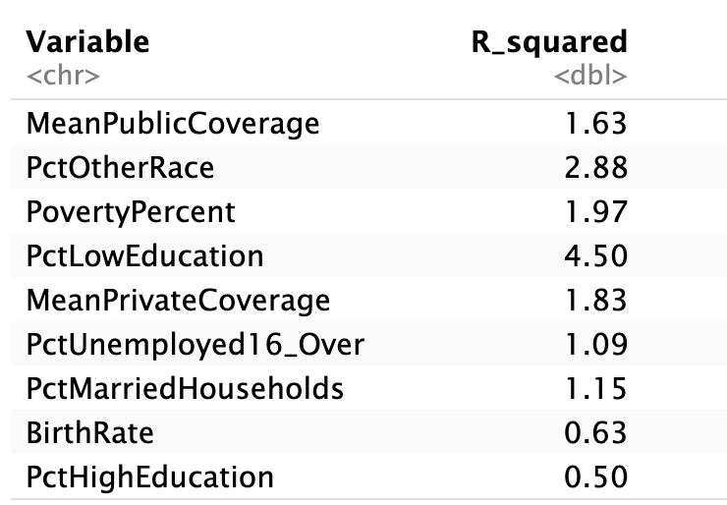
Question Which predictor has the highest individual contribution to explaining the variance in the dependent variable, considering other predictors? adding Pct of Low Education to the model, while other predictors already in the model , reduced SSE by 4.50%.

