Slide 1
Mooc (Massive Open Online Course)
Ali Hassan
FA16-BSE-001
Raja Muhammad Saad
FA16-BSE-029
Nabba Asif
FA16-BSE-027
Supervisor:
Mr. Rizwan Rashid

Slide 2
PROJECT DOMAIN
Web Application
Image Processing
RESEARCH BASED PROJECT?
NO, Not a research based project

Slide 3
INTRODUCTION
Not just a learning management system
MOOC includes:
-- Learning management system
-- Portal
-- Student-teacher communication (audio calls, conference video calls, direct messaging and classroom chat)
-- Online rooms
-- Auto Zoom Feature
-- E-learning analytics
Key Goals
Provide users with:
All-in-one platform
Two perspective e-learning
Increased ways of student-teacher interaction
Proper way of conducting assignments and quizzes
Auto zoom feature for making lecture understandability easier during live broadcast

Slide 4
Problem Statement
Most of these web applications do not allow much student teacher interaction.
These systems only allow sending messages via chat and comments.
Most of the teachers even share their emails for queries. But due to large crowd of queries, most of them remain unanswered.
No proper way of conducting assignments and quizzes (Portal)
Sometimes in a video or during a live broadcasting it becomes difficult for the students to read the words written on the board.
A few of the systems even don’t provide the facility of live streaming. They only have pre-uploaded videos and content in them.
So, for effective online studies, students and teachers have to use more than one platform. They do not have any all-in-one platform.

Slide 5
Literature Review
Weaknesses in Existing Applications
Application Name | Application Description | Weakness
Udemy | Udemy is the world's largest online learning platform. It is aimed at professional adults and students. | No auto- zoom based on action recognition. No Interactive Communication. No portal system.
Udacity | Udacity is an online education provider that offers online courses, pre-recorded video lectures that you can watch on a weekly schedule or when it's convenient for you. | No auto- zoom based on action recognition. No Interactive Communication. No portal system.
Zoom | Zoom is a cloud based service which provides simple online meetings, content sharing, and video conferencing capability. | No auto- zoom based on action recognition. Not enough interactive system No portal system

Slide 6
Problem Solution
MOOC would provide all-in-one platform with increased student teacher interaction.
Our system would provide the users with facilities like audio calls, live broadcasting, screen sharing, direct messaging and classroom chat.
The students and teachers both would have different ways of file sharing like direct messaging, portal or classroom chat.
The teachers can use portal for uploading, viewing, updating lecture files, marks, assignment, quizzes and videos.
The students can view these files, download them and also submit their own files.
Our system would provide us with two perspectives of E-learning: Online perspective & Offline
The teachers can enable auto zoom feature during live video broadcasting.
The students will be able to view recommended courses and trending courses.
The visitors on the web application and the top courses will be shown in the form of graphs, charts and tables to the admin.

Slide 7
Advantages of MOOC
Various ways of file sharing
Auto zoom
Increased student-teacher communication
The content will be protected
Video download facility for teachers
Online rooms
Course recommendation
Graphical analytics for admin
Notifications and daily reminders

Slide 8
Scope
Included
Two perspectives of e-learning: 1) Online Courses 2) Offline Courses
Student’s and Teacher’s portal
Communication ways: - live broadcast - Classroom chat - Audio call - Direct Message
Screen sharing
Auto Zoom
E-learning Analytics (Recommended courses, trending courses, graphical analytics)
Excluded
Payment plans
Certifications
Limitations
Good quality external camera for auto zoom (Minimum 5MP)
The video quality will not exceed 720p
The number of students in online room shall not exceed 15.

Slide 9
Modules of the Project
Module 1: Account Management
Module 2: Portal
Module 3: Admin Panel
Module 4: Notification and Messaging
Module 5: Communication Using VOIP
Module 6: Conference Video Call
Module 7: Auto Zoom
Module 8: Screen Sharing
Module 9: E-Learning Analytics

Slide 10
Module 1: Account Management
This module will help the user to make account in our web application and control it. All the activities that the user will perform related to his account will be handled by this module. These activities include:
Login
Register
Verify Account
Forgot Password
View Profile
Update Profile
Edit Details
Change Password
Change Image
Logout
Delete Account
Report User

Slide 11
Module 2: Portal
File Sharing
Assignments
Quizzes (Timer for quizzes)
Course Content
Videos
Marks
Subscribe/Unsubscribe
Course Management (online courses, offline courses)
Course Calendar (Online Courses)
Complaints

Slide 12
Module 3: Admin Panel
Admin Panel will help in managing our system.
This module will include all the activities that the admin will perform.
Approve/Disapprove Course
Block/Unblock User
Answering and Solving User Complaints

Slide 13
Module 4: Notification and Messaging
Notification
The user will be notified about the courses he has subscribed.
The teacher will make announcements that will be sent to the students in the form of notifications.
User be notified whenever his queries will be answered by the admin.
Daily Reminders
It will give only the daily reminders to the users (e.g., “Today is the last date for XXX assignment submission”).
Direct Messages
- One to one communication
Classroom Chat
Many to many communication
In online rooms

Slide 14
Module 5: Communication Using VOIP
Online Room
One to many communication
Many to many communication
Direct Call
One to one communication
Push-to-Talk functionality will also be provided in this module.
The user will push “P” whenever he wants to speak, on releasing the P key microphone will be muted.

Slide 15
Module 6: Conference Video Call
One to many communication
Online courses will be the courses in which the participants can join a room for mutual discussions.
The teachers will be able to start a live broadcast in that room and students can join that live broadcast.
Through this module the teachers will be able to give lectures by simply sharing the web camera.
Conference video call will increase the student-teacher interaction.
This functionality will only be limited to teachers, student won’t be allowed to use Conference Video Call to share their web camera.

Slide 16
Module 7: Auto Zoom
Detect Writing Board using object detection Model.
Training Data Collection
Compiling and training the Model
Action recognition
Action Classification
Zoom on the Writing board through image processing techniques

Slide 17
Module 8: Screen Sharing
Online room
One to many
Teachers will be able to share their laptop screen with students during the live broadcast.
The teachers will enable the “Screenshare” option for this functionality.
Teacher’s laptop/computer screen will be broadcasted to all the students who are online in the online classroom.
This functionality will only be limited to teachers

Slide 18
Module 9: E-learning Analytics
Recommended Courses
Using machine learning algorithm courses’ suggestions will be tuned according to the student's subscription only those courses will display to the student that are relevant instead of showing all the courses.
Trending Courses
The most famous that are taken by most of the students will be shown to the students under the category of “Trending Courses”.
Top Courses’ Analytics
The admin will be able to view the top courses based on subscriptions. These courses will be shown in the form of tables and charts.
Visitors’ Analytics
This submodule will show the number of visitors each week in the web application.

Slide 19
Software Methodology
INCREMENTAL DEVELOPMENT MODEL
It is an adaptive methodology for changing requirements
Flexible for changes
Lower defect rates
Faster development times
Core functionalities are known
OBJECT ORIENTED PROGRAMMING
Reduces complexity
Modularity for easier troubleshooting
Code Reuse
Flexibility for code changing and integration

Slide 20
Tools and Technologies
Tools And Technologies | Tools | Version | Rationale
 | TensorFlow Js | 1.10 | Object Tracking Action Detection
 | Mongo DB Atlas | M0 | DBMS
 | OpenCV Js | 3.0/4.0 | Object Tracking Action Detection
 | MS Word | 2015 | Documentation
 | MS Power Point | 2015 | Presentation
 | Pencil | 2.0.5 | Mockups
 | Technology | Version | Rationale
 | JavaScript | ECMAScript 2019 | Programming language
 | Python | 3.6/3.7 | Programming Language
 | React Js | 16.9 | Web Application Framework
 | Express Js | 4.17 | Web Application Framework
 | Node Js | 12.0 | Programming Language

Slide 21
Concepts
Concept Name | Definition | Use in our system
Web Development | “Building creating and maintaining the systems. Web designing, web publishing, web programming and database management are all studies in this concept.” | Server-Client side
Digital Communication | “Electronic transmission of text, voice or video using digital values.” | Communication
Network Protocol | “Network protocol is the set of formal standards and policies that dictates rules, procedures and formats for the transfer of data over a computer network.” | Communication
Image Processing | “A method to convert an image into digital form and perform some operations on it, in order to get an enhanced image or to extract some useful information from it.” | Auto Zoom
Machine Learning | “A category of algorithm that allows software applications to become more accurate in predicting outcomes without being explicitly programmed.” | E-learning Analytics
Deep Neural Networks | “Deep learning is an artificial intelligence function that imitates the workings of the human brain in processing data and creating patterns for use in decision making.” | Auto Zoom

Slide 22
Intended Users
This E-learning web application would be used for e-learning purpose and hence the intended users of this system would be
- Students
- Teachers

Slide 23
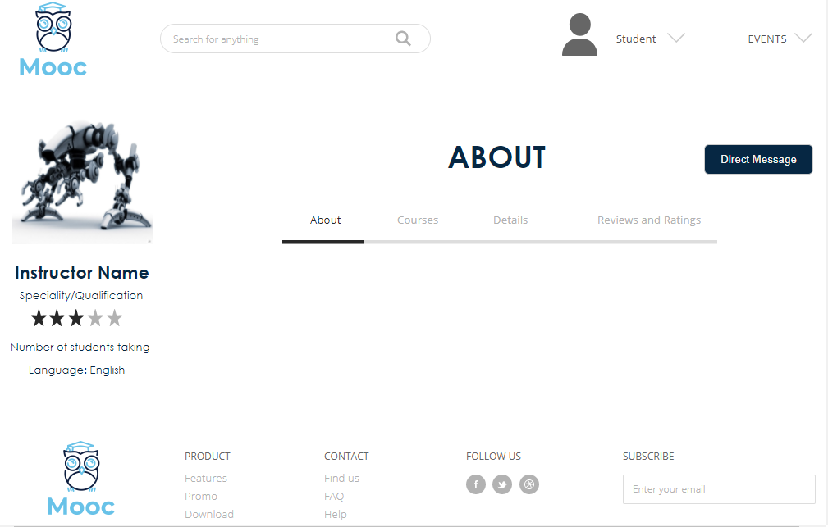
Mockup: Teacher’s Profile

Slide 24
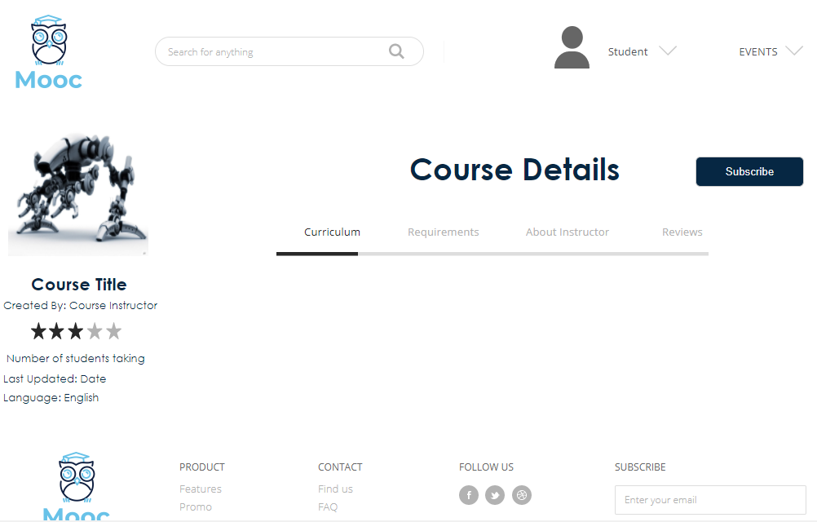
Mockup: Course Profile

Slide 25
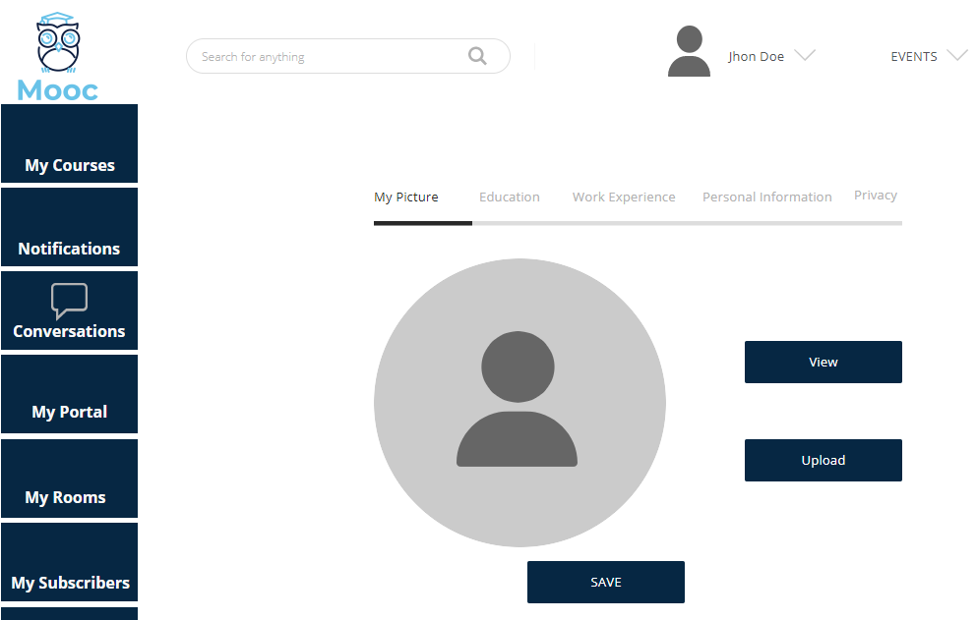
Mockup: My Profile

Slide 26
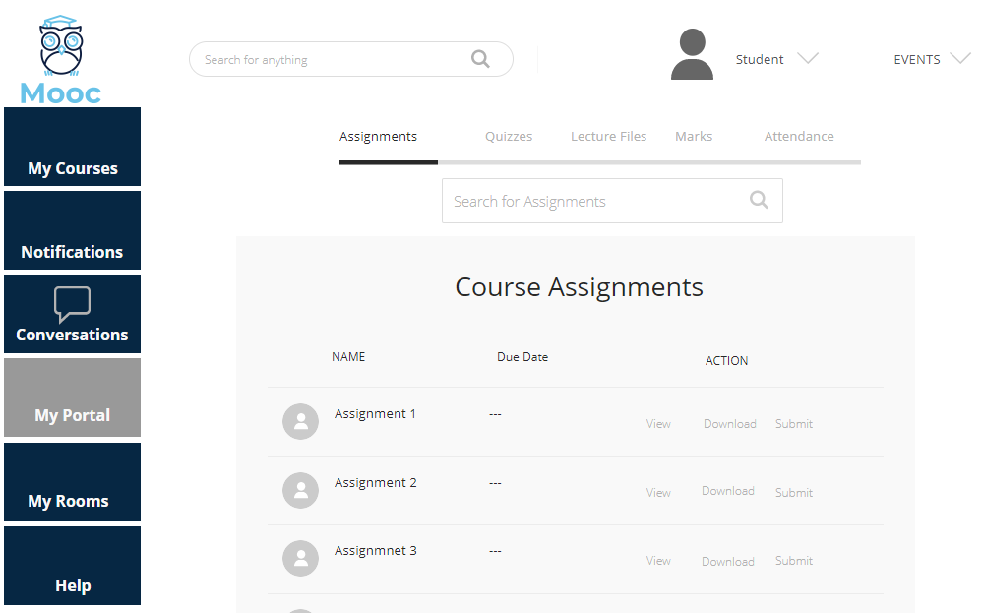
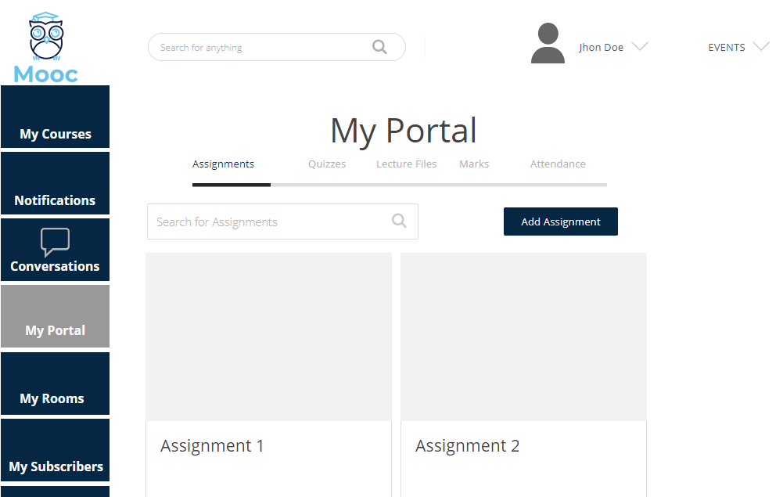
Mockup: My Portals
Student’s View
Teacher’s View

Slide 27
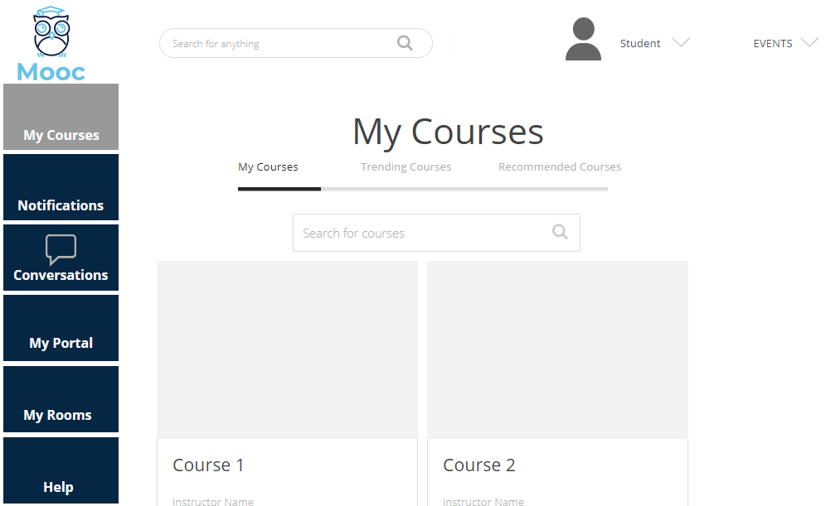
Mockup: My Courses

Slide 28
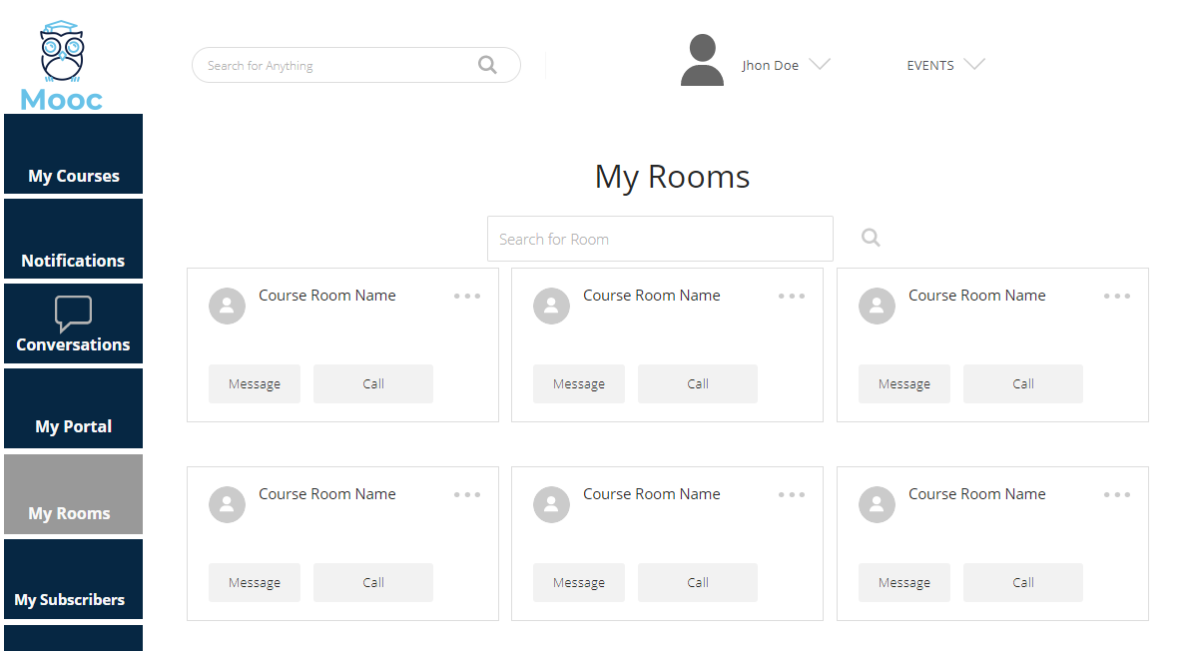
Mockup: My Rooms

Slide 29
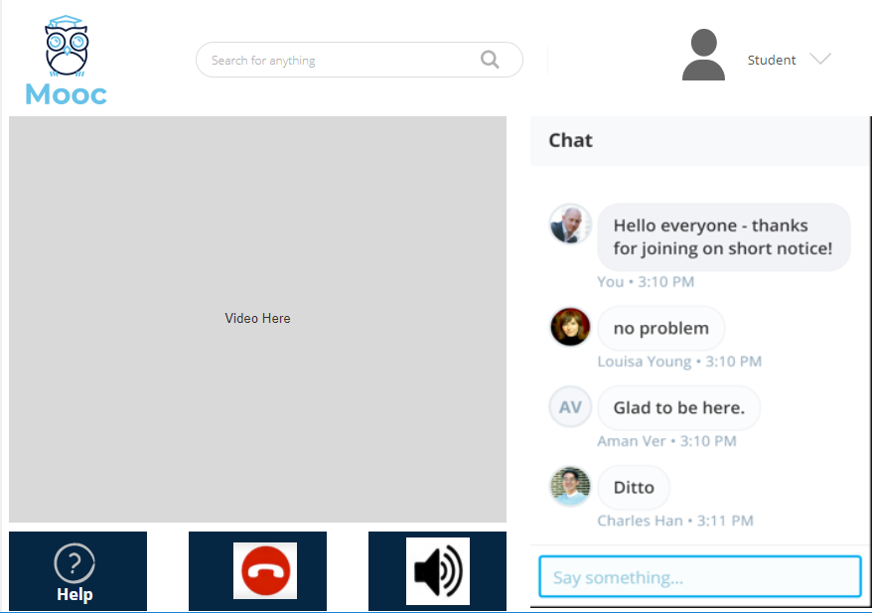
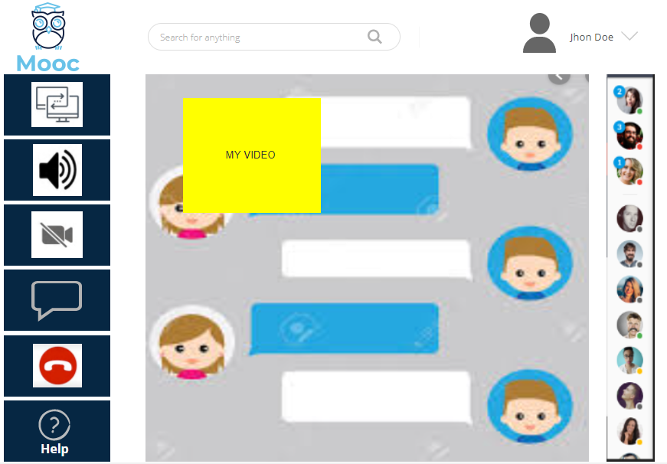
Mockup: Video Call
Student’s View
Teacher’s View

Slide 30
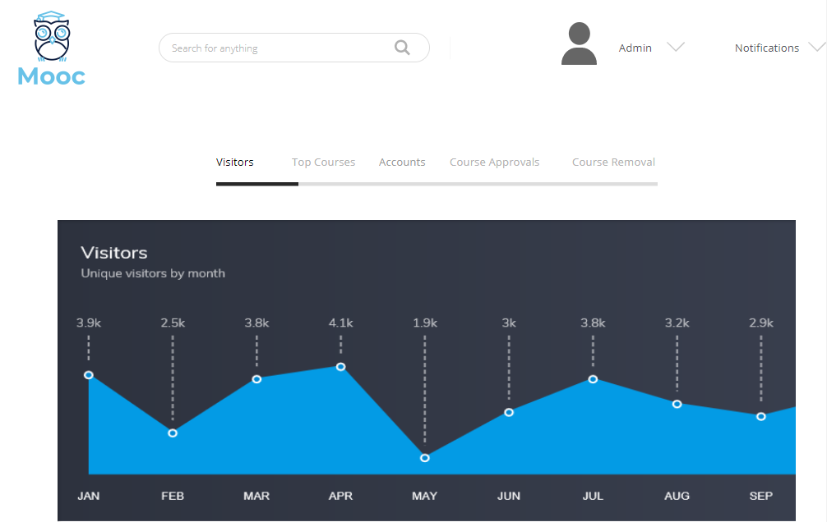
Mockup: Admin Panel

Slide 31
Conclusion
To summarize with,
Highly interactive student-teacher platform
This web application will consist of student teacher portal
Live broadcasting facility also provides the teachers a chance to directly interact with their students and give them lectures.
Our system will help the teachers to make their videos more understandable and viewable through auto zoom feature.
This web application will make online teaching and learning quite a lot easier through features like course recommendation system.
This project gives a clue that computer vision and image processing have a promising direction for future works and inventions.

Slide 32
Questions and Answers

