Slide 1
Internet & Intranet Architecture (IIA)
Course Instructor: Hira Beenish

Slide 2

Routing Basics
4-1

Slide 3
Routing
Routing is the process of moving a packet of data from source to destination. Routing is usually performed by a dedicated device called a router.
IP Routing
Is the set of protocols that determine the path that data follows in order to travel across multiple networks from its source to its destination. Data is routed from its source to its destination through a series of routers, and across multiple networks. The IP Routing protocols enable routers to build up a forwarding table that correlates final destinations with next hop addresses.

Slide 4

Protocols
Set of Rules Governing Communication is called Protocol.
Protocol represents an agreement between communicating devices.
Without Protocol, two devices may be connected but they will not be able to communicate.
A Protocol defines what is communicated, how it is communicated and when is communicated.
Example:
Consider the communication between a person speaking French and Japanese. They can only communicate provided they both speak the same language.

Slide 5
Intra- and Interdomain Routing
Today, an internet can be so large that one routing protocol cannot handle the task of updating the routing tables of all routers.
For this reason, an internet is divided into autonomous systems
Autonomous systems
An autonomous system (AS) is a group of networks and routers under the authority of a single administration
Intra domain Routing
Routing inside an autonomous system is referred to as intra domain routing

Slide 6
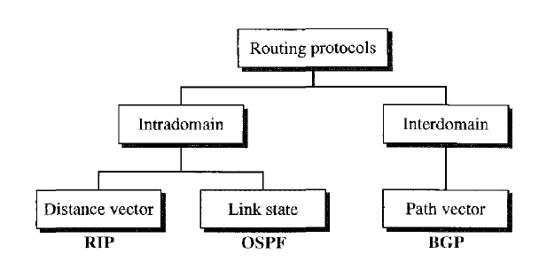
Inter domain routing
Routing between autonomous systems is referred to as inter domain routing.

Slide 7
IP Routing protocols
These Protocols Include
RIP (Routing Information Protocol)
IGRP (Interior gateway Routing Protocols)
EIGRP (Enhanced Interior gateway Protocol)
BGP (Border gateway Protocol)

Slide 8
Types of Routing Protocols
There are two major categories of Routing Protocols:-
Static Routing Protocols
Dynamic Routing Protocols

Slide 9
Static Routing Protocols
Static routing is not really a routing protocol. Static routing is simply the process of manually entering routes into a device's routing table via a configuration file that is loaded when the routing device starts up. As an alternative, these routes can be entered by a network administrator who configures the routes manually. Since these manually configured routes don't change after they are configured (unless a human changes them) they are called 'static' routes.
Static routing is the simplest form of routing, but it is a manual process. Use static routing when you have very few devices to configure (Less than 5) and when you know the routes will probably never change.

Slide 10
Static Routing Protocols
Static routing also does not handle failures in external networks well because any route that is configured manually must be updated or reconfigured manually to fix or repair any lost connectivity.

Slide 11
Dynamic Routing Protocols
In dynamic routing, the routers monitor the network, and can change their routing tables based on the current network conditions. The network thus adapts to changing
Conditions.
Dynamic routing protocols are supported by software applications running on the routing device (the router) which dynamically learn network destinations and how to get to them and also advertise those destinations to other routers. This advertisement function allows all the routers to learn about all the destination networks that exist and how to those networks

Slide 12
Types of Dynamic Routing Protocols
Dynamic routing protocols can be categorized on the basis of various parameters.
Dynamic routing protocols are classified protocols:-
Routing Information Protocol (RIP)
Interior gateway routing protocol (IGRP)
Open shortest path first (OSPF)
Border Gateway Protocol (BGP)
into following

Slide 13
Distance Vector Routing
Distance vector routing is so named because it involves two factors: the distance, or metric, of a destination, and the vector, or direction to take to get there. Routing information is only exchanged between directly connected neighbors.
The whole idea of distance vector routing is the sharing of information between directly connected neighbors.
DV determine the path to remote networks using hop count
as the metric.
Hop Count
A hop count is defined as the number of times a packet needs to pass through a router to reach a remote destination

Slide 14
In distance vector routing, each node shares its routing table with its immediate neighbors periodically and when there is a change.
Router periodically (every 30 seconds, transmits the routing table via a broadcast packet that reaches all other routers on the local segments.

Slide 15
Link State Routing
Routers send updates only when there’s a change
Router that detects change creates a link-state advertisement (LSA) and sends it to neighbors
Neighbors propagate the change to their neighbors
Routers update their topological database if necessary

Slide 16
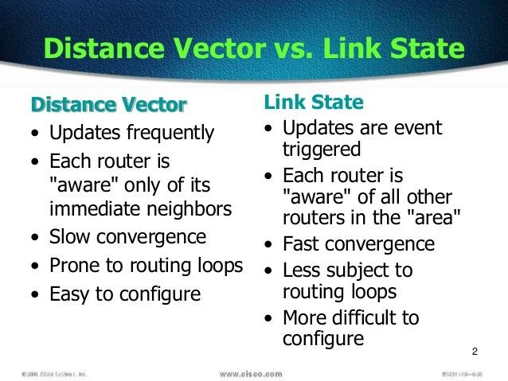
Distance-Vector Vs. Link-State

Slide 17
Routing Information Protocol (RIP)
Most common routing protocol used to transfer routing information between routers
Allows the router to determine which path it will use to send data, based on a concept called Distance vector routing.
Whenever data travels on a router, and thus through a new network number, it is considered to have traveled one hop.
A path that has a hop count of 4 indicates that data traveling along that path must have passed through four routers before reaching its final destination on the network
Broadcasts its routing table every 30 seconds

Slide 18
Interior Gateway Routing Protocol (IGRP)
Developed by Cisco Corporation
Its a distance-vector protocol
Sends routing updates at 90-second intervals
When the router detects changes, its sends only partial updates to neighbor routers
When determining the best consideration such things as:
Bandwidth Load Delay Reliability
path, it also takes into

Slide 19
Open shortest path first (OSPF)
Makes more intelligent path selection than RIP, IGRP, and EIGRP
It sends only changes, not the entire routing table Support VLSM
considers any or all of the following:
Bandwidth
Delay
Reliability
Load
The Open Shortest Path First (OSPF) most widely used in the network of big business companies

Slide 20
Difference between RIP, OSPF and IGRP Routing Protocols
Characteristics | RIP | IGRP | OSPF
Type | Distance Vector | Hybrid | Link State
Update Timers | 30 Sec | 90 Sec | Only when changes occur
Updates | Full Table | Full Table | Only changes
Hop count Limit | 15 | 255 | None
Default Metric | Hop count | Bandwidth/Delay | Bandwidth/Delay

Slide 21
Thank you

