Slide 1
Dynamic Routing Protocols
4
CHAPTER
Routing Protocol Basics
Distance Vector Routing Protocols
Link State Routing Protocols
Interior and Exterior Gateway Protocols
Static or Dynamic Routing

Slide 2
Dynamic Routing Protocols
Dynamic routing protocols not only perform these path determination and route table update functions but also determine the next-best path.

Slide 3
Routing Protocol Basics
A routing algorithm must, at a minimum, specify the following:
A procedure for passing reachability information about networks to other routers
A procedure for determining optimal routes based on the reachability information it has and for recording this information in a route table
A procedure for reacting to, compensating for, and advertising topology changes in an internetwork

Slide 4
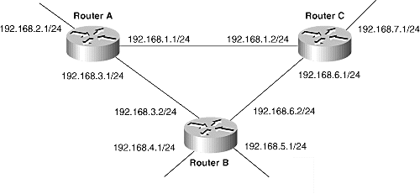
Path Determination
At first quick look, the information-sharing procedure seems simple. Look at router A:
1. Router A examines its IP addresses and associated masks and deduces that it is attached to networks 192.168.1.0, 192.186.2.0, and 192.168.3.0.

Slide 5
Path Determination
2. Router A enters these networks into its route table, along with some sort of flag indicating that the networks are directly connected.
3. Router A places the information into a packet: "My directly connected networks are 192.168.1.0, 192.186.2.0, and 192.168.3.0."
4. Router A transmits copies of these route information packets, or routing updates, to routers B and C.
5. Routers B and C, having performed the same steps, have sent updates with their directly connected networks to A. Router A enters the received information into its route table, along with the source address of the router that sent the update packet. Router A now knows about all the networks, and it knows the addresses of the routers to which they are attached.

Slide 6
Metrics
Network | Next Hop Router
192.168.1.0 | Directly connected
192.168.2.0 | Directly connected
192.168.3.0 | Directly connected
192.168.4.0 | B,C
192.168.5.0 | B,C
192.168.6.0 | B,C
192.168.7.0 | B,C

Slide 7
Metrics
Hop Count: A hop count metric simply counts router hops.
From router A it is 1 hop to network 192.168.5.0 if packets are sent out interface 192.168.3.1 (through router B) and 2 hops if packets are sent out 192.168.1.1 (through routers C and B). Assuming hop count is the only metric being applied, the best route is the one with the fewest hops, in this case, A-B.
Bandwidth: A bandwidth metric would choose a higher-bandwidth path over a lower-bandwidth link.
Load: This metric reflects the amount of traffic utilizing the links along the path. The best path is the one with the lowest load.
Delay: Delay is a measure of the time a packet takes to traverse a route.

Slide 8
Metrics
A routing protocol using delay as a metric would choose the path with the least delay as the best path.
Reliability: Reliability measures the likelihood that the link will fail in some way and can be either variable or fixed.
Examples of variable-reliability metrics are the number of times a link has failed or the number of errors it has received within a certain time period.

Slide 9
Distance vector Routing Protocols
The name distance vector is derived from the fact that routes are advertised as vectors of (distance, direction), where distance is defined in terms of a metric and direction is defined in terms of the next-hop router.
Distance vector routing protocols include the following:
  Routing Information Protocol (RIP) for IP
  Xerox Networking System's XNS RIP
  Novell's IPX RIP
  Cisco's Internet Gateway Routing Protocol (IGRP)
  DEC's DNA Phase IV
  AppleTalk's Routing Table Maintenance Protocol (RTMP)

Slide 10
Common Characteristics
A typical distance vector routing protocol uses a routing algorithm in which routers periodically send routing updates to all neighbors by broadcasting their entire route tables.
Periodic Updates: Periodic updates means that at the end of a certain time period, updates will be transmitted. This period typically ranges from 10 seconds for AppleTalk's RTMP to 90 seconds for Cisco's IGRP.
Neighbors: In the context of routers, neighbors always means routers sharing a common data link. A distance vector routing protocol sends its updates to neighboring routers and depends on them to pass the update information along to their neighbors.

Slide 11
Common Characteristics
Broadcast Updates:
The simplest is to send the updates to the broadcast address
Neighboring routers speaking the same routing protocol will hear the broadcasts and take appropriate action.

Slide 12
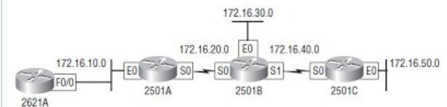

Slide 13
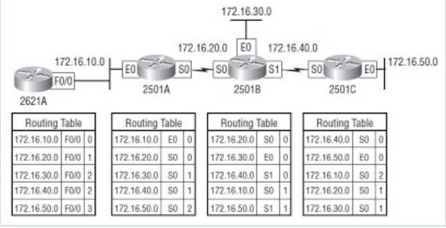

Slide 14
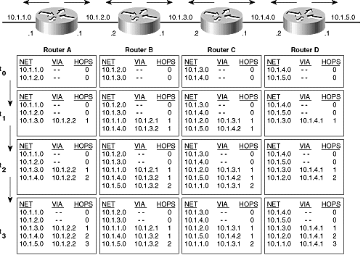
Distance Vector protocols converge hop-by-hop

Slide 15
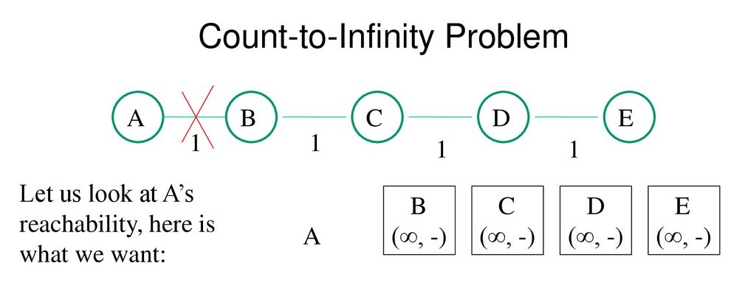

Slide 16
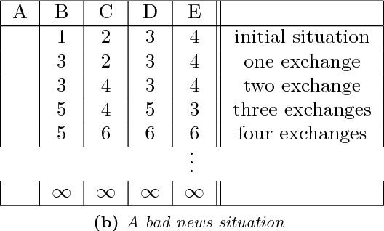
Count to infinity problem

Slide 17
Router Invalidation Timer
A timer Is set when a router hears about a network, called route invalidation timer. After an update information timer resets again when timer expires the network is marked unreachable.
Typical periods for route timeouts range from three to six update periods.
In previous diagram if router D goes down, C will no longer hear updates about 10.1.5.0. The timer will expire, C will flag the route as unreachable and will pass the information along in the next update.

Slide 18
Split Horizon
Split horizon just means you don't advertise learned routes back to who told you about them.

Slide 19
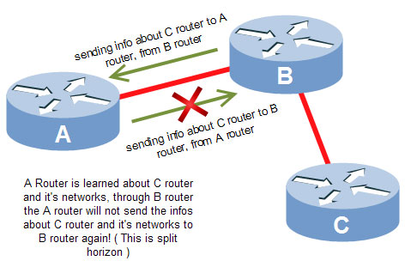
Split horizon
Split horizon helps stop routing loops by telling the router not to advertise routes out the same interface from which the route was originally learned

Slide 20
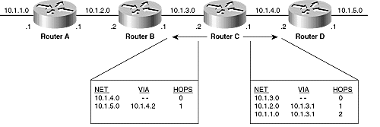
Split Horizon
A route pointing back to the router from which packets were received is called reverse route. Split horizon is a technique for preventing reverse route b/w two routers.
The principle is simple – a router will not advertise a route back onto the interface from which it was learned.

Slide 21
Areas
An area is a subset of the routers that make up an internetwork. Dividing an internetwork into areas is a response to three concerns commonly expressed about link state protocols:
• The necessary databases require more memory than a distance vector protocol requires.
• The complex algorithm requires more CPU time than a distance vector protocol requires.
• The flooding of link state packets adversely affects available bandwidth, particularly in unstable internetworks.
The routers connecting two areas (Area Border Routers, in OSPF terminology)belong to both areas and must maintain separate topological databases for each.
Distance vector protocols, such as RIP and IGRP, do not use areas.

Slide 22
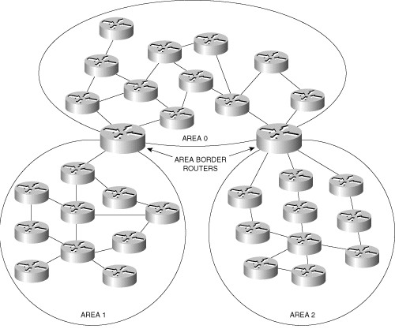
Areas

Slide 23
Interior and Exterior Gateway Protocols
Higher-level areas are called autonomous systems in the IP world and routing domains in the ISO world.
An autonomous system was once defined as a group of routers under a common administrative domain running a common routing protocol.
The routing protocols that run within an autonomous system are referred to as Interior Gateway Routing Protocols(IGRP).
Routing protocols that route between autonomous systems or routing domains are referred to as Exterior Gateway Protocols (EGPs).

Slide 24
Thank you

