Slide 1
VLANs
LAN Switching

Slide 2
Objectives
Explain the role of VLANs in a converged network.
Explain the role of trunking VLANs in a converged network.
Configure VLANs on the switches in a converged network topology.
Troubleshoot the common software or hardware misconfigurations associated with VLANs on switches in a converged network topology.

Slide 3
VLANs
Switches also have enabled the creation of Virtual LANs (VLANs). VLANs provide greater opportunities to manage the flow of traffic on the LAN and reduce broadcast traffic between segments.
VLANs are groups of computers in an intelligent switched network.

Slide 4
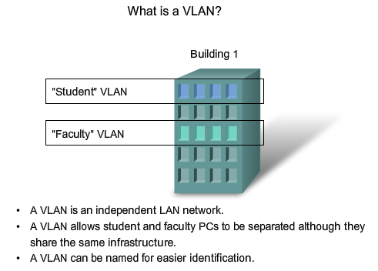
Explain the Role of VLANs in a Converged Network
Explain the role of VLANs in a converged network

Slide 5
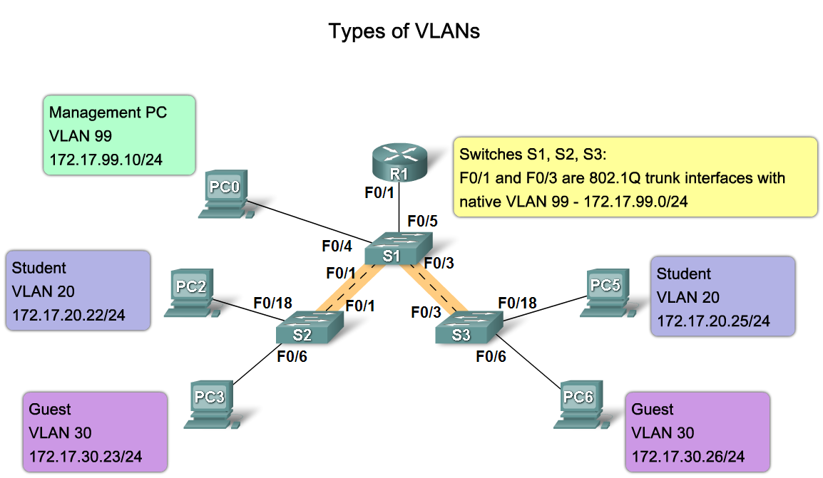
Explain the Role of VLANs in a Converged Network
Describe the different types VLANs

Slide 6
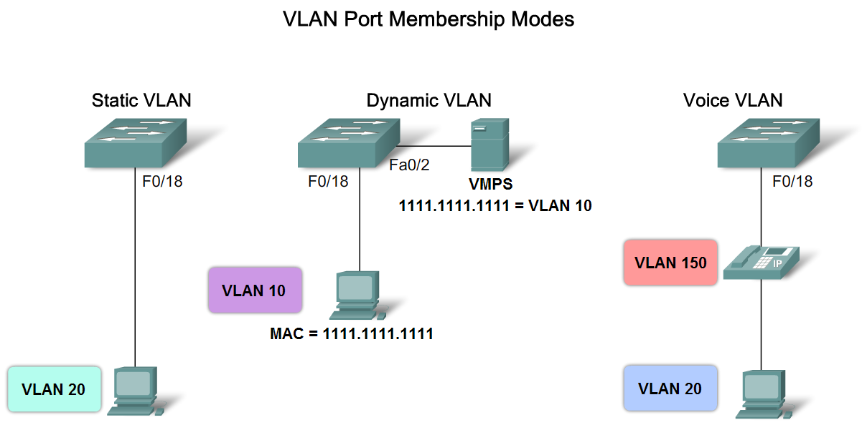
Explain the Role of VLANs in a Converged Network
Describe the VLAN port membership modes

Slide 7
Port-Based VLANs
Port-based VLANs use the physical port address to form the groups for the VLAN.
It is logical to connect computers that are physically close together on the LAN into ports that are physically close together on the switch, and to assign ports that are physically close together into the same VLAN.
This is the approach used in traditional LAN design: physical location determines the LAN, but is not always the most effective approach.

Slide 8
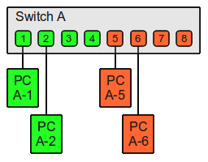
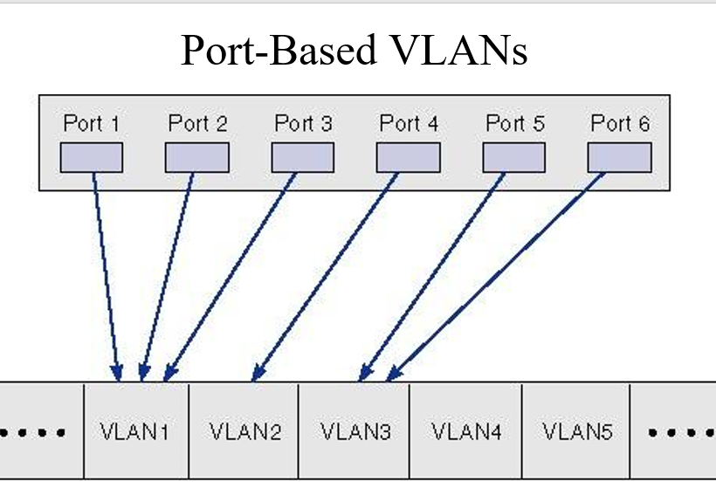

Slide 9
MAC-Based VLANs
Layer-2 VLANs
MAC-based VLANs use the same data link layer addresses to form the VLAN groups.
The advantage is that they are simpler to manage when computers are moved.

Slide 10
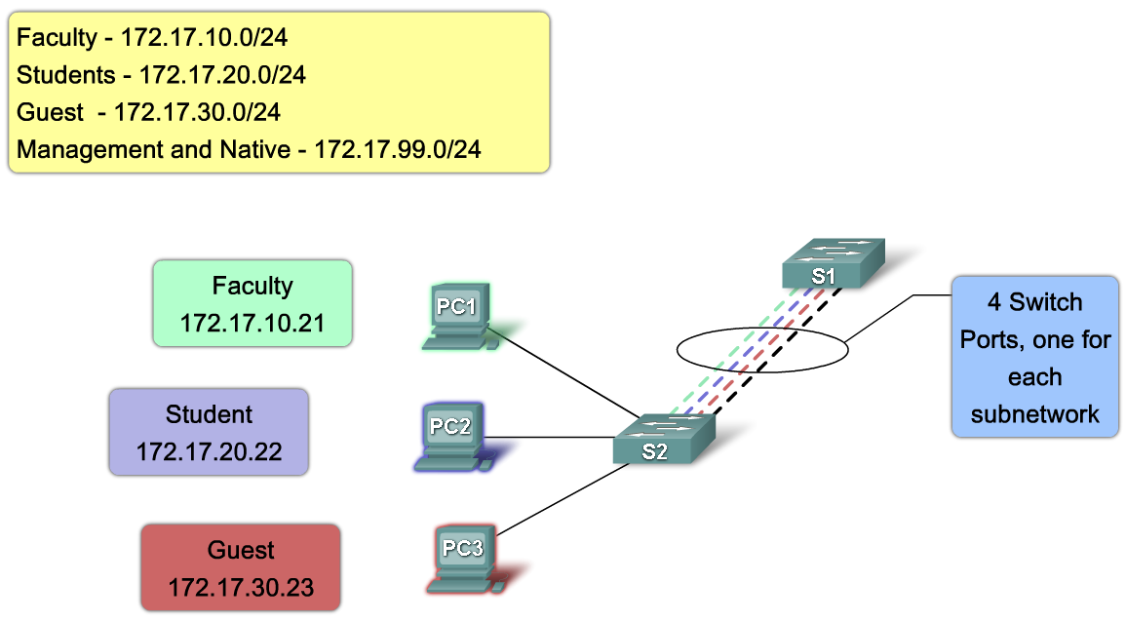
Explain the Role of Trunking VLANs in a Converged Network
Explain the role of a trunk when using multiple VLANs in a converged network

Slide 11
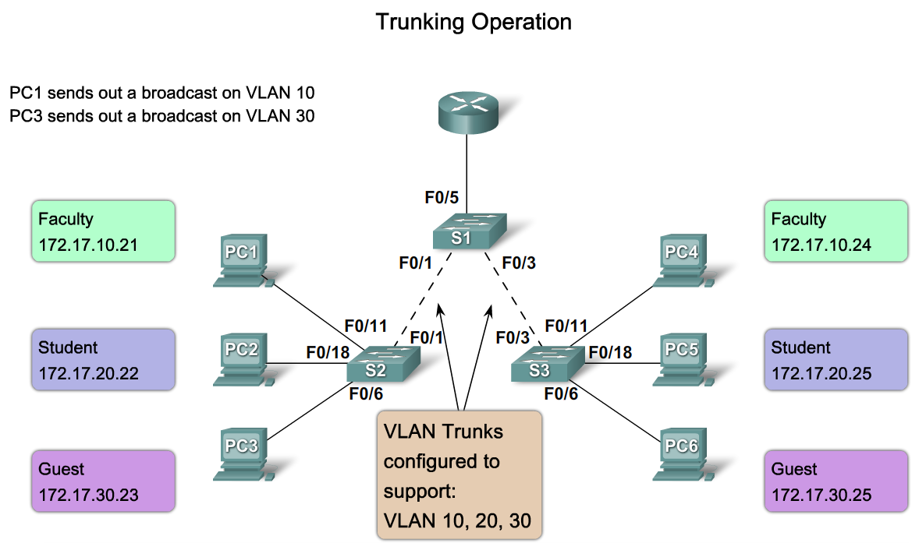
Explain the Role of Trunking VLANs in a Converged Network
Describe how a trunk works

Slide 12

Voice VLAN
Use with IP phone.
Phone acts as a switch too.
Voice traffic is tagged, given priority.
Data not tagged, no priority.

Slide 13
Native VLAN
VLAN is identified by a “tag” in the frame.
Native VLAN does not have a tag.
any frame that has no tag will be put into native VLAN.

Slide 14
Default VLAN
VLAN 1 on Cisco switches.
Carries CDP and STP (spanning tree protocol) traffic.
Initially all ports are in this VLAN.
Do not use it for data, voice or management traffic for security reasons.

Slide 15
Static VLAN
The normal type. Port configured to be on a VLAN. Connected device is on this VLAN.
VLAN can be created using CLI command, given number and name.
If a port is put on a VLAN and the VLAN does not exist, then the VLAN is created.

Slide 16
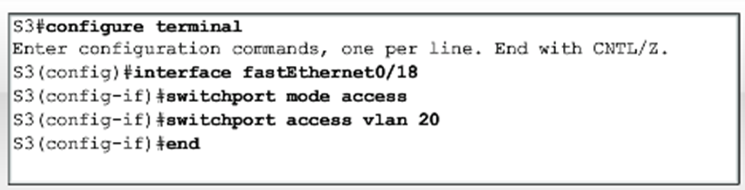
Static VLAN (Port-centric)
If VLAN 20 did not exist before – then it does now.

Slide 17
Dynamic VLAN
Not widely used.
Use a VLAN Membership Policy Server (VMPS).
Assign a device to a VLAN based on its MAC address.
Connect device, server assigns VLAN.
Useful if you want to move devices around.

Slide 18
Trunk
A trunk is a point-to-point link between one or more Ethernet switch interfaces and another networking device, such as a router or a switch.
Ethernet trunks carry the traffic of multiple VLANs over a single link.
A VLAN trunk allows you to extend the VLANs across an entire network.

Slide 19
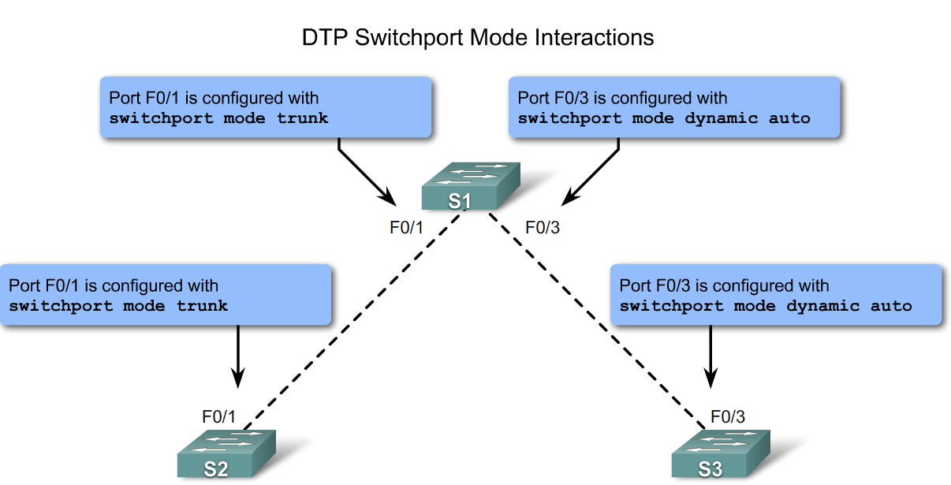
Explain the Role of Trunking VLANs in a Converged Network
Describe the switch port trunking modes

Slide 20
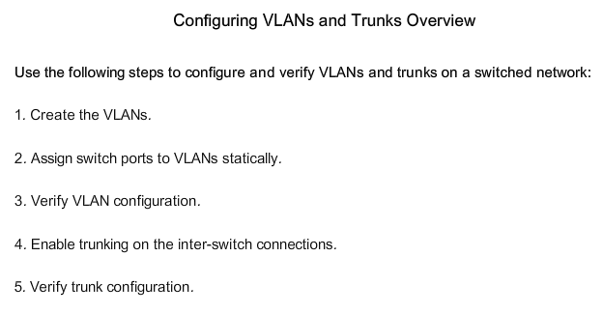
Configure VLANs on the Switches in a Converged Network Topology
Describe the steps to configure trunks and VLANs

Slide 21
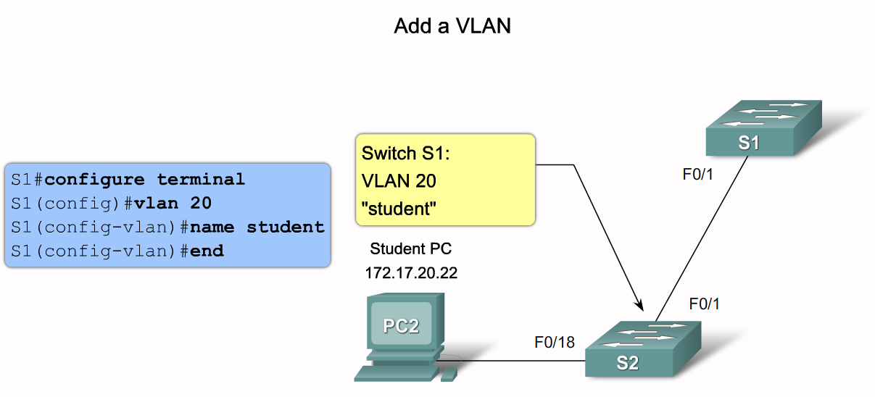
Configure VLANs on the Switches in a Converged Network Topology
Describe the Cisco IOS commands used to create a VLAN on a Cisco Catalyst switch

Slide 22
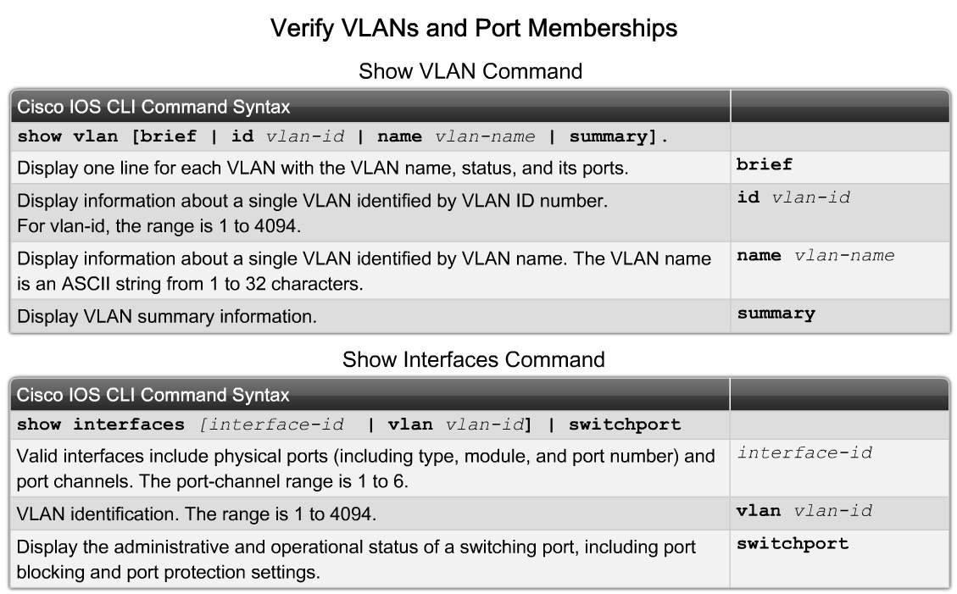
Configure VLANs on the Switches in a Converged Network Topology
Describe the Cisco IOS commands used to manage VLANs on a Cisco Catalyst switch

Slide 23
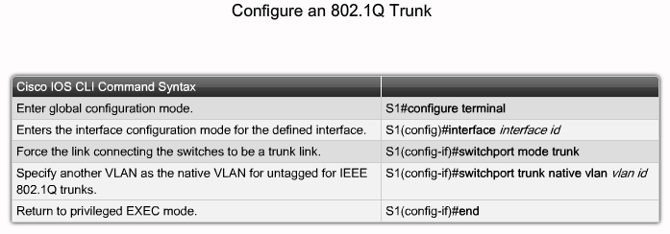
Configure VLANs on the Switches in a Converged Network Topology
Describe the Cisco IOS commands used to create a trunk on a Cisco Catalyst switch

Slide 24
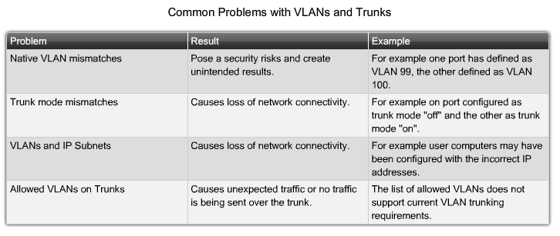
Troubleshoot Common Software or Hardware Misconfigurations Associated with VLANs
Describe the common problems with VLANs and trunks

Slide 25
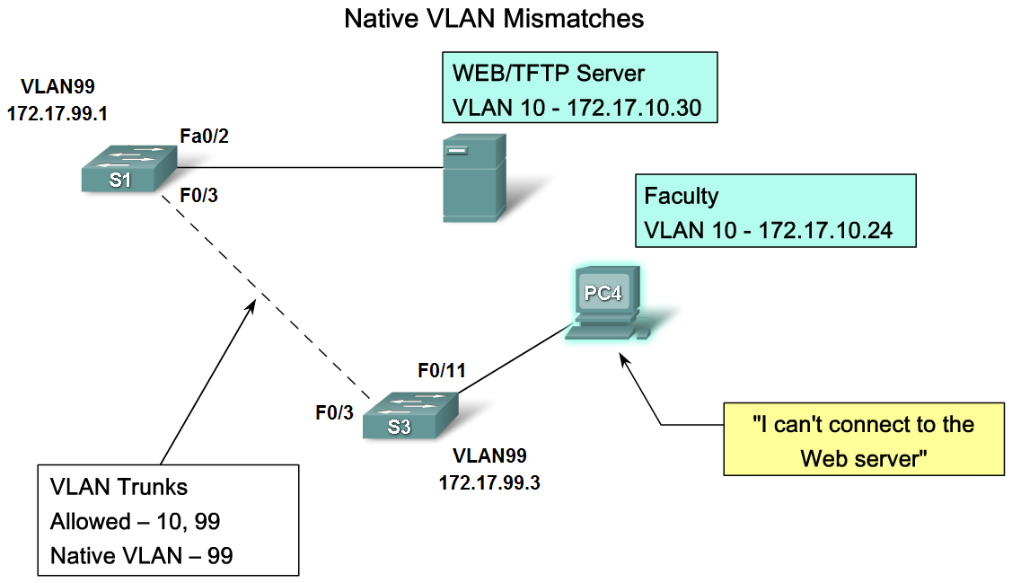
Troubleshoot Common Software or Hardware Misconfigurations Associated with VLANs
Describe the common problems with VLANs and trunks

Slide 26
What is VTP?
The VLAN Management Challenge
  As the number of switches increases on a small- or medium-sized business network, the overall administration required to manage VLANs and trunks becomes a challenge.

Slide 27
VTP
  VTP allows a network manager to configure a switch so that it will propagate VLAN configurations to other switches in the network.
  Switch can be configured a VTP server or VTP client
  The VTP server distributes and synchronizes VLAN information to VTP-enabled switches throughout the switched network, which minimizes the configuration inconsistencies.

Slide 28
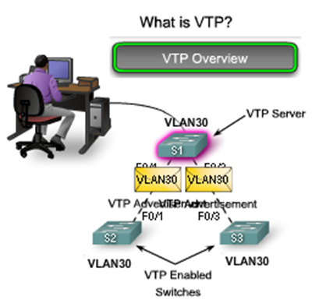
VTP

Slide 29
VTP Components
VTP Domain - Consists of one or more interconnected switches.
  All switches in a domain share VLAN configuration details using VTP advertisements.
  Router or Layer 3 switch defines the boundary of domain
VTP Modes - 3 different VTP modes
  VTP Server - VTP servers advertise the VTP VLAN information to other switches in the same VTP domain.
    VTP servers store the VLAN information for the domain in NVRAM.
    The server is where VLAN can created, deleted, or renamed for the domain.

Slide 30
VTP Components
  VTP Client - VTP clients function the same way as VTP servers, but you cannot create, change, or delete VLANs.
    A VTP client only stores the VLAN information for the entire domain while the switch is on.
    A switch reset deletes the VLAN information. You must configure VTP client mode on a switch.
  VTP Transparent - Transparent switches forward VTP advertisements to VTP clients and VTP servers.
    VLANs that are created, renamed, or deleted on transparent switches are local to that switch only.
    Transparent switches do not participate in VTP.

Slide 31
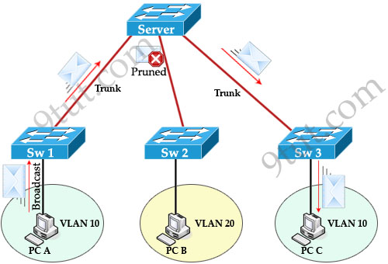
VTP Components
VTP Pruning - VTP pruning increases network available bandwidth by restricting flooded traffic to those trunk links that the traffic must use to reach the destination devices.

Slide 32
VTP Components
VTP Advertisements - VTP uses a hierarchy of advertisements to distribute and synchronize VLAN configurations across the network.
VTP Revision Number
The configuration revision number determines whether the configuration information received from another VTP-enabled switch is more recent than the version stored on the switch.
  The default revision number for a switch is zero.
  Each time a VLAN is added or removed, the configuration revision number is incremented.
  Each VTP device tracks the VTP configuration revision number that is assigned to it.

Slide 33
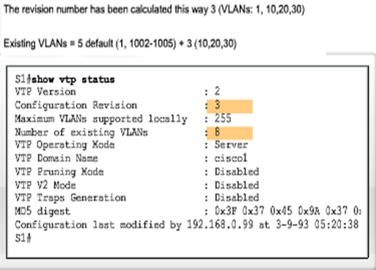
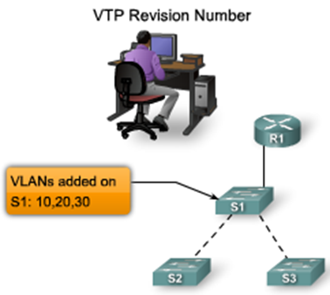
The figure shows a network manager adding three VLANs to switch S1.
  The highlighted area shows that the revision number on switch S1 is 3,
  The number of VLANs is 8,
    because 3 VLANs have been added to the 5 default VLANs

Slide 34
Summary
VLANS
Allows an administrator to logically group devices that act as their own network
Are used to segment broadcast domains
Some benefits of VLANs include
Cost reduction, security, higher performance, better management

Slide 35
Summary
Types of Traffic on a VLAN include
  Data
  Voice
  Network protocol
  Network management
Communication between different VLANs requires the use of
  Routers

Slide 36
Thank you

