Slide 1
ENABLING OSPF

Slide 2


Introducing OSPF
OSPF
Open Standard
Shortest Path first (SPF) Algorithm
Written by John Moy
RFC1247, RFC2328
Link State Routing Protocol (Vs distance vector)

Slide 3
Feature of OSPF
The use of areas, which reduces the protocol's impact on CPU and memory, contains the flow of routing protocol traffic, and makes possible the construction of hierarchical internetwork topologies.
Fully classless behavior, eliminating such classful problems as Discontiguous subnets
Equal-cost load balancing for more efficient use of multiple paths
Support of authentication for more secure routing

Slide 4
OSPF as a Link State Protocol
OSPF propagates link-state advertisements rather then routing table updates.
LSA are flooded to all OSPF Link state database pieced together from the LSAs generated by the OSPF routers.
OSPF uses the SPF algorithm to calculate the shortest path to a destination.
  Link = router interface
  State = description of an interface and its relationship to neighboring routers.

Slide 5
OSPF Cost
The cost (also called metric) of an interface in OSPF is an indication of the overhead required to send packets across a certain interface.
The cost of an interface is inversely proportional to the bandwidth of that interface.
A higher bandwidth indicates a lower cost. There is more overhead (higher cost) and time delays involved in crossing a 56k serial line than crossing a 10M Ethernet line.
The formula used to calculate the cost is:
cost= 10000 0000/bandwith in bps
For example, it will cost 10⁸/10⁷ = 10 to cross a 10M Ethernet line and will cost 10⁸/1544000 = 64 to cross a T1 line.
By default, the cost of an interface is calculated based on the bandwidth; you can force the cost of an interface with the ip ospf cost <value> interface sub-configuration mode command.

Slide 6
BANDWIDTH | COST
10MB | 8
100 MB | 4
1000MB | 2
100000MB | 0

Slide 7
Operation of OSPF
OSPF-speaking routers send Hello packets out all OSPF-enabled interfaces. If two routers sharing a common data link agree on certain parameters specified in their respective Hello packets, they will become neighbors.
OSPF defines several network types and several router types. The establishment of an adjacency is determined by the types of routers exchanging Hellos and the type of network over which the Hellos are exchanged.
Each router sends link state advertisements (LSAs) over all adjacencies. The LSAs describe all of the router's links, or interfaces, and the state of the links. These links may be to stub networks (networks with no other router attached), to other OSPF routers, to networks in other areas, or to external networks (networks learned from another routing process). Because of the varying types of link state information, OSPF defines multiple LSA types.

Slide 8
Operation of OSPF
Each router receiving an LSA from a neighbor records the LSA in its link state database and sends a copy of the LSA to all of its other neighbors.
By flooding LSAs throughout an area, all routers will build identical link state databases.
When the databases are complete, each router uses the SPF algorithm to calculate a loop-free graph describing the shortest (lowest cost) path to every known destination, with itself as the root. This graph is the SPF tree.
Each router builds its route table from its SPF tree.

Slide 9
Router ID
Cisco routers derive their Router IDs by the following means:
1. The router chooses the numerically highest IP address on any of its loopback interfaces.
2. If no loopback interfaces are configured with IP addresses, the router chooses the numerically highest IP address on any of its physical interfaces.
The OSPF router begins a neighbor relationship by advertising its Router ID in Hello packets.
Int se0/0/11 10.5.4.11
Int se0/0/2 185.41.7.8
Int se0/0/11 170.5.64.3

Slide 10
The Hello Protocol
It is the means by which neighbors are discovered.
It advertises several parameters on which two routers must agree before they can become neighbors.
Hello packets act as keep alive between neighbors.
It ensures bi-directional communication between neighbors.
It elects Designated Routers (DRs) and Backup Designated Routers (BDRs) on Broadcast and Non broadcast Multi access (NBMA) networks.
Hello Interval (By default 10 sec) RFC
Dead Interval (Declare the neighbor down, 4 times Hello interval)
Hello Interval (ip ospf hello-interval)
Dead Interval (ip ospf dead-interval)

Slide 11
Each Hello packet contains:
The Router ID of the origination router
The Area ID of the origination router interface
The address of the originating interface
The authentication type and authentication information for the origination interface
The Hello Interval of the originating interface
The Router Dead Interval of the origination interface
The DR and BDR
Five flag bits signifying optional capabilities

Slide 12
2 types of networks
All networks fall into one of two more general types:
  Transit networks have two or more OSPF-enabled routers.
  Stub networks have only a single attached router.
  Loopback interfaces are also considered stub networks.

Slide 13
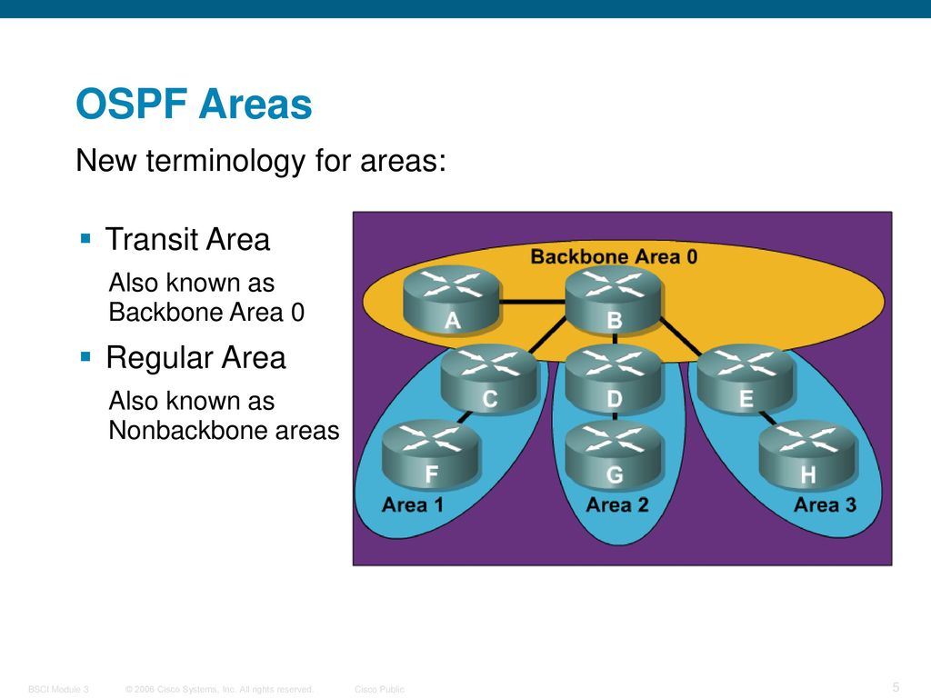
Transit Area

Slide 14
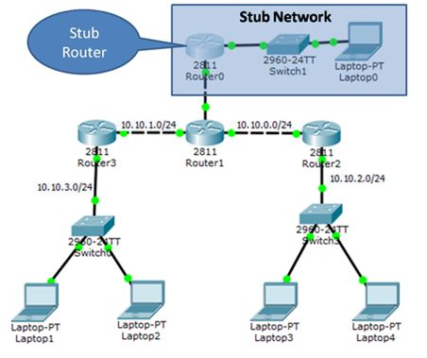
Stub Area
networks with no other router attached

Slide 15
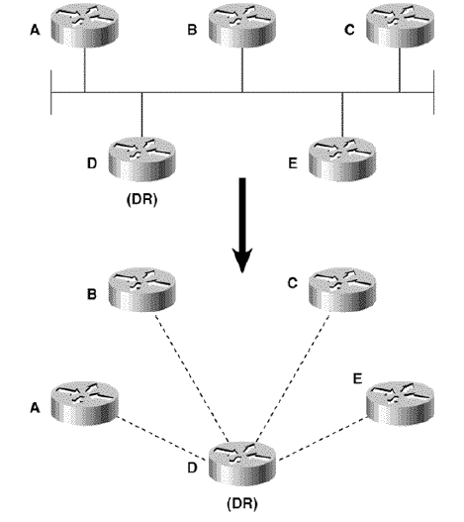
Designated Routers and Backup Designated Routers
The Designated Router represents the multi-access network.
Other routers on the network will form adjacencies with the DR, not with each other. If the DR fails, the BDR becomes the new DR.

Slide 16
Benefits of Areas
OSPF uses areas to reduce these adverse effects.
In the context of OSPF, an area is a logical grouping of OSPF routers and links that effectively divide an OSPF domain into sub-domains.
Routers within an area will have no detailed knowledge of the topology outside of their area.
The reduced size of the database reduces the impact on a router's memory.
The smaller link state databases mean fewer LSAs to process and therefore less impact on the CPU.
Because the link state database must be maintained only within an area, most flooding is also limited to the area.

Slide 17
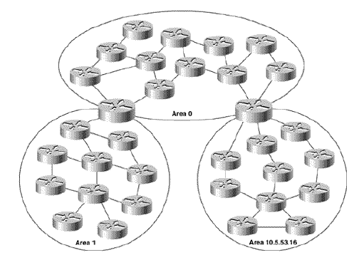
Benefits of Areas
An OSPF area is a logical grouping of OSPF routers. Each area is described by its own link state database, and each router must maintain a database only for the area to which it belongs.

Slide 18
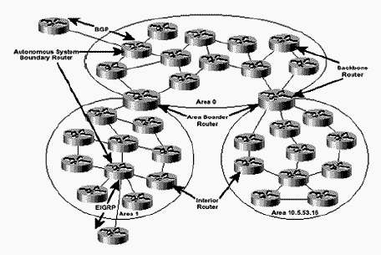
Router Types
All OSPF routers can be classified as an Internal Router, a backbone Router, an Area Border Router (ABR), or an Autonomous System Boundary Router (ASBR).

Slide 19
Router Types
Internal Routers are routers whose interfaces all belong to the same area.
Area Border Routers (ABRs) connect one or more areas to the backbone and act as a gateway for inter-area traffic.
An ABR always has at least one interface that belongs to the backbone, and must maintain a separate link state database for each of its connected areas. For this reason, ABRs often have more memory and perhaps more powerful processors than internal routers.
An ABR will summarize the topological information of its attached areas into the backbone, which will then propagate the summary information to the other areas.
Autonomous System Boundary Routers (ASBRs) are gateways for external traffic, injecting routes into the OSPF domain that were learned (redistributed) from some other protocol, such as the BGP and EIGRP processes.

Slide 20
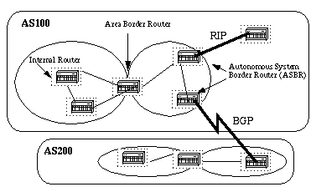
Router Types

Slide 21
Neighbor and Adjacencies
Before any LSAs can be sent, OSPF routers must discover their neighbors and establish adjacencies.
The neighbor will be recorded in a neighbor table, along with the link (interface) on which each neighbor is located and other information necessary for the maintenance of the neighbor.

Slide 22
Selecting the Best Path
OSPF uses the Dijkstra (pronounced Dike-stra) algorithm to calculate the best path to a destination network.
The SPF algorithm finds all possible paths to a destination network using the information in the link-state database, then sorts them by cost so that the ‘shortest’ path to each destination is at the top of the list.
These lowest-cost routes are then placed in the IP routing table.

Slide 23
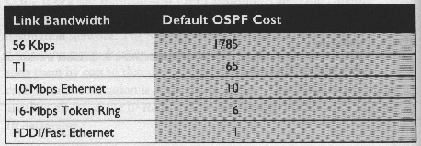
Default OSPF Cost

Slide 24
Intra/Inter/External routes
Intra-area routes refer to updates that are passed within the area.
Inter-area routes refer to updates that are passed between areas.
External routes refer to updates passed from another routing protocol into the OSPF domain by the Autonomous System Border Router (ASBR).

Slide 25
Enabling OSPF on the Router
Enabling OSPF on the router involves the following two steps in config mode:
Enabling an OSPF process using the router ospf <process-id> command.
Assigning areas to the interfaces using the network <network or IP address> <mask> <area-id> command.
The OSPF process−id is a numeric value local to the router.
It does not have to match process−ids on other routers.
It is possible to run multiple OSPF processes on the same router.

Slide 26
Enabling OSPF on the Router
The network command is a way of assigning an interface to a certain area.
The mask is used as a shortcut and it helps putting a list of interfaces in the same area with one line configuration line.
The mask contains wild card bits where 0 is a match and 1/ is a "do not care" bit, e.g. 0.0.255.255 indicates a match in the first two bytes of the network number.
The area-id is the area number we want the interface to be in.
The area-id can be an integer between 0 and 4294967295

Slide 27
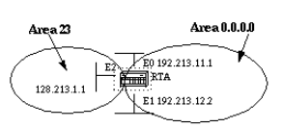
Enabling OSPF on the Router
Here's an example:
RTA#
router ospf 100
network 192.213.0.0 0.0.255.255 area 0
network 128.213.1.1 0.0.0.0 area 23
Note the mask of 0.0.0.0, which indicates a full match on the IP address.

Slide 28
OSPF Authentication
It is possible to authenticate the OSPF packets such that routers can participate in routing domains based on predefined passwords. By default, a router uses a Null authentication which means that routing exchanges over a network are not authenticated.
Two other authentication methods exist:
  Simple password authentication
  Message Digest authentication (MD-5).

Slide 29
Message Digest Authentication
Message Digest authentication is a cryptographic authentication.
A key (password) are configured on each router.
The router uses an algorithm based on the OSPF packet, the key, and the key-id to generate a "message digest" that gets appended to the packet. Unlike the simple authentication, the key is not exchanged over the wire.

Slide 30

Message Digest Authentication
Following are the commands used for message digest authentication:
ip ospf message-digest-key keyid md5 key (used under the interface)
area area-id authentication message-digest (used under "router ospf <process-id>")

Slide 31
Configuring OSPF
The three steps necessary to begin a basic OSPF process are:
1. Determine the area to which each router interface will be attached.
2. Enable OSPF with the command router ospf process-id.
3. Specify the interfaces on which to run OSPF, and their areas, with the network area command.
An area ID can be classified as either a decimal value or as an ip address

Slide 32
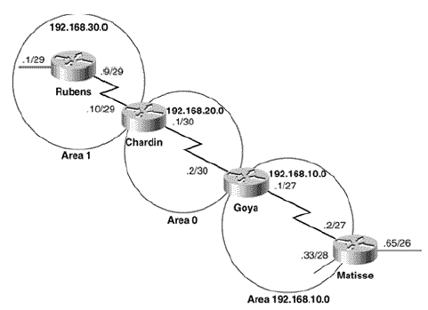
Configuring OSPF
The configurations are:
Rubens
router ospf 10
network 0.0.0.0 255.255.255.255 area 1
Chardin
router ospf 20
network 192.168.30.0 0.0.0.255 area 1
network 192.168.20.0 0.0.0.255 area 0
Goya
router ospf 30
network 192.168.20.0 0.0.0.3 area 0.0.0.0
network 192.168.10.0 0.0.0.31 area 192.168.10.0
Matisse
router ospf 40
network 192.168.10.2 0.0.0.0 area 192.168.10.0
network 192.168.10.33 0.0.0.0 area 192.168.10.0

Slide 33
Case Study: Setting Router Ids with Loopback Interfaces
Loopback interface always up.
Suppose router Matisse from has been configured in a staging center and then sent to the field to be installed. During the boot up, the router reports that it cannot allocate a Router ID, and it seems to report the network area commands as configuration errors. Worse, the OSPF commands are no longer in the running configuration.
The configurations of the last section are modified to use loopback addresses as follows:
Rubens
interface Loopback0
ip address 192.168.50.1 255.255.255.255
!
router ospf 10
network 192.168.30.0 0.0.0.255 area 1
Chardin
interface Loopback0
ip address 192.168.50.2 255.255.255.255
!

Slide 34
Case Study: Setting Router Ids with Loopback Interfaces
router ospf 20
network 192.168.30.0 0.0.0.255 area 1
network 192.168.20.0 0.0.0.255 area 0
Goya
interface Loopback0
ip address 192.168.50.3 255.255.255.255
!
router ospf 30
network 192.168.20.0 0.0.0.3 area 0.0.0.0
network 192.168.10.0 0.0.0.31 area 192.168.10.0
Matisse
interface Loopback0
ip address 192.168.50.4 255.255.255.255
!
router ospf 40
network 192.168.10.2 0.0.0.0 area 192.168.10.0
network 192.168.10.33 0.0.0.0 area 192.168.10.0

Slide 35
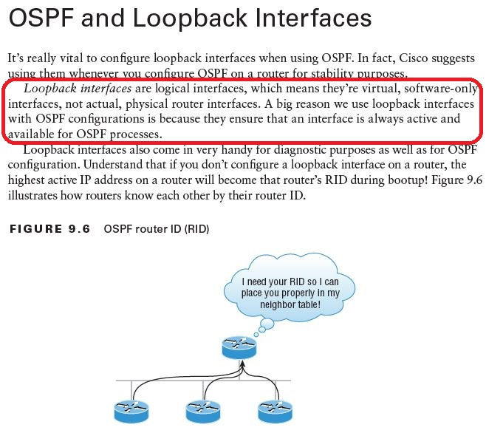

Slide 36
Thank you

