Slide 1
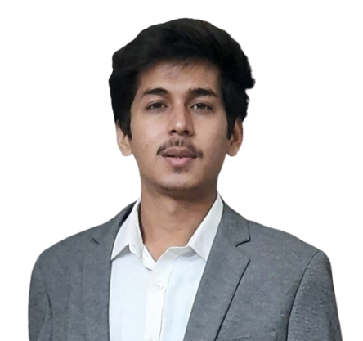


Mohd Nabeel Siraj Mew
Master of Computer Application
2020- 2022
Analyst/Software Engineer
Skills
Basics C#
.NET Framework | Basic Architecture
Asp.net | Basics Architecture
Database | MS SQL
Tools | Visual Studio 2019 Visual Studio Code Swagger
UI Technology | HTML5 ,CSS & Angular
Add On Skills | Quick Learner Team Management Communication Skills
Mumbai
mohd-nabeel.siraj-mew@capgemini.com
+91 7974730328
A4
Full Stack Developer
Open to learn new technologies and ready to implement them to further improve my knowledge.
Eager to work in a team of dedicated people and serve a key role in the enhancement and development of the project.
Trained on .NET, ASP.NET Core and MS SQL.
Understanding of HTML5, CSS, and Angular CLI.
Project : Railway Reservation System
Completed end to end case study of Online Railway Reservation System Application which is a web-based application along with Swagger testing. Responsive UI with HTML, CSS and Angular and MS SQL as database.
Technologies used:
ASP.NET Core
Angular
MS SQL
GitHub Link

