Slide 1

MSQN IPS - Enterprise Grade Intrusion Prevention & Threat Monitoring
Implementation of Real-time Web Application Firewall (WAF) & Behavioral Analytics.
Presented by: Nabeela Ashiq

Slide 2

INTRODUCTION
The Imperative of Robust Information Security
In today's digital landscape, robust information security is paramount. Proactive defense mechanisms are critical to safeguard sensitive data and maintain operational integrity against ever-evolving cyber threats.

Slide 3
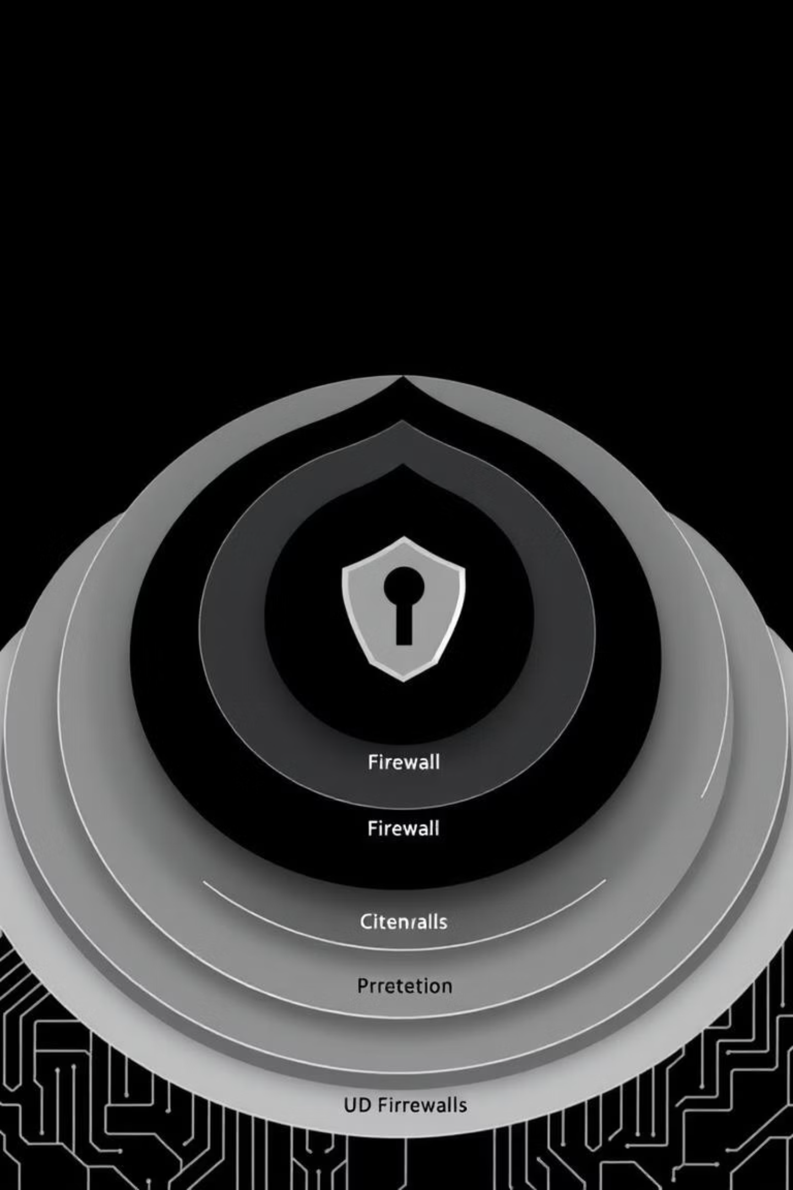
SECURITY ARCHITECTURE
Multi-Layered Defense: The Shield
Browser-Level Validation
Client-Side Scripting Filters
Initial checks performed directly within the user's browser, preventing many common attacks before they reach the server.
Filters to sanitize inputs and prevent malicious scripts from executing on the client side, reinforcing early threat detection.
Server-Side Logging
Comprehensive logging on the server to record all security events, crucial for forensic analysis and incident response.

Slide 4

REAL-TIME DETECTION
Immediate Threat Identification
Our system employs sophisticated "Pattern Matching" logic to analyze every login attempt and input field in real-time. This ensures immediate detection of SQL Injection (SQLi) and Cross-Site Scripting (XSS) patterns.
Upon detection, malicious input is instantly blocked from execution, and a detailed log is securely saved to the backend for further investigation.

Slide 5
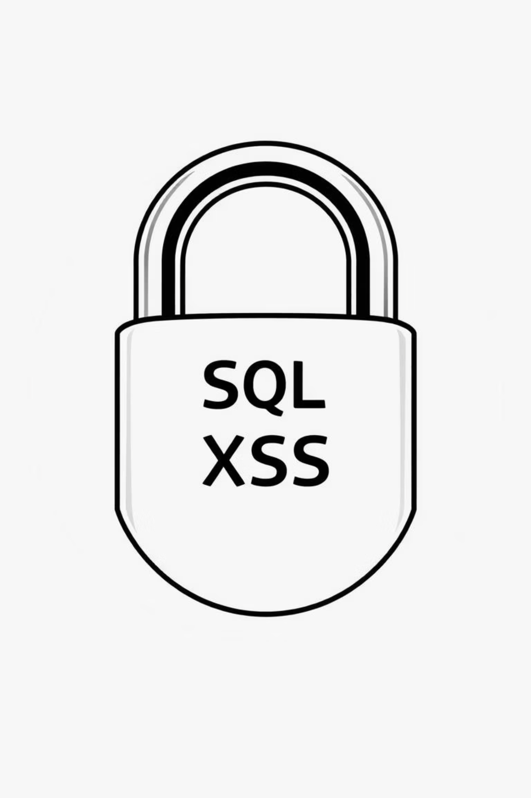
THREAT DETECTION CAPABILITIES
Targeted Protections
SQL Injection (SQLi) Defense
1
Utilizes Regular Expression (Regex) patterns to identify and block suspicious keywords like 'select', 'insert', and '--' at the entry point, safeguarding database integrity.
Cross-Site Scripting (XSS) Prevention
2
Filters out HTML tags and script-related characters (<, >, script) to prevent malicious scripts from executing and compromising user sessions.
Brute-Force Protection
3
Implements a "Login Attempt Counter" that automatically locks an IP address after more than 5 failed login attempts, thwarting credential stuffing attacks.

Slide 6
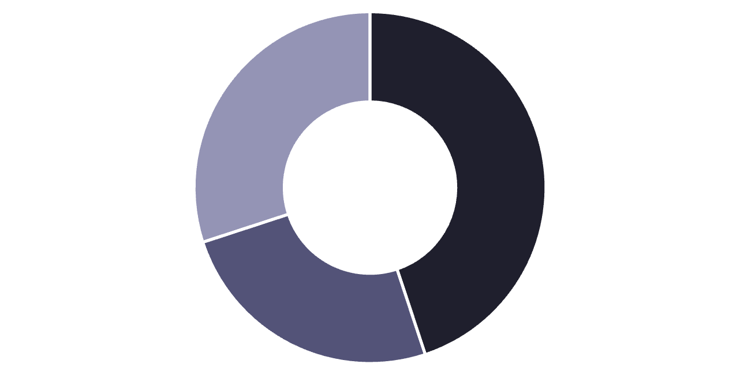
BEHAVIORAL INTELLIGENCE
IPS Monitor: Live Threat Dashboard
Our live threat dashboard provides visual analytics, illustrating the frequency and types of attacks (e.g., SQLi vs. Brute-force) through intuitive doughnut charts.
This immediate visualization allows security teams to grasp the current threat landscape at a glance, facilitating rapid response and strategic planning.
SQLi
XSS
Brute-Force

Slide 7
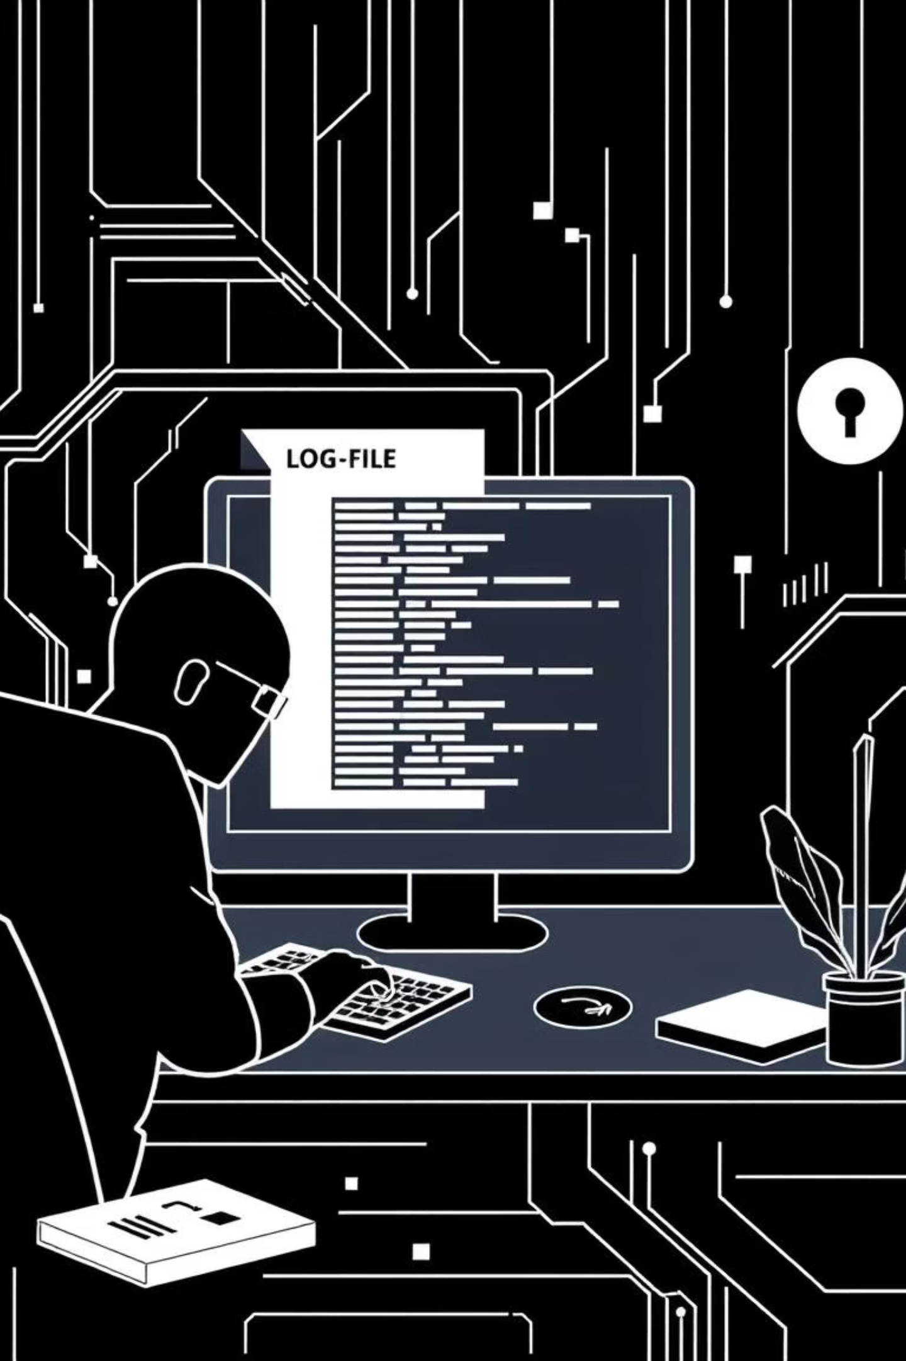
BEHAVIORAL INTELLIGENCE
Advanced Anomaly Detection
1
DDoS/Rate Limiting
Client-side IPS logic detects abnormal refresh frequencies (Anti-Refresh) and redirects suspicious users to a "403 Forbidden" page, mitigating DDoS attacks.
2
Security Audit Logs
A persistent file (security-audit.log) meticulously records each attack with timestamp and message, providing critical data for forensic analysis and post-incident review.

Slide 8


ADMIN CONTROLS
Active Response and System Lockdown
Active Response
Traffic Transparency
Administrators have "One-Click Control" directly from the dashboard to instantly block any identified malicious source IP, enabling swift containment of threats.
Live data fetching from the server provides a real-time overview of the network's current security state, ensuring informed decision-making.
System Lockdown
Measures like F12 (Inspect Element) and Right-click protection are implemented to prevent unauthorized access and "reverse engineering" of sensitive client-side code.

Slide 9

SECURITY IMPACT
Proactive and Scalable Security
Proactive Defense
This project shifts focus from reactive security measures to a proactive defense strategy, anticipating and neutralizing threats before they can inflict damage.
Scalable Framework
The designed security framework is highly scalable and can be seamlessly integrated as a robust security layer within any web application, regardless of its size or complexity.

Slide 10


