Slide 1
HANGMAN GAME
An Object-Oriented Programming through Java Course project by:
MD NABEEL AHMED (2103A51058)
K NIKHIL (2103A51130)
G VIGNESH (2103A51353)
HEY Y’ALL...
INTRODUCTION

Slide 2

CONTENTS
1. OBJECTIVES.
2. ELEMENTS USED IN THE
PROJECT.
3. SCREENS, TESTCASES,
TEST RESULTS.
CONTENTS.

Slide 3
1.OBJECTIVE
"Hangman Game in Java" project is a classic word-guessing game developed using the Java programming language. The game is designed to entertain and challenge players by testing their vocabulary and word-guessing skills. It provides an interactive and user-friendly interface, making it enjoyable for players of all ages.
The objective of the Hangman Game Project in Java with GUI is to design and implement an interactive and visually appealing hangman game application that provides an engaging user experience.
The project aims to incorporate key programming concepts and features, including but not limited to:
1.Graphical User Interface (GUI)
2.Game Logic
3.Word Database
4.User Feedback
5.User Feedback
6.Customization Options
7.Error Handling
8.Testing

Slide 4




2.ELEMENTS USED IN THE PROJECT
Design
Results
Swing
(javax.swing)
Abstract Window Toolkit
(java.awt)

Slide 5
SWING(javax.swing)
Swing is a set of graphical user interface (GUI) components and tools included in the Java Standard Edition (Java SE) platform. It provides a rich set of libraries for creating and managing interactive graphical applications in Java.
Jframe.
Jpanel.
Jbutton.
Jlabel.
LayoutManager.

Slide 6
II.ABSTRACT WINDOW TOOLKIT(java.awt)
AWT (Abstract Window Toolkit) is a set of application programming interfaces (APIs) developed by Sun Microsystems (now owned by Oracle) as part of the Java Standard Edition (Java SE) platform.
ActionListener
Graphics
Random Class
StringBuilder

Slide 7
III.DESIGN
The design of a functional Hangman Game is broken down into the following elements which use the modules to make the game functional:
User Interface (UI)
Game Initialization.
File-Based Word List (Updated).
Word Selection.
Game Logic.
User Interaction.
Hangman Drawing Panel.
Game Outcome Handling.
Random Word Selection.
Game Reset.
Object-Oriented Approach.

Slide 8
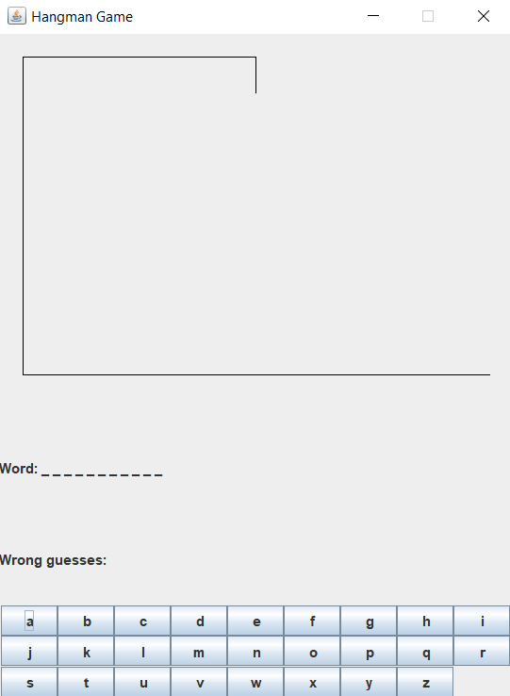
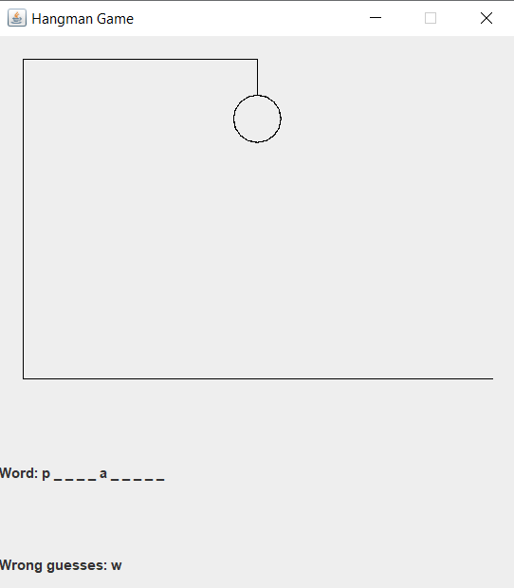
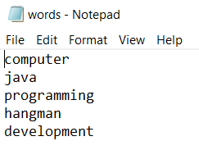


FILE-BASED WORD LIST (UPDATED)
WORD SELECTION
GAME INITIALIZATION
GAME LOGIC
USER INTERACTION

Slide 9
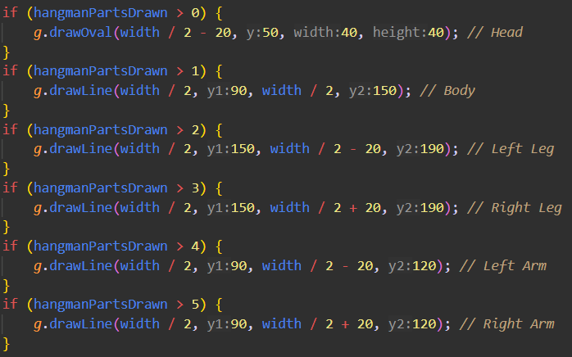
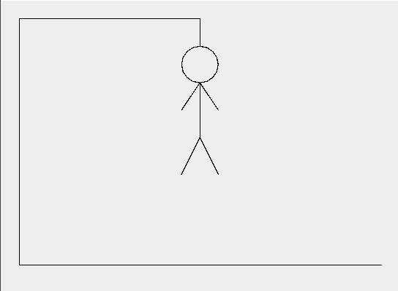
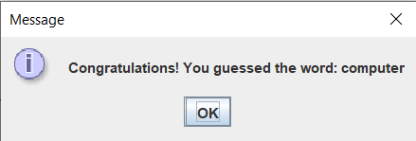
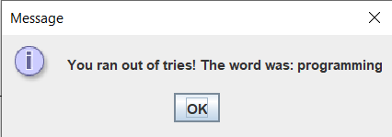
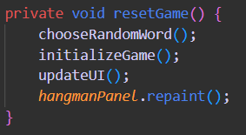
HANGMAN DRAWING PANEL
GAME OUTCOME HANDLING
RANDOM WORD SELECTION
GAME RESET

Slide 10
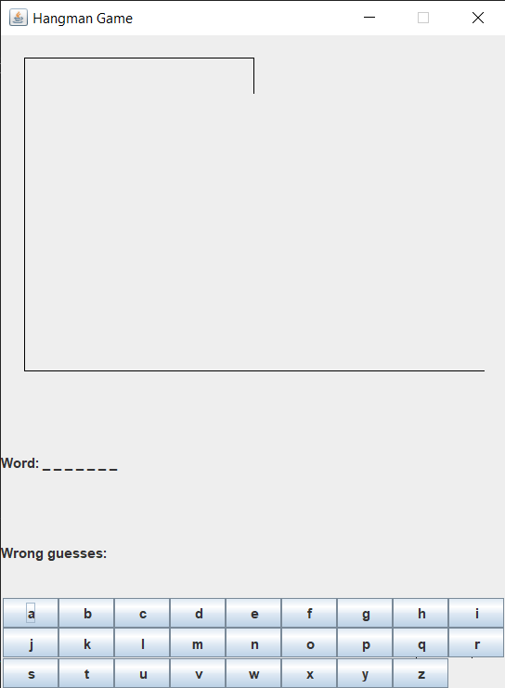
IV.IMPLMENTATIONS & RESULTS
GUI of Hangman Game at the beginning of the game:

Slide 11
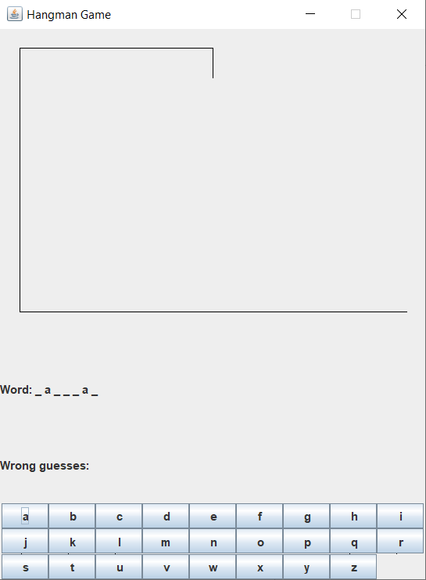
IMPLMENTATIONS & RESULTS
When player guesses the right letter:

Slide 12
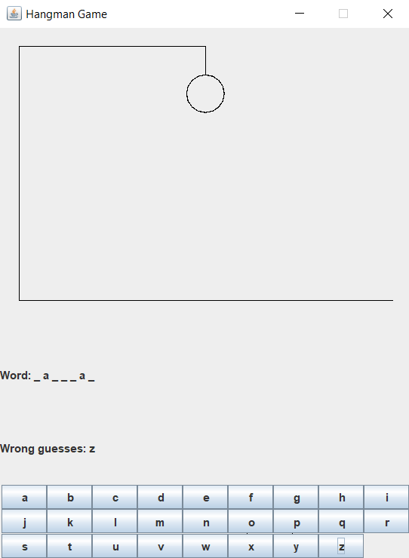
IMPLMENTATIONS & RESULTS
When player guesses the wrong letter:

Slide 13
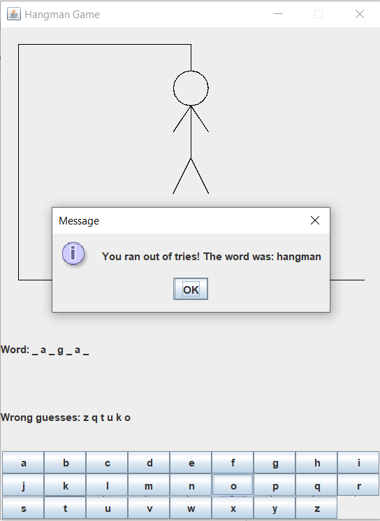
IMPLMENTATIONS & RESULTS
When player runs out of tries and loses:

Slide 14
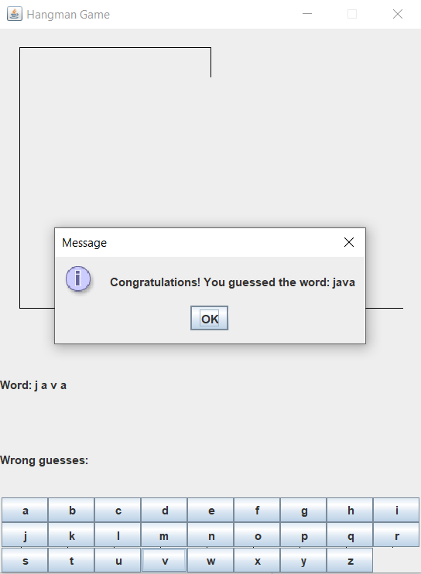
IMPLMENTATIONS & RESULTS
When player guesses the word right:

Slide 15
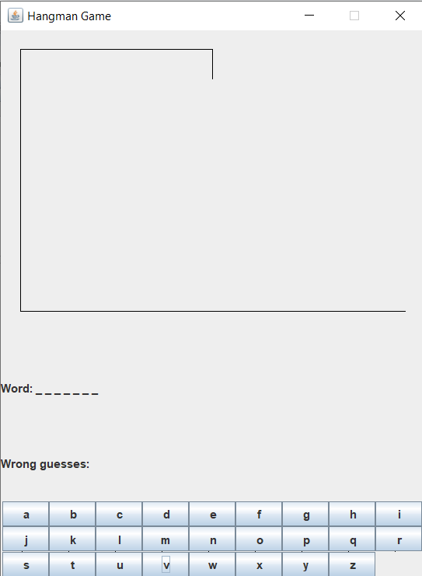
IMPLMENTATIONS & RESULTS
When player clicks on OK after winning or loosing:

Slide 16









RESPECT THE DEADLINE.
PROJECT# | TEAM | DEADLINE | TIME THAT REMAINS | TASKS THAT REMAIN
46412321=091 | 616 | 30.10.2023 | 02:15:02 | 161
46409821=590 | 199999 | 10.11.2023 | 00:02:04 | 8
46417171=717 | 17 | 17.07.2017 | 17:17:17 | 17
46454356=077 | 9 | 18.15.1413 | 19:18:15 | 14131
46423454=432 | 12 | 15.11.9125 | 91:21:59 | 12159

