Slide 1
BijliCast: Hourly Demand Intelligence
[Team Name] | Data-to-Decision · Energy demand | K-Electric & 9 DISCOs
Notes:
BijliCast forecasts the hourly electricity demand of K-Electric (Karachi) and Pakistan's nine other distribution companies a month ahead, using only official Pakistani data, and explains every number.

Slide 2
Problem Statement
THE PROBLEM
1
Who is affected?
Each month, K-Electric must decide how much grid power to plan for every hour ahead. The usual method copies last year's numbers, but Karachi's grid draw jumped in 2025-26, fuel prices spiked, and even official ISMO files contain errors. A wrong peak means load-shedding or crores wasted.
KE planners, 9 DISCOs, Karachi homes & industry
2
Why does it matter?
Evening peak = 22-31% of KE's daily grid cost
3
Our goal
Beat "copy last year" by 10%+, with 80% ranges
Notes:
Primary user: K-Electric's demand-planning and power-procurement desk. Decision: how much to draw from the national grid for each hour of next month, and when to run demand-response messaging. Today's default is last year's same month, which is our declared baseline.

Slide 3
Dataset Declaration
Dataset name | ISMO hourly demand: K-Electric + 9 DISCOs ISMO marginal prices · ERA5 weather
Source / link | ismo.gov.pk downloads · Open-Meteo ERA5 API NEPRA, IGCEP and K-Electric documents
Size | 459,275 cleaned rows from 163 raw files (49 MB), each SHA-256 fingerprinted
Time period | Demand: Sep 2023 – Sep 2026 Prices: Jul 2024 – Sep 2026 Weather: Jan 2022 – Oct 2026
Format & license | XLSX: public ISMO data, with attribution JSON: Open-Meteo, CC BY 4.0 (ERA5)
Key features / target | Target: mean MW for each hour of the month 21 features: demand lags, weather, Ramadan
459K
Rows / records
21
Model features
49 MB
Raw data (163 files)
Notes:
All demand data is ISMO's public monthly publications: the average demand for each hour of the day, per company. Weather is ERA5 for each DISCO's headquarters city. The manifest records source, fetch time, SHA-256 and licence for every file; raw files are never edited.

Slide 4
Pipeline Used
1
2
3
4
5
Data Collection
Data Cleaning
Analysis / EDA
Modeling
Dashboard / App
ISMO workbooks, prices, ERA5 API; SHA-256 manifest
Data Quality Agent: fix, fill or flag, with a reason
Load shapes, drift checks, Peak Cost Lens
Gradient boosting with 80% ranges, vs baseline
FastAPI dashboard, EN/UR assistant, hourly Prefect
Official ISMO data in → checked hourly forecasts, costs and cited advice out
Notes:
Raw files land unedited with a SHA-256 manifest. The Data Quality Agent writes cleaned tables and a decision log; gold tables carry stable row IDs. The model and the assistant read only gold. A Supervisor agent runs the whole chain every hour through Prefect.

Slide 5
Pipeline Details & Tools
Stage | Tools / Libraries | What we did
Collection | Python, requests, SHA-256 manifest | Public ISMO links only; every raw file fingerprinted, never edited
Preprocessing | pandas, pandera, DuckDB | Data Quality Agent: FIX / FILL / FLAG with a reason; RED quality keeps last good data
Analysis / EDA | DuckDB SQL, matplotlib | Hourly load shapes by season; drift monitor; Peak Cost Lens at ISMO prices
Modeling | scikit-learn HistGradientBoosting, conformal ranges | Rolling-origin tuning; scored once on 7 unseen months vs the declared baseline
Dashboard / App | FastAPI, JavaScript, Prefect, FAISS + BM25 | Hourly pipeline; dashboard and EN/UR assistant with row IDs and citations
Notes:
Everything is reproducible: `make data` rebuilds the warehouse from an empty folder, `make model` trains and evaluates once against the baseline, and `make flow` runs the Prefect flow.

Slide 6
How BijliCast Works
ASK BIJLICAST · A REAL ANSWER
1
Data Quality Agent
Q: Compare next month with last year
K-Electric's November 2026 demand averages 2,062 MW, +17.5% on November 2025. Its peak (01:00) falls outside the 6-10 PM tariff peak, so plan night-time grid purchases.
48 row IDs (FC-KE-202611-01 …) · Source: K-Electric Tariff Structure [DOC-KETOU]
Numbers from row IDs · advice cited · English & Urdu · says "I don't know"
Fix, fill or flag every file, with a reason
2
Forecast model
Gradient boosting + conformal 80% ranges
3
Supervisor + Prefect
Runs hourly; a failed quality gate keeps the last good data
Notes:
Numbers in answers are inserted by code from SQL on gold tables, so the language layer cannot invent them. Recommendations cite a trusted document page. The golden test set of 12 questions passes 12/12, including 'I don't know' and premise correction.

Slide 7
Results: Model vs Baseline
13.5%
Overall · baseline 18.0%
10.1%
K-Electric · baseline 17.3%
12.5%
Evening peak · baseline 16.9%
Error (MAPE %) on 7 unseen months, Jan-Sep 2026 (ISMO did not publish Jun-Jul). Lower is better. IESCO and FESCO show no real gain.
Notes:
Test set: Jan-Sep 2026, 1,680 rows (10 companies x 24 hours x 7 months), used once. Overall error falls from 17.97% to 13.49%, 25% lower. K-Electric: 10.11% vs 17.31%, mean error 204 MW vs 338 MW. The 80% ranges cover 75.9%: slightly narrow, worst in summer. We compare with the declared baseline, not with K-Electric's internal forecasts, which are not public.

Slide 8
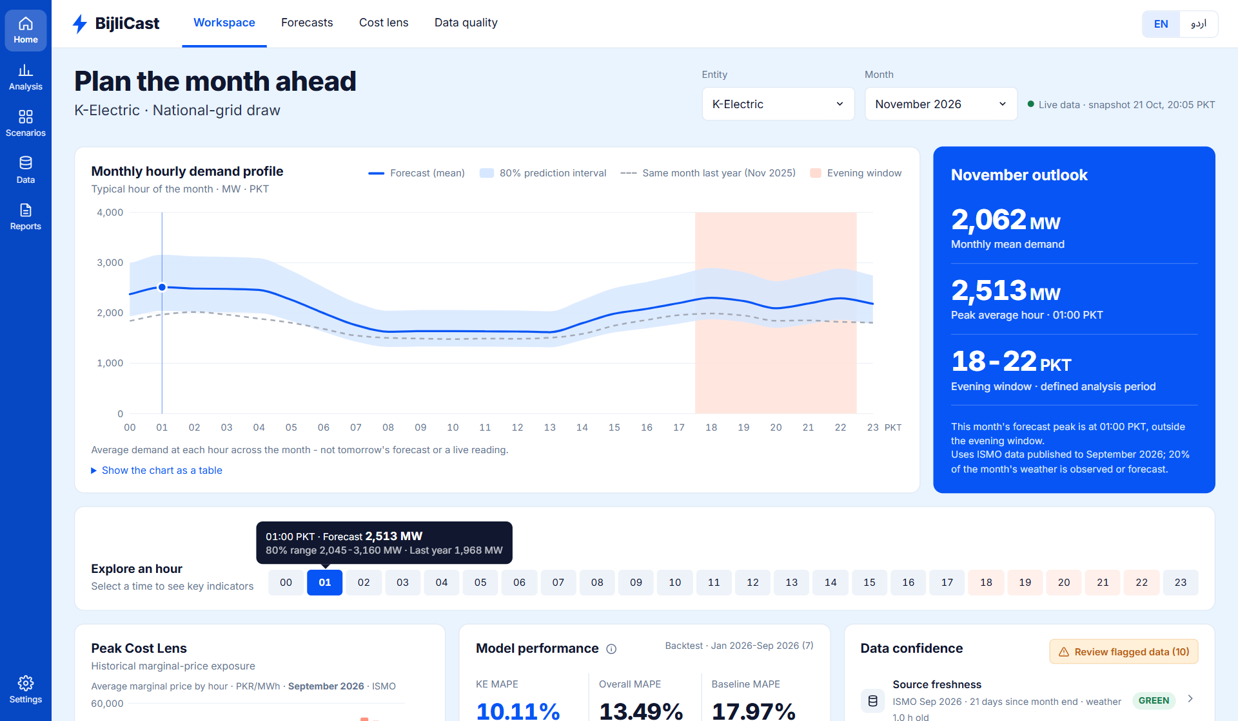
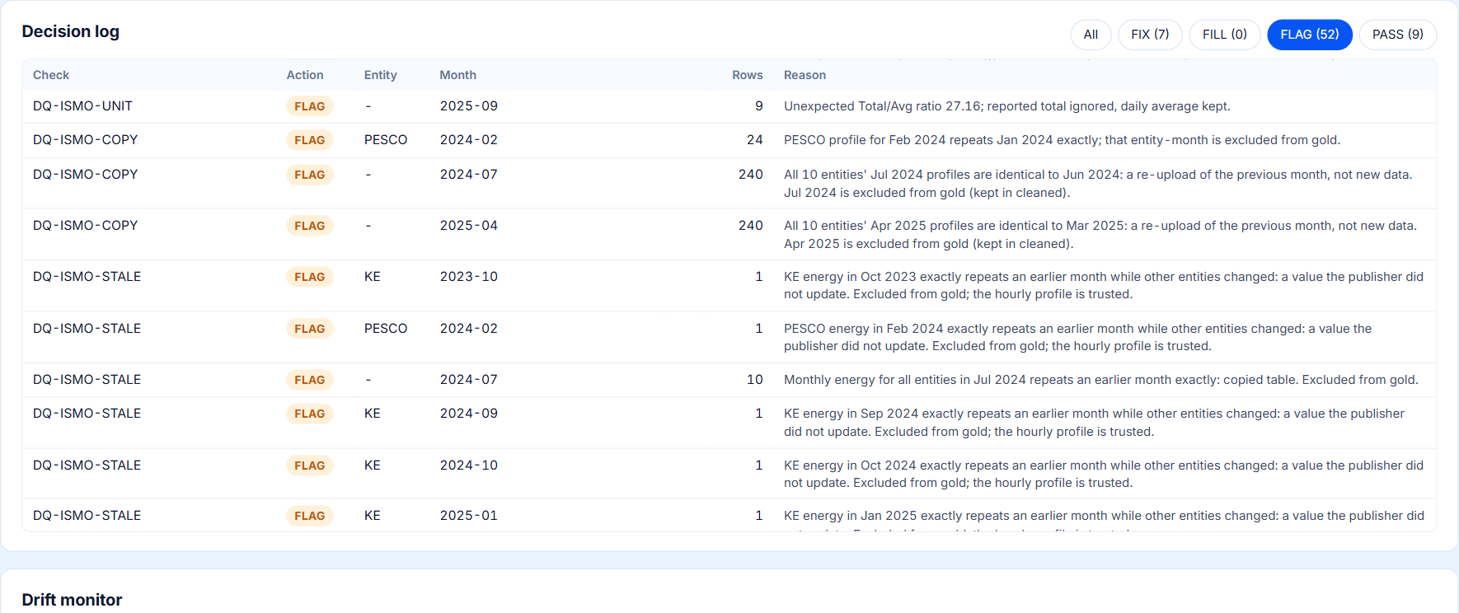
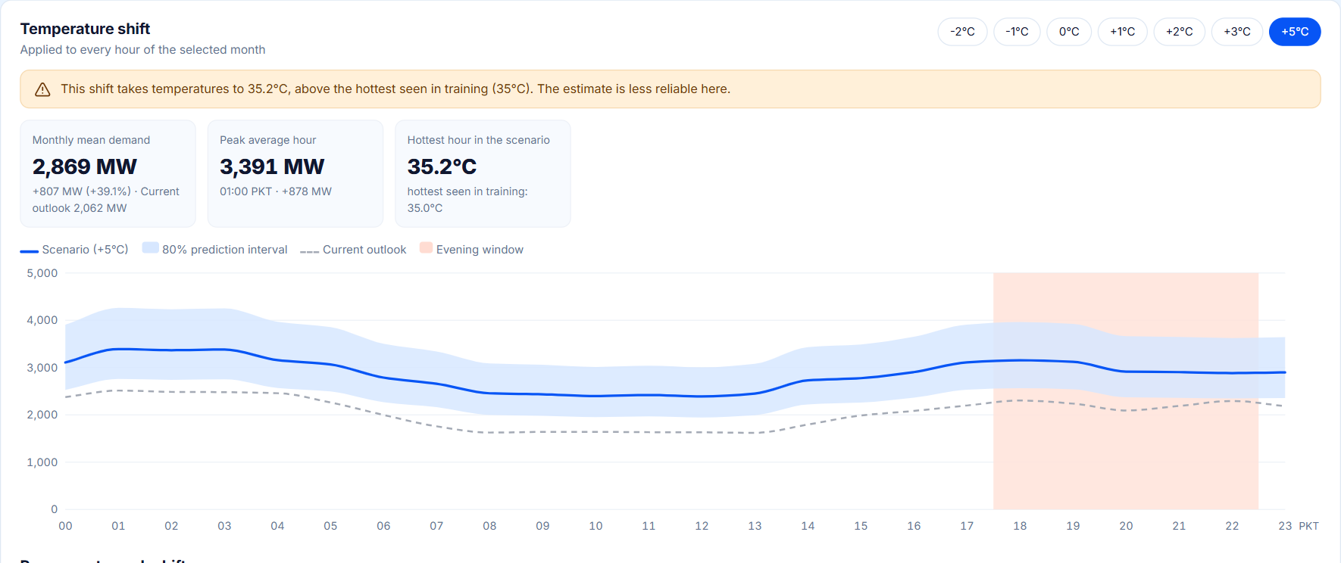
Dashboard / App Views
Data quality: decision log
Workspace: hourly forecast and outlook
Scenarios: +5 °C hotter
Live demo: nabeelali0960-bijlicast.static.hf.space | Code: github.com/nabeelali0707/hack-insight-hacakthon
Notes:
Workspace: pick a company and month; the chart shows the hourly forecast, its 80% range, last year and the evening tariff window, with the outlook card and Peak Cost Lens below. Data quality: every decision with its reason; here the copied ISMO months. Scenarios: re-forecast with temperatures shifted -2 to +5 °C, with a warning outside the training range.

Slide 9
Business Model
Who uses it
VALUE
1
K-Electric's procurement desk; planners at the 9 DISCOs; ISMO and NEPRA analysts
Rs 83.9M a day
less mismatch exposure than the baseline (K-Electric, test months, at ISMO prices)
2
Who pays
K-Electric licence (API, alerts, retraining); DISCOs via CTBCM programmes; free public tier
IF ONLY 1% IS CAPTURED
≈ Rs 306M a year
far above the running cost; exposure is money at risk, not a guaranteed saving
3
What it costs to run
About US$20 a month of compute, free Hugging Face hosting, a quarter-time analyst
Notes:
Exposure = forecast mismatch (MWh) priced at ISMO's hourly marginal price, from gold rows EC-KE-202601 to EC-KE-202609. It is money at risk from planning to the wrong number, not a saving K-Electric banks automatically; contracts and dispatch rules decide how much can be captured. Freemium: public dashboard and Urdu briefs are free; planner-grade forecasts, alerts and the API are paid.

Slide 10
Conclusion
25% lower error than the declared baseline
IMPACT
1
13.5% vs 18.0% MAPE on 7 unseen months, all 10 companies × 24 hours
Planners see every hour's grid draw with an 80% range, its cost and cited advice, in English or Urdu.
2
K-Electric's error cut by 42%
10.1% vs 17.3% MAPE; average miss 204 MW vs 338 MW
FUTURE WORK
Daily forecasts once ISMO publishes daily data; K‑Electric feeder data; better summer peaks.
3
Official data needed checking
The agent caught copied months, stale values and unit changes in ISMO files: 52 flags, each with a reason
Notes:
Limits we report: IESCO and FESCO show no gain; summer peaks are under-forecast (bias about -11%); the 80% ranges cover 75.9%. Outputs are planning information, not an official ISMO or NEPRA forecast.

Slide 11
Team & Credits
[TEAM NAME]
AB
AB
AB
AB
[Member Name]
[Member Name]
[Member Name]
[Member Name]
[Role | Roll No.]
[Role | Roll No.]
[Role | Roll No.]
[Role | Roll No.]
Mentor / Supervisor: [Name] | Contact: github.com/nabeelali0707/hack-insight-hacakthon
Thank you!
Notes:
Every team member should be ready to explain the code, the data quality decisions, the baseline, the business model and the optimisation log at the viva.

