Slide 1
AIS APSACS Information System

Slide 2
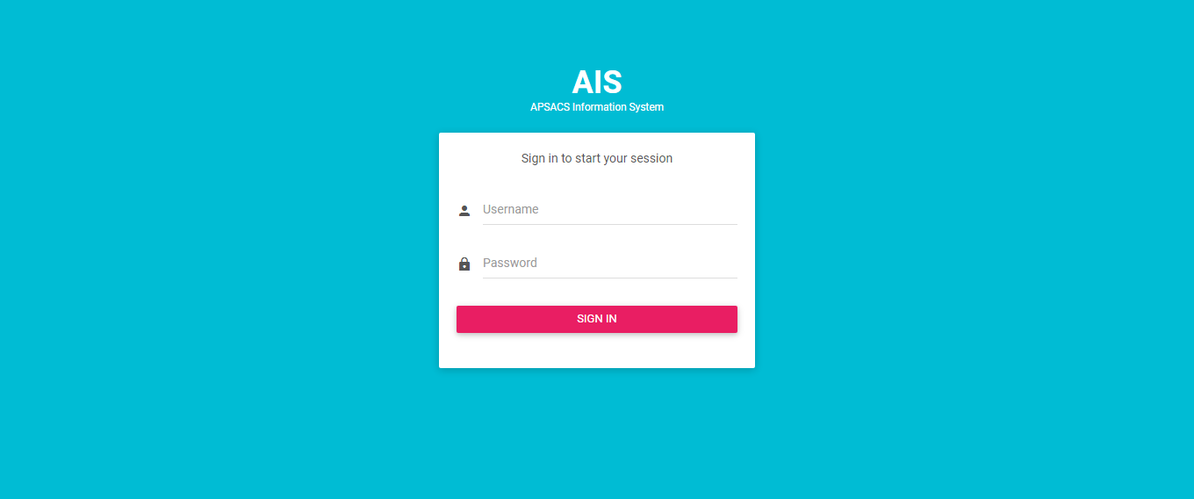
AIS LOGIN

Slide 3
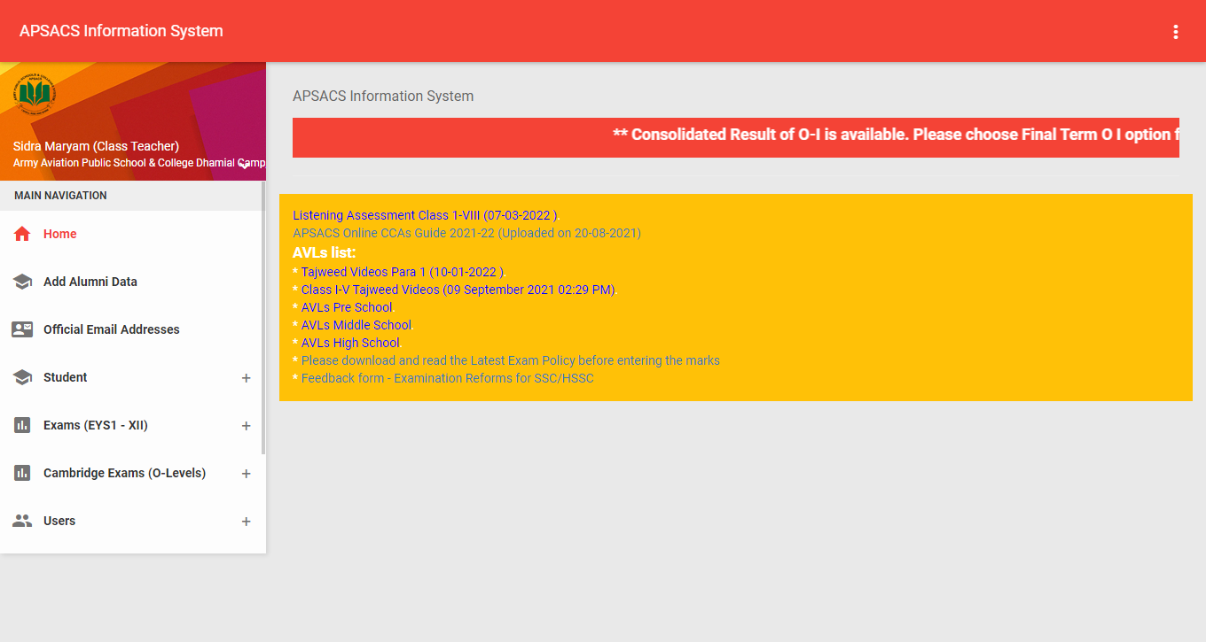
AIS DASHBOAD

Slide 4
OPEN THE EXAMS (EYS1 - XII)

Slide 5
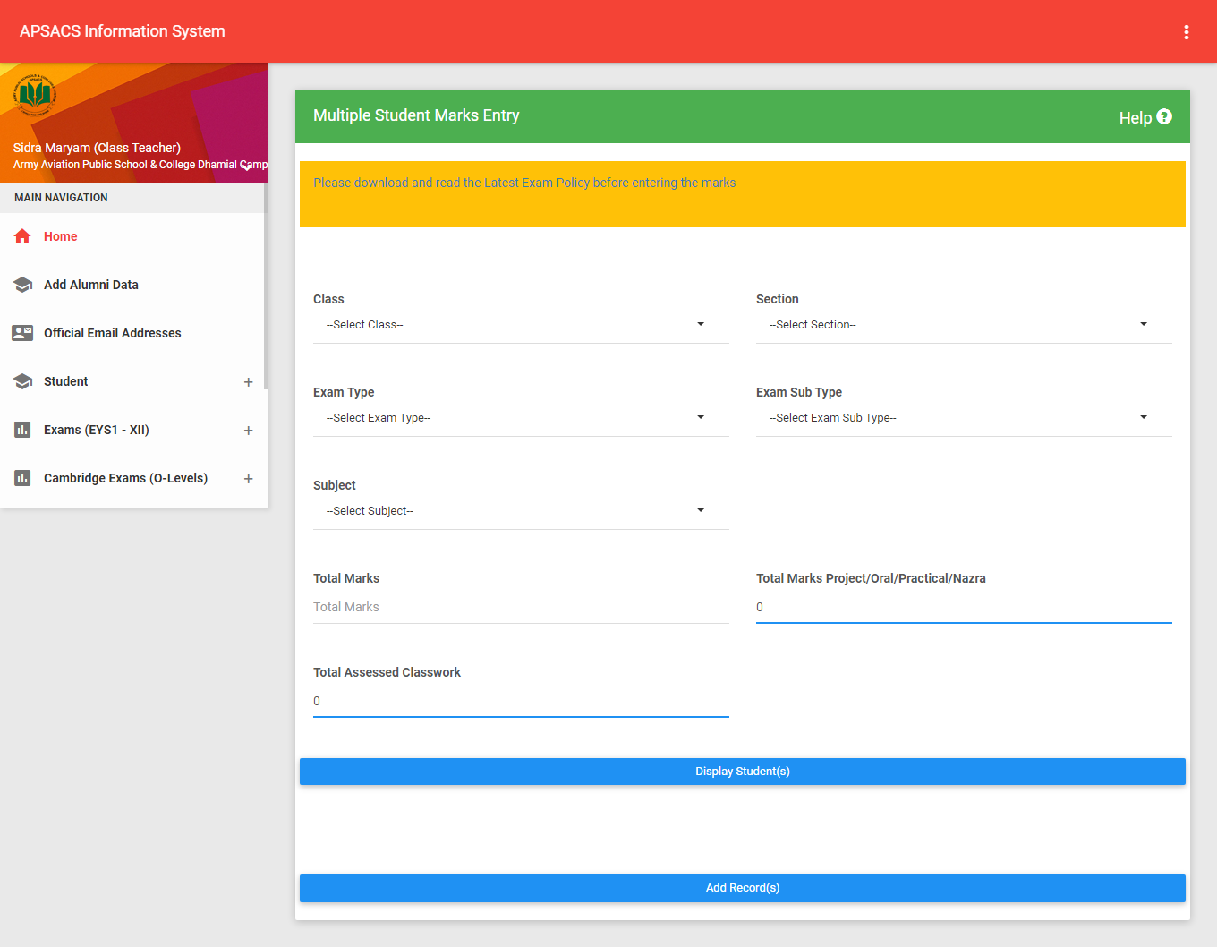
MULIPLE MARKS ENTRY

Slide 6
MARK ENTRY

Slide 7
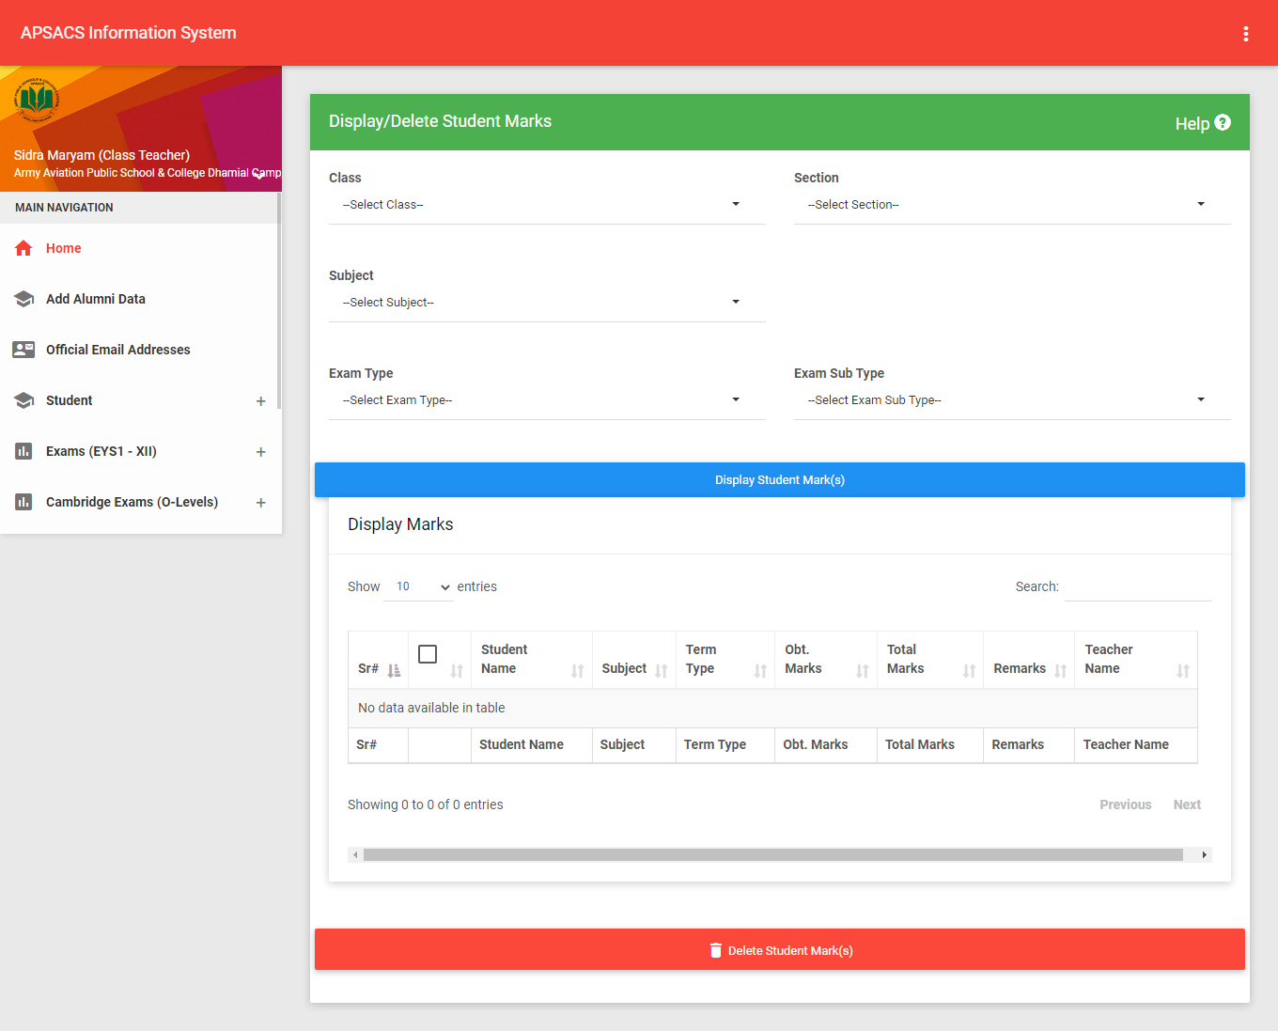
DELETE MARKS

Slide 8
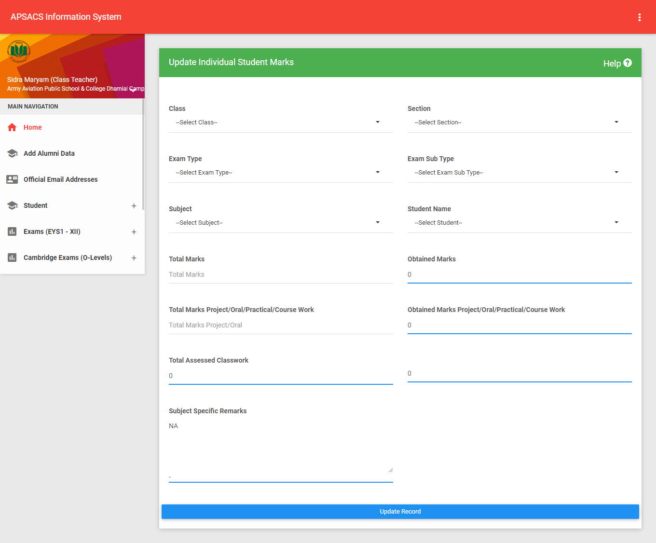
UPDATE MARKS

Slide 9
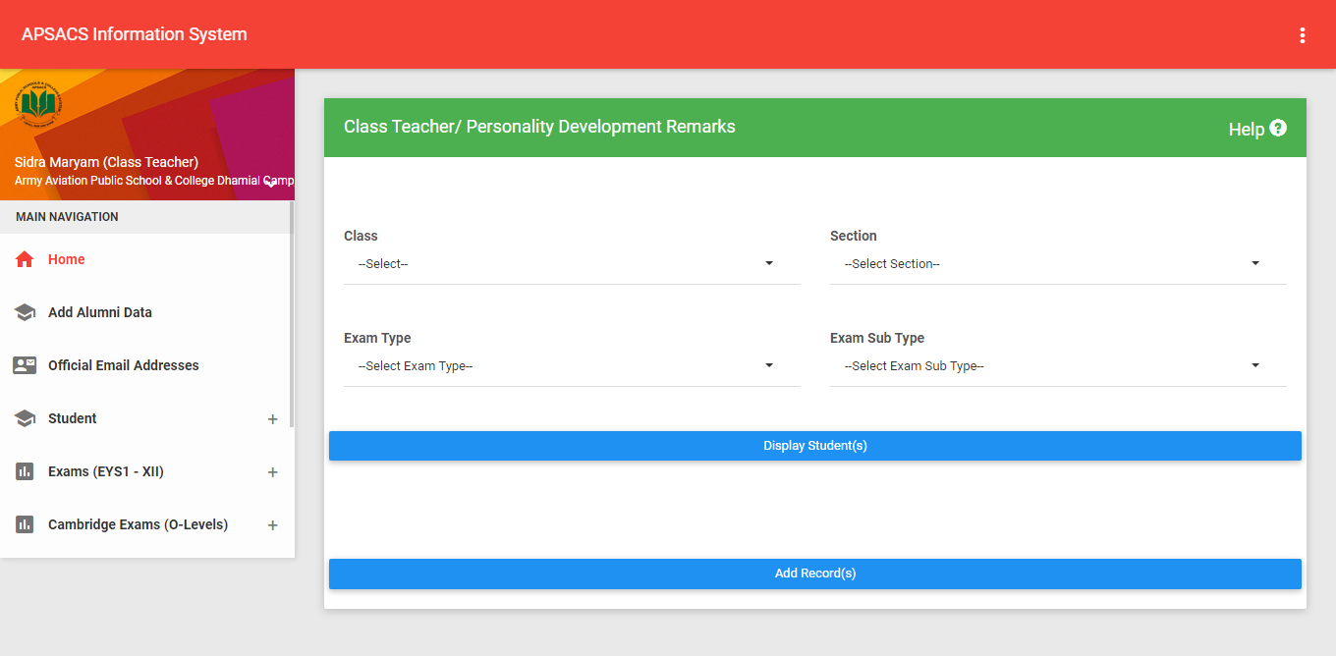
CLASS TEACHER PDR RE-MARKS

Slide 10
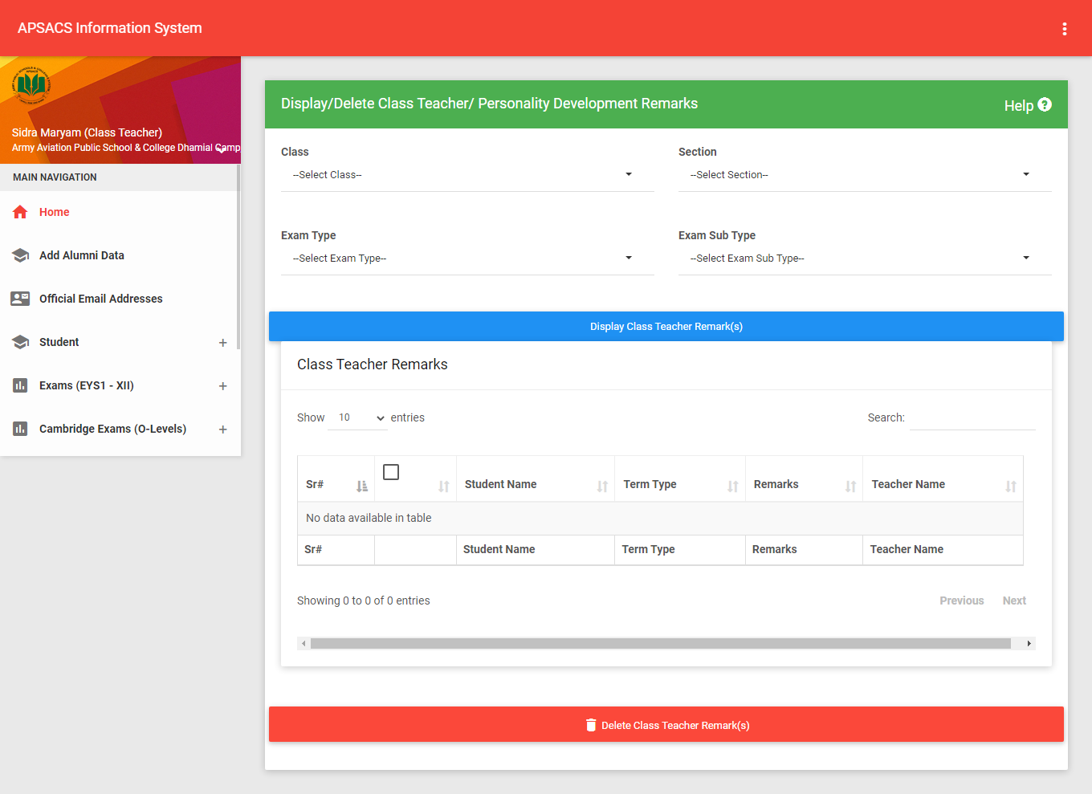
DELETE CLASS TEACHER/ PDR REMARK

Slide 11
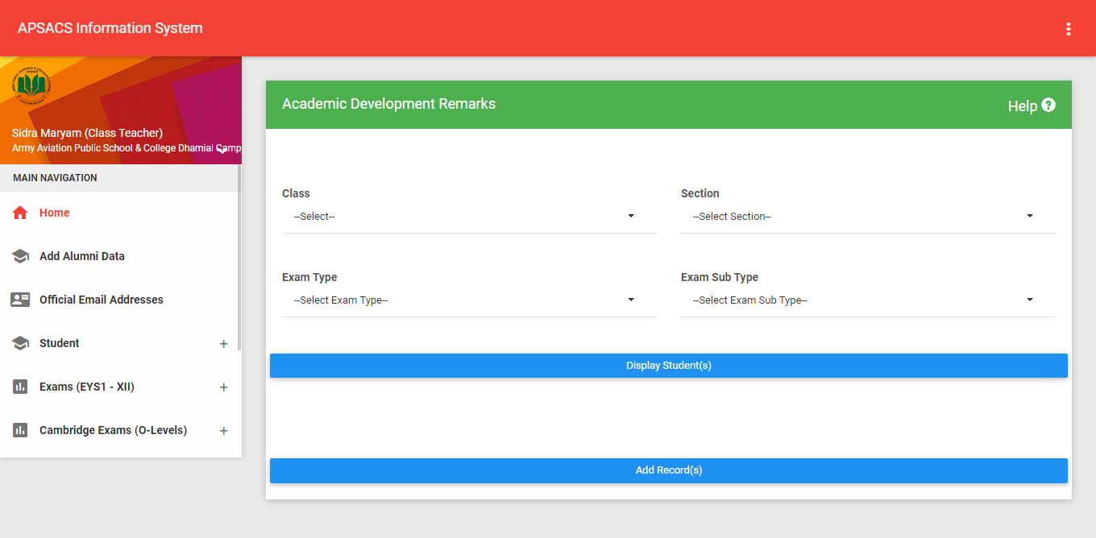
ACADEMIC DEVELOPMENT RECORD

Slide 12
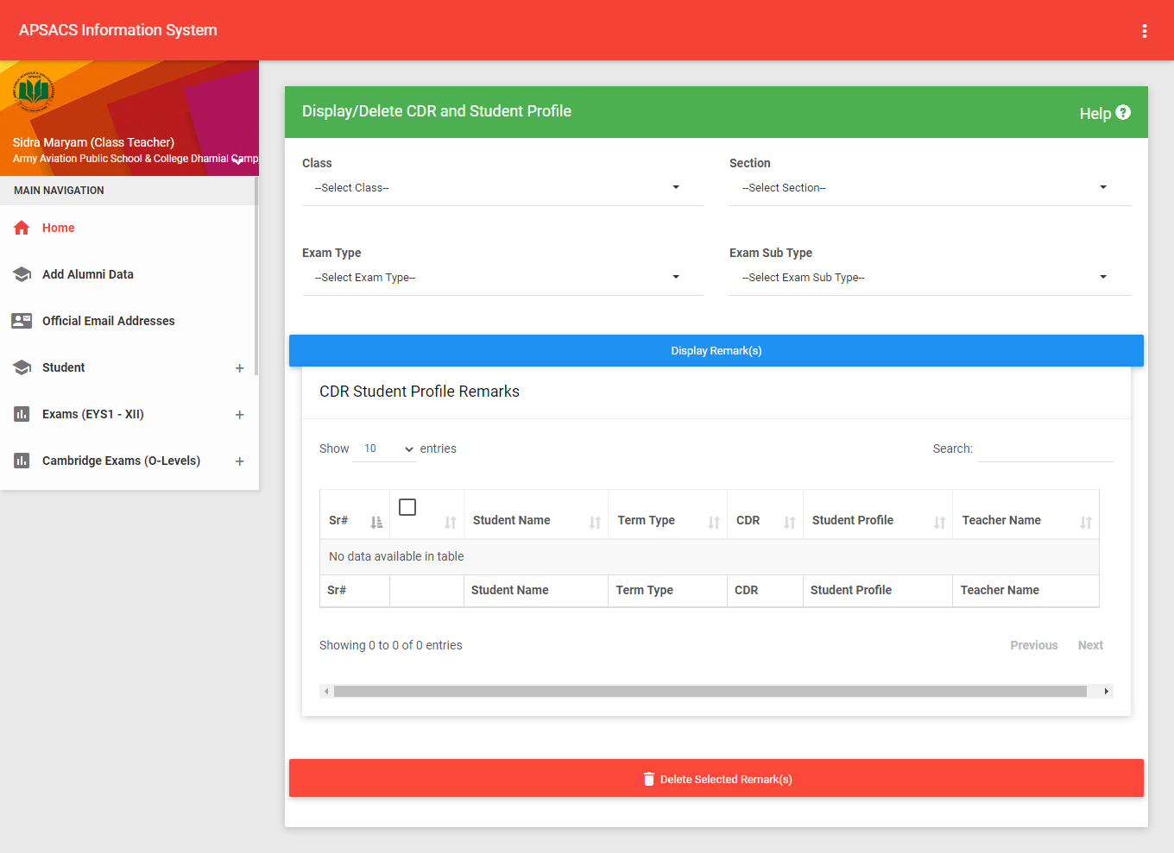
DELETE ACADEMIC DEVELOPMENT RECORD

Slide 13
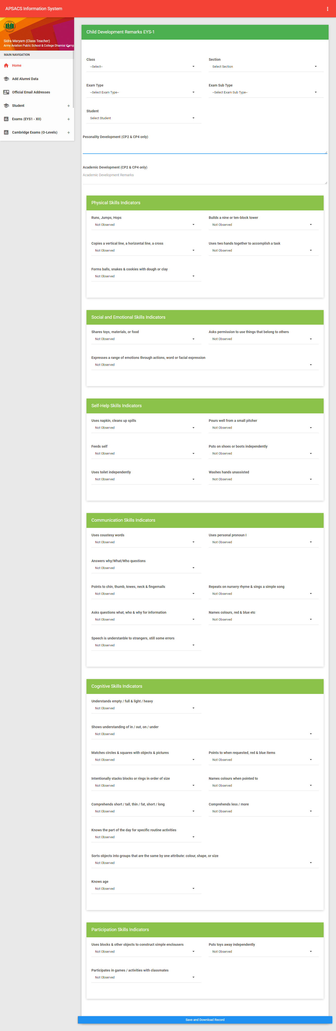
CDR FOR CLASS (EYS-1)

Slide 14
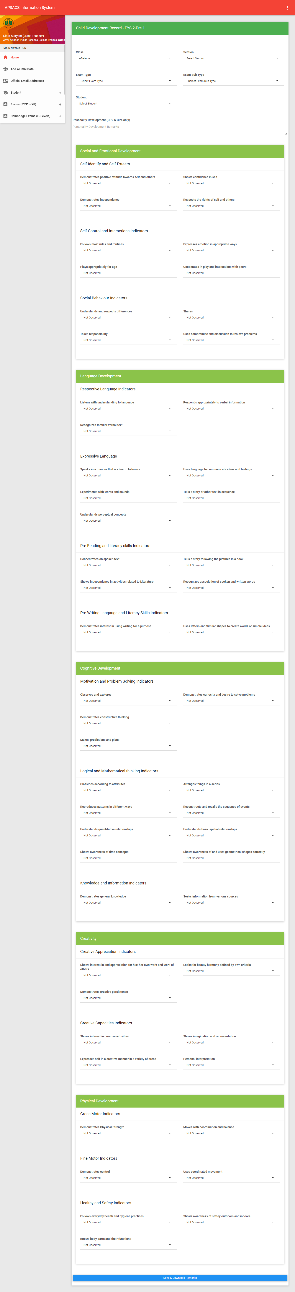
CDR for Class (EYS 2-Pre)

Slide 15
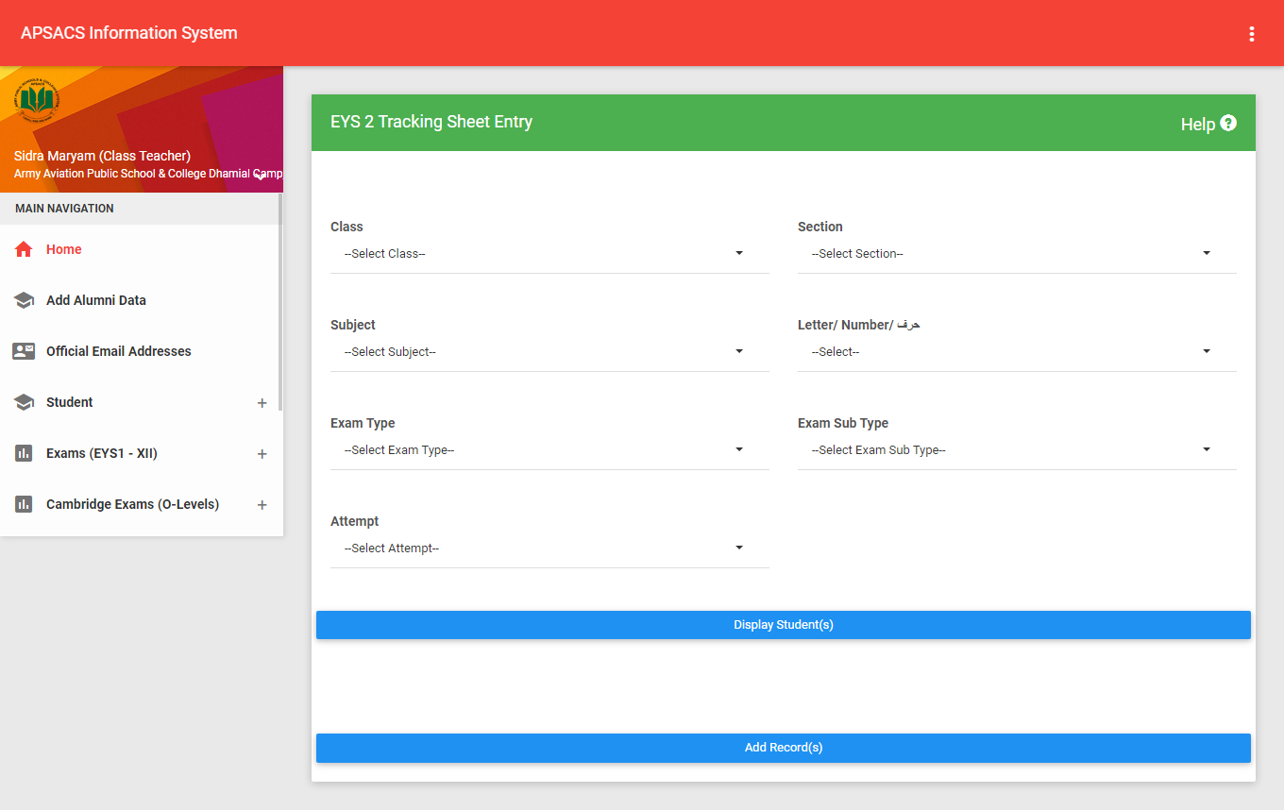
TRACKING SHEET (EYS-2)
Tracking Sheet (EYS-2)

Slide 16
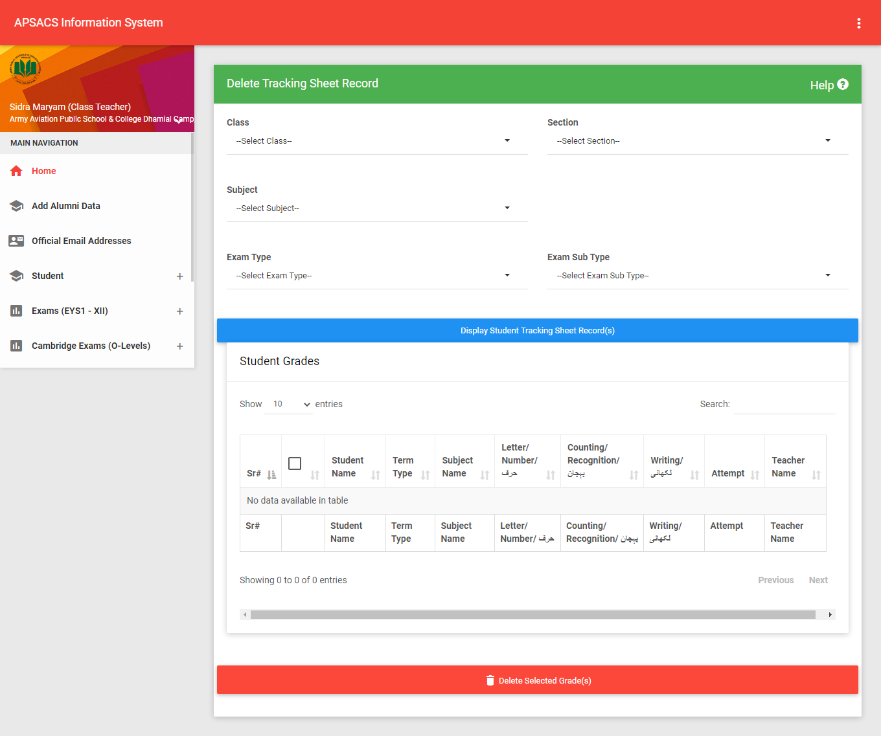
DELETE TRACKING SHEET (EYS-2)

Slide 17
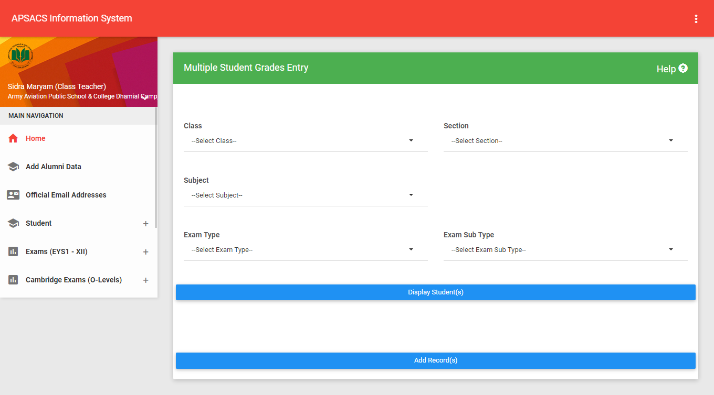
GRADE ENTRY

Slide 18
THANKS

