Slide 1

Case I - Hult International Business School Student Spotlight
Presented by: Nabeel Keloth
Text Analytics and Natural Language Process

Slide 2
Agenda
Purpose of the Anlysis
Problem Satement
Methodology
Explore the dataset
Visualization
Key Insights
Recommendation

Slide 3

Purpose of the Anlysis
To evaluate the student’s behaviors and interests at Hult.
To identify the new opportunities to improve the brand awareness of the business school.

Slide 4

Problem Satement
How might Hult develop and establish a market strategy in a feasible manner to increase the admission rate by 5% for the upcoming academic period?

Slide 5
Methodology
R
Libraries: qdap, tm, wordcloud, pbapply, RColorBrewer, ggplot2,
plotrix, ggthemes, ggalt, readr
CleanCorpus
Stopwords: Smart and a few sentences

Slide 6
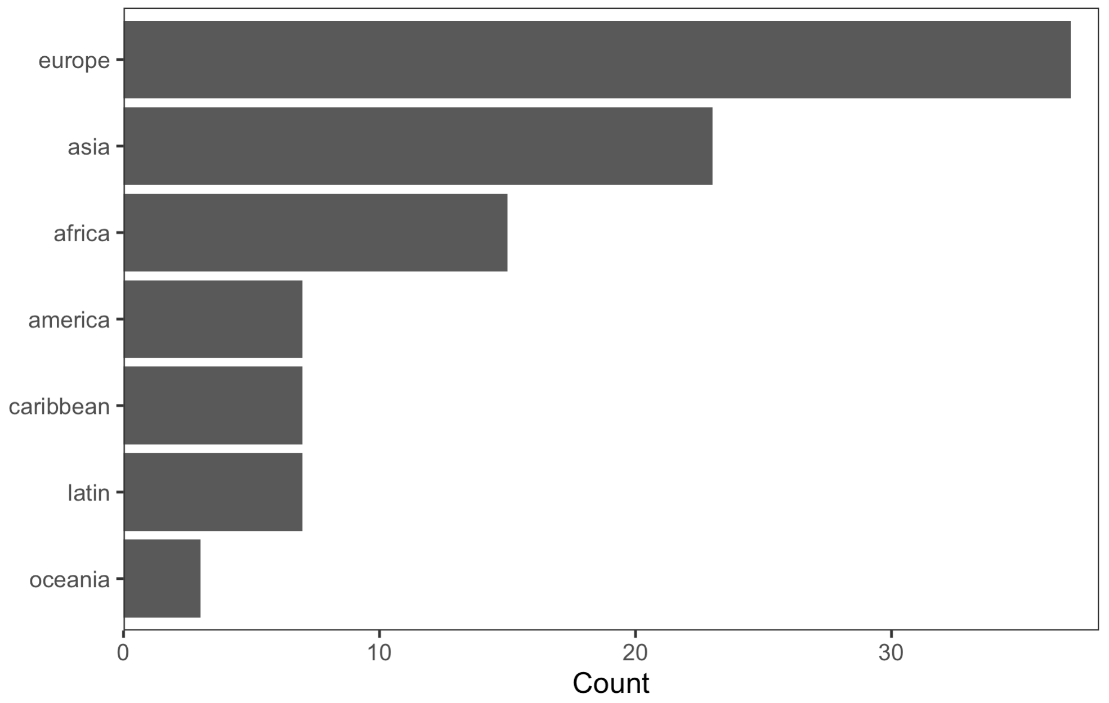
Explore the dataset
Region

Slide 7
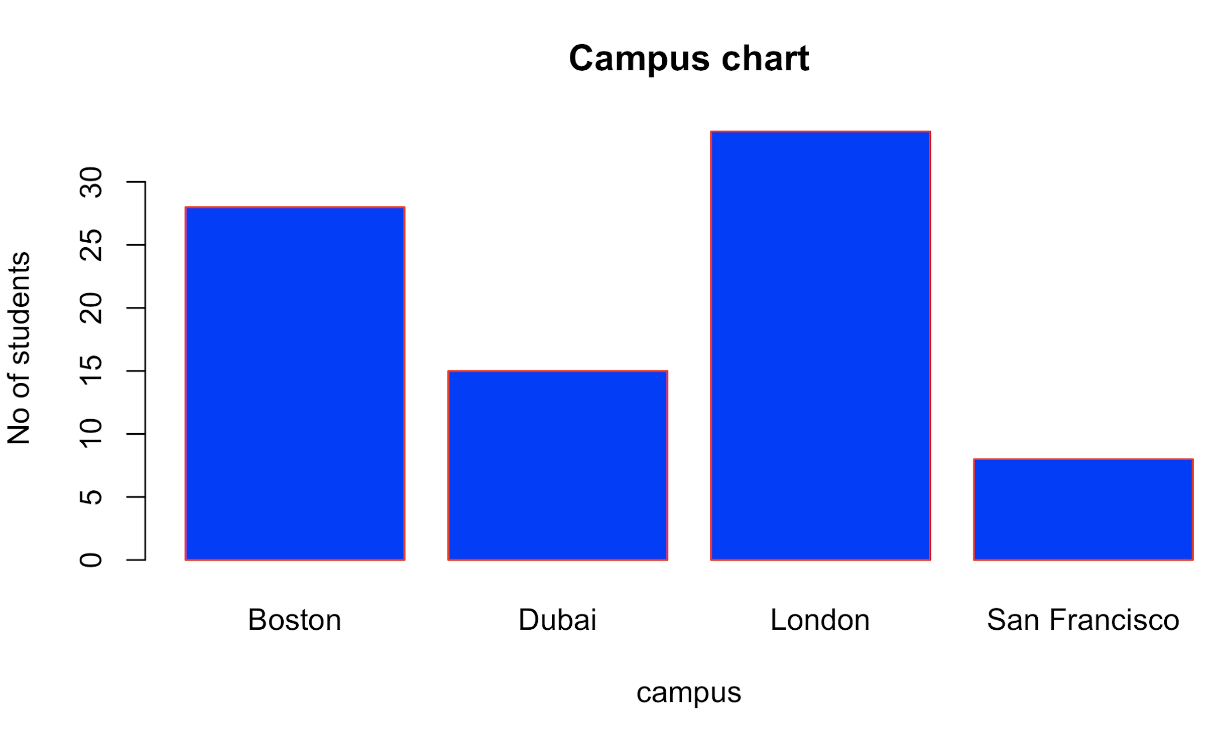
Explore the dataset

Slide 8
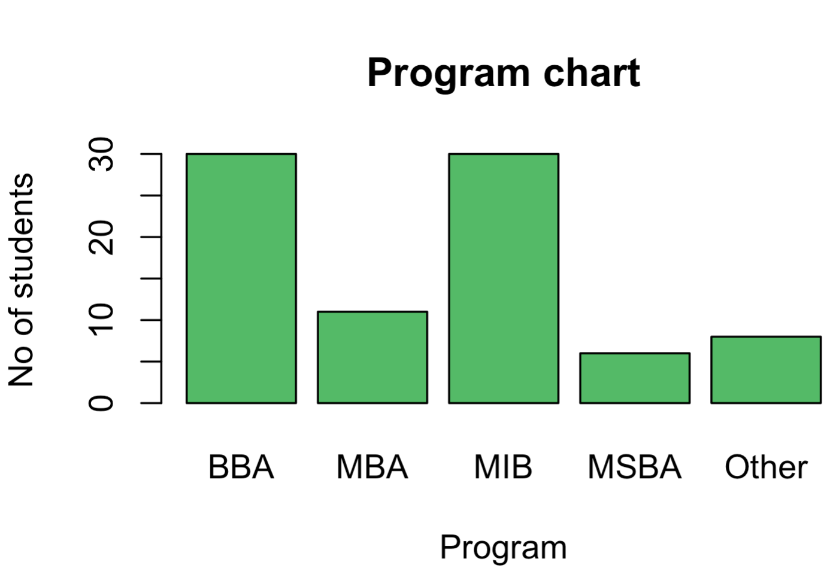
Explore the dataset

Slide 9
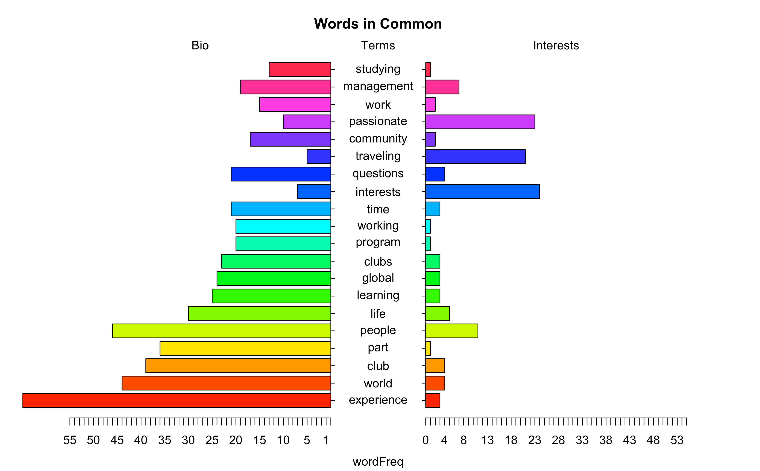
Visualization: Pyramid plot
As the pyramid plot shows, there are several words that are common in bio and interest. Therefore, concatenating these two columns for further analysis

Slide 10
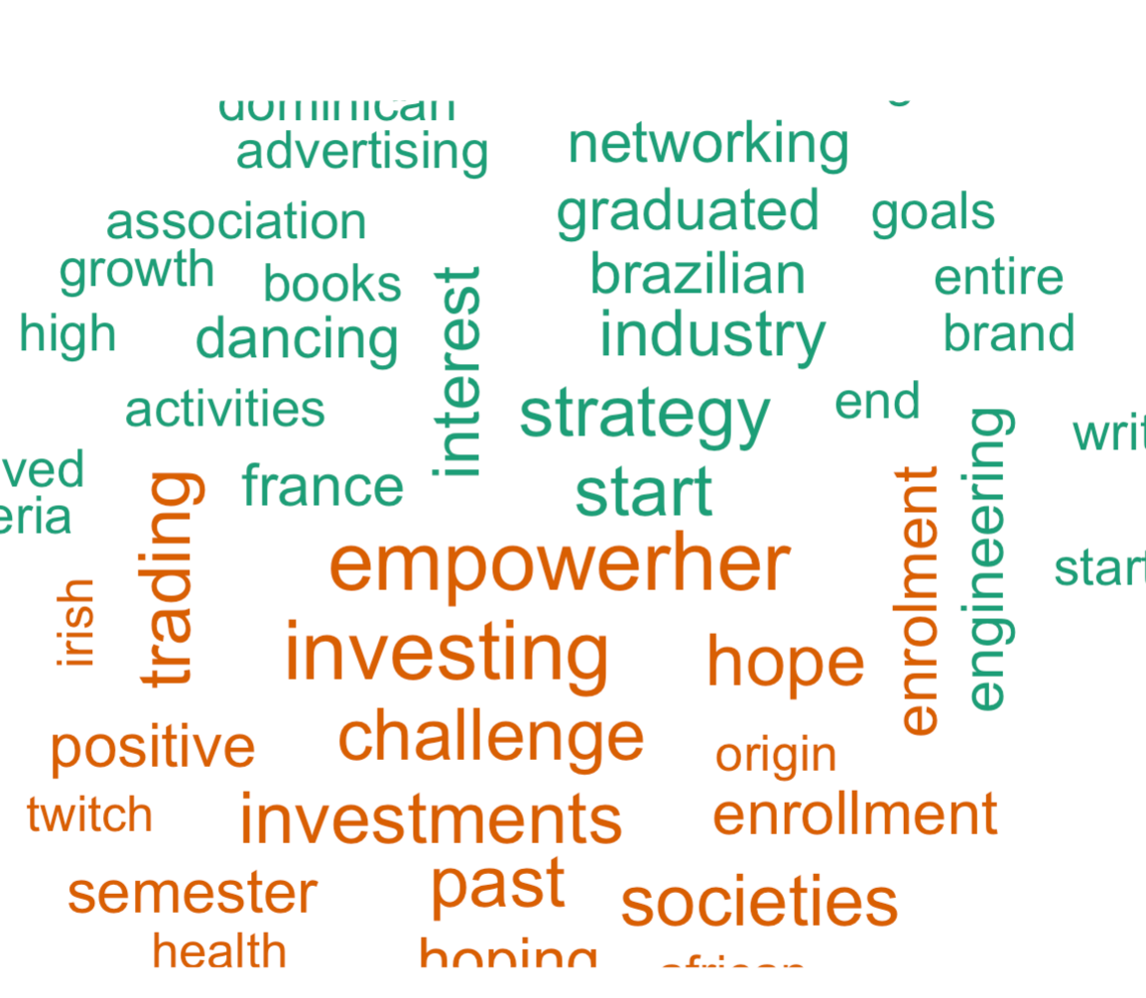
Visualization: Comparison cloud
Other Campuses
London Campus

Slide 11
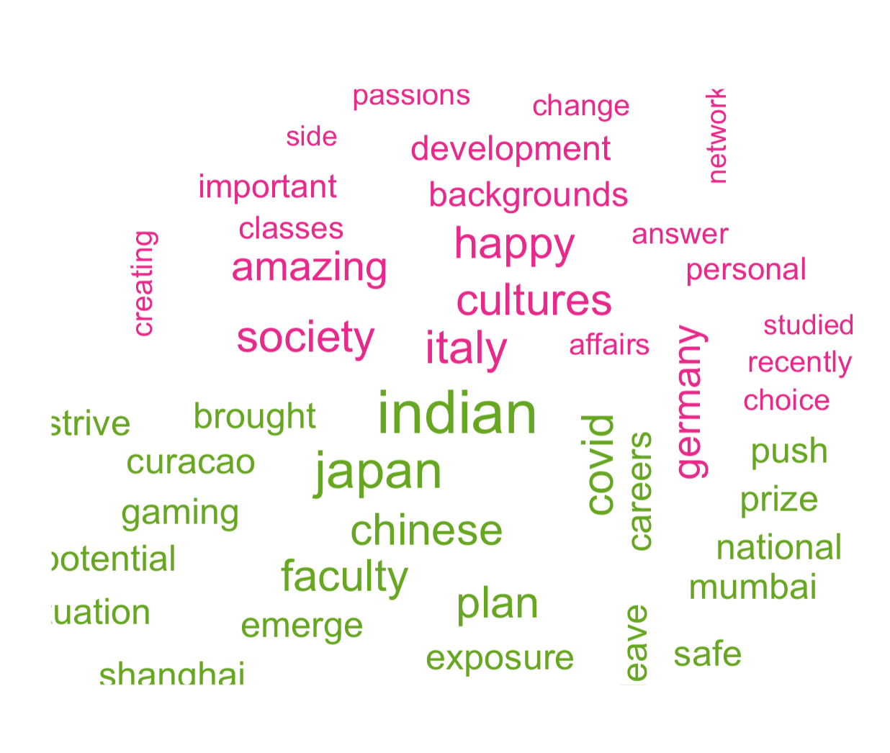
Visualization: Comparison cloud
Non Aisa
Aisa

Slide 12
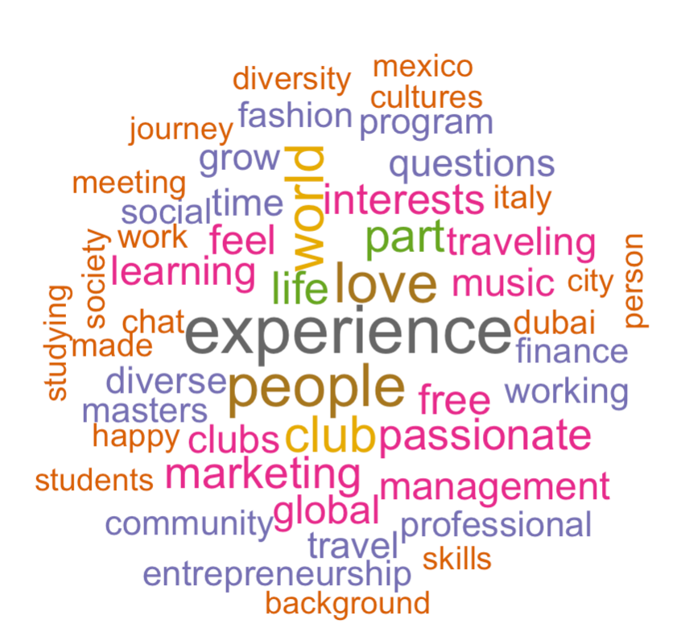
Visualization: Wordcloud

Slide 13
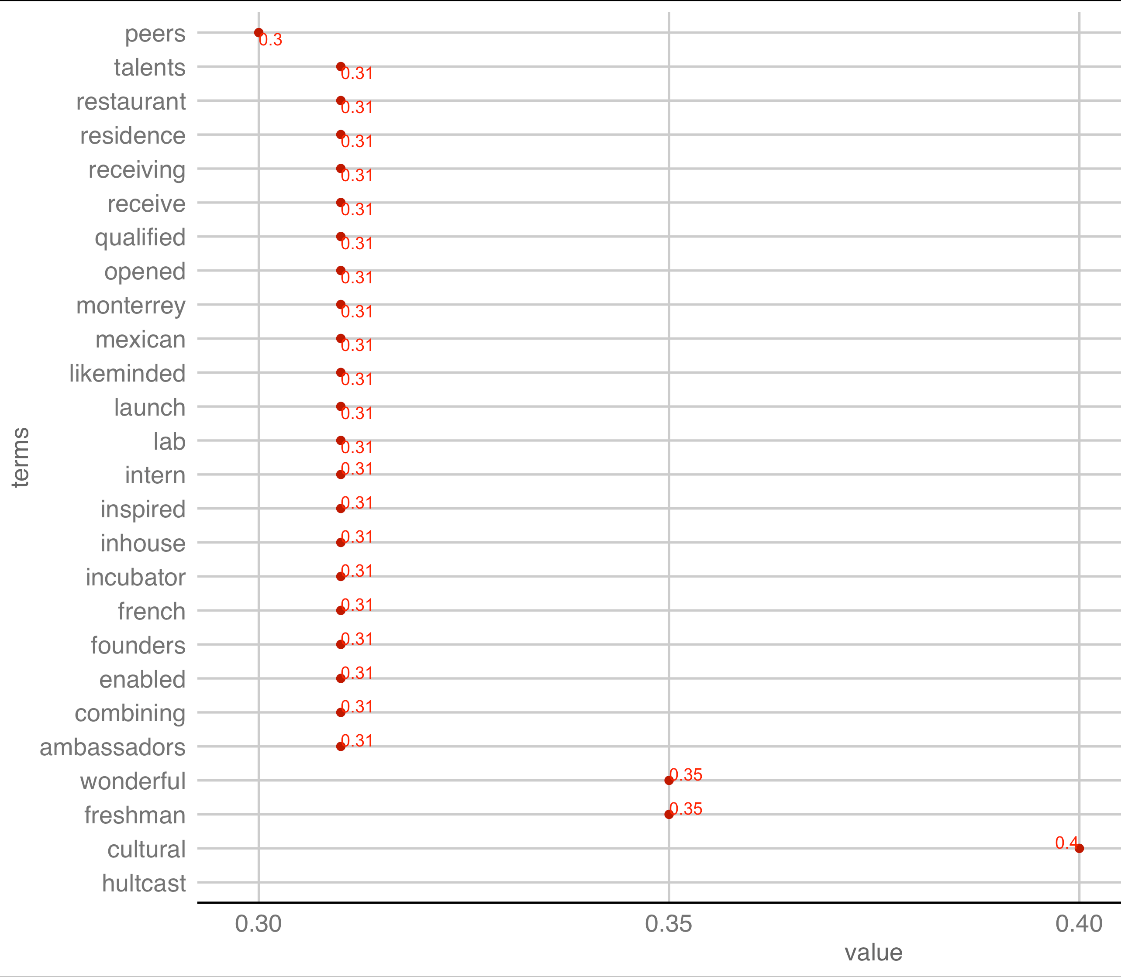
Visualization: Dot plot
Finding the word associations with experience by using bio column

Slide 14
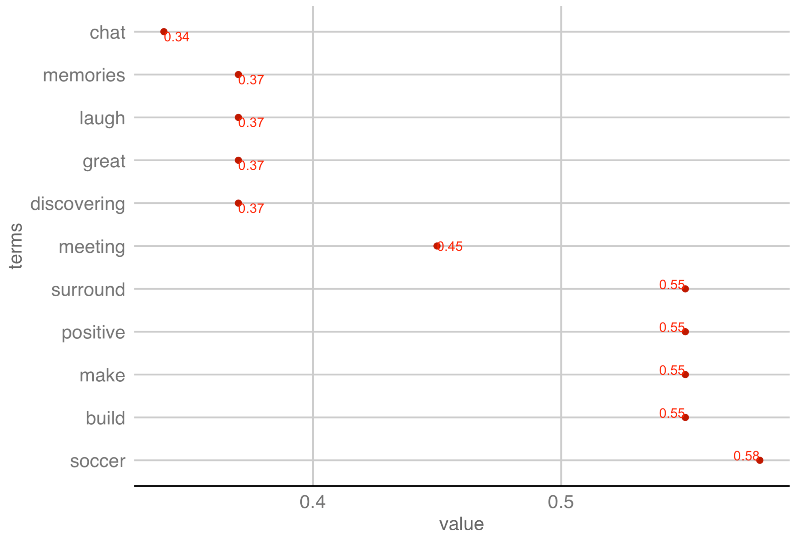
Visualization: Dot plot
Finding the word associations with people by using interest column

Slide 15
Key Insights
Most of the students are based in london campus
Europe and Asia biggest market
BBA and MIB most selling courses
Frequent word: Experience, People, Love, Happy, Life, World,
Community, Diversity and so on.
The visualiations shows a high repetence the word ‘world’

Slide 16
Recommendation
Provide MSBA program in London campus (6 students)
Focus on Indian market (5th of generation Z. (McKeever, 2020)
Learning from experience

Slide 17


Slide 18
Reference
McKeever, V. (2020, November 20). Gen Z incomes predicted to beat millennials. Retrieved from CNBC: https://www.cnbc.com/2020/11/20/gen-z-incomes-predicted-to-beat-millennials-in-10-years.html

