Slide 1
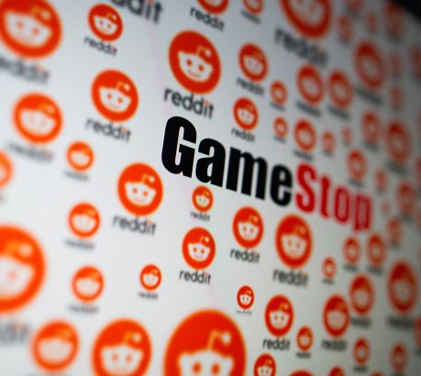
WallStreetBets GameStop Analysis
Presented by: Nabeel Keloth

Slide 2
Agenda
Purpose of the Analysis
Problem Statement
Methodology
Preliminary findings
Polarity
Sentiment Analysis
Key Outcomes
Recommendations

Slide 3
Purpose of the Analysis
To evaluate the customer’s comment
To identify any early indication in GameStop stock price

Slide 4
Problem Statement
How can GameStop identify the sudden rise in stock price and reduce the loss of their investors?

Slide 5
Methdology
Rstudio
Comment
Emojis

Slide 6
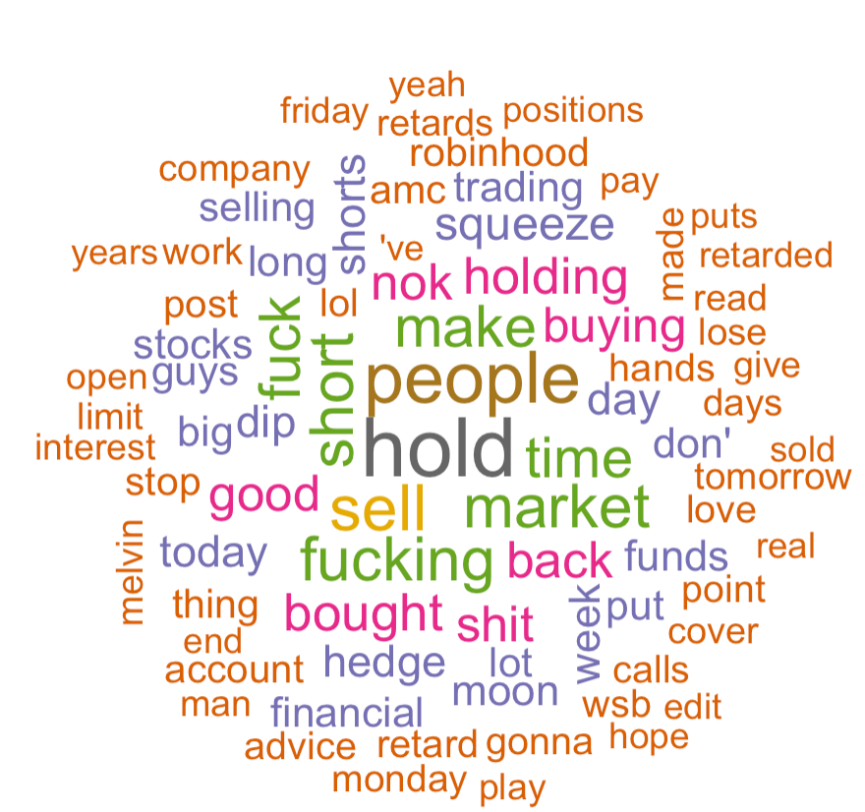
Preliminary findings
Expressive
Time

Slide 7
Polarity
Polarity on comments
Total sentences | Total words | Avg polarity
18940 | 465650 | -0.003

Slide 8
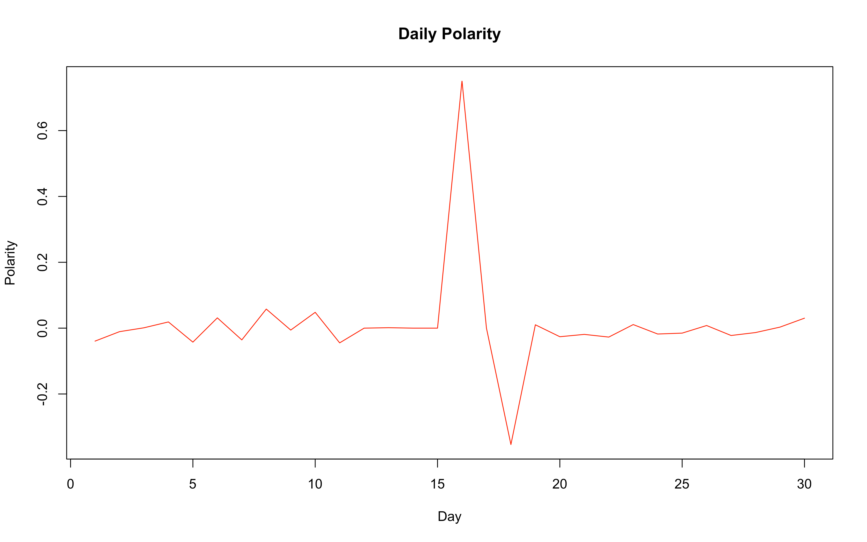
Polarity over time
Daily polarity

Slide 9
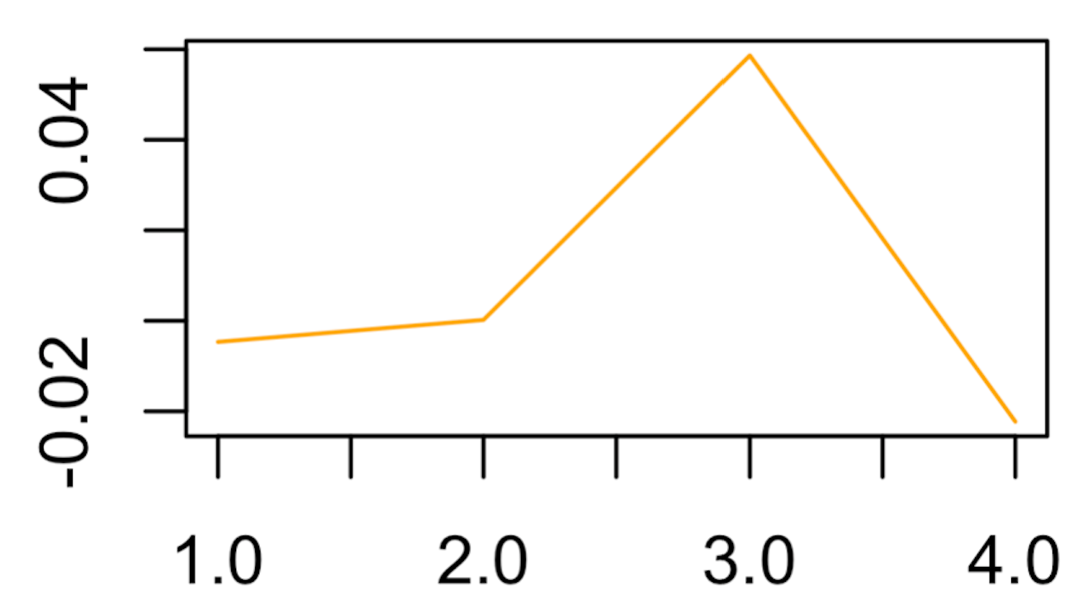
Polarity over time
Weekly Polarity
week | Polarity
First week | -0.004
Second Week | 0.0002
Third Week | 0.058
Fourth Week | -0.022

Slide 10
Polarity over time
Month | polarity
January_2021 | -0.001
February_2021 | -0.034
March_2020 | 0.004
April_2020 | 0.011
June_2019 | -0.007
July_2020 | 0.059
August_2020 | -0.062
October_2020 | 0
November_2020 | 0
December_202 | -0.022
Monthly Polarity

Slide 11
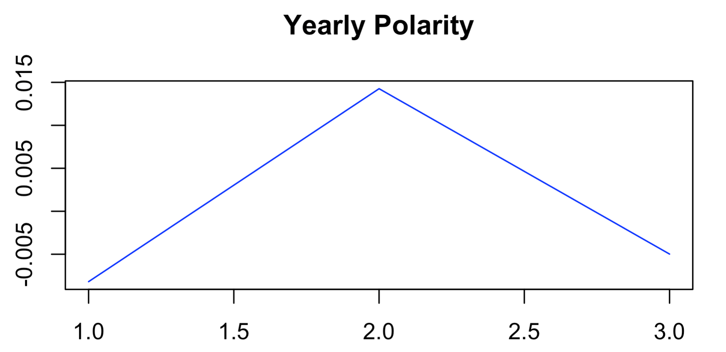
Polarity over time
Yearly polarity
Year | Polarity
2019 | -0.008
2020 | 0.014
2021 | -0.004

Slide 12
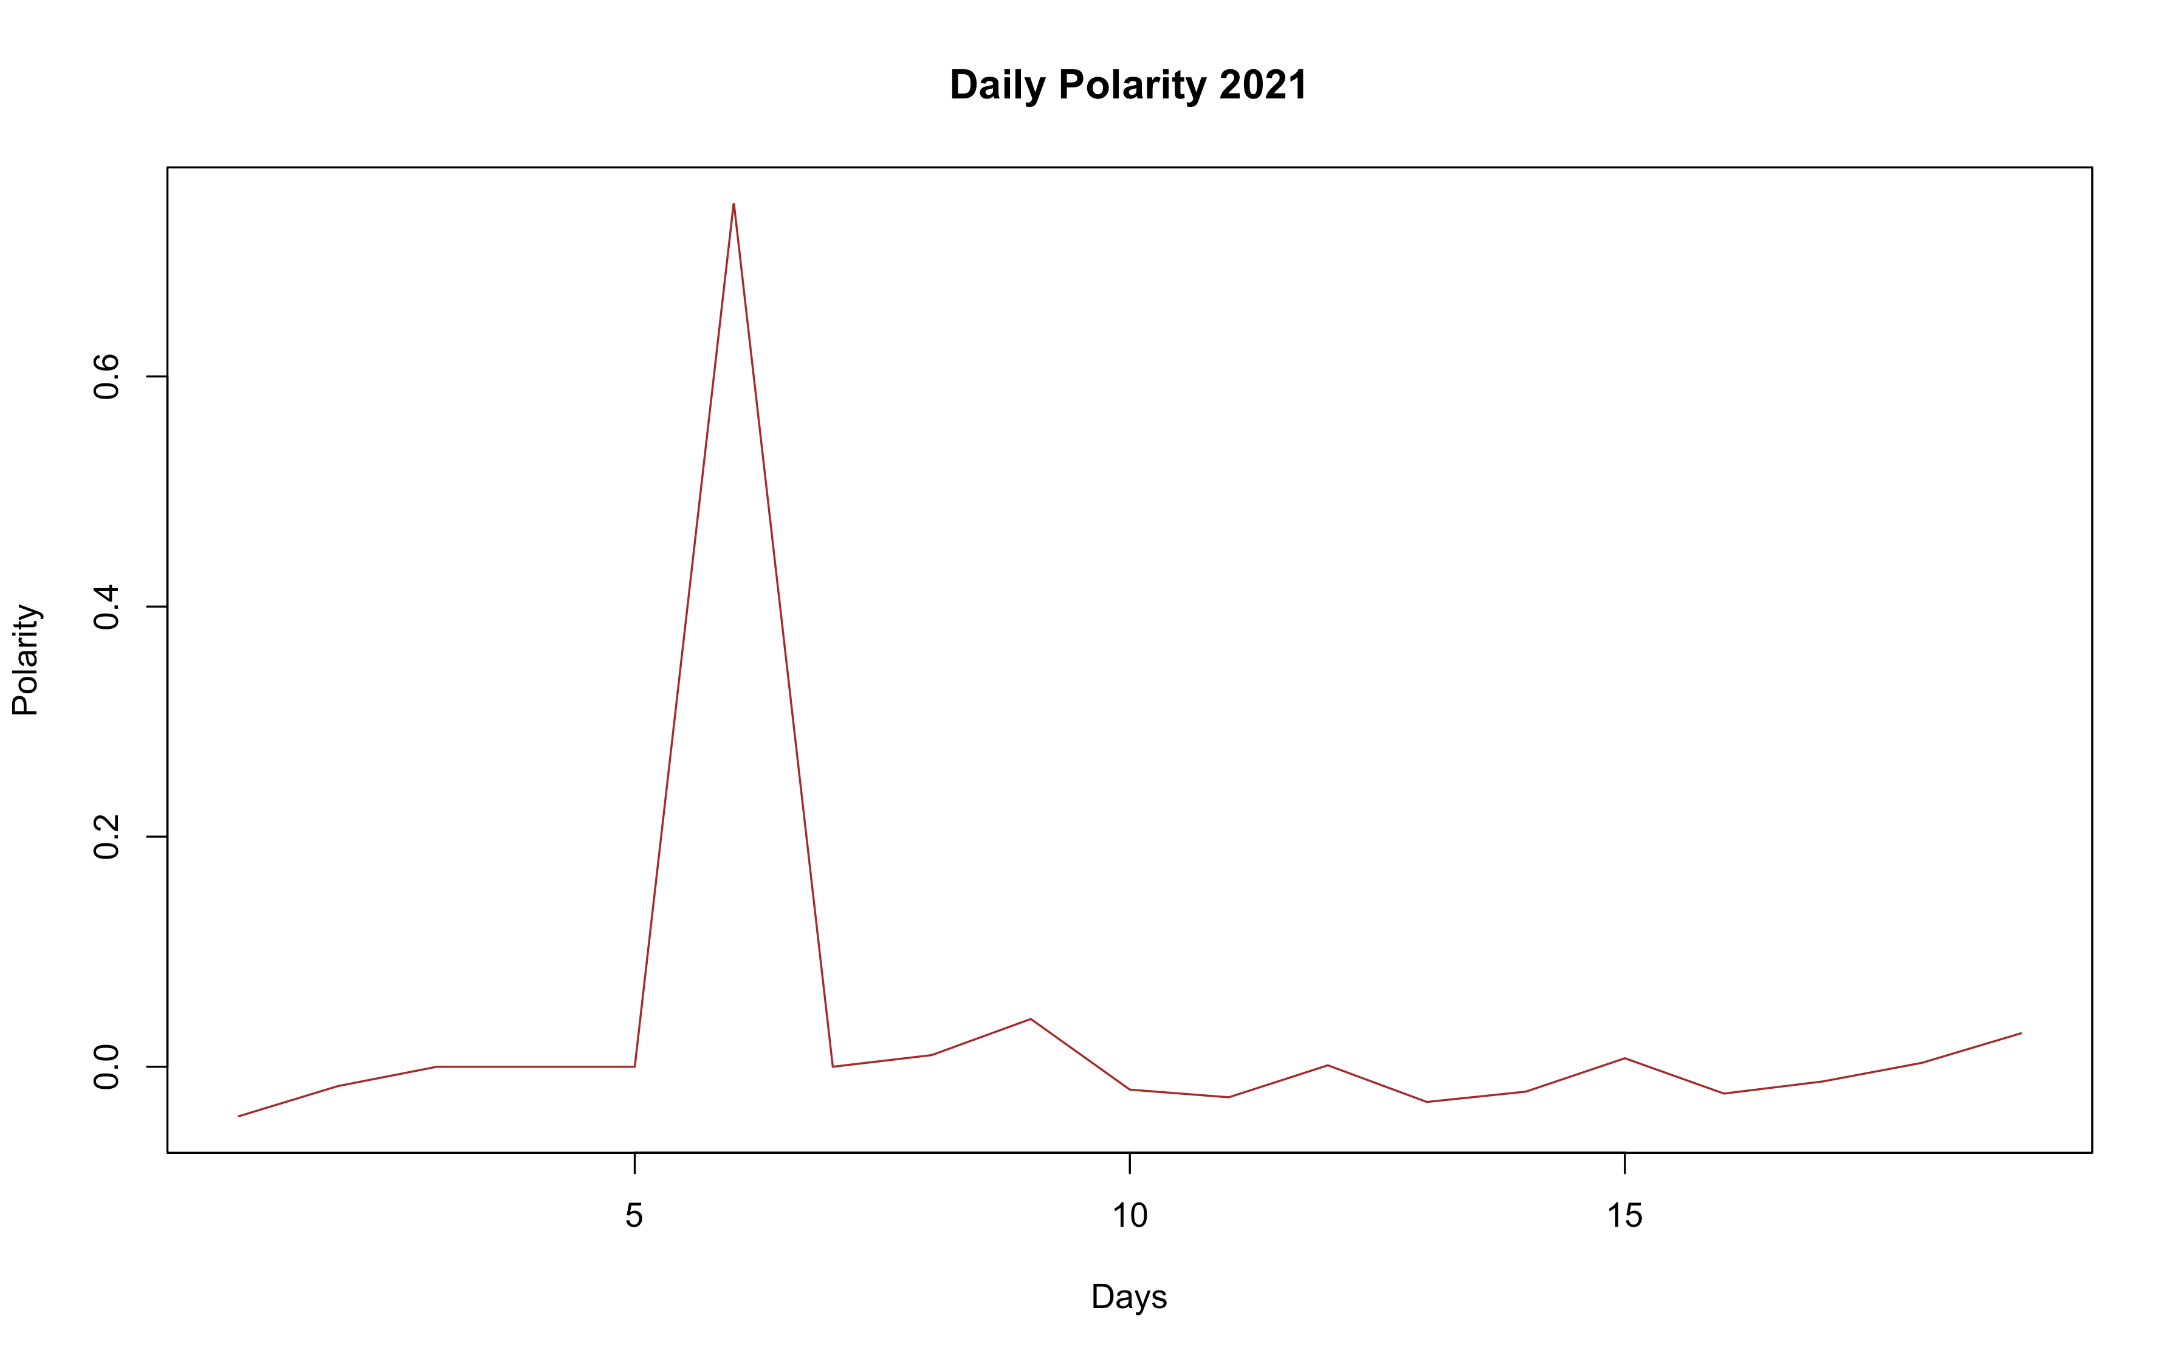
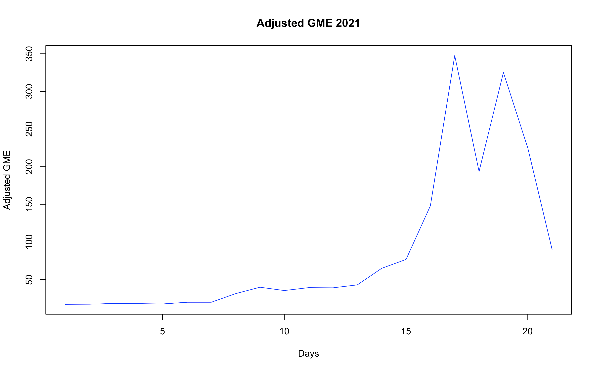
Polarity vs Adjusted GME score
Year 2021

Slide 13
Sentiment Analysis
Bing lexicon
Negative words: 15,227
Positive words: 9,143
Afinn Lexicon
Mean: -0.51

Slide 14
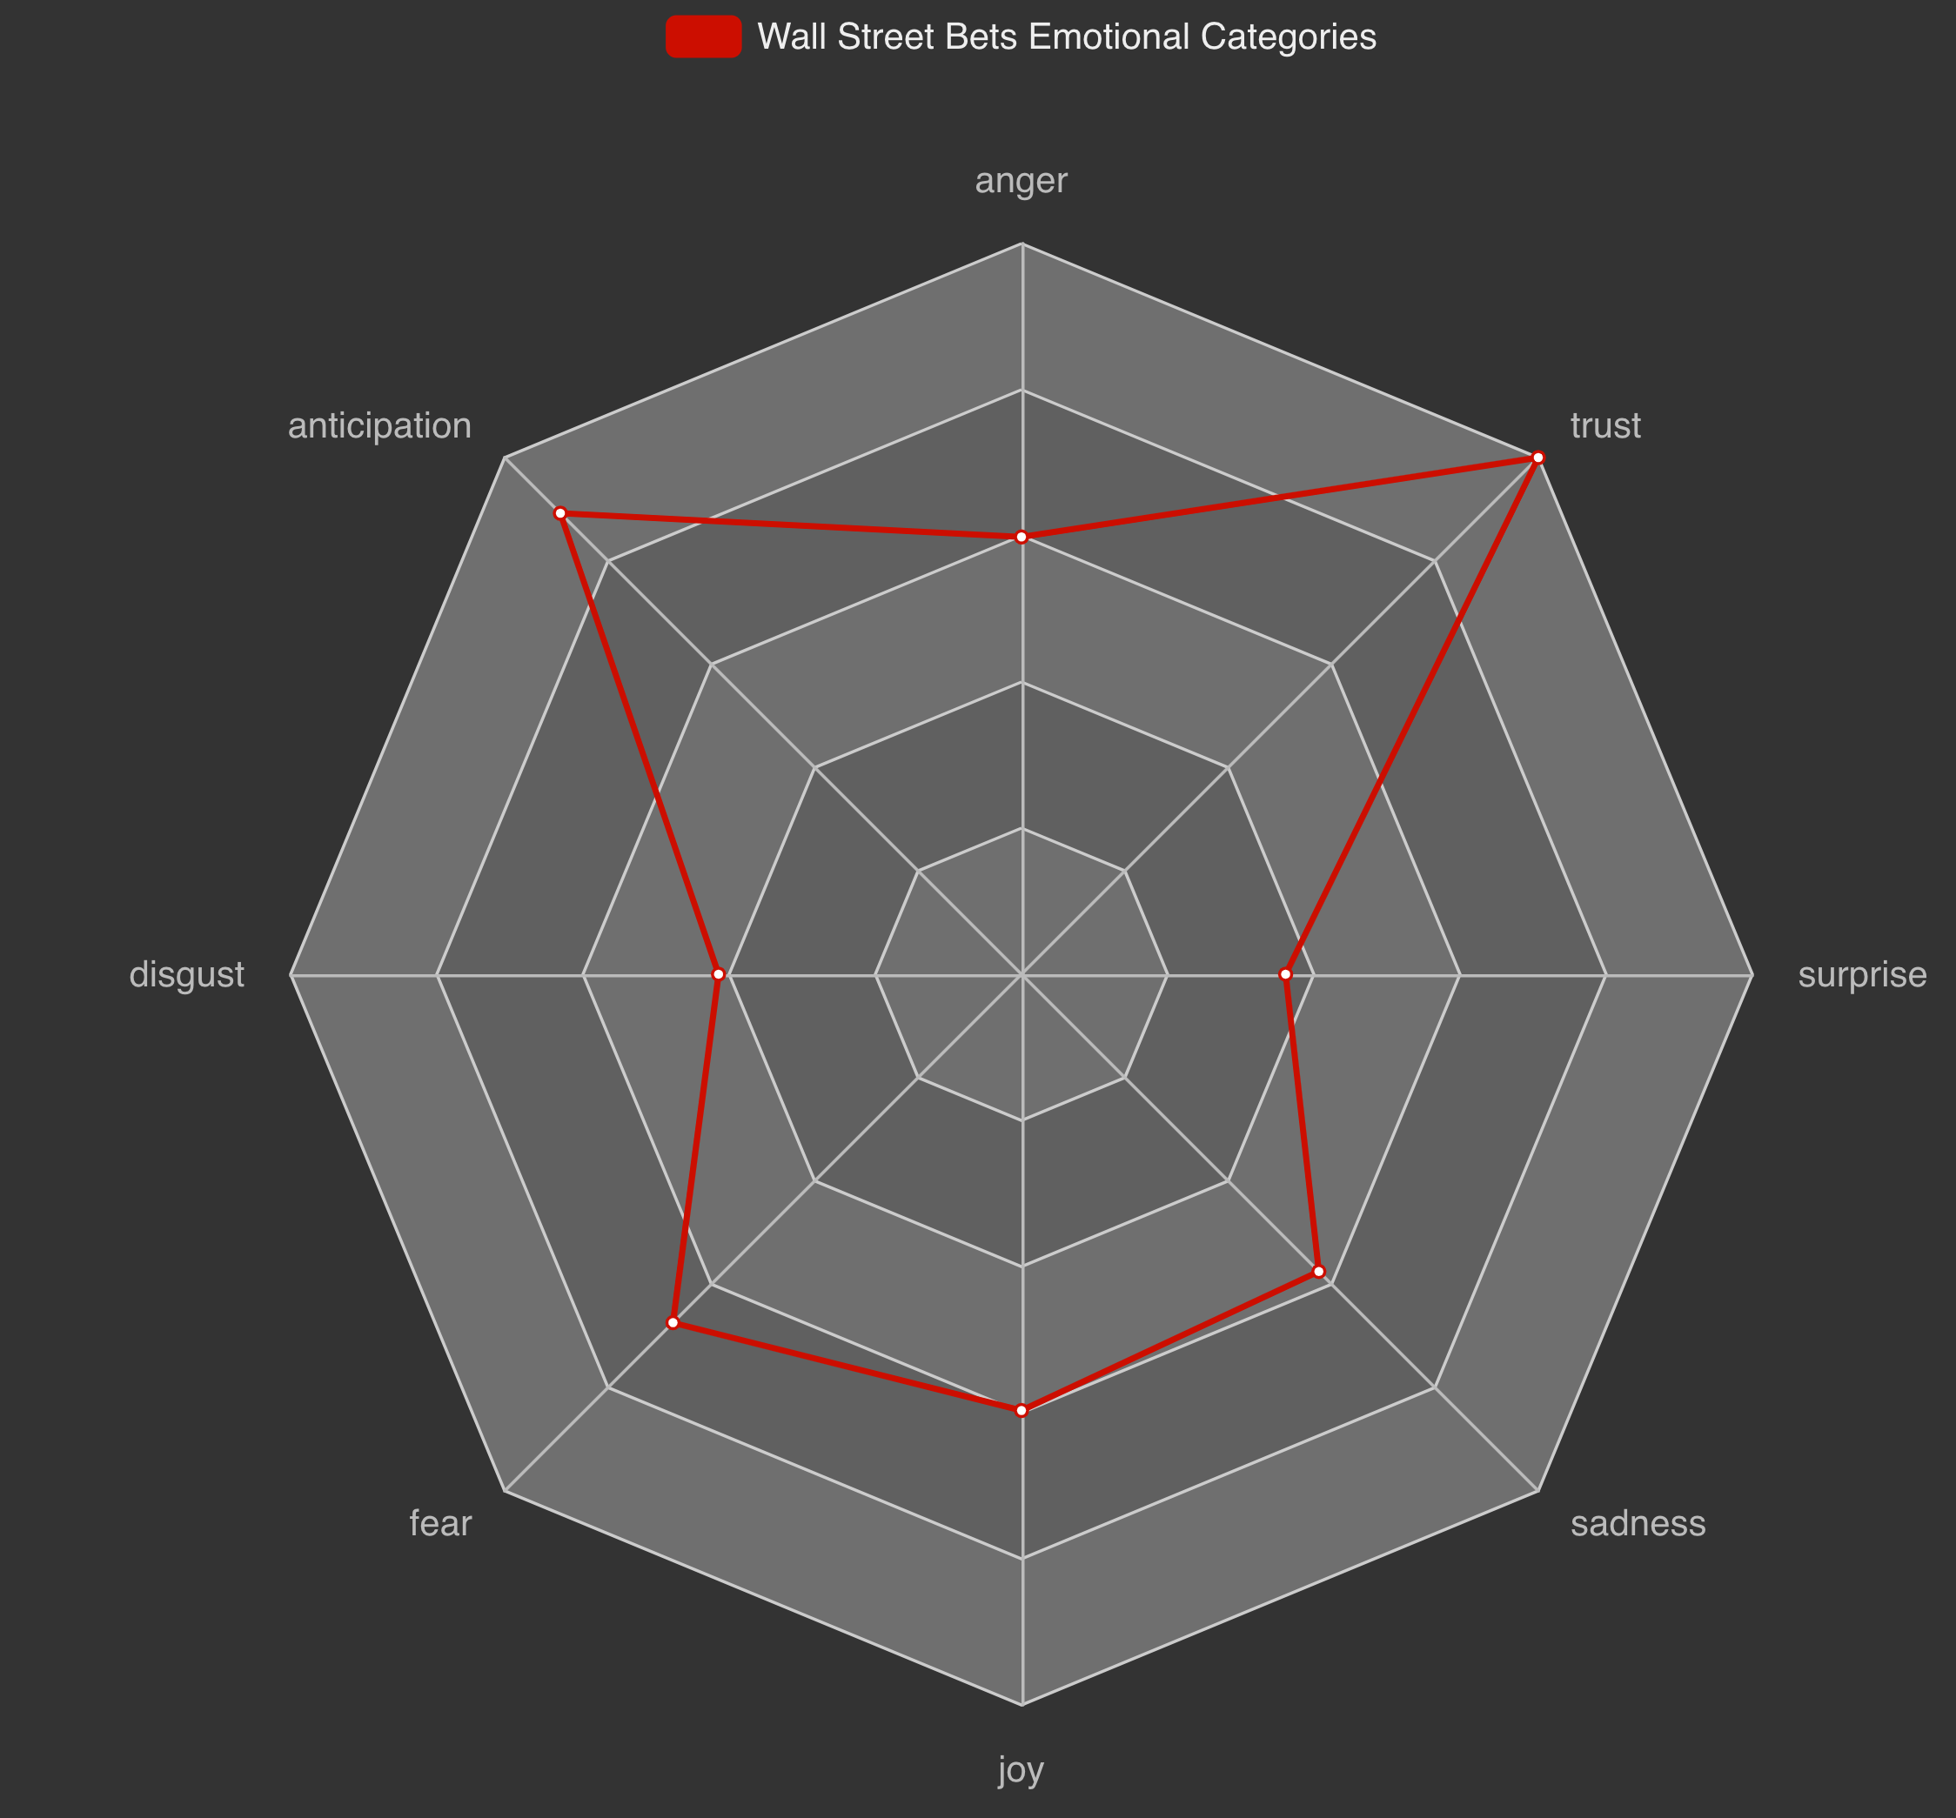
Sentiment Analysis
NRC lexicon

Slide 15
Key Outcomes
Customers are expressive
Change is constant
Negative polarity affecting the stock price
Positive emotion

Slide 16
Recommendations
Focus on negative comments
Target the audience with similar personality. i.e expressive
Promote through negative words by keeping it in positive emotion
For example, This game is too good, but I hate it.

Slide 17




Thank You for your attention and time

