Slide 1
Some SQL Techniques

Slide 2
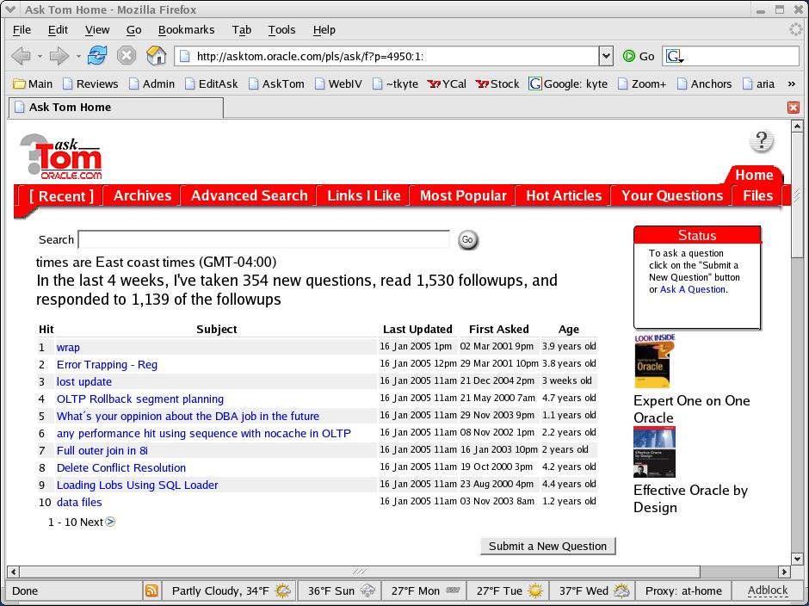



Who am I
Been with Oracle for 12 years
User of Oracle for 17 years
The “Tom” behind AskTom in Oracle Magazine
  www.oracle.com/oramag
Effective Oracle by Design
Expert One on One Oracle
Beginning Oracle

Slide 3
Agenda
What do you need to write “good” SQL
The Schema Matters
Knowing what is available
  Using rownum (yes, to 'tune')
  Scalar subqueries
  Analytics
  Some hints
Don’t tune queries!
Other things
  Materialized Views
  With subquery factoring
  Merge
  …

Slide 4
What do you need to know…
Access Paths
  There are a lot of them
  There is no best one (else there would be, well, one)
A little bit of physics
  Full scans are not evil
  Indexes are not all goodness
How the data is managed by Oracle
  high water marks for example
  IOT’s, clusters, etc
What your query needs to actually do
  Is that outer join really necessary or “just in case”

Slide 5
The Schema Matters
A Lot!
Tune this query:
Select *
from documents
where userid=:x;
That is about as easy as it gets (the SQL)
Not too much we can do to rewrite it…
But we’d like to make it better.
Iot01.sql

Slide 6
The Schema Matters
There are
  B*Tree clusters
  Hash clusters
  IOT’s
  Segment Compression
  Index Key Compression
  Function Based Indexes
  Domain Indexes
  Use them when appropriate

Slide 7
Knowing what is available
There is a lot out there…
I learn something new every day
Skimming the docs works
  Oh, I remember something similar…
Check out the “whats new in” at the head of the docs
Participate in the forums
Things change… Some things must be “discovered”
af.sql
Ignulls.sql

Slide 8
Using ROWNUM
Psuedo Column – not a “real” column
Assigned after the predicate (sort of during) but before any sort/aggregation
Select x,y
from t where rownum < 10
order by x
Versus
Select * from
(select x,y from t order by x)
where rownum < 10

Slide 9
Using ROWNUM
Incremented after a successful output
Select * from t where rownum = 2
Rownum = 1
For x in ( select * from t )
Loop
if ( rownum = 2 )
then
output record
rownum = rownum+1;
end if
End loop

Slide 10
Using ROWNUM
To reduce the number of times a function is called..
  Rn01.sql
When you have two queries that run light speed separately
  But not so together
  Generally a mixed “CBO/RBO” problem
  Use of RBO with a feature that kicks in the CBO
  Rownum can be a temporary fix till all things are CBO
rn01.sql

Slide 11
Using ROWNUM
Top-N queries
Select *
from (select * from t where … order by X )
where rownum <= 10;
Does not have to sort the entire set
Sets up an “array” conceptually
Gets the first 10
When we get the 11th, see if it is in the top 10
  If so, push out an existing array element, slide this in
  Else throw it out and get the next one.
Do not attempt this in CODE! (well – what about 10g?)
rn02.sql

Slide 12
Using ROWNUM
Pagination
Select *
From ( select a.*, ROWNUM rnum
From ( your_query_goes_here ) a
Where ROWNUM <= :MAX_ROW_TO_FETCH )
Where rnum >= :MIN_ROW_TO_FETCH;
Everything from prior slide goes here…
Never ever let them “count the rows”, never.
Do not attempt this in CODE!
rn03.sql

Slide 13
Scalar Subqueries
The ability to use a single column, single row query where you would normally use a “value”
Select dname, (select count(*)
from emp
where emp.deptno =
dept.deptno ) cnt
From dept
That example shows a possible use of scalar subquerys – outer join removal

Slide 14
Scalar Subqueries
Outer join removal
  That works great for a single column
  What about when you need more than one?
ss01.sql

Slide 15
Scalar Subqueries
Reducing PLSQL function calls (part 2)
Select * from t where x = pkg.getval()
versus
Select * from t where x =
(select pkg.getval() from dual)
How to call them (scalar subqueries) “as little as possible”
ss02.sql

Slide 16
Generating Data
I need to fill in the gaps – even if there is missing data, I need to see it for that day
Select to_date(:x,’fmt’)+level-1
from dual
Connect by level <= :n
gd.sql

Slide 17
Generating Data
To outer join with…
With Dates AS
(Select to_date(:x,’fmt’)+level-1 dt
from dual
Connect by level <= :n )
Select dt, prod, inv,
lag(inv) over (partition by prod order by dt)
from INV partition by (Prod)
right outer join dates
on (dates.dt = inv.dt)

Slide 18
Analytics
Ordered Array Semantics in SQL queries
Select deptno,ename,sal
from emp
over (partition by deptno
Row_number()
Order by sal desc )
SCOTT 3000
FORD 3000
JONES 2975
ADAMS 1100
SMITH 800
1
2
3
4
5
Deptno Ename Sal
King 5000
Clark 2450
Miller 1300
1
2
3
10
20
30

Slide 19
Analytics
A running total (demo001.sql)
Percentages within a group (demo002.sql)
Top-N queries (demo003.sql)
Moving Averages (demo004.sql)
Ranking Queries (demo005.sql)
Medians (med.sql)
And the list is infinitely long
  "Analytics are the coolest thing to happen to SQL since the keyword Select"
  Lets look at a complex example

Slide 20
Analytics
I am not able to find the exact answer to my question. I have records like this:
Time Amount
11/22/2003 12:22:01 100
11/22/2003 12:22:03 200
11/22/2003 12:22:04 300
11/22/2003 12:22:45 100
11/22/2003 12:22:46 200
11/22/2003 12:23:12 100
11/22/2003 12:23:12 200
What I need to do is sum the amounts where the time of the records is within 3 seconds of each other. In the case where the data is like this:
11/22/2003 12:22:03 200
11/22/2003 12:22:04 200
11/22/2003 12:22:05 200
11/22/2003 12:22:06 200
11/22/2003 12:22:07 200
11/22/2003 12:22:08 200
11/22/2003 12:22:09 200
There would only be one row with the total for all the rows. (Basically, we are looking for "instances" where we define an instance such that all the records within the instance are no more than three seconds apart. So there can be 1 or many records all of the same instance and the resulting summation would have one summary record per instance.) Would you please point me in the right direction?

Slide 21
Analytics
Start with first row (thinking iteratively here)
  If prior row is within 3 seconds -- same group, continue
    Abs(lag(x) over (order by x)-x) <= 3 seconds
  Else new group, break and get a "new" group id
  Need to use analytics on top of analytics
    Inline views -- very powerful here
  Demo006.sql

Slide 22
Some Hints
People either
  Swear on them
  Swear about them
I like hints that give the optimizer information
I do not like so much hints that tell the optimizer “how to do it”

Slide 23
Some Hints
Except for the good hints…
  When you are trying to prove the optimizer made the wrong decision
  In the event of an emergency fix. With the intention to get the real fix
  Hardly ever in my experience

Slide 24
Some Hints
ALL_ROWS
FIRST_ROWS(n) or FIRST_ROWS
CHOOSE
(NO)REWRITE
DRIVING_SITE
(NO)PARALLEL
(NO)APPEND
CURSOR_SHARING_EXACT
DYNAMIC_SAMPLING
*CARDINALITY cardinality.sql

Slide 25
Don’t tune queries!

Slide 26
Think in SETS!

Slide 27
Other Things
Materialized Views
With subquery factoring
Merge
External Tables
350 some odd new things in 10g
Hundreds of new things in 9ir2 over r1
9ir1 over 8i
8i over 8.0
And so on…

Slide 28

“Question Authority.”
Make the experts prove everything
Statements that should raise your eyebrows:
  It is my opinion...
  I claim...
  I think...
  I feel…
Everything can (and should) be proven
TKPROF goes a long way here
Statspack is great
“Runstats” is a tool I use as well (search asktom for runstats)
Things change, expect that
It only takes a single counter case
Notes:
I’d like to close up with a thought. There are lots of “experts” out there expousing “facts”. Many of the facts are really opinions or myths in disgiuse. I would encourage you to question them, make them prove things. It is something I do everyday on my site – i don’t just “say things”, I say something and then back it up. Sometimes – I find I have to change my initial answer before I publish it because the facts did not support my hypothesis. Everything that is true is provable – just ask for the proof. And remember – it only takes a single counter case to disprove something. I only need to show ONCE that having 10,000 extents does not materially affect performance – no matter how many times people say “but it must”.

Slide 29
Questions
and
Answers

