Slide 1

A Project/Dissertation/Seminar Report PRESENTATION Chatbots: Past, Present and Future
SUBMITTED BY SUPERVISED BY
Nabeel Syed Hasan Mr. Piyush Kumar Gupta
2019-301-041 Assistant Professor
BCA
SUBMITTED TO
Department of Computer Science & Engineering
School of Engineering Sciences & Technology
JAMIA HAMDARD

Slide 2
Introduction
In my paper I have reviewed different research papers and articles published on chatbots.
Chatbots are advanced conversational computer programs that mimic real-life human speech. A chatbot can take user input and generate an output. They are being used in a wide range of areas and applications, including education, e-commerce, healthcare, and entertainment.
There are 2 main types of chatbots: Generative and Retrieval-based
Retrieval-based chatbot are programmed to select the best response from a collection of predetermined responses. The replies are based on previously collected data. These chatbots employ techniques such as keyword matching, machine learning, or deep learning.
Generative chatbots can generate new conversation based large quantities of conversational training data. For multi-step training, generative chatbots combine supervised learning, unsupervised learning, reinforcement learning, and adversarial learning.

Slide 3
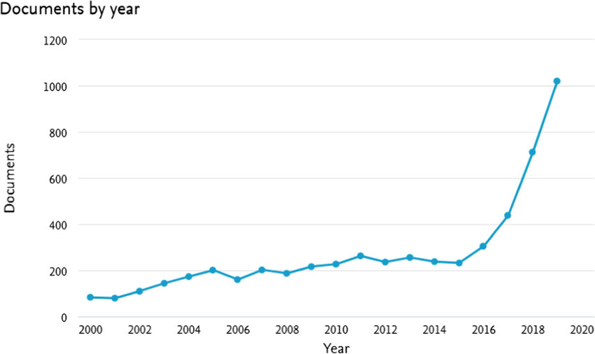
Introduction
Graph showing rising popularity in chatbot related research

Slide 4
History of Chatbots
Alan Turing is credited with being the first to think of a chatbot in 1950, when he wondered, "Can machines think?"
ELIZA was the first chatbot to be developed in 1966, and it relied heavily on linguistic rules and pattern matching algorithms by Professor Joseph Weizenbaum. It could interact with the user using a keyword matching program.
In 1972, Another well-known chatbot known as PARRY was developed at Stanford's Psychiatry Department by Kenneth Mark Colby, a psychiatrist and computer scientist. The program imitated a patient with schizophrenia. It worked via a complicated system of assumptions, attributions, and “emotional responses”.
The Artificial Intelligence Markup Language (AIML), an extension of XML, was used to create A.L.I.C.E. (Artificial Linguistic Internet Computer Entity) in 1995, it is first chatbot to be available online, it was made with inspiration from Eliza. ALICE could extend it’s knowledgebase because of AIML.

Slide 5
History of Chatbots
SmarterChild was introduced in the year 2001 on messengers such as Microsoft Messenger (MSN) and AOL. It was the first time a chatbot could assist individuals with actual everyday chores by retrieving information from databases such as movie timings, sports scores, stock prices, news etc.
IBM Watson was launched in 2011. Watson understood genuine human language well enough to defeat two previous champions on the quiz show "Jeopardy,“. One big disadvantage of Watson is that it only supports English.
ChatScript, the successor to AIML, served as the foundation for subsequent Loebner prize-winning chatbots. The basic concept underlying this technology was to match users' textual inputs to a topic, with each topic having its own set of rules for generating an output.
Microsoft XiaoIce also called Zo in the U.S., the world's most popular social chatbot, released in the year 2014. XiaoIce's primary design aim is to be an AI companion with whom users may develop long-term, emotional bonds.

Slide 6
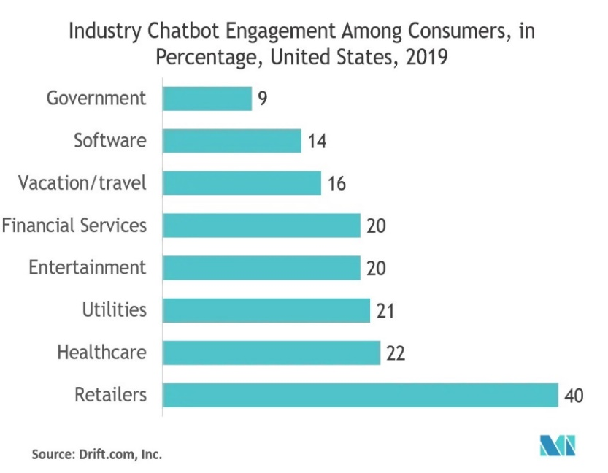
Chatbots in Present Day
Graph showing use of Chatbots in Different industries in the U.S (2019)

Slide 7
Chatbots in Present Day
In present times chatbots are being used for various reasons such as:
They are being utilised by companies for the purpose of customer service to improve the support staff efficiency, reduce response time.
They are used by different E-Commerce companies to collect data from the conversations that the customers have with the chatbot and hence understand the customer’s needs and preferences.
Chatbots also help in the banking sector by guiding customers to perform a variety of financial operations in the form of conversations and with complete safety.
Chatbots help in automation by making it possible for the user to control everyday use appliances like light bulbs and smart televisions just by speaking.

Slide 8
Limitations of Chatbots
In the article and paper [19] and [3], it has been discussed that the four main reasons for the limitations in chatbots are:
Failure in Intent Understanding
Hard to create global appeal
Lack of Training Data
Laws Protecting Data
Being Repetitive
Training is time-consuming

Slide 9
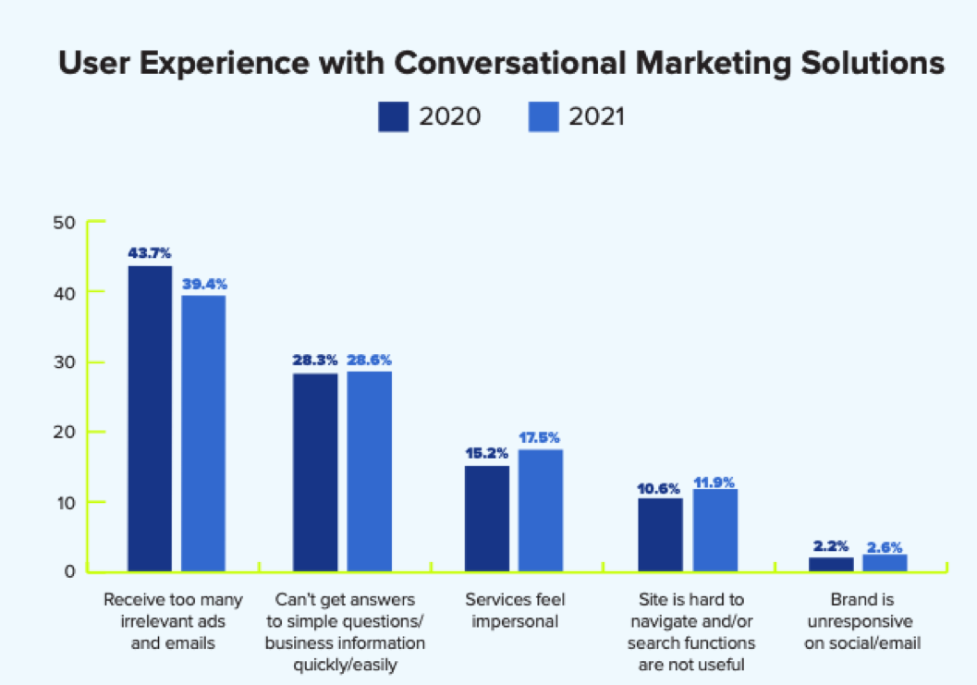
Limitations of Chatbots
Graph showing user experience with chatbots when employed by different businesses:

Slide 10
Future Scope of Chatbots
According to [20], [21] and [22] the main improvements that could greatly increase the efficiency and productivity of chatbots are:
Processing emotions
Voice bots will become more common
Chatbots will become more human-like in their behaviour
Banking and Financial Industry

Slide 11
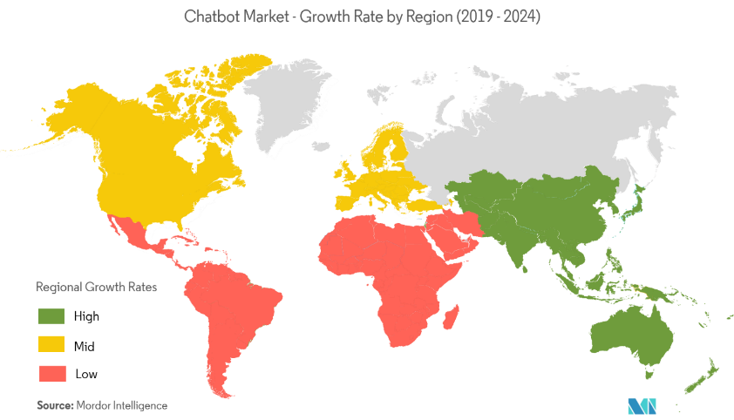
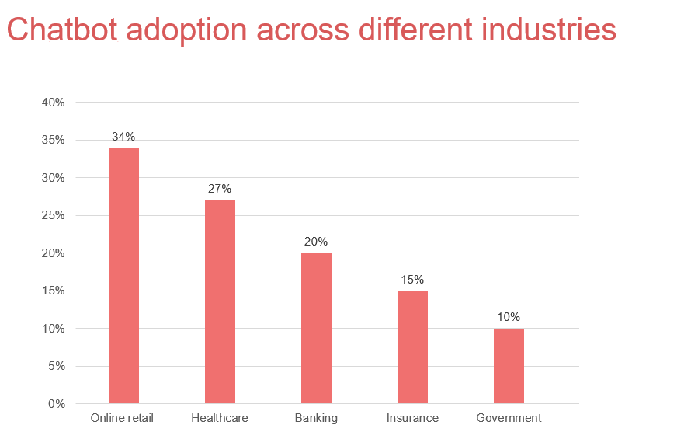
Future Scope of Chatbots
Map showing Growth of Chatbots in Different Countries and Graph showing chatbot adoption across different industries [24], [25]:

Slide 12
Programming a Basic Retrieval-Based Chatbot
The different languages and libraries used for the development of this chatbot:
Python
TensorFlow
Keras
Natural Language ToolKit (NLTK)
Tkinter

Slide 13
Programming a Basic Retrieval-Based Chatbot
Data Flow Diagrams (DFD)

Slide 14
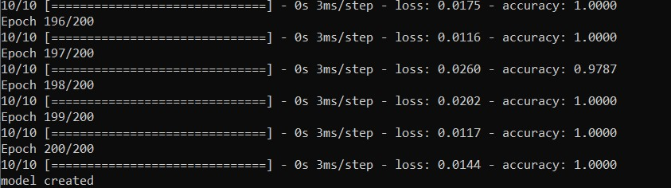
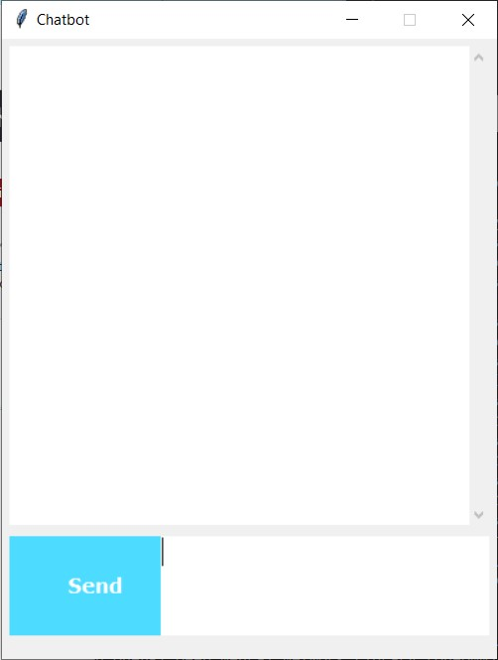
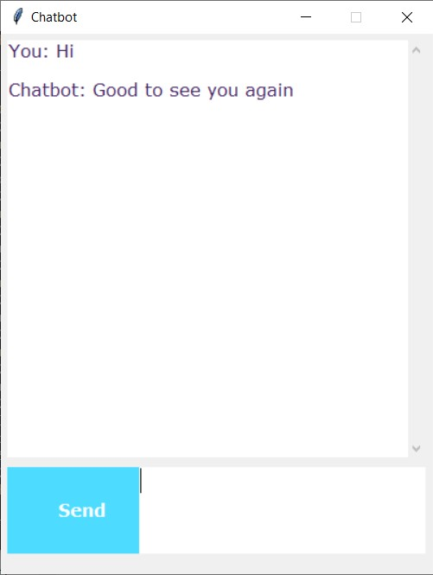
Screenshots
Creating our model
Chatbot GUI and Working

Slide 15
Conclusion
We have highlighted existing issues and limitations, as well as knowledge gaps. Despite advances in technology, AI chatbots are still unable to mimic human speech. This is due to a flawed approach to conversation modelling and a lack of open-access domain-specific data.
Large models demand a significant amount of computer resources as well as a large amount of training data. There is no standardised method for assessing chatbots. Human evaluation is used in some models; however, it is costly, time-consuming, difficult to scale, biased, and lacks consistency.
To address these limitations, a new, trustworthy automated assessment technique should be given. It's difficult to tell the difference between chatbot programs and social or companion chatbots.

