Slide 1
Sequence Diagram

Slide 2
Presented By
Muhammad Talha
Syed Saad Ahmed
Nabeel Wasi
Omer Irfan
Abdul Rehman

Slide 3
Interaction Diagrams
Interaction diagrams model the behavior of use cases by describing the way groups of objects interact to complete the task of the use case. They portray the interaction among the objects of a system and describe the dynamic behavior of the system.
There are two types of interaction diagrams
Sequence Diagrams and Communication Diagrams (formally known as collaboration diagrams)
Notes:
1) Sequence diagram
Emphasize explicit chronological sequence of messages
Useful in situations where the order in which events occurs is important
WE ARE BUILDING ONLY SEQUENCE DIAGRAMS; helpful in seeing if you have all the methods for the different classes
2) Collaboration diagrams
Emphasize the relationship between objects
Powerful tool for understanding the structure of the software product
Events are represented by annotated arrows placed alongside lines connecting boxes containing the names of actors

Slide 4
Interaction Diagrams
Sequence diagrams
  generally show the sequence of events that occur.
Collaboration diagrams demonstrate how objects are statically connected.
Both diagrams are relatively simple to draw and contain similar elements.
Notes:
1) Sequence diagram
Emphasize explicit chronological sequence of messages
Useful in situations where the order in which events occurs is important
WE ARE BUILDING ONLY SEQUENCE DIAGRAMS; helpful in seeing if you have all the methods for the different classes
2) Collaboration diagrams
Emphasize the relationship between objects
Powerful tool for understanding the structure of the software product
Events are represented by annotated arrows placed alongside lines connecting boxes containing the names of actors

Slide 5
Sequence Diagram
Illustrates the objects that participate in a use case and the messages that pass between them over time for one use case
In design, used to distribute use case behavior to classes
Notes:
In 3350, each team MUST CREATE SEQUENCE DIAGRAM FOR NORMAL SCENARIO FOR EACH USE CASE ON USE CASE DIAGRAM
Sequence Diagram
Used to document the details of a use case
Shows the sequence of messages that implement a service or transaction
Class diagram has a modeling focus on the class level while sequence diagram has a modeling focus is on the object level
Represents a scenario from a use case
Is a graphical representation of interactions between objects showing the sending and receiving of messages in sequence
Emphasize the time-based ordering of the activity that takes place among a set of objects
Used to understand the flow of control of a scenario by time
Depicts the objects and classes involved in the scenario and the sequence of messages exchanged between the objects needed to carry out the functionality of the scenario

Slide 6
Sequence Diagram
X-Axis (objects)
member:
LibraryMember
book:Book
:Book
Copy
borrow(book)
Object
Life Line
Y-Axis (time)
ok = mayBorrow()
Message
Focus of control
[ok] borrow(member)
setTaken(member)
Condition
Notes:
In a sequence diagram
Each column represents an object that is participating in the interaction.
The vertical axis represents time (from top to bottom).
Messages are shown by full arrows.
Labels on full arrows represent message names and arguments.
The operation can itself send other requests to other objects
An object can request an operation from itself (looping arrow)
Activations
the time it takes to perform an operation
are depicted by a rectangle attached to an object.
The height of the rectangle is indicative for the duration of the operation
The vertical rectangle shows that an object is active, that is, it is handling a request made by another object.

Slide 7
Sequence Diagram Syntax
AN ACTOR
AN OBJECT
A LIFELINE
A FOCUS OF CONTROL
A MESSAGE
OBJECT DESTRUCTION
anObject:aClass
aMessage()
x

Slide 8
Sequence Diagram
Two major components
  Active objects
  Communications between these active objects
    Messages sent between the active objects
Notes:
Sequence Diagram
Shows the sequence of messages that implement a service or transaction
Class diagram has a modeling focus on the class level while sequence diagram has a modeling focus is on the object level
Emphasize the time-based ordering of the activity that takes place among a set of objects
Used to understand the flow of control of a scenario by time
Depicts the objects and classes involved in the scenario and the sequence of messages exchanged between the objects needed to carry out the functionality of the scenario

Slide 9
Sequence Diagram
Active objects
  Any objects that play a role in the system
  Participate by sending and/or receiving messages
  Placed across the top of the diagram
  Can be:
    An actor (from the use case diagram)
    Object/class (from the class diagram) within the system
Notes:
Object in a sequence diagram
Still represented by the rectangle with object name on inside

Slide 10
Active Objects
Object
  Can be any object or class that is valid within the system
  Object naming
    Syntax
  [instanceName][:className]
Class name only :Classname
Instance name only objectName
Instance name and class name together object:Class
myBirthdy
:Date
Notes:
3 ways to name:
Just an object name
Object name and class name
Just a class name
Object names are always underlined and begin with a lowercase letter
Class names are always capitalized
Naming objects
Name classes consistently with your class diagram (same classes).
Include instance names when objects are referred to in messages or when several objects of the same type exist in the diagram.
Most of the time you use the class name, but if you refer to a particular instance in a scenario the object:Class notation is used.
Objects can be named by
Using generic object names to clarify the class
Including the name of the class after the name of the object, separated by a colon

Slide 11
Active Objects
Actor
  A person or system that derives benefit from and is external to the system
  Participates in a sequence by sending and/or receiving messages
Notes:
Actor in a Sequence diagram
Still represented by the stick figure as on use case diagram
don’t have to place in any particular order across the top of the diagram but better to organize them in the order in which they participate in the sequence
Illustrating actors as active objects models how actors interact with the system and how the system interacts with the user
Actors can call objects and objects can notify actors

Slide 12
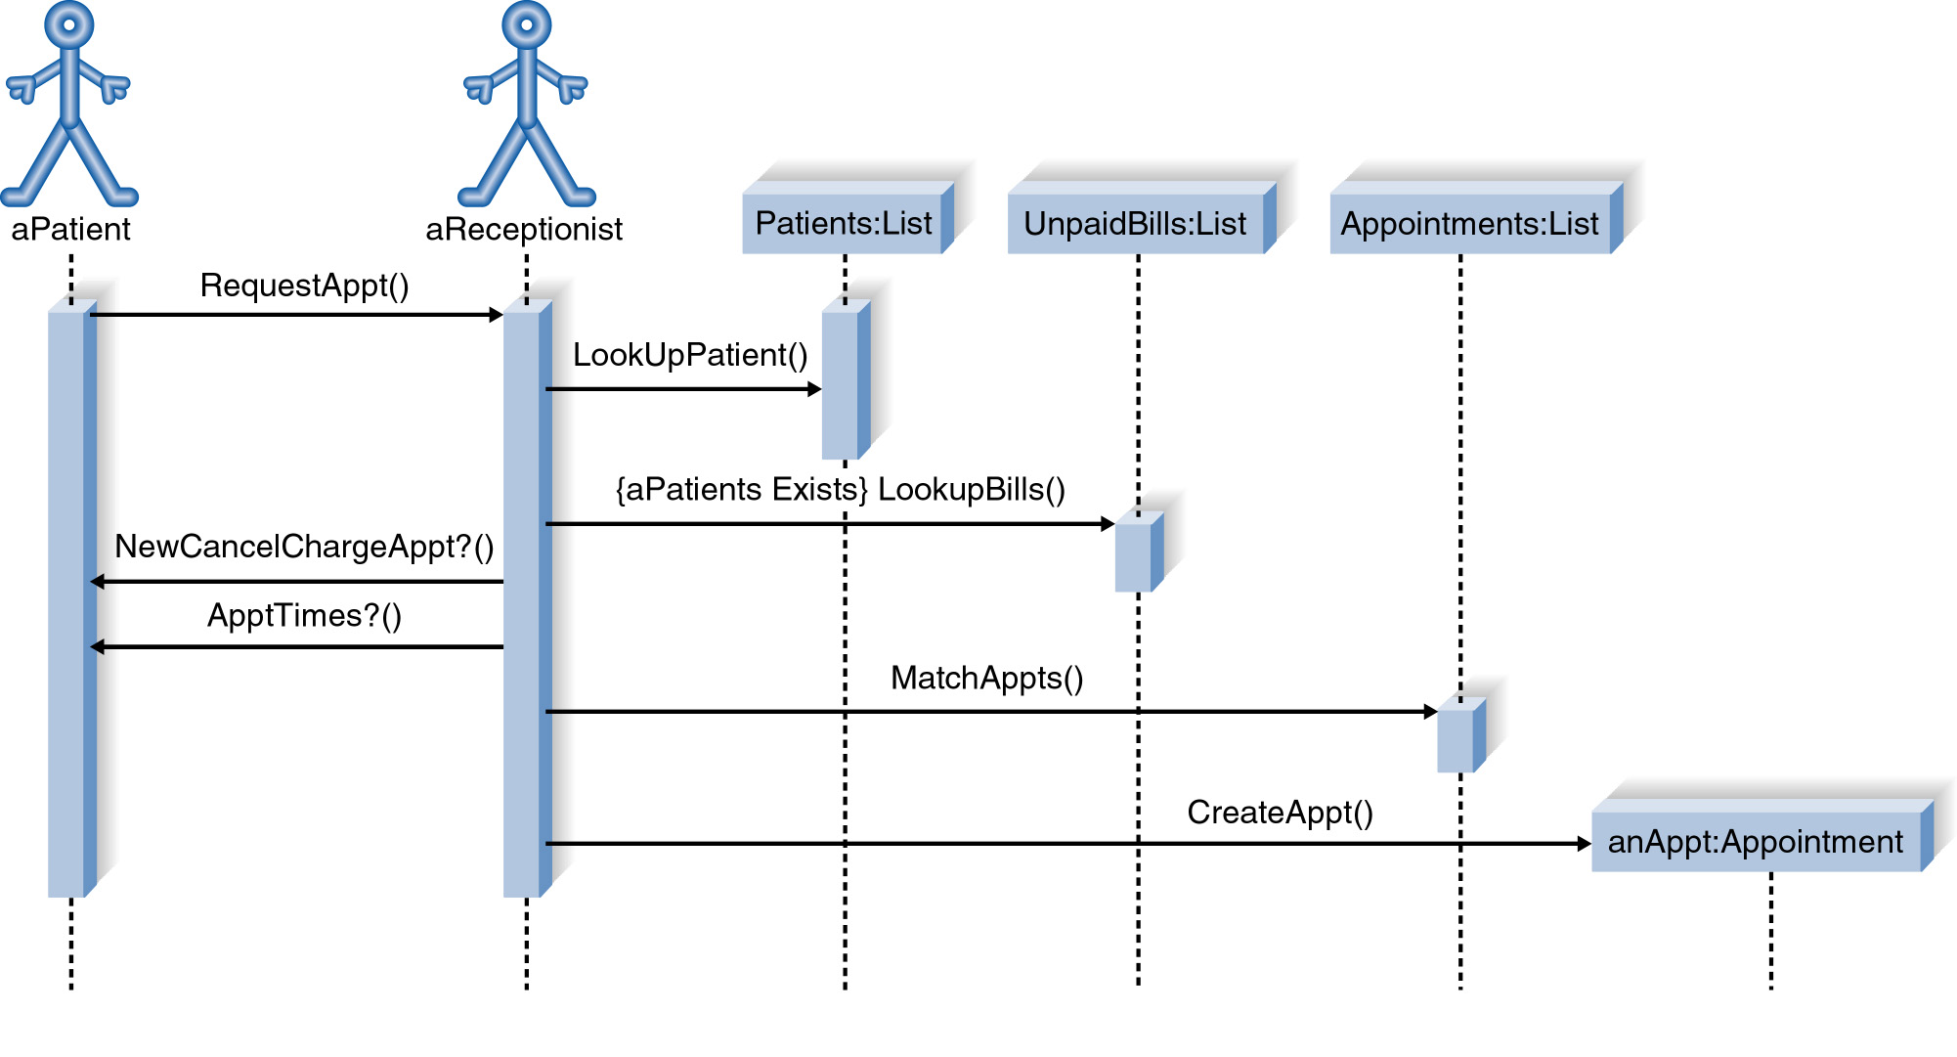
Sequence Diagram

Slide 13
Communications between Active Objects
Messages
  Used to illustrate communication between different active objects of a sequence diagram
  Used when an object needs
    to activate a process of a different object
    to give information to another object
Notes:
Messages
An interaction between two objects is performed as a message sent from one object to another.
HOW ACTIVE OBJECTS COMMUNICATE WITH EACH OTHER IN A SEQUENCE DIAGRAM
Illustrate the flow between the objects, how they interact, and what conditions change the flow

Slide 14
Messages
A message is represented by an arrow between the life lines of two objects.
  Self calls are allowed
A message is labeled at minimum with the message name.
  Arguments and control information (conditions, iteration) may be included.
Notes:
Time required by the receiver object to process the message is denoted by focus of control

Slide 15
Types of Messages
Synchronous (flow interrupt until the message has completed)
Asynchronous (don’t wait for response)
Flat (no distinction between sysn/async)
Return (control flow has returned to the caller)
Notes:
3) Flat
Use when we don’t care and don’t know if a message is synchronous or asynchronous
NOTICE THAT THE ARROW HEAD IS ONLY 2 LINES, NOT A FILLED-IN TRIANGLE

Slide 16
Synchronous Messages
The routine that handles the message is completed before the calling routine resumes execution.
:A
:B
doYouUnderstand()
return (optional)
Caller Blocked
yes
Notes:
Synchronize Messages
The object :A is in a hold pattern waiting for the response from the object :B
Indicates that flow is interrupted until the message has completed, and any messages that were sent from that message are completed as well.
Used for procedural system flow where one piece of functionality is executed before another
Modeled with a solid arrow head and line

Slide 17
Asynchronous Messages
Calling routine does not wait for the message to be handled before it continues to execute.
  As if the call returns immediately
Examples
  Notification of somebody or something
  Messages that post progress information
Notes:
Asynchronous messages
Used when control flow does not need to be interrupted before completing
Can be used for modeling concurrent systems
Can:
Create a new thread (a new activation record)
Create a new object
Communicate with a thread that is already running
Active objects own an execution thread and can initiate control activity.

Slide 18
Sequence Diagram
X-Axis (objects)
member:
LibraryMember
book:Book
:Book
Copy
borrow(book)
Object
Life Line
Y-Axis (time)
ok = mayBorrow()
Message
Focus of control
[ok] borrow(member)
setTaken(member)
Condition
Notes:
In a sequence diagram
Each column represents an object that is participating in the interaction.
The vertical axis represents time (from top to bottom).
Messages are shown by full arrows.
Labels on full arrows represent message names and arguments.
The operation can itself send other requests to other objects
An object can request an operation from itself (looping arrow)
Activations
the time it takes to perform an operation
are depicted by a rectangle attached to an object.
The height of the rectangle is indicative for the duration of the operation
The vertical rectangle shows that an object is active, that is, it is handling a request made by another object.

Slide 19
Other Elements of Sequence Diagram
Lifeline
Focus of control (activation box or execution occurrence)
Control information
  Condition, repetition

Slide 20
Sequence Diagram
Lifeline
  Denotes the life of actors/objects over time during a sequence
  Represented by a vertical line below each actor and object (normally dashed line)
For temporary object
  place X at the end of the lifeline at the point where the object is destroyed
Notes:
Lifeline in a sequence diagram
Represented by a vertical line for which our book uses a dotted (dashed) line or other people use a solid line
Sometimes an object creates a temporary object and in this case an X is placed at the end of the object’s lifeline to show that it is going out of existence (is destroyed)
Example: shopping cart object for a Web commerce application which is no long needed while the order is placed
If objects exist in the system after they are used in the sequence diagram, their lifeline continues to the bottom of the diagram

Slide 21
Sequence Diagram
Focus of control (activation box)
  Means the object is active and using resources during that time period
  Denotes when an object is sending or receiving messages
  Represented by a thin, long rectangular box overlaid onto a lifeline
Notes:
A focus of control in a sequence diagram
Shows the period of time in which an object has a thread of control

Slide 22
Sequence Diagram
X-Axis (objects)
member:
LibraryMember
book:Book
:Book
Copy
borrow(book)
Object
Life Line
Y-Axis (time)
ok = mayBorrow()
Message
Focus of control
[ok] borrow(member)
setTaken(member)
Condition
Notes:
In a sequence diagram
Each column represents an object that is participating in the interaction.
The vertical axis represents time (from top to bottom).
Messages are shown by full arrows.
Labels on full arrows represent message names and arguments.
The operation can itself send other requests to other objects
An object can request an operation from itself (looping arrow)
Activations
the time it takes to perform an operation
are depicted by a rectangle attached to an object.
The height of the rectangle is indicative for the duration of the operation
The vertical rectangle shows that an object is active, that is, it is handling a request made by another object.

Slide 23
Control Information
Condition
  syntax: ‘[‘ expression ’]’ message-label
  The message is sent only if the condition is true
[ok] borrow(member)
Notes:
Conditional messages: A message might contain a guard condition denoted in square brackets

