Slide 1
DECODELABS • DATA ANALYTICS
E-commerce Orders:
Revenue & Customer Insights
Project 4 | Data Visualization
Dataset period: January 2023 – June 2025 | 1,200 orders
Source: Cleaned E-commerce Orders Dataset

Slide 2
Sales performance at a glance
The dataset contains 1,200 orders across Jan 2023–Jun 2025.
TOTAL REVENUE
ORDERS
1,264,761.96
1,200
AVERAGE ORDER VALUE
DATA PERIOD
1,053.97
Jan 2023 – Jun 2025
These KPIs establish the scale of the dataset before exploring revenue patterns.
2
Source: Cleaned E-commerce Orders Dataset, Jan 2023 – Jun 2025

Slide 3
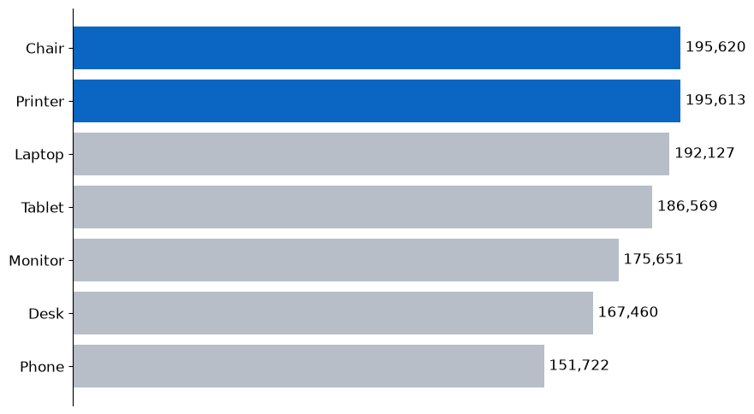
Chair and Printer lead product revenue
Chair and Printer each generate about 196K; Phone is lowest at about 152K.
3
Source: Cleaned E-commerce Orders Dataset, Jan 2023 – Jun 2025

Slide 4
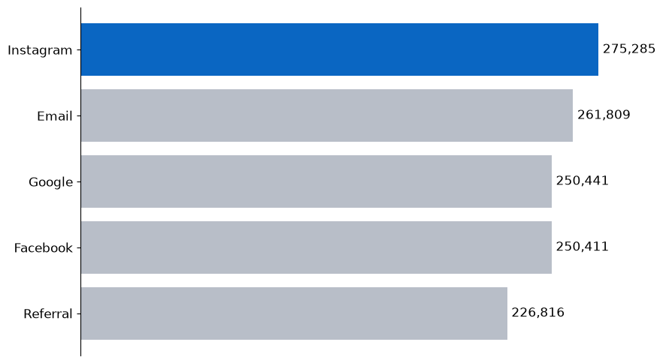
Instagram is the leading referral source
Instagram contributes approximately 275K in revenue (about 21.8% of total).
4
Source: Cleaned E-commerce Orders Dataset, Jan 2023 – Jun 2025

Slide 5
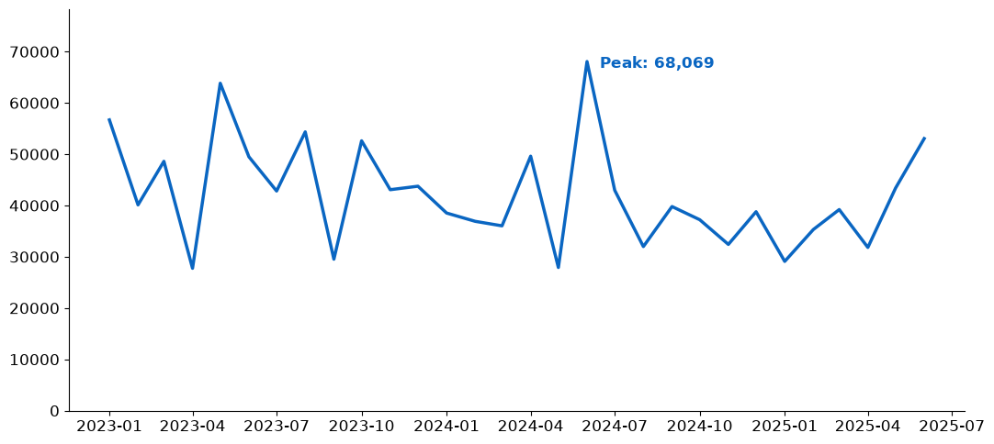
Monthly revenue fluctuates rather than following a steady rise
Revenue varies month to month; the highest month is June 2024 at 68,069.
BUSINESS COMPLICATION
Uneven monthly revenue makes it harder to plan inventory, campaigns, and cash flow confidently.
Next: investigate drivers of peaks and dips by month and channel.
5
Source: Cleaned E-commerce Orders Dataset, Jan 2023 – Jun 2025

Slide 6
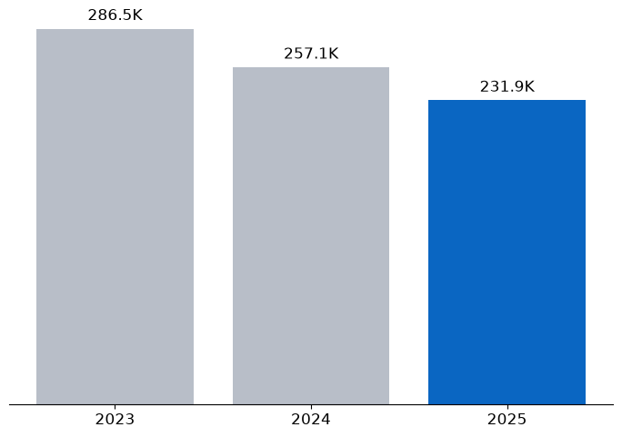
Jan–Jun revenue declined 19.1% from 2023 to 2025
Comparable first-half revenue decreased from 286.5K (2023) to 231.9K (2025).
6
Source: Cleaned E-commerce Orders Dataset, Jan 2023 – Jun 2025

Slide 7
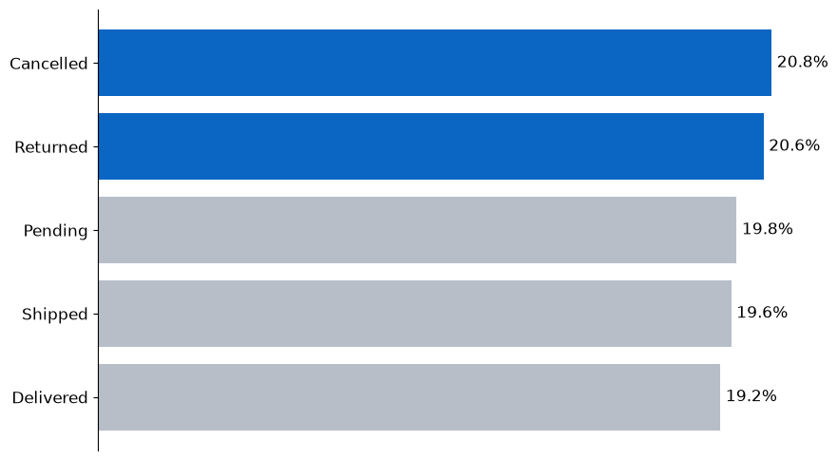
Cancelled and Returned make up 41.4% of orders
Only 19.2% of orders are Delivered in the dataset’s status distribution.
7
Source: Cleaned E-commerce Orders Dataset, Jan 2023 – Jun 2025

Slide 8
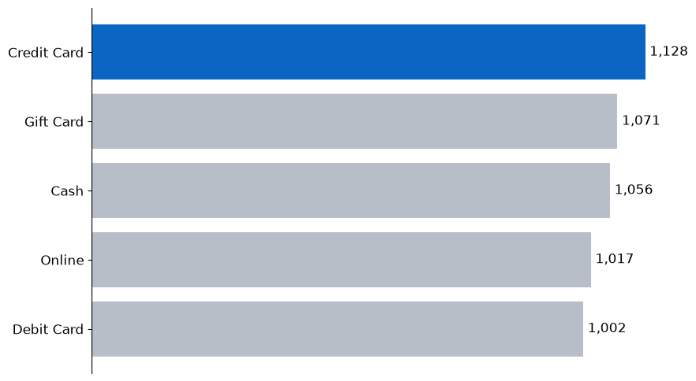
Credit Card has the highest average order value
Credit Card average order value is 1,128, ahead of Gift Card, Cash, Online, and Debit Card.
8
Source: Cleaned E-commerce Orders Dataset, Jan 2023 – Jun 2025

Slide 9
What should we do next?
Three actions grounded in the patterns observed in this dataset
1
Investigate order outcomes
Review the Cancelled and Returned share (41.4%) by product, payment method, and referral source to identify avoidable loss.
2
Diagnose revenue volatility
Compare monthly peaks and dips with campaign timing, product mix, and order volume before changing inventory or budgets.
3
Test channel and payment improvements
Run measured experiments around Instagram acquisition and the high-AOV Credit Card segment; track conversion and completed orders, not revenue alone.
These recommendations propose further investigation and testing; they do not claim causation.
9
Source: Cleaned E-commerce Orders Dataset, Jan 2023 – Jun 2025

