Slide 1
Stop Data Analysis of Minneapolis Police Department 2017
CSE 8990 Data Science
Presented by
M M NABI
Graduate student, ECE, Mississippi State University

Slide 2
Contents
Data Source
Dataset Content
Data Analysis
Visualization
Transformation
Modeling
Conclusion
References

Slide 3
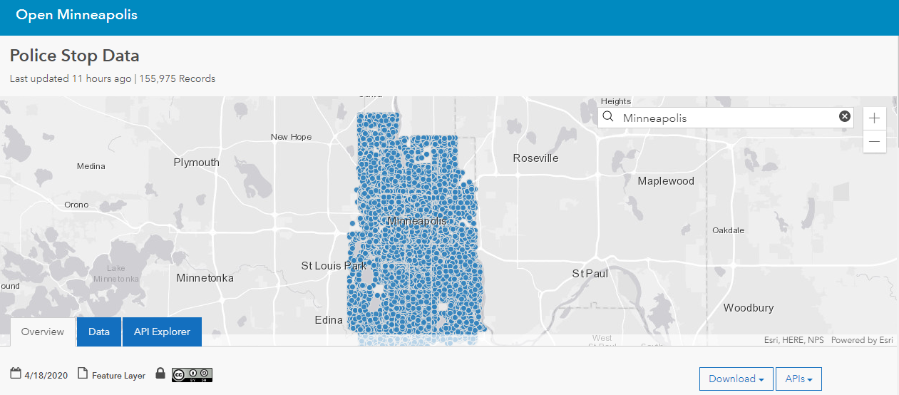
Data Source
http://opendata.minneapolismn.gov/datasets/police-stop-data

Slide 4
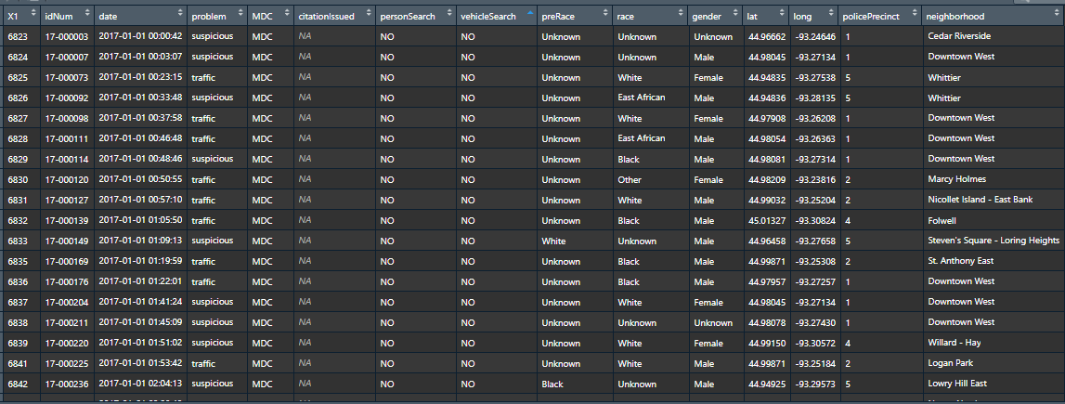
Dataset Content
view(Police_record)

Slide 5
Dataset Content
str(Police_record)
## Classes 'spec_tbl_df', 'tbl_df', 'tbl' and 'data.frame': 51920 obs. of 15 variables: ## $ X1 : num 6823 6824 6825 6826 6827 ... ## $ idNum : chr "17-000003" "17-000007" "17-000073" "17-000092" ... ## $ date : POSIXct, format: "2017-01-01 00:00:42" "2017-01-01 00:03:07" ... ## $ problem : chr "suspicious" "suspicious" "traffic" "suspicious" ... ## $ MDC : chr "MDC" "MDC" "MDC" "MDC" ... ## $ citationIssued: logi NA NA NA NA NA NA ... ## $ personSearch : chr "NO" "NO" "NO" "NO" ... ## $ vehicleSearch : chr "NO" "NO" "NO" "NO" ... ## $ preRace : chr "Unknown" "Unknown" "Unknown" "Unknown" ... ## $ race : chr "Unknown" "Unknown" "White" "East African" ... ## $ gender : chr "Unknown" "Male" "Female" "Male" ... ## $ lat : num 45 45 44.9 44.9 45 ... ## $ long : num -93.2 -93.3 -93.3 -93.3 -93.3 ... ## $ policePrecinct: num 1 1 5 5 1 1 1 2 2 4 ... ## $ neighborhood : chr "Cedar Riverside" "Downtown West" "Whittier"
Total Column – 15
Total Rows - 51920

Slide 6
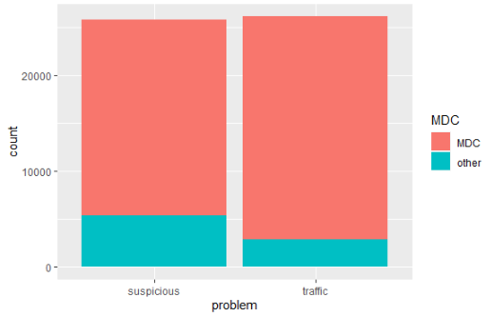
Data Analysis
ggplot(data = Police_record) +
geom_bar(mapping = aes(x = problem, y = ..count.., group = MDC, fill = MDC))
Problem:
Suspicious-suspicious vehicle or person stops
Traffic-traffic stops
MDC Record
MDC - Data collected via in-vehicle computer
Other - data submitted by officers not in a vehicle, either on foot, bicycle or horseback

Slide 7
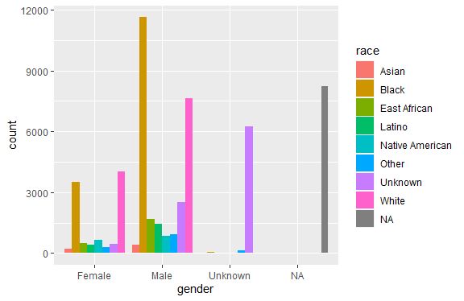
Data Analysis
ggplot(data = Police_record) +
geom_bar(mapping = aes(x = gender, fill = race), position = "dodge")

Slide 8
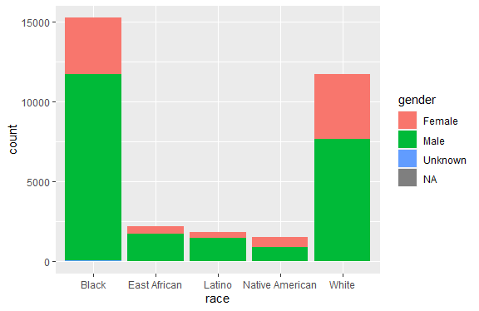
Data Analysis
u <- Police_record %>% select(race, gender) %>% filter(race %in% c("Black","White","Native American","East African", "Latino"))
ggplot(data = u) + geom_bar(mapping = aes(x = race, y = ..count.., group = gender, fill = gender))

Slide 9
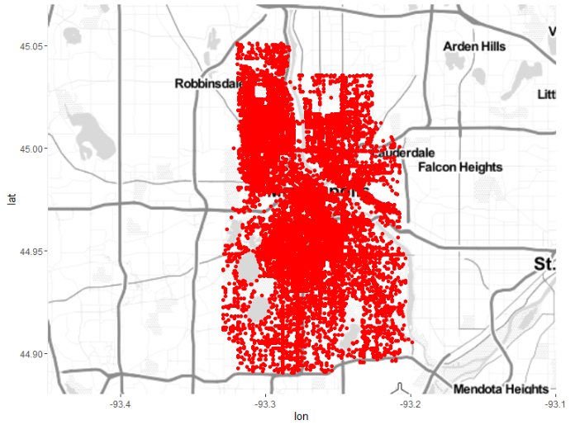
Data Analysis (Plotting in map)

Slide 10
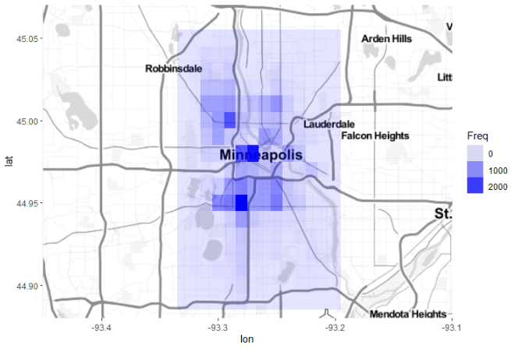
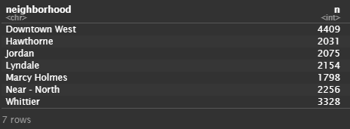
Data Analysis (heat map)
w <- Police_record %>%
count(neighborhood) %>%
filter(n > 1500)

Slide 11
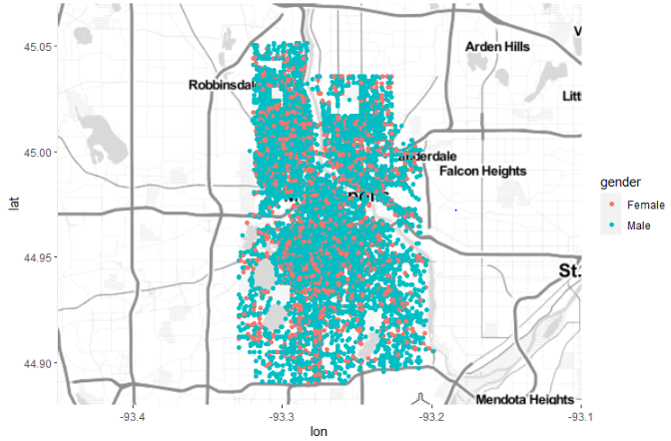
Data Analysis (Stopping based on gender)
q <- Police_record %>%
select(gender, lat, long) %>%
filter(gender %in% c("Male", "Female"))
Base_map + geom_point(data = q, aes(x = long, y = lat, color = gender))

Slide 12
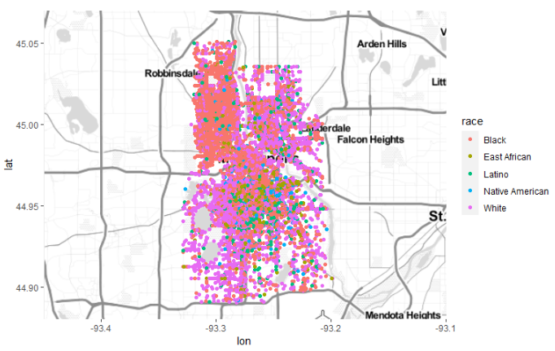
Data Analysis (Stopping based on race)
r <- Police_record %>%
select(race, lat, long) %>%
filter(race %in% c("Black", "White", "Native American","East African", "Latino"))
Base_map + geom_point(data = r, aes(x = long, y = lat, color = race))

Slide 13
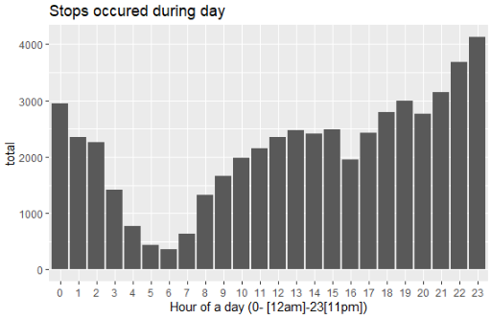
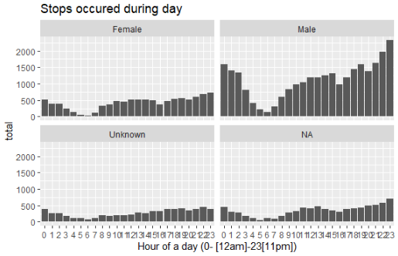
Data Analysis (Hour of a day)

Slide 14
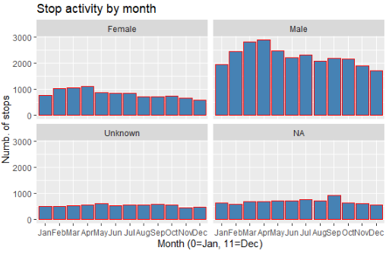
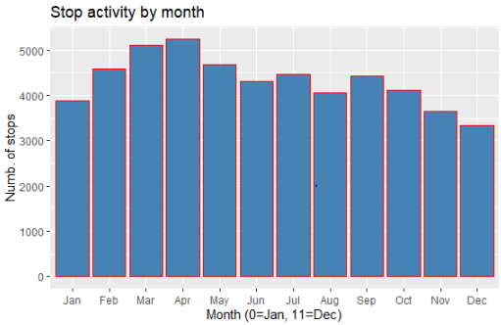
Data Analysis (Month-wise data)

Slide 15
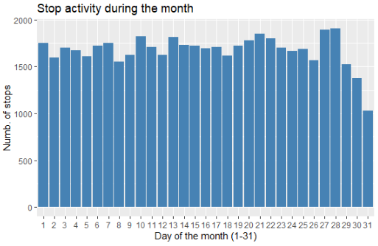
Data Analysis (Days of the Month)
day_data <- comb %>%
group_by(day) %>%
dplyr::summarize(Total = n())
ggplot(day_data, aes(day, Total)) +
geom_bar( stat = "identity", fill = "steelblue")

Slide 16
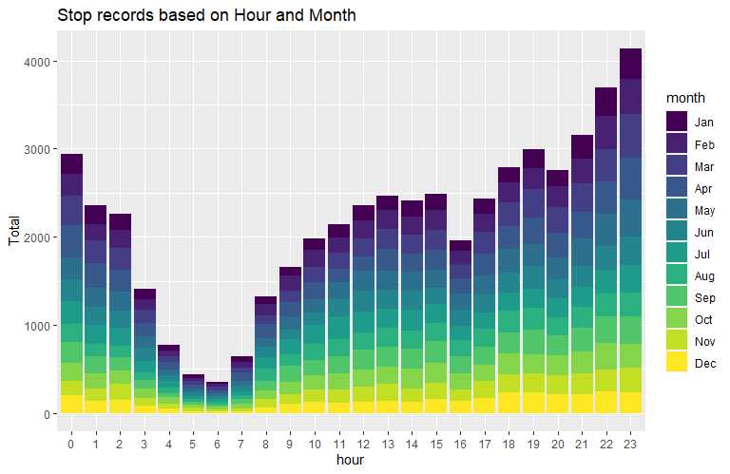
Data Analysis (Hour & Month)
month_hour <- comb %>%
group_by(month, hour) %>%
dplyr::summarize(Total = n())
ggplot(month_hour, aes(hour, Total, fill = month)) +
geom_bar( stat = "identity") +
ggtitle("Trips by Hour and Month")

Slide 17
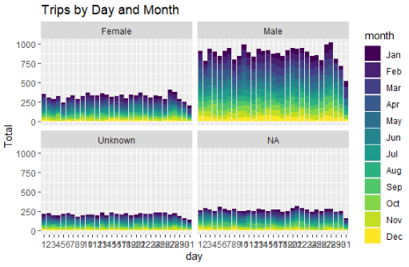
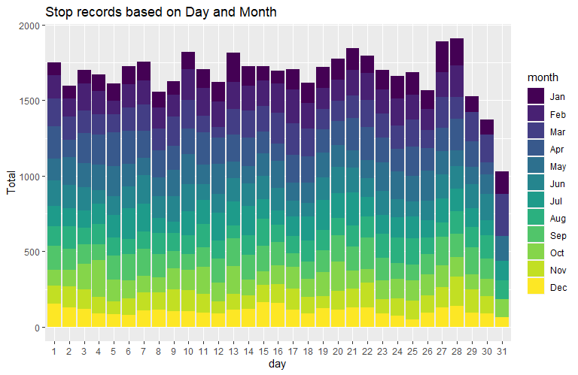
Data Analysis (Days of the Month & Month)

Slide 18
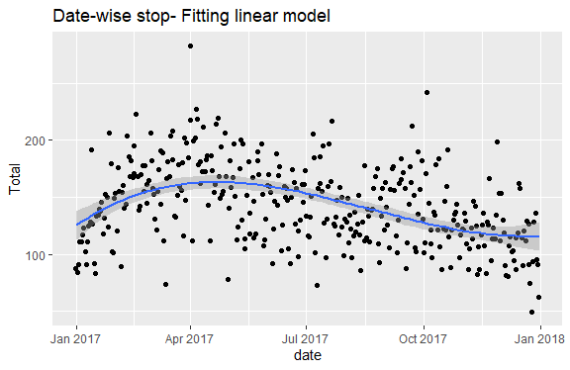
Data Analysis (Linear Modeling)
ggplot(Date_data, mapping=aes(x=date, y= Total)) +
geom_jitter()+
geom_smooth(method = lm, formula = y ~ splines::bs(x, 3))+
ggtitle("Date-wise stop")

Slide 19
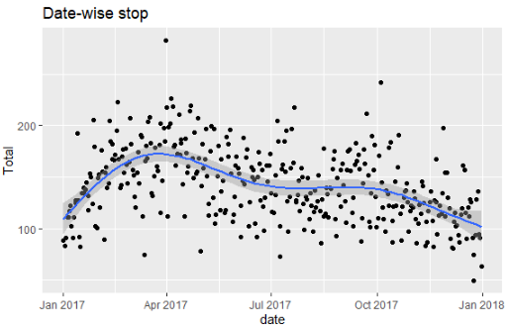
Data Analysis (Generalized Additive Modeling)
ggplot(Date_data, mapping=aes(x=date, y= Total)) +
geom_jitter()+
geom_smooth(method = "gam")+
ggtitle("Date-wise stop")

Slide 20
Conclusion
Males have highest number of record in all cases.
Black and white Race have higher number of record
Areas where the number record is higher.
Time analysis of data.
Downward trend from the model.

Slide 21
Reference
[1] Online: “http://opendata.minneapolismn.gov/datasets/police-stop-data” Minneapolis Police Department 2017 Stop Data.
[2] Online: “https://ggplot2.tidyverse.org/reference/geom_smooth”.
[3] Online: “https://rstudio-pubs-static.s3.amazonaws.com/407566_47415e9536964db2939600c448809bcd.html”.

Slide 22
Thank You

