Slide 1


Next-Generation Smart Integrated City Infrastructure With IoT Automation,Multi-VLAN Segmentation and Advanced Cybersecurity Enforcement.
Prepared for:
Practicum Defense Committee,
Department of Computer Science and Engineering
IUBAT-International University of Business Agriculture and Technology
Supervised By: Prepared By:
Mahedi Hasan Nabidur Rahaman
Lecturer ID: 22103011
Department of Computer Science and Engineering, IUBAT.
Date:Sunday, 25 January,2026

Slide 2
Contents
Organizational Overview
Introduction
Existing Network of Digi Jadoo Broadband Limited(Mohammadi Group)
Proposed Network for Digi Jadoo Broadband Limited(Mohammadi Group)
Demonstration
Conclusion

Slide 3
Organizational Overview

Slide 4
Mission and Vision of Digi Jadoo Broadband Limited(Mohammadi Group)
Mission:
1. Deliver Reliable & Affordable Broadband Connectivity
2. Enable Digital Transformation for Business & Household
3. Maintain Network Excellence & Customer Satisfaction
Vision:
1. Become Bangladesh’s Leading Broadband Service Provider
2. Bridge the Digital Divide
3. Foster Innovation in IoT , Smart Cities & Connected Infrastructure
4.Contribute to National Digital Economy Growth

Slide 5

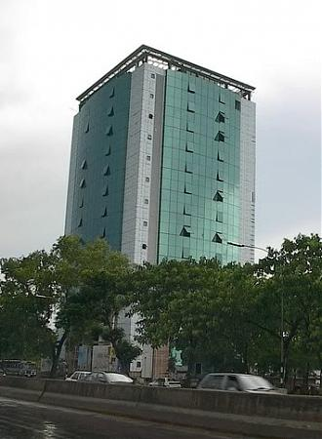

Office Information
Address of the Organization:
Name: Digi Jadoo Broadband Linited(Mohammadi Group)
Head-Office: Lotus Kamal Tower-One,Level-9,10,11,14,57 Joar Sahara C/A,Nikunja-2,Khilkhet,Dhaka-1229,Bangladesh.
Phone: +880 9613016503
Website: www.jadoobroadband.com
Email: noc@digijadoo.com
Figure 1: Organization picture

Slide 6
Introduction

Slide 7
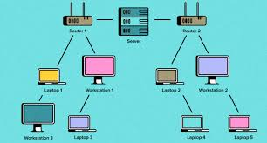
Computer Network
Enables communication and resource sharing between devices
Consists of hardware (routers, switches, cables) and software (protocols, services)
Uses protocols like TCP/IP to ensure reliable communication
Enhances security through firewalls, encryption, and access control
Requires regular monitoring, maintenance, and troubleshooting

Slide 8
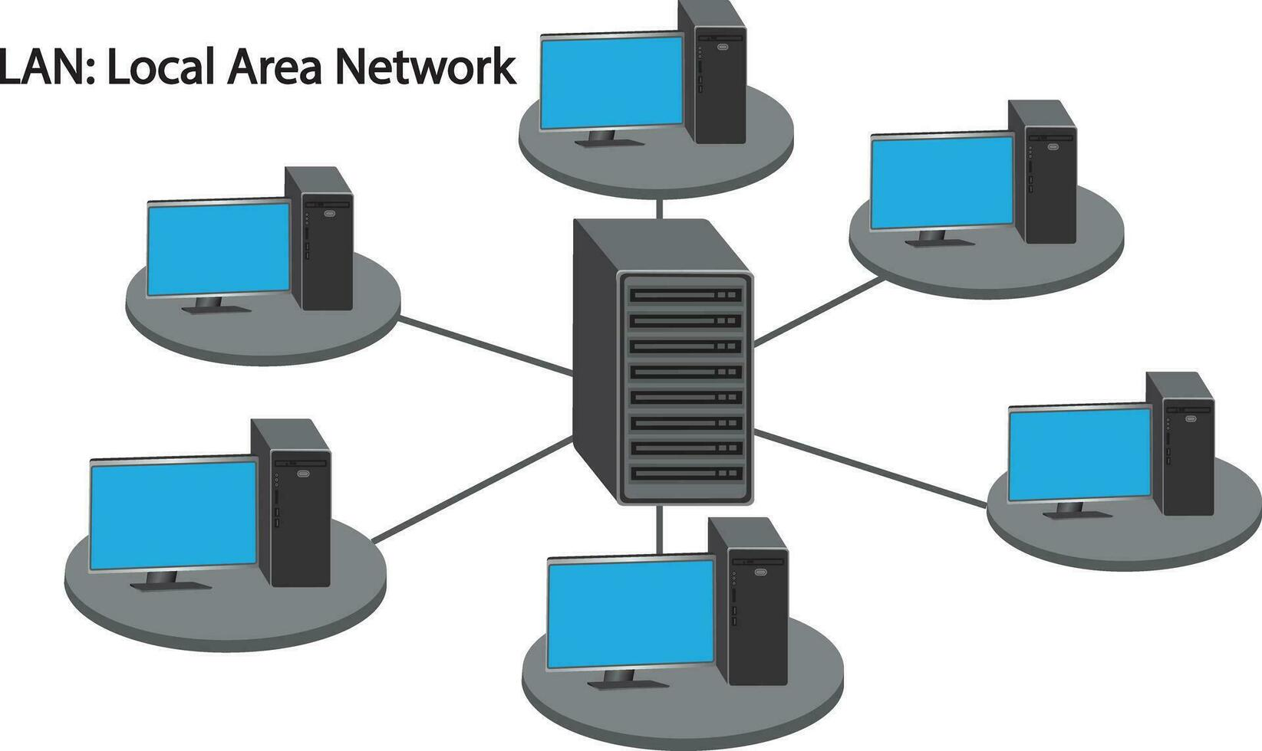
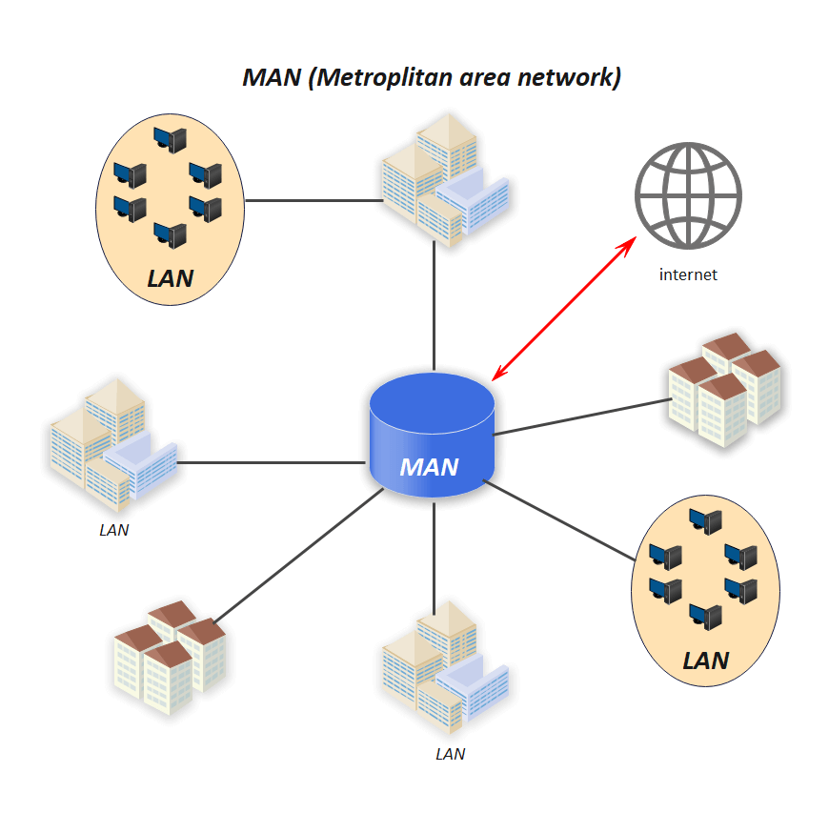
Network Types
Figure 3: Local Area Network
Figure 4: Metroplitan Area Network

Slide 9
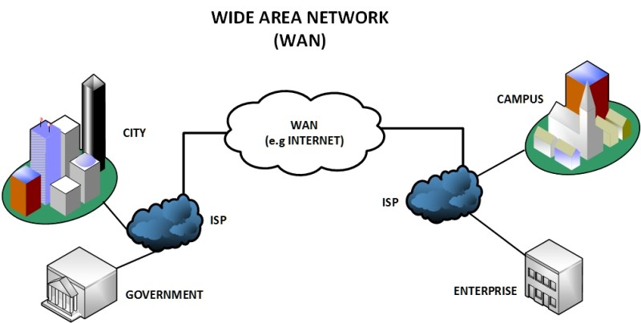
Network Types(Contd.)
Figure 5: Wide Area Network

Slide 10
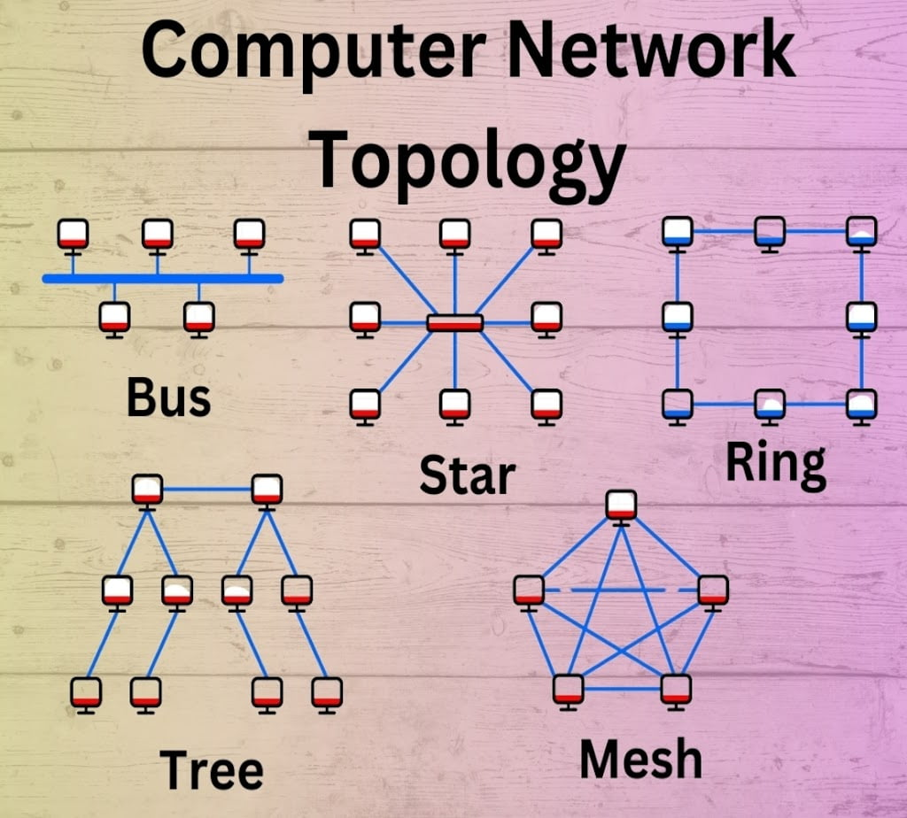
Network Topology
Bus Network
Star Network
Ring Network
Tree Network
Mesh Network
Figure 6: Network Topology

Slide 11
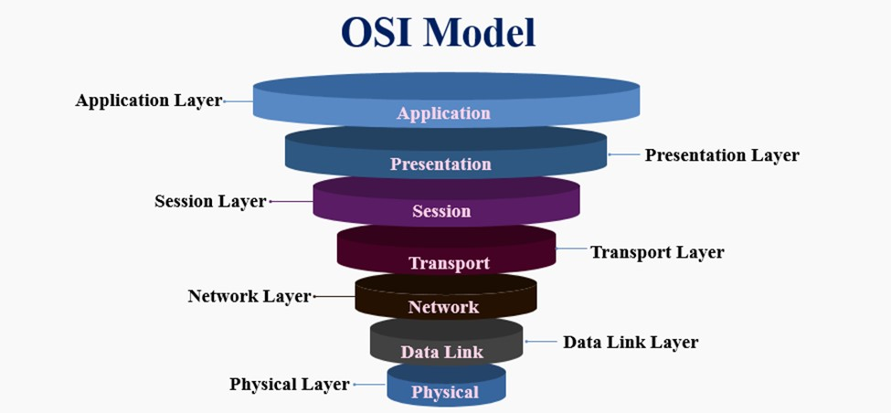
Network Model
OSI Model
OSI Model standardizes how network system communicates
Divided into 7 layers
Communication flows from top (Layer 7) to bottom (Layer 1) for sending data and bottom to top for receiving
Figure 7: Open System Interconnection

Slide 12
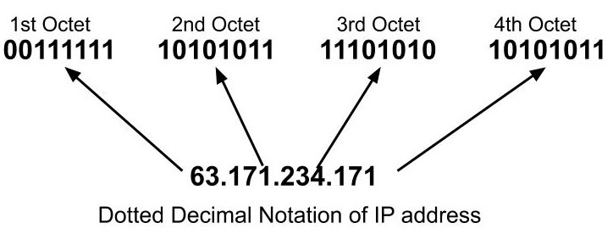
IP Addressing
An IP address uniquely identifies a device on a network
IP addresses are essential for routing and communication between devices
Two versions exist: IPv4 (e.g., 192.168.1.1) and IPv6 (e.g., 2001:0db8::1)
IP addresses are divided into network and host portions
Can be static (manually assigned) or dynamic (assigned via DHCP)
Figure 8: An Example of IP Address

Slide 13
Existing Network of Digi jadoo Broadband Limited

Slide 14
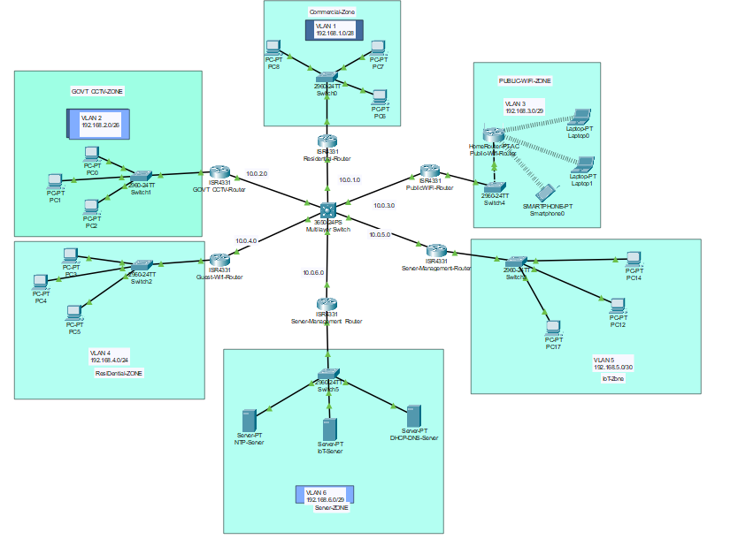
Existing Network Model
Figure 9: Layout of Existing Network

Slide 15
Network Devices
Core Router
Core Multilayer Switch
Distribution Switches(6)
PC’s(15)
Home-Router(2)
Servers(3)

Slide 16
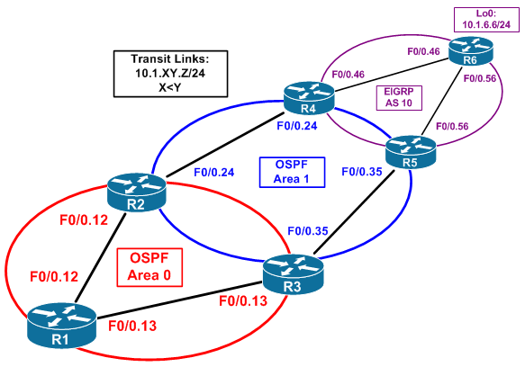
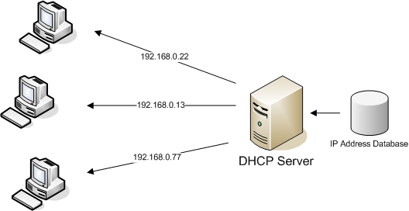
Routing Protocols
Static Routing
Dynamic Routing(OSPF, RIP)
Figure 10: Open Shorted Path Found
Figure 11: Dynamic Host Configuration Protocol

Slide 17
Servers
MAIL Server
NTP Server
DHCP-DNS server

Slide 18
Limitations of Existing Network
Network Congestion & Security risks
Limited IoT scalability
Vulnerable to Unauthorized access
Manual Management Only

Slide 19
Proposed Network for Digi jadoo Broadband Limited(Mohammadi Group)

Slide 20
Features of Proposed Network
Hierarchical design with core, distribution, and access layers for better IoT integration
IoT automation Control Via Home-Gateway and IoT Server
Improved manageability through layered design and logical VLAN segmentation(6 Zones)
Uses Giga Ethernet Cable for better data communication between Device
6 server (DHCP-DNS,Web,NTP,IoT,Syslog) for automated network Services

Slide 21
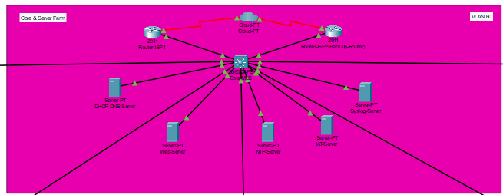
Proposed Network Model
Figure 12: Layout of Proposed Network

Slide 22
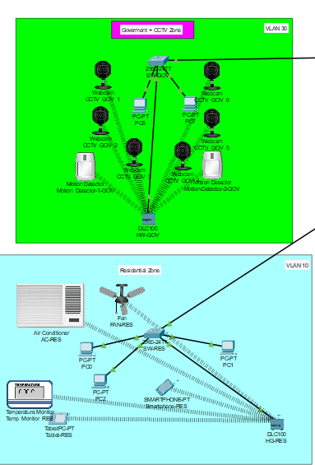
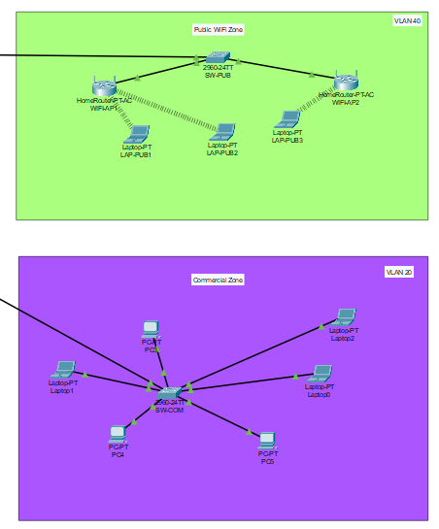
Proposed Network Model
Figure 12: Layout of Proposed Network

Slide 23
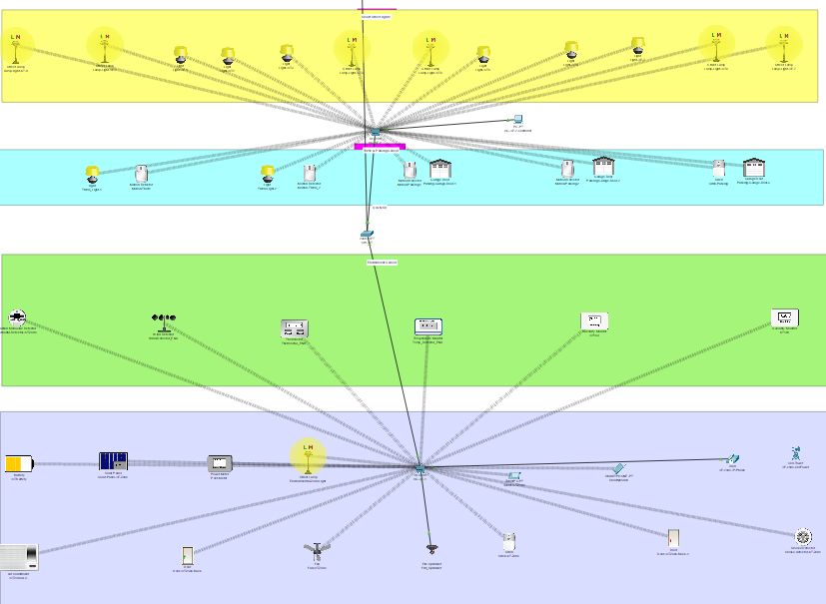
Proposed Network Model
Figure 12: Layout of Proposed Network

Slide 24
Network Devices
Core Router
Back up Router
Core Multilayer Switch
Distribution Switch(5)
Home-Router(2)
End Device(12)
Home-Gateway(4)
Servers(5)
IoT End Device(50)

Slide 25
Servers
DHCP-DNS Server
WEB Server
NTP server
IoT Server
Syslog Server

Slide 26
Demonstration

Slide 27
Existing Network
Figure 13: Existing Network Demonstrates

Slide 28
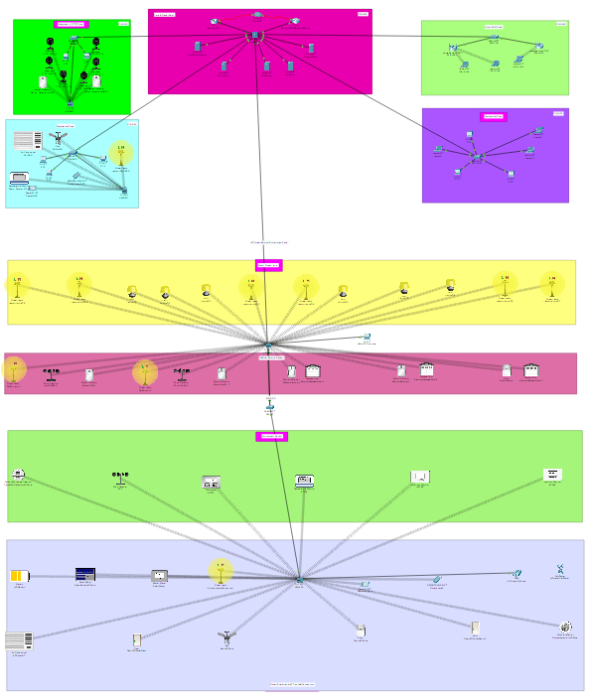
Proposed Network
Figure 14: Proposed Network Demonstrates

Slide 29
Cost Estimation
Item | Quantity | Unit Price (USD) | Total (USD)
Cisco Layer 3 Core Switch | 1 | 4500 | 3500
Cisco Core Router and Backup router | 2 | 3500 | 7000
Distribution Switch | 5 | 1100 | 5500
Home-Gateway | 4 | 800 | 3200
Servers (DHCP-DNS, NTP, web,IoT,Syslog) | 5 | 4000 | 20000
Home Router | 2 | 400 | 800
IoT End Device | 50 | 500 | 25000
Total |  |  | 65,000

Slide 30
Comparison between Existing and Proposed Network
Existing Network | Proposed Network
Weak/No Security Mechanism | Hierarchical topology (core, distribution, access layers)
Weak or absent security mechanisms | Enhanced security using Access Control Lists (ACLs)
No redundancy – prone to single points of failure | Redundant links and backup router ensure high availability.
Poor scalability and adaptability | Scalable VLAN and modular design supports future expansion
Not IoT Control | IoT Automation and Public wifi Service

Slide 31
Conclusion

Slide 32
Conclusion
This project successfully delivered a Next-Generation Smart City Infrastructure that transforms flat, unmanaged networks into secure, scalable, IoT-enabled environments.
Key Achievements:
Hierarchical 3-tier design (Core MLS, Distribution HG, 5 Access switches) replacing single broadcast domain
6-VLAN segmentation (Residential/Commercial/Govt/WiFi/IoT/Servers) providing zone isolation & security
Automated IoT control: 14 street lights + 4 traffic signals via centralized Home Gateway dashboard
Enterprise services: DHCP/DNS/NTP/Web/IoT/Syslog for centralized management & monitoring
Multi-layer security: ACL, Port Security, DHCP Snooping, SSH encryption across all zones

Slide 33
Reference
[1] Academy, C. N. (2022). Packet Tracer User Guide. Retrieved from https://www.computernetworkingnotes.com
[2] geeksforgeeks. (2021). Wired and Wireless Networking. Retrieved from https://www.geeksforgeeks.org
[3] geeksforgeeks. (2025). Network Devices (Hub, Repeater, Bridge, Switch, Router, Gateways and Brouter). Retrieved from geeksforgeeks https://www.geeksforgeeks.org
[4] networklessons. (n.d.). ASA Firewall. Retrieved from https://networklessons.com
[5] What Is a Subnet Mask? Definition, Working, and Benefits. (2022). Retrieved from SpiceWorks https://www.spiceworks.com
[6] Yasar, K. (2023). IP address (Internet Protocol address). Retrieved from https://www.techtarget.com
https://www.techtarget.com

Slide 34


