Slide 1

presents
Design Practices

Slide 2
Let’s talk about
User eXperience
Search Engine Optimization
Accessibility
Cross-Browser compatibility
Browser developer tools
Content creation
Modern web browsers

Slide 3
User Experience & Interface
Thinking out loud about design

Slide 4
What is User eXperience?

Slide 5
What is User eXperience?
User experience is how you feel when interacting with a website.

Slide 6
What is User eXperience?
Findable
Accessibility
Credibility
Design
Content
Performance
Usability
Research
Human-Computer Interaction

Slide 7
Let’s talk about
human-computer interaction

Slide 8
When you visit a website for the first time,
where do your eyes go first?

Slide 9
Simple, top left.
It’s where the logo is, title, etc

Slide 10
F
The F-pattern is the most
common eye scanning patten

Slide 11
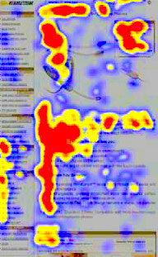
The F-pattern is the most
common eye scanning patten
Heat overlay of the F-pattern

Slide 12
Do your eyes ever feel strained when reading or scanning web content?

Slide 13
White
Space
Also known as ‘negative space’
Crucial for scanning, readability,
and balance.

Slide 14
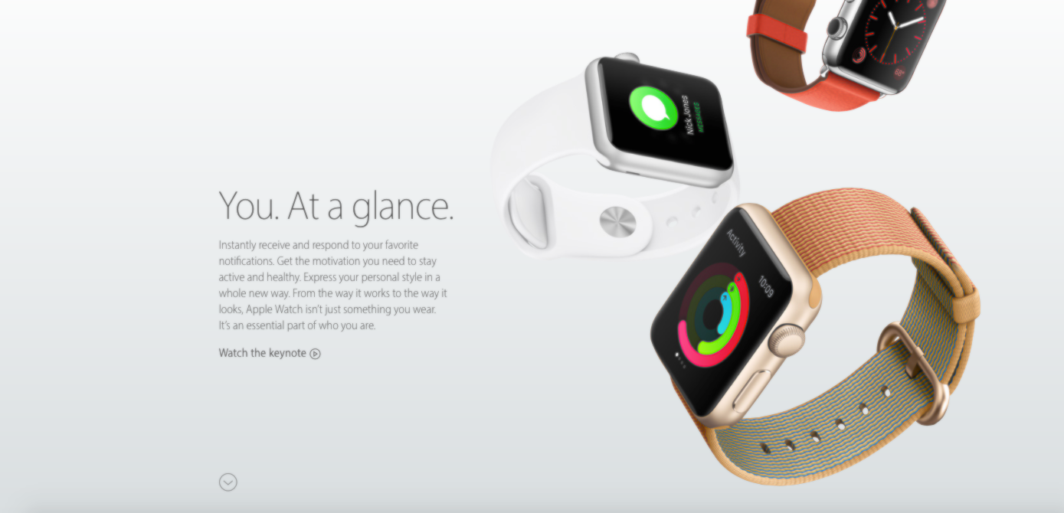
White
Space
http://www.apple.com/watch/

Slide 15
Search Engine Optimization
Attracting Attention

Slide 16
Search Engine Optimization
SEO is the process of boosting the rank of a website in search results to increase the number of visitors

Slide 17
SEO shares many aspects of
User eXperience.

Slide 18
SEO shares much with UX
Performance
Bounce rate
Percentage of visitors who navigate away from a website after viewing only one page
Credibility
Mobile Compatibility
Content - images, keywords, headings, etc
And more!

Slide 19
SEO basics
add keywords to URLs
consistent meta data
keywords in headers
alt text for images
pick good web hosting
title tags
transcripts for audio and video
rich snippets: extra bit of text that appear under search results
use Content Delivery Network’s (CDN) to speed up load time
Notes:
CDN: serve content to end-users with high availability and high performance

Slide 20
Accessibility
Leveling the playing field with friendly websites

Slide 21
How many people do you suppose are blind?

Slide 22
Based on multiple extrapolated estimates, roughly
2.3% of the population has a visual disability.

Slide 23
This brings us to accessibility.

Slide 24
Accessibility
What does it mean
to be accessible?

Slide 25
Accessibility
It means that everyone
has the same UX.

Slide 26
Think about this
What if everything on the page was disabled?
images flash css javascript
Would everything still make sense?

Slide 27
What if the user accessing your site has an
OUTDATED COMPUTER
Will they share the experience of your other users?

Slide 28
Accessibility Tips
Use descriptive headings
Use descriptive link text
Provide information in lists
Use descriptive page titles
Don’t forget periods
Place information in a logical linear fashion
Use short and concise alt text
Write short front-loaded paragraph text

Slide 29
Cross-Browser Compatibility
Websites should play well with others

Slide 30
Google’s take on it
Google Supports:
Chrome
Firefox
Safari
Internet Explorer
Microsoft Edge

Slide 31
Google supports
Google Supports:
Chrome (latest version)
Firefox (last 3 major releases)
Safari (last 3 major releases)
Internet Explorer (last 3 major releases)
Microsoft Edge (last 3 major releases)

Slide 32
Tips
Test as much as you can
Write valid HTML and CSS
Specify Character Encoding
Also, test without Javascript or Images

Slide 33
Browser Developer Tools
Testing, Debugging, Exploring, Creating

Slide 34
Let’s quick explore the Chrome Dev Tools

Slide 35
Content Creation
Content is KING

Slide 36
Pretty self-explanatory.
Present respectable and expected content.
Give the users what they want. Focus keywords.

Slide 37
Enhance content with great UX and UI.

