Slide 1
URBAN8 RENT-CAR
Manual Book
Panduan Pemakaian Aplikasi + Demo Setiap Modul
Stack: Laravel 13 · Inertia · React 19 · Tailwind 4 · Postgres 15
Coverage: 27 Use Case · 55 Test Case · 54 PASS / 1 SKIP / 0 FAIL
Tanggal: 2026-05-24 · Versi: 1.0 · UML AS-BUILT
Disusun oleh tim Engineering Urban8 · Internal Documentation

Slide 2
DAFTAR ISI
Apa yang dibahas
1
Tentang Aplikasi
Stack, modul, dan ringkasan domain
2
Akun & Akses
Role, kredensial seeder, redirect dashboard
3
Coverage E2E Test
55 case Playwright headless 1920×1080
4
Demo Modul Customer
UC-01..UC-09, UC-25 (registrasi → order → bukti)
5
Demo Modul Admin
UC-11..UC-22, UC-27 (verifikasi, lifecycle, refund)
6
Demo Modul Kasir & Driver
UC-10, UC-12, UC-26
7
Lampiran
Log audit, settings, dan ringkasan UC
Manual Book · Rent-Car Urban8
2

Slide 3
BAB 1
Tentang Aplikasi
Apa itu Urban8 Rent-Car?
TECH STACK
Aplikasi rental kendaraan + shuttle service untuk customer retail dan korporat. Mendukung pemesanan kendaraan harian/jam, layanan jemput-antar bandara/stasiun, manajemen driver, sistem refund, dan audit-log untuk seluruh transaksi.
BACKEND
Laravel 13 · PHP 8.3 · Postgres 15
FRONTEND
Inertia v3 · React 19 · TypeScript · Tailwind 4
Modul utama
AUTH
Customer Portal
Registrasi, katalog, pemesanan, riwayat, upload bukti
Admin Console
CRUD master data, verifikasi, lifecycle, laporan, refund
Kasir Console
Catat tunai, cetak kuitansi, verifikasi transfer
Driver Portal
Lihat order assigned, status keberangkatan
Fortify + Spatie Permission (4 role)
ROUTING
Wayfinder typed routes
TESTING
Pest 3 · Playwright 1920×1080
DEPLOY
Docker Compose · Nginx · Vite build
Manual Book · Rent-Car Urban8
3

Slide 4
BAB 2
Akun & Akses
Role yang didukung sistem
CUSTOMER
ADMIN
KASIR
DRIVER
Login email
Login email
Login email
Login email
customer@urban8.com
admin@urban8.com
kasir@urban8.com
driver@urban8.com
Password
Password
Password
Password
password
password
password
password
Akses
Akses
Akses
Akses
Akun publik. Registrasi mandiri. Akses katalog, pemesanan, riwayat, upload bukti, cancel order pending.
Hak penuh: master data, lifecycle order, verifikasi, refund, laporan, settings.
Catat pembayaran tunai, cetak kuitansi, verifikasi transfer (limited).
Lihat order yang ditugaskan, status keberangkatan kendaraan.
Manual Book · Rent-Car Urban8
4

Slide 5
BAB 3
Coverage E2E Test
Playwright headless Chromium · viewport 1920×1080 · full-page screenshots
55
54
1
0
TOTAL CASES
PASS
SKIP
FAIL
23 use case ter-cover dari 27 yang dipetakan di UML AS-BUILT
23/27 (85%)

Slide 6
UC-01
Registrasi & Login
AKTOR
MODUL
TEST CASES
Customer
Authentication
4 step
Customer baru dapat membuat akun dan masuk ke sistem. Akun terverifikasi via email + password yang di-hash bcrypt.

Slide 7
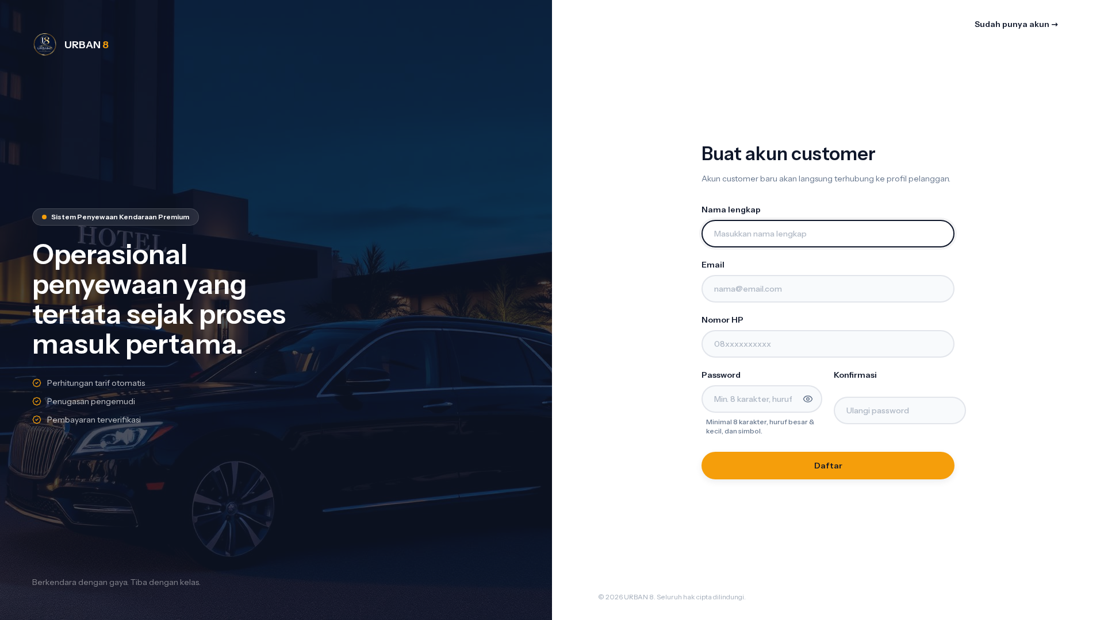
UC-01 · Registrasi & Login
PASS
Halaman Registrasi Customer
URL: /register · Component: Form registrasi · Kondisi: Initial render
Manual Book · Rent-Car Urban8
6

Slide 8

UC-01 · Registrasi & Login
PASS
Form Registrasi Filled
URL: /register · Component: Form filled · Kondisi: Filled with valid data
Manual Book · Rent-Car Urban8
7

Slide 9
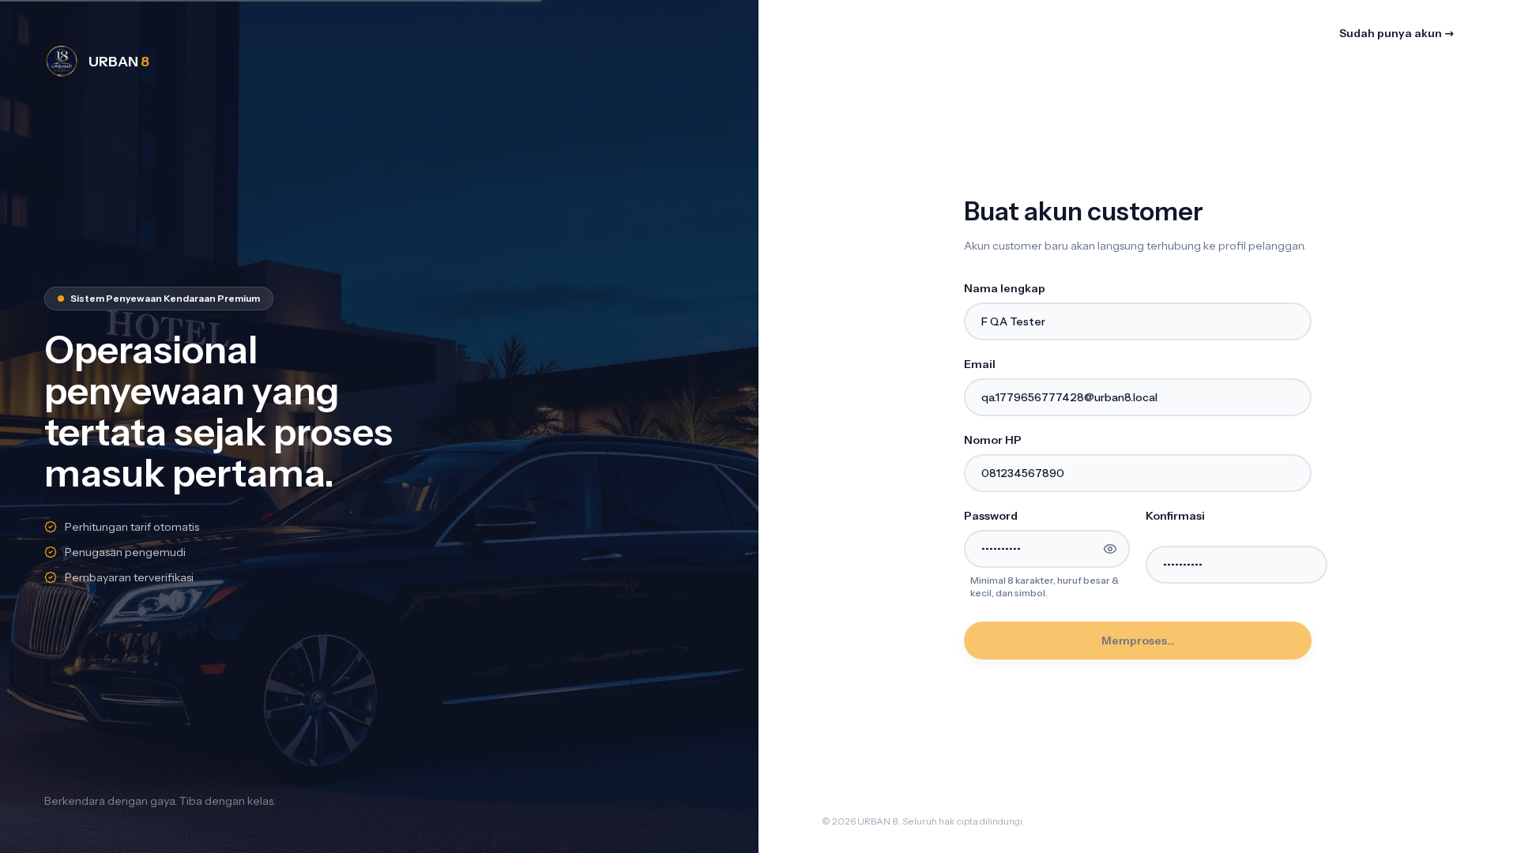
UC-01 · Registrasi & Login
PASS
After Register Submit
URL: /register · Component: Submit success · Kondisi: Setelah register sukses
📝 Email: qa.1779656777428@urban8.local
Manual Book · Rent-Car Urban8
8

Slide 10
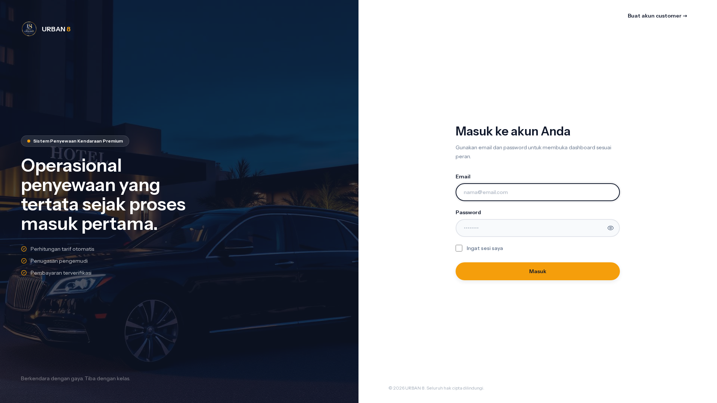
UC-01 · Registrasi & Login
PASS
Halaman Login
URL: /login · Component: Form login · Kondisi: Initial
Manual Book · Rent-Car Urban8
9

Slide 11
UC-02
Browse Katalog & Detail Kendaraan
AKTOR
MODUL
TEST CASES
Public / Customer
Catalog
2 step
Pengunjung dan customer dapat melihat seluruh kendaraan yang tersedia, filter per kategori, dan lihat detail spesifikasi.

Slide 12
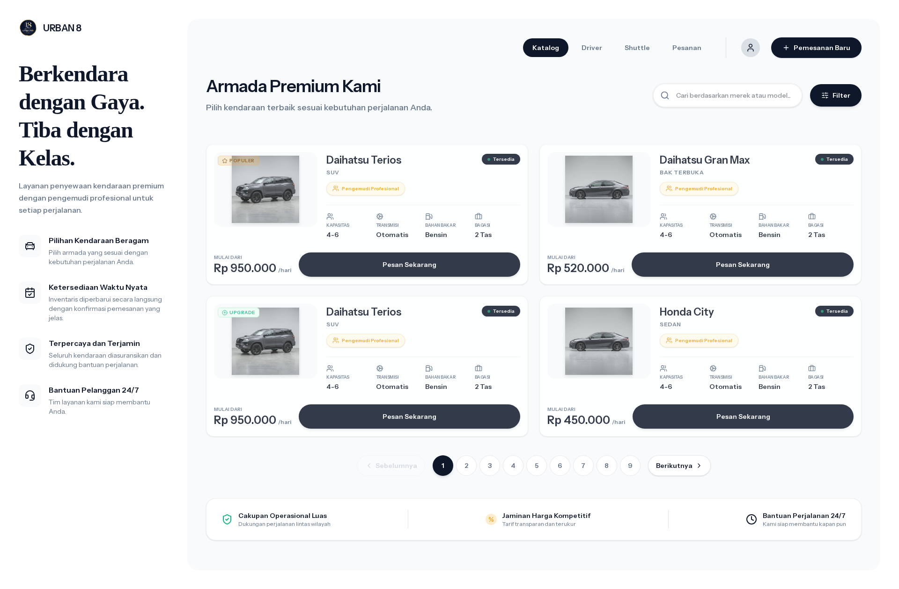
UC-02 · Browse Katalog & Detail Kendaraan
PASS
Browse Katalog (publik)
URL: /catalog · Component: List kategori/kendaraan · Kondisi: Anonymous browse
Manual Book · Rent-Car Urban8
11

Slide 13
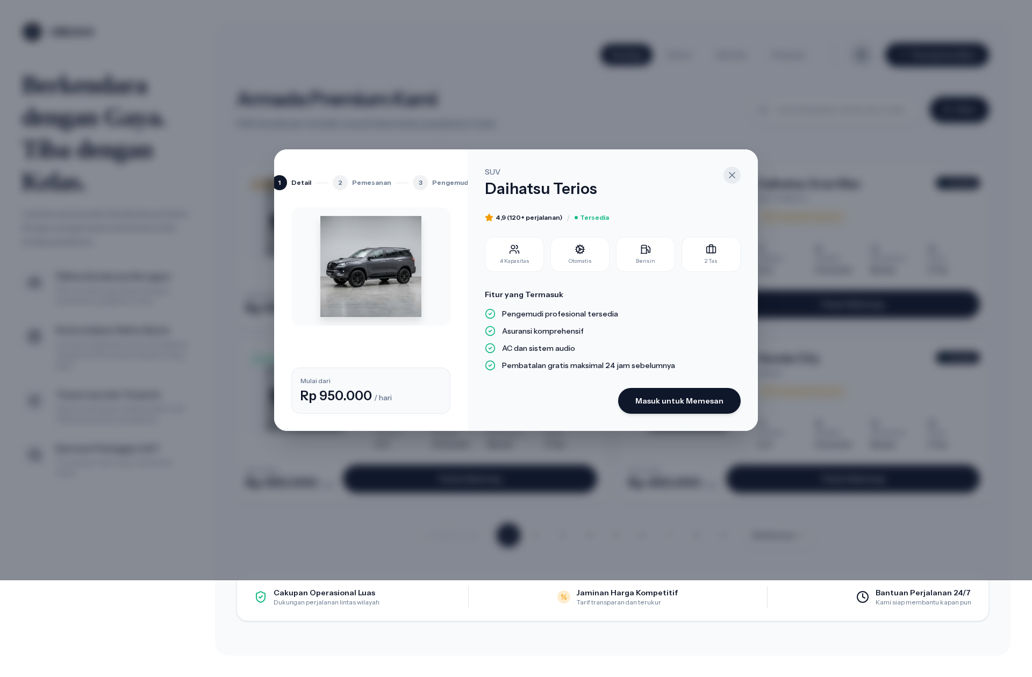
UC-02 · Browse Katalog & Detail Kendaraan
PASS
Detail Kategori/Kendaraan
URL: /catalog · Component: Halaman detail · Kondisi: Click katalog item
Manual Book · Rent-Car Urban8
12

Slide 14
UC-03
Mulai Buat Order Kendaraan
AKTOR
MODUL
TEST CASES
Customer
Rental Order
4 step
Customer memilih kendaraan dari katalog, modal order step-by-step terbuka. Step 1: detail kendaraan + spesifikasi.

Slide 15
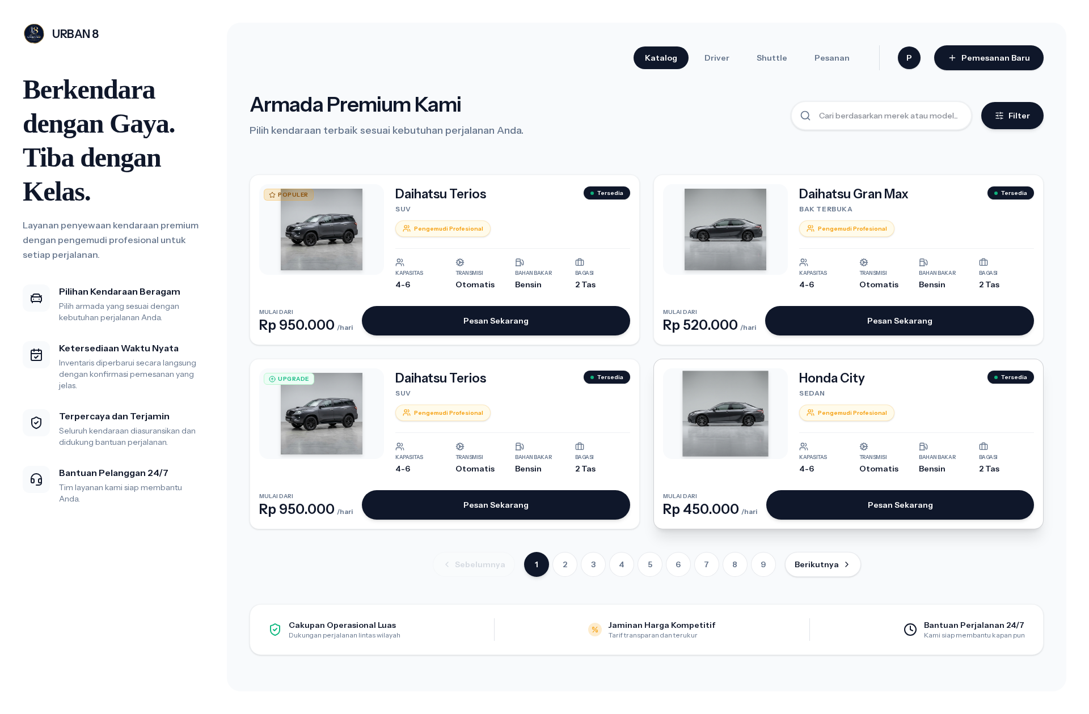
UC-03 · Mulai Buat Order Kendaraan
PASS
Non-loyal customer — Mulai Buat Order
URL: /catalog · Component: Catalog list (logged-in) · Kondisi: Customer logged-in browsing
Manual Book · Rent-Car Urban8
14

Slide 16

UC-03 · Mulai Buat Order Kendaraan
PASS
Non-loyal customer — Modal Order Step 1 Detail
URL: /catalog · Component: Vehicle order modal · Kondisi: Step 1 Detail kendaraan
Manual Book · Rent-Car Urban8
15

Slide 17

UC-03 · Mulai Buat Order Kendaraan
PASS
Loyal customer — Mulai Buat Order
URL: /catalog · Component: Catalog list (logged-in) · Kondisi: Customer logged-in browsing
Manual Book · Rent-Car Urban8
16

Slide 18

UC-03 · Mulai Buat Order Kendaraan
PASS
Loyal customer — Modal Order Step 1 Detail
URL: /catalog · Component: Vehicle order modal · Kondisi: Step 1 Detail kendaraan
Manual Book · Rent-Car Urban8
17

Slide 19
UC-04
Form Order — Durasi & Lokasi
AKTOR
MODUL
TEST CASES
Customer
Rental Order
2 step
Step 2: customer mengisi durasi sewa, satuan (jam/hari), waktu mulai, opsi pickup, dan alamat pengantaran.

Slide 20
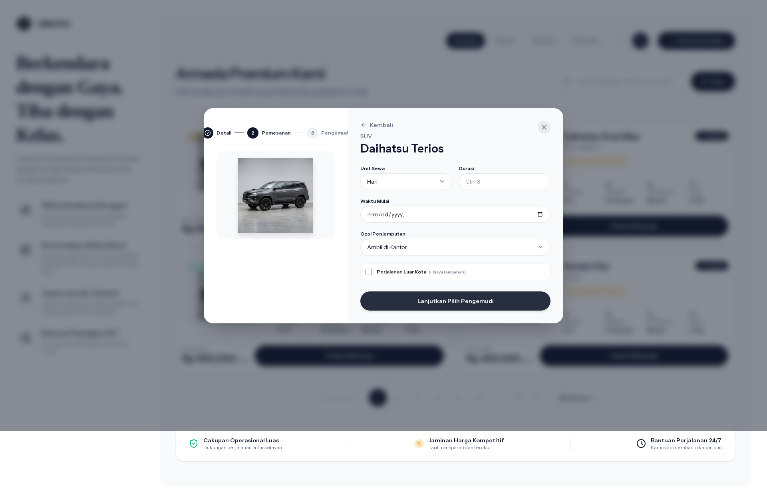
UC-04 · Form Order — Durasi & Lokasi
PASS
Non-loyal customer — Modal Order Step 2 Form Sewa
URL: /catalog · Component: Order form fields · Kondisi: Step 2 Durasi/unit/waktu/lokasi
Manual Book · Rent-Car Urban8
19

Slide 21

UC-04 · Form Order — Durasi & Lokasi
PASS
Loyal customer — Modal Order Step 2 Form Sewa
URL: /catalog · Component: Order form fields · Kondisi: Step 2 Durasi/unit/waktu/lokasi
Manual Book · Rent-Car Urban8
20

Slide 22
UC-05
Hitung Tarif Otomatis
AKTOR
MODUL
TEST CASES
Customer / System
Pricing Engine
2 step
Sistem otomatis menghitung total tarif berdasarkan PricingRule (per kategori + unit) + biaya luar kota +20%. Updated real-time.

Slide 23
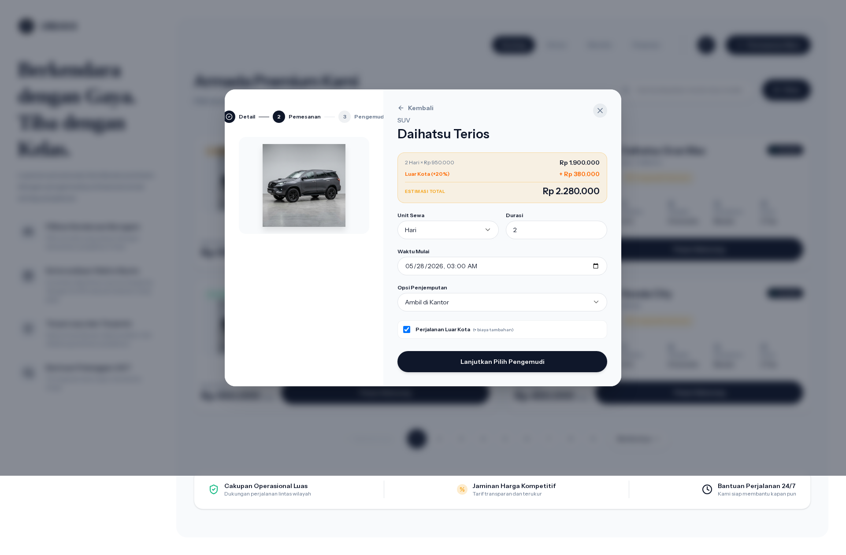
UC-05 · Hitung Tarif Otomatis
PASS
Non-loyal customer — Modal Order Step 2 Hitung Tarif
URL: /catalog · Component: Auto-quote panel · Kondisi: Estimasi total muncul setelah durasi diisi
Manual Book · Rent-Car Urban8
22

Slide 24

UC-05 · Hitung Tarif Otomatis
PASS
Loyal customer — Modal Order Step 2 Hitung Tarif
URL: /catalog · Component: Auto-quote panel · Kondisi: Estimasi total muncul setelah durasi diisi
Manual Book · Rent-Car Urban8
23

Slide 25
UC-06
Pilih Pengemudi (Loyal Privilege)
AKTOR
MODUL
TEST CASES
Customer Loyal
Driver Selection
3 step
Step 3: customer pilih driver. Loyal customer dapat memilih driver spesifik. Non-loyal melihat list tapi disabled (auto-assign oleh admin).

Slide 26
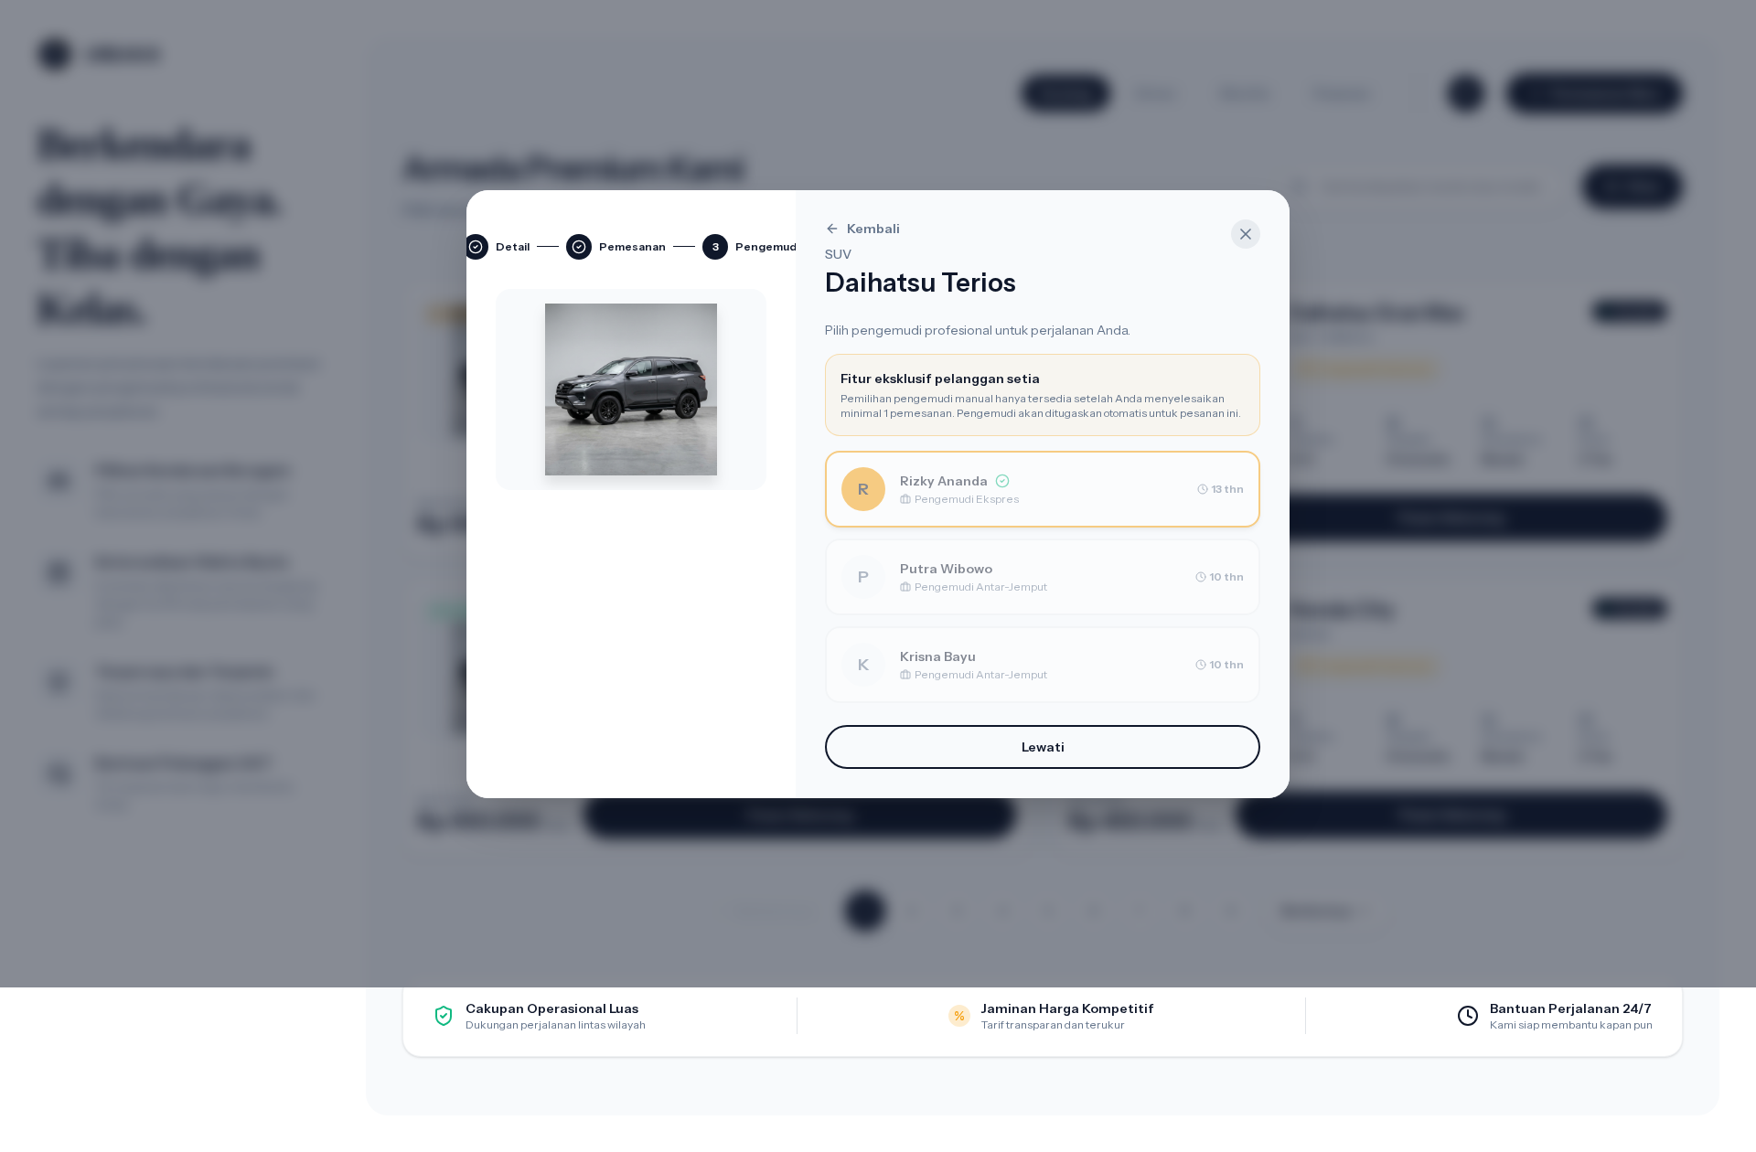
UC-06 · Pilih Pengemudi (Loyal Privilege)
PASS
Non-loyal customer — Modal Order Step 3 Pilih Supir
URL: /catalog · Component: Driver selection in order modal · Kondisi: Driver cards tetap tampil tapi disabled
Manual Book · Rent-Car Urban8
25

Slide 27
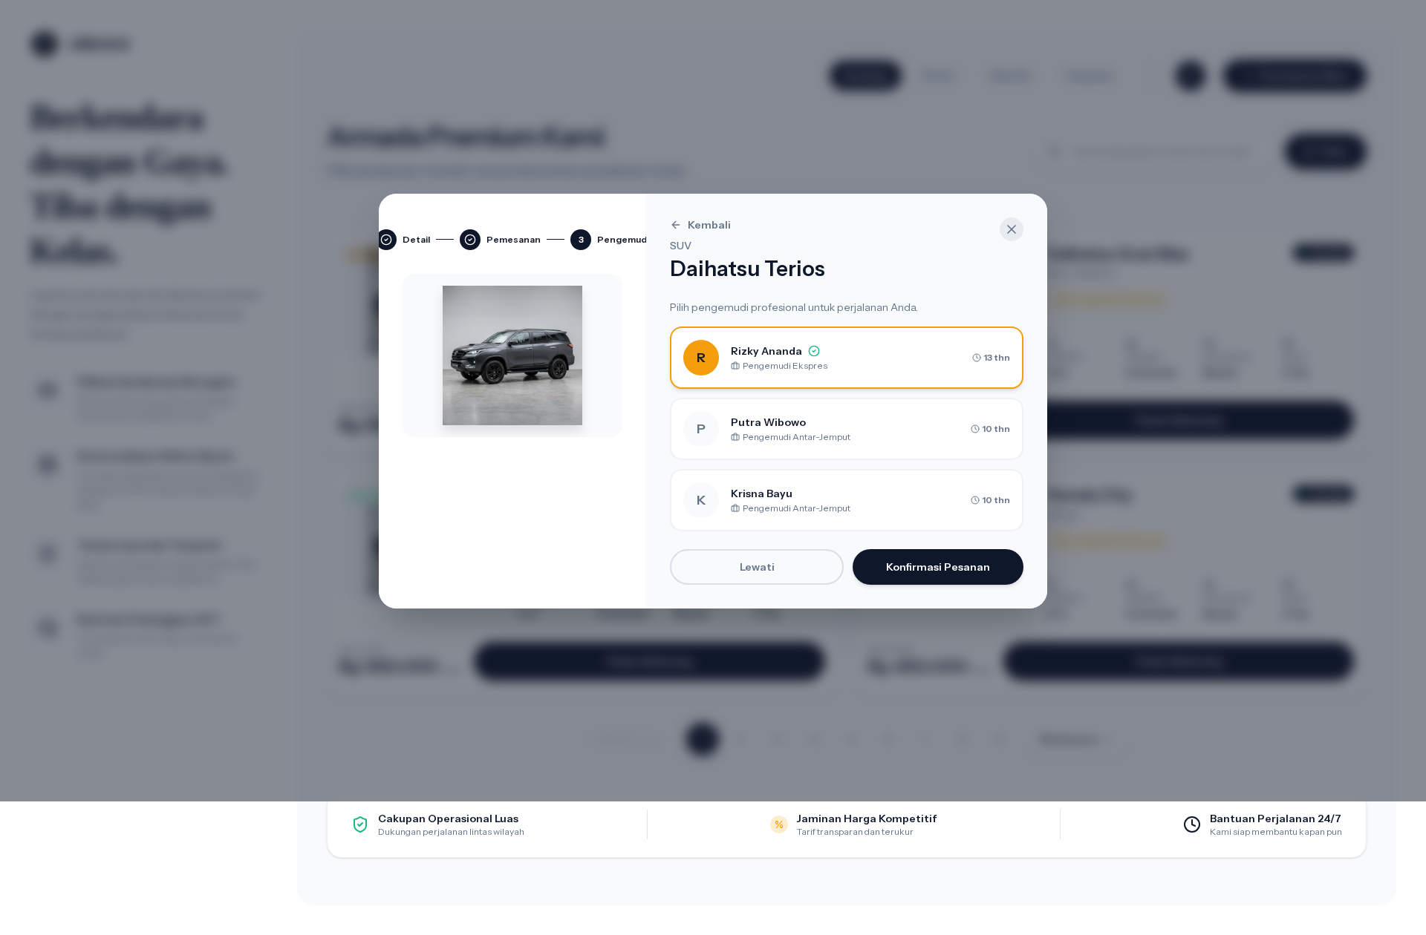
UC-06 · Pilih Pengemudi (Loyal Privilege)
PASS
Loyal customer — Modal Order Step 3 Pilih Supir
URL: /catalog · Component: Driver selection in order modal · Kondisi: Driver cards selectable untuk loyal customer
Manual Book · Rent-Car Urban8
26

Slide 28
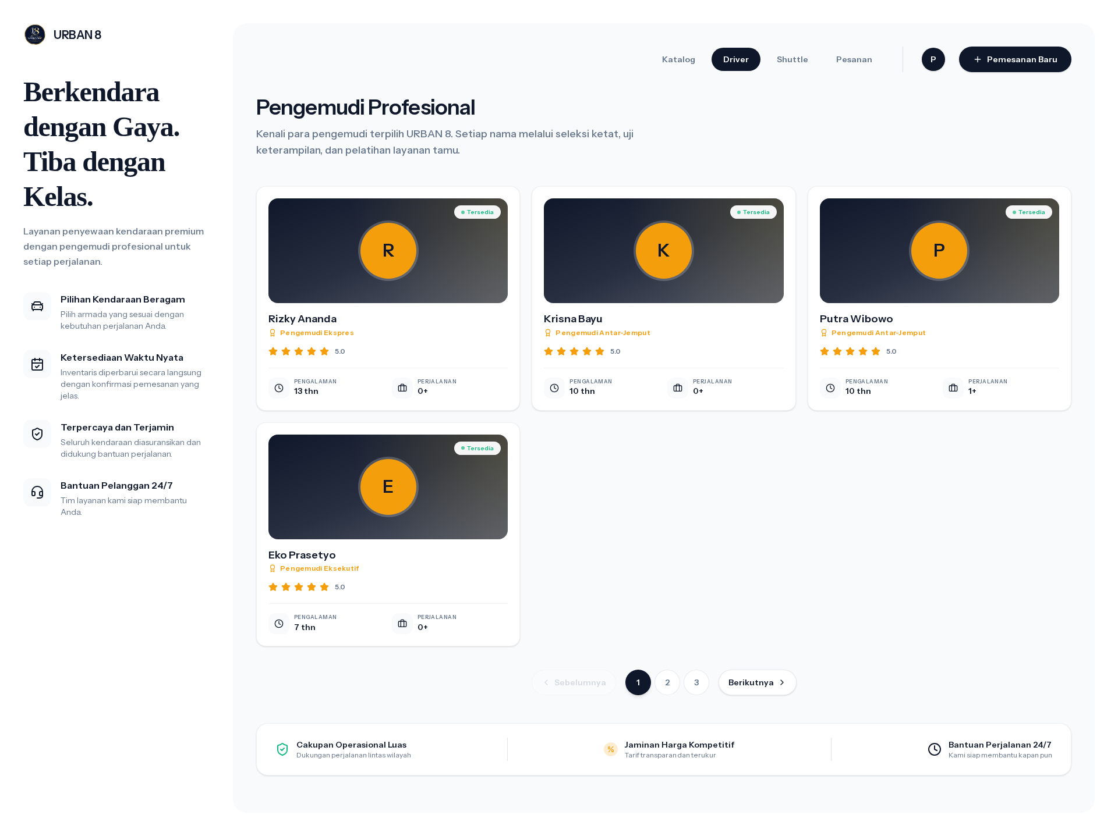
UC-06 · Pilih Pengemudi (Loyal Privilege)
PASS
Daftar Supir (loyal customer dapat memilih)
URL: /drivers · Component: Driver list · Kondisi: Render
Manual Book · Rent-Car Urban8
27

Slide 29
UC-08
Pesan Shuttle Bandara/Stasiun
AKTOR
MODUL
TEST CASES
Customer
Shuttle Order
1 step
Form pesan shuttle dengan ShuttleTariff fixed price. Pickup point + destinasi + jadwal jemput.

Slide 30
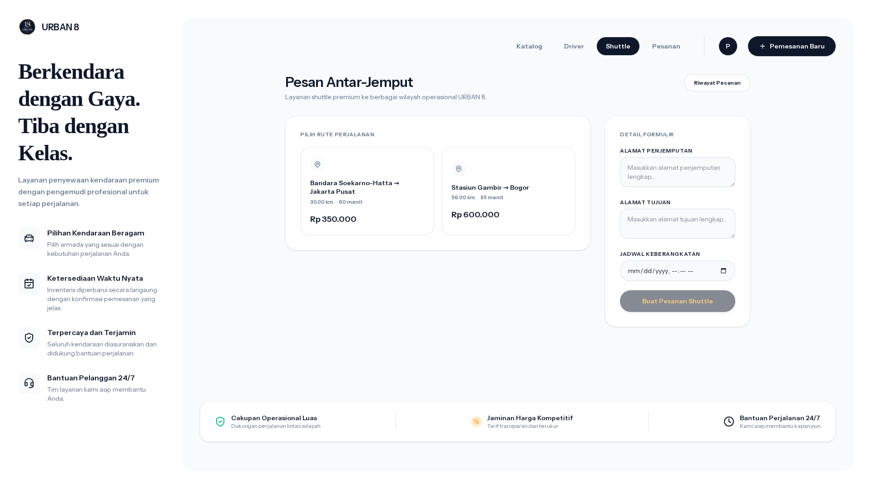
UC-08 · Pesan Shuttle Bandara/Stasiun
PASS
Form Pesan Shuttle
URL: /shuttle · Component: Form shuttle · Kondisi: Render form
Manual Book · Rent-Car Urban8
29

Slide 31
UC-11
Verifikasi Pembayaran Transfer
AKTOR
MODUL
TEST CASES
Admin / Kasir
Payment Verification
4 step
Admin/Kasir verifikasi bukti transfer. Approve → status WaitingVerification → Paid. Reject → kembali Unpaid + alasan.

Slide 32
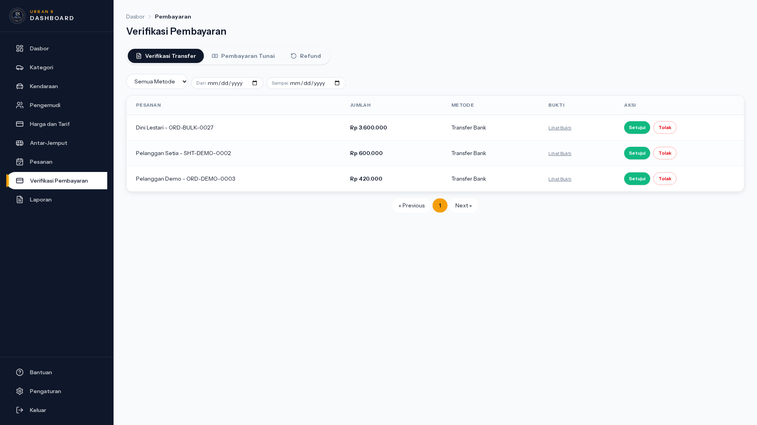
UC-11 · Verifikasi Pembayaran Transfer
PASS
Halaman Verifikasi Transfer (Admin)
URL: /admin/payments/verification · Component: Pending verification list · Kondisi: Render verifikasi list
Manual Book · Rent-Car Urban8
31

Slide 33
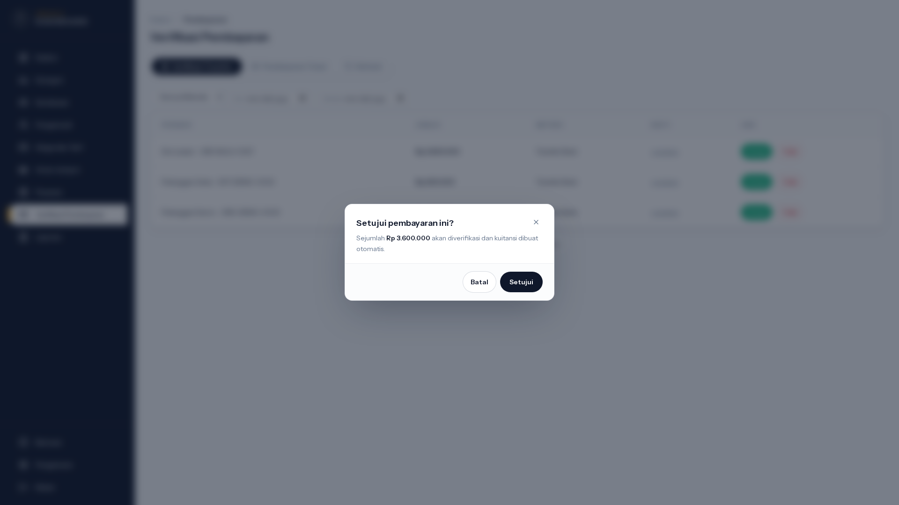
UC-11 · Verifikasi Pembayaran Transfer
PASS
Modal Verifikasi Pembayaran (Setujui)
URL: /admin/payments/verification · Component: Approve payment dialog · Kondisi: Trigger row "Setujui"
Manual Book · Rent-Car Urban8
32

Slide 34
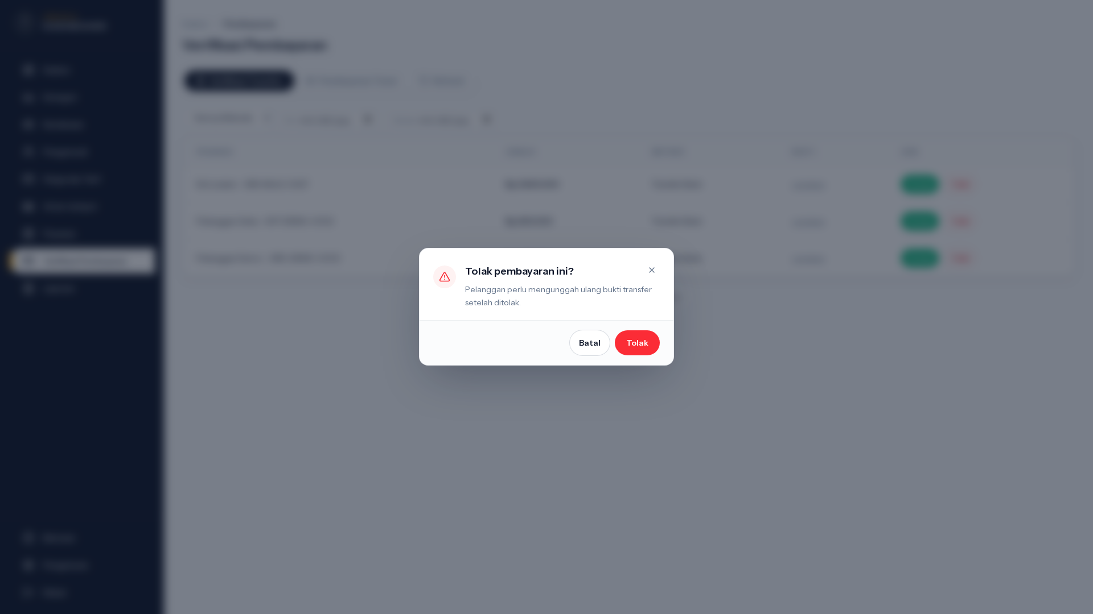
UC-11 · Verifikasi Pembayaran Transfer
PASS
Modal Tolak Pembayaran
URL: /admin/payments/verification · Component: Reject payment dialog · Kondisi: Trigger row "Tolak"
Manual Book · Rent-Car Urban8
33

Slide 35
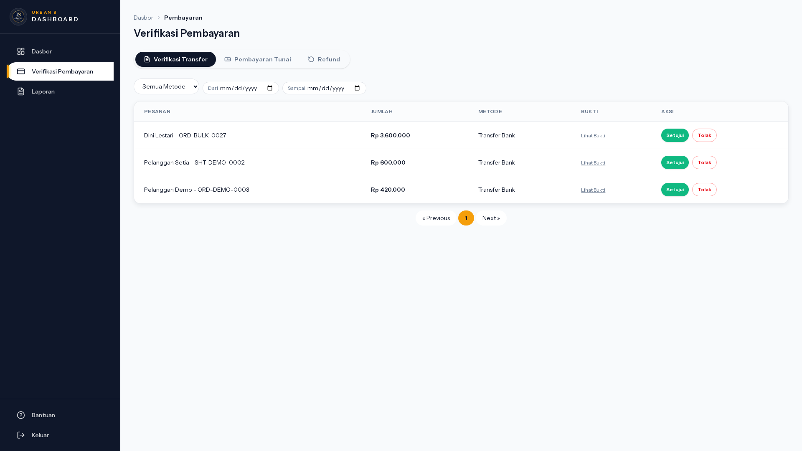
UC-11 · Verifikasi Pembayaran Transfer
PASS
Verifikasi Transfer (Kasir)
URL: /admin/payments/verification · Component: Verifikasi tabs · Kondisi: Render
Manual Book · Rent-Car Urban8
34

Slide 36
UC-12
Generate & Cetak Kuitansi
AKTOR
MODUL
TEST CASES
System / Kasir
Receipt
1 step
Setelah Paid, sistem auto-generate Receipt dengan kode KWT-DEMO-####. Kasir bisa preview dan cetak.

Slide 37

UC-12 · Generate & Cetak Kuitansi
PASS
Generate Kwitansi (link receipt visible)
URL: /admin/payments/verification · Component: Receipt link visible · Kondisi: List dengan tombol Lihat Bukti/Kwitansi
Manual Book · Rent-Car Urban8
36

Slide 38
UC-13
Kelola Kendaraan & Kategori
AKTOR
MODUL
TEST CASES
Admin
Vehicle Master
5 step
CRUD penuh atas Vehicle (plate, brand, model, kapasitas, tarif harian, status) dan VehicleCategory.

Slide 39
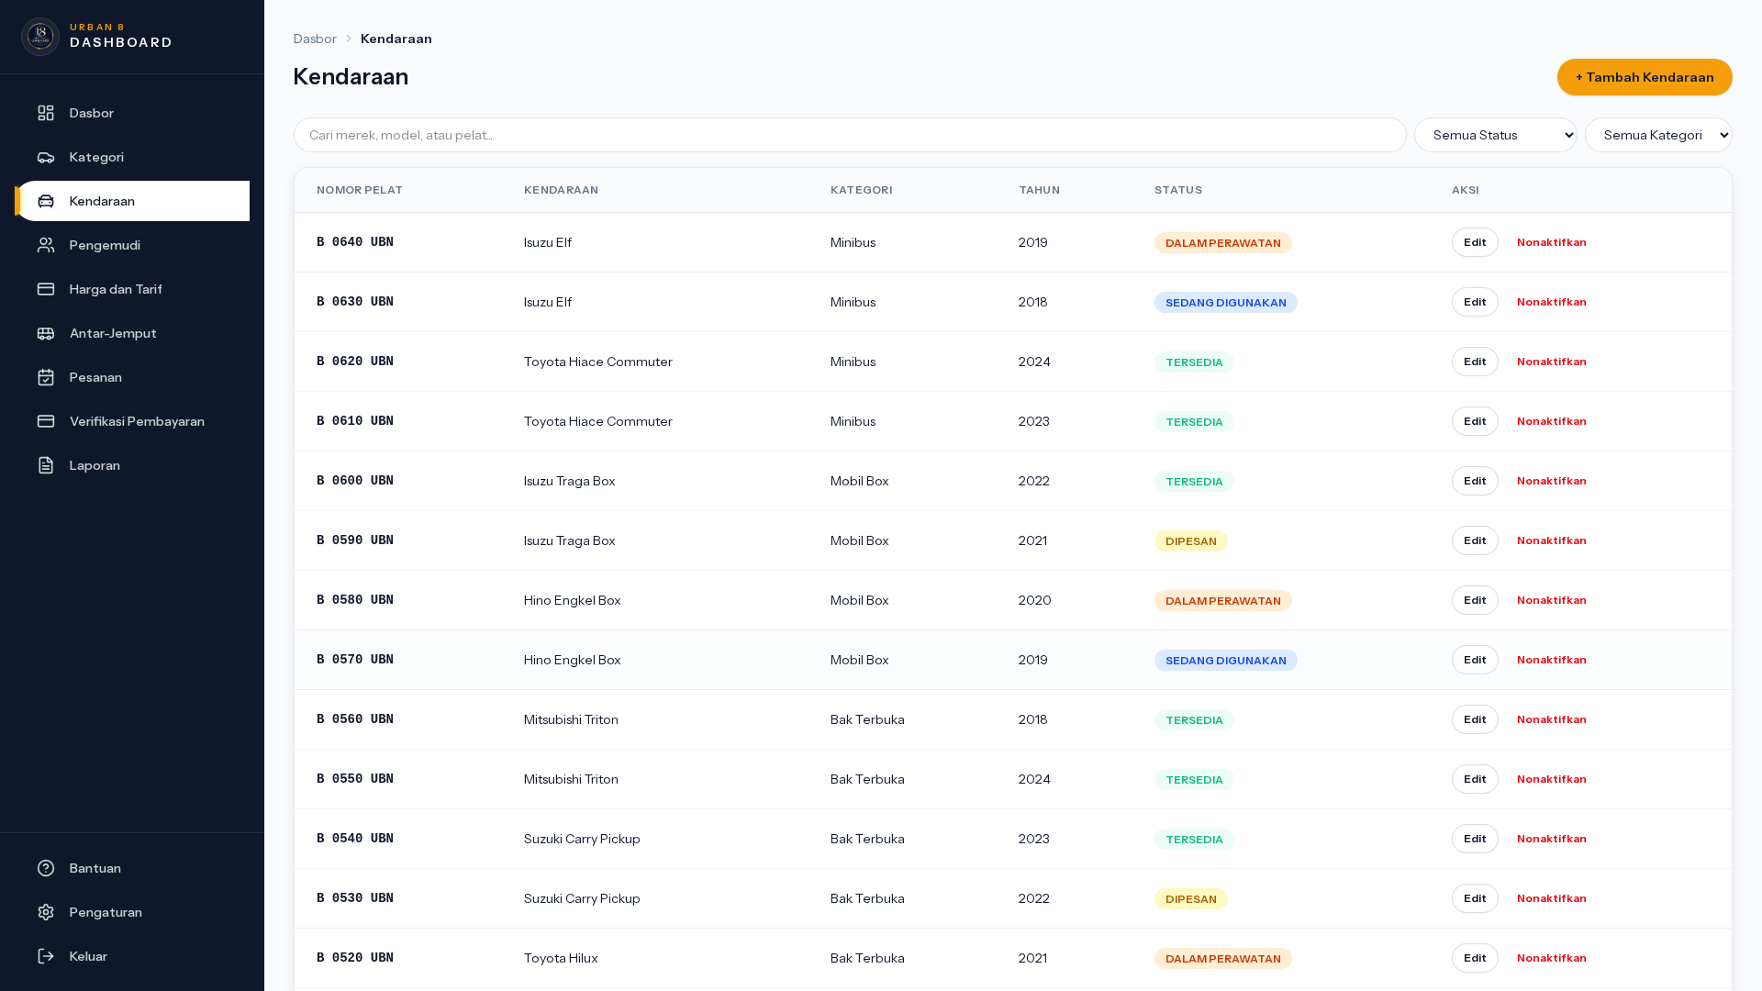
UC-13 · Kelola Kendaraan & Kategori
PASS
Kelola Kendaraan (List)
URL: /admin/vehicles · Component: Vehicles index · Kondisi: List render
Manual Book · Rent-Car Urban8
38

Slide 40
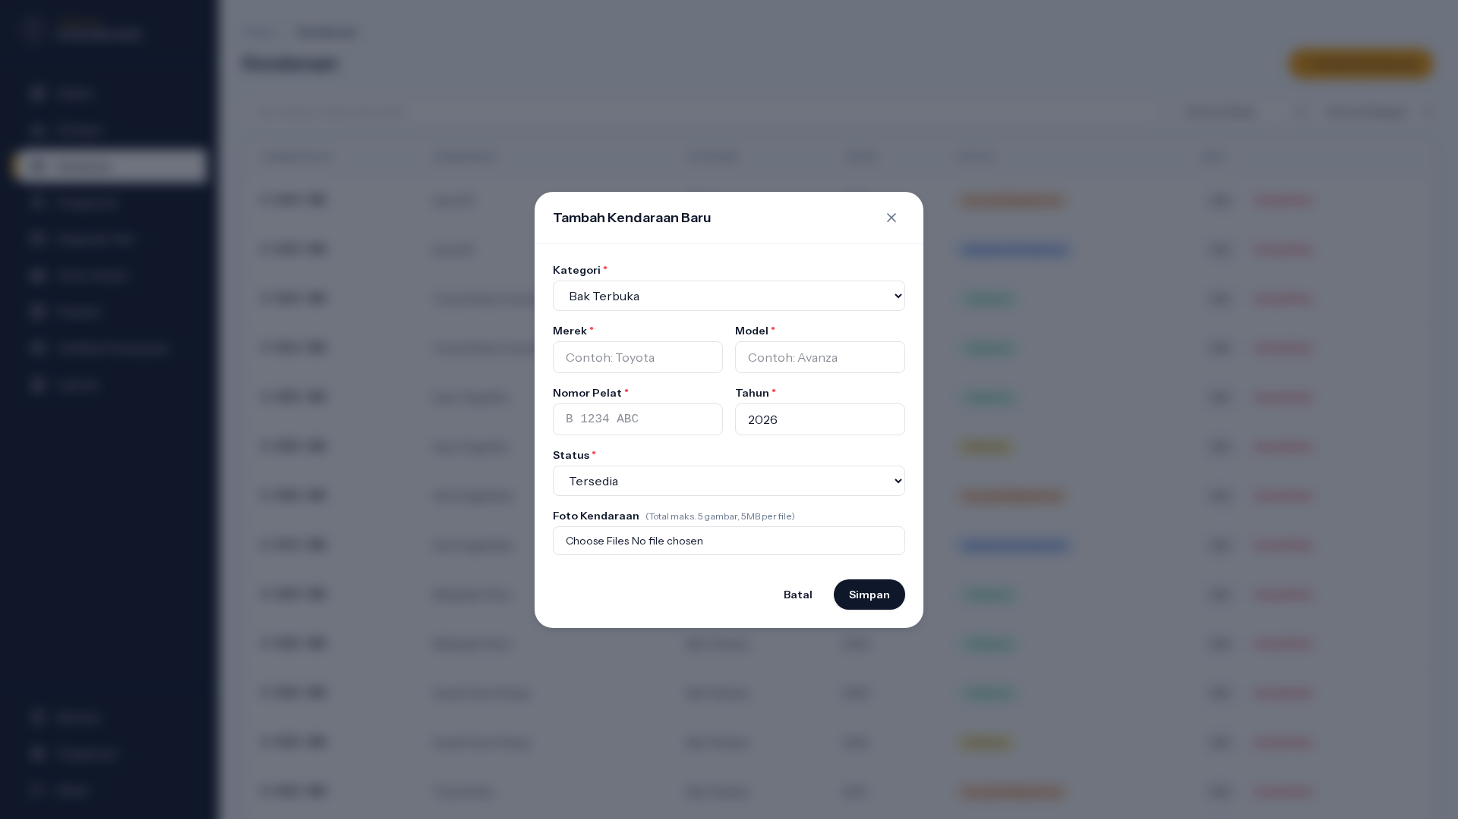
UC-13 · Kelola Kendaraan & Kategori
PASS
Modal Tambah Kendaraan
URL: /admin/vehicles · Component: Add vehicle dialog · Kondisi: Trigger tombol "+ Tambah Kendaraan"
Manual Book · Rent-Car Urban8
39

Slide 41
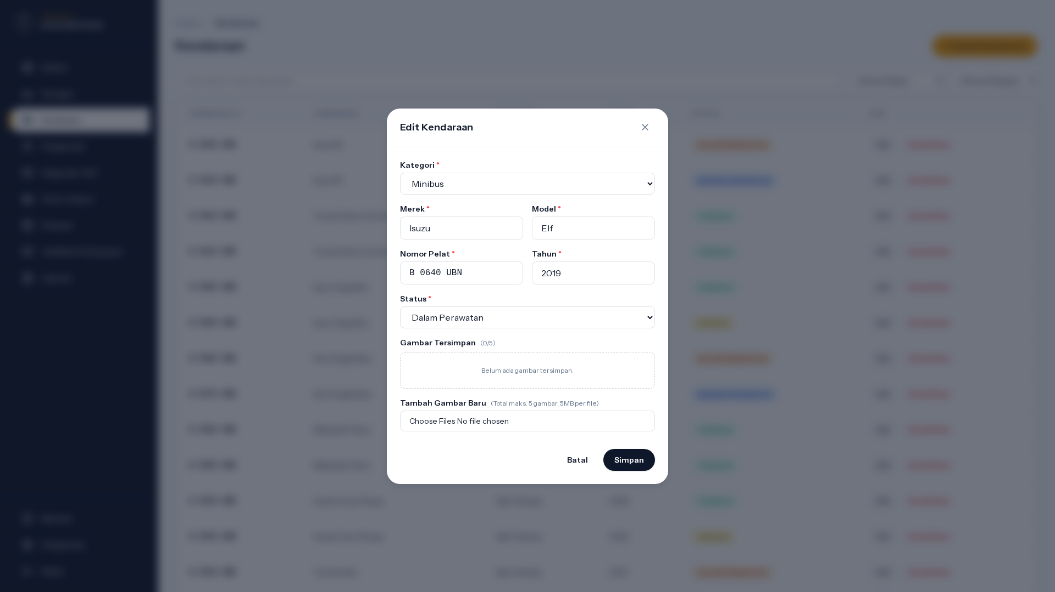
UC-13 · Kelola Kendaraan & Kategori
PASS
Modal Edit Kendaraan
URL: /admin/vehicles · Component: Edit vehicle dialog · Kondisi: Trigger row "Edit"
Manual Book · Rent-Car Urban8
40

Slide 42
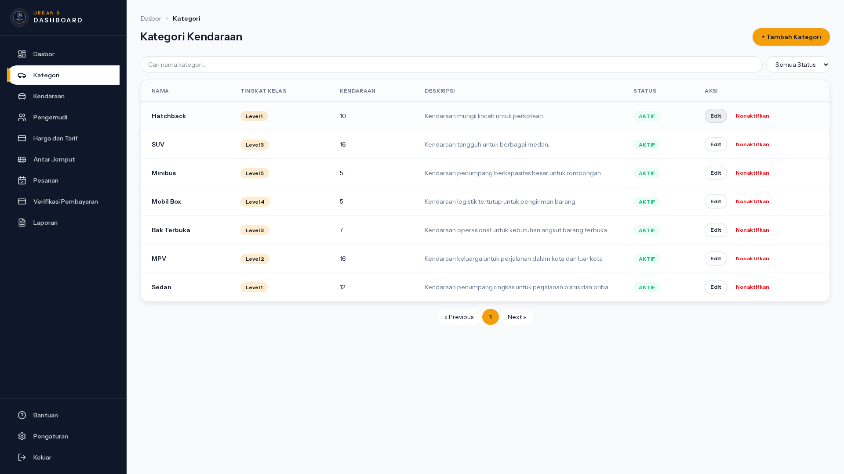
UC-13 · Kelola Kendaraan & Kategori
PASS
Kelola Kategori Kendaraan (List)
URL: /admin/vehicle-categories · Component: Categories index · Kondisi: List render
Manual Book · Rent-Car Urban8
41

Slide 43
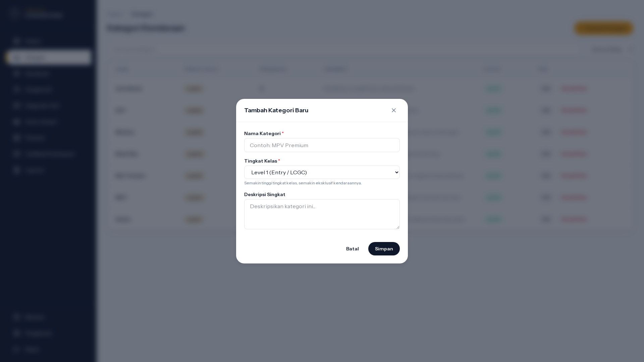
UC-13 · Kelola Kendaraan & Kategori
PASS
Modal Tambah Kategori
URL: /admin/vehicle-categories · Component: Add category dialog · Kondisi: Trigger tombol Tambah
Manual Book · Rent-Car Urban8
42

Slide 44
UC-14
Kelola Pricing Rule & Overtime Penalty
AKTOR
MODUL
TEST CASES
Admin
Pricing
4 step
Set tarif per kategori per RentalUnit (Hour/Day) dan denda overtime per jam keterlambatan.

Slide 45
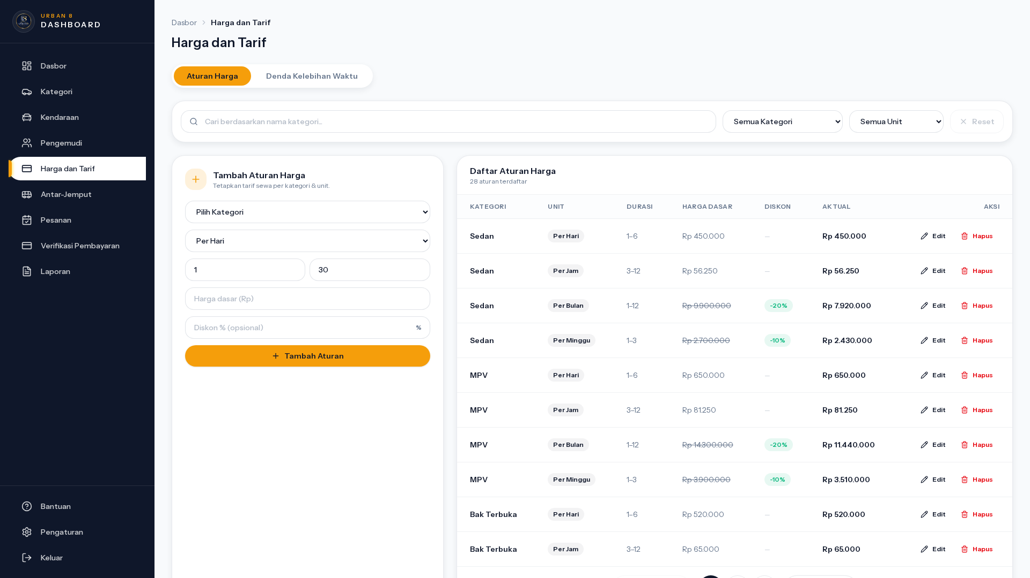
UC-14 · Kelola Pricing Rule & Overtime Penalty
PASS
Kelola Pricing Rule (List + Form Inline)
URL: /admin/pricing-rules · Component: Pricing rule list + inline form · Kondisi: List render
Manual Book · Rent-Car Urban8
44

Slide 46
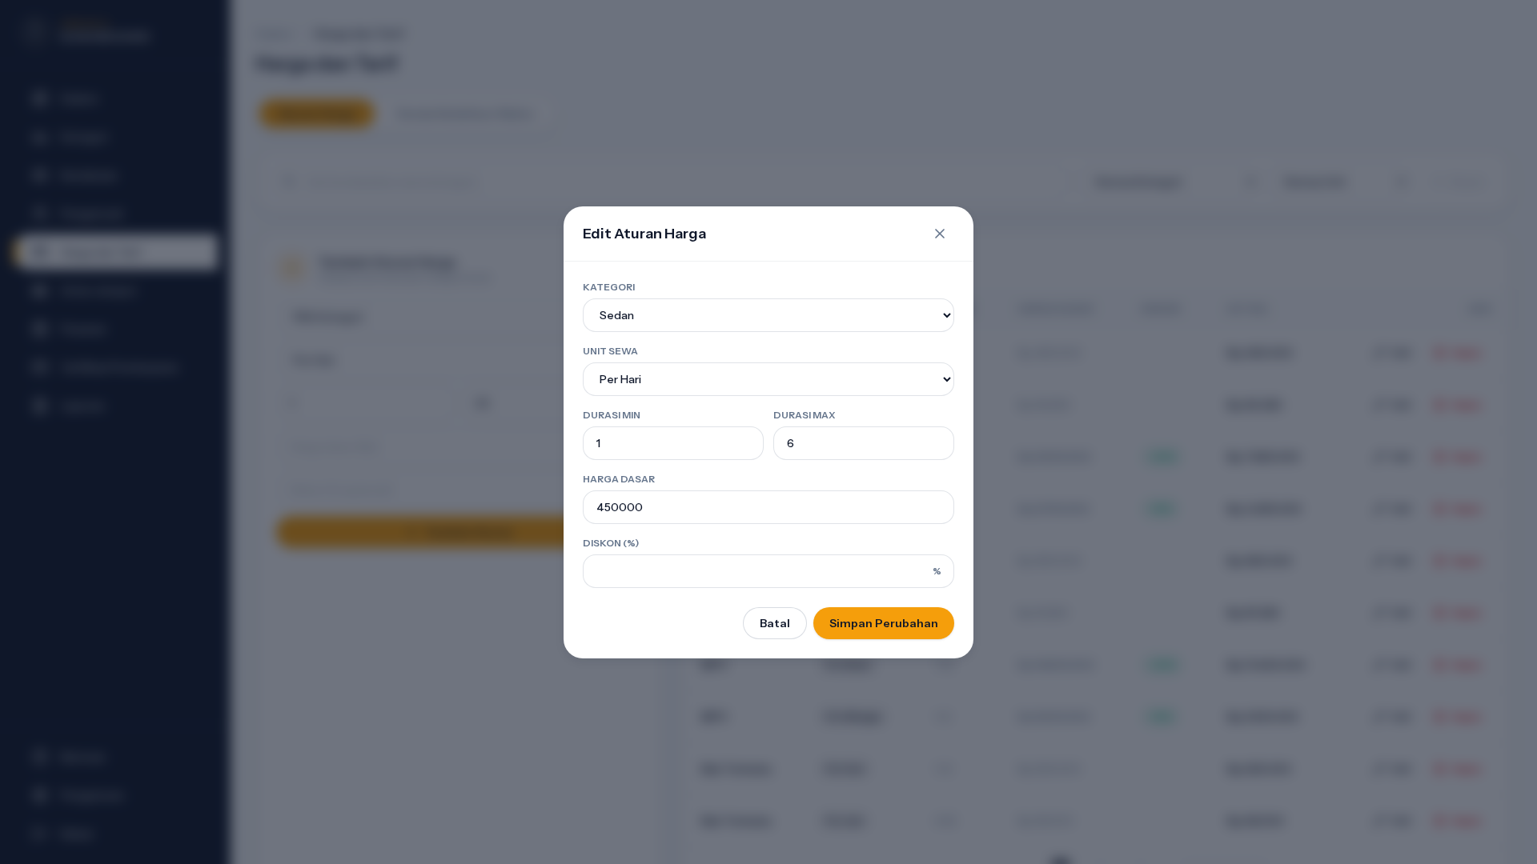
UC-14 · Kelola Pricing Rule & Overtime Penalty
PASS
Modal Edit Pricing Rule
URL: /admin/pricing-rules · Component: Edit pricing dialog · Kondisi: Trigger row "Edit"
Manual Book · Rent-Car Urban8
45

Slide 47

UC-14 · Kelola Pricing Rule & Overtime Penalty
PASS
Kelola Overtime Penalty (List + Form Inline)
URL: /admin/pricing-rules · Component: Overtime tab + inline form · Kondisi: Render
Manual Book · Rent-Car Urban8
46

Slide 48
UC-14 · Kelola Pricing Rule & Overtime Penalty
PASS
Modal Edit Overtime Penalty
URL: /admin/pricing-rules · Component: Edit overtime dialog · Kondisi: Trigger row "Edit" di tab Overtime
Manual Book · Rent-Car Urban8
47

Slide 49
UC-15
Kelola Data Pengemudi
AKTOR
MODUL
TEST CASES
Admin
Driver Master
2 step
CRUD driver: nama, SIM, nomor HP, status (aktif/nonaktif). Driver dapat di-assign ke order.

Slide 50
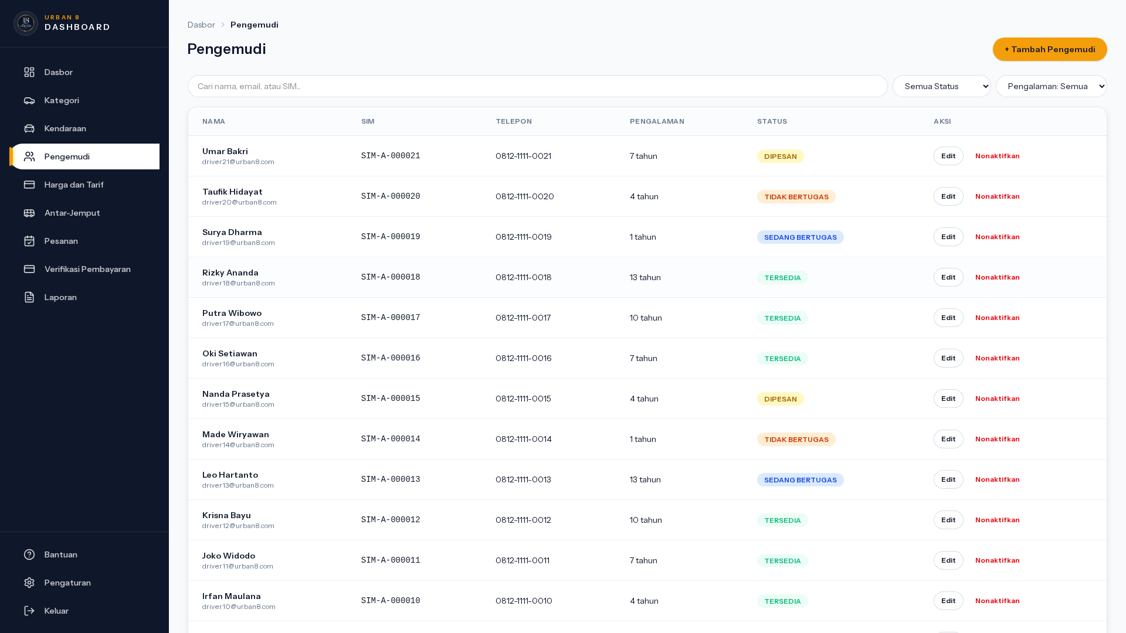
UC-15 · Kelola Data Pengemudi
PASS
Kelola Data Supir (List)
URL: /admin/drivers · Component: Drivers index · Kondisi: List render
Manual Book · Rent-Car Urban8
49

Slide 51
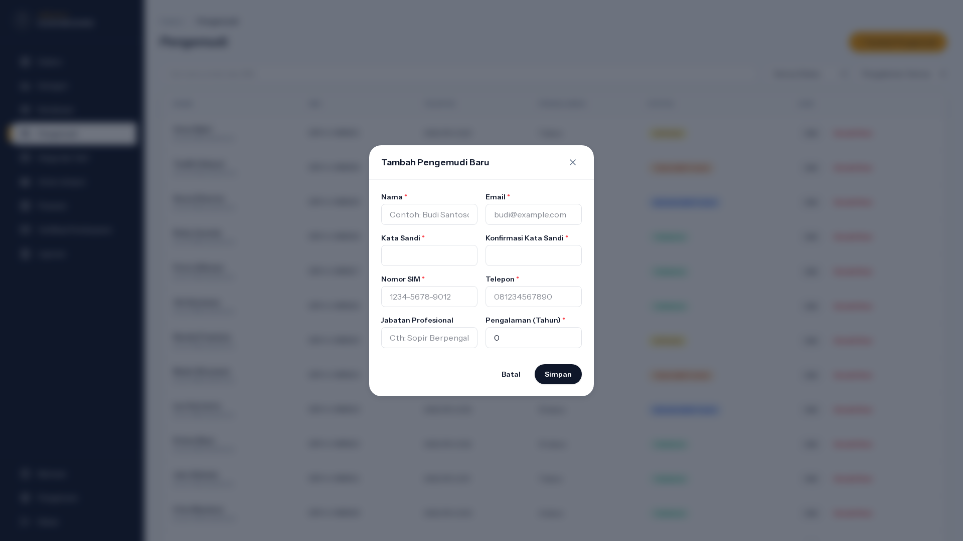
UC-15 · Kelola Data Pengemudi
PASS
Modal Tambah Supir
URL: /admin/drivers · Component: Add driver dialog · Kondisi: Trigger "+ Tambah Pengemudi"
Manual Book · Rent-Car Urban8
50

Slide 52
UC-16
Lifecycle Order — Dispatch & Cancel
AKTOR
MODUL
TEST CASES
Admin
Order Lifecycle
4 step
Admin kirim kendaraan (Paid → ReadyToDispatch → Ongoing) atau batalkan order. Cancel after Paid trigger refund flow.

Slide 53
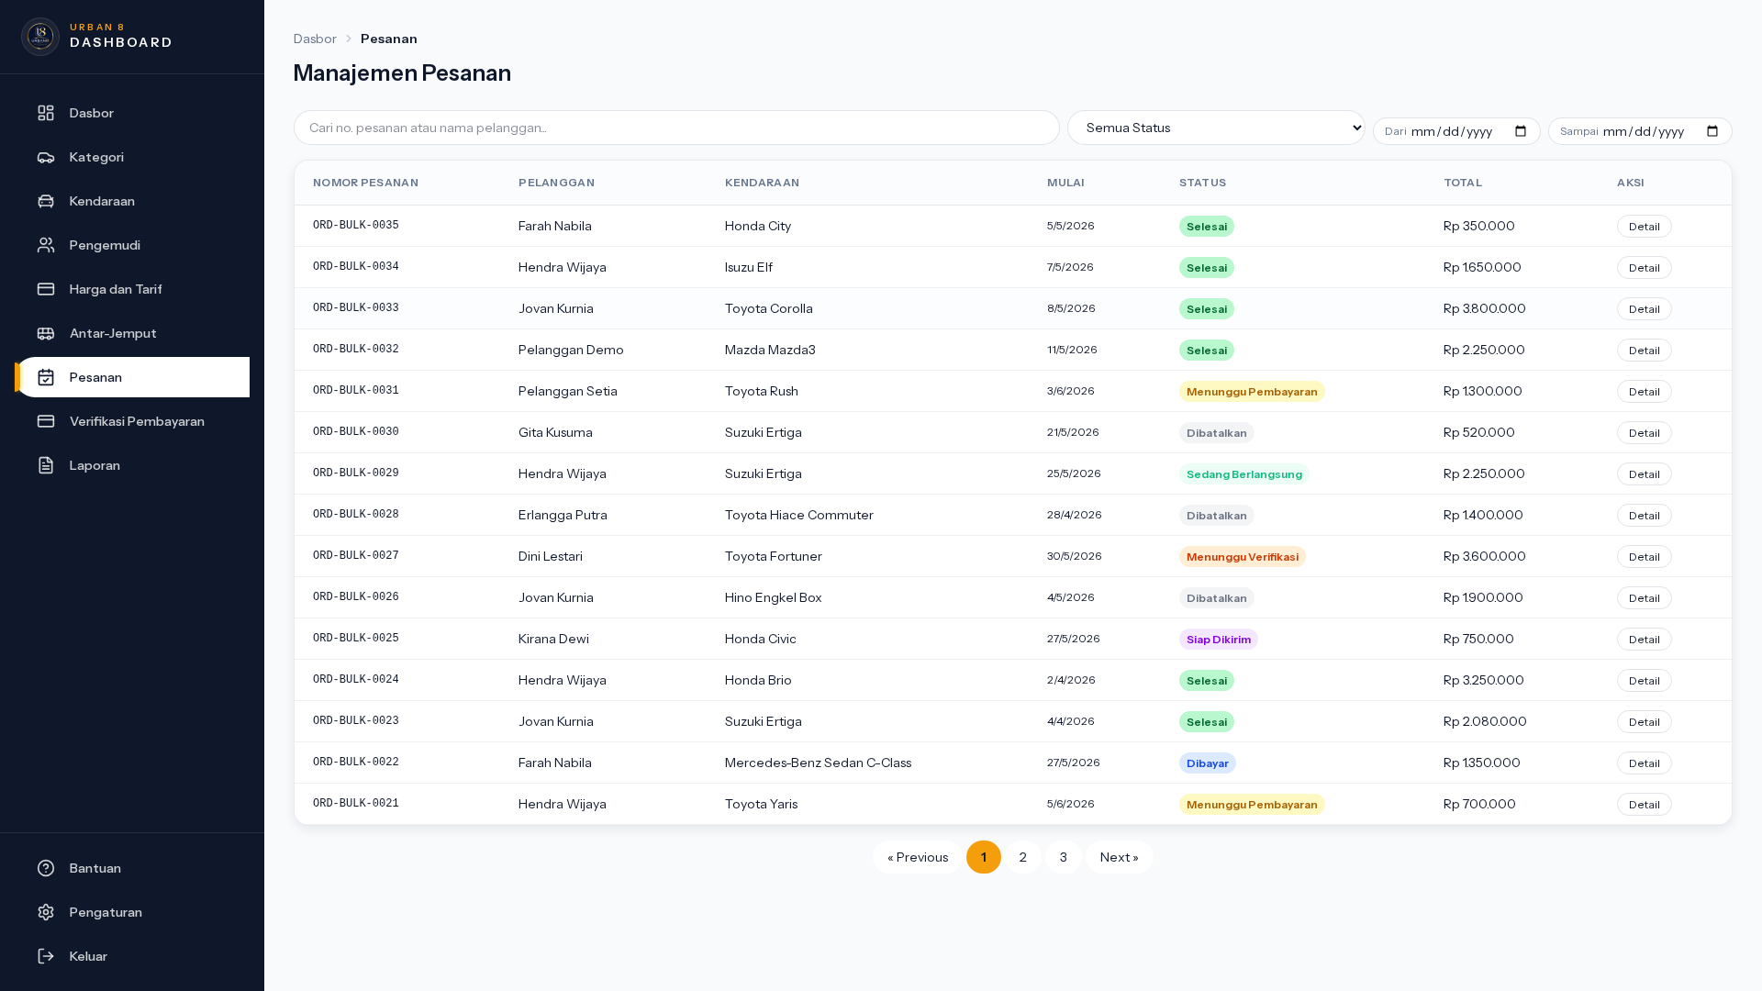
UC-16 · Lifecycle Order — Dispatch & Cancel
PASS
Admin Order Lifecycle — List
URL: /admin/orders · Component: Orders index · Kondisi: List render
Manual Book · Rent-Car Urban8
52

Slide 54
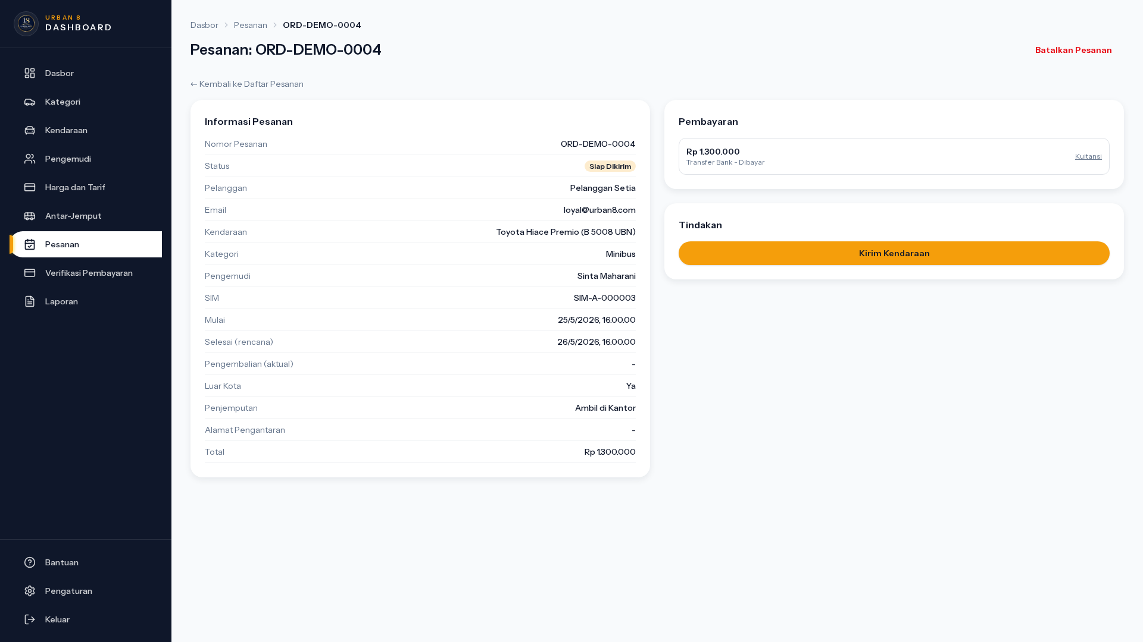
UC-16 · Lifecycle Order — Dispatch & Cancel
PASS
Admin Order Lifecycle — Detail (ReadyToDispatch)
URL: /admin/orders/ORD-DEMO-0004 · Component: Action buttons · Kondisi: Detail render
Manual Book · Rent-Car Urban8
53

Slide 55
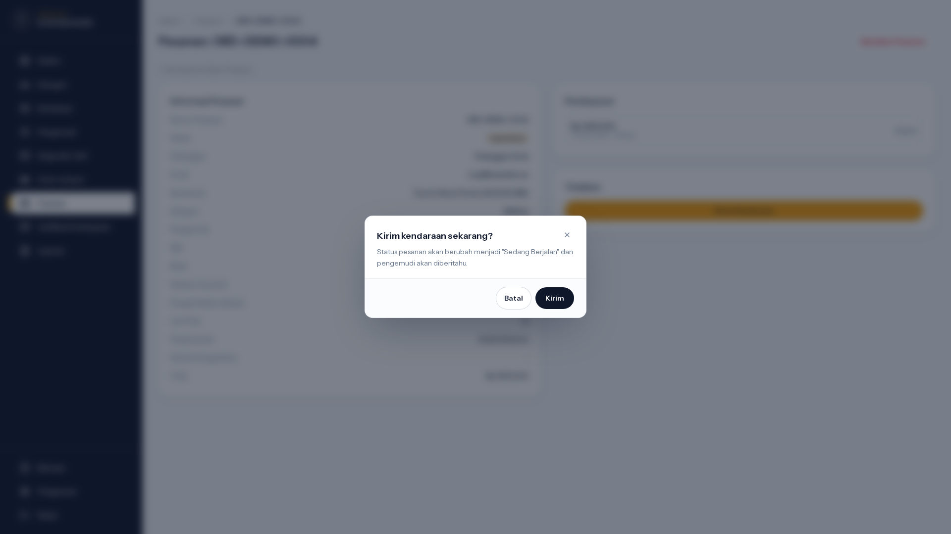
UC-16 · Lifecycle Order — Dispatch & Cancel
PASS
Modal Kirim Kendaraan (Dispatch)
URL: /admin/orders/ORD-DEMO-0004 · Component: Dispatch dialog · Kondisi: Trigger "Kirim Kendaraan"
Manual Book · Rent-Car Urban8
54

Slide 56
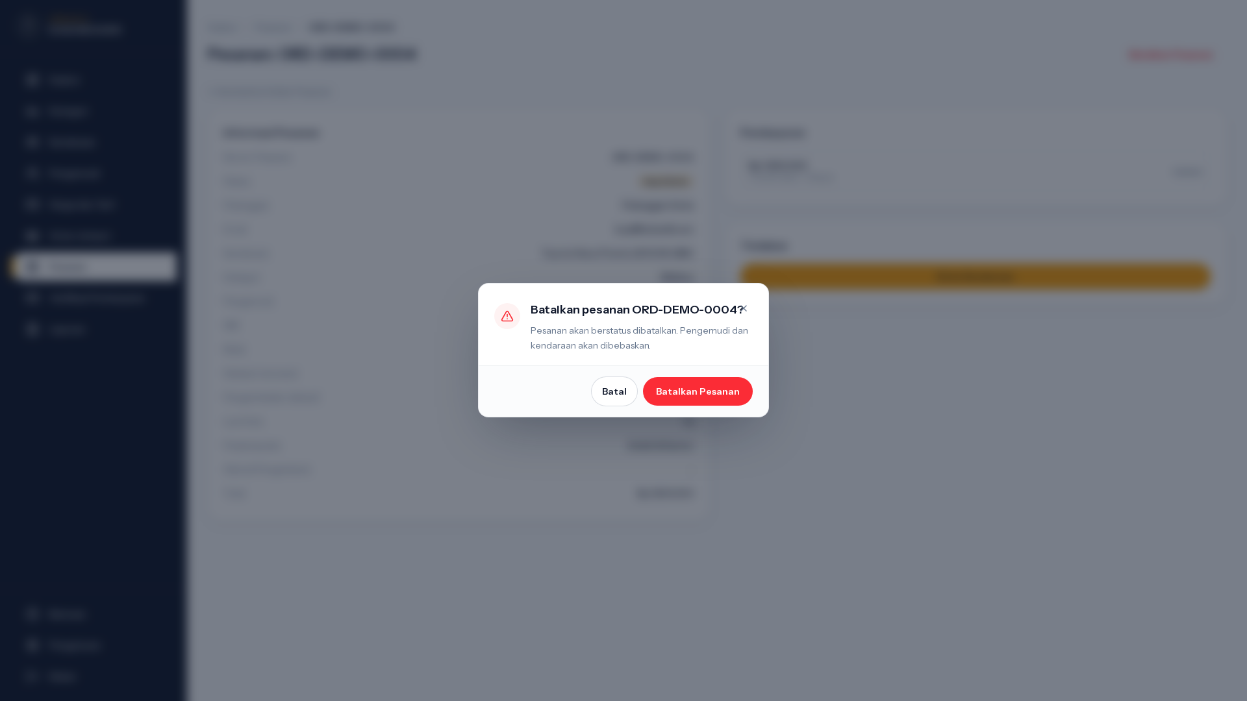
UC-16 · Lifecycle Order — Dispatch & Cancel
PASS
Modal Cancel Order (Admin)
URL: /admin/orders/ORD-DEMO-0004 · Component: Cancel order dialog · Kondisi: Trigger "Batalkan Pesanan"
Manual Book · Rent-Car Urban8
55

Slide 57
UC-17
Catat Pengembalian Kendaraan
AKTOR
MODUL
TEST CASES
Admin
Order Return
1 step
Admin catat actual_return_at saat customer kembalikan kendaraan. Sistem deteksi overtime jika > scheduled return.

Slide 58
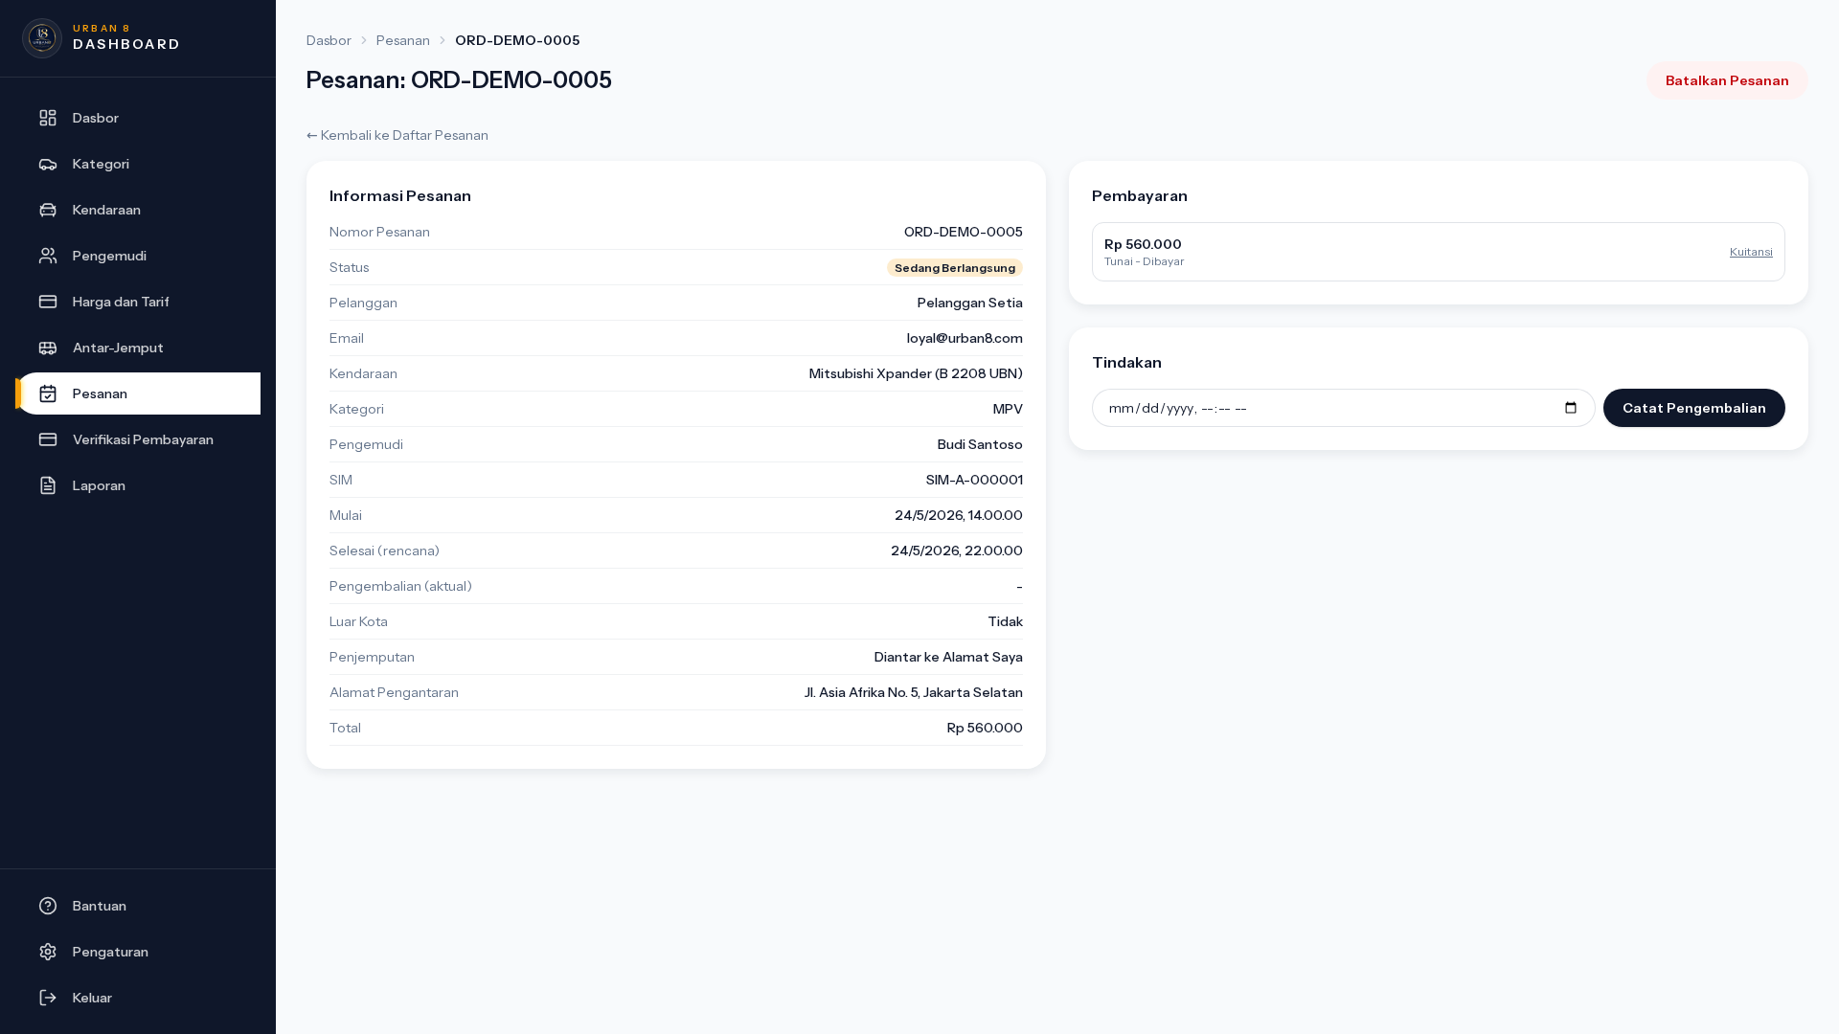
UC-17 · Catat Pengembalian Kendaraan
PASS
Admin Order — Form Catat Return (Ongoing)
URL: /admin/orders/ORD-DEMO-0005 · Component: Return form (inline) · Kondisi: Render form pengembalian
Manual Book · Rent-Car Urban8
57

Slide 59
UC-18
Hitung Overtime Penalty
AKTOR
MODUL
TEST CASES
System
Pricing Engine
1 step
Auto-hitung denda overtime: ceil(menit_terlambat / 60) * tarif_per_jam dari OvertimePenalty. Status order → WaitingOvertimePayment.

Slide 60
UC-18 · Hitung Overtime Penalty
PASS
Hitung Overtime (panel di detail)
URL: /admin/orders/ORD-DEMO-0004 · Component: Overtime panel · Kondisi: Display
Manual Book · Rent-Car Urban8
59

Slide 61
UC-19
Kelola Tarif Shuttle
AKTOR
MODUL
TEST CASES
Admin
Shuttle Master
2 step
CRUD ShuttleTariff: pickup point, destinasi, jarak (km), durasi estimasi, tarif fixed.

Slide 62
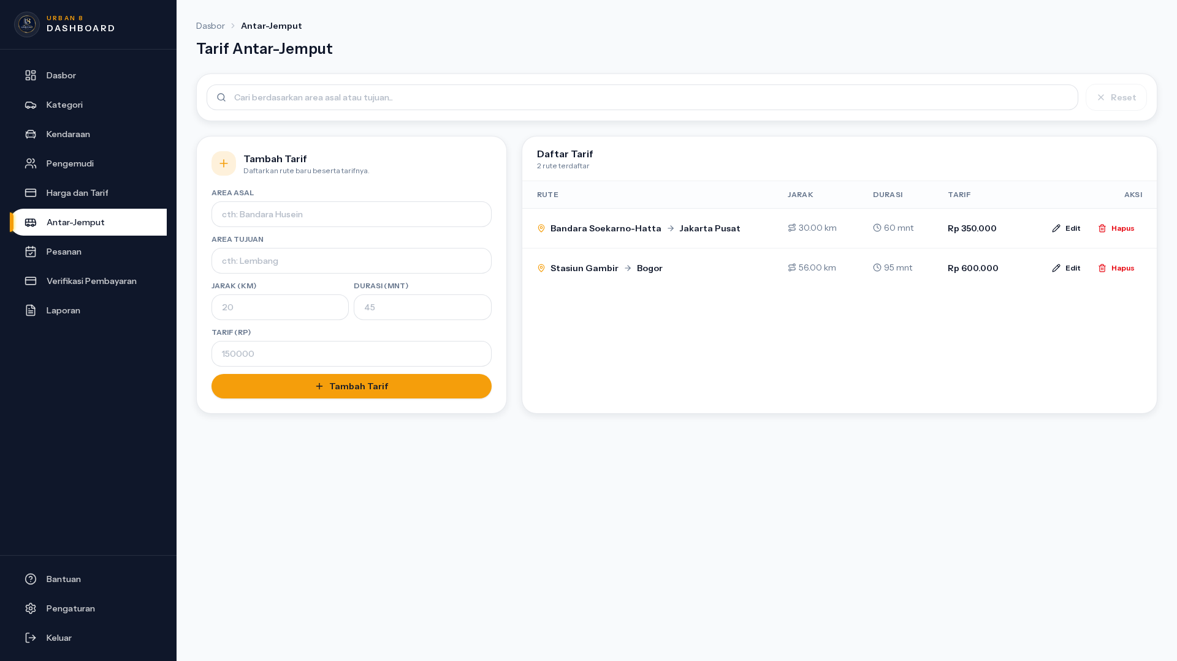
UC-19 · Kelola Tarif Shuttle
PASS
Kelola Tarif Shuttle (List + Form Inline)
URL: /admin/shuttle-tariffs · Component: Shuttle tariff list + inline form · Kondisi: List render
Manual Book · Rent-Car Urban8
61

Slide 63
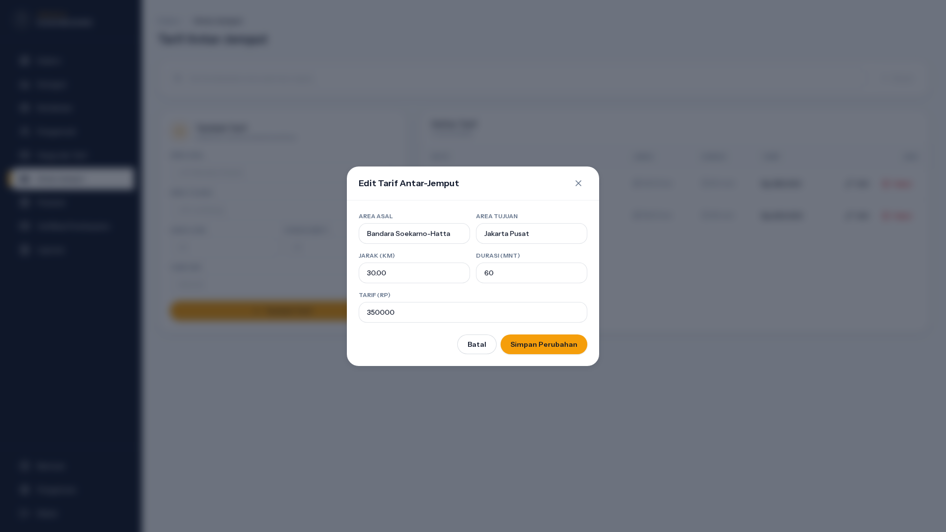
UC-19 · Kelola Tarif Shuttle
PASS
Modal Edit Tarif Shuttle
URL: /admin/shuttle-tariffs · Component: Edit shuttle dialog · Kondisi: Trigger row "Edit"
Manual Book · Rent-Car Urban8
62

Slide 64
UC-20
Selesaikan Order (Complete)
AKTOR
MODUL
TEST CASES
Admin
Order Lifecycle
2 step
Admin tandai order Completed setelah seluruh pembayaran (incl overtime) sudah verified. Order tertutup.

Slide 65
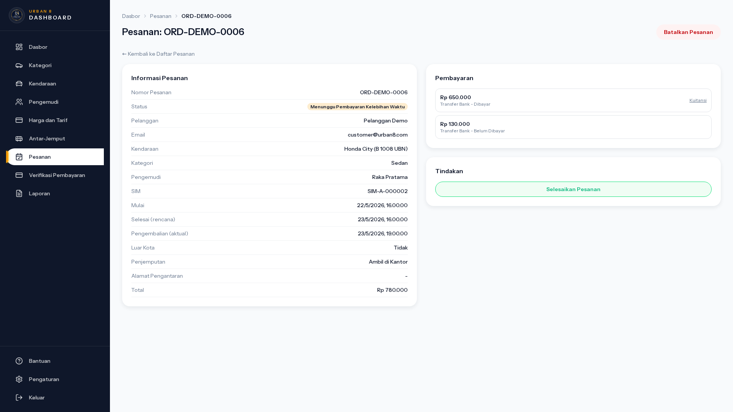
UC-20 · Selesaikan Order (Complete)
PASS
Admin Order — Detail (WaitingOvertimePayment)
URL: /admin/orders/ORD-DEMO-0006 · Component: Complete button · Kondisi: Detail render dengan tombol Complete
Manual Book · Rent-Car Urban8
64

Slide 66
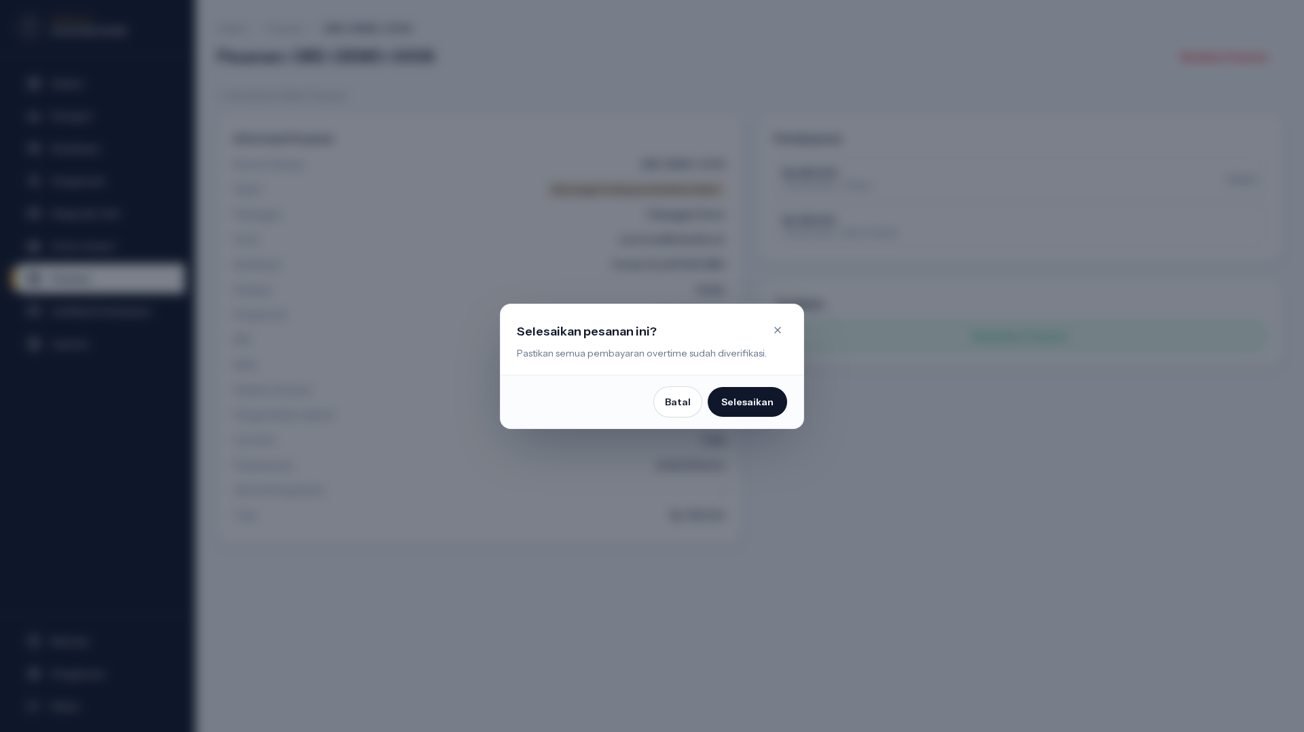
UC-20 · Selesaikan Order (Complete)
PASS
Modal Complete Order
URL: /admin/orders/ORD-DEMO-0006 · Component: Complete dialog · Kondisi: Trigger "Selesaikan Pesanan"
Manual Book · Rent-Car Urban8
65

Slide 67
UC-21
Dashboard Operasional Admin
AKTOR
MODUL
TEST CASES
Admin
Dashboard
1 step
Ringkasan operasional: order hari ini, pembayaran pending, kendaraan tersedia, revenue periode.

Slide 68
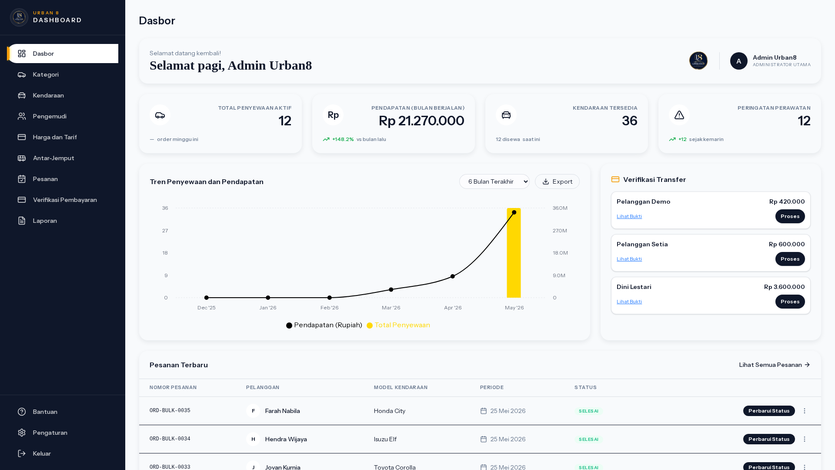
UC-21 · Dashboard Operasional Admin
PASS
Admin Dashboard Operasional
URL: /admin/dashboard · Component: KPI cards + chart · Kondisi: Render dashboard
Manual Book · Rent-Car Urban8
67

Slide 69
UC-22
Generate Laporan & Settings
AKTOR
MODUL
TEST CASES
Admin
Reports
2 step
Generate laporan transaksi & revenue per periode. Konfigurasi setting global (PPN, biaya admin, dll).

Slide 70
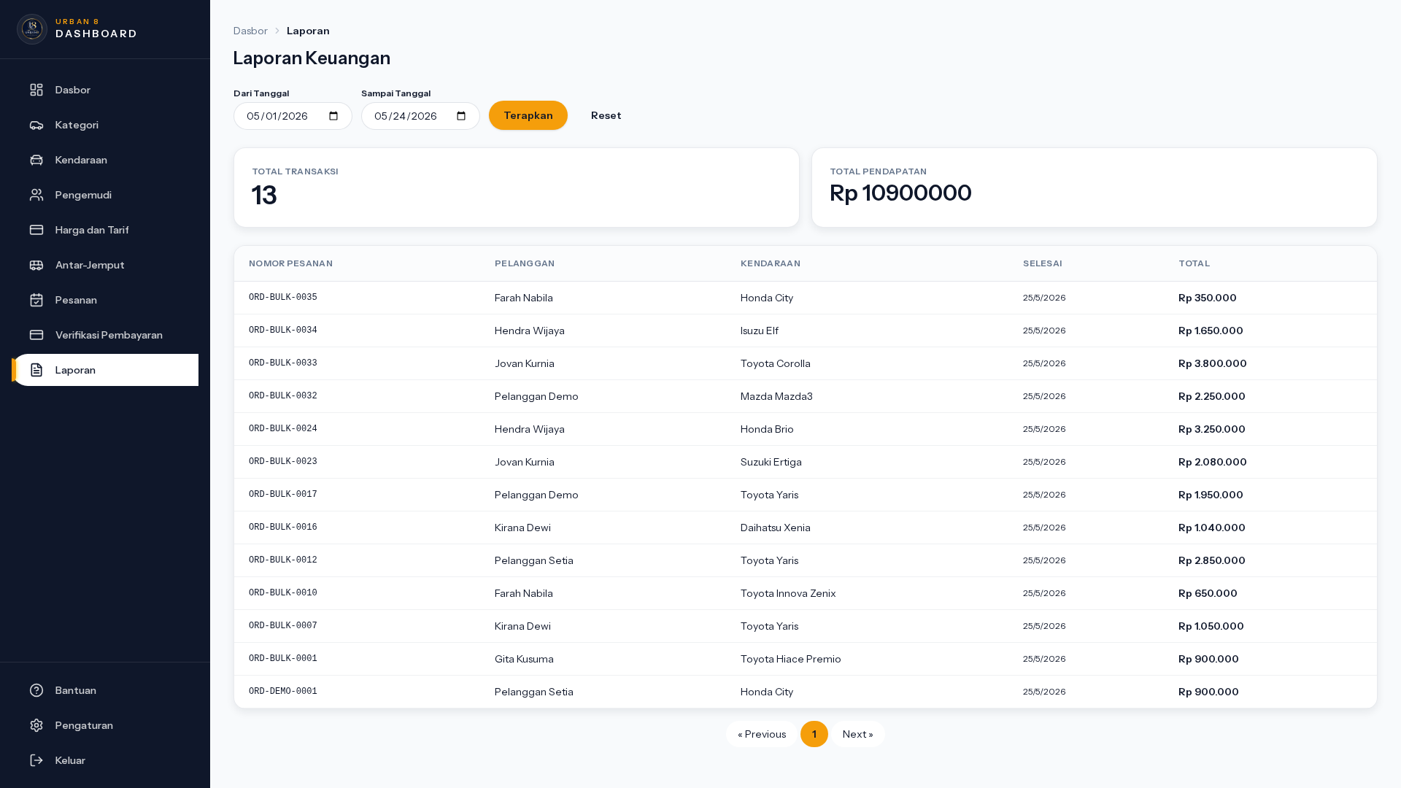
UC-22 · Generate Laporan & Settings
PASS
Generate Laporan Transaksi & Revenue
URL: /admin/reports · Component: Reports page · Kondisi: Render
Manual Book · Rent-Car Urban8
69

Slide 71
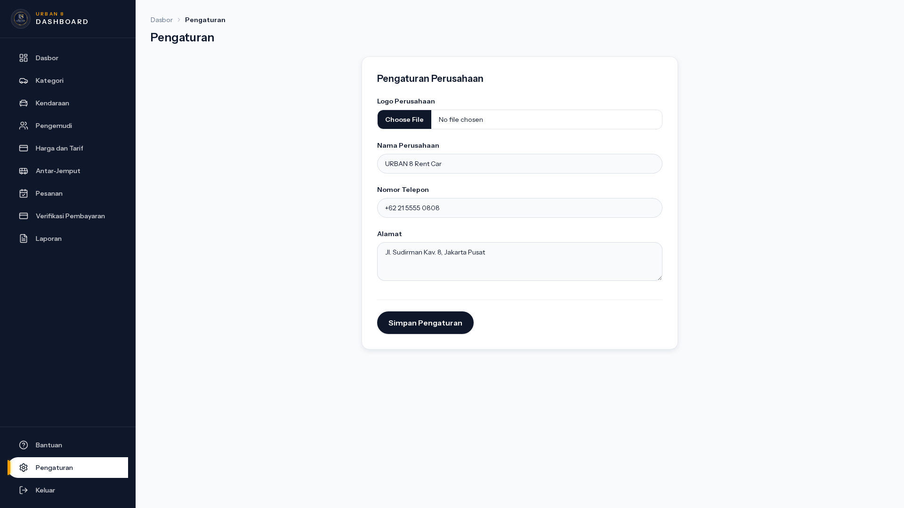
UC-22 · Generate Laporan & Settings
PASS
Admin Settings
URL: /admin/settings · Component: Settings page · Kondisi: Render
Manual Book · Rent-Car Urban8
70

Slide 72
UC-23
View Audit Log
AKTOR
MODUL
TEST CASES
Admin
Audit
1 step
AuditLogger backend service mencatat seluruh perubahan kritis (login, payment, dispatch, refund). UI viewer optional.

Slide 73

UC-23 · View Audit Log
SKIP
View Audit Log (route belum ter-expose)
URL: /admin/dashboard · Component: Audit log surface · Kondisi: Tidak ada route admin/audit-logs
📝 Audit log via service AuditLogger; tidak ada UI list eksplisit
Manual Book · Rent-Car Urban8
72

Slide 74
UC-25
Riwayat Order & Cancel Customer-side
AKTOR
MODUL
TEST CASES
Customer
Order History
1 step
Customer lihat riwayat seluruh order (Paid, Ongoing, Completed, Cancelled). Bisa cancel order dengan status PendingPayment/WaitingVerification.

Slide 75
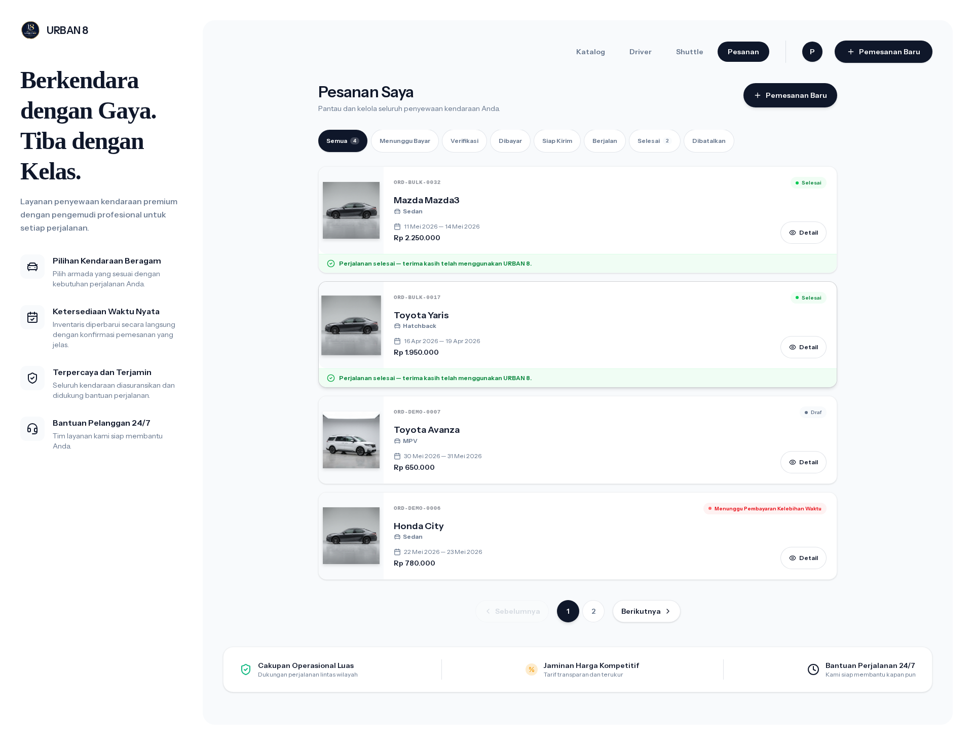
UC-25 · Riwayat Order & Cancel Customer-side
PASS
Riwayat Order Customer
URL: /orders · Component: Orders list · Kondisi: Render list
Manual Book · Rent-Car Urban8
74

Slide 76
UC-26
Role-based Dashboard Redirect
AKTOR
MODUL
TEST CASES
All
Auth Routing
4 step
Setelah login, sistem redirect berdasarkan role: Customer → /dashboard, Admin → /admin, Kasir → /kasir, Driver → /driver.

Slide 77
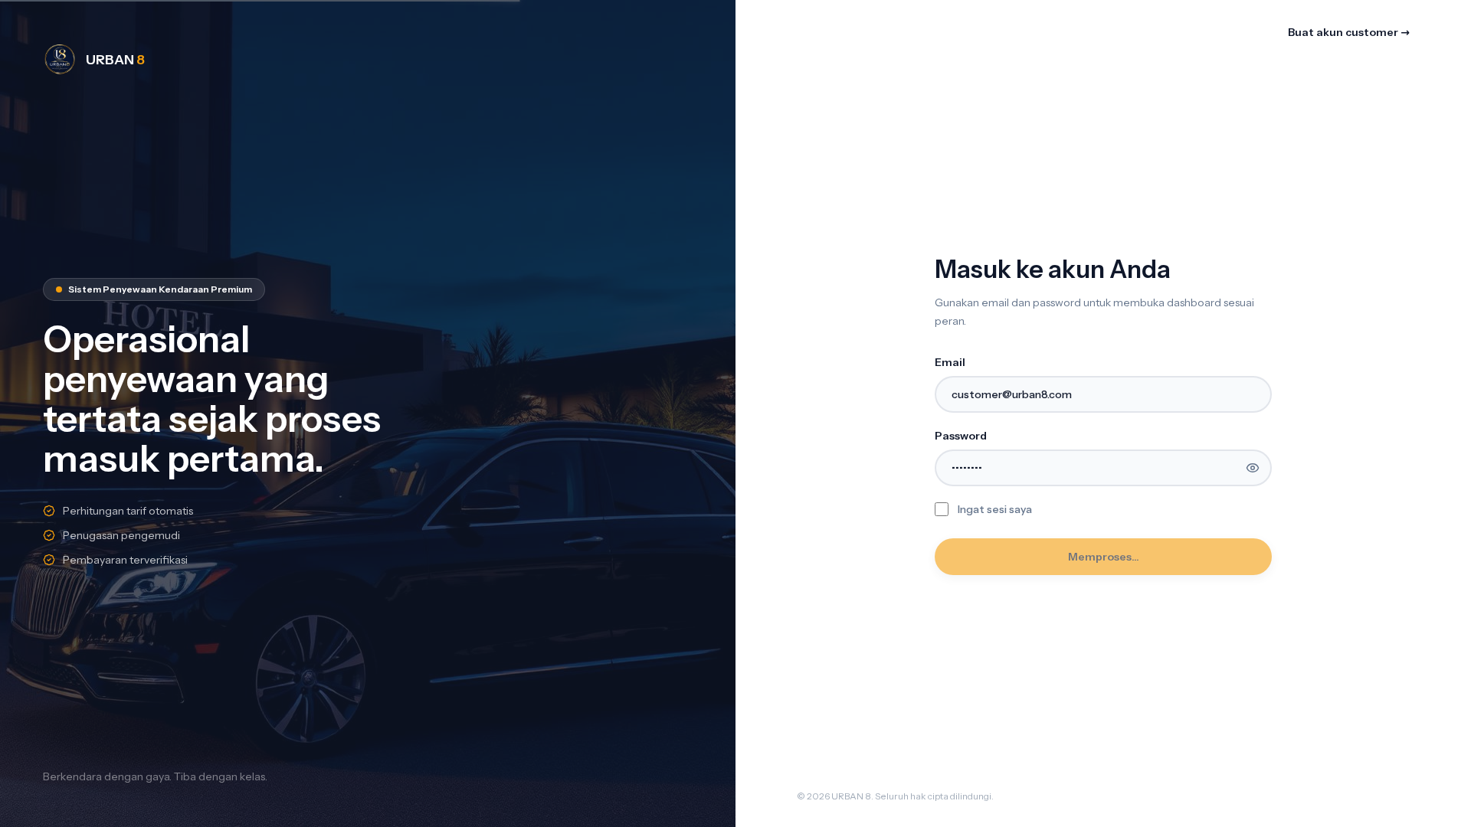
UC-26 · Role-based Dashboard Redirect
PASS
Dashboard Customer (role redirect)
URL: /dashboard · Component: Auto-redirect · Kondisi: Customer login
Manual Book · Rent-Car Urban8
76

Slide 78
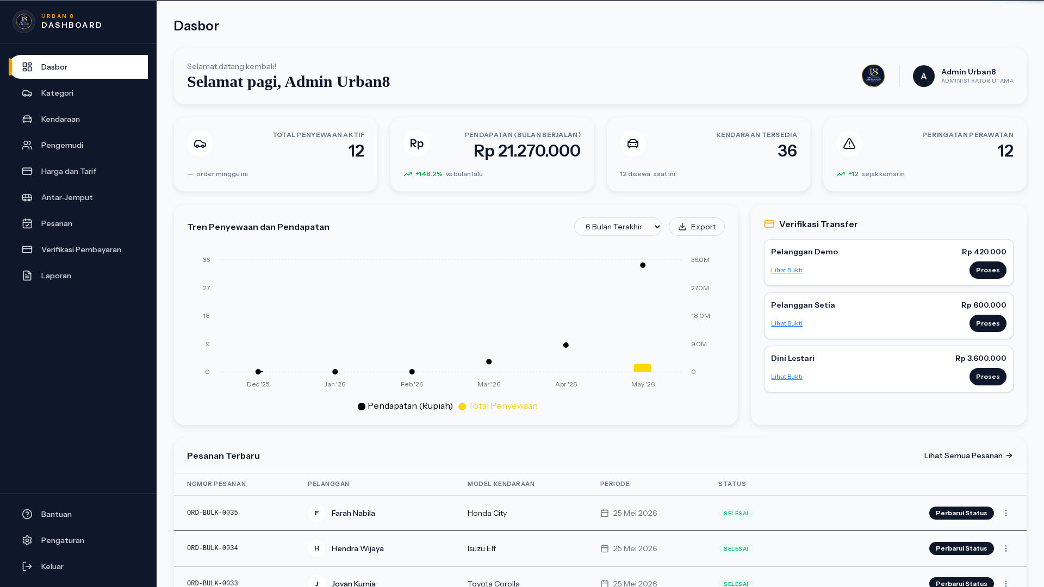
UC-26 · Role-based Dashboard Redirect
PASS
Role redirect Admin
URL: /admin/dashboard · Component: Auto-redirect · Kondisi: Admin login
Manual Book · Rent-Car Urban8
77

Slide 79
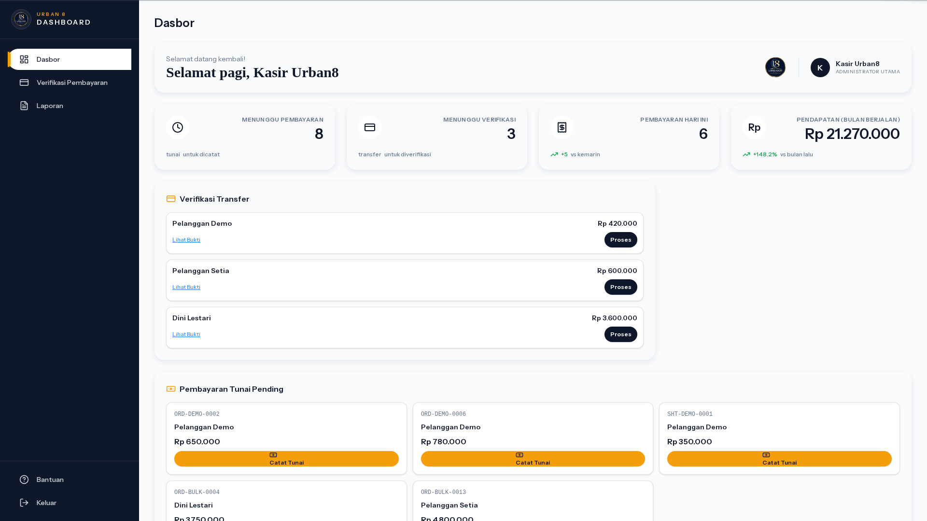
UC-26 · Role-based Dashboard Redirect
PASS
Role redirect Kasir
URL: /admin/dashboard · Component: Auto-redirect · Kondisi: Kasir login
Manual Book · Rent-Car Urban8
78

Slide 80
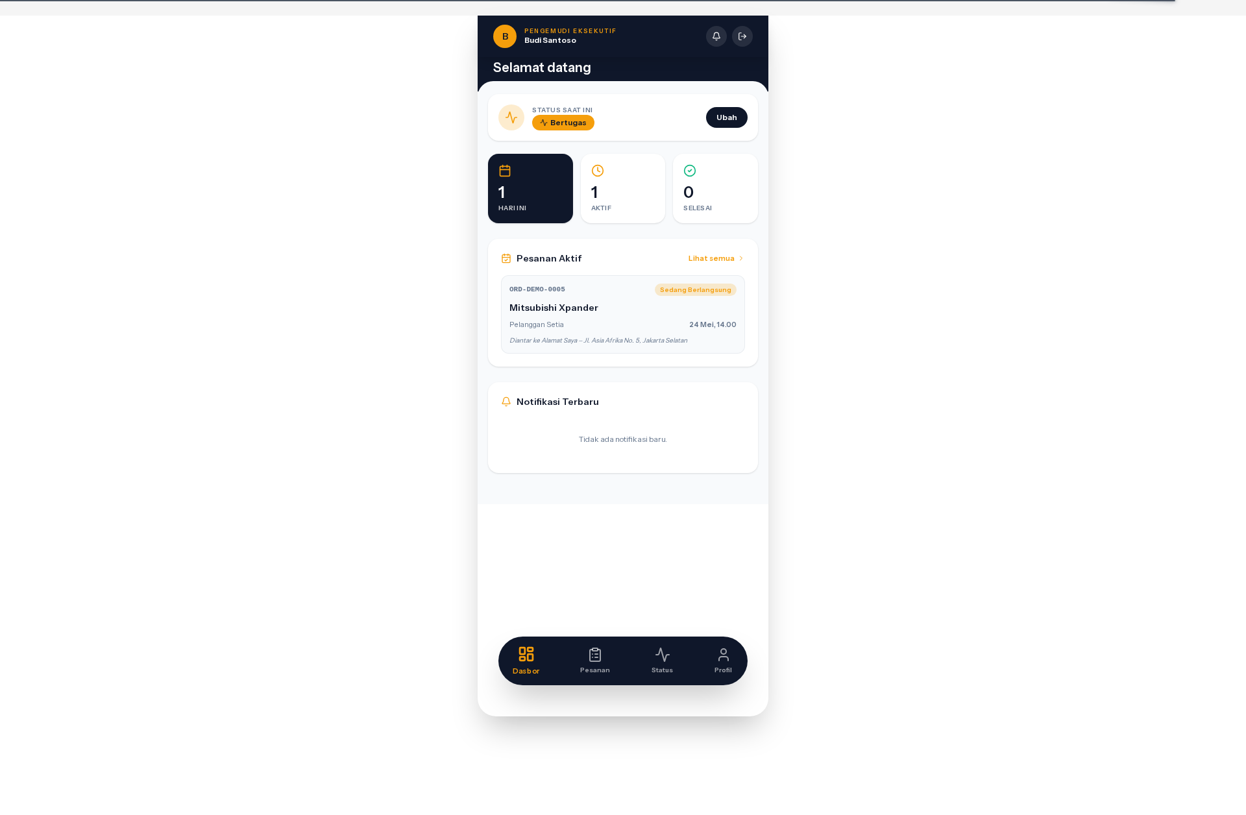
UC-26 · Role-based Dashboard Redirect
PASS
Role redirect Driver
URL: /driver/dashboard · Component: Auto-redirect · Kondisi: Driver login
Manual Book · Rent-Car Urban8
79

Slide 81
UC-27
Refund Pembayaran (Admin)
AKTOR
MODUL
TEST CASES
Admin
Payment Refund
2 step
Admin refund payment Paid via tab Refund. Modal isi alasan (min 5 char). Payment Paid → Refunded, order terkait di-cancel + audit log.

Slide 82
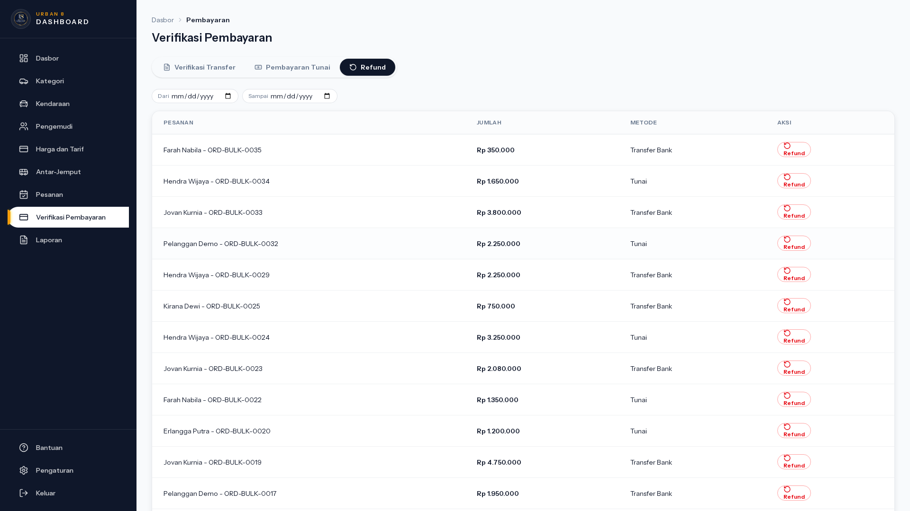
UC-27 · Refund Pembayaran (Admin)
PASS
Refund — Paid tab list
URL: /admin/payments/verification?tab=paid · Component: Paid tab · Kondisi: List pembayaran Paid yang bisa di-refund
Manual Book · Rent-Car Urban8
81

Slide 83
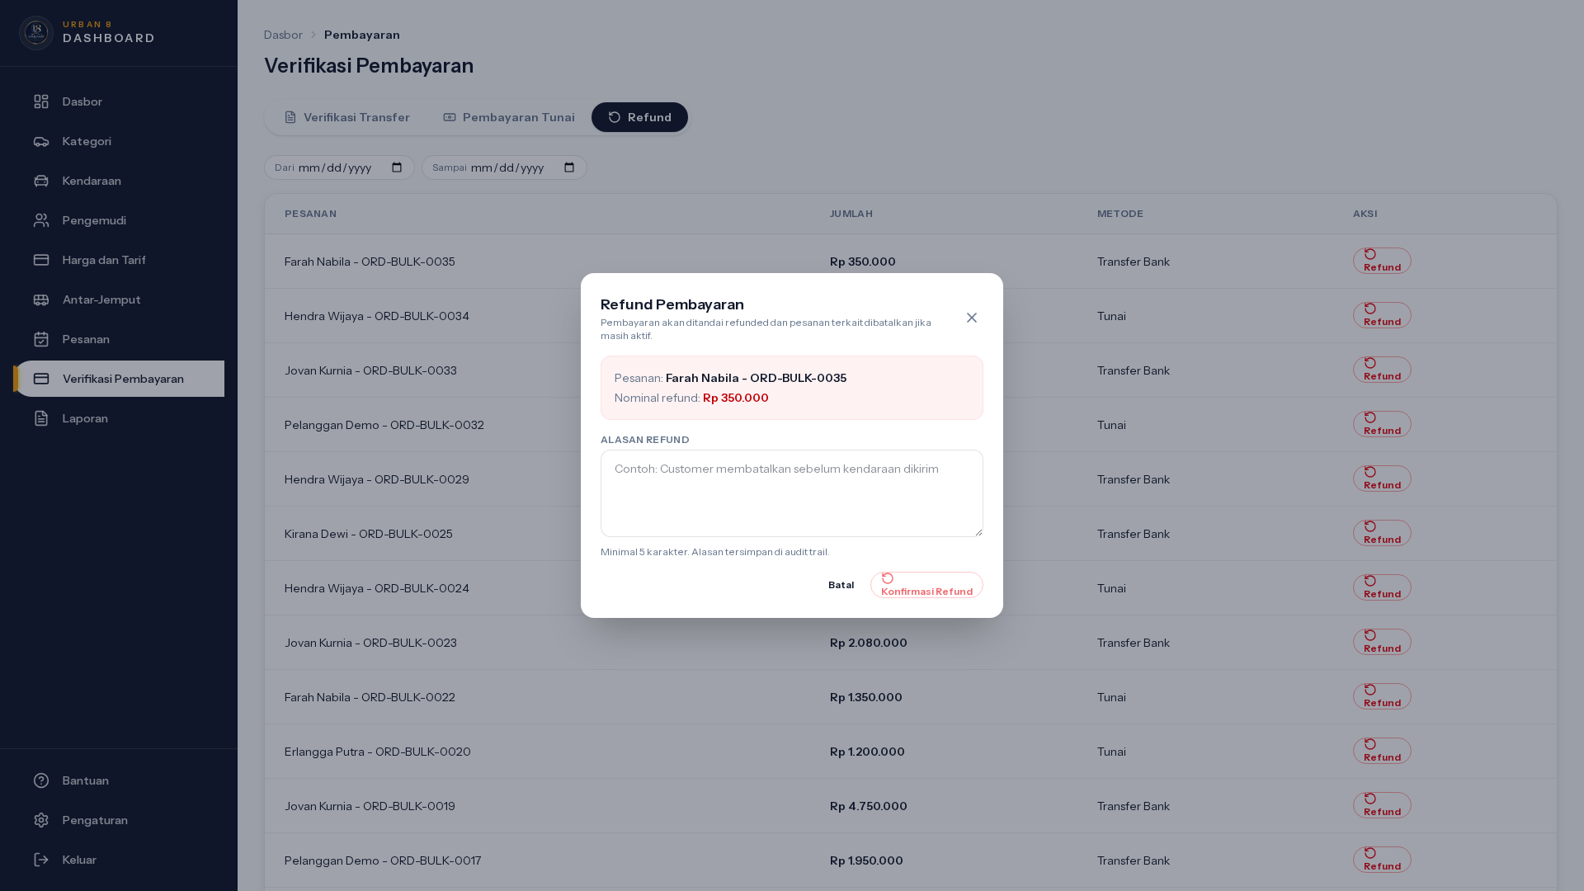
UC-27 · Refund Pembayaran (Admin)
PASS
Modal Refund Pembayaran
URL: /admin/payments/verification?tab=paid · Component: Refund dialog · Kondisi: Trigger row "Refund"
Manual Book · Rent-Car Urban8
82

Slide 84
SELESAI
Manual Book selesai.
Dokumen ini disusun otomatis dari hasil E2E walkthrough Playwright + screenshot 1920×1080. Setiap step diverifikasi headless lawan rent-car-dev docker stack.
Reproduce: node tests/qa/run-e2e-walkthrough.mjs && node tests/qa/render-report.mjs
Sumber screenshot: docs/qa-reports/screenshots/
Urban8 Engineering · Internal Documentation

