Slide 1
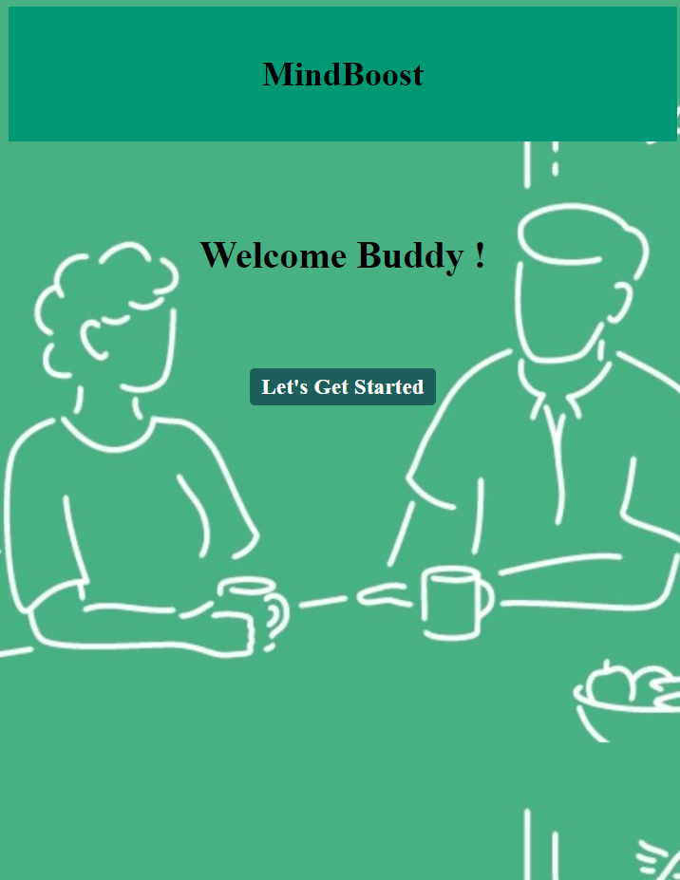
The Starting Page

Slide 2
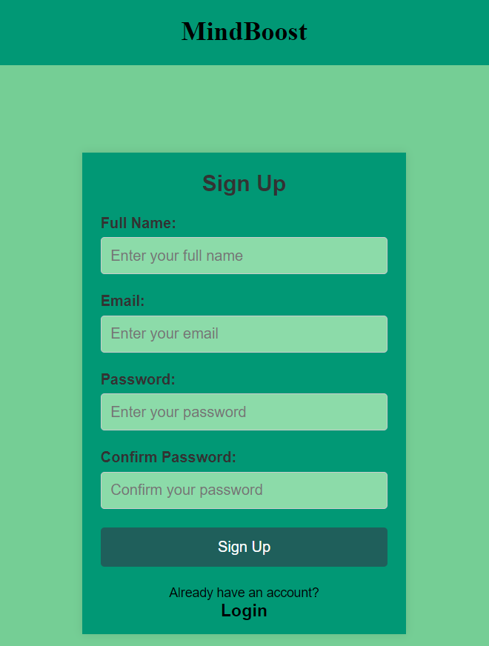
The SignUp Page

Slide 3
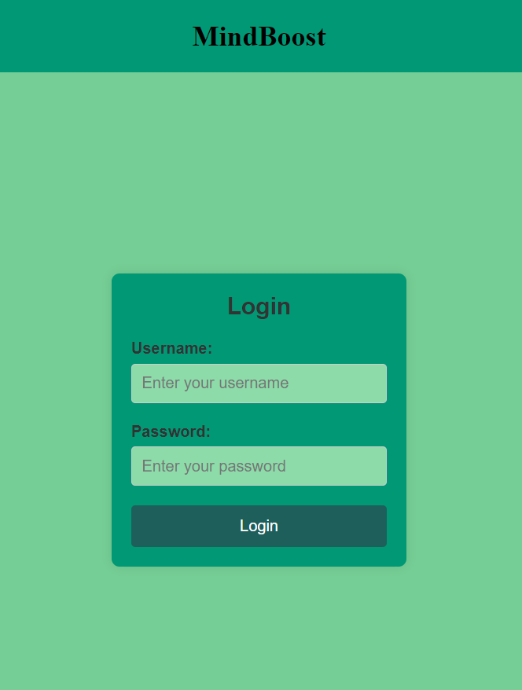
The LogIn Page

Slide 4
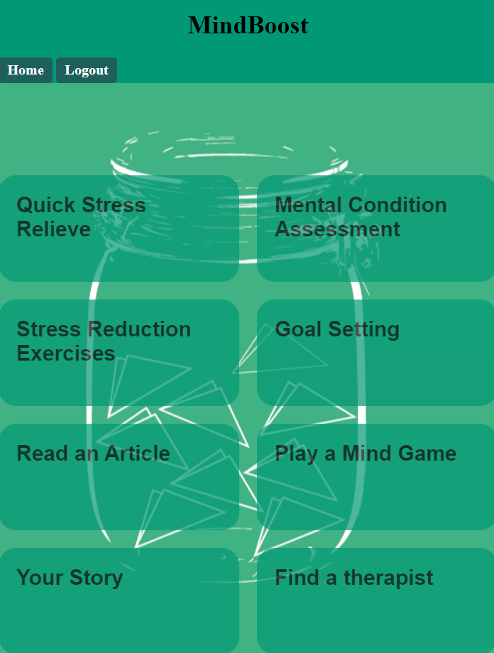
The Functions Page

Slide 5
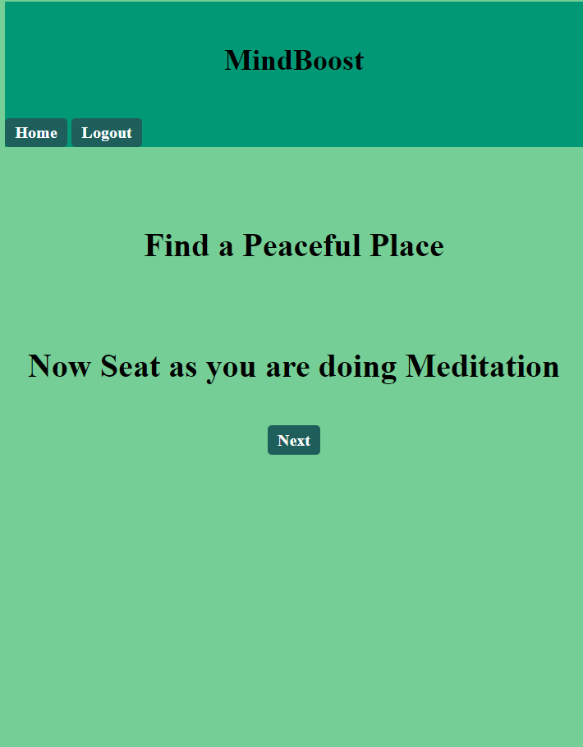
Quick Stress Relief Step 01

Slide 6
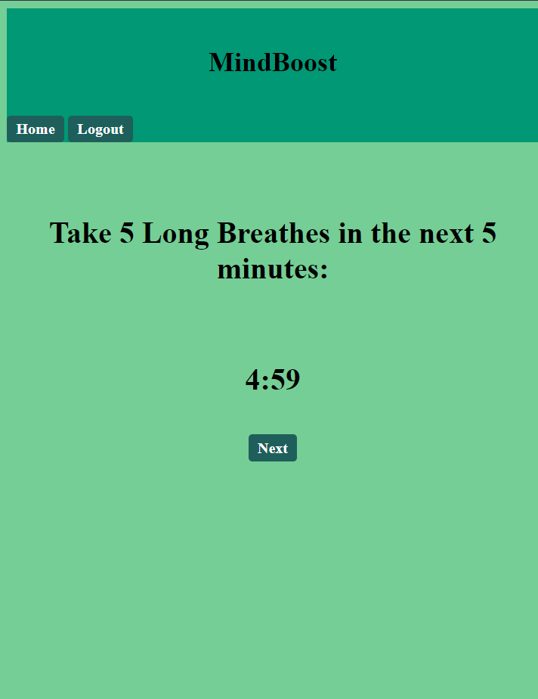
Quick Stress Relief Step 02

Slide 7
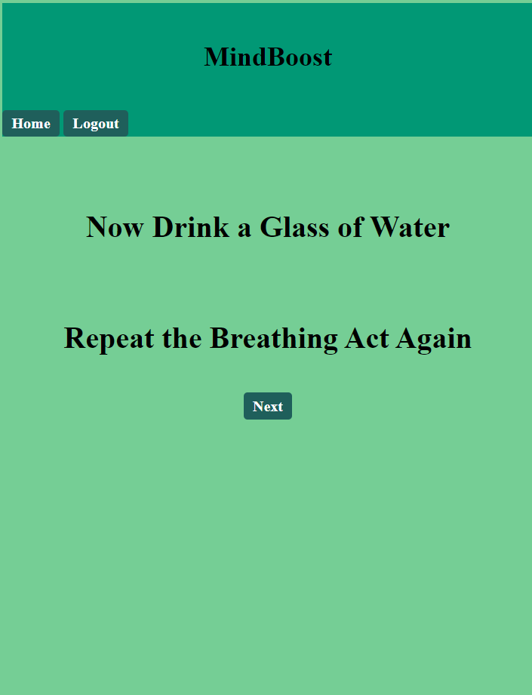
Quick Stress Relief Step 03

Slide 8
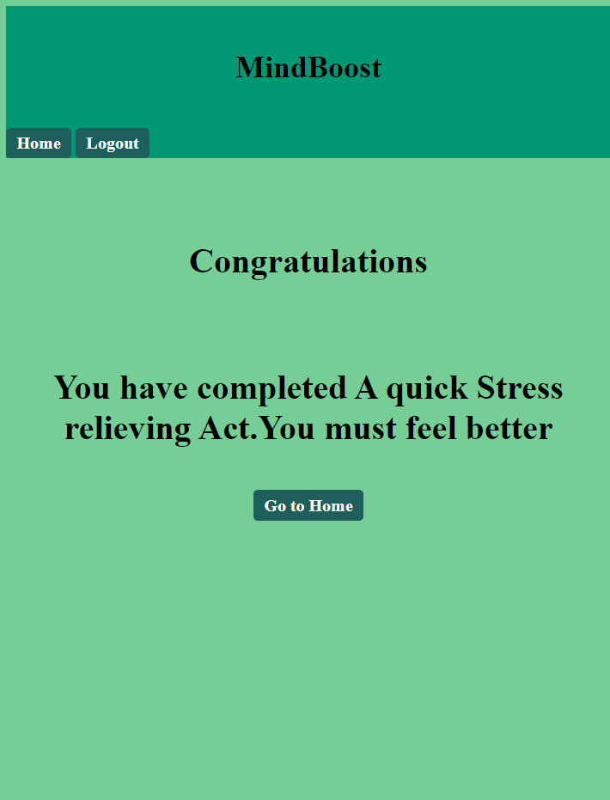
Quick Stress Relief Step 04

Slide 9
Get Back to Functionality Page

Slide 10

Read Mental Health Related Articles

Slide 11

Sample Article 01

Slide 12
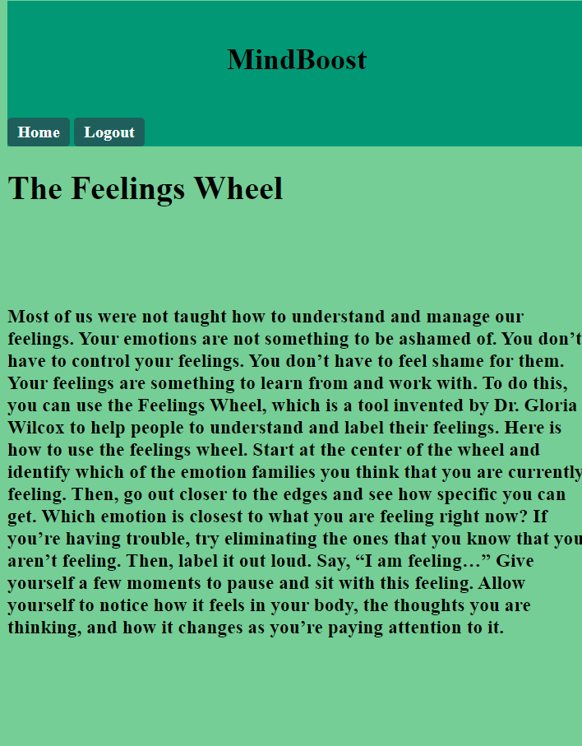
Sample Article 02

Slide 13
Here Home Again

Slide 14
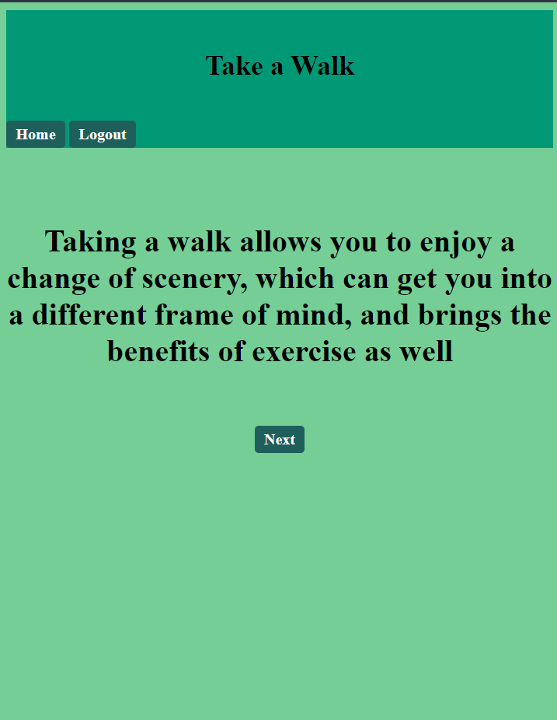
Stree Relieve Regular Partices 01

Slide 15
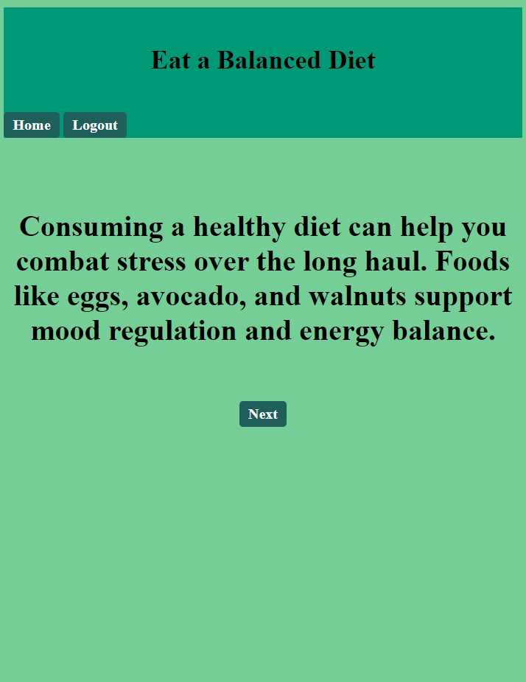
Stree Relieve Regular Partices 02

Slide 16

Stree Relieve Regular Partices 03

Slide 17
Functions

Slide 18
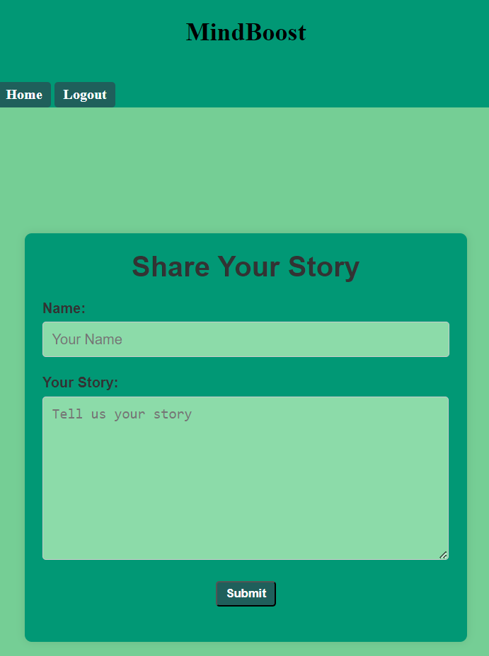
Your story Section to inspire Others

Slide 19
Log Out and Come to Homepage

