Slide 1



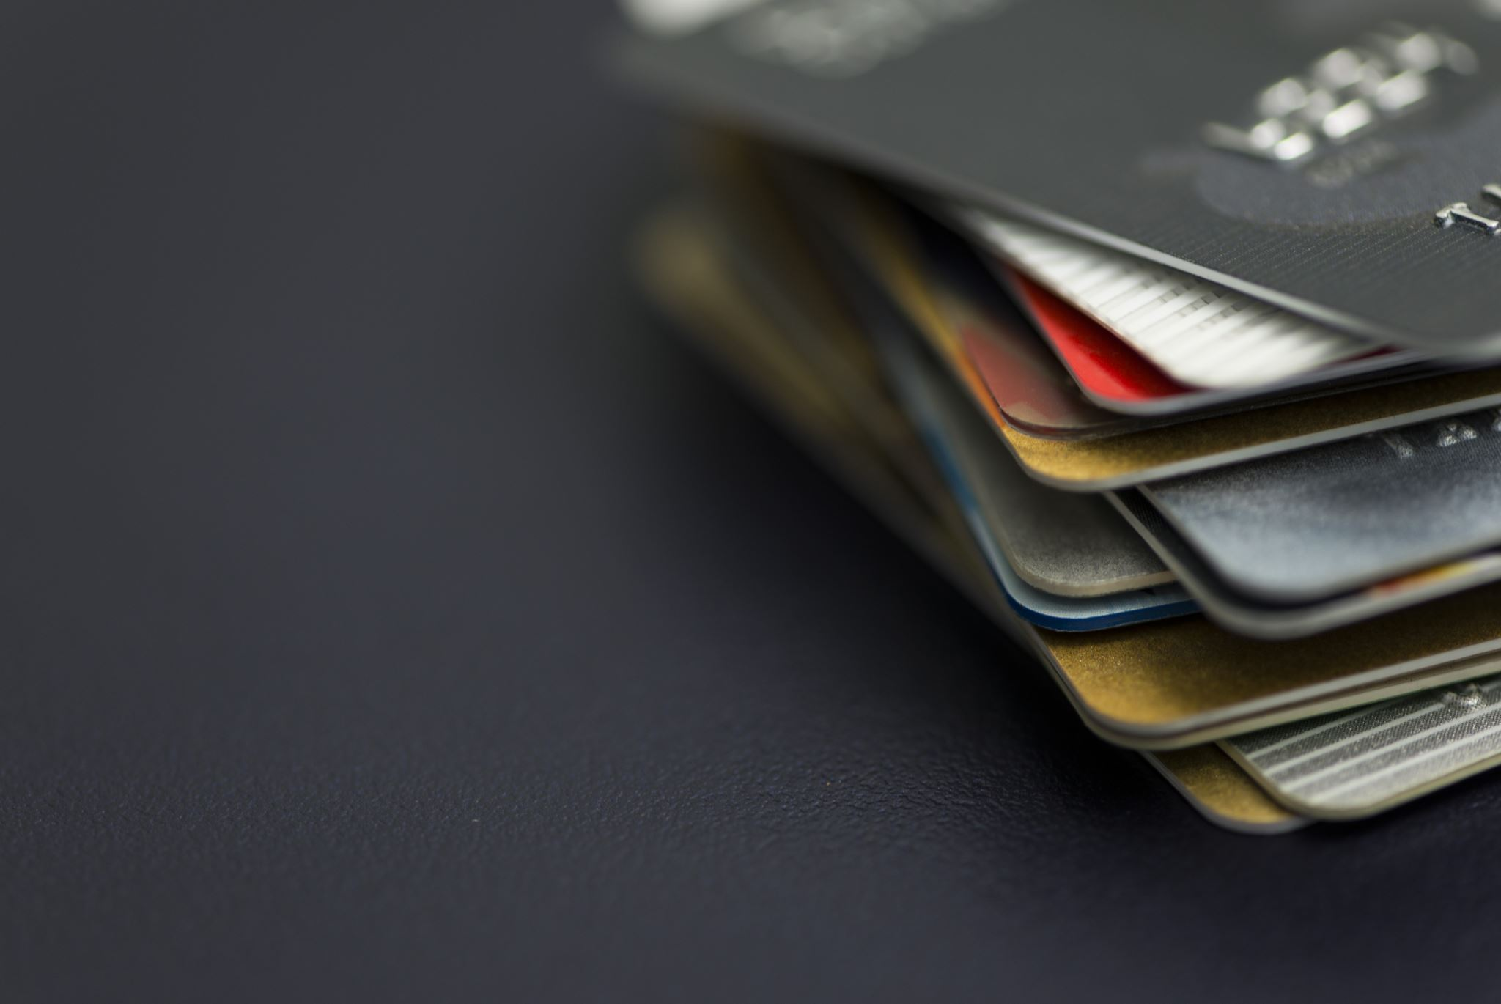
4 types of credit market instruments
Simple Loan
Fixed payment loan or Fully amortized loan
Coupon Bond
Discount Bond or Zero-coupon Bond

Slide 2
Simple Loan
must be repaid to the lender at the maturity date
with an additional payment for the interest
Examples: Short term commercial loans to business

Slide 3
Simple Loan
City Bank loan through Bkash
9% per annum interest rate will be applicable.
3 months short term loan
repayment amount will be automatically deducted from the user’s bKash account on the due date
2% extra if time is over.
EBL Agrim
Loan facility minimum Tk.200,000 – maximum Tk.950,000
No collateral security required
Loan tenure 4 month to 6 months
Partial payment and early payment allowed- no additional fee required
Single shot payment at maturity but interest will be realized on monthly basis

Slide 4
Simple Loan
Grameen Bank Livestock Loan
The maximum ceiling of livestock loans is BDT 40,000.
The duration of the loan is 9 months or 39 weeks.
Repayment of the loan immediately after the sale

Slide 5
Fixed payment loan or Fully amortized loan
the borrower must repay the principal and interest, every period (such as a month) for a set number of years.
Examples: Installment loans , mortgages

Slide 6
Fixed payment loan or Fully amortized loan
EBL Mukti
Credit facility from BDT 5 lac to BDT 50 Lac for women entrepreneurs or women lead business
No collateral security required
Interest Rate is 10% p.a.
Repayable in 6-60 months according to cashflow in installments
Rupali Bank Shohoj Rin
Loan maximum BDT 10 lac
For term loan Maximum 48 months (installment monthly/ quarterly).
Interest Rate is 9% p.a.
Repayment will be in installments.

Slide 7
Fixed payment loan or Fully amortized loan
Rupali bank, Babshahi RIN
Loan maximum BDT 5 crores
Interest Rates: 9.00%
Security: Auxiliary collateral real state needed. For Exclusive ownership, the maximum loan amount (MCL) will be 75% of the immediate sell price of the property and co-shared/ third party ownership the maximum loan amount (MCL) will be 50% of the immediate sell price of the property.
Repayment will be in installments.
IFIC Bank Auto Loan (Mortgage Backed)
Loan amount up to BDT 40,00,000
Tenor: Minimum 12 months, Maximum 60 months
Competitive Interest Rate
Repayment will be in installments.

Slide 8
Coupon Bond
It pays the owner of the bond a fixed interest payment (coupon payment) every year until the maturity, when a specified final amount (face value or par value) is repaid.
In example, a coupon bond has a yearly coupon payment of $100 and a face value of $1,000. The coupon rate is then $100>$1,000 = 0.10, or 10%.
coupon bonds first emerged in the 19th century as governments and companies sought new ways to raise money

Slide 9
Discount Bond or Zero-coupon Bond
It is bought at a price below its face value (at a discount), and the face value is repaid at the maturity date.
Unlike a coupon bond, a discount bond does not make any interest payments.
It just pays off the face value.
income from zero-coupon bonds is tax free for investors in Bangladesh

Slide 10
Coupon Bond & Discount Bond in Bangladesh
There are different Government treasury Bonds in Bangladesh with different maturity date. Like 2 year, 5 years, 10 years, 15 years, 20 years treasury bond with 11.60%-12.17% yield to maturity.
From mid-2012 to mid-2019, the BSEC approved 94 corporate bonds worth over Tk37,000 crore.
Aamra Networks Limited got the BSEC approval to issue zero-coupon bonds worth up to Tk100 crore to strengthen its Internet infrastructure.
Brac, the world's largest nongovernmental organisation (NGO), has recently applied for a Tk1,350 crore bond to fuel its microfinance programme.

Slide 11
Coupon Bond & Discount Bond in Bangladesh
Sajida Foundation, another reputed NGO, applied for Tk100 crore zero-coupon bonds.
Summit Tower Limited, a subsidiary of Summit Communications Limited, has applied for two bonds – one zero-coupon bond and another coupon-bearing bond – worth nearly Tk220 crore.
Pran Agro got approval for a bond worth Tk210 crore and is waiting for another one worth Tk150 crore.
Standard Chartered Bangladesh, as the first foreign bank in Bangladesh, offered zero-coupon bonds worth Tk850 crore in year 2020

