Slide 1
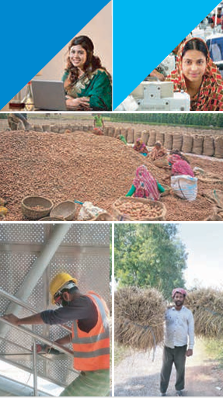
Labour Force Survey 2022
Mubasir Hossain (956)
Reyad Hasan (960)

Slide 2

Background
Chapter 1: Introduction
Labour Force Survey (LFS) 2022 conducted by BBS
Provides updated labour market statistics
Follows international standards (ILO concepts)
Covers employment, unemployment, labour participation, etc.

Slide 3
Objectives of the Survey
Measure labour force size and structure
Estimate employment and unemployment
Assess informal employment
Measure labour underutilization
Provide data for policy formulation

Slide 4
Concepts and Definitions
Working-age population (15+)
Labour force
Employed
Unemployed
Outside labour force
Informal employment

Slide 5

Chapter 2: Survey Methodology
Scope and Coverage
National coverage
Urban & Rural areas
Quarterly data collection

Slide 6
Sample Design & Size
Two-stage stratified sampling
Nationally representative sample
Determined scientifically for accuracy

Slide 7
Data Collection Process
CAPI (Computer Assisted Personal Interviewing)
Structured questionnaire
Trained enumerators

Slide 8
Data Quality & Processing
Monitoring & supervision
Validation checks
Data cleaning & processing

Slide 9

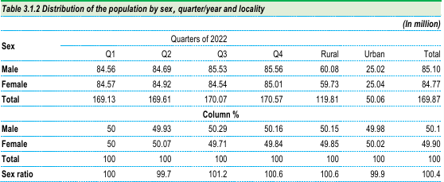
Chapter 3: Population & Housing Characteristics
Population Structure
Total population (2022): 169.87 million
Working-age population: 119.37 million

Slide 10
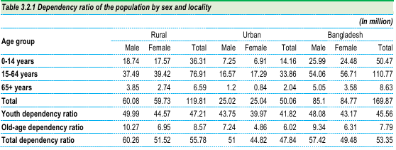
Dependency Ratio
Measures economic burden
Youth and old-age dependents

Slide 11


Housing & Living Conditions
Electricity access
Cooking fuel sources
Sanitation facilities
Drinking water sources

Slide 12
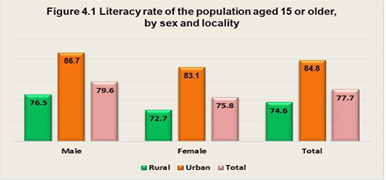
Chapter 4: Education & Vocational Training
Literacy Profile
Literacy rate (15+)
Male vs Female literacy
Urban vs Rural differences

Slide 13
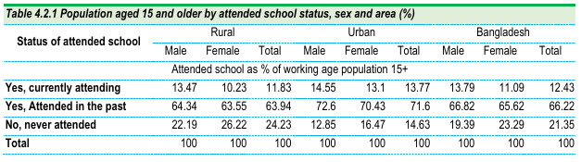
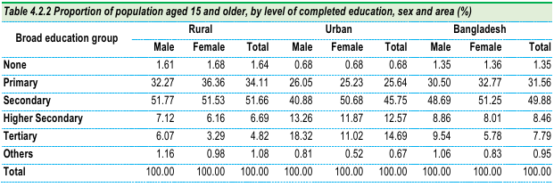
Educational Attainment
Primary, Secondary, Higher education levels
Education distribution of working-age population

Slide 14
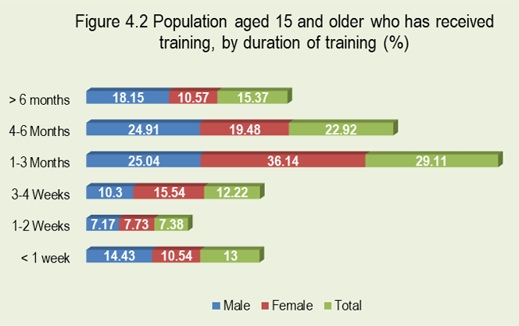
Vocational Training
Percentage receiving training
Duration & source of training
Gender differences

Slide 15
Chapter 5: Participation in Labour Market
Working-Age Population
Population aged 15+
Male vs Female distribution

Slide 16
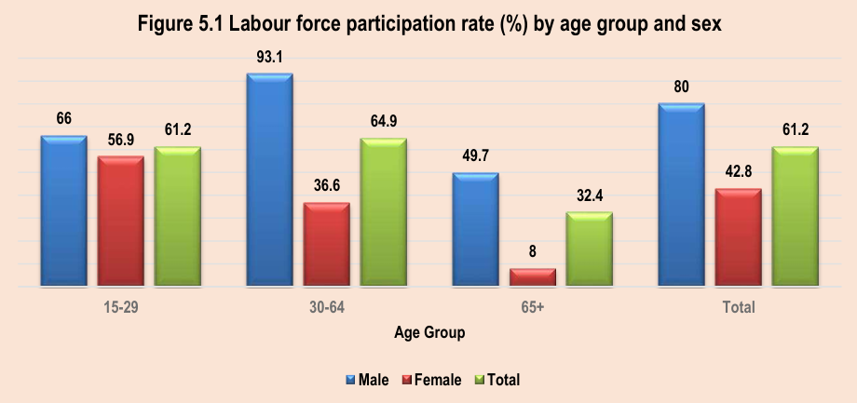
Labour Force
Total labour force: 73.05 million
Male: 47.27 million
Female: 25.78 million

Slide 17
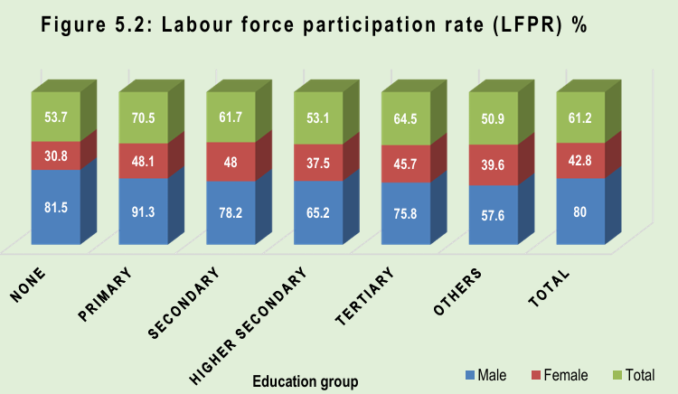
Labour Force Participation Rate (LFPR)
Overall LFPR: 61.2%
Male LFPR: 80%
Female LFPR: 42.77%
Rural vs Urban variation

Slide 18
Chapter 6: Employment
Employment Overview
Employed population: 70.47 million
Growth trend from previous surveys

Slide 19
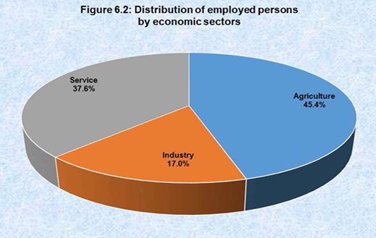
Employment by Sector
Agriculture: 45.4%
Industry: 17%
Services: 37.6%

Slide 20
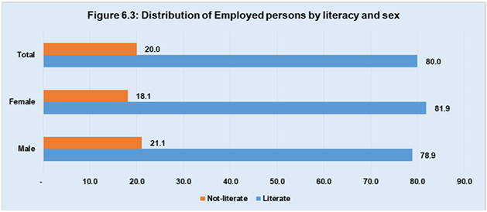
Employment by literacy and educational level

Slide 21
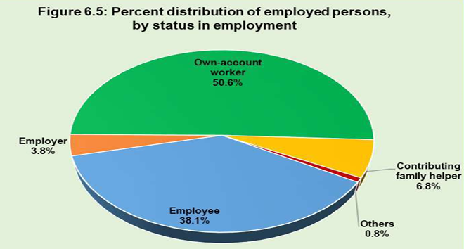
Employment by Status
Employees
Own-account workers
Contributing family workers

Slide 22
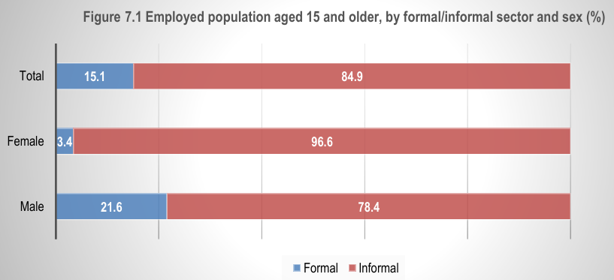
Chapter 7: Informal Employment
Informal Employment Overview
Major share of employment
Higher in rural areas

Slide 23
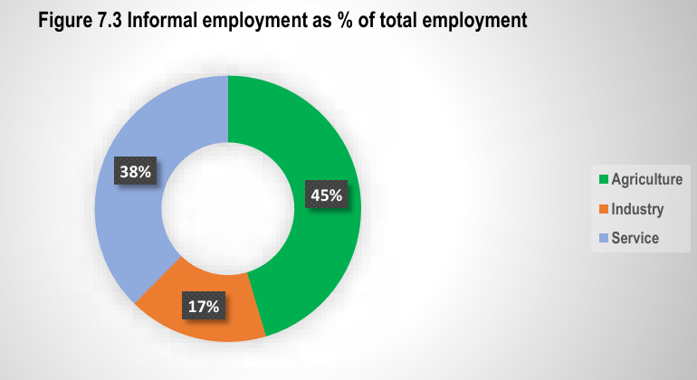
Informal Employment by Gender & Sector
Male vs Female comparison
Sectoral distribution

Slide 24
Chapter 8: Unemployment
Unemployment Overview
Total unemployed: 2.58 million
National unemployment rate: 3.53%

Slide 25
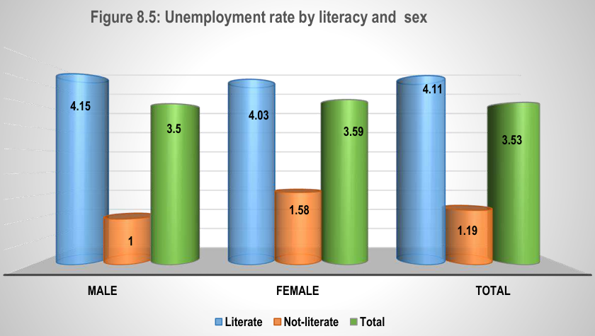
Unemployment by Gender
Male: 3.50%
Female: 3.59%

Slide 26
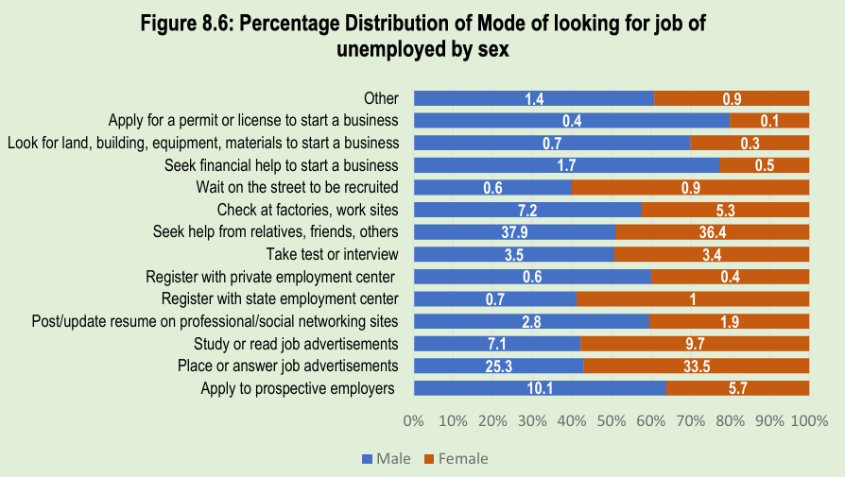
Job Search Methods
Applications
Informal networks
Self-employment attempts

Slide 27
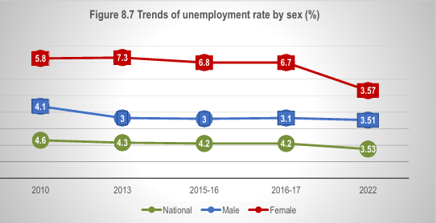
trends of the unemployment rate

Slide 28
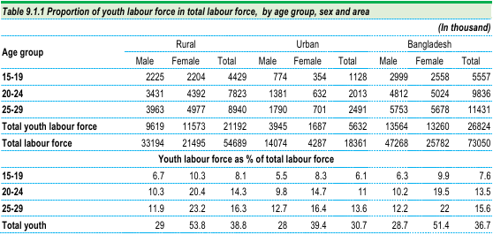
Chapter 9: Youth Employment & Unemployment
Youth Labour Force (15–29)
Total youth labour force: 26.82 million

Slide 29
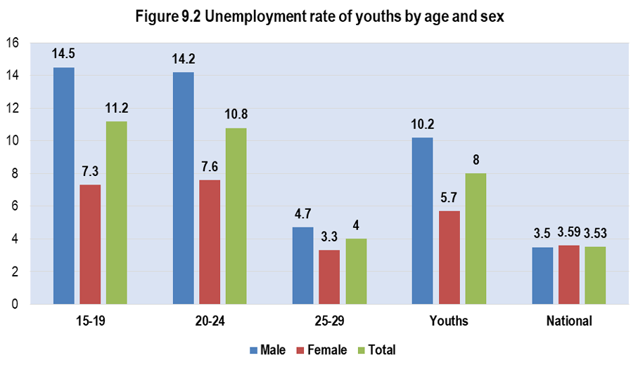
Youth Unemployment
Higher than national average
Educated youth more affected

Slide 30
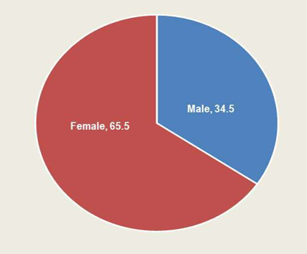
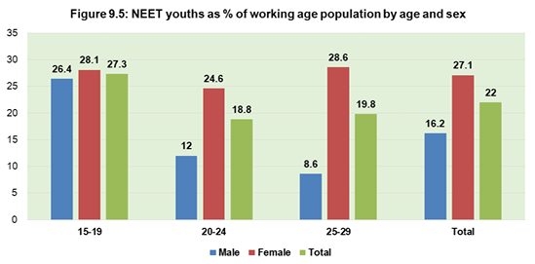
NEET Youth
Not in Education, Employment, or Training
Higher proportion among females

Slide 31
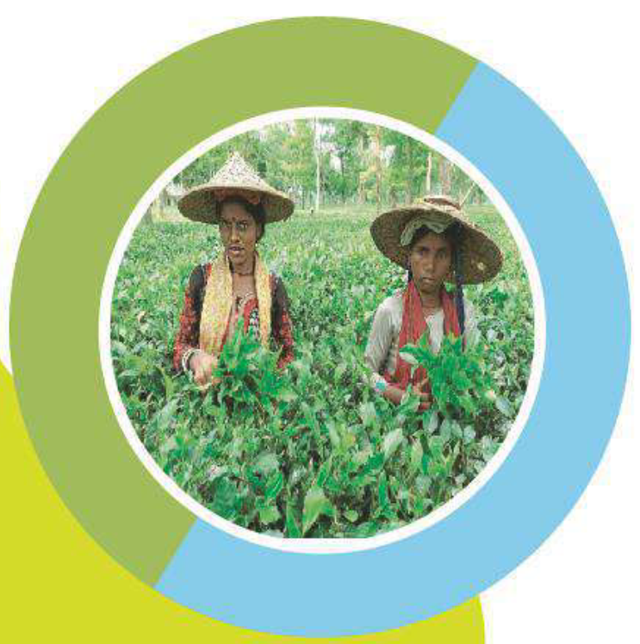
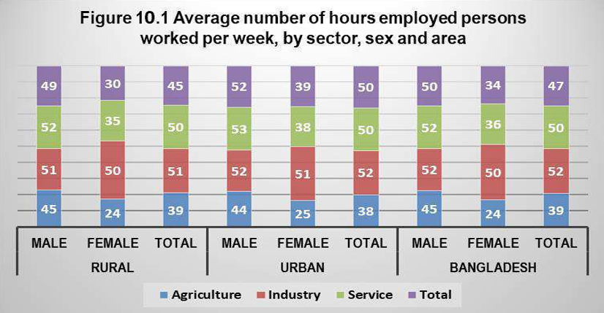
Chapter 10: Working Hours & Earnings
Working Hours:
Average weekly working hours
Sector-wise differences

Slide 32
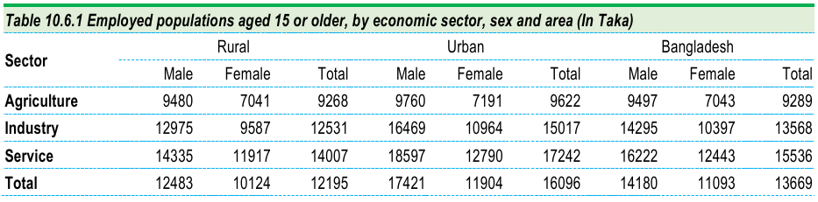
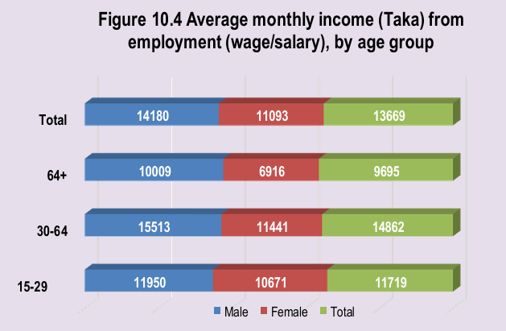
Earnings
Average monthly income
Variation by occupation
Variation by age group

Slide 33

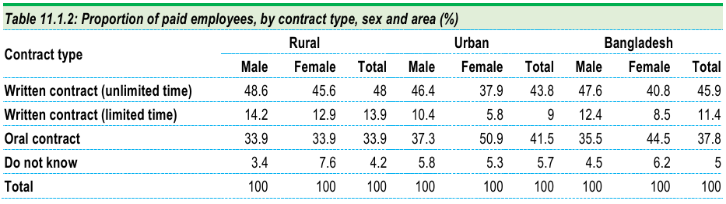
Chapter 11: Quality, stability, Social Security and safety of works
Contract types
Permanent vs Temporary work

Slide 34
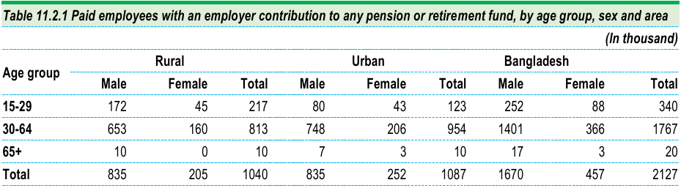
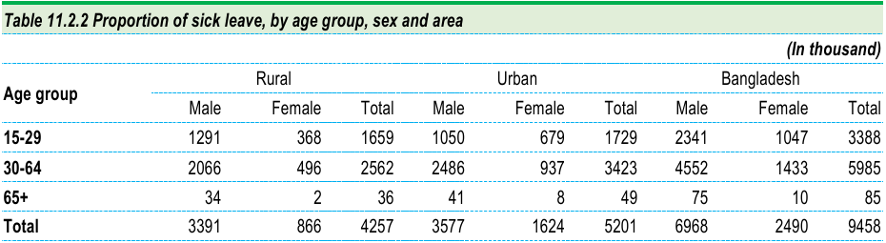
Social Protection
Pension coverage
Sick leave benefits

Slide 35
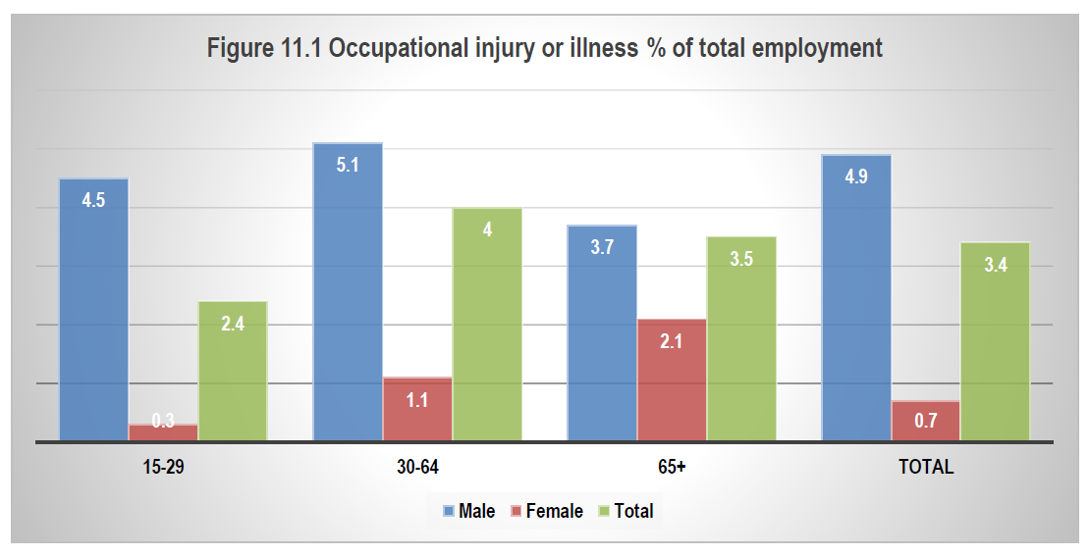
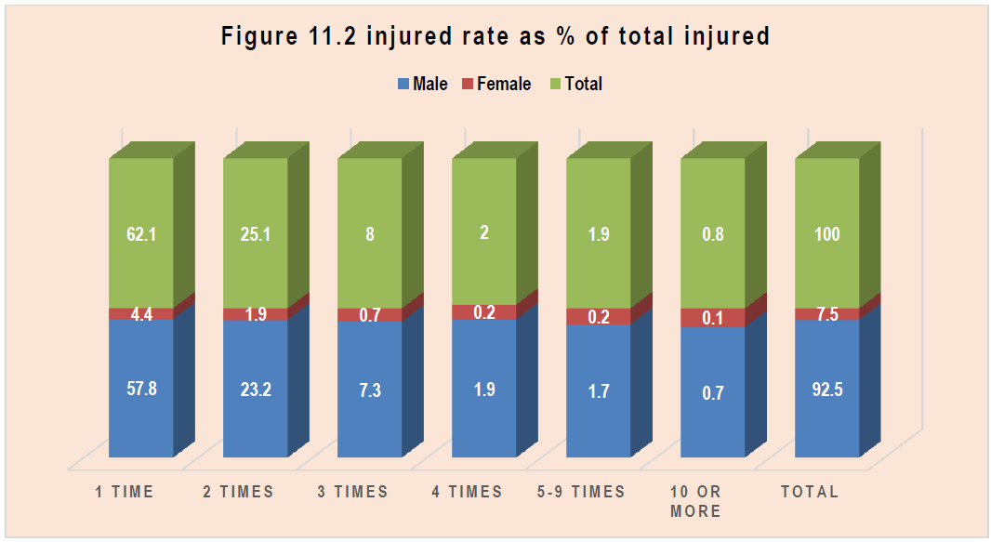
Occupational Safety
Injury rates
Workplace hazards

Slide 36
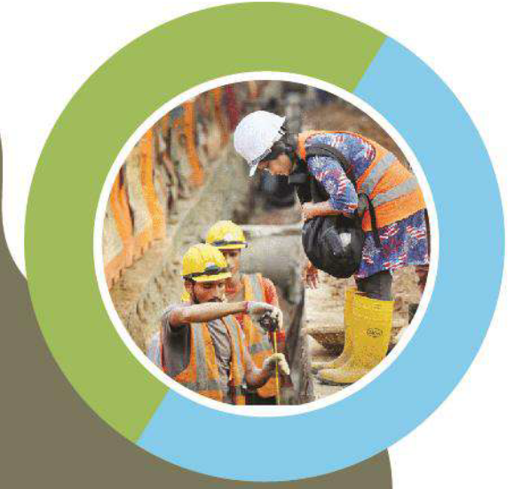
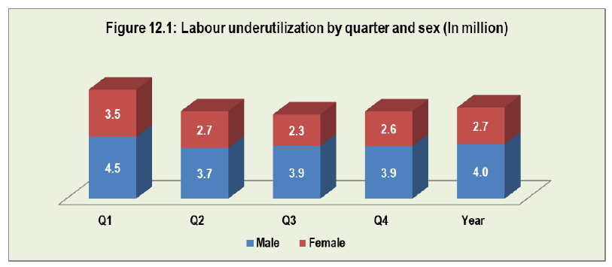
Chapter 12: Labour Underutilization
Time-related underemployment
Includes unemployment
Potential labour force

Slide 37
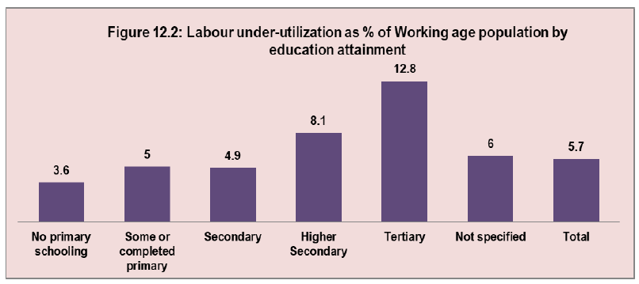
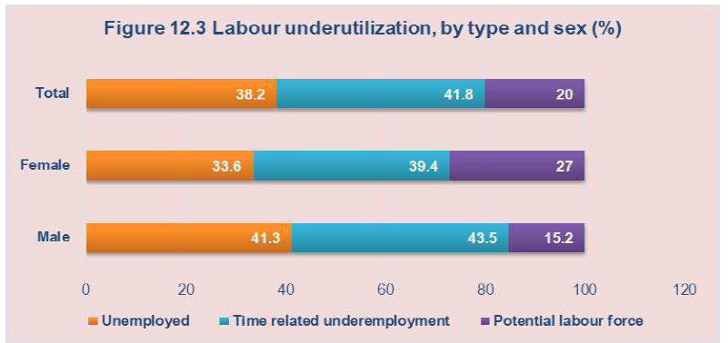
Reflect the distribution of
the underutilized in terms of their education level.
The distribution of
the underutilized in terms of type of underutilization. Of
those who were underutilized in 2022.

Slide 38
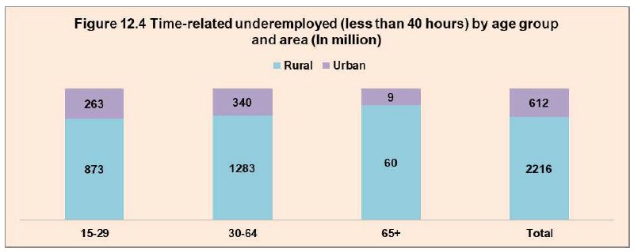
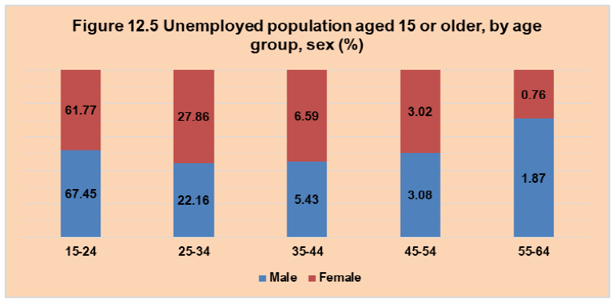
An estimated 2.82 million population (4.01 percent) were underemployed.
In the case of underemployment, the majority of them lived in rural areas 2.2 million populations compared with 0.6 million populations in urban areas.
The unemployed population aged 15 and above during the survey was approximately 2.58 million of which 1.65 million were males and 0.9 million were females.

Slide 39
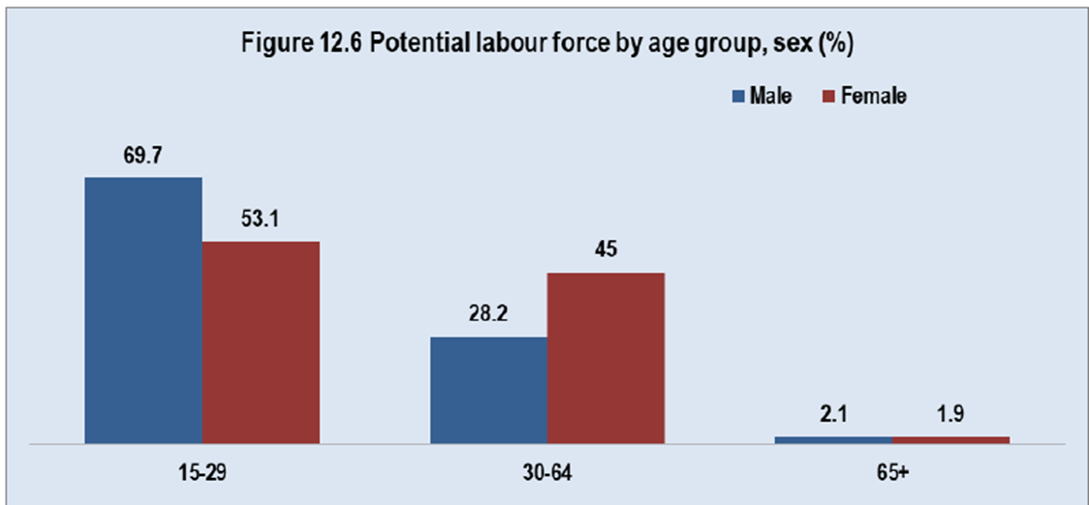
Among the 119.3 million working-age population, aged 15 years or older, 1.3 million were potential labour force.

Slide 40
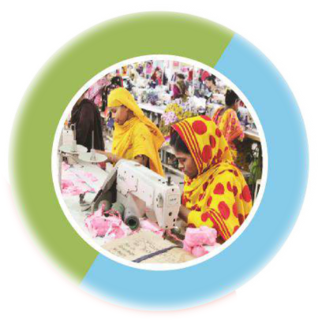
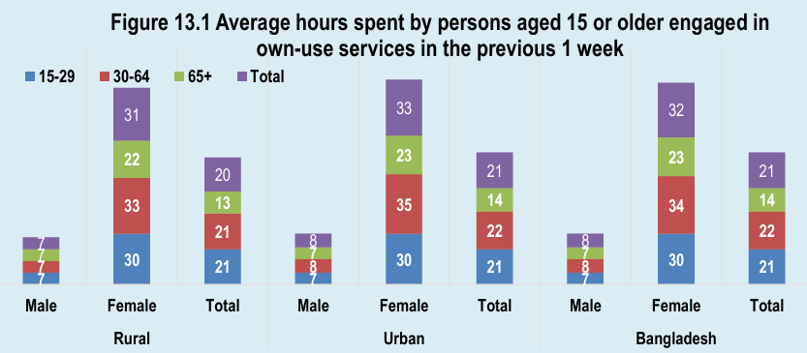
Chapter 13:Forms of Work
Types of Work
Employment work
Own-use production
Volunteer work
Apprentice work

Slide 41
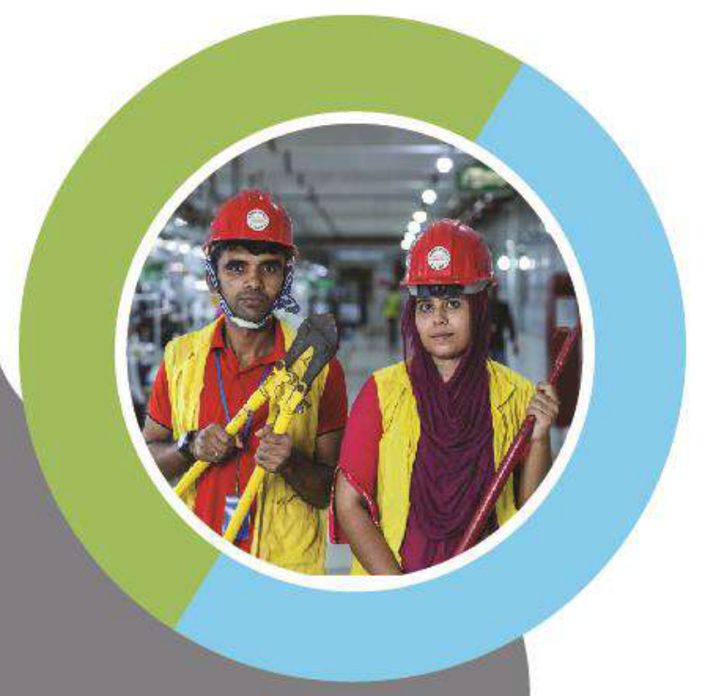
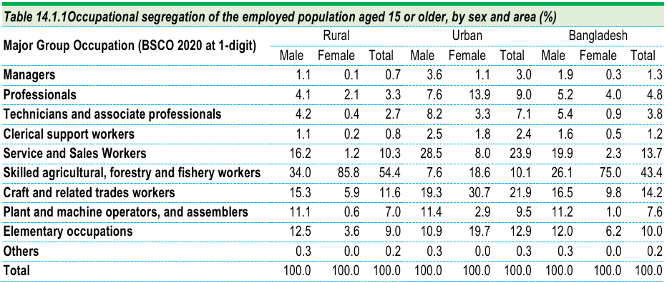
Chapter14:EqualOpportunities
Occupational Segregation
Gender-based occupation differences

Slide 42
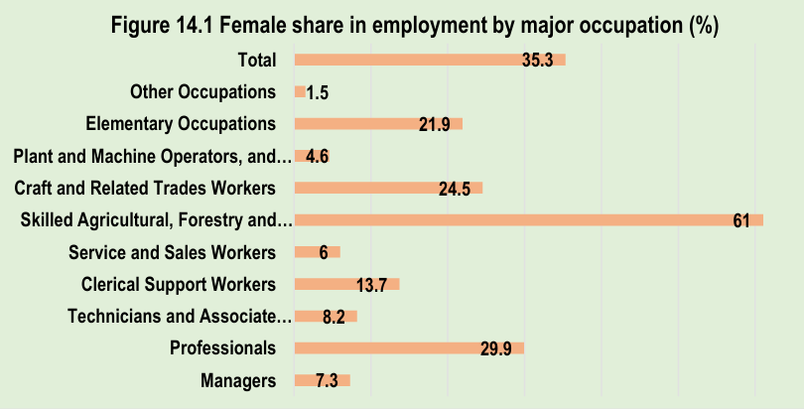
Female Share in High-Status Occupations
Leadership & professional jobs

Slide 43
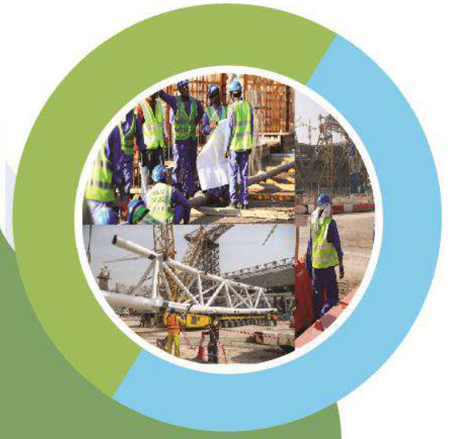
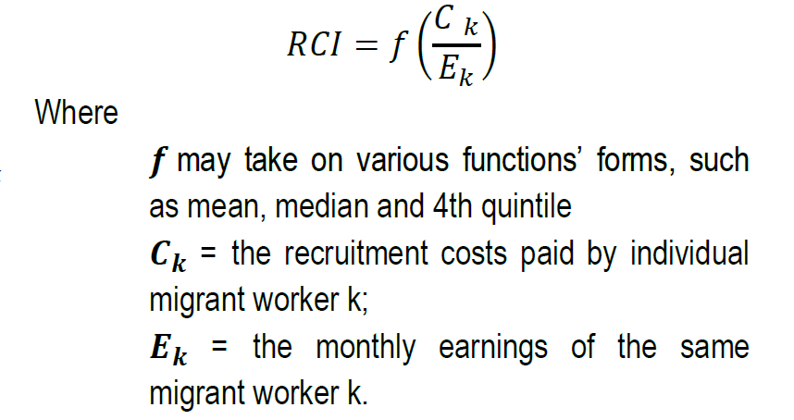
Chapter 15:Recruitment cost & income of Migrant Workers
Recruitment Cost
Proportion of recruitment cost to income

Slide 44
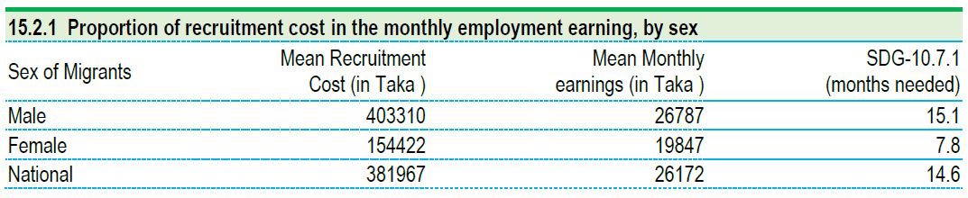
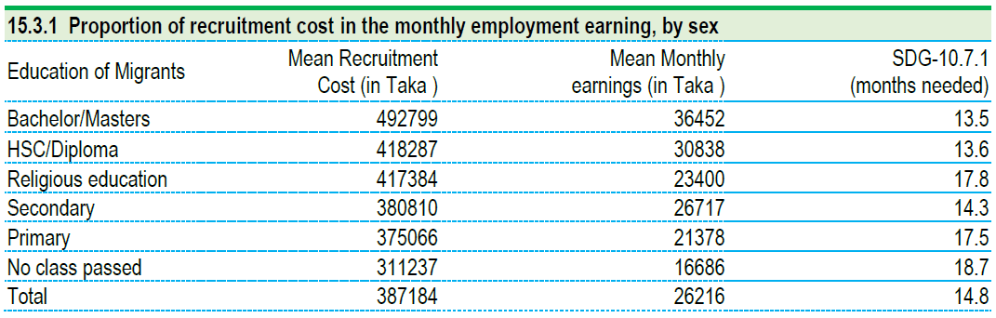
Recruitment cost indicator by sex
Recruitment cost indicator by education

Slide 45
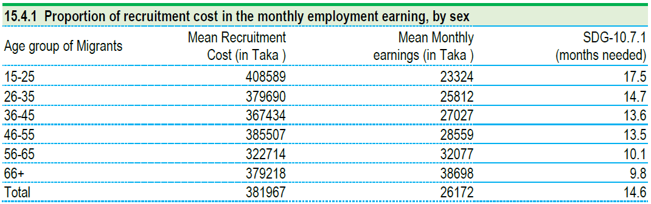
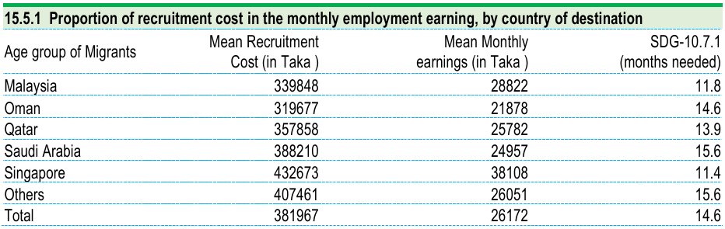
Recruitment cost indicator by age group
Recruitment cost indicator by Country of destination

Slide 46
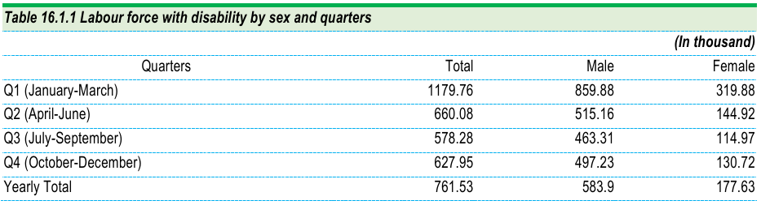
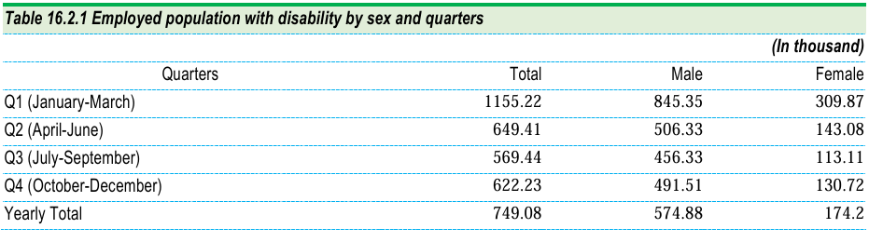
Chapter 16:Employment & Disability
Labour Force with Disability:
Participation rate
Employment rate

Slide 47


Social Protection for Disabled
Cash benefits
Official recognition

Slide 48


