Slide 1

Mepco Schlenk Engineering College (Autonomous)
Sense Understanding of Text Using CNN
Guided By:
Dr.T. Manonmani
Assistant Professor (Sr. Grade)
Presented By:
Mohamed Younush. N A (Reg. No. : 201904095)
Nabil Ahamed. H (Reg. No. : 201904097)
Department of Computer Science and Engineering
1

Slide 2
Mepco Schlenk Engineering College (Autonomous)
Contents:
Problem Statement
Objective
Outcomes
Literature Survey
Dataset Description
System Design
Modules
Implementation Results
Algorithm
Experimental Results
Modules yet to be done
Social Aspect
References
Department of Computer Science and Engineering
2

Slide 3
Mepco Schlenk Engineering College (Autonomous)
Problem Statement
Identifying and detecting fake reviews is a critical issue for both consumers and businesses. The growth of online reviews and their influence on consumer decision-making has led to the rise of fake reviews that mislead consumers and harm legitimate businesses. The problem is further compounded by the increasing use of automated tools to generate fake reviews, making it difficult to distinguish between genuine and fake ones. Therefore, the aim is to develop a machine learning-based approach to accurately identify and classify fake reviews, which can help consumers make informed decisions and businesses maintain their reputation and credibility.
Department of Computer Science and Engineering
3

Slide 4
Mepco Schlenk Engineering College (Autonomous)
Objectives
The objective was to develop and contrast several prediction models, using deep learning and machine learning methods to identify fake reviews.
To compare the accuracy scores of various machine learning and deep learning models and select the best performing model for the task of fake review detection.
To help customers to make informed purchase decisions by providing them with trustworthy and unbiased reviews.
Department of Computer Science and Engineering
4

Slide 5
Mepco Schlenk Engineering College (Autonomous)
Outcomes
Machine Learning Model and Deep Learning Model can be developed, and its accuracy score can be calculated.
The accuracy scores of the machine learning and deep learning models are compared and the best performing model can be selected.
The results can be used to provide customers with trustworthy and unbiased reviews, helping them make informed purchase decisions.
Department of Computer Science and Engineering
5

Slide 6
Mepco Schlenk Engineering College (Autonomous)
LITERATURE SURVEY
1)M. Abdulqader, A. Namoun, and Y. Alsaawy, "Fake online reviews: A unified detection model using deception theories," IEEE Access, vol. 7, pp. 68596-68608, 2019.
Description:
The paper proposes a unified framework for detecting fake online reviews using deception theories. The authors suggest that deception is a complex phenomenon that involves various cognitive, social, and linguistic aspects, and they use this insight to develop a multi-dimensional feature space for detecting deceptive reviews. The proposed framework combines linguistic analysis with sentiment analysis and network analysis to capture the various aspects of deception in online reviews.
Department of Computer Science and Engineering
6

Slide 7
Mepco Schlenk Engineering College (Autonomous)
Literature Survey
1)M. Abdulqader, A. Namoun, and Y. Alsaawy, "Fake online reviews: A unified detection model using deception theories," IEEE Access, vol. 7, pp. 68596-68608, 2019.
Advantage:
The paper provides a comprehensive approach to detecting fake online reviews by considering various dimensions of deception, including cognitive, social, and linguistic factors
The authors use deception theories to develop a multi-dimensional feature space that can capture different aspects of deception in online reviews
The proposed framework combines multiple techniques, including sentiment analysis and network analysis, to improve the accuracy of fake review detection
Disadvantage:
The proposed approach requires access to large amounts of review data, which may not be available in some cases
The paper does not provide a detailed evaluation of the proposed framework on a large-scale dataset, making it difficult to assess its effectiveness in practice
Department of Computer Science and Engineering
7

Slide 8
Mepco Schlenk Engineering College (Autonomous)
2) A. Singh, S. Singh, and D. Kumar, "Fake Profile Detection on Social Networking Websites: A Comprehensive Review," in Proceedings of the 2018 4th International Conference on Computing Sciences (ICCS), Mangalore, India, 2018, pp. 71-76. doi: 10.1109/ICCS.2018.00020.
Description:
The paper "Fake Profile Detection on Social Networking Websites: A Comprehensive Review" provides a comprehensive review of the state-of-the-art techniques for detecting fake profiles on social networking websites. The authors discuss the different types of fake profiles, including spam, fraud, and impersonation, and highlight the challenges and limitations of existing detection methods. They also provide a critical analysis of the different evaluation metrics used in this field and propose a framework for future research directions.
Department of Computer Science and Engineering
8

Slide 9
Mepco Schlenk Engineering College (Autonomous)
2) A. Singh, S. Singh, and D. Kumar, "Fake Profile Detection on Social Networking Websites: A Comprehensive Review," in Proceedings of the 2018 4th International Conference on Computing Sciences (ICCS), Mangalore, India, 2018, pp. 71-76. doi: 10.1109/ICCS.2018.00020.
Advantage:
The paper provides a detailed overview of the challenges associated with fake profiles, making it a useful resource for researchers and practitioners working in this field
The review covers a wide range of existing detection approaches, including their strengths and weaknesses, which can help in choosing appropriate methods for detecting fake profiles
The paper also provides insights into the limitations of current detection approaches and suggests potential areas for future research
Disadvantage:
The paper does not present any new methods or techniques for detecting fake profiles, but rather provides a comprehensive review of existing approaches
Some of the methods and techniques discussed in the paper may be outdated
Department of Computer Science and Engineering
9

Slide 10
Mepco Schlenk Engineering College (Autonomous)
3) L. Ma, Z. Sun, and X. Li, “Attention-based bidirectional LSTM for deceptive opinion spam classification,” in Proceedings of the 2017 Conference on Empirical Methods in Natural Language Processing, Copenhagen, Denmark, Sep. 2017, pp. 986–991.
Description:
The paper "Attention-based Bidirectional LSTM for Deceptive Opinion Spam Classification" proposes a new method for detecting deceptive opinion spam in online reviews. The method utilizes a bidirectional long short-term memory (LSTM) network with an attention mechanism to extract relevant features from the input data. The proposed model achieves state-of-the-art performance on several benchmark datasets, demonstrating its effectiveness in detecting deceptive reviews.
The key contribution of the paper lies in the application of attention mechanisms to the task of detecting deceptive opinion spam. The attention mechanism allows the model to focus on the most informative parts of the input data, thereby improving its ability to distinguish between genuine and deceptive reviews. The paper also presents a comprehensive evaluation of the proposed model on multiple datasets, demonstrating its robustness and effectiveness.
Department of Computer Science and Engineering
10

Slide 11
Mepco Schlenk Engineering College (Autonomous)
3) L. Ma, Z. Sun, and X. Li, “Attention-based bidirectional LSTM for deceptive opinion spam classification,” in Proceedings of the 2017 Conference on Empirical Methods in Natural Language Processing, Copenhagen, Denmark, Sep. 2017, pp. 986–991.
Advantage:
The proposed approach achieves high accuracy in detecting deceptive opinion spam
The attention mechanism used in the model helps to capture the most relevant information and improve the classification performance
The method is generalizable and can be applied to different domains and languages
Disadvantage:
The study is limited to only two datasets, which may not represent all types of deceptive opinion spam
The proposed approach is computationally expensive, which may limit its scalability to large datasets
The study lacks an analysis of the model's interpretability, which may limit its practical use in some applications
Department of Computer Science and Engineering
11

Slide 12
Mepco Schlenk Engineering College (Autonomous)
4)N. N. Ho-Dac, S. J. Carson, and W. L. Moore, “The effects of positive and negative online customer reviews: Do brand strength and category maturity matter?” J. Marketing, vol. 77, no. 6, pp. 37–53, Nov. 2013.
Description:
The paper discussed an experimental study in which participants were shown favourable and unfavourable evaluations of goods from an established category (digital cameras) and a developing category (tablet computers). The study discovered that, especially for products in mature categories, negative evaluations had a bigger influence on consumer attitudes and purchase intentions than favourable ratings.
Negative evaluations had a bigger impact on customer attitudes and purchase intentions for products from weaker brands than for products from stronger brands, the study also discovered, but brand strength tempered these impacts.
Department of Computer Science and Engineering
12

Slide 13
Mepco Schlenk Engineering College (Autonomous)
4)N. N. Ho-Dac, S. J. Carson, and W. L. Moore, “The effects of positive and negative online customer reviews: Do brand strength and category maturity matter?” J. Marketing, vol. 77, no. 6, pp. 37–53, Nov. 2013.
Advantage:
The ability to identify how positive and negative online customer reviews affect consumer attitudes and purchase intentions.
The use of an experimental design that allows for the manipulation of review valence and brand strength.
The examination of how these effects vary depending on category maturity.
Disadvantage:
The study is based on a specific context (digital cameras and tablet computers) which may not generalize to other products or industries.
The study is limited to a specific geographic region and demographic group.
The study is based on a self-report measures which may be biased.
Department of Computer Science and Engineering
13

Slide 14
Mepco Schlenk Engineering College (Autonomous)
5)F. Li, M. Huang, Y. Yang, and X. Zhu, “Learning to identify review spam,” in Proc. 22nd Int. Joint Conf. Artif. Intell., 2011, pp. 2488–2493.
Description:
The method is described in the paper, which combines machine learning and natural language processing to assess reviews and spot spam-related tendencies. A classifier is trained on labelled data using the method's supervised learning methodology to discriminate between spam and non-spam reviews. The authors demonstrate the efficacy of their strategy for detecting review spam by testing it on a dataset of product reviews.
The paper's key contribution is the creation of a system for spotting review spam using machine learning techniques. Review spam is a serious issue in online reviews as it may have a big impact on how popular a good or service is perceived to be.
Department of Computer Science and Engineering
14

Slide 15
Mepco Schlenk Engineering College (Autonomous)
5)F. Li, M. Huang, Y. Yang, and X. Zhu, “Learning to identify review spam,” in Proc. 22nd Int. Joint Conf. Artif. Intell., 2011, pp. 2488–2493.
Advantage:
The ability to accurately identify review spam using machine learning techniques.
The use of natural language processing and machine learning techniques to analyze reviews.
The ability to train the classifier on labeled data to distinguish between spam and non-spam reviews.
Disadvantages:
The method requires a large amount of labeled data for training, which can be difficult to obtain.
The method may not be able to identify all types of spam reviews.
The method may not be able to generalize to other domains or languages.
Department of Computer Science and Engineering
15

Slide 16
Mepco Schlenk Engineering College (Autonomous)
6)E.-P. Lim, V.-A. Nguyen, N. Jindal, B. Liu, and H. W. Lauw, “Detecting product review spammers using rating behaviors,” in Proc. 19th ACM Int. Conf. Inf. Knowl. Manage. (CIKM), 2010, pp. 939–948
Description:
The method described in the study analyses reviews and rating behaviors to find patterns that point to spam by combining natural language processing and machine learning techniques. A classifier is trained on labelled data using the method's supervised learning methodology to discriminate between spam and non-spam reviews. The authors demonstrate the efficacy of their strategy for identifying review spammers by testing it on a dataset of product reviews.
The key contribution is the creation of a technique for identifying review spammers using rating habits. Review spam is a serious issue in online reviews since it may significantly affect how popular a good or service is considered to be. The study also emphasizes the significance of taking into account the rating behaviors of reviewers, which can be an indicator of spam reviews.
Department of Computer Science and Engineering
16

Slide 17
Mepco Schlenk Engineering College (Autonomous)
6)E.-P. Lim, V.-A. Nguyen, N. Jindal, B. Liu, and H. W. Lauw, “Detecting product review spammers using rating behaviors,” in Proc. 19th ACM Int. Conf. Inf. Knowl. Manage. (CIKM), 2010, pp. 939–948
Advantage:
The ability to accurately identify review spammers using rating behaviors.
The use of natural language processing and machine learning techniques to analyze reviews and rating behaviors.
The ability to train the classifier on labeled data to distinguish between spam and non-spam reviews.
Disadvantage:
The method requires a large amount of labeled data for training, which can be difficult to obtain.
The method may not be able to identify all types of spam reviews.
The method may not be able to generalize to other domains or languages.
Department of Computer Science and Engineering
17

Slide 18
Mepco Schlenk Engineering College (Autonomous)
7)G. Wang, S. Xie, B. Liu, and P. S. Yu, “Review graph based online store review spammer detection,” in Proc. IEEE 11th Int. Data Mining, Dec. 2011, pp. 1242–1247
Description:
The method is described in the paper, which makes use of machine learning techniques to spot patterns that are suggestive of spam and a graph-based approach to represent the connections between reviews, reviewers, and products. By connecting reviews, reviewers, and items based on their interactions, the authors create a review graph. They then train a classifier to differentiate between spam and non-spam reviews using graph centrality measures and other graph-based attributes.
The primary contribution of the study is the creation of a graph-based method for locating review spammers in online stores. This is a crucial issue in online reviews as spam reviews can significantly affect the perception of a product's or service's popularity. The report also emphasises the significance of taking into account the connection between reviews, reviewers and products, which can be an indicator of spam reviews
Department of Computer Science and Engineering
18

Slide 19
Mepco Schlenk Engineering College (Autonomous)
7)G. Wang, S. Xie, B. Liu, and P. S. Yu, “Review graph based online store review spammer detection,” in Proc. IEEE 11th Int. Data Mining, Dec. 2011, pp. 1242–1247
Advantage:
The two-view co-training algorithms can achieve better results than the single-view algorithm
The ability to accurately identify review spammers in online stores using a graph-based approach.
The use of graph-based features and central
Disadvantages:
The method may require a large amount of data to build the review graph, which can be difficult to obtain.
The method may not be able to identify all types of spam reviews, particularly those that are not connected to other reviews or reviewers in the graph.
The method may not be able to generalize to other domains or languages.
Department of Computer Science and Engineering
19

Slide 20
Mepco Schlenk Engineering College (Autonomous)
8)A. Mukherjee, V. V. Venkataraman, B. Liu, and N. S. Glance, “What yelp fake review filter might be doing?” in Proc.Weblogs Social Media, 2013, pp. 409–418.
Description:
In order to comprehend the traits of fake reviews and how the Yelp fake review filter detects them, the paper outlines an examination of a dataset of reviews from Yelp, a well-known online review platform. The authors discovered that the Yelp filter employs a variety of characteristics, including the review's text, the reviewer's actions, and the metadata it contains, to recognise fraudulent reviews.
The understanding of the Yelp false review filter and the techniques it may employ to identify fraudulent reviews is the paper's key contribution. The study emphasises the value of combining various features rather than depending solely on one factor or technique to identify bogus reviews.
Department of Computer Science and Engineering
20

Slide 21
Mepco Schlenk Engineering College (Autonomous)
8)A. Mukherjee, V. V. Venkataraman, B. Liu, and N. S. Glance, “What yelp fake review filter might be doing?” in Proc.Weblogs Social Media, 2013, pp. 409–418.
Advantage:
The ability to understand the Yelp fake review filter and the methods it might be using to identify fake reviews.
The use of a dataset of reviews from Yelp, a popular online review platform, to understand the characteristics of fake reviews.
The identification of the importance of using a combination of different features to detect fake reviews.
Disadvantage:
The method is based on an analysis of a dataset of reviews from Yelp, which may not generalize to other review platforms or industries.
The method may not be able to identify all types of fake reviews.
The method is based on the assumption that Yelp's filter is effective, but it doesn't consider the possibility that the filter might not be as effective as it claims.
Department of Computer Science and Engineering
21

Slide 22
Mepco Schlenk Engineering College (Autonomous)
9)C. Xu and J. Zhang, “Towards collusive fraud detection in online reviews,” in Proc. IEEE Int. Conf. Data Mining, Nov. 2015, pp. 1051–1056.
Description:
The method described in the study employs network analysis tools to find reviewer relationship patterns suggestive of collusive fraud. The authors demonstrate the effectiveness of their strategy for identifying collusive fraud by evaluating it using a dataset of reviews from a well-known online review platform.
The primary contribution of the research is the creation of a system for identifying collusive fraud in online reviews using network analysis techniques, which can assist in minimising the effect of phoney reviews on the perceived popularity of a good or service.
Department of Computer Science and Engineering
22

Slide 23
Mepco Schlenk Engineering College (Autonomous)
9)C. Xu and J. Zhang, “Towards collusive fraud detection in online reviews,” in Proc. IEEE Int. Conf. Data Mining, Nov. 2015, pp. 1051–1056.
Advantage:
The ability to accurately detect collusive fraud in online reviews using network analysis techniques.
The use of a dataset of reviews from a popular online review platform to evaluate the method.
The ability to identify patterns of relationships between reviewers that are indicative of collusive fraud.
Disadvantage:
The method may not be able to detect all types of collusive fraud in online reviews.
The method is based on an analysis of a dataset of reviews from a specific online review platform, which may not generalize to other platforms or industries.
The method requires a large amount of data to identify patterns of relationships between reviewers, which can be difficult to obtain.
Department of Computer Science and Engineering
23

Slide 24
Mepco Schlenk Engineering College (Autonomous)
10) H. S. Dutta, V. R. Dutta, A. Adhikary, and T. Chakraborty, “HawkesEye: Detecting fake retweeters using Hawkes process and topic modeling,” IEEE Trans. Inf. Forensics Security, vol. 15, pp. 2667–2678, Jan. 2020. [Online].
Description:
The study describes a technique dubbed HawkesEye, which models user retweeting behaviour using a Hawkes process and examines tweet content using topic modelling. The authors demonstrate the effectiveness of their strategy for identifying bogus retweeters by training and analyzing a dataset of tweets. This paper's key contribution is the creation of a technique for identifying fraudulent retweeters using a mix of subject modelling and the Hawkes process, which can aid in minimizing the impact of bogus tweets on social media sites.
Department of Computer Science and Engineering
24

Slide 25
Mepco Schlenk Engineering College (Autonomous)
10) H. S. Dutta, V. R. Dutta, A. Adhikary, and T. Chakraborty, “HawkesEye: Detecting fake retweeters using Hawkes process and topic modeling,” IEEE Trans. Inf. Forensics Security, vol. 15, pp. 2667–2678, Jan. 2020. [Online].
Advantage:
The ability to accurately detect fake retweeters using a combination of Hawkes process and topic modeling.
The use of a dataset of tweets to train and evaluate the method.
The ability to model the retweeting behavior of users and analyze the content of tweets.
Disadvantage:
The method may not be able to detect all types of fake retweeters.
The method is based on an analysis of a dataset of tweets, which may not generalize to other social media platforms or types of content.
The method may require a large amount of data to train and evaluate, which can be difficult to obtain.
Department of Computer Science and Engineering
25

Slide 26
Mepco Schlenk Engineering College (Autonomous)
Dataset Description:
Amazon dataset from Kaggle. It contains 40400 rows X 4 columns,. The dataset contains Category, Rating, Label and Review Text of Products.
Category | Rating | Label | text
Home_and_Kitchen | 3 | OR | Great for weighing in lbs and oz not grams. Fast shipping.
Movies_and_TV | 3 | CG | I laughed a bit at some of the scenes, but I didn't feel like I was watching a major plot twist
Electronics | 5 | CG | It works great to keep my phone safe. I've also used this for a few hours.
Tools_and_Home_Improvement | 5 | CG | One of the best values that I have ever owned. I will be purchasing more in the future.
Department of Computer Science and Engineering
26

Slide 27
Mepco Schlenk Engineering College (Autonomous)
SYSTEM DESIGN
Dataset
Deep Learning
CNN
Accuracy of each classifier
Preprocessing
Stop Word Removal
Punctuation Removal
Stemming
LSTM
CNN+LSTM
Label Encoding
Machine Learning
Performance
Evaluation
TF-IDF
Logistic Regression
N-grams
Feature
Selection
Multinomial
Nave Bayes
CountVectorizer
Accuracy of each classifier
Linear SVC
XGBoost
SGD
Department of Computer Science and Engineering
27

Slide 28
Mepco Schlenk Engineering College (Autonomous)
Modules:
Data Preprocessing
Feature Selection
Model Training
Evaluation
Department of Computer Science and Engineering
28

Slide 29
Mepco Schlenk Engineering College (Autonomous)
Module Description:
Data Preprocessing:
1)Tokenization
The raw data is tokenization using natural language processing. The text are break down into a piece of text called Tokens.
Tokenization will separate the phrase "wearing helmets is a must for pedal cyclists" should be broken down into the words "wearing," "helmets," "is," "a," "must," "for," and "cyclists."
2)Stop Word Removal
The words that occur frequently in text was removed by Natural Language Processing (NLP) techniques, text such as "a", "an", "the", "and“ , "is", "of", etc. were removed.
Department of Computer Science and Engineering
29

Slide 30
Mepco Schlenk Engineering College (Autonomous)
Module Description:
Data Preprocessing:
3)Lemmatization
The Word is reduced to its base form, also know as lemma.
By identifying the part of speech of a word (e.g. noun, verb, adjective, etc.) and then applying rules to reduce the word to its base form.
Eg:-the lemma of the word "running" is "run", and the lemma of the word "ran" is also "run".
It improve the accuracy of these tasks by reducing the dimensionality of the text data and reducing the number of unique words that need to be processed.
Department of Computer Science and Engineering
30

Slide 31
Mepco Schlenk Engineering College (Autonomous)
Module Description:
Feature Extraction:
N-gram:
The tokenized text is broken down into chunks of words. Where N is the number of words.
If n=3,then the text “I love to eat ice cream” break into following trigrams as “I love to", "love to eat", "to eat ice "and “eat ice cream”.
The formula for the step is :
n-gram={(w1,w2,w3),(w2,w3,w4),..}
Department of Computer Science and Engineering
31

Slide 32
Mepco Schlenk Engineering College (Autonomous)
Module Description:
Feature Extraction:
N-gram:
Then the frequency of each n-gram is calculated using:
Frequency(n-gram) = Number of occurrences of n-gram in the text.
Then the probability of an n-gram is calculated by dividing the frequency of each n-gram by the total number of n-gram in the text.
Probability(n-gram) = frequency(n-gram) / (total number of n-grams in the text)occurrences of n-gram in the text)
Department of Computer Science and Engineering
32

Slide 33
Mepco Schlenk Engineering College (Autonomous)
Module Description:
Feature Extraction:
TF-IDF:
The Term Frequency(TF) is calculated for each word in the document by counting the number of occurrence of each word in the document by the formula:
TF(t)=(Number of occurrences of t in the document)/(Total number of words in the document)
Then the Inverse Document Frequency(IDF) is calculated for each word in the corpus by taking the logarithm of the total number of words documents in the corpus divided by the number of documents that contain the word.
IDF(t) = log((Total number of documents in the corpus) / (Number of documents that contain t))
Department of Computer Science and Engineering
33

Slide 34
Mepco Schlenk Engineering College (Autonomous)
Module Description:
Feature Extraction:
Then the TF-IDF score is calculated by multiplying its TF and IDF values. The formula for TF-IDF is:
TF-IDF(t) = TF(t) * IDF(t)
Then the computed values would normalize then the values are in similar range of values.
Department of Computer Science and Engineering
34

Slide 35
Mepco Schlenk Engineering College (Autonomous)
Reviewer Comments & Action Taken:
Reviewer Comment: Asked to add CNN and LSTM confusion matrix, add Label Encoding.
Action Taken : CNN and LSTM confusion matrix was added along with Label Encoding.
Department of Computer Science and Engineering
35

Slide 36
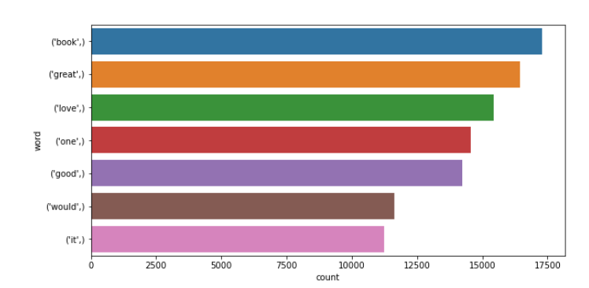
Mepco Schlenk Engineering College (Autonomous)
Implementation Results:
One Gram
z
Department of Computer Science and Engineering
36

Slide 37
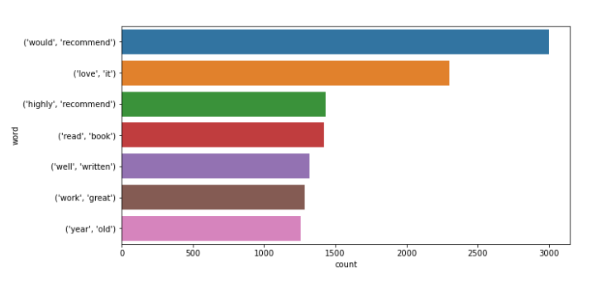
Mepco Schlenk Engineering College (Autonomous)
Implementation Results:
Bi Gram
z
Department of Computer Science and Engineering
37

Slide 38
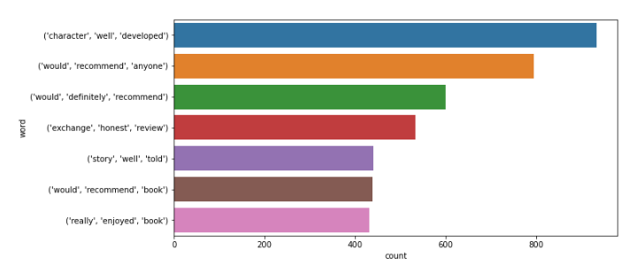
Mepco Schlenk Engineering College (Autonomous)
Implementation Results:
Tri Gram
z
Department of Computer Science and Engineering
38

Slide 39
Mepco Schlenk Engineering College (Autonomous)
Formula’s
Precision:
tp/(tp+fp)
tp = True Positive
fp = False Positive
Recall:
tp/(tp+fn)
fn= No of False Negative.
Accuracy:
(tp+tn)/(tp+tn+fp+fn)
Department of Computer Science and Engineering
39

Slide 40
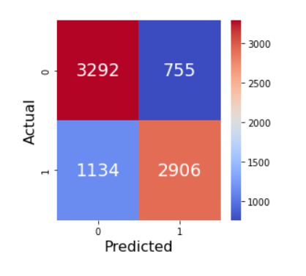
Mepco Schlenk Engineering College (Autonomous)
Model Trainings:
Logistic Regression
Accuracy: 0.77
F1 Score: 0.75
Report: precision recall f1-score support
0 0.74 0.81 0.78 4047
1 0.79 0.72 0.75 4040
accuracy 0.77 8087
macro avg 0.77 0.77 0.77 8087
weighted avg 0.77 0.77 0.77 8087
Department of Computer Science and Engineering
40

Slide 41
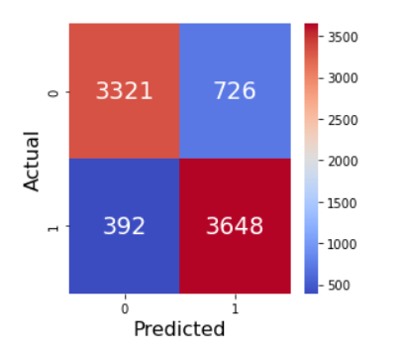
Mepco Schlenk Engineering College (Autonomous)
Implementation Results:
MultinomialNB
Accuracy: 0.86
F1 Score: 0.87
Report: precision recall f1-score support
0 0.89 0.82 0.86 4047
1 0.83 0.90 0.87 4040
accuracy 0.86 8087
macro avg 0.86 0.86 0.86 8087
weighted avg 0.86 0.86 0.86 8087
z
Department of Computer Science and Engineering
41

Slide 42
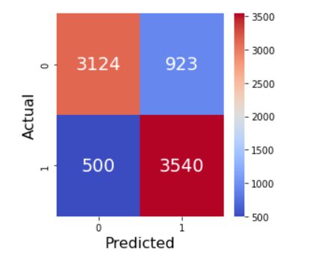
Mepco Schlenk Engineering College (Autonomous)
Implementation Results:
XGBClassifier
Accuracy: 0.82
F1 Score: 0.83
Report: precision recall f1-score support
0 0.86 0.77 0.81 4047
1 0.79 0.88 0.83 4040
accuracy 0.82 8087
macro avg 0.83 0.82 0.82 8087
weighted avg 0.83 0.82 0.82 8087
z
Department of Computer Science and Engineering
42

Slide 43
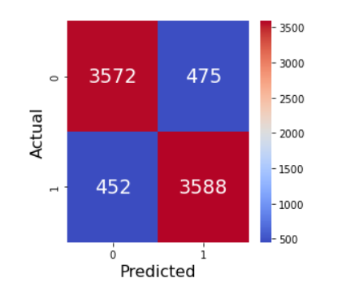
Mepco Schlenk Engineering College (Autonomous)
Implementation Results:
LinearSVC
Accuracy: 0.89
F1 Score: 0.89
Report: precision recall f1-score support
0 0.89 0.88 0.89 4047
1 0.88 0.89 0.89 4040
accuracy 0.89 8087
macro avg 0.89 0.89 0.89 8087
weighted avg 0.89 0.89 0.89 8087
z
Department of Computer Science and Engineering
43

Slide 44
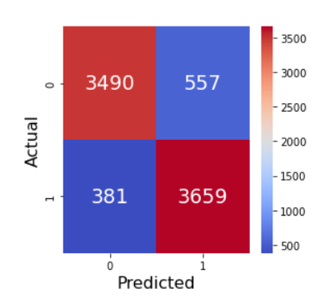
Mepco Schlenk Engineering College (Autonomous)
Implementation Results:
SGD
Accuracy: 0.88
F1 Score: 0.89
Report: precision recall f1-score support
0 0.90 0.86 0.88 4047
1 0.87 0.91 0.89 4040
accuracy 0.88 8087
macro avg 0.88 0.88 0.88 8087
weighted avg 0.88 0.88 0.88 8087
z
Department of Computer Science and Engineering
44

Slide 45
Mepco Schlenk Engineering College (Autonomous)
LABEL ENCODING:
Label Encoding is a technique used in machine learning and data science to convert categorical or textual data into numerical data, so that it can be used in machine learning models. In label encoding, each unique value in a categorical variable is assigned a numerical value.
Department of Computer Science and Engineering
45

Slide 46
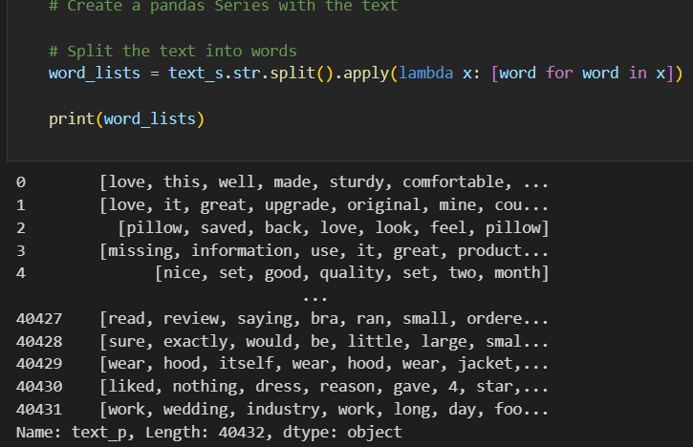
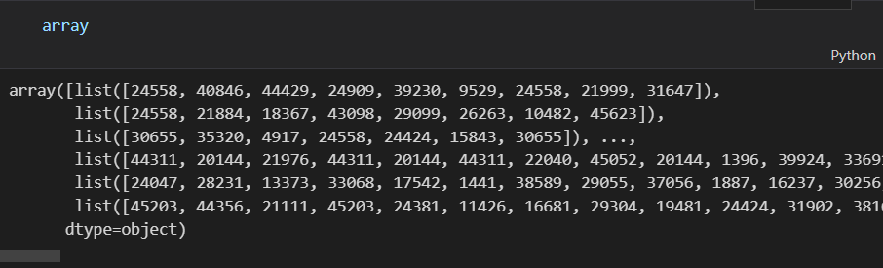
Mepco Schlenk Engineering College (Autonomous)
LABEL ENCODING
Input = Text
[love, this, well, made, sturdy, very, comfortable, very, pretty]
[love, it, great, upgrade, original, mine, couple, years]
[pillow, saved, back, love, look, feel, pillow]
………
Output :
array([list([24558, 40846, 44429, 24909, 39230, 9529, 24558, 21999, 31647]),
list([24558, 21884, 18367, 43098, 29099, 26263, 10482, 45623]),
list([30655, 35320, 4917, 24558, 24424, 15843, 30655]), .........,)
Department of Computer Science and Engineering
46

Slide 47
Mepco Schlenk Engineering College (Autonomous)
CNN Architecture
Embedding
(Input Layer)
GlobalMaxPooling1D
Conv1D
Activation=‘relu’
Dense
Activation=‘relu’
MaxPooling1D
Dense
Activation=‘sigmoid’
Department of Computer Science and Engineering
47

Slide 48
Mepco Schlenk Engineering College (Autonomous)
CNN
Layer (type) | Output Shape | Param #
embedding | (None, 240, 128) | 9600000
conv1d | (None, 238, 128) | 49280
max_pooling1d | (None, 34, 128) | 0
global_max_pooling1d | (None, 128) | 0
dense | (None, 32) | 4128
dense_1 | (None, 1) | 33
Department of Computer Science and Engineering
48

Slide 49
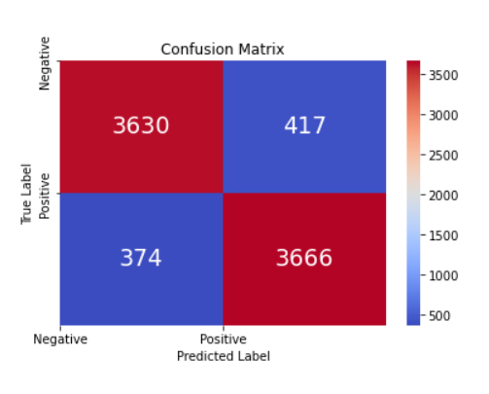
Mepco Schlenk Engineering College (Autonomous)
CNN Implementation Results:
Label | Precision | Recall | F1-Score | Accuracy
0 | 0.89 | 0.88 | 0.89 | 0.89
1 | 0.89 | 0.90 | 0.89
Department of Computer Science and Engineering
49

Slide 50
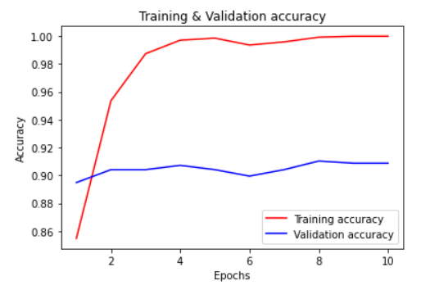
Mepco Schlenk Engineering College (Autonomous)
Implementation Results:
CNN
Best Validation Accuracy = 91.03555083274841
Best Training Accuracy = 99.99368786811829
Department of Computer Science and Engineering
50

Slide 51
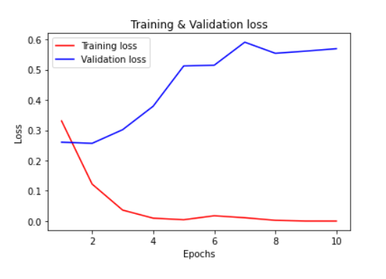
Mepco Schlenk Engineering College (Autonomous)
Implementation Results:
CNN
Training Loss = 0.0089
Validation Loss = 0.5702
Department of Computer Science and Engineering
51

Slide 52








Mepco Schlenk Engineering College (Autonomous)
LSTM CELL ARCHITECTURE
$$C_{t−1}$$
X
+
$$C_{t}$$
X
tanh
$$σ$$
$$σ$$
tanh
$$σ$$
X
$$h_{t−1}$$
$$h_{t}$$
$$X_{t}$$
Department of Computer Science and Engineering
52

Slide 53
Mepco Schlenk Engineering College (Autonomous)
LSTM Architecture:
Embedding Layer
(Input Layer)
Dropout Layer
0.3
LSTM Layer
Activation = ‘tanh’
Recurrent activation = ‘sigmoid’
Dense Layer
Activation = ‘relu’
Dense Layer
Activation = ‘relu’
Dense Layer
Activation = ‘sigmoid’
Department of Computer Science and Engineering
53

Slide 54
Mepco Schlenk Engineering College (Autonomous)
LSTM:
Layer (type) | Output Shape | Param #
embedding_1 | (None, 240, 32) | 1600000
lstm | (None, 128) | 82432
dense_2 | (None, 64) | 8256
dropout | (None, 64) | 0
dense_3 | (None, 32) | 2080
dense_4 | (None, 1) | 33
Department of Computer Science and Engineering
54

Slide 55
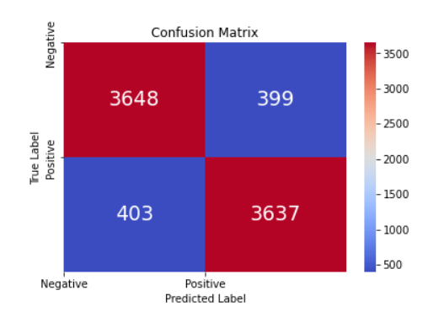
Mepco Schlenk Engineering College (Autonomous)
LSTM Implementation Results:
Label | Precision | Recall | F1-Score | Accuracy
0 | 0.91 | 0.90 | 0.91 | 0.90
1 | 0.90 | 0.92 | 0.91
Department of Computer Science and Engineering
55

Slide 56
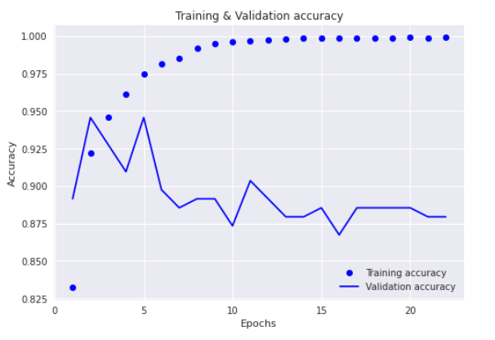
Mepco Schlenk Engineering College (Autonomous)
LSTM:
Best Validation Accuracy = 94.57831382751465
Best Training Accuracy = 99.91298913955688
Department of Computer Science and Engineering
56

Slide 57
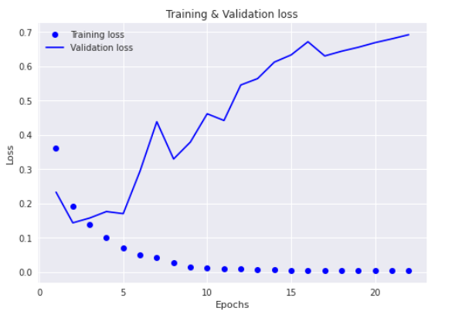
Mepco Schlenk Engineering College (Autonomous)
LSTM:
Training loss: 0.0041
Validation loss: 0.6917
Department of Computer Science and Engineering
57

Slide 58
Mepco Schlenk Engineering College (Autonomous)
CNN + LSTM Architecture
Embedding
(Input Layer)
LSTM Layer
Units=64
Activation = ‘tanh’,
Recurrent dropout = 0.2
Conv1D
Filters=64,
Filter Size=3
Activation=‘relu’
MaxPooling1D
(pool_size=2)
Dense
Activation=‘sigmoid’
Department of Computer Science and Engineering
58

Slide 59
Mepco Schlenk Engineering College (Autonomous)
CNN + LSTM:
Layer (type) | Output Shape | Param #
embedding | (None, 240, 32) | 1600000
conv1d | (None, 240, 64) | 6208
max_pooling1d | (None, 120, 64) | 0
lstm | (None, 64) | 33024
dense | (None, 1) | 65
Department of Computer Science and Engineering
59

Slide 60
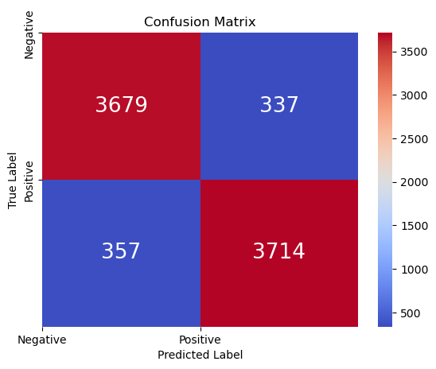
Mepco Schlenk Engineering College (Autonomous)
CNN + LSTM Implementation Results:
Label | Precision | Recall | F1-Score | Accuracy
0 | 0.91 | 0.92 | 0.91 | 0.91
1 | 0.92 | 0.91 | 0.91
Department of Computer Science and Engineering
60

Slide 61
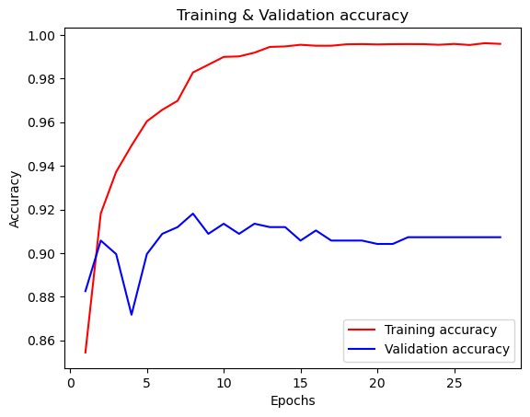
Mepco Schlenk Engineering College (Autonomous)
CNN + LSTM:
Best Validation Accuracy = 91.808
Best Training Accuracy = 99.621
Department of Computer Science and Engineering
61

Slide 62
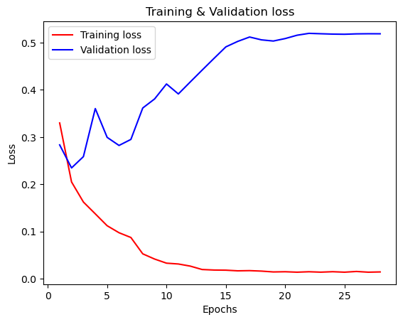
Mepco Schlenk Engineering College (Autonomous)
CNN + LSTM:
Training Loss = 0.0143
Validation Loss = 0.5189
Department of Computer Science and Engineering
62

Slide 63
Mepco Schlenk Engineering College (Autonomous)
Experimental Results:
Machine Learning Results:
Model | Label | Precision | Recall | F1-Score | Accuracy
Logistic Regression | 0 | 0.74 | 0.81 | 0.78 | 0.77
 | 1 | 0.79 | 0.72 | 0.75
MultinomialNB | 0 | 0.89 | 0.82 | 0.86 | 0.86
 | 1 | 0.83 | 0.90 | 0.87
XGBoost | 0 | 0.86 | 0.77 | 0.81 | 0.82
 | 1 | 0.79 | 0.88 | 0.83
LinearSVC | 0 | 0.89 | 0.88 | 0.89 | 0.89
 | 1 | 0.88 | 0.89 | 0.89
SGD | 0 | 0.90 | 0.86 | 0.88 | 0.88
 | 1 | 0.87 | 0.91 | 0.89
Department of Computer Science and Engineering
63

Slide 64
Mepco Schlenk Engineering College (Autonomous)
Experimental Results:
Deep Learning Models Validation Accuracy:
Model | Validation Accuracy
CNN (Adam) | 0.91
LSTM (Adam) | 0.94
CNN + LSTM (RMSProp) | 0.91
Department of Computer Science and Engineering
64

Slide 65
Mepco Schlenk Engineering College (Autonomous)
Experimental Results:
Precision, Recall and F1-Score for Deep Learning:
Model | Label | Precision | Recall | F1-Score | Accuracy
CNN (Adam) | 0 | 0.89 | 0.88 | 0.89 | 0.89
 | 1 | 0.89 | 0.90 | 0.89
LSTM (Adam) | 0 | 0.91 | 0.90 | 0.91 | 0.90
 | 1 | 0.90 | 0.92 | 0.91
CNN + LSTM (RMSProp) | 0 | 0.91 | 0.92 | 0.91 | 0.91
 | 1 | 0.92 | 0.91 | 0.91
Department of Computer Science and Engineering
65

Slide 66
Mepco Schlenk Engineering College (Autonomous)
Economic Aspect:
Improved Customer Experience: By detecting and filtering out fake reviews, it can help to ensure that the customers make informed decisions, leading to increased trust in the platform and potentially more revenue for businesses.
Cost Savings: For businesses, detecting fake reviews can be a time-consuming and resource-intensive task. By automating this process with machine learning, it can potentially save businesses significant costs associated with manual review monitoring.
Increased Platform Reliability : By detecting and removing fake reviews, it can help improve the trustability of the platform, leading to increased usage and potentially more revenue.
Department of Computer Science and Engineering
66

Slide 67
Mepco Schlenk Engineering College (Autonomous)
Social Impact:
Fake Review Detection might potentially enhance sales for firms with real favorable reviews by accurately identifying fake reviews, which would increase consumer confidence in the reviews and allow them to make more educated purchasing decisions.
It may also assist companies in developing more sincere and pleasant interactions with their clients by lowering the prevalence of fake reviews, which may result in greater customer loyalty and favorable word-of-mouth.
The idea might also contribute to a more wholesome and reliable online environment by promoting transparency and honesty in online evaluations as well as preventing the spread of incorrect information online.
Department of Computer Science and Engineering
67

Slide 68
Mepco Schlenk Engineering College (Autonomous)
References:
1)A. Mukherjee, B. Liu, and N. Glance, “Spotting fake reviewer groups in consumer reviews,” in Proc. 21st Int. Conf. World Wide Web (WWW), 2012, pp. 191–200.
2)S. Dhawan, S. C. R. Gangireddy, S. Kumar, and T. Chakraborty, “Spotting collective behaviour of online frauds in customer reviews,” 2019, arXiv:1905.13649. [Online]. Available: http://arxiv.org/abs/1905. 13649
3)B. Liu, M. Hu, and J. Cheng, “Opinion observer: Analyzing and comparing opinions on the Web,” in Proc. 14th Int. Conf. World Wide Web (WWW), 2005, pp. 342–351.
4)N. N. Ho-Dac, S. J. Carson, and W. L. Moore, “The effects of positive and negative online customer reviews: Do brand strength and category maturity matter?” J. Marketing, vol. 77, no. 6, pp. 37–53, Nov. 2013.
5)F. Li, M. Huang, Y. Yang, and X. Zhu, “Learning to identify review spam,” in Proc. 22nd Int. Joint Conf. Artif. Intell., 2011, pp. 2488–2493.
Department of Computer Science and Engineering
68

Slide 69
Mepco Schlenk Engineering College (Autonomous)
6)E.-P. Lim, V.-A. Nguyen, N. Jindal, B. Liu, and H. W. Lauw, “Detecting product review spammers using rating behaviors,” in Proc. 19th ACM Int. Conf. Inf. Knowl. Manage. (CIKM), 2010, pp. 939–948
7)G. Wang, S. Xie, B. Liu, and P. S. Yu, “Review graph based online store review spammer detection,” in Proc. IEEE 11th Int. Conf. Data Mining, Dec. 2011, pp. 1242–1247
8)A. Mukherjee, V. V. Venkataraman, B. Liu, and N. S. Glance, “What yelp fake review filter might be doing?” in Proc. 7th Int. Conf. Weblogs Social Media, 2013, pp. 409–418.
9)C. Xu and J. Zhang, “Towards collusive fraud detection in online reviews,” in Proc. IEEE Int. Conf. Data Mining, Nov. 2015, pp. 1051–1056.
10)H. S. Dutta, V. R. Dutta, A. Adhikary, and T. Chakraborty, “HawkesEye: Detecting fake retweeters using Hawkes process and topic modeling,” IEEE Trans. Inf. Forensics Security, vol. 15, pp. 2667–2678, Jan. 2020. [Online].
Department of Computer Science and Engineering
69

Slide 70
Mepco Schlenk Engineering College (Autonomous)
THANK YOU
Department of Computer Science and Engineering
70

