Slide 1

Mepco Schlenk Engineering College (Autonomous)
Identifying Mental Conditions Of Covid-19 Stressors By Using Topic Modelling
GUIDED BY:
Mrs.S.Santhi, M.E,Ph.d
Assistant Professor(Sr.Gr.)/CSE
Done By:
Manoj Kannan S (Reg. No. : 201904086)
Nabil Ahamed H (Reg. No. : 201904097)
Department of Computer Science and Engineering
1

Slide 2
Mepco Schlenk Engineering College (Autonomous)
PROBLEM STATEMENT
To apply the natural language processing on the social media to identify the psychological stressors during COVID-19 pandemic and to analyze the trend on prevalence of those stressors at different stages of the pandemic based on the post
Department of Computer Science and Engineering
2

Slide 3
Mepco Schlenk Engineering College (Autonomous)
OBJECTIVES
To know about Mental Health symptoms of the people
To predict the topics about the pandemic related stressors during different stages of Covid-19 using Latent Dirichlet Allocation technique and lexicon methods
Department of Computer Science and Engineering
3

Slide 4
OUTCOMES
Mepco Schlenk Engineering College (Autonomous)
Extracted features.
Topics identified by topic model
Word cloud for each of the topics identified
Classify the dominant topic among the documents
Department of Computer Science and Engineering
4

Slide 5
LITERATURE SURVEY
Mepco Schlenk Engineering College (Autonomous)
J. S. Yarrington et al., “Impact of the COVID-19 pandemic on mental health among 157,213 Americans,” J. Affect. Disord., vol. 286, pp. 64–70, 2021.
Paper Description:
This paper represents an unpredicted crisis with potential negative mental health impacts
It uses Latent growth curve model and linear regression model to predict changes
The outcome variable is psychological distress as measured by the Kessler psychological distress scale
It uses Longitudinal Survey methods are conducted
Department of Computer Science and Engineering
5

Slide 6
Mepco Schlenk Engineering College (Autonomous)
Merits:
Models that is used for predictions
Latent growth curve model
Latent growth linear model
Linear regression model
Other factors such as health related characteristics and personality traits, were associated with the level of distress before the pandemic
Limitations:
The system does nothing to guard against network spoofing.
It doesn’t to distinguish ‘live’ face & ‘not live’ fact.
Department of Computer Science and Engineering
6

Slide 7
Mepco Schlenk Engineering College (Autonomous)
2)S. Taylor, C. A. Landry, M. M. Paluszek, T. A. Fergus, D. McKay, and G. J. G. Asmundson, “Development and initial validation of the COVID Stress Scales,” J. Anxiety Disord., vol. 72, p. 102232, May 2020, doi: 10.1016/j.janxdis.2020.102232.
Paper Description:
Data were collected from Canda and the United states using an Internet-based self-report survey delivered in English
The self-report survey comprised measures demographics,currect and depression experiences with covid-19
To determine whether the covid stress syndrome is dimensional or multicategorical construct ,latent class analyses were conducted
It uses either Latent Semantic Analysis or the LDA method
Limitations:
There is a need to improve this accuracy by the use of other classifiers.
Department of Computer Science and Engineering
7

Slide 8
Mepco Schlenk Engineering College (Autonomous)
Merits:
The 5-factor model, obtained in the exploratory factor analysis from the Canadian sample, could be tested in RML confirmatory factor analysis in the United States sample
The scales were scored by adding the unit-weighted items together. Higher scores indicate greater levels of COVID-19-related distress
Due to the large sample sizes, the correlations between the five scales of the CSS and social desirability were statistically significant for each country
Limitations:
In terms of limitations, the present study did not include structured diagnostic assessments (i.e., DSM-5 or ICD-11 diagnoses), which would have been useful in evaluating criterion-related (known-groups) validity of the CSS.
Department of Computer Science and Engineering
8

Slide 9
Mepco Schlenk Engineering College (Autonomous)
3) H. Jelodar, Y. Wang, R. Orji, and S. Huang, “Deep Sentiment Classification and Topic Discovery on Novel Coronavirus or COVID-19 Online Discussions: NLP Using LSTM Recurrent Neural Network Approach,” IEEE J. Biomed. Health Inform., vol. 24, no. 10, pp. 2733–2742, Oct. 2020, doi:
Paper Description:
This paper proposes a system for convenient channels for users concerned about healthcare issues and share information with others
We investigate how to use LSTM recurrent neural network for sentiment classification of COVID-19 comments.
We used automated extraction of COVID-19-related discussions from social media and a natural language process (NLP) method based on topic modeling
Experiments demonstrated that the research model achieved an accuracy of 81.15% - a higher accuracy than that of several other well-known machine-learning algorithms for COVID-19-Sentiment Classification.
Department of Computer Science and Engineering
9

Slide 10
Mepco Schlenk Engineering College (Autonomous)
Merits
A higher accuracy than that of several other well-known machine-learning algorithms for COVID-19-Sentiment Classification.
Our findings shed light on the importance of using public opinions and suitable computational techniques to understand issues surrounding COVID-19 and to guide related decision-making.
Limitations:
This research was limited to English-language text, which was considered a selection criterion. Therefore, the results do not reﬂect comments made in other languages
Department of Computer Science and Engineering
9

Slide 11
Mepco Schlenk Engineering College (Autonomous)
4) S. Singh, D. Roy, K. Sinha, S. Parveen, G. Sharma, and G. Joshi, “Impact of COVID-19 and lockdown on mental health of children and adolescents: A narrative review with recommendations,” Psychiatry Res., vol. 293, p. 113429, Nov. 2020, doi: 10.1016/j.psychres.2020.113429.
Paper Description:
This paper is aimed at narratively reviewing various articles related to mental-health aspects of children and adolescents impacted by COVID-19 pandemic
We searched the electronic data bases of MEDLINE through PubMed, Cochrane Library, Science-direct and Google Scholar databases, from January,2020 till June,2020
It uses various topic modeling algorithms
Latent Semantic Allocation
Non matrix Factorization
Department of Computer Science and Engineering
11

Slide 12
Mepco Schlenk Engineering College (Autonomous)
Merits:
There is a need to ameliorate children and adolescents’ access to mental health support services geared towards providing measures for developing healthy coping mechanisms during the current crisis.
Identify the people with the bad mental conditions and give treatment with priority
Limitations:
The review articles for this review have been selected during the time of global lockdown, where the issues and challenges were new and the global crisis was at peak times.
Due to strict selection criteria and the short period of data collection and the only use of electronic databases for our research, there is a possibility of missing studies relevant to the care of children and adolescents.
Department of Computer Science and Engineering
12

Slide 13
Mepco Schlenk Engineering College (Autonomous)
5)M. D. Choudhury and S. De, “Mental Health Discourse on reddit: Self-disclosure, Social Support, and Anonymity,” p. 10.
Paper Description:
Social media is continually emerging as a platform of information exchange around health challenges. We study mental health discourse on the popular social media. Building on findings about health information seeking and sharing practices in online forums, and social media like Twitter, we address three research challenges
We use negative binomial regression as our prediction method because both our dependent variables, karma and comments are counts, and negative binomial regression is typically well-suited to handle over dispersed count outcome variables.
We use a measure called deviance to evaluate goodness of fit, since this model has no direct analog of the proportion of variance explained by the predictors (R 2 ) in linear regression.
Department of Computer Science and Engineering
13

Slide 14
Mepco Schlenk Engineering College (Autonomous)
Merits:
This research reveals how social media like reddit are fulfilling unique information and social needs of a cohort challenged with a stigmatic health concern looking through the lenses of disclosure, social support, and disinhibition.
Potentially, our work may provide a wealth of resources to clinicians, health practitioners, caregivers, and policy makers to identify communities at risk.
Limitations:
This work is a preliminary exploration, focusing on a set of high precision reddit communities, however expanding to other subreddits is a ripe area of future research.
understanding the extent to which the greater reddit population engaged in mental illness discourse embodies the observed behavior, is also valuable from a generalization perspective.
Department of Computer Science and Engineering
14

Slide 15
Mepco Schlenk Engineering College (Autonomous)
6)D. M. Low, L. Rumker, T. Talkar, J. Torous, G. Cecchi,
and S. S. Ghosh, “Natural Language Processing Reveals
Vulnerable Mental Health Support Groups and
Heightened Health Anxiety on Reddit During
COVID-19:
Paper Description:
The aim of this study is to leverage natural language processing (NLP) with the goal of characterizing changes in 15 of the world's largest mental health support groups (e.g., r/schizophrenia, r/SuicideWatch, r/Depression) found on the website Reddit
Using regression, we analyzed trends from 90 text-derived features such as sentiment analysis, personal pronouns, and semantic categories.
Using supervised machine learning, we classified posts into their respective support groups and interpreted important features to understand how different problems manifest in language.
Department of Computer Science and Engineering
15

Slide 16
Mepco Schlenk Engineering College (Autonomous)
In this, unsupervised methods are applied such as topic modeling and unsupervised clustering throughout the reddit before and during the pandemic.
Merits:
By using a broad set of NLP techniques and analyzing a baseline of prepandemic posts, we uncovered patterns of how specific mental health problems manifest in language
thus may have utility during the ongoing pandemic and other world-changing events such as elections and protests.
Limitations:
Support group reveals the mental health conditions of all the people in the pandemic. But fails to predict the exact number of people who are really in the height of anxiety
Department of Computer Science and Engineering
16

Slide 17
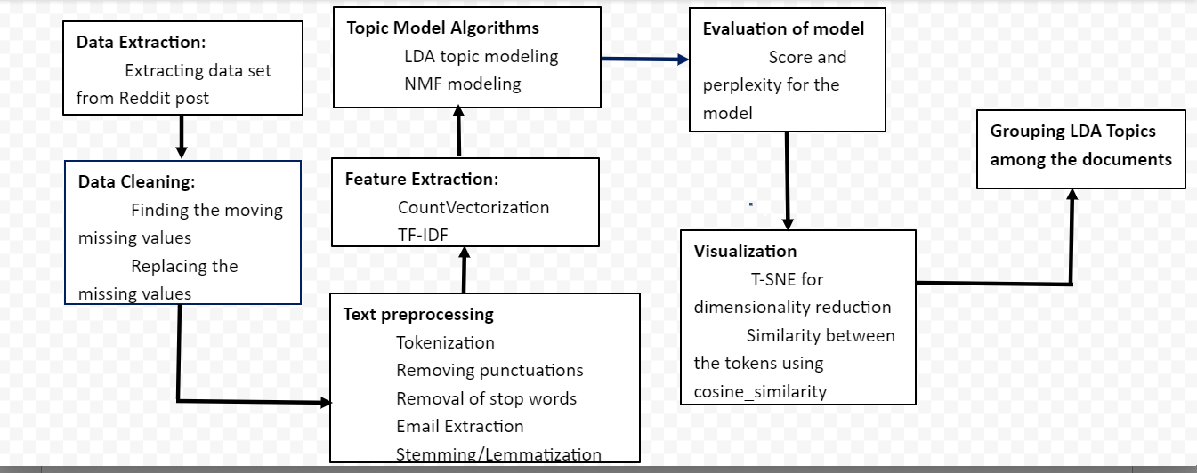
Mepco Schlenk Engineering College (Autonomous)​​
System Design
Department of Computer Science and Engineering
17

Slide 18
MODULES , DESCRIPTION AND DEFENITION
Mepco Schlenk Engineering College (Autonomous)
Modules
Data Preprocessing
Feature Extraction
LDA model, NMF model
Visualization
Grouping LDA topics
Data Preprocessing
In this module we had preprocessed the data . After preprocessing of this data the final data will be free of useless words, stop words and punctuations and lemmatization or stemming
Department of Computer Science and Engineering
18

Slide 19
MODULES , DESCRIPTION AND DEFENITION(Contd.)
Mepco Schlenk Engineering College (Autonomous)
Feature Extraction
There are various feature extraction techniques to find out the frequency of words in each of the documentation and to give less preference to more frequently occurred words and more preference to less frequently occurred words
These will be shown in the form of word-cloud
These techniques would be done by using vectorization (TF-IDF,Bag of words)
LDA Model
The latent Dirichlet allocation (LDA) is a generative statistical model that allows sets of observations to be explained by unobserved groups that explain why some parts of the data are similar.
Department of Computer Science and Engineering
19

Slide 20
MODULES , DESCRIPTION AND DEFENITION(Contd.)
Mepco Schlenk Engineering College (Autonomous)
NMF Model:
NMF can be used as a dimensionality reduction pre-processing step in classification, regression, clustering, and other mining tasks. Scoring an NMF model produces data projections in the new feature space. The magnitude of a projection indicates how strongly a record maps to a feature.
Visualization
Visualizing the topics and the respected tokens in the var chart based on the components and frequency of the words. pyLDAvis is the python library that is used to visualize the LDA tokens and frequency with respect to selected topics
Department of Computer Science and Engineering
20

Slide 21
Mepco Schlenk Engineering College (Autonomous)
Topics classification among the documents
Tokens are classified to the documents based on the identification of frequency of word in the document-term matrix
Department of Computer Science and Engineering
21

Slide 22
Dataset Description
Mepco Schlenk Engineering College (Autonomous)
We will use here reddit post text which is posted by the people during pandemic situation, consist of text posted by the individuals in the social media
Kaggle dataset : https://www.kaggle.com/datasets/pavellexyr/the-reddit-covid-dataset
Department of Computer Science and Engineering
22

Slide 23
Mepco Schlenk Engineering College (Autonomous)
S. No | Text
1) | I think Coronavirus is good. Don't need to develop the cure, Corona is good for population control if the cure comes out then we human will certainly way too much and cause major problem on earth like pollution. If many of you died and only the finest ones remain..
2) | When Trump almost started a World War a month ago, I couldn't help but feel excited. I know it's wrong, but I found myself anticipating, even hoping that a war would start, knowing there's a good chance I could die. I know it's horrible, and the number of people that would die alongside me would be staggering, but I feel so numb to the concept of mortality when my own life feels like a joke with me as the punchline....
ma
Department of Computer Science and Engineering
23

Slide 24
Mepco Schlenk Engineering College (Autonomous)
3) | A couple days ago I woke up with a sore throat, now it is full blown flu(although webmd also says coronavirus fits my symptoms). The guy who owns the house I live in chainsmokes and the smell of maverick menthols causes me to have a deep coughing fit that is so severe it makes me puke....
Department of Computer Science and Engineering
24

Slide 25
Mepco Schlenk Engineering College (Autonomous)
Alogorithm for LDA
Function: LDA(preprocessed_data)
INPUT://preprocessed_data
OUTPUT://lda_topics and tokens based on LDA model
BEGIN
LDA(preprocessed_data)
//LDA Model available in sklearn.decomposition package
lda = LatentDirichletAllocation(n_components=12, max_iter=5,
learning_method = 'online', learning_offset = 50., random_state = 0)
lda_model = lda.fit_transform(x)
END
Department of Computer Science and Engineering
25

Slide 26
Mepco Schlenk Engineering College (Autonomous)
Alogorithm for NMF(Non-matrix factorization)
Function: NMF(preprocessed_data)
INPUT://preprocessed_data
OUTPUT://nmf_topics and tokens based on NMF model
BEGIN
NMF(preprocessed_data)
//NMF Model available in sklearn.decomposition package
nmf= NMF(n_components=12, random_state=1, beta_loss="kullback-leibler", solver="mu",
max_iter=1000, alpha=0.1, l1_ratio=0.5)
nmf_model = nmf.fit_transform(x)
) END
Department of Computer Science and Engineering
26

Slide 27
Mepco Schlenk Engineering College (Autonomous)
Alogorithm for GridSearchCV
Function: GridSearchCV(preprocessed_data)
INPUT://preprocessed_data
OUTPUT:Best LDA model with high low perplexity and high log likelyhood
BEGIN
NMF(preprocessed_data)
search_params ={'n_components': [10, 15, 20, 25, 30], 'learning_decay': [.5, .7, .9]}
lda = LatentDirichletAllocation()
model = GridSearchCV(lda, param_grid=search_params)
model.fit(x)
) END
Department of Computer Science and Engineering
27

Slide 28
Mepco Schlenk Engineering College (Autonomous)
Implementation
Experiments and results:
https://colab.research.google.com/drive/1vYwJHuWWvBaheryyzgjYocaAtVIBnS2t#scrollTo=Z7XyW4KeprUU
Department of Computer Science and Engineering
28

Slide 29
Results and Discussion(contd.)
Mepco Schlenk Engineering College (Autonomous)
Count vectorizer(Bag of words)
WORDS | COUNT
Feel | 3
friend | 3
Parent | 3
much | 2
potentially | 2
Department of Computer Science and Engineering
29

Slide 30
Results and Discussion(contd.)
Mepco Schlenk Engineering College (Autonomous)
Tfidf vectorizer(Frequency of words)
Tf-idf(t,d)=
Tf(t,d) * idf(t)
WORDS | COUNT
Cure | 0.467929
goddent | 0.233964
develop | 0.233964
remain | 0.233964
population | 0.233964
Department of Computer Science and Engineering
30

Slide 31
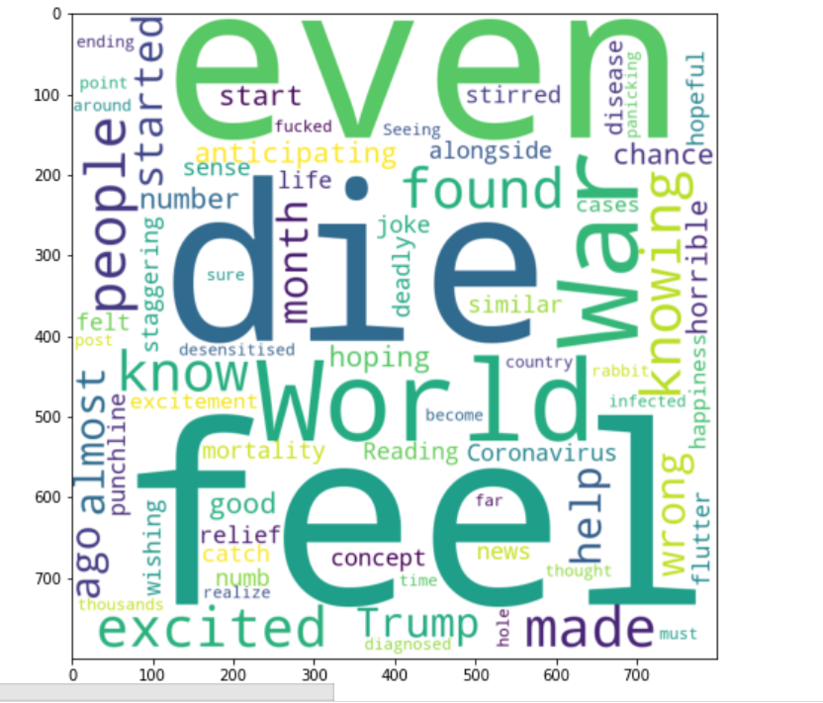
Results and Discussion(contd.)
Mepco Schlenk Engineering College (Autonomous)
Frequency of the words would look like this
Department of Computer Science and Engineering
31

Slide 32
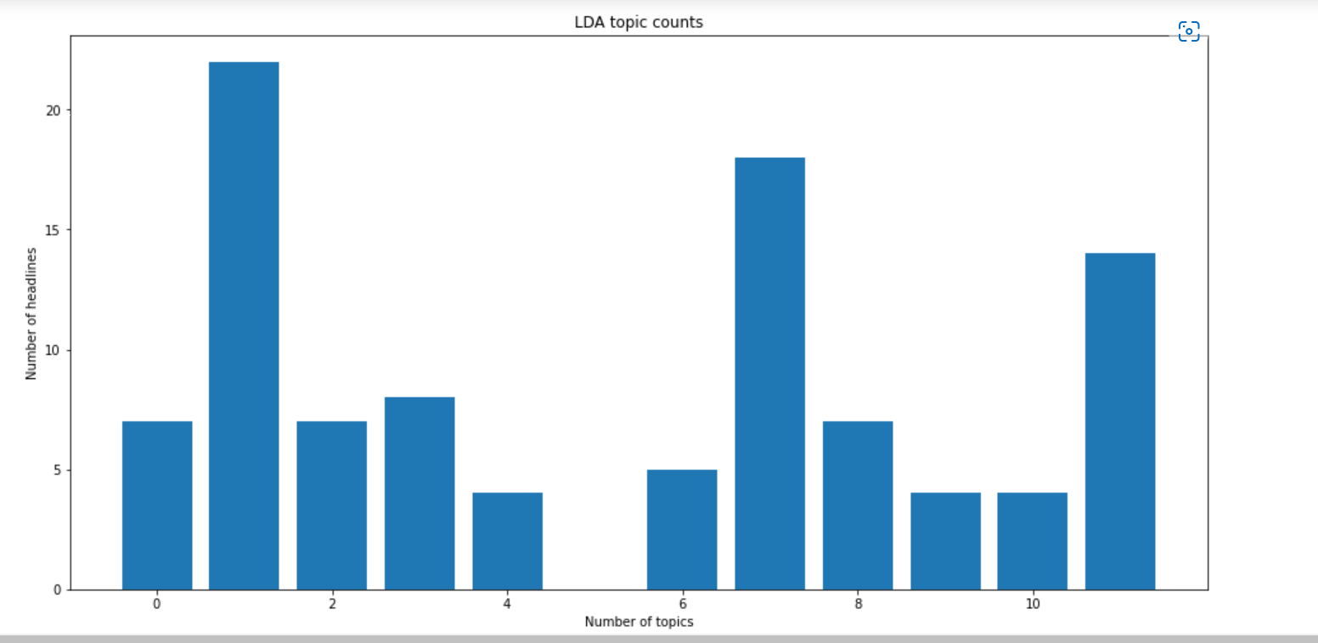
Results and Discussion(contd.)
Mepco Schlenk Engineering College (Autonomous)
LDA topics and number of headlines
Department of Computer Science and Engineering
32

Slide 33
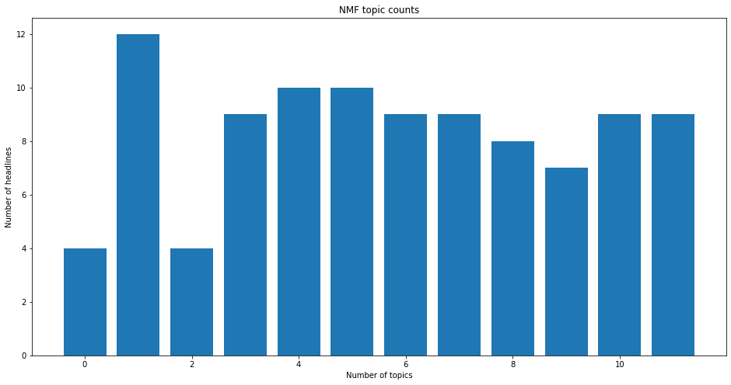
Mepco Schlenk Engineering College (Autonomous)​
Results and Discussion
NMF topics and headlines
7 May 2022
Department of Computer Science and Engineering
33

Slide 34
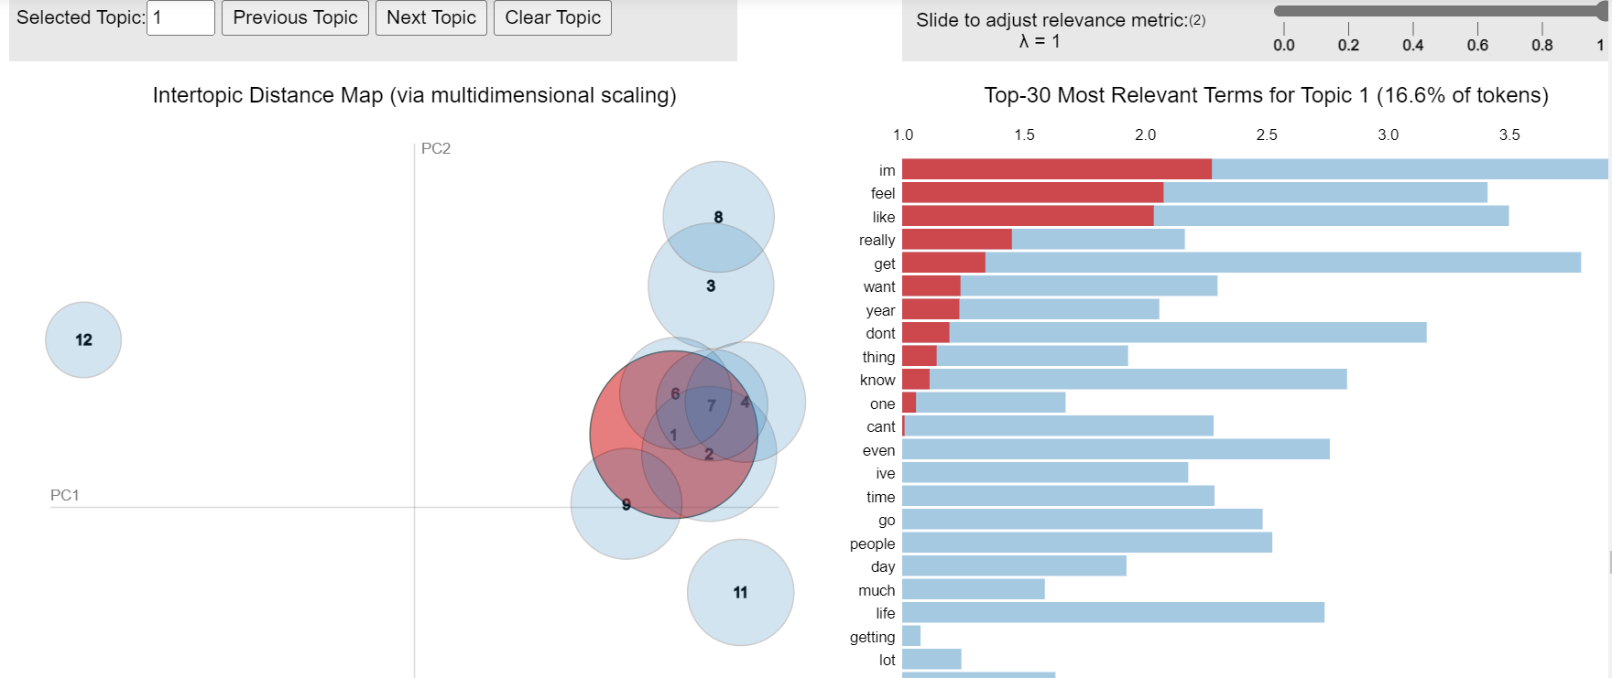
Mepco Schlenk Engineering College (Autonomous)​
Results and Discussion
Applying GridSearchCV to find out the best LDA model
Best Model's Params: {'learning_decay': 0.9, 'n_components': 10} Best Log Likelihood Score: -3039.071273694827 Model Perplexity: 118889.97607505125
7 May 2022
Department of Computer Science and Engineering
34

Slide 35
Mepco Schlenk Engineering College (Autonomous)​
Results and Discussion
Identifying the dominant topic across the documents
 | Topic0 | Topic1 | Topic2 | Topic3 | Topic4 | Topic5 | Topic6 | Topic7 | Topic8 | Topic9 | dominant_topic
Doc0 | 0.020000 | 0.440000 | 0.020000 | 0.020000 | 0.020000 | 0.430000 | 0.020000 | 0.020000 | 0.020000 | 0.020000 | 1
Doc1 | 0.010000 | 0.010000 | 0.430000 | 0.010000 | 0.010000 | 0.490000 | 0.010000 | 0.010000 | 0.010000 | 0.010000 | 5
Doc2 | 0.010000 | 0.390000 | 0.010000 | 0.010000 | 0.010000 | 0.520000 | 0.010000 | 0.010000 | 0.010000 | 0.010000 | 5
Doc3 | 0.010000 | 0.010000 | 0.010000 | 0.010000 | 0.010000 | 0.450000 | 0.470000 | 0.010000 | 0.010000 | 0.010000 | 6
Doc4 | 0.010000 | 0.580000 | 0.010000 | 0.010000 | 0.010000 | 0.350000 | 0.010000 | 0.010000 | 0.010000 | 0.010000 | 1
Department of Computer Science and Engineering
7 May 2022
35

Slide 36
PLATFORM, LANGUAGES/TOOLS USED
Mepco Schlenk Engineering College (Autonomous)
Operating System: Raspbian OS
Programming Language Used: Python 3.8
Components:
Numpy
pandas
NLTK
sklearn
Matplotlib
Wordcloud
seaborn
Department of Computer Science and Engineering
36

Slide 37
REFERENCES
Mepco Schlenk Engineering College (Autonomous)
J. S. Yarrington et al., “Impact of the COVID-19 pandemic on mental health among 157,213 Americans,” J. Affect. Disord., vol. 286, pp. 64–70, 2021.
S. Taylor, C. A. Landry, M. M. Paluszek, T. A. Fergus, D. McKay, and G. J. G. Asmundson, “Development and initial validation of the COVID Stress Scales,” J. Anxiety Disord., vol. 72, p. 102232, May 2020, doi: 10.1016/j.janxdis.2020.102232.
H. Jelodar, Y. Wang, R. Orji, and S. Huang, “Deep Sentiment Classification and Topic Discovery on Novel Coronavirus or COVID-19 Online Discussions: NLP Using LSTM Recurrent Neural Network Approach,” IEEE J. Biomed. Health Inform., vol. 24, no. 10, pp. 2733–2742, Oct. 2020
Department of Computer Science and Engineering
37

Slide 38
REFERENCES
Mepco Schlenk Engineering College (Autonomous)
S. Singh, D. Roy, K. Sinha, S. Parveen, G. Sharma, and G. Joshi, “Impact of COVID-19 and lockdown on mental health of children and adolescents: A narrative review with recommendations,” Psychiatry Res., vol. 293, p. 113429, Nov. 2020, doi: 10.1016/j.psychres.2020.113429.
M. D. Choudhury and S. De, “Mental Health Discourse on reddit: Self-disclosure, Social Support, and Anonymity,” p. 10.
D. M. Low, L. Rumker, T. Talkar, J. Torous, G. Cecchi, and S. S. Ghosh, “Natural Language Processing Reveals Vulnerable Mental Health Support Groups and
Heightened Health Anxiety on Reddit During COVID-19:
Department of Computer Science and Engineering
38

Slide 39
Mepco Schlenk Engineering College (Autonomous)
THANK YOU
Department of Computer Science and Engineering
39

