Slide 1

Project Specification Communicate Data Findings

Slide 2
Outline
1- An introduction of the project 2- An introduction of the dataset 3- The key insights 4- A conclusion

Slide 3
An introduction of the project
In this project, I will analyze a dataset and share my findings.
To make my findings easy to understand, I will use a different types of charts to visual my finding
So, let’s go

Slide 4
2- An introduction of the dataset
I used “the ford go bike trip” dataset that contains information about individual rides made in a bike-sharing system covering the greater San Francisco Bay area.
I will try to answer the following three questions:
1. When are most trips taken in terms of time of day, or day of the week?
2. How long does the average trip take? and what are the factors that affect it?
3. Does the above depend on if a user is a subscriber or customer?

Slide 5
2- An introduction of the dataset
The data wrangle part ( what I did):
There are some NaN values in some columns, so I removed these values
The format of the end time and start time columns is not good, so I will change it
I droped the useless columns
member_birth_year column is not useful, but I will get the client age for each client from it

Slide 6
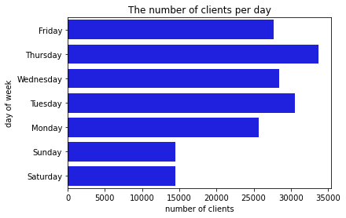
3- The key insights
I found that:
The days of the holiday are less in the number of clients and don't reach to 15000 clients per day
Thursday, Tuesday, and Wednesday in order are more in the number of clients and reach to more than 30000 clients per day
We should increase the number of our bikes in the busy days such as Tuesday, and Wednesday
If we should fix any bike we can do this in the holidays

Slide 7
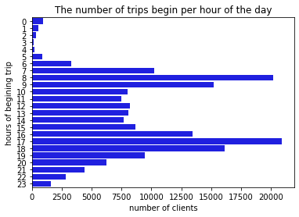
The key insights
the first hours of the morning are less in the number of trips that begin and don't reach 1000 trips per hour
17, 8, and 18 o'clock in order are more in the number of trips that begin and reach to more than 15000 trips per hour
So, if we want to choose time to fix our bikes the first hour of the day will be good
Knowing Peak traffic periods will improve our marketing plan

Slide 8
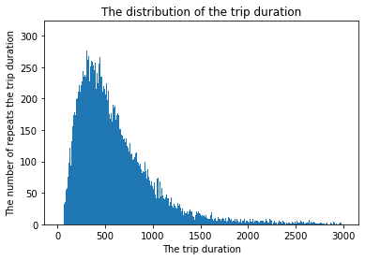
The key insights
The mean duration of the trips is about 12 minutes which is so low and most of the clients don't use the bike for all the trip
The trip duration are too short and right skewed

Slide 9
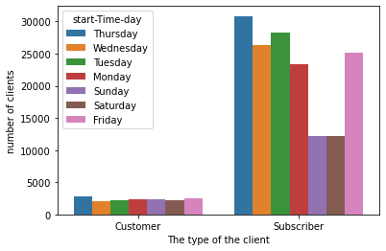
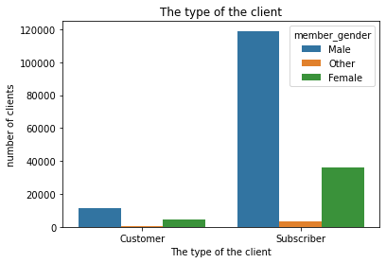
The key insights
The gap between the number of males and females is so high which lead us to say that the company failed to market its services to the female
The busy day is the same for the customers and subscribers
This leads us to conculcated that the company focus more on the males

Slide 10
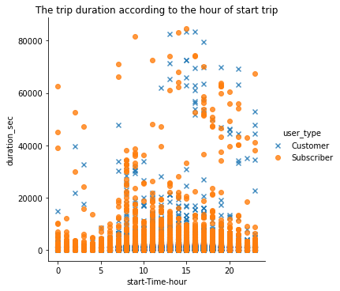
The key insights
the trip duration of the customers is more than the trip duration of the subscribers
from 15 o'clock to 20 is a busy time in the day

Slide 11
A conclusion
The data is 183412 row over one month, So the data is so limited, but it gives us a general look at the characterics of the clients and the busy days and hours
So, most of findings are for reference only

