Slide 1
MongoDB
Slides extracted from www.cse.psu.edu/~yul189/cmpsc431w and https://www.openmymind.net/mongodb.pdf

Slide 2
MongoDB Basics
A MongoDB instance has databases
high-­‐level containers
A database have collections
Collections are made up of documents
Documents have fields
When asking data from MongoDB, the result set is returned as a cursor
Can count, skip ahead, before actually pulling down data

Slide 3
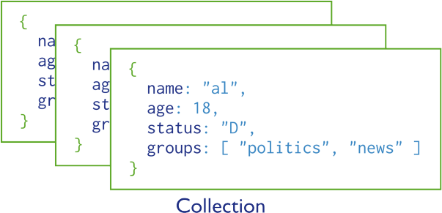
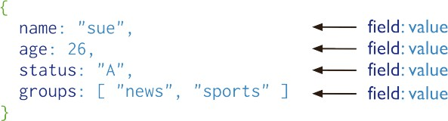
MongoDB Basics (cont.)
Each document within a collection can have its own unique set of fields

Slide 4
MongoDB CRUD
MongoDB provides rich semantics for reading and manipulating data
CRUD = Create, Read, Update, and Delete

Slide 5
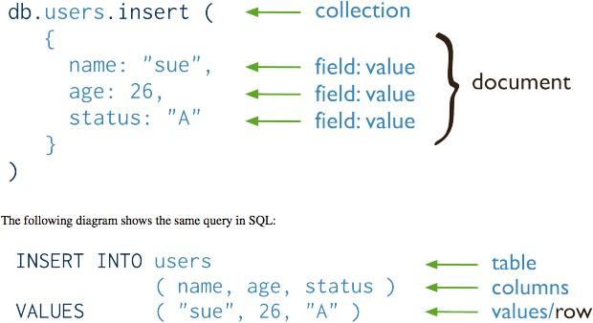
CRUD: Create
In MongoDB
In SQL

Slide 6
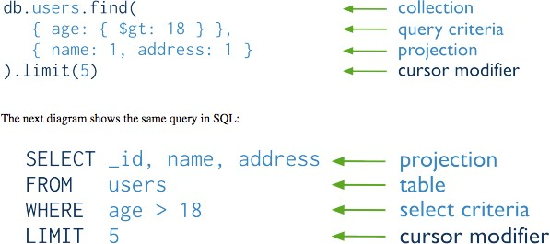
CRUD: Read
In MongoDB
In SQL

Slide 7
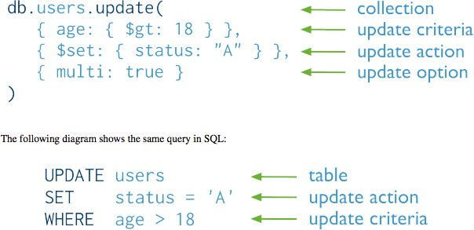
CRUD: Update
In MongoDB
In SQL

Slide 8
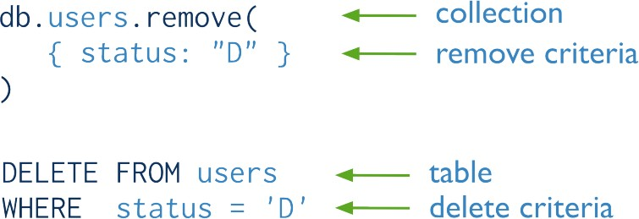
CRUD: Delete
In MongoDB
In SQL

Slide 9
Using MongoDB
You can either install MongoDB on your machine, or visit: https://www.mongodb.com/products/shell

Slide 10
To Get Started…
Global commands: help, exit, etc.
Commands execute against the current database are executed against the db object, for example:
db.help(): returns a list of commands that you can use against db object
Note: db.help without () gives you the method body

Slide 11
Create Database
To create a wonderland database:
use wonderland
* creates the database and switches to it
To get the collections in the current database:
db.getCollectionNames()

Slide 12
Insert Data
To insert a document into the collection:
db.unicorns.insert(
{name: ‘Aurora’,
gender: ‘f’, weight: 450}
)
* Try out db.getCollectionNames() now, you’ll see:

Slide 13
List Documents in a Collection
Try out:
db.unicorns.find()
One more field is added: _id
Every document must have a unique _id field
Can generate your own or have MongoDB generate automatically for you

Slide 14
Query Selector
First use
db.unicorns.remove({}) to delete documents in the unicorns collection

Slide 15
Query Selector (cont.)
Use
{field: value}
to select documents that match the condition.
If matching multiple conditions is desired:
{field1: value1, field2: value2…}
* This implies the AND statement

Slide 16
Comparison Operators in MongoDB
$lt
$lte
$gt
$gte
$ne
less than
less than or equal to greater than
greater than or equal to not equal to

Slide 17
(Q1) Find the male unicorns weigh more than 700 pounds

Slide 18
(Q2) Find the unicorns that have no vampire field

Slide 19
(Q3) Find the unicorns that like apples or oranges

Slide 20
(Q4) Find the female unicorns that either love apples or weigh less than 500 pounds

Slide 21
CRUD: Update
Intuitively, updating unicorn Roooooodles’ weight to 590 can be:
db.unicorns.update(
{name: “Roooooodles”},
{weight: 590})
But if you try:
db.unicorns.find({name: “Roooooodles”})
the result will be: the same

Slide 22
CRUD: Update (cont.)
The reason that no document was found was because the second parameter we supplied didn’t have any update operators
Therefore, the original document was replaced
Try the following command to see:
db.unicorns.find({weight: 590})

Slide 23
CRUD: Update (cont.)
To fix the problem, we should do:
db.unicorns.update({weight: 590},
{$set: { name: “Roooooodles”,
dob: new Date(1979, 7, 18, 18, 44), loves: [“apple”],
gender: “m”, vampires: 99}})

Slide 24
CRUD: Update (cont.)
The correct way to update at the beginning should therefore be:
db.unicorns.update({name: “Roooooodles”},
{$set: {weight: 590}})

Slide 25
More Update Operators
$inc: increment a field by a certain positive or negative amount
$push: add a value to the existing field

Slide 26
(Q5) Decrease unicorn Pilot’s number of vampires by 2

Slide 27
(Q6) Add “sugar” to the list of food unicorn Aurora loves to eat

Slide 28
Projection
find() can take a second argument, which is the project list
Example:
db.unicorns.find({}, {name:1, _id:0})
The values following field names are boolean:
1 means including the field
0 means excluding the field
Note that except excluding _id, the list cannot have a mixture of exclusion and inclusion

Slide 29
Upserts
An upsert updates the document if found or inserts it if not
To enable upserting we pass a third parameter to update {upsert: true}

Slide 30
Upserts (cont.)
This will not do anything:
db.unicorns.update({name: "Walala"},
{$inc: {vampires: 1}})
Instead, do this:
db.unicorns.update({name: "Walala"},
{$inc: {vampires: 1}},
{upsert: true})

Slide 31
Multiple Updates
By default, update will only update a single document. Passing the third parameter
{multi: true} will enable the multiple
update

Slide 32
(Q7) Give all of the unicorns vaccine (set vaccinated to be true)

Slide 33
(Q8) Sort the unicorns based on weights decreasingly

Slide 34
(Q9) Sort the unicorns based on the names increasingly, then the number of vampires decreasingly

Slide 35
(Q10) Get the second and third heaviest unicorns

Slide 36
(Q11) Count the number of unicorns who have more than 50 vampires

Slide 37
References
Karl Seguin, The Little MongoDB Book, http://openmymind.net/mongodb.pdf
Kristina Chodorow, MongoDB: The Deﬁnite Guide, O’Reilly
MongoDB CRUD Operations, https://docs.mongodb.org/master/MongoDB-­‐ crud-­‐guide-­‐master.pdf

