Slide 1





AHSANULLAH UNIVERSITY OF SCIENCE AND TECHNOLOGY
Unveiling the Genetic Mosaic: A CNN-Driven
Exploration of Rice Varietal Diversity Through
Advanced Image Classification

Slide 2
GROUP INTRODUCTION
Shuvashis Sarker
ID : 20200104116
Ahanaf Tajwar Basunia
ID : 20200104104
Shamim Rahim Refat
ID : 20200104125
Nafis Shahriar
ID : 20200104126

Slide 3
PROJECT INTRODUCTION
Literature Review
CONTENTS
DATASET
METHODOLOGY
RESULTS AND COMPARISON
LIMITATIONS AND FUTURE WORKS
CONCLUSION

Slide 4
PROJECT
INTRODUCTION
This research classifies five rice varieties in Turkey: Arborio, Basmati, Ipsala, Jasmine, and Karacadag. These varieties differ in texture, shape, and color, which show their genetic diversity and affect their quality, adaptability, nutrition, and resilience. The research uses image analysis to compare these features using 5,000 grain images for machine learning and 75,000 gain images for deep learning. The research aims to classify the rice varieties by their genetic characteristics and to improve agricultural research and practice.

Slide 5
Literature Review

Slide 6
Literature Review
PAPER NAME | MODEL | DATASET | RESULT
Comparing Inception V3, VGG 16, VGG 19, CNN, and ResNet 50: A Case Study on Early Detection of a Rice Disease | ResNet Inception V3 VGG 16 The VGG 19 CNN KNN | Kaggle | ResNet Accuracy : 99.75% InceptionV3 Accuracy : 97% VGG19 : 81% CNN : 90.1% KNN : 98.91%
Investigating YOLO models for Rice Seed Classification | YOLOv5 YOLOv6 YOLOv7 | Image dataset of rice seed varieties | YOLOV5 Accuracy : 99..2% YOLOv6 Accuracy : 99% YOLOv7 Accuracy : 97.2%
Classification of Rice Varieties using Convolution Neural Networks | AWD CNN | Local Dataset | Accuracy : 91.34%
Rice Transformer: A Novel Integrated Management System for Controlling Rice Diseases | VGG Rice Fusion model | Collected using CCD Camera | VGG Accuracy : 92% Rice Fusion model Accuracy : 93.51%.
Effects of Image Dataset Configuration on the Accuracy of Rice Disease Recognition Based on Convolution Neural Network | CNN VGG16 Inception v3 ResNet50 | Three independent datasets | Overall Accuracy :99 %

Slide 7
DATASET

Slide 8
CREATION
CLASSES
ELEMENTS
Rice Image Dataset
Arborio
Basmati
Ipsala
Jasmine
Karacadag
In Machine Learning Model, 1,000 images were meticulously selected for each of the five classes
In Deep Learning Model, 15,000 images were meticulously selected for each of the five classes
DATASET

Slide 9
METHODOLOGY

Slide 10
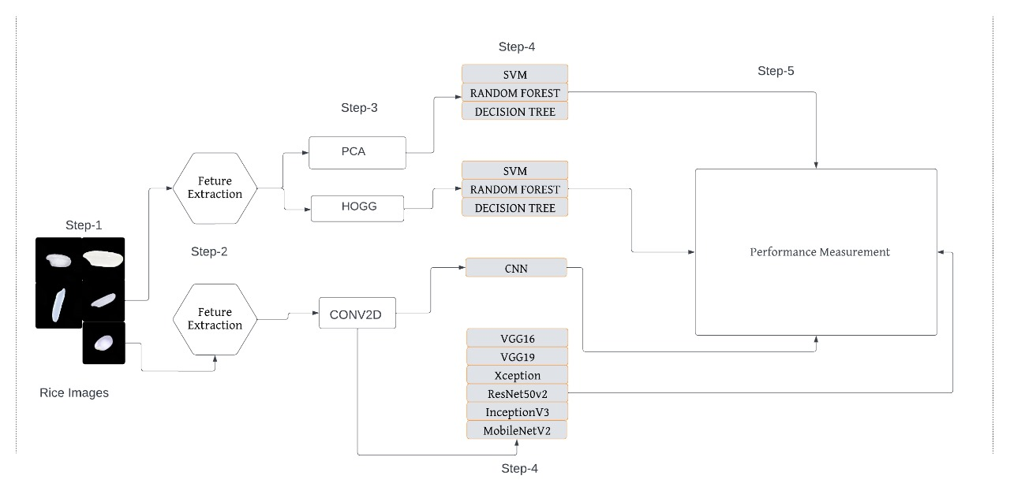
METHODOLOGY
STEPS
RICE IMAGES
FEATURE EXTRACTION
FEATURE EXTRACTOR
MODEL
PERFORMANCE ANALYSIS

Slide 11
RESULTS AND COMPARISON

Slide 12
RESULTS AND COMPARISON
Model | Accuracy
CNN | 0.9978
VGG16 | 0.9994
VGG19 | 0.9976
InceptionV3 | 0.9991
MobileNetV2 | 0.9986
ResNet50V2 | 0.9969
Xception | 0.9989
DEEP LEARNING

Slide 13
RESULTS AND COMPARISON
FOR PCA :
Model | Accuracy
Random Forest Classifier | 0.964
SVM | 0.982
DicisionTree | 0.927
MACHINE LEARNING
FOR HOG :
Model | Accuracy
Random Forest Classifier | 0.969
SVM | 0.93
DicisionTree | 0.93

Slide 14
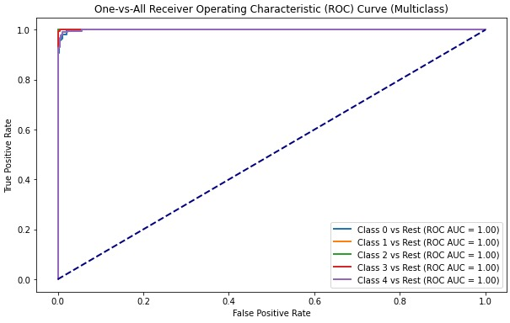
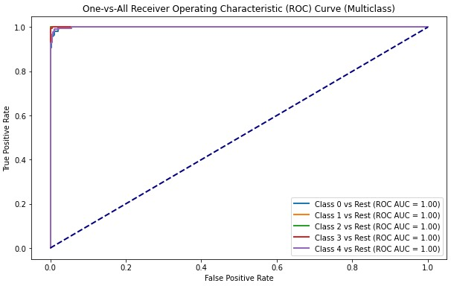
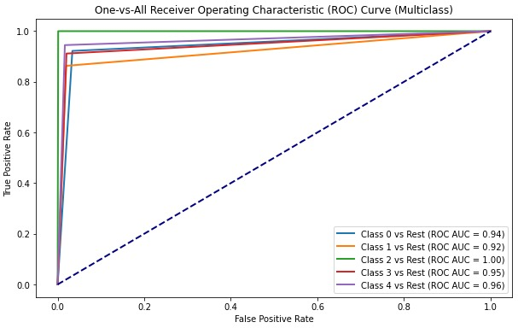
RESULTS AND COMPARISON
MACHINE LEARNING (PCA)
SVM
RANDOM FOREST
DECISION TREE

Slide 15
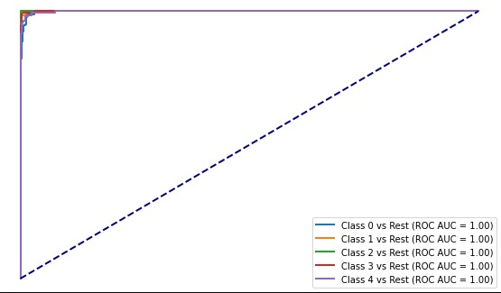
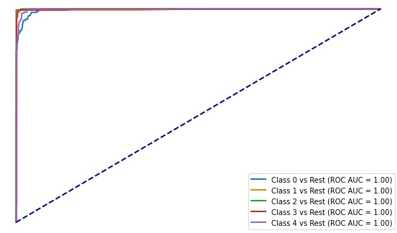
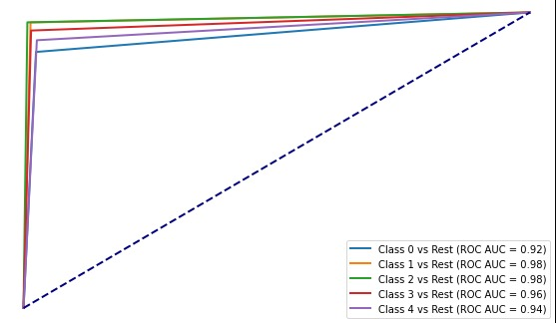
RESULTS AND COMPARISON
MACHINE LEARNING (HOG)
SVM
RANDOM FOREST
DECISION TREE

Slide 16
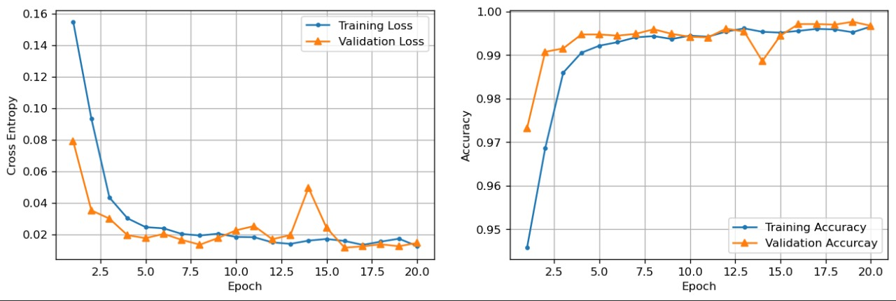
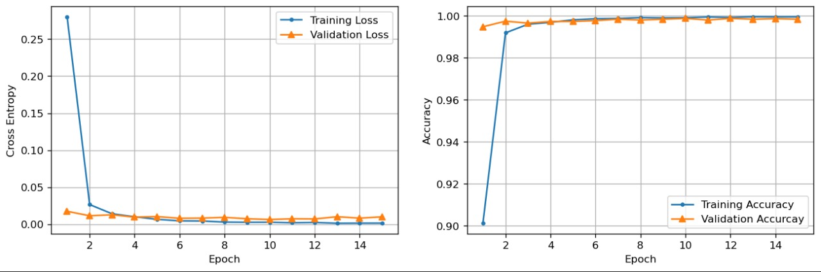
RESULTS AND COMPARISON
(DEEP LEARNING)
CNN
InceptionV3

Slide 17
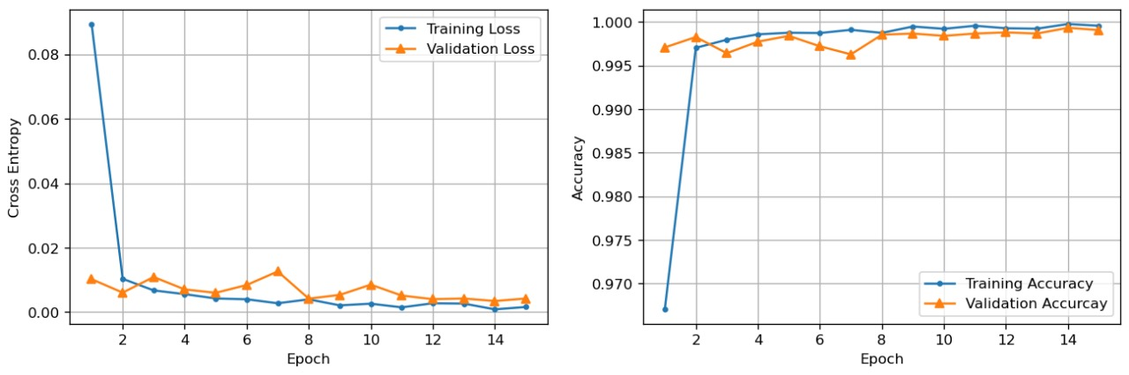
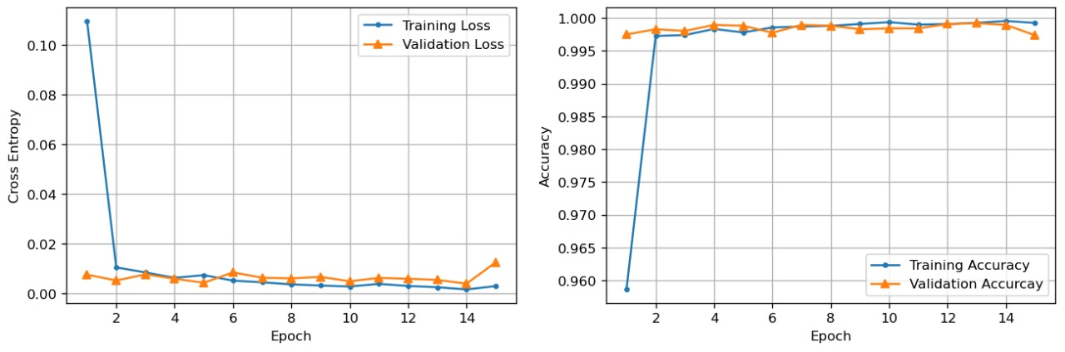
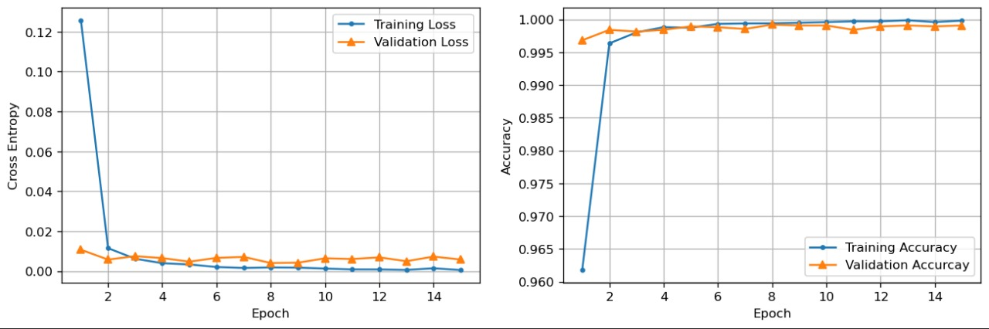
RESULTS AND COMPARISON
(DEEP LEARNING)
VGG16
VGG19
Xception

Slide 18
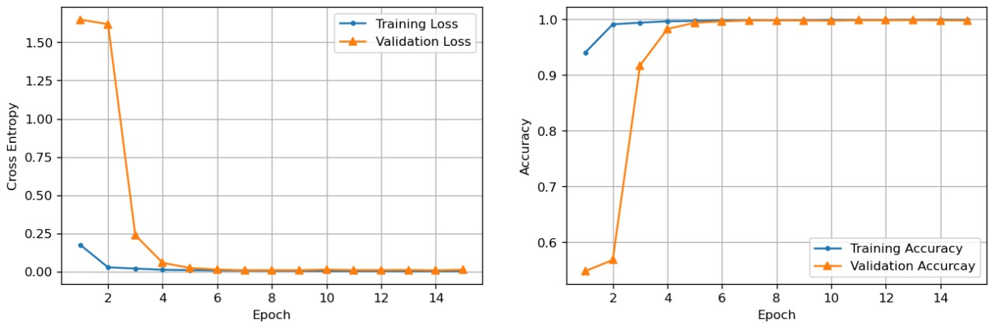
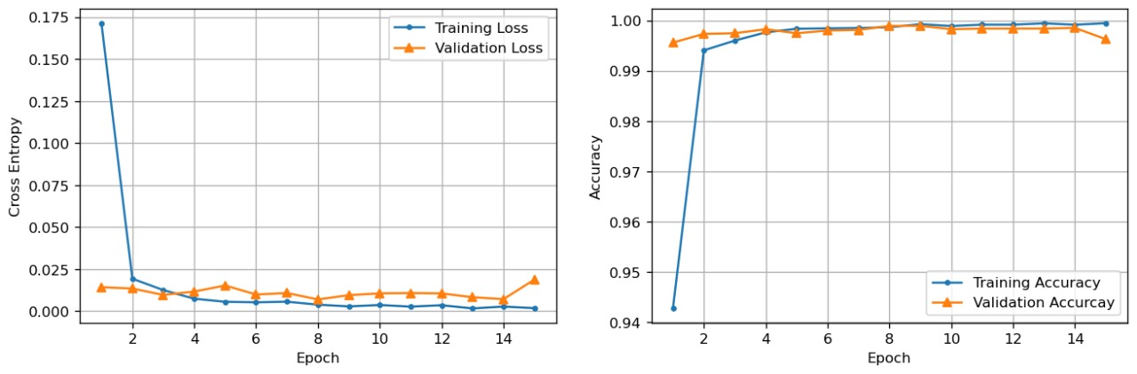
RESULTS AND COMPARISON
(DEEP LEARNING)
MobileNetV2
ResNet50V2

Slide 19
LIMITATIONS AND FUTURE WORKS

Slide 20
LIMITATIONS
Limited dataset diversity
FUTURE WORK
Use of traditional feature extraction techniques
Integration of advanced feature extraction methods
Lack of interpretability in deep learning models
Development of explainable AI techniques
Integration of image-based analysis with genomic data

Slide 21
CONCLUSION
This study classified five Turkish rice varieties using advanced image analysis on a dataset of 75,000 images. Traditional machine learning and deep learning CNN’s achieved high accuracies, highlighting their potential for precise rice classification. These findings suggest promising applications for advanced image analysis in sustainable agriculture worldwide

Slide 22
THANK YOU

