Slide 1
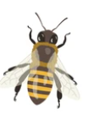
Artificial Bee Colony
Loke K.S.

Slide 2
Reference
Karaboga, D. (2005). An Idea Based on Honey Bee Swarm for Numerical Optimization. Technical Report TR06. Erciyes University, Engineering Faculty
Karaboga, Dervis & Basturk, Bahriye. (2007). A powerful and efficient algorithm for numerical function optimization: Artificial bee colony (ABC) algorithm. Journal of Global Optimization. 39. 459-471. 10.1007/s10898-007-9149-x.

Slide 3
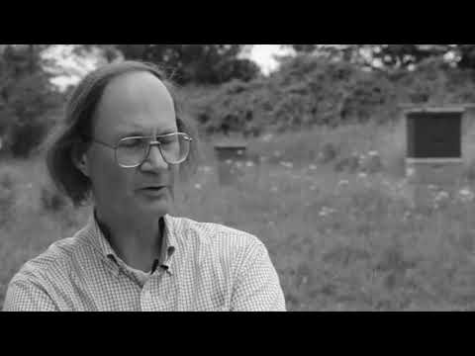
Seeley on Swarm Intelligence

Slide 4
Hive Mind
We will see that the 1.5 kilograms (3 pounds) of bees in a honeybee swarm, just like the 1.5 kilograms (3 pounds) of neurons in a human brain, achieve their collective wisdom by organizing themselves in such a way that even though each individual has limited information and limited intelligence, the group as a whole makes first-rate collective. - Thomas Seeley
https://www.wired.com/2011/12/the-true-hive-mind-how-honeybee-colonies-think/

Slide 5
Honey Bee Swarm Foraging Model
The collective intelligence foraging model of bee swarms consists of 3 essential components: food sources, employed foragers and unemployed forager.
The model also requires two different modes of behavior: recruitment of nectar source and abandonment of a source.

Slide 6
Information Sharing
Best-known examples of information sharing are found in social insects such as bees and ants, in which many have evolved complex signaling mechanism to recruit members to food sources.
Honeybees are unique among the social bees because they are the only bees that have evolved a recruitment mechanism that relies on the direct transfer of information: the waggle dance.

Slide 7
Waggle Dance
The honeybee's waggle dance encodes both the direction and the distance to the advertised source. This source can either be a food patch (von Frisch 1967) or a new nest site
During a typical dance, the dancer strides forward while vigorously shaking her body from side to side. This is known as the “waggle phase” of the dance.
After the waggle phase, she makes an abrupt turn to the left or right, circling back to start the waggle phase again. This is known as the “return phase.”
At the end of the second waggle, the dancer turns in the opposite direction so that with every second circuit of the dance she will have traced the famous figure-of-8 pattern of the waggle dance

Slide 8
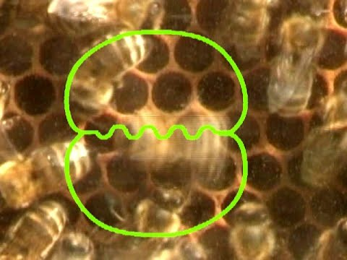
Waggle Dance

Slide 9
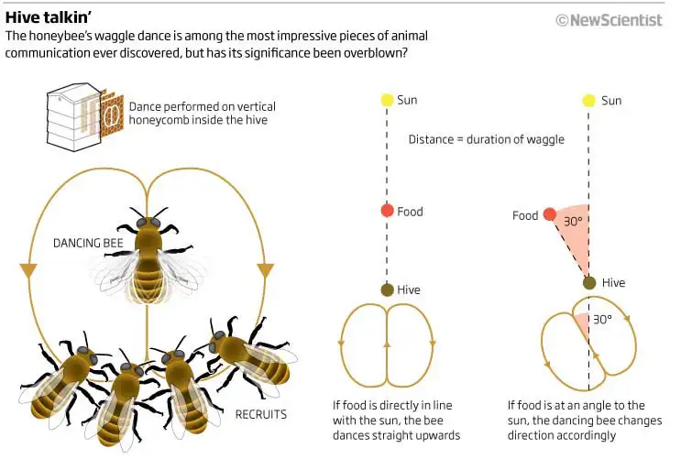
Waggle Dance

Slide 10
Food Sources
The value of a food source depends on many factors such as its proximity to the nest, its richness or concentration of its energy, and the ease of extracting this energy.
For the sake of simplicity, the “profitability” of a food source can be represented with a single quantity – its nectar quality

Slide 11
Dance Democracy
Honeybee swarms and complex brains show many parallels in how they make decisions.
In both, separate populations of units (bees or neurons) integrate noisy evidence for alternatives, and, when one population exceeds a threshold, the alternative it represents is chosen.
Nest-site scouts send inhibitory stop signals to other scouts producing waggle dances, causing them to cease dancing, and each scout targets scouts' reporting sites other than her own.
Seeley, T. D., Visscher, P. K., Schlegel, T., Hogan, P. M., Franks, N. R., & Marshall, J. A. (2012). Stop signals provide cross inhibition in collective decision-making by honeybee swarms. Science (New York, N.Y.), 335(6064), 108–111.

Slide 12
Benefits of Dance
Seeley and Visscher (1988) proposed 3 means by which a honeybee colony could benefit from information sharing among foragers about the location of profitable food sources. The sharing of information
1) reduces the cost of finding new food sources;
2) increases the quality of the food sources found; or
3) increases the colony's ability to exploit a high-quality food source quickly, thereby outcompeting other colonies as well as other species.
Only 2 and 3 is found to be true

Slide 13
Benefits of Dance
In many species of social insects, recruitment toward profitable food sources occurs outside the nest, for example, via odor trails or the marking of food sources. This allows other species as well as conspecifics to “eavesdrop” on those signals
Honeybee's dance communication prevents eavesdropping, whereas the transfer of spatial information allows the colony to rapidly monopolize highly profitable food sources thus making the honeybee a superior competitor.

Slide 14
Efficiency of Dance
Several researchers have noted that the dance language appears to be less efficient at recruiting new foragers than was originally proposed by von Frisch.
Seeley reported an experiment in which dancers performed a total of 8722 waggle runs and recruited 153 bees. This corresponds to 58 waggle runs per successful recruit, indicating that the transfer of location information is either inefficient or that the dance language is being decoded only by a small proportion of the bees interacting with a dancer.
Christoph Grüter, Walter M. Farina, The honeybee waggle dance: can we follow the steps?, Trends in Ecology & Evolution, Volume 24, Issue 5, 2009, Pages 242-247,

Slide 15
Efficiency of Dance
In 93% of all cases when bees were following dances providing spatial information that diverged from their private navigational information, followers subsequently relied on self-acquired information. These results suggest that foragers with self-acquired (private) information about the location of profitable food sources are usually not interested in the vector information transmitted by the dancer
Grüter, C., Balbuena, M. S., & Farina, W. M. (2008). Informational conflicts created by the waggle dance. Proceedings. Biological sciences, 275(1640), 1321–1327. https://doi.org/10.1098/rspb.2008.0186

Slide 16
Scent and Arousal
Wenner et al suggested that, although the dancers successfully recruited bees to forage, recruits relied mainly on olfactory information to locate the food, rather than on the location information of the waggle dance.
The dance attracts followers so that they can learn the odor of the food source.
Dances can also serve as a signal aimed at increasing the number of bees departing to search for food without communicating spatial information.

Slide 17
Scouts
Foragers sometimes leave the hive without having followed dances.
Such bees are often called ‘scouts,’ and it is assumed that they do not use acquired information

Slide 18
Bee Intelligence
Swarm intelligent behavior requires two fundamental concepts – self-organization and division of labor.
The two fundamental concepts are necessary and sufficient properties to obtain swarm intelligent behaviour such as distributed problem-solving systems that self-organize and -adapt to the given environment.

Slide 19
Division of Labor
Inside a swarm, there are different tasks, which are performed simultaneously by specialized individuals.
This kind of phenomenon is called division of labour. Simultaneous task performance by cooperating specialized individuals is believed to be more efficient than the sequential task performance by unspecialized individual

Slide 20
Self Organization
Bonabeau et al. have characterized four basic properties on which self organization relies: Positive feedback, negative feedback, fluctuations and multiple interactions.
Recruitment and reinforcement such as trail laying and following in some ant species or dances in bees can be shown as the examples of positive feedback
Negative feedback counterbalances positive feedback and helps to stabilize the collective pattern. In order to avoid the saturation which might occur in terms of available foragers, food source exhaustion, crowding or competition at the food sources, a negative feedback mechanism is needed

Slide 21
Self Organization
Fluctuations such as random walks, errors, random task switching among swarm individuals are vital for creativity and innovation. Randomness is often crucial for emergent structures since it enables the discovery of new solutions

Slide 22
Honey Bee Swarm Model: Foragers
Employed foragers: They are associated with a particular food source which they are currently exploiting or are “employed” at
Unemployed foragers: They are continually at look out for a food source to exploit.
There are two types of unemployed foragers:
scouts, searching the environment surrounding the nest for new food sources
onlookers waiting in the nest and establishing a food source through the information shared by employed foragers.

Slide 23
Honey Bee Swarm: Information Sharing
Employed foragers share their information with a probability proportional to the profitability of the food source by making the waggle dancing longer in duration.
Hence, the recruitment of the onlooker is proportional to the profitability of the food source.

Slide 24
Honey Bee Swarm Model: Behavior
At the very beginning, a potential forager will start as unemployed forager.
That bee will have no knowledge about the food sources around the nest.
There are two possible options for such a bee:
It can be a scout and starts searching around the nest spontaneously for a food due to some internal motivation or possible external clue.
It can be a recruit after watching the waggle dances and starts searching for a food source

Slide 25
Honey Bee Swarm Model: Behavior
After unloading the food, the bee has the following three options:
It becomes an uncommitted follower after abandoning the food source (UF).
It dances and then recruits nest mates before returning to the same food source (EF1)
It continues to forage at the food source without recruiting other bees (EF2)

Slide 26
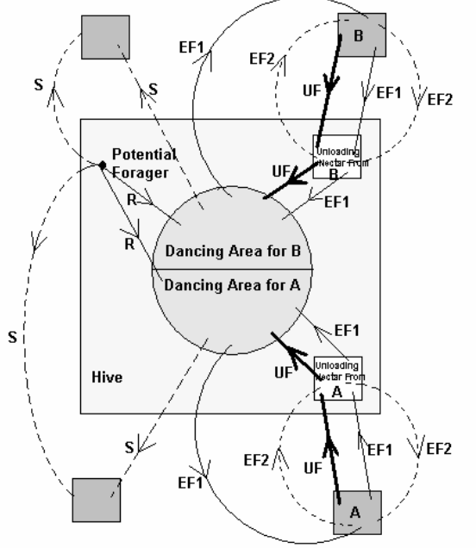
Honey Bee Swarm Model:
The behaviour of honey bee foraging for nectar.
S for Scout
R for Recruit

Slide 27
ABC Model
In the ABC algorithm, the colony of artiﬁcial bees contains three groups of bees: employed bees, onlookers and scouts.
A bee going to the food source visited by itself previously is named an employed bee.
A bee waiting on the dance area for making decision to choose a food source is called an onlooker
A bee carrying out random search is called a scout.

Slide 28
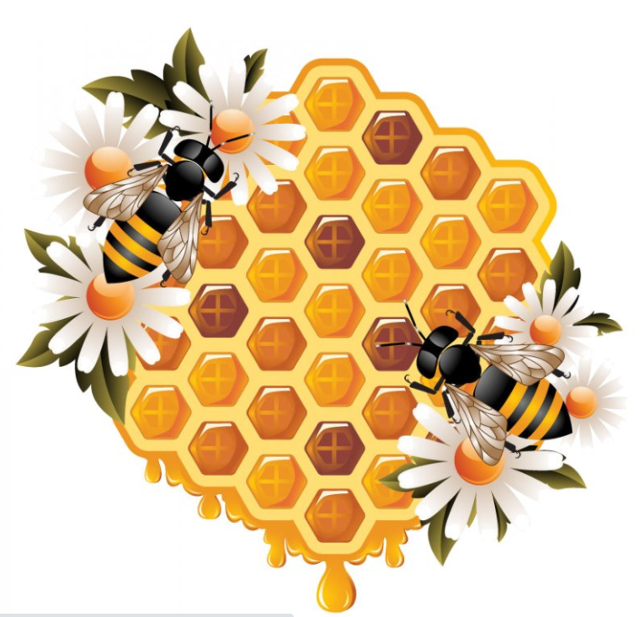
Honey Bee Swarm Model: Food source
The position of a food source represents a possible solution of the optimization problem
The nectar amount of a food source corresponds to the quality (ﬁtness) of the associated solution

Slide 29
ABC Swarm Model: Phases
In the ABC algorithm, ﬁrst half of the colony consists of employed artiﬁcial bees and the second half constitutes the onlookers.
For every food source, there is only one employed bee. In other words, the number of employed bees is equal to the number of food sources around the hive.
The employed bee whose food source is exhausted by the employed and onlooker bees becomes a scout

Slide 30
ABC Swarm Model: Phases
Each cycle of the search consists of three steps: moving the employed and onlooker bees onto the food sources and calculating their nectar amounts; and determining the scout bees and directing them onto possible food sources.
Onlookers are placed on the food sources by using a probability based selection process. As the nectar amount of a food source increases, the probability value with which the food source is preferred by onlookers increases, too

Slide 31
ABC Algorithm
Initialize.
REPEAT.
(a) Each employed bee goes to a neighboring food source in memory, and evaluates its nectar quality. It waggle dances to indicate quality.
(b) Onlooker bee watches the dance and make their choice on the food source and chooses a neighbor around that.
(c) Food sources that does not increase in quality are abandoned, the employed bee becomes a scout to look for new food source
UNTIL (requirements are met)
Karaboga, Dervis & Basturk, Bahriye. (2007).

Slide 32
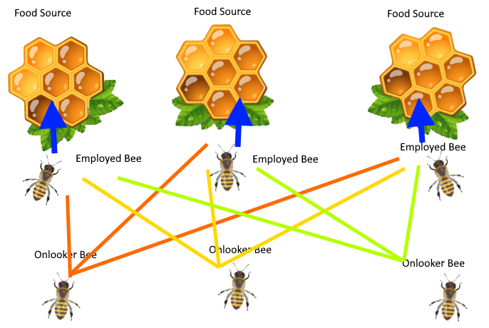
Artificial Bee Colony
Equal in numbers:
Employed Bee
Onlooker bee
Food Source

Slide 33
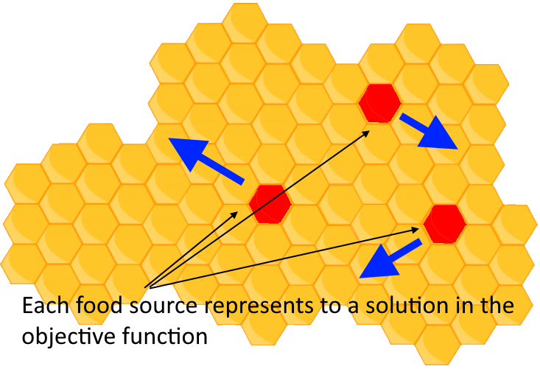
Artificial Bee Colony
The movement of the Bee changes the location of the food sources.
The change of location of food source represents the search for better solutions for the objective function

Slide 34
ABC: Overview
In the ABC algorithm, each cycle of the search consists of three steps:
Sending the employed bees onto the food sources and measuring their nectar amounts;
Selecting of the food sources by the onlookers after sharing the information of employed bees and determining the nectar amount of the foods;
Determining the scout bees and then sending them onto possible food sources.

Slide 35
ABC: First Stage
At the initialization stage food source positions are randomly selected by the bees and their nectar amounts are determined.
These bees come into the hive and share the nectar information of the sources with the bees waiting on the dance area within the hive.

Slide 36
ABC: Second Stage
At the second stage, after sharing the information, every employed bee goes to the food source area visited by herself at the previous cycle since that food source exists in her memory
Then chooses a new food source in the neighborhood of the present one.

Slide 37
ABC: Third Stage
At the third stage, an onlooker prefers a food source area depending on the nectar information distributed by the employed bees on the dance area.
As the nectar amount of a food source increases, the probability with which that food source is chosen by an onlooker increases, too.
Hence, the dance of employed bees carrying higher nectar recruits the onlookers for the food source areas with higher nectar amount.

Slide 38
ABC: Third Stage
After arriving at the selected area, she chooses a new food source in the neighborhood of the one in the memory
When the nectar of a food source is abandoned by the bees, a new food source is randomly determined by a scout bee and replaced with the abandoned one

Slide 39
ABC Model: Number of Bees
In our model, at each cycle at most one scout goes outside for searching a new food source and the number of employed and onlooker bees were equal.
The number of the employed bees or the onlooker bees is equal to the number of solutions in the population

Slide 40
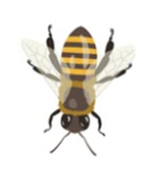
Algorithm
Employed Phase
Onlooker Phase
Generate a new solution
Calculate new Fitness
Apply Greedy Selection
Calculate probabilities
Produce new Solution based on probability
Calculate Fitness
Apply Greedy Selection
Scout Phase
Produce new Solution randomly

Slide 41
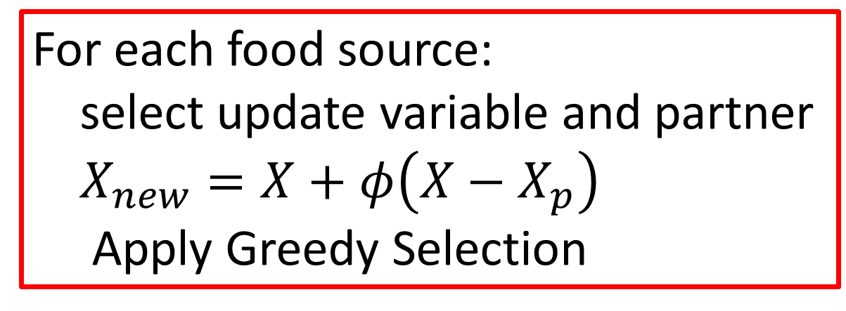
Algorithm
Employed Phase
For each food source:
select update variable and partner
$X_{new}=X+φ\left(X−X_{p}\right)$
Apply Greedy Selection
Scout Phase
Generate New Solution randomly
Onlooker Phase
Select random number (r)
If r < prob
Update the food sources
If trial counter > limit

Slide 42
Maximize
$$f\left(x\right)=x_{1}^{2}−x_{1}x_{2}+x_{2}^{2}+2x_{1}+4x_{2}+3$$
No of employed bees= no of onlooker bees = 5
Total Swarm size=10
Dimension of function = 2

Slide 43
Initialization
Food Source
F(x)
Fitness
Trial

Slide 44

Randomly initialize food source between -5 and 5
Food Source
3.1472 | -4.0246
4.0579 | -2.2150
-3.7301 | 0.4688
4.1338 | 4.5751
1.3236 | 4.6489
$$x=L+rand∗(U−L)$$

Slide 45
Maximize
$$f\left(x\right)=x_{1}^{2}−x_{1}x_{2}+x_{2}^{2}+2x_{1}+4x_{2}+3$$
Food Source
F(x)
3.1472 | -4.0246
4.0579 | -2.2150
-3.7301 | 0.4688
4.1338 | 4.5751
1.3236 | 4.6489
31.9645
31.6168
13.2971
48.6753
41.4537

Slide 46
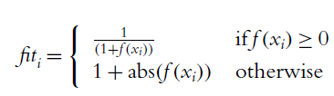
Food Source
F(x)
Fitness
Fitness: smaller is better for maximization
3.1472 | -4.0246
4.0579 | -2.2150
-3.7301 | 0.4688
4.1338 | 4.5751
1.3236 | 4.6489
31.9645
31.6168
13.2971
48.6753
41.4537
0.0303
0.0297
0.0699
0.0201
0.0236

Slide 47
Food Source
F(x)
Fitness
Trial
3.1472 | -4.0246
4.0579 | -2.2150
-3.7301 | 0.4688
4.1338 | 4.5751
1.3236 | 4.6489
31.9645
31.6168
13.2971
48.6753
41.4537
0.0303
0.0297
0.0699
0.0201
0.0236
0
0
0
0
0

Slide 48
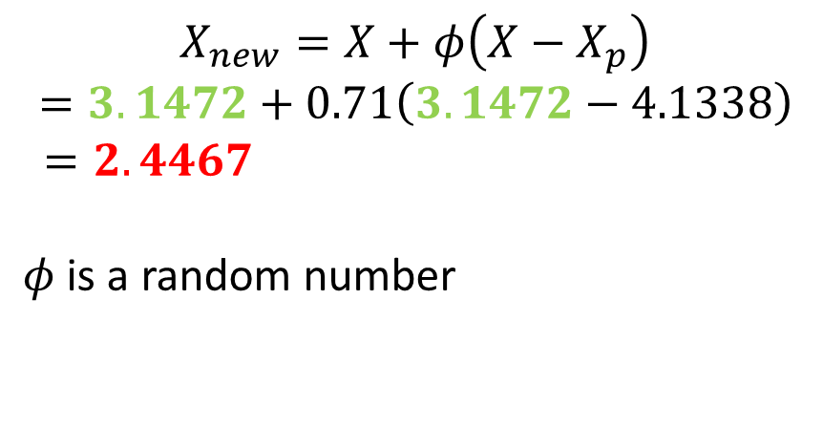
Employed Bee Phase
Food Source
1st Employed Bee –
Select random variable to change = x₁ or x₂
Select random partner
3.1472 | -4.0246
4.0579 | -2.2150
-3.7301 | 0.4688
4.1338 | 4.5751
1.3236 | 4.6489
2.4467 | -4.0246
4.0579 | -2.2150
-3.7301 | 0.4688
4.1338 | 4.5751
1.3236 | 4.6489
$$X_{new}=X+φ\left(X−X_{p}\right)$$
$$=3.1472+0.71\left(3.1472−4.1338\right)$$
$=2.4467$
$φ$ is a random number

Slide 49
Food Source
F(x)
Fitness
Trial
2.4467 | -4.0246
23.8259
0.0403
1
Current Value
Previous Value
3.1472 | -4.0246
31.9645
0.0303
0
Perform Greedy Selection
Since 0.0303 < 0.0403
Preserve the PREVIOUS value
Increase the Trial vector by 1

Slide 50
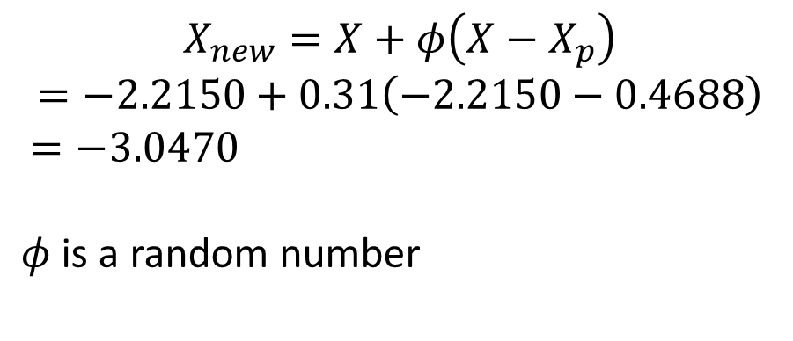
Employed Bee Phase
Food Source
2nd Employed Bee –
Select random variable to change = x₁ or x₂
Select random partner
3.1472 | -4.0246
4.0579 | -2.2150
-3.7301 | 0.4688
4.1338 | 4.5751
1.3236 | 4.6489
$$X_{new}=X+φ\left(X−X_{p}\right)$$
$$=−2.2150+0.31\left(−2.2150−0.4688\right)$$
$=−3.0470$
$φ$ is a random number

Slide 51
Food Source
F(x)
Fitness
Trial
3.1472 | -4.0246
4.0579 | -3.0470
31.9645
37.0428
0.0303
0.0263
1
0
Current Value
Previous Value
3.1472 | -4.0246
4.0579 | -2.2150
31.9645
32.6168
0.0303
0.0297
0
0
Perform Greedy Selection
Since 0.0263 < 0.0297
Replace the PREVIOUS value

Slide 52
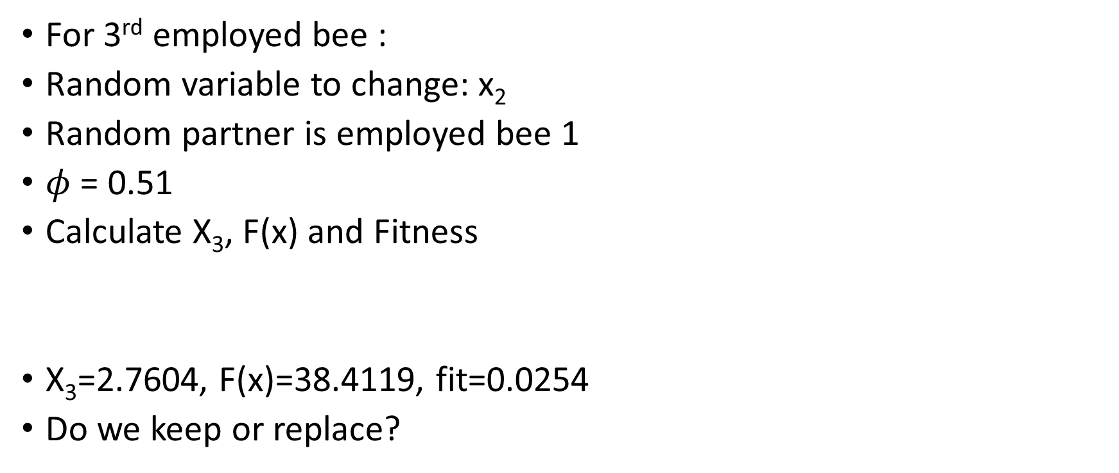
Verify the following
Maximize
$$f\left(x\right)=x_{1}^{2}−x_{1}x_{2}+x_{2}^{2}+2x_{1}+4x_{2}+3$$
Food Source
For 3rd employed bee :
Random variable to change: x₂
Random partner is employed bee 1
$φ$ = 0.51
Calculate X₃, F(x) and Fitness
X₃=2.7604, F(x)=38.4119, fit=0.0254
Do we keep or replace?
3.1472 | -4.0246
4.0579 | -2.2150
-3.7301 | 0.4688
4.1338 | 4.5751
1.3236 | 4.6489

Slide 53
Food Source
F(x)
Fitness
Trial
3.1472 | -4.0246
4.0579 | -3.0470
-3.7301 | 2.7604
31.9645
37.0428
38.4119
0.0303
0.0263
0.0254
1
0
0

Slide 54
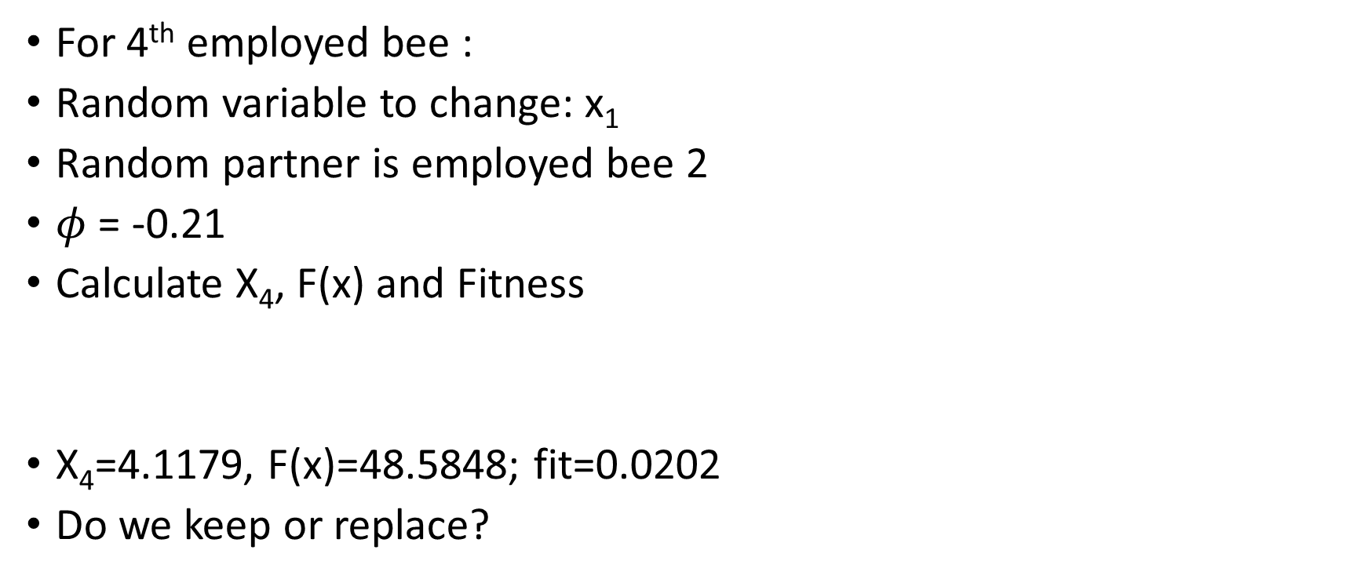
Verify the following
Maximize
$$f\left(x\right)=x_{1}^{2}−x_{1}x_{2}+x_{2}^{2}+2x_{1}+4x_{2}+3$$
Food Source
For 4th employed bee :
Random variable to change: x₁
Random partner is employed bee 2
$φ$ = -0.21
Calculate X₄, F(x) and Fitness
X₄=4.1179, F(x)=48.5848; fit=0.0202
Do we keep or replace?
3.1472 | -4.0246
4.0579 | -2.2150
-3.7301 | 0.4688
4.1338 | 4.5751
1.3236 | 4.6489

Slide 55
Food Source
F(x)
Fitness
Trial
3.1472 | -4.0246
4.0579 | -3.0470
-3.7301 | 2.7604
4.1338 | 4.5751
31.9645
37.0428
38.4119
48.6753
0.0303
0.0263
0.0254
0.0201
1
0
0
1

Slide 56
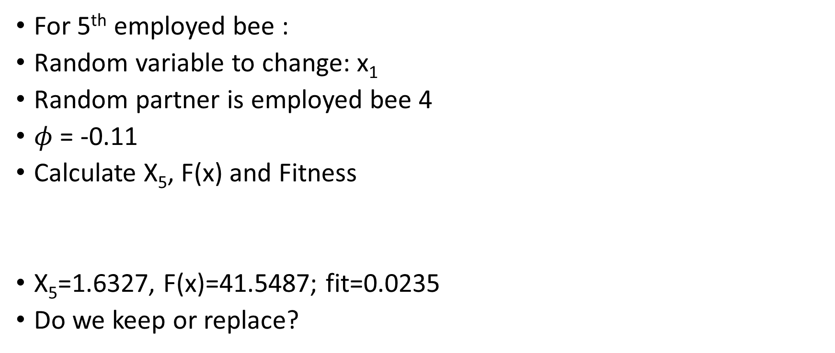
Verify the following
Maximize
$$f\left(x\right)=x_{1}^{2}−x_{1}x_{2}+x_{2}^{2}+2x_{1}+4x_{2}+3$$
Food Source
For 5th employed bee :
Random variable to change: x₁
Random partner is employed bee 4
$φ$ = -0.11
Calculate X₅, F(x) and Fitness
X₅=1.6327, F(x)=41.5487; fit=0.0235
Do we keep or replace?
3.1472 | -4.0246
4.0579 | -2.2150
-3.7301 | 0.4688
4.1338 | 4.5751
1.3236 | 4.6489

Slide 57
Food Source
F(x)
Fitness
Trial
3.1472 | -4.0246
4.0579 | -3.0470
-3.7301 | 2.7604
4.1338 | 4.5751
1.6727 | 4.6489
31.9645
37.0428
38.4119
48.6753
41.5487
0.0303
0.0263
0.0254
0.0201
0.0235
1
0
0
1
0

Slide 58
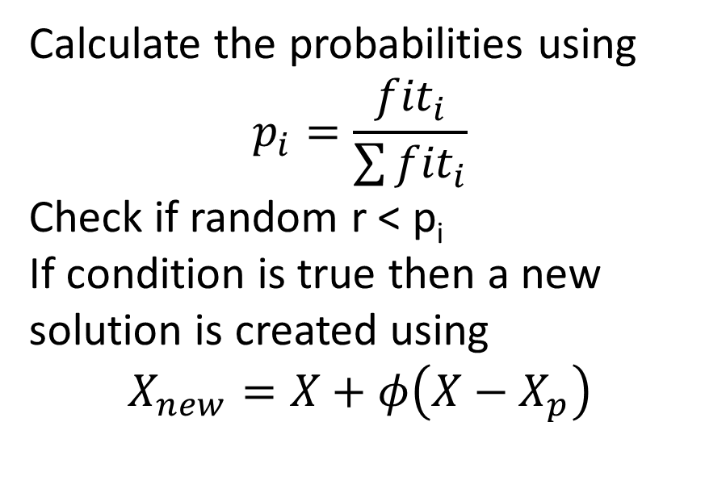
Onlooker Bee Phase
Fitness
P
Calculate the probabilities using
$$p_{i}=\frac{{fit}_{i}}{\sum{{fit}_{i}}}$$
Check if random r < p_{i}
If condition is true then a new
solution is created using
$$X_{new}=X+φ\left(X−X_{p}\right)$$
0.0303
0.0263
0.0254
0.0201
0.0235
0.2415
0.2092
0.2020
0.1602
0.1871
SUM= 0.1256

Slide 59
Onlooker Bee Phase
P
1st Bee
Random r = 0.23
Since r< prob: 0.23<0.2415
Therefore we calculate the new solution.
Random Variable=x₂
Random Partner=3
0.2415
0.2092
0.2020
0.1602
0.1871

Slide 60
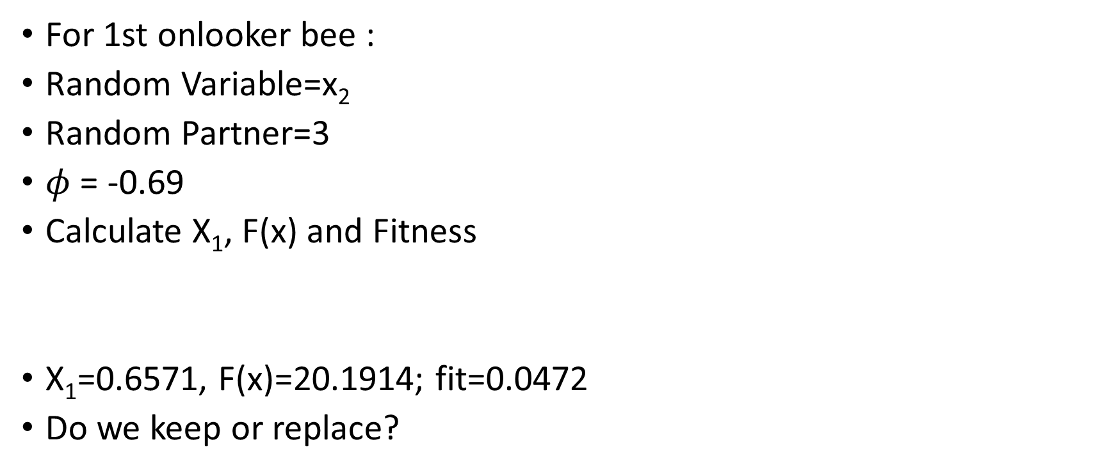
Verify the following
Maximize
$$f\left(x\right)=x_{1}^{2}−x_{1}x_{2}+x_{2}^{2}+2x_{1}+4x_{2}+3$$
Food Source
For 1st onlooker bee :
Random Variable=x₂
Random Partner=3
$φ$ = -0.69
Calculate X₁, F(x) and Fitness
X₁=0.6571, F(x)=20.1914; fit=0.0472
Do we keep or replace?
3.1472 | -4.0246
4.0579 | -3.0470
-3.7301 | 2.7604
4.1338 | 4.5751
1.6327 | 4.6489
Corrected Error

Slide 61
Food Source
F(x)
Fitness
Trial
3.1472 | -4.0246
4.0579 | -3.0470
-3.7301 | 2.7604
4.1338 | 4.5751
31.9645
37.0428
38.4119
48.6753
0.0303
0.0263
0.0254
0.0201
2
0
0
1

Slide 62
Onlooker Bee Phase
P
2nd Onlooker Bee
Random r = 0.15
Since r< prob: 0.15<0.2092
Therefore we calculate the new solution.
Random Variable=x₁
Random Partner=5
0.2415
0.2092
0.2020
0.1602
0.1871

Slide 63
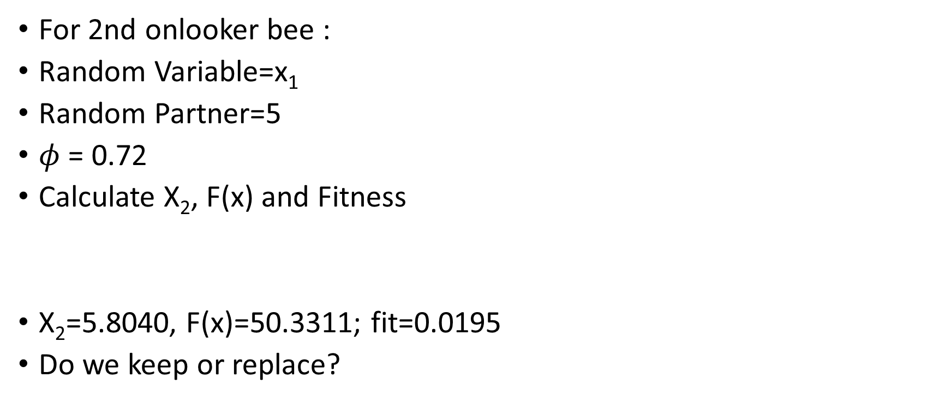
Verify the following
Maximize
$$f\left(x\right)=x_{1}^{2}−x_{1}x_{2}+x_{2}^{2}+2x_{1}+4x_{2}+3$$
Food Source
For 2nd onlooker bee :
Random Variable=x₁
Random Partner=5
$φ$ = 0.72
Calculate X₂, F(x) and Fitness
X₂=5.8040, F(x)=50.3311; fit=0.0195
Do we keep or replace?
3.1472 | -4.0246
4.0579 | -3.0470
-3.7301 | 2.7604
4.1338 | 4.5751
1.6327 | 4.6489
Corrected Error

Slide 64
2nd Onlooker Bee
Food Source
F(x)
Fitness
Trial
3.1472 | -4.0246
5.0000 | -3.0470
-3.7301 | 2.7604
4.1338 | 4.5751
31.9645
50.3311
38.4119
48.6753
0.0303
0.0195
0.0254
0.0201
2
0
0
1

Slide 65
Onlooker Bee Phase
4th Onlooker Bee
Random r = 0.35
Since r< prob: 0.35<0.1602
No UPDATE
Select r again = 0.13 for 5th food source
Since r< prob: 0.13<0.1871
We perform calculate Xnew on the 5th food source.
Now the 5th Onlooker Bee will work on the first food source because the 4th Onlooker updated the 5th food source.
P
0.2415
0.2092
0.2020
0.1602
0.1871

Slide 66
Food Source
F(x)
Fitness
Trial
3.1472 | -4.0246
5.0000 | -3.0470
-5.000 | 2.7604
4.1338 | 4.5751
1.6727 | 5.000
31.9645
50.3311
50.4639
48.6753
45.7676
0.0303
0.0195
0.0194
0.0201
0.0214
3
0
0
1
0
Best Food Source: (-5.000, 2.7604)
Best F(X)= 50.4639

Slide 67

Scout Bee Phase
Limit = 1
If the trial > Limit, then implement SCOUT bee
So for the first food source it is greater than Limit, so we implement the scout bee.
In this case we discard the first food source solution and randomly generate a new solution using
$$x=L+rand∗(U−L)$$

Slide 68
End of Iteration 1
Food Source
F(x)
Fitness
Trial
3.6045 | -1.7170
5.0000 | -3.0470
-5.000 | 2.7604
4.1338 | 4.5751
1.6727 | 5.000
25.4710
50.3311
50.4639
48.6753
45.7676
0.0378
0.0195
0.0194
0.0201
0.0214
0
0
0
1
0

Slide 69
Solution
Best Food Source: (-5.000, 5.000)
Best F(X)= 88.0

Slide 70
Applications of ABC
Hossain and El-shafie (2013) use the ABC algorithm to optimize the reservoir release per month at the Aswan high dam. The algorithm was used to solve the problem based on actual historical inflow data and it succeeded in meeting the demand over a specific period.
Bolaji et al. (2013) provides a survey of modifications to the ABC algorithm and indicate a number of applications of the algorithm.
They include: stock price forecasting, artificial neural networks, image processing, electric load forecasting and flow job scheduling.

Slide 71
Applications of ABC
The paper of Bacanin et al. (2014) describes how the authors have applied the ABC algorithm to minimizing risk in investment portfolio selection which is major financial problem.
Chen (2014) applies the ABC method to specific numerical examples in portfolio selection. He indicates the results show the ABC algorithm is effective for solving the portfolio selection problem.
Bacanin, N., Pelevic, B., Tuba, M., 2014. Constrained portfolio selection using artificial bee colony (ABC)
algorithm. International Journal of Journal of Mathematical Models and Methods in Applied Science 8,
190–198.
Chen, W., 2014. An artificial bee colony algorithm for uncertain portfolio selection. The Scientific World Journal 2014, 578182.

