Slide 1
PSO Program
Walkthrough

Slide 2
Plan
Last week we went through the algorithm but the code may seem too difficult
So this week we review the code in detail.
After lecture open up PSO-follow.ipnyb Jupyter notebook and follow the along with the lecture notes on your own.
Try to complete the PSO.ipnyb Jupyter notebook on your own. They are already presented in the lecture notes, but as much as possible try recall how to code it.
Then complete rastrigin-2 jupyter notebook.

Slide 3
Introduction
Last week we went through the calculation updates for PSO – we will go through it again today
This week we will go through details of the program in details

Slide 4

Import
numpy is the numerical python support for arrays and other functions. ‘np’ is the short name for numpy
math is for all the mathematical functions
random is to generate random numbers

Slide 5
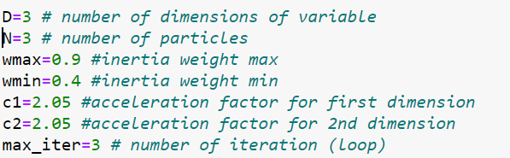
Parameters and Constants
D is the number of variables (dimensions) in the function that is used for optimization
N is the number of particles used in PSO
wmax, wmin is the max and min value for the inertia update
c1,c2 is the constant used to update the swarm
max_iter is the number of loops to run the PSO.
All these parameters can be changed

Slide 6
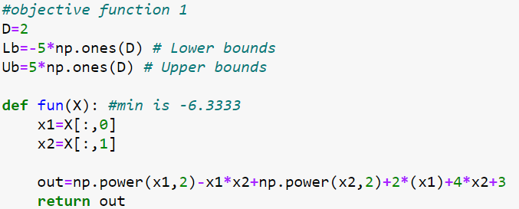
Objective function
In the notebook a few objective function is given. The objective function is the function that you want to optimize

Slide 7
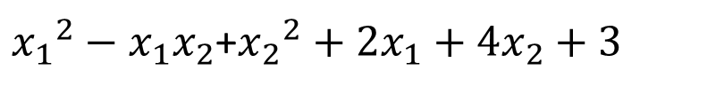
Objective function
This is the first objective function in maths and python
${x_{1}}^{2}−x_{1}x_{2}$+${x_{2}}^{2}+2x_{1}+4x_{2}+3$

Slide 8

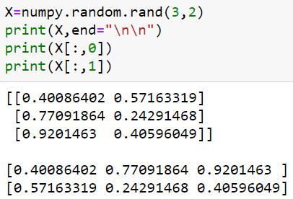
Objective function
The function takes in as parameter X as a numpy array.
X[:,0] takes the first column of numbers.
X[:,1] takes 2nd column of numbers
So we have ensure that the parameters passed in is the correct shape
It must be of shape (N,D).
N is the number of particles
D is the number of variables in the function

Slide 9
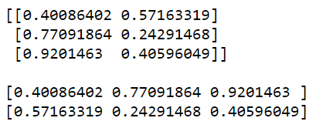

Objective function
X1
X2
Particle -1
Particle -2
Particle -3
Particle-1 X1
Particle-2 X1
Particle-3 X1
Particle-1 X2
Particle-2 X2
Particle-3 X2

Slide 10
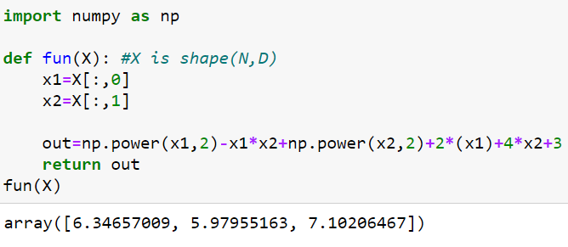

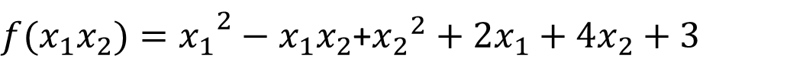
Objective function
X[:,0] refers to X₁ in the formula
X[:,1] refers to X₂ in the formula
${{f(x_{1}x_{2})=x}_{1}}^{2}−x_{1}x_{2}$+${x_{2}}^{2}+2x_{1}+4x_{2}+3$
Particle-1
Particle-2
Particle-3

Slide 11
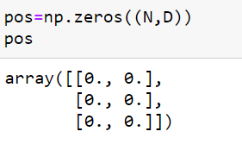
Initialize Particles
First we create a variable called pos with the required shape and filled it with zeros – here again 3 particles for function with 2 variables.
Particle-1
Particle-2
Particle-3
X1
X2

Slide 12

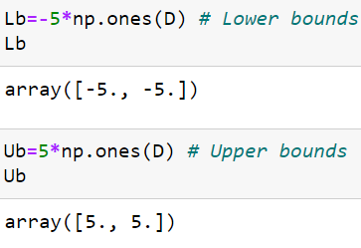
Initialize Particles - limit
We want to particles to have its values between some lower and upper bounds.
np.ones filled the vector with 1’s instead of 0’s
Each is multiplied by -5 and 5.
LB will have -5’s
UB will have 5’s
Each dimension have same limits

Slide 13
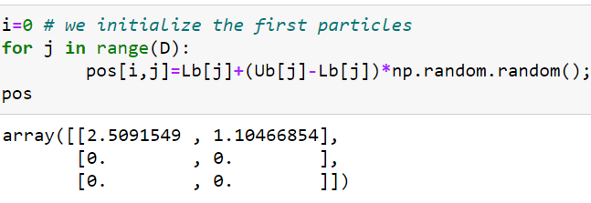
Initialize 1st Particle
Lb[j] has -5 and Ub[j] has 5
Lb[j]+(Ub[j]-Lb[j])*np.random.random()
-5 + (5+5)*[random btw 0 and 1]
-5 + 10 (1) = 5 (max)
All will be between -5 and 5
Particle-1
Particle-2
Particle-3
J=0
J=1

Slide 14
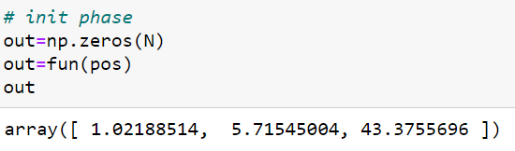
Initial phase
Again we create the out variable to store the result from the optimization function. The size must equal the number of particles N
Then we pass in the pos array that we just initialized to the function fun()
We assign the output to the out array.
The out now store the result of the function fun()
Particle-1
Particle-2
Particle-3

Slide 15

Store the function output and pos
We store the output of the fun() and pos because we want to use it to compare at the next iteration.
We use the copy method and not direct assignment because direct assignment references the same array.

Slide 16
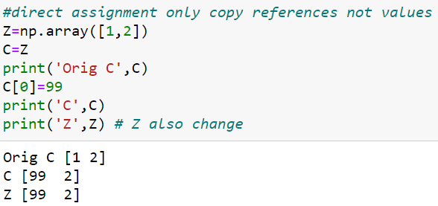
Array Direct Assignment
Changing C values also changes Z values
If you don’t want that you should use np.copy() instead

Slide 17
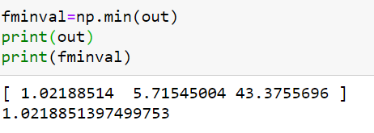
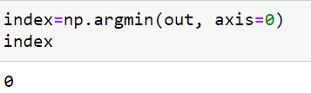
Find the best out value (min)
np.min(out) returns the min value in out
Recall out stores the function evaluation for current pos particles
This is the current best (min) value, we store in fminval.
np.argmin gives the index of the best value

Slide 18
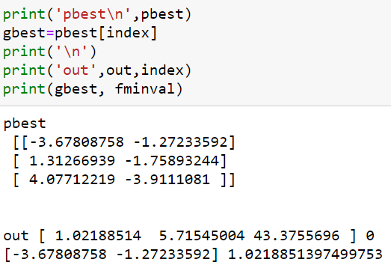
Find the best out value (min)
We want the particle (pos) that gives the best function value (min)
Which of these particles values give the best function value (min)
Copied from pos previous iteration
Out is function output
Gbest is the best particle given by the fminval
Fminval is best value in out

Slide 19
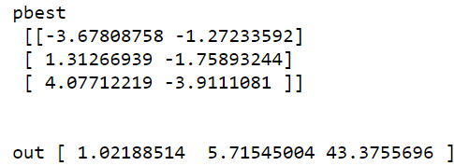
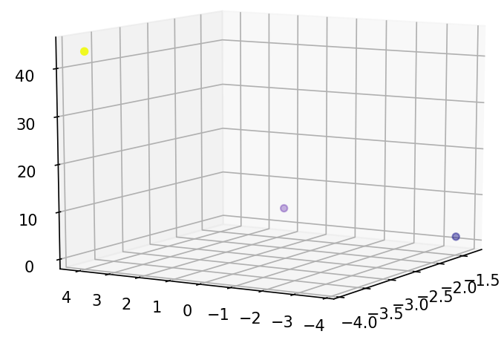
Find the best out value (min)

Slide 20
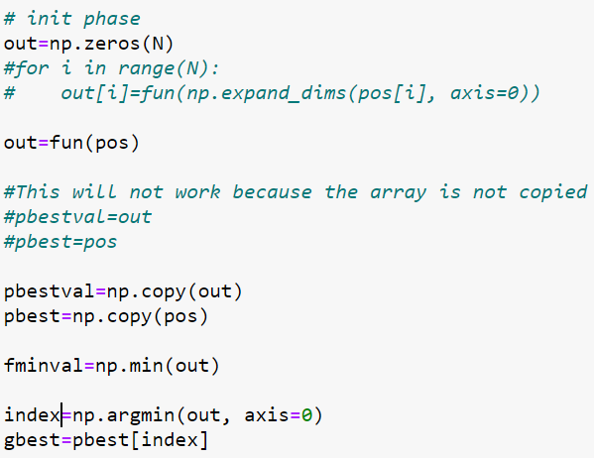
Store values before iteration

Slide 21


Iteration - 1
‘it’ is the loop counter.
We calculate w (inertia weight), its value changes as it loops.
We recompute the latest fun output based on pos values of the particles

Slide 22
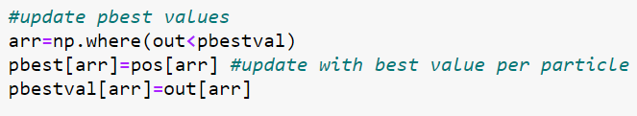
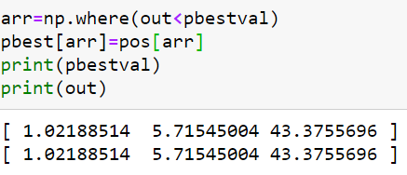
Iteration – update pbest
We now want to find the pbestval compare with previous iteration.
But there are no changes in the first iteration

Slide 23
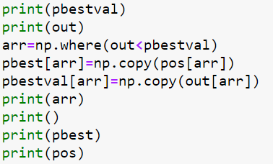
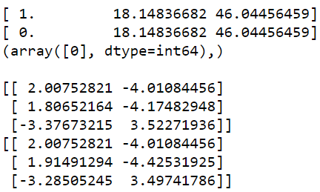
Iteration – update pbest
At a later stage the values will differ – see sample values.
pbestval
out
Copy from pos to pbest because the out value is smaller
pbest
pos

Slide 24
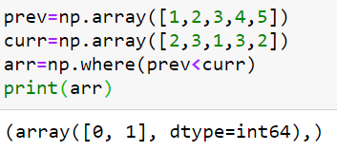
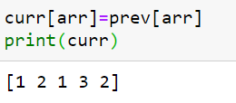
How to update best value in an array?
Using numpy.where()
Returns an array where the conditions are true.
Then you can use it to update another array.

Slide 25
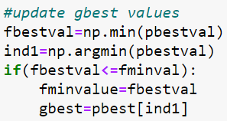
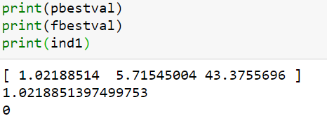
Update gbest
Return the min value in pbestval
Return the index of min value in pbestval

Slide 26

Update gbest
If the current fbestval is better than the so far best value (fminval), then update fminval to store the so far best value.
Then we use the index of the fbestval to update gbest

Slide 27
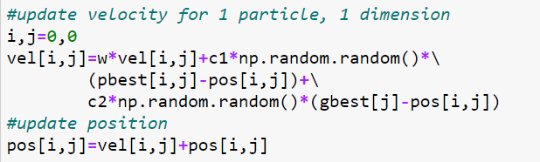

How to update velocity
i=particle
j=dimension
vel[i,j] already have been initialized as 0.1*pos
r1,r2 are random numbers between 0-1
$v_{t+1}=w∗v_{t}+ c_{1}r_{1}({pbest}_{t}−x_{t})$+ $c_{2}r_{2}({gbest}_{t}−x_{t})$
$$x_{t+1}=x_{t}+v_{t+1}$$

Slide 28
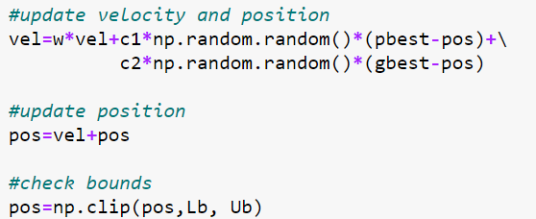
How to update velocity
Note: We can also update it entirely in vector form.

Slide 29



Vel
J-dimension
J=0 V1
J=1 V2
i=0,1,2
Particle-1 Vel
Current Vel[i,j]
+
Particle-2 Vel
Particle-3 Vel
=
Next Vel[i,j]

Slide 30



POS update
i=0, j=0
Vel
+
pos
pos

Slide 31
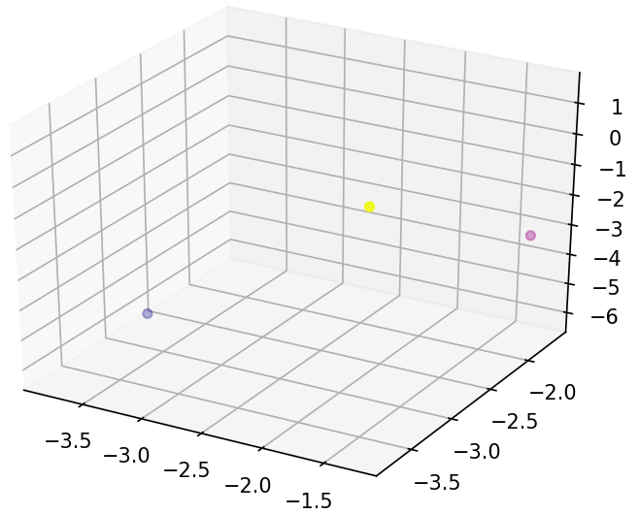
How to update velocity
If run the complete double loop (N,D) we will get the updated positions of all particles.
We also need to evaluate the function fun with pos array.
You can see all the values from to negative

Slide 32

Keep Looping
We repeat and keep iterating until it reaches the last loop.

Slide 33

Get the answer
When the loop terminates, obtain the gbest values.
Recall that gbest stores the positions of the particles as the so far best values.
To get the best function values, we evaluate fun with gbest

Slide 34
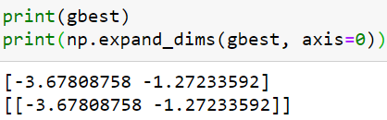
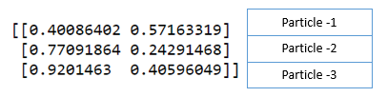
What is expand_dims?
We use expand dims to add an extra dimension to the array because that is the form expected by the function fun
Recall that the pos array also has this form when we used it earlier.
pos array

Slide 35
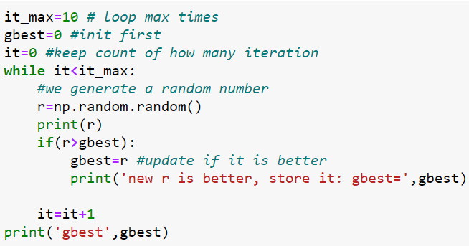
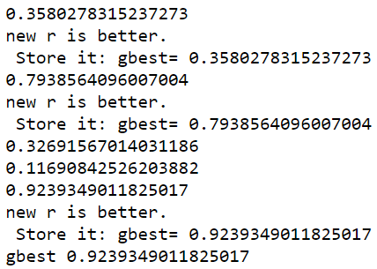
How to store the best value from loops?

Slide 36
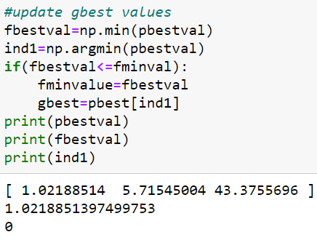

How to store the best value from loops?
We basically do the same thing with PSO except that they are arrays not individual values so we can’t do a simple compare:
So we have to work a bit harder to get the best value.

Slide 37
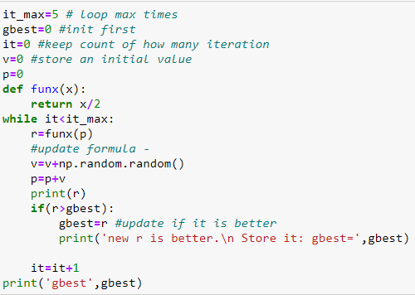
Basic Loop
In PSO instead of updating a random number, we have an vel and pos updating formula.
Conceptually similar to this program here.

Slide 38
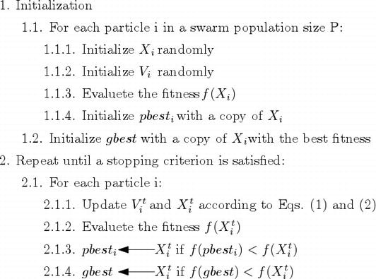
PSO Algorithm

