Slide 1
Bayesian Decision Theory
Nabil Akbarazzima Fatih
Sommersemester 2022

Slide 2
Overview
Introduction
Investigation
Illustration
Conclusion

Slide 3
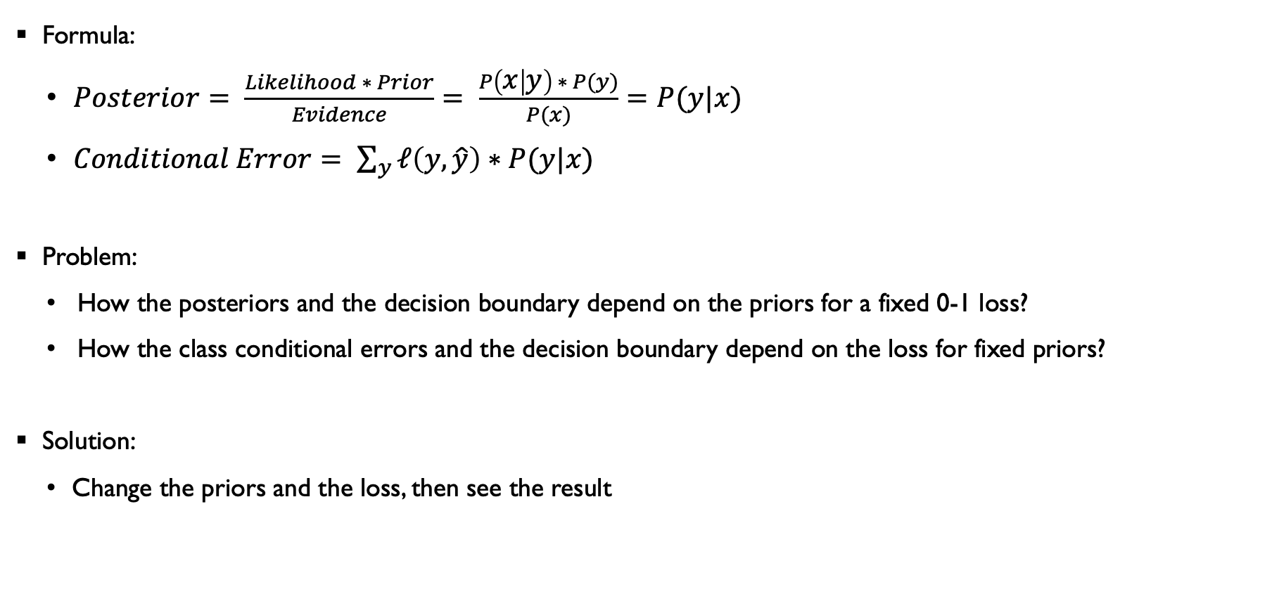
Introduction
Formula:
$Posterior= \frac{Likelihood ∗ Prior}{Evidence}= \frac{P\left(x | y\right) ∗ P(y)}{P(x)}=P(y|x)$
$Conditional Error= \sum_{y}{ℓ\left(y,\hat{y}\right)∗P(y|x)}$
Problem:
How the posteriors and the decision boundary depend on the priors for a fixed 0-1 loss?
How the class conditional errors and the decision boundary depend on the loss for fixed priors?
Solution:
Change the priors and the loss, then see the result

Slide 4
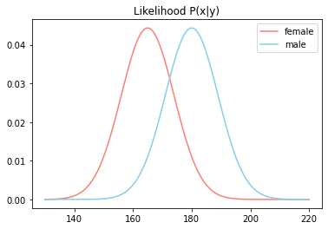

Investigation
Given:
$p\left(x | y=f\right) \sim 𝒩(μ=165, σ=9)$
$p\left(x | y=m\right) \sim 𝒩(μ=180, σ=9)$
Information:
$𝒩$ = Normal distribution
$μ$ = Mean
$σ$ = Standard deviation

Slide 5
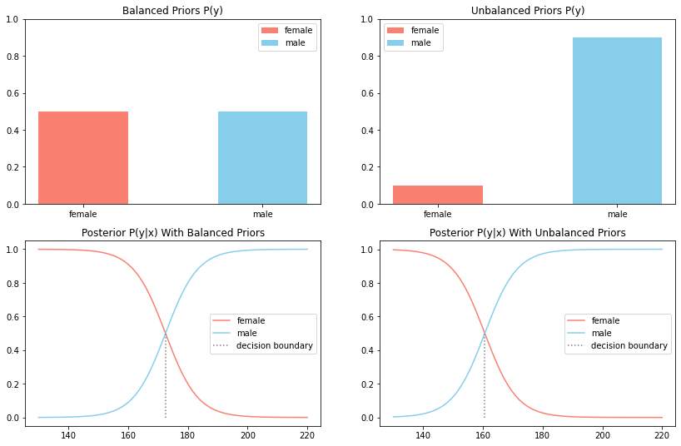

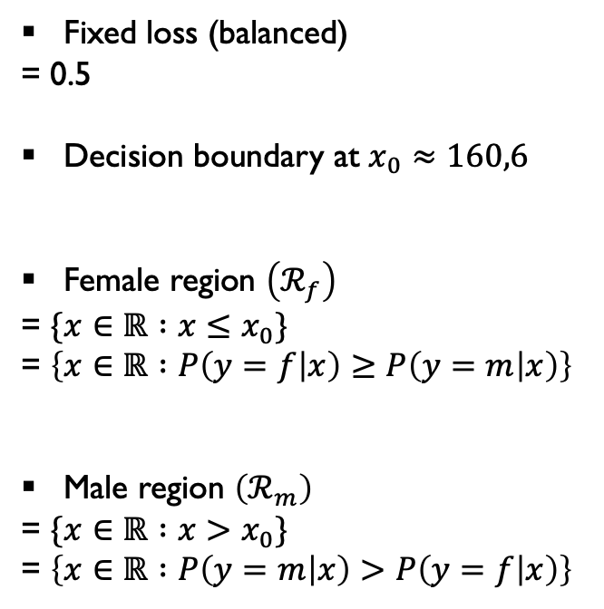

Investigation
How the posteriors and the decision boundary depend on the priors for a fixed 0-1 loss?
Fixed loss (balanced)
= 0.5
Decision boundary at $x_{0}≈160,6$
Female region $\left(ℛ_{f}\right)$
= $\{x∈ℝ :x≤x_{0}\}$
= $\left\{x∈ℝ :P\left(y=f | x\right)≥P\left(y=m | x\right)\right\}$
Male region $\left(ℛ_{m}\right)$
= $\{x∈ℝ :x>x_{0}\}$
= $\left\{x∈ℝ :P\left(y=m | x\right)>P\left(y=f | x\right)\right\}$
$$ℛ_{f}$$
$$ℛ_{m}$$

Slide 6
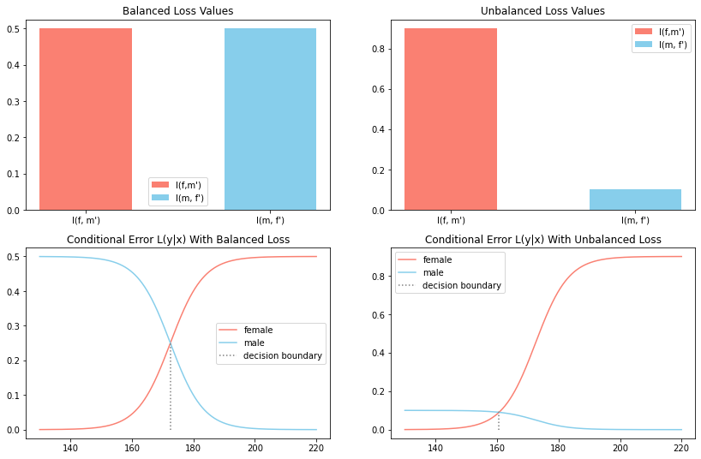
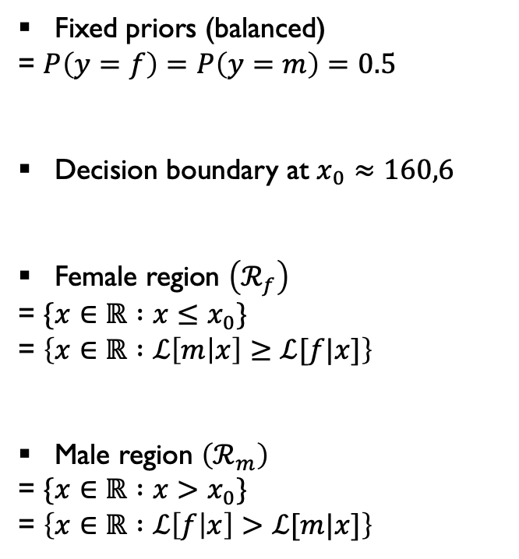
Investigation
How the class conditional errors and the decision boundary depend on the loss for fixed priors?
Fixed priors (balanced)
= $P\left(y=f\right)=P\left(y=m\right)=0.5$
Decision boundary at $x_{0}≈160,6$
Female region $\left(ℛ_{f}\right)$
= $\{x∈ℝ :x≤x_{0}\}$
= $\left\{x∈ℝ :ℒ\left[m | x\right]≥ℒ[f|x]\right\}$
Male region $\left(ℛ_{m}\right)$
= $\{x∈ℝ :x>x_{0}\}$
= $\left\{x∈ℝ :ℒ\left[f | x\right]>ℒ[m|x]\right\}$
$$ℛ_{f}$$
$$ℛ_{m}$$

Slide 7
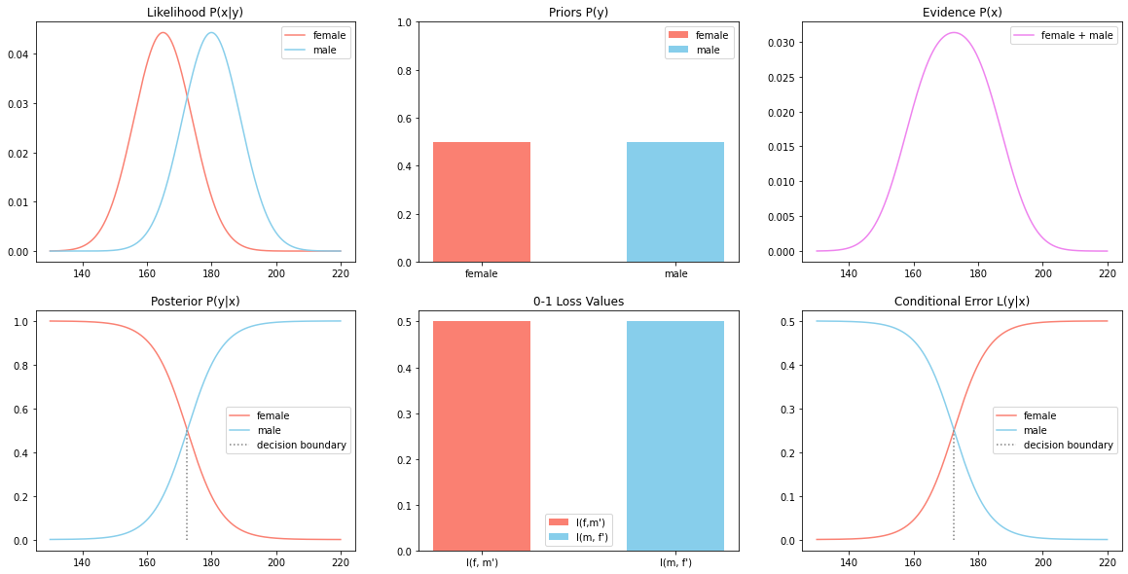
Illustration
1. Balance priors and balanced loss

Slide 8
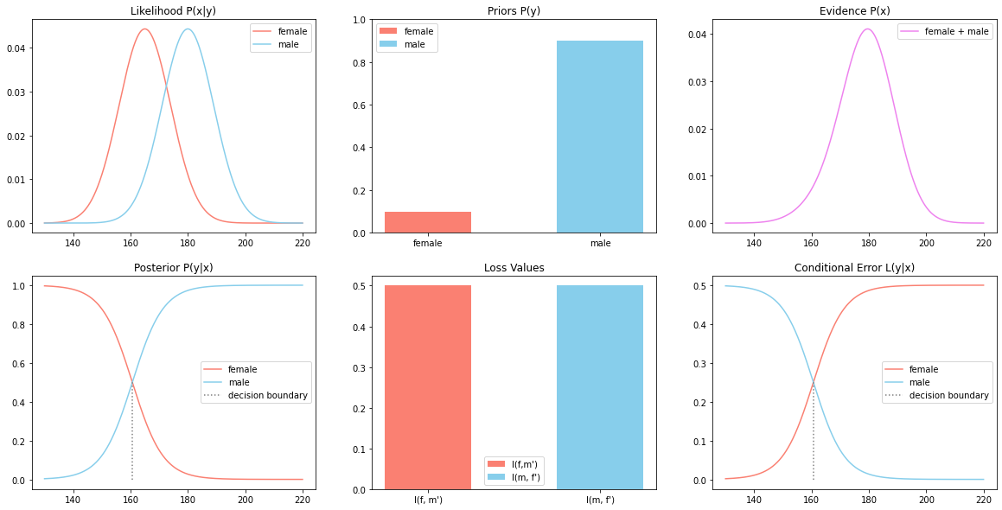
Illustration
2. Unbalance priors and balanced loss

Slide 9
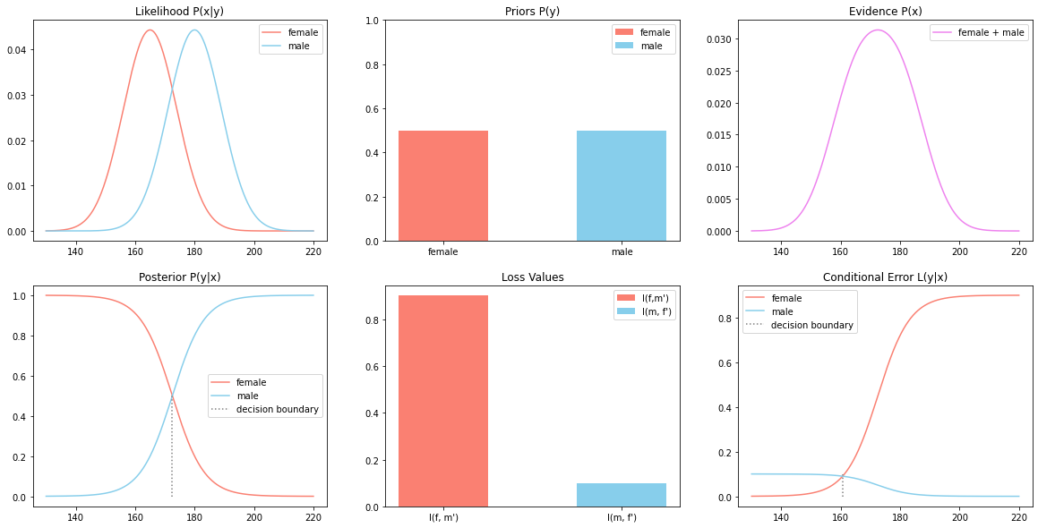
Illustration
3. Balance priors and unbalanced loss

Slide 10
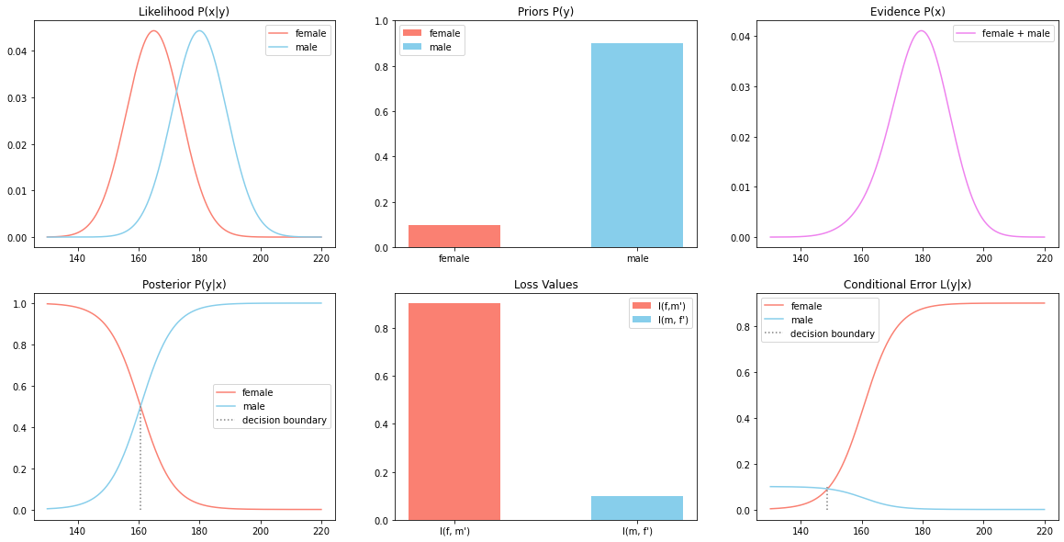
Illustration
4. Unbalance priors and unbalanced loss

Slide 11
Conclusion
Summarize main results / finding
Present outlook to interesting future work / directions

